Slide 1
One Page Reloads Everything.
The Other Only Updates What Changed.
Plain HTML multi-page sites vs. React single-page apps — and why the Virtual DOM matters.

Slide 2
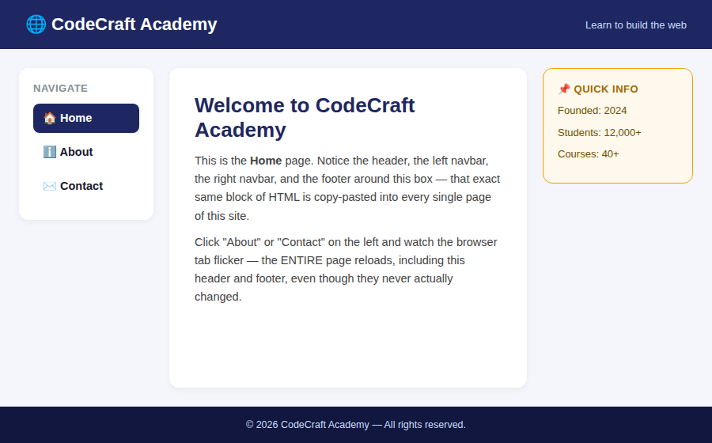
The Site We're Building
Header on top, a left navbar, a right navbar, a footer at the bottom — and a center area that changes per page.
home.html — the Home page

Slide 3
The Vanilla Way: 3 Separate HTML Files
home.html
about.html
contact.html
Header
Header
Header
Left Navbar
Left Navbar
Left Navbar
Center Content
(home)
Center Content
(about)
Center Content
(contact)
Right Navbar
Right Navbar
Right Navbar
Footer
Footer
Footer
🟨 Same header / navbars / footer code, copy-pasted into all 3 files. 🟦 Only this part actually differs.

Slide 4
What Happens When You Click “About”? (Vanilla)
1
You click <a href="about.html">
2
Browser THROWS AWAY the entire current page
3
Sends a fresh HTTP request for about.html
4
Downloads the WHOLE file again — header, navbars, footer included
5
Re-parses and re-renders EVERYTHING from scratch
🔴 Result: a visible flash/reload. Every navigation re-downloads and re-builds the header, both navbars, and the footer — even though none of them changed.

Slide 5
Initial Page Load — Vanilla HTML
Browser requests
home.html
→
Downloads full
HTML + CSS
→
Parses HTML
top to bottom
→
Paints header,
navbars, footer,
center — all together
Fast and simple: the browser already understands HTML — no extra download needed to “build” anything.
The whole page — header, navbars, footer, AND center — appears together in one paint.
But this ENTIRE process repeats, from scratch, every single time the user clicks a link.

Slide 6
What if the header, both navbars, and the footer were written only ONCE…
…and clicking “About” only swapped the small piece in the middle?
That's exactly what React's component model gives you.

Slide 7
The React Way: One Shell, Swappable Center
<App />
<Header />
<LeftNav />
{ currentPage }
<RightNav />
<Footer />
rendered ONCE
rendered ONCE
SWAPS: Home / About / Contact
rendered ONCE
rendered ONCE
Header, LeftNav, RightNav, and Footer are written as components ONE time, in one project.
Clicking “About” doesn't navigate to a new file — it just changes a piece of STATE (currentPage = "about").
React re-renders only the part of the tree connected to that state — everything else is left completely alone.
This is called a Single Page Application (SPA) — there really is only ONE html file (index.html).

Slide 8
What That Looks Like in Code
function App() {
const [currentPage, setCurrentPage] = React.useState("home");
return (
<>
<Header />
<div className="main-row">
<LeftNav onNavigate={setCurrentPage} active={currentPage} />
{currentPage === "home" && <Home />}
{currentPage === "about" && <About />}
{currentPage === "contact" && <Contact />}
<RightNav />
</div>
<Footer />
</>
);
}

Slide 9
Initial Page Load — React
Browser requests
index.html
(nearly empty)
→
Downloads the
JS bundle
→
JS runs, builds
a Virtual DOM
→
React mounts it
into the real DOM
→
Header, navbars,
footer, center
all appear
Honest trade-off: there's one extra step here — downloading and running the JS bundle — so the very FIRST load can feel a touch slower than plain HTML.
But that cost is paid only ONCE. After this, the header/navbars/footer never have to be rebuilt again.
Every click after this point skips straight to step 3 — no new HTML request at all.

Slide 10
What Happens When You Click “About”? (React)
1
You click a <LeftNav> link — no href, no page navigation
2
setCurrentPage("about") runs — a piece of STATE changes
3
React builds a new Virtual DOM tree in memory
4
React compares (“diffs”) it against the previous Virtual DOM tree
5
Only the ONE changed node is patched into the real DOM
🟢 Result: no flash, no reload, no new HTTP request for a page. The header, both navbars, and the footer are never touched — only the center content changes.

Slide 11
The Virtual DOM Diff — Only Update What Changed
Virtual DOM — BEFORE (Home)
Virtual DOM — AFTER (About)
Header
Header
LeftNav
LeftNav
Home
About
diff →
RightNav
RightNav
Footer
Footer
React compares the old and new Virtual DOM trees node by node.
Header, LeftNav, RightNav, and Footer come back identical — React ignores them completely.
Only the center node is different, so only that one small patch gets applied to the REAL browser DOM.
This diff-then-patch strategy is the Virtual DOM — the whole reason React feels instant.

Slide 12
Vanilla Multi-Page Site vs. React SPA
Term
MPA (Multi-Page App)
SPA (Single-Page App)
HTML files
3 separate files (home/about/contact.html)
1 file (index.html)
Header/navbar/footer code
Copy-pasted into every file
Written once, as components
On clicking a nav link
Full page reload (new HTTP request)
Only state changes — no reload
What re-renders
EVERYTHING — header, navbars, footer, center
ONLY the center content
Initial load
Simple & fast — just parse HTML
Slight delay — JS bundle must load first
Every load after that
Repeats the full process again
Instant — no HTML re-download

Slide 13
Same website. Same content.
One rebuilds the whole page every click. The other only touches what actually changed.
That difference — the Virtual DOM deciding exactly what needs to update — is the core idea behind every React app you'll build from here on.

