Slide 1
Enhancing Stock Price Prediction
with Real-time Sentiment Analysis

Slide 2
Why Stock Prediction ?
Stock prediction is a cornerstone of financial markets, guiding investment strategies for individuals and institutions worldwide.
Billions of dollars and extensive resources are invested annually by companies in developing advanced predictive models.
The primary goal is to anticipate market trends and individual stock movements amid complex, often unpredictable economic conditions.
Continuous advancements in AI, machine learning, and big data analytics are revolutionizing stock prediction methods.

Slide 3




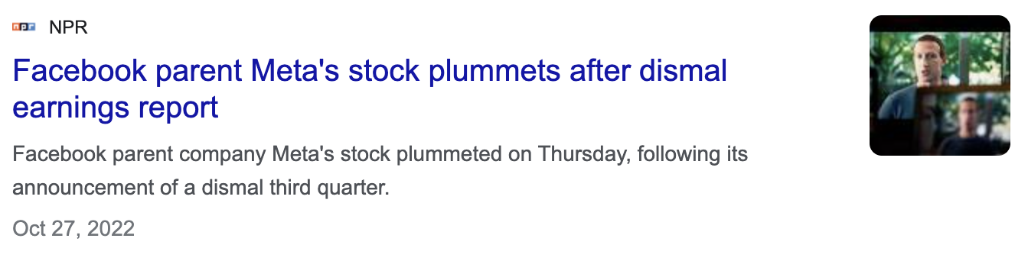
Limitations of Traditional Time Series Models
Time series models alone often fail to capture market dynamics.
Public perception and sentiment can be heavily influenced by CEOs' personal events, impacting stock prices.
Incorporating NLP can enhance predictions by analyzing sentiment and trends from textual data, offering a more comprehensive view.
Example: Elon Musk's tweets have historically caused significant fluctuations in cryptocurrency values.

Slide 4
Benefits of leveraging Sentiment Analysis
Sentiment analysis provides a deeper understanding of market sentiment, capturing investor emotions and public perceptions.
Incorporates real-time data from news, social media, and other textual sources for more timely and relevant predictions.
Combines quantitative data with qualitative insights, leading to more accurate and comprehensive stock predictions.
Helps in identifying emerging trends and shifts in investor sentiment before they are reflected in market prices.

Slide 5
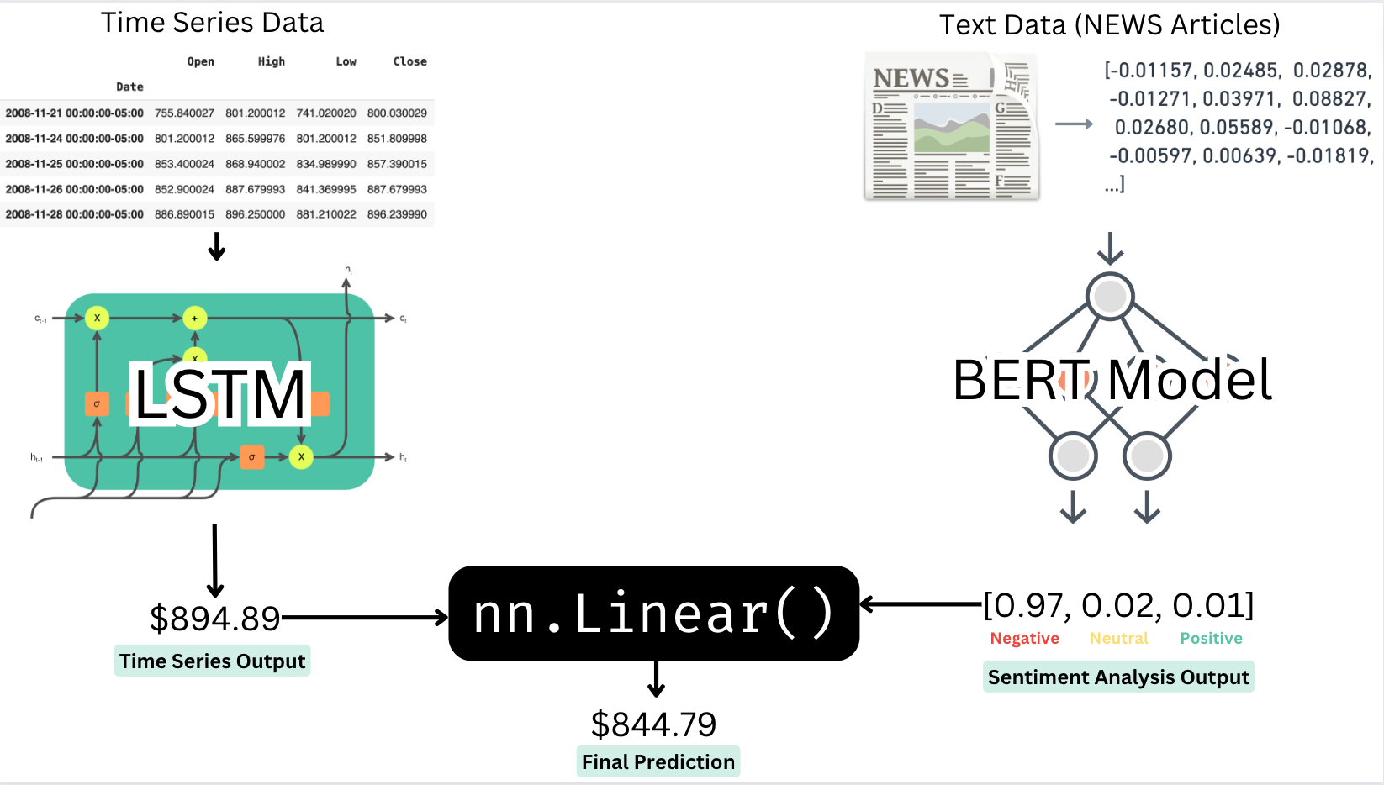
Ensemble Learning

Slide 6
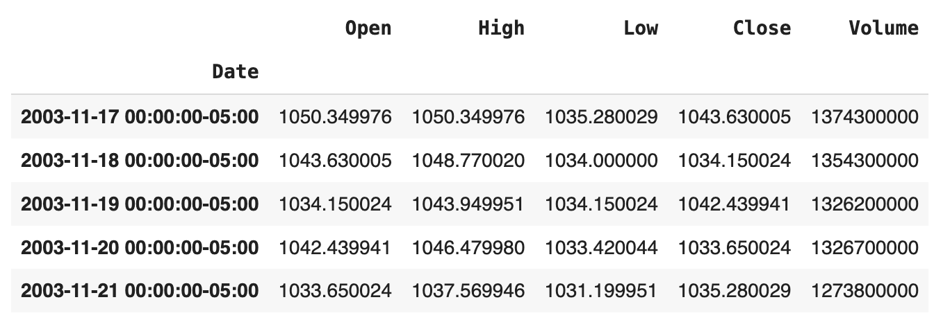
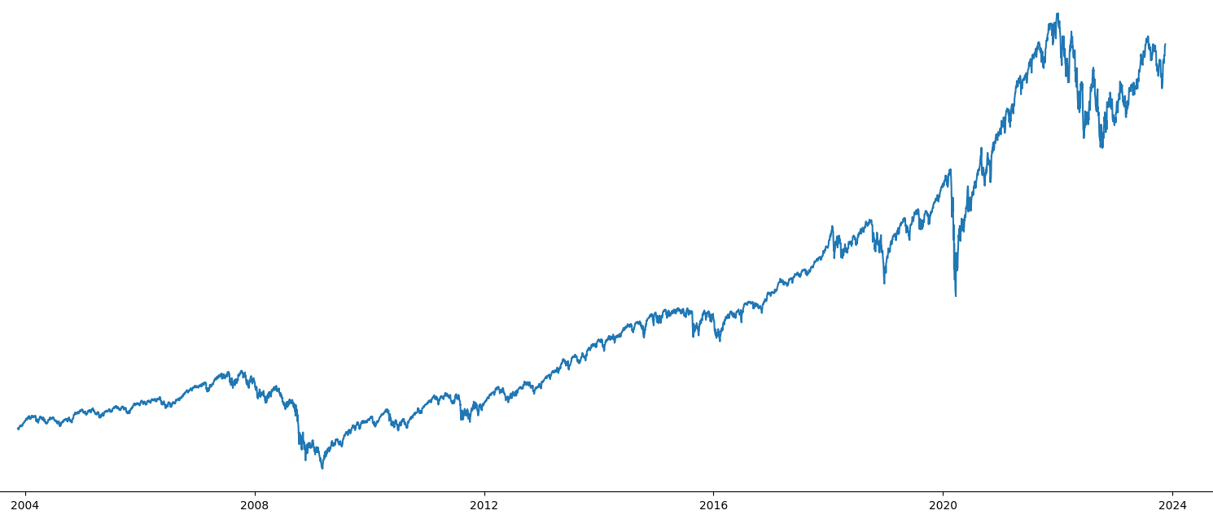
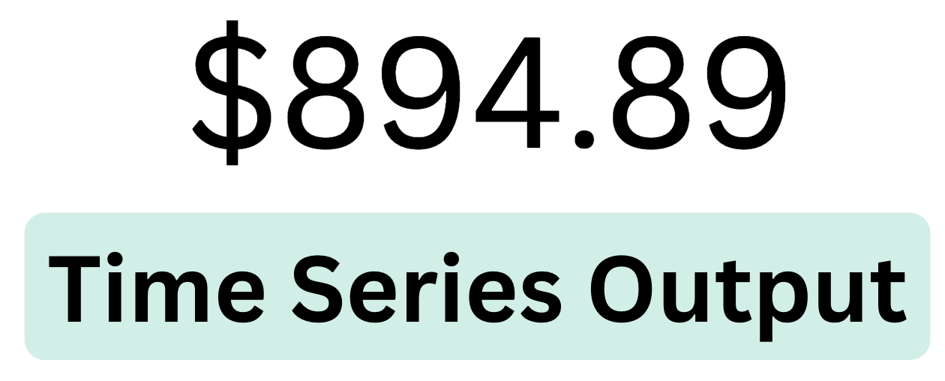
LSTM
Employed a single-layer LSTM model, chosen for its ability to capture long-term dependencies in time series data.
Data: 15 years of S&P 500 daily stock data
Optimizer: Adam optimizer, Initial lr = 0.001, with a ReduceOnPlateau learning rate scheduler
Model evaluated using various metrics: Mean Squared Error, Mean Absolute Error, Mean Absolute Percentage Error

Slide 7
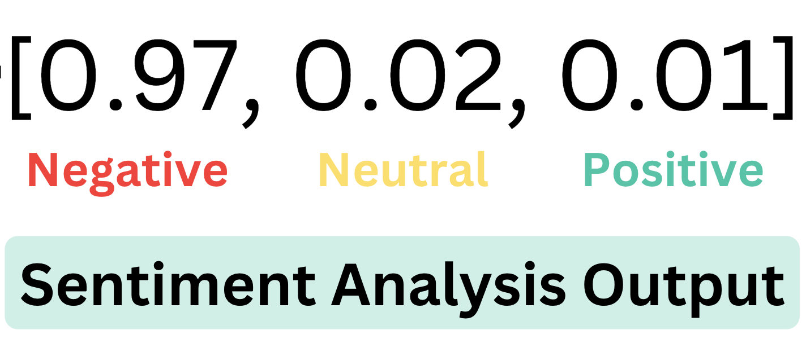
NLP Sentiment Analysis
Initialised BERT language model, then further fine tuned it on a large financial corpus for enhanced accuracy in the finance domain.
Data: Financial PhraseBank by Malo et al. (2014) for fine-tuning, specifically for financial sentiment classification.
Output: Softmax probabilities for three sentiment labels: positive, negative, or neutral.
Configured with "hidden_act": "gelu" and a maximum sequence length of 512.

Slide 8
Ensemble Learning

Slide 9
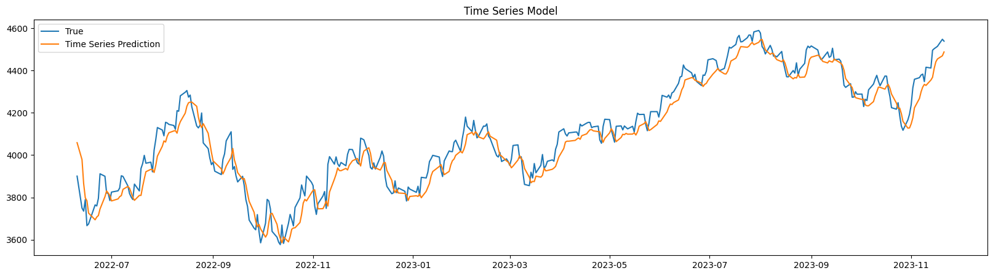
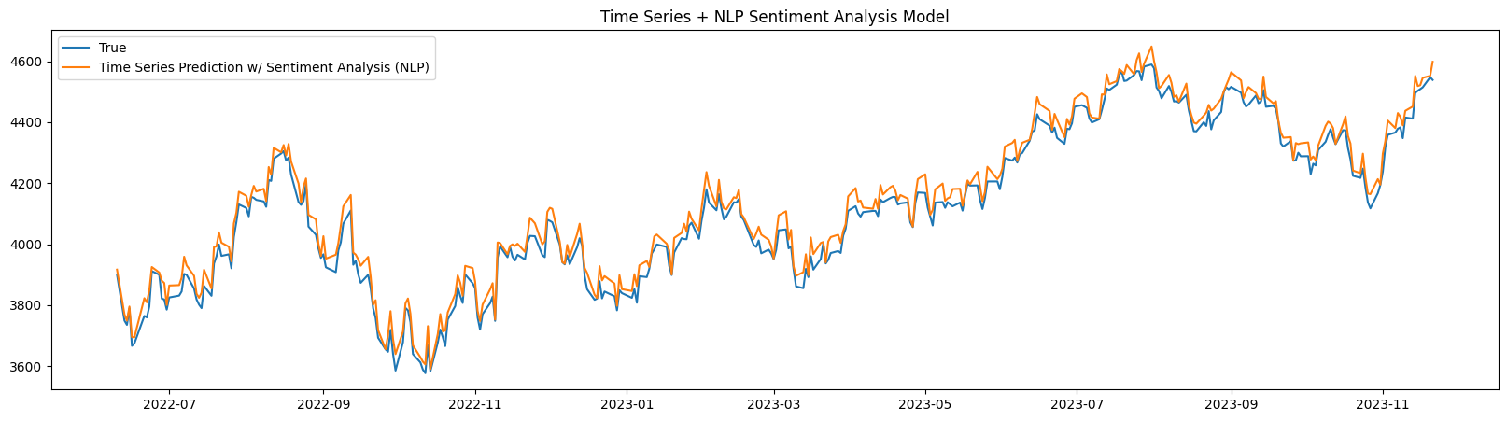

Slide 10
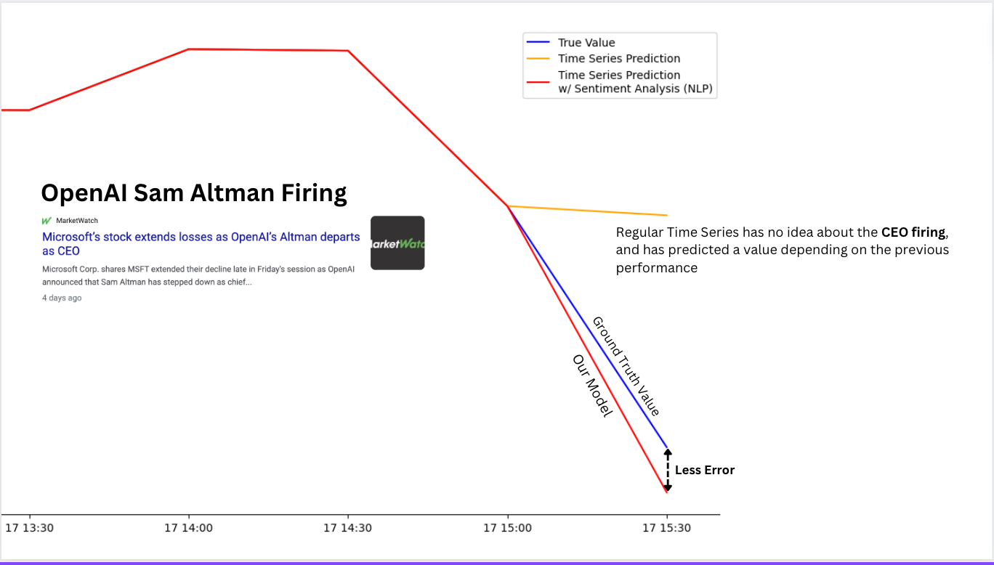

Slide 11
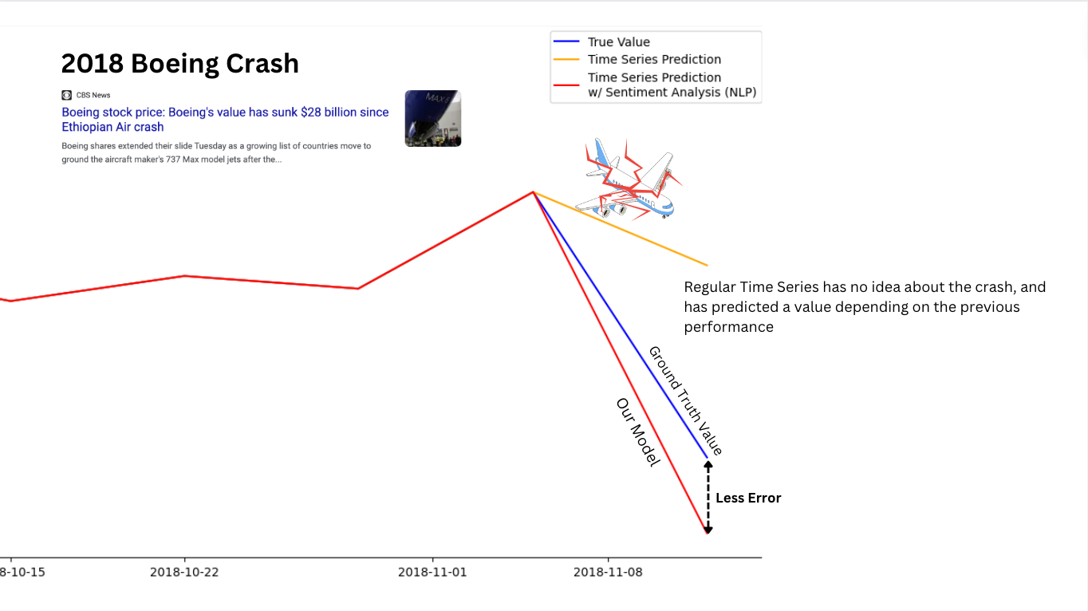

Slide 12
“Thank You”

