Slide 1
Introduction to Programming, Python Basics & Dev Environment Setup
Session 01
Saksham Arora Software Engineer 2 @ Intuit | Ex - Microsoft | 2x Intern @ Microsoft + 1x Intern @ Amazon linkedin.com/in/sakshamarora9575

Slide 2
Session Objective
✦ Configuring a professional local development environment
✦ Navigating the terminal confidently
✦ Executing your first Python script
Agenda
1. Python Setup – Installing Python, VS Code, Terminal basics
2. Core Fundamentals – Variables, Data Types, Operators

Slide 3
Development Environment Setup
Installing VS Code • Installing Python • Terminal Basics

Slide 4
Installing VS Code
Visual Studio Code – a free code editor used by developers worldwide. Think of it like Microsoft Word, but for writing code.
✦ Download: code.visualstudio.com/download
✦ Select installer for your OS (Windows / macOS / Linux)
✦ Run installer and follow the steps
Important Installation Options:
Option | What it does
Add "Open with Code" action | Right-click any folder → open in VS Code
Enable Auto Save | File → Auto Save — code saves automatically

Slide 5
Installing Python
✦ Download: python.org/downloads
✦ Download latest stable version (e.g. Python 3.12 or 3.13)
✦ Run the installer
⚠ CRITICAL: Check "Add Python to PATH" during installation!
Without this, you'll get errors when running Python from terminal.
Verify Installation:
python3 --version
# Expected: Python 3.12.0

Slide 6
Working with the Terminal
The terminal (command line) is a window where you type text commands instead of clicking buttons. It's like having a conversation with your computer.
Why Do We Need It?
What happens when you run python3 index.py?
✦ Run Python programs
✦ Install packages and tools
✦ Used daily by professionals
1. Finds Python on your computer
2. Opens your file index.py
3. Runs the code line by line
4. Shows output on screen

Slide 7
Your First Python Program
Step 1: Open VS Code → create a new file → save as index.py
Step 2: Type the code shown on the right
Step 3: Save the file (or rely on Auto Save)
Step 4: Open Terminal → New Terminal (Ctrl+` or Cmd+`)
Step 5: Run: python3 index.py
print("Hello, World!")
Output:
Hello, World!

Slide 8
Terminal: Do's and Don'ts
Do's ✓
Don'ts ✗
✦ Make sure terminal is in the right folder
✦ Use cd to move to your project folder first
✦ Open VS Code from the project folder
✦ Check the path shown in terminal
✗ Don't run python3 index.py from wrong folder
✗ Don't forget to save before running
✗ Don't use spaces in file names
✗ Don't mix up python and python3
# Wrong folder:
$ python3 index.py
python3: can't open file 'index.py': No such file or directory
# Fix: Navigate first
$ cd Desktop/myproject
$ python3 index.py
Hello, World!

Slide 9
Understanding Syntax
Rules for writing code • Common errors • Good vs Bad examples

Slide 10
Variables
Named containers for storing values

Slide 11
Variables
A variable is a named container that stores a value. Think of it like a locker: the name is the label, the contents are the value.
score = 100 # Assignment
name = "Alice"
age = 25
# Read as: "score is assigned 100"
# Variable on LEFT, value on RIGHT
Changing Variables
score = 100
print(score) # 100
score = 75 # Changed!
print(score) # 75
Naming Rules
✦ Start with letter or underscore
✦ Use only letters, numbers, underscores
✦ Use snake_case: student_name, total_score

Slide 12
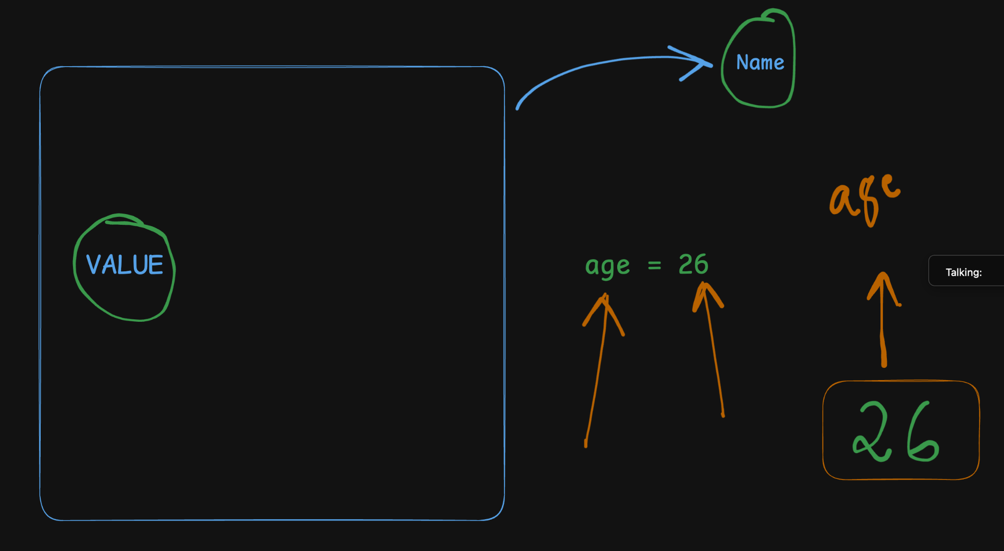

Slide 13
Data Types
int • float • str • bool

Slide 14
Why Different Data Types?
✦ Numbers need math — multiply price × quantity, add tax
✦ Text needs different handling — join strings, get length
✦ "19" × 3 = "191919" (text) vs 19 × 3 = 57 (number)
✦ Types tell the computer HOW to use each value correctly
✦ int (integers) → counting: 3 apples, 10 students
✦ float → measurements: 19.99 rupees, 5.5 feet
Type | Example | Use | Python
int | 25, -10 | Whole numbers | age = 25
float | 19.99, 3.14 | Decimals | price = 19.99
str | "Hello" | Text | name = "Alice"
bool | True, False | Yes/No logic | is_active = True

Slide 15
Data Types: Examples
int & float
str (strings)
age = 25 # int
price = 19.99 # float
# Division always returns float
print(10 / 2) # 5.0
# Mixing: result is always float
# 25 + 5.8 → 30.8
name = "Alice"
message = 'Hello, World!'
# Joining strings
greeting = "Hello, " + name
print(greeting) # Hello, Alice
# Cannot mix: "Age: " + 25 → Error!
# Fix: "Age: " + str(25)
bool (booleans)
Checking type with type()
is_active = True
is_passing = False
# Only two values: True or False
score = 100
print(type(score)) # <class 'int'>
name = "Alice"
print(type(name)) # <class 'str'>

Slide 16
Arithmetic Operators
Addition • Subtraction • Multiplication • Division • Modulo • Power

Slide 17
Arithmetic Operators
Operator | Name | Example
+ | Addition | 5 + 3 → 8
- | Subtraction | 5 - 3 → 2
* | Multiplication | 5 * 3 → 15
/ | Division | 10 / 2 → 5.0
// | Integer Division | 10 // 3 → 3
% | Remainder (Modulo) | 10 % 3 → 1
** | Power | 2 ** 3 → 8
score = 100
bonus = 50
total = score + bonus
print(total) # 150
price = 50
quantity = 3
subtotal = price * quantity
print(subtotal) # 150
Key Points:
✦ Division (/) always gives a float ✦ Integer division (//) drops the decimal
✦ Modulo (%) gives the remainder — useful for checking even/odd: number % 2

Slide 18
Division Deep Dive: / vs // vs %
# Division vs Integer Division
print(10 / 3) # 3.333... (float)
print(10 // 3) # 3 (drops decimal)
# Use / for averages, precise calculations
# Use // for whole parts
# e.g. 100 rupees ÷ 3 people = 33 each
# Modulo — gives the remainder
number = 10
print(number % 2) # 0 → even
number = 7
print(number % 2) # 1 → odd
# Great for: even/odd, wrapping, cycles

Slide 19
Operator Precedence (PEMDAS)
P — Parentheses ()
E — Exponents **
M/D — Multiplication, Division *, /, //, %
A/S — Addition, Subtraction +, -
# Multiplication before addition
result = 2 + 3 * 4
# 3*4=12, then 2+12=14
print(result) # 14
# Parentheses change the order
result = (2 + 3) * 4
# 2+3=5, then 5*4=20
print(result) # 20
# Exponents first
result = 2 + 3 ** 2
# 3**2=9, then 2+9=11
print(result) # 11
Tip: When unsure, use parentheses to make your intent clear: total = (price * quantity) + tax

Slide 20
Comparison Operators
The foundation of decision-making in programs

Slide 21
The Six Comparison Operators
Operator | Meaning | Example → Result
== | Equal to | 5 == 5 → True
!= | Not equal to | 5 != 3 → True
> | Greater than | 5 > 3 → True
< | Less than | 3 < 5 → True
>= | Greater or equal | 5 >= 5 → True
<= | Less or equal | 3 <= 5 → True
age = 18
print(age == 18) # True
print(age == 20) # False
score = 85
print(score > 75) # True
print(score >= 85) # True
# Store results in variables
is_adult = age >= 18
print(is_adult) # True
print(type(is_adult)) # <class 'bool'>

Slide 22
Comparisons: Types
Comparing Different Types
# Numbers: int vs float works fine
print(5 == 5.0) # True
print(10 > 9.5) # True
# Strings: compared alphabetically
# Case matters: "ABC" != "abc"
# Type mismatch:
print(5 == "5") # False!
# print(10 < "20") # TypeError!

Slide 23
Common Mistakes & How to Fix Them
Mistake | What Happens | Fix
= vs == | SyntaxError | Use == for comparison
Wrong folder | No such file or directory | cd to project folder first
Unquoted text | name = Alice → NameError | Use quotes: name = "Alice"
Mixing str + int | "Total: " + 100 → TypeError | Convert: str(100)
Wrong precedence | 2+3*4 gives 14, not 20 | Use parentheses: (2+3)*4
Forgot to save | Old code runs | Ctrl+S / Cmd+S before running

Slide 24
Key Takeaways
1. Setup — Install VS Code + Python. Add Python to PATH. Enable Auto Save.
2. Terminal — Use it to run python3 index.py and see output.
3. Variables — Named containers. Use = to assign. snake_case naming.
4. Data Types — int, float, str, bool — each has a purpose.
5. Arithmetic — + - * / // % **
6. Comparison — == != > < >= <= — return True or False.
7. Precedence — PEMDAS. Use parentheses when order matters.
8. Syntax — Quotes for strings, indentation matters, case-sensitive.

Slide 25
Debugging Tips
Problem | What to Check
"No such file or directory" | Terminal is in the wrong folder → use cd
"python3 is not recognized" | Reinstall Python with "Add to PATH" checked
SyntaxError | Missing quote, wrong indentation, typo
TypeError (str + int) | Mixing types → use str() or int() to convert
Wrong calculation result | Check precedence → add parentheses

Slide 26
Practice Exercise
score = 80
bonus = 20
total = score + bonus
print("Total score:", total)
print("Passing?", total >= 60)
Expected Output:
Total score: 100
Passing? True
Challenge:
Try 2 + 3 * 4 in a variable — print it. Then try (2 + 3) * 4 — see the difference! This reinforces operator precedence.

Slide 27
Syntax: Good vs Bad Examples
Syntax = rules for writing code. Break the rules → SyntaxError.
Good ✓
Bad ✗
name = "Alice"
message = 'Hello'
score = 100
age = 25
if score > 50:
print("Passed")
print("Hello")
name = Alice # Missing quotes!
message = "Hello # No closing quote!
100 = score # Value on left!
25 = age # Same mistake!
if score > 50:
print("Passed") # Not indented!
Print("Hello") # Case-sensitive!

Slide 28
Thank You!
Saksham Arora Software Engineer 2 @ Intuit | Ex - Microsoft linkedin.com/in/sakshamarora9575

