Slide 1
Capstone Project - 1
Play Store App Review Analysis
Presented By Gaurav Kumar

Slide 2
Content
Introduction
Objective & Problem Statement
Description of Data
Import Library and data
Data Cleaning
Data analysis & visualizations
Conclusion

Slide 3
Objective
The objective of this project is to deliver insights to understand customer demands better and thus help developers to popularize the product.
Problem Statements
1. Top 10 installed apps in any category
2. Distribution of paid apps and free apps
3. Top Categories Apps in Google Play store
4. Which apps have the highest number of review?
5. Which app's have maximum number of installs in any category?
6. Top 10 expensive apps in the play store
7. Percentage of Review Sentiments
8. Positive review
9. Negative review

Slide 4
Data Set Description
There are two Data set. 1). Play Store Data 2). User Review Data
Play Store Data:
1. App – Application name
2. Category – Apps Category
3. Rating – Rating given to the apps
4. Review – Number of reviews given to the apps
5. Size – size of the app
6. Installs – No of users installed of the apps
7. Type – Free or Paid
8. Price – Price of the apps
9. Content Rating – An App belong which age group
10. Genres – Type of Genres the application belong to
11. Last Updated – When last time app updated
12. Current Ver – Current version of the app
13. Android Ver – Android version of the app

Slide 5
User review data set
App - App name
Translated Review – Reviews given by the consumer
Sentiment - Review sentiment i.e. Positive, Negative, Neutral
Sentiment Polarity – sentiment in numerical form range from -1 to 1
Sentiment Subjectivity – a measure of expression, of opinion, evaluations, feelings, and speculations

Slide 6
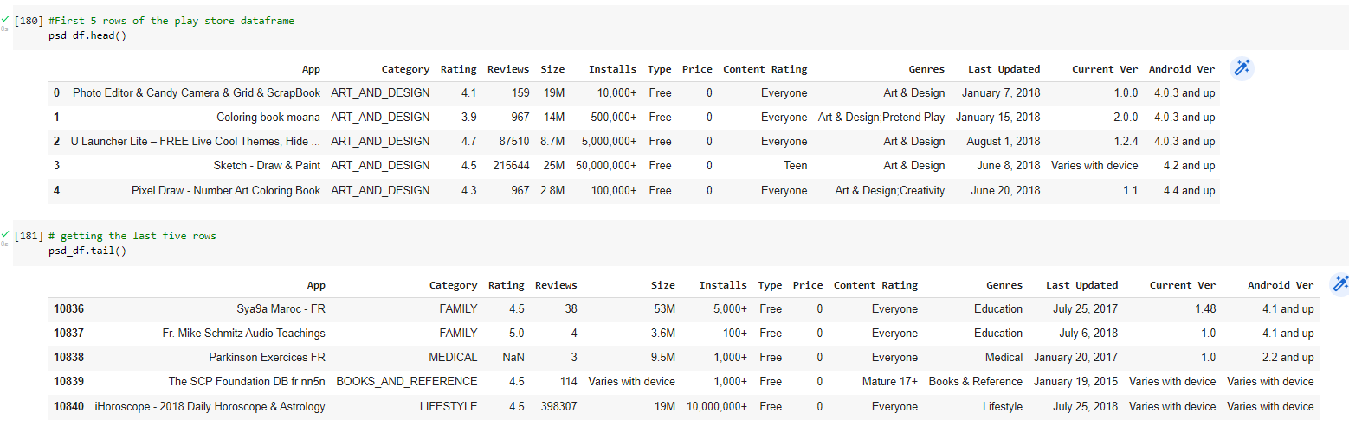
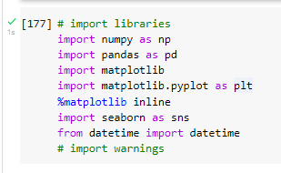
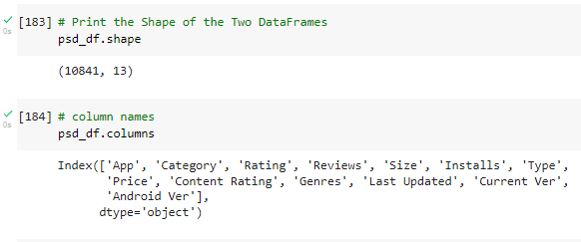
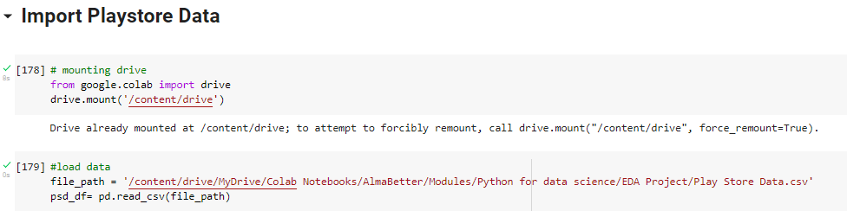
Import library & data

Slide 7
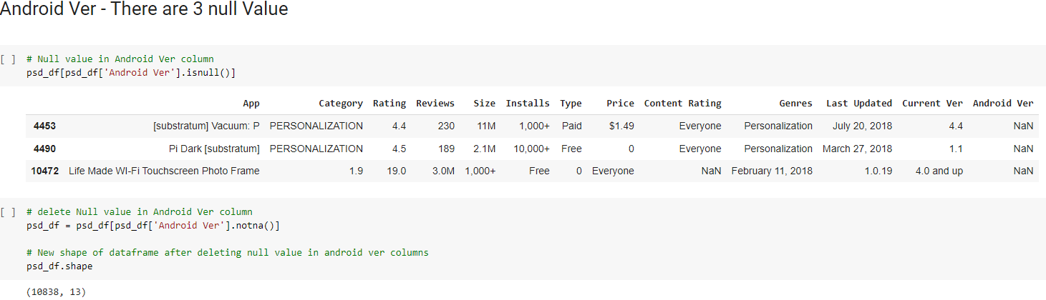
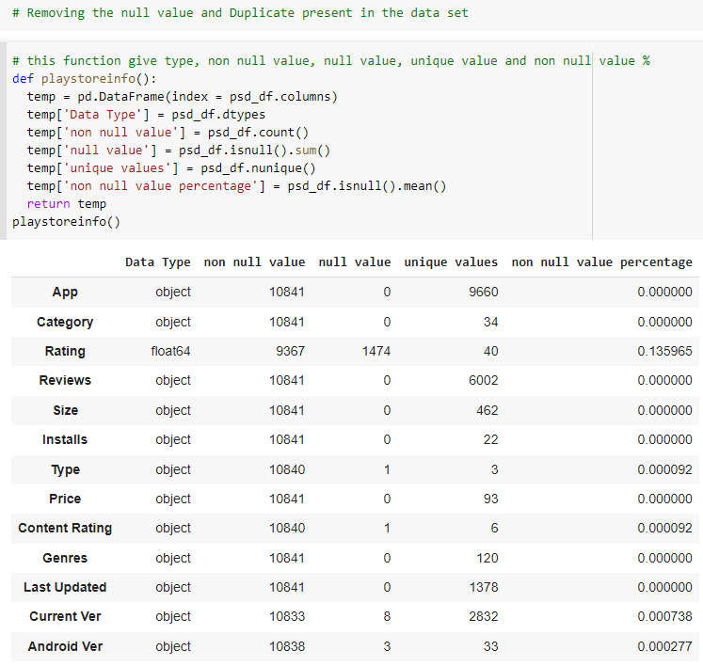
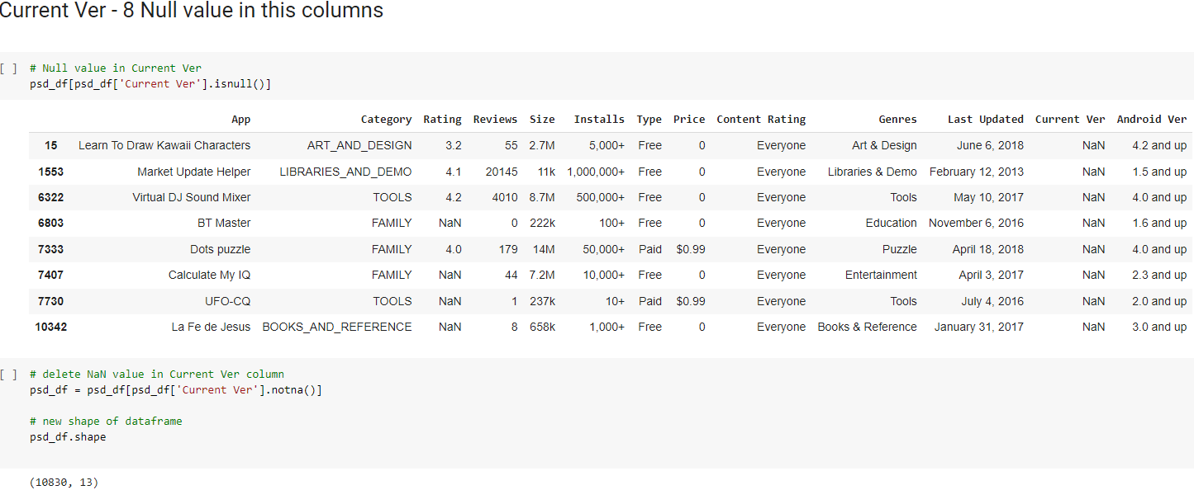
Data Cleaning cont....
Handling null value

Slide 8
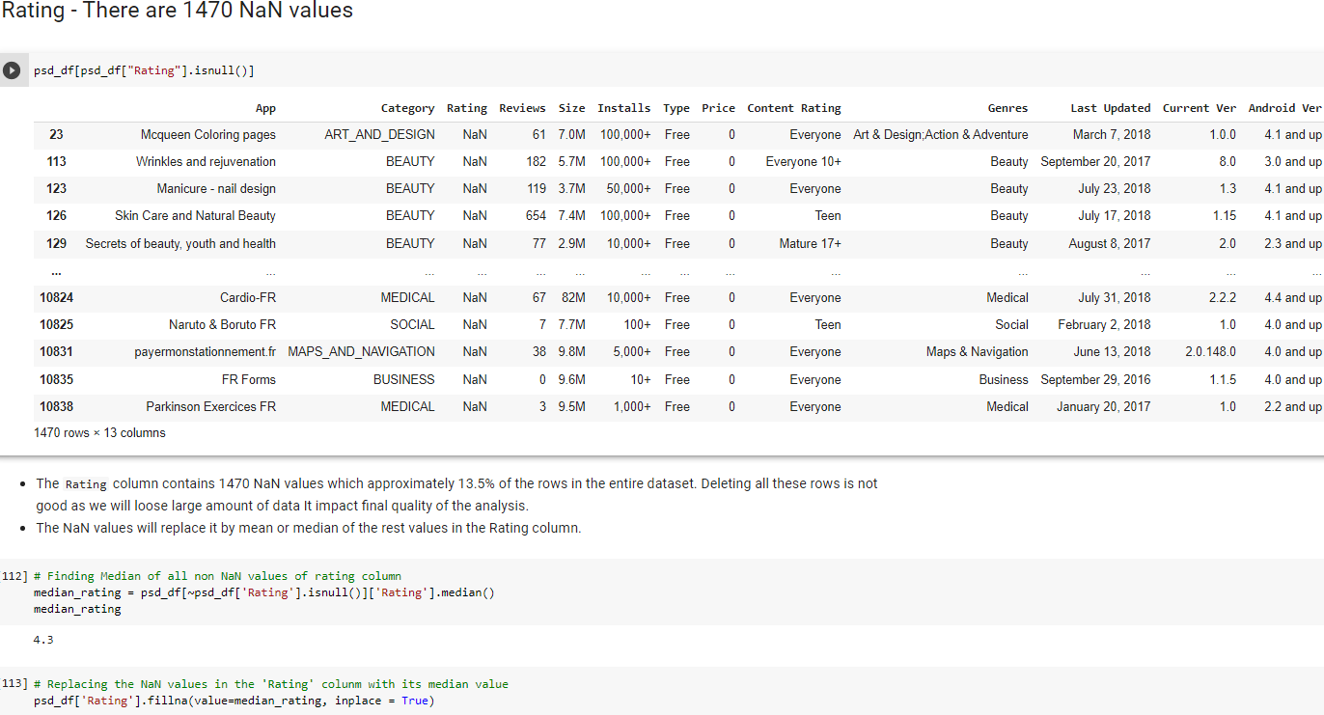
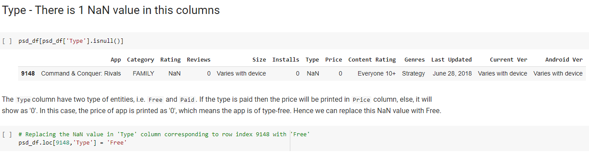
Cont….

Slide 9
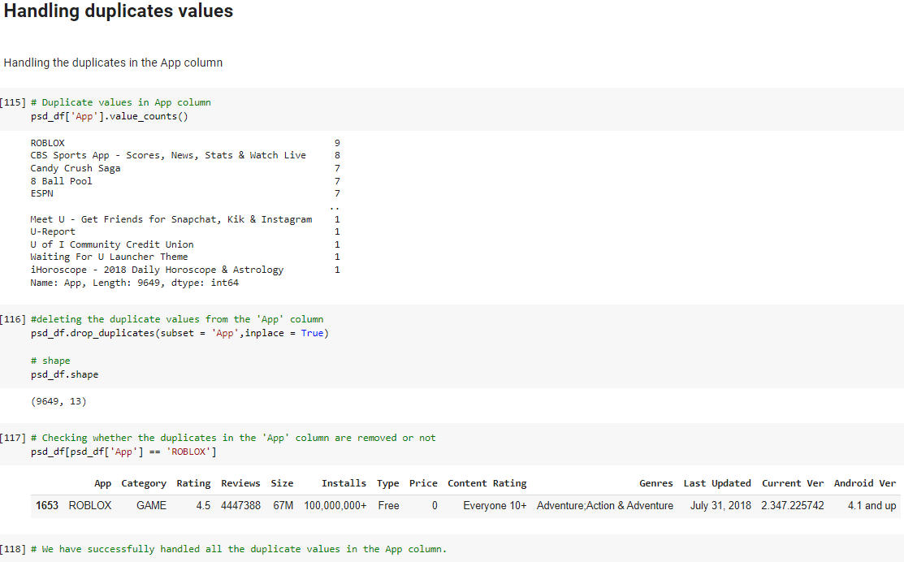
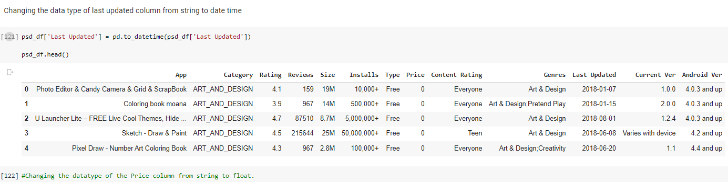
Data Cleaning cont….

Slide 10
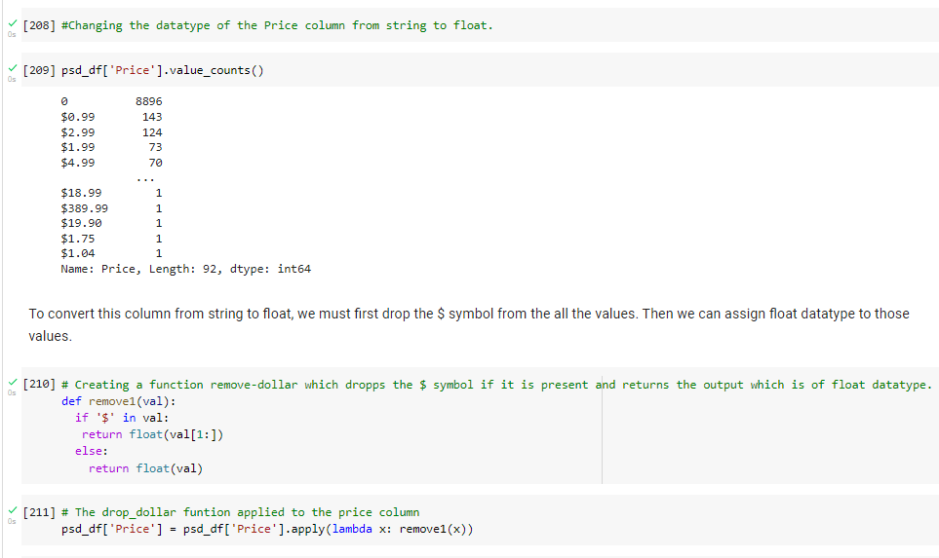
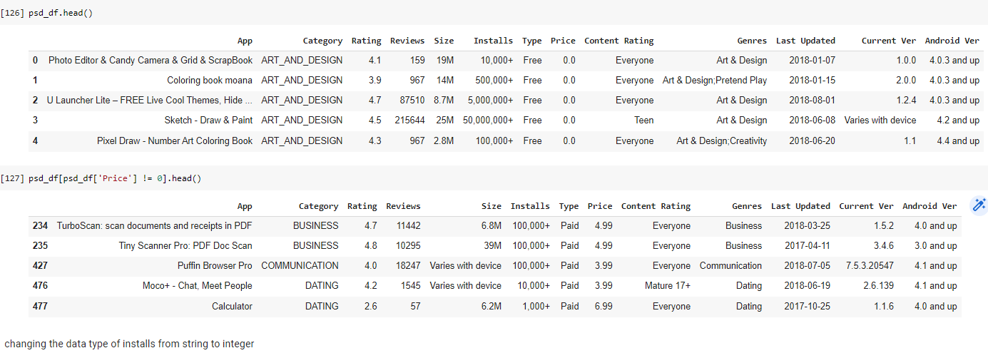
Data Cleaning
Changing data type

Slide 11
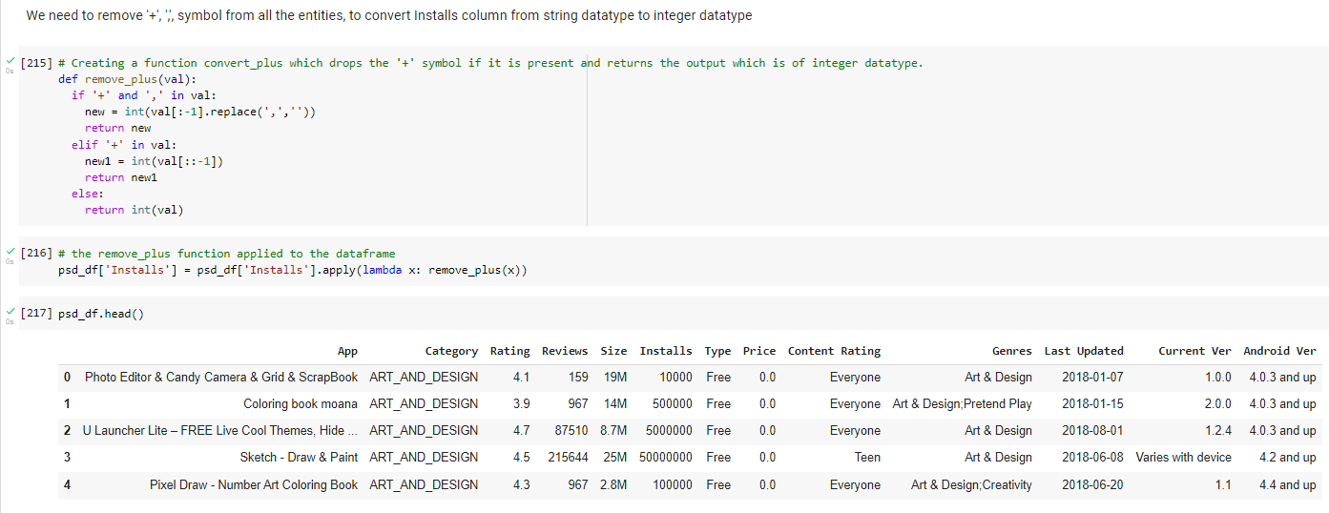
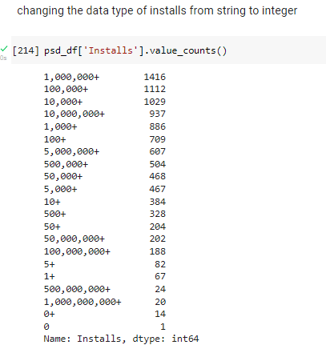
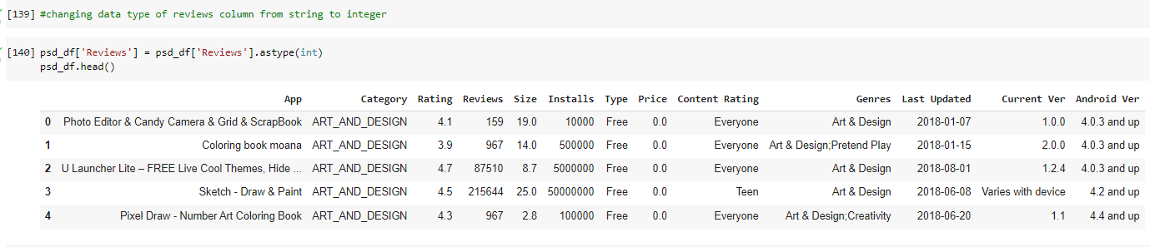
Data Cleaning
Changing data type

Slide 12
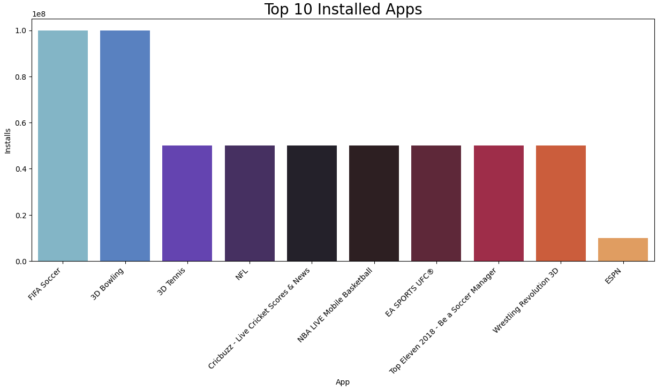
Data Visualization
Top 10 installed apps in any category
* From the above graph we can see that in the Sports category FIFA Soccer and 3D Bowling has the highest installs.

Slide 13
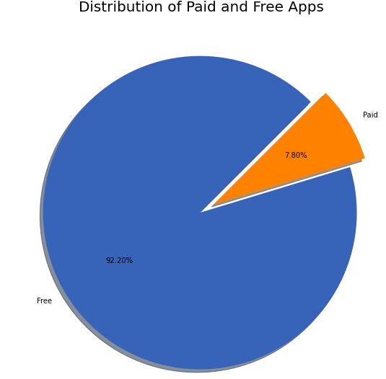
Distribution of paid apps and free apps
* Free apps in play store are 92.20% and Paid apps in play store are 7.80%

Slide 14
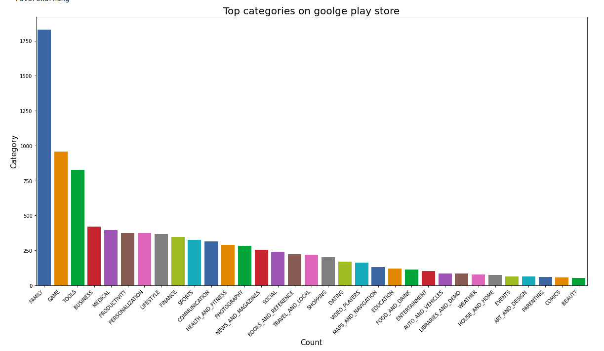
Top Categories Apps in Google Play store
* So there are all total 33 categories in the dataset From the above output we can come to a conclusion that in play store most of the apps are under` FAMILY & GAME` category and least are of `EVENTS & BEAUTY` Category.

Slide 15
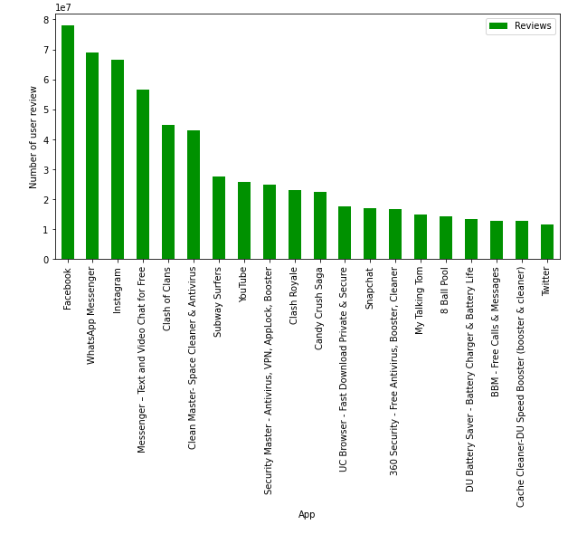
Which apps have the highest number of review?
* Top 20 apps with the highest number of review
* Facebook has the highest number of user review

Slide 16
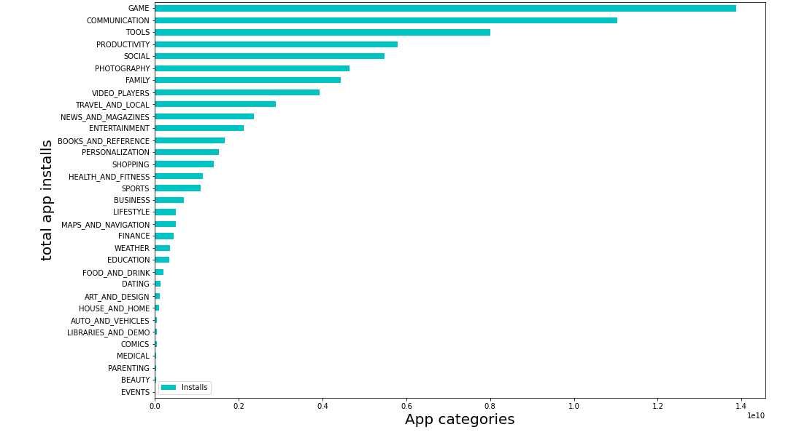
Which app's have maximum number of installs in any category?
This tells us the category of apps that has the maximum number of installs. The `Game,` `Communication and Tools` categories has the highest number of installs compared to other categories of apps.

Slide 17
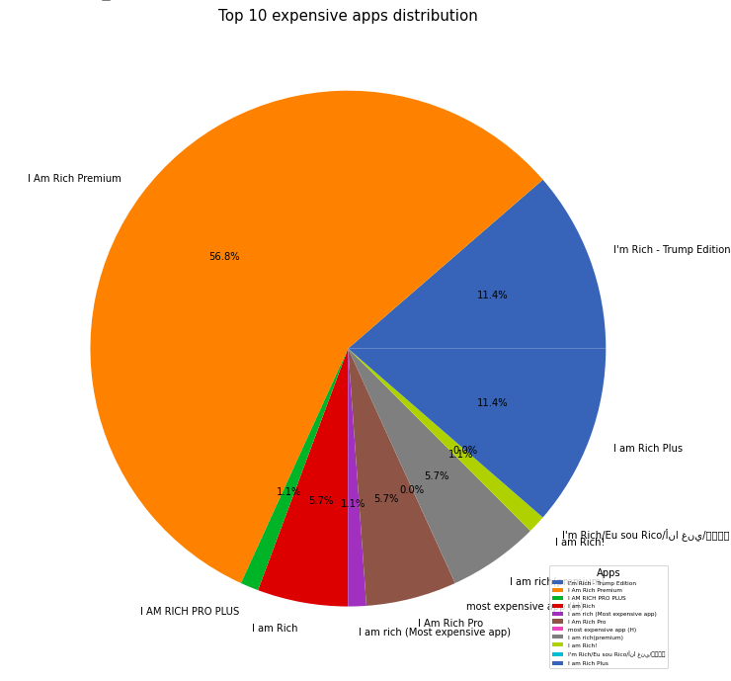
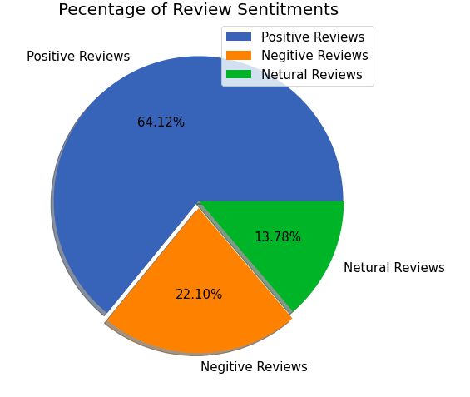
Top 10 expensive apps in the play store
Percentage of Review Sentiments
* From the above graph we can interprete that the I am Rich Premium app is the most expensive app in the play store.
Findings:
1. Positive reviews are 64.12%
2. Negative reviews are 22.10%
3. Neutral reviews are 13.78%

Slide 18
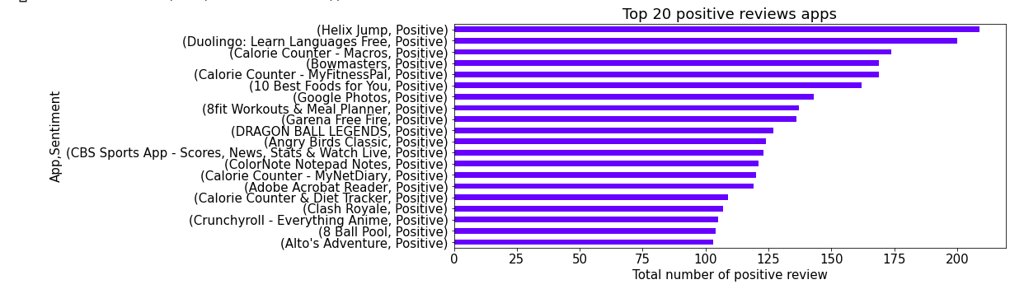
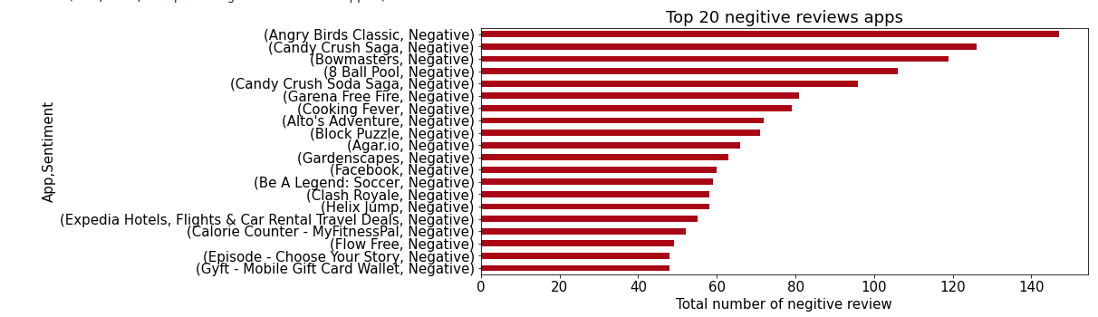
Positive review
* It is clear that Helix jump as max no. of positive review
Negative review
* It is clear that Angry Birds Classic has got highest negative reviews

Slide 19
Conclusion
In the initial phase, we focused more on the problem statements and data cleaning, in order to ensure that we give them the best results out of our analysis.
* In the Sports category FIFA Soccer and 3D Bowling has the highest number of installs.
* Percentage of free apps = 92.20%
* Maximum apps in the play store are from Family category
* Category with the highest number of installs: Game
* Most popular app in the Play Store based on the number of reviews: Facebook
* I am Rich Premium app is the most expensive app in the play store.
* Overall percentage of review sentiment in which Positive sentiment count is 64%, Negative 22% and Neutral 14%.
* Helix Jump has the highest number of positive reviews
* Angry Birds Classic has the highest number of negative reviews.

Slide 20
Q&A

