Slide 1

BLOOD DONATION DATABASE
BLOOD DONATION DATABASE

Slide 2
1.Introduction
Our project is giving us an overview about the database regarding blood donation first of all blood donation plays an vital part of worldwide healthcare. It relates to blood transfusion as a life-sustaining and life-saving procedure as well as a form of therapeutic phlebotomy as a primary medical intervention. our database consist of four modules. First consist of patient details second consist of donor details and third module consist of blood bank details.
There are patient details which require blood donation which consist of name, gender, their id, blood group and diseases.
There are donor details as they are donating their blood consist of their name, gender, contact number, id, blood group and medical report.
Then there are blood blank details which consist of their name, address, contact number.
For donating blood to the patient donor blood group should have a proper match with the patient blood group.
Plus the donor blood reports should be normal and the donor does not have any major diseases.

Slide 3
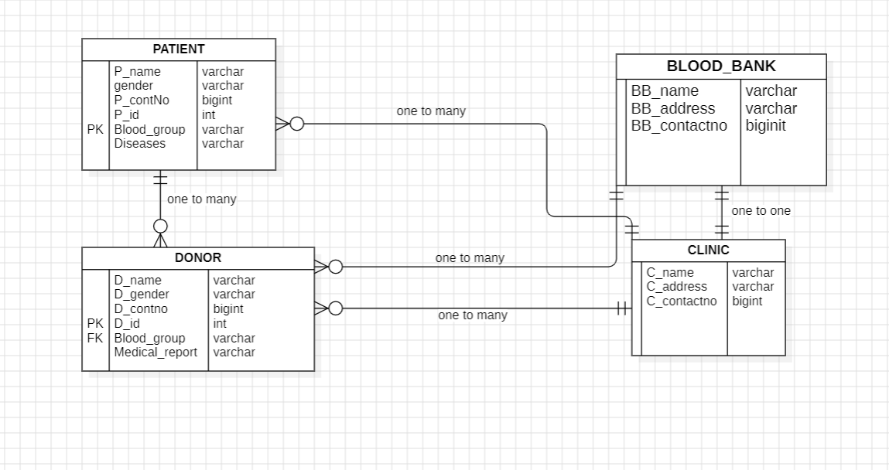
2. ER Diagram

Slide 4
3.DATABASE DESIGN
DATABASES-BLOOD DONATION
Tables:
-Patient
-Donor
-Blood Bank--
-Clinic

Slide 5
4.Creating table
a: PATIENT
b: DONOR

Slide 6
C&D:BLOOD_BANK & CLINIC

Slide 7
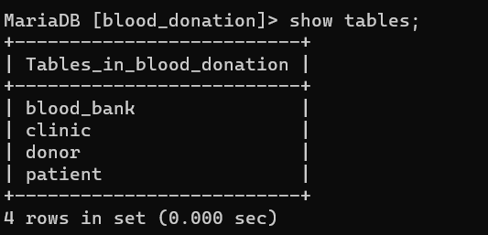
5.Tables in databases

Slide 8
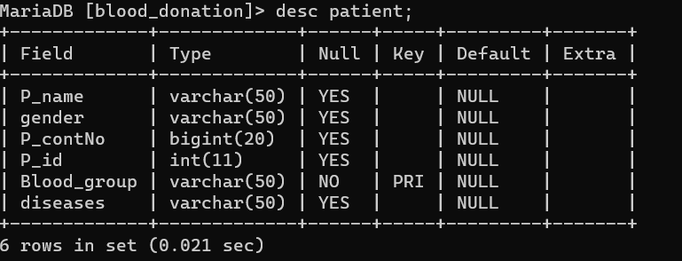
6. Data Definition language (DDL)
a) Creating Tables:
1:Patient

Slide 9
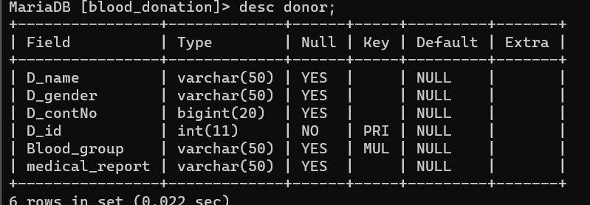
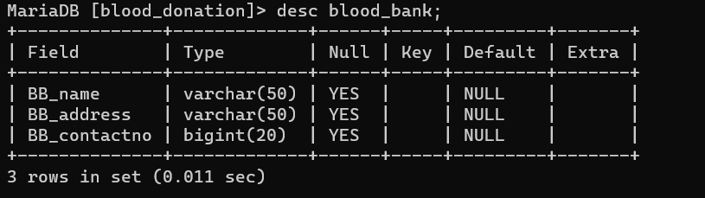
2: Donor
3: Blood_bank

Slide 10
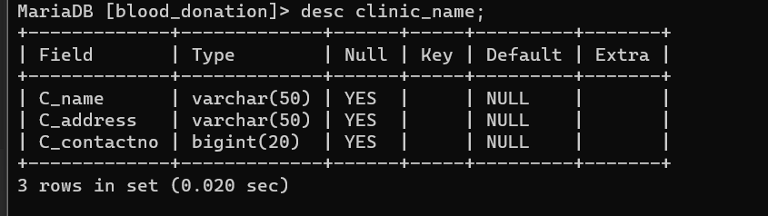
4: Clinic

Slide 11

b) Alter table
1) Alter table add column:
2) Alter table modify column:

Slide 12


3) Alter table rename column:
4) Alter table drop column:

Slide 13

c) Rename table :
d) Truncate table:

Slide 14

e) Drop table:
7. Data Manipulation language (DML)
Insert into table

Slide 15
b. Update into table
c. Delete into table

Slide 16
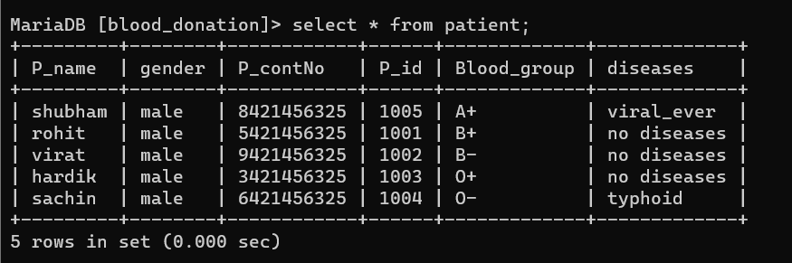
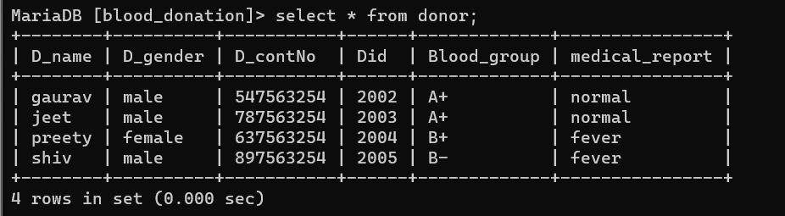
8. Data Query Language (DQL)
a. Select query

Slide 17
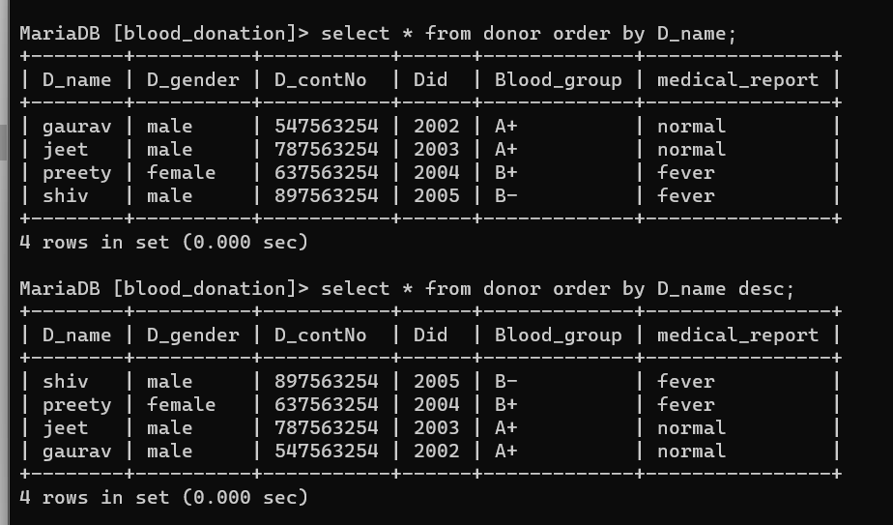
b. Order by query ASC &desc.

Slide 18
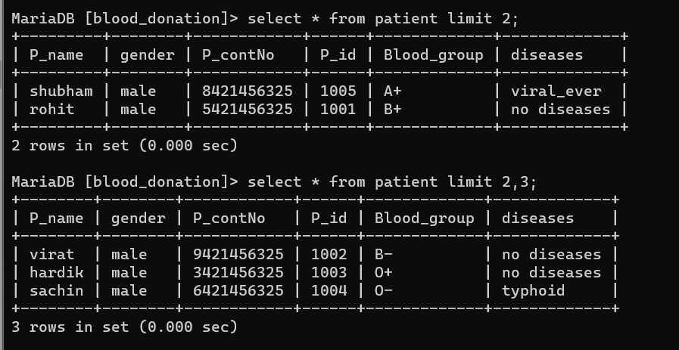
c. Limit query

Slide 19
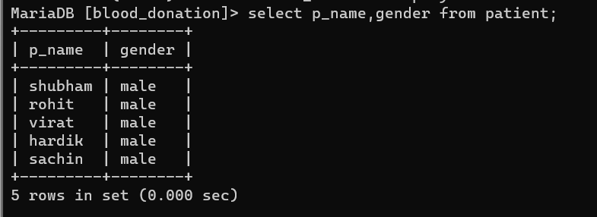
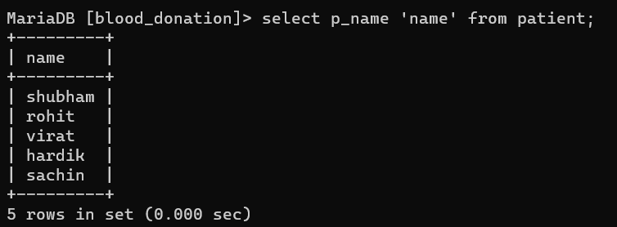
d. Select query with specific column
e. Select query with column name change

Slide 20
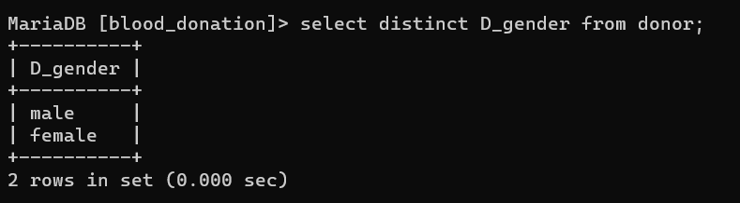
f. Distinct query

Slide 21
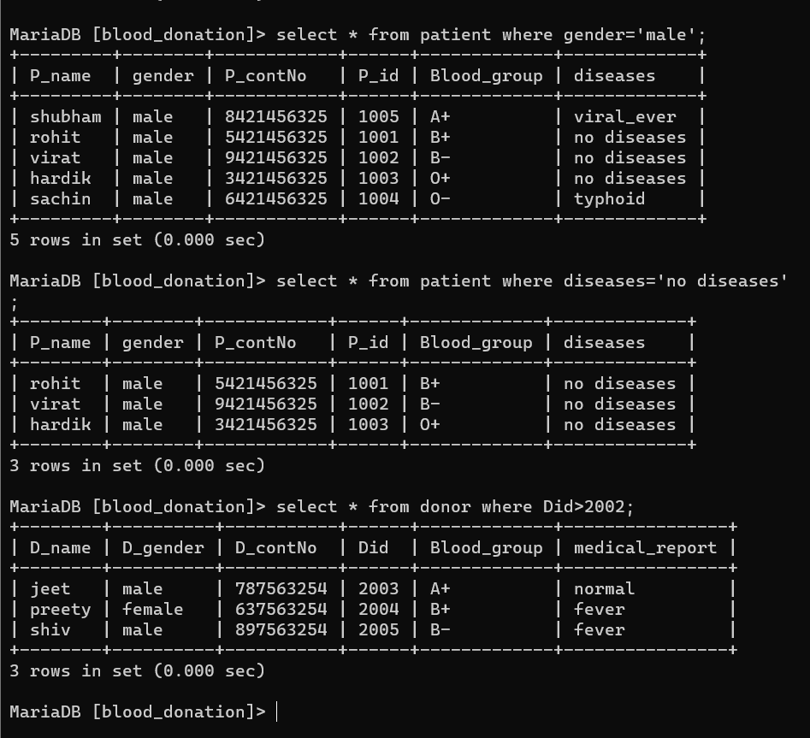
9. Using where clause
a. With Comparision Operator

Slide 22
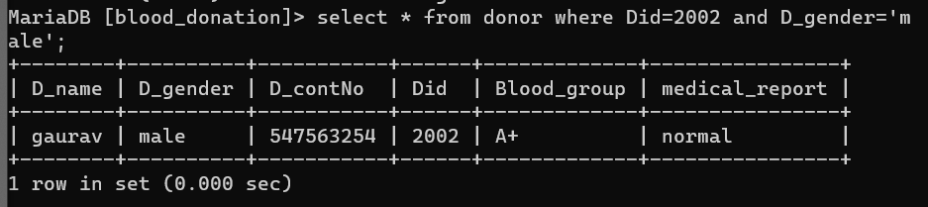
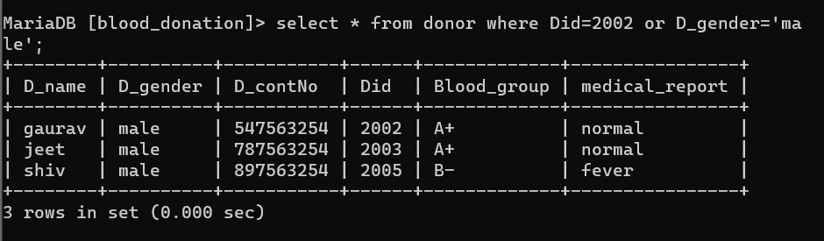
10. Using Logical Operator
a. Using AND operator
b. Using AND/ OR operator
b. Using OR operator
b. Using AND/ OR operator

Slide 23
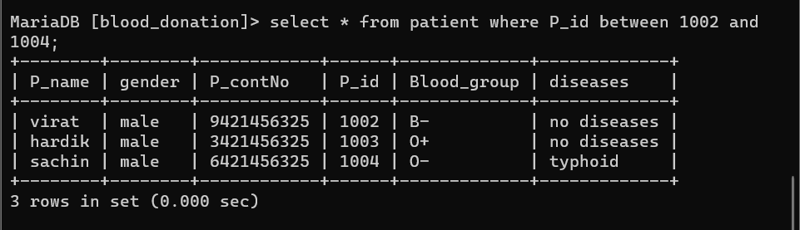
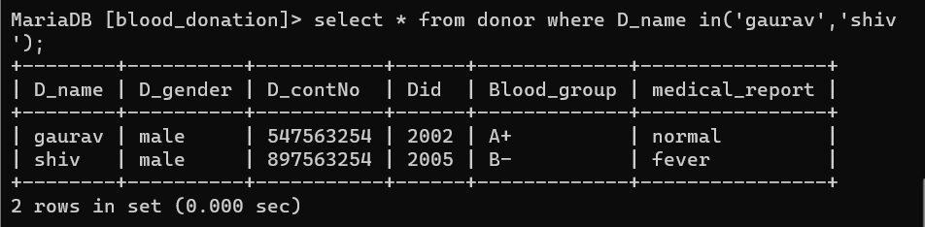
c. Using between clause
d. Using IN clause

Slide 24
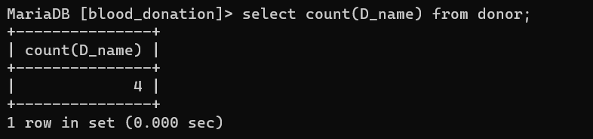
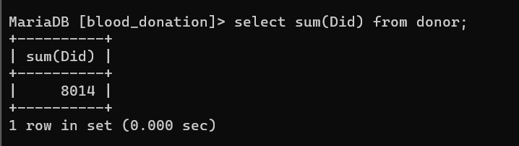
11. Aggregate function
a. count function
a. Count function
b. Sum function

Slide 25
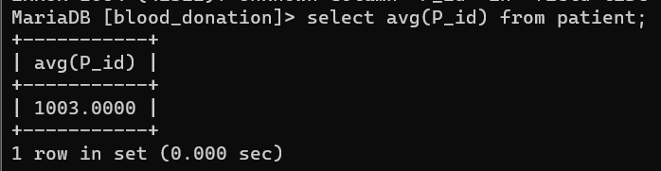
c. Average function

Slide 26
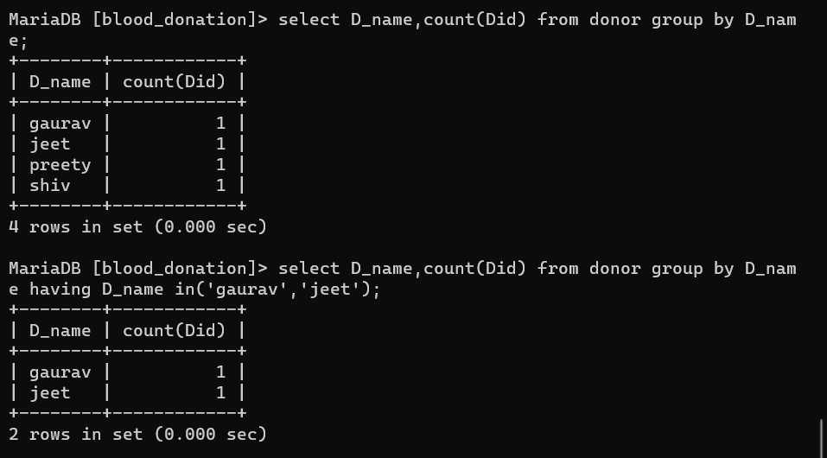
12. Group By clause

Slide 27
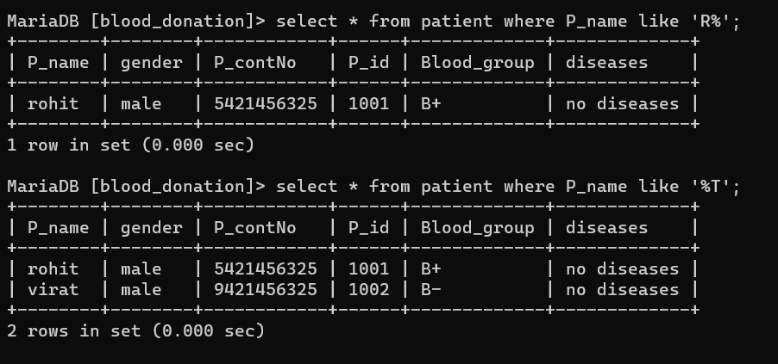
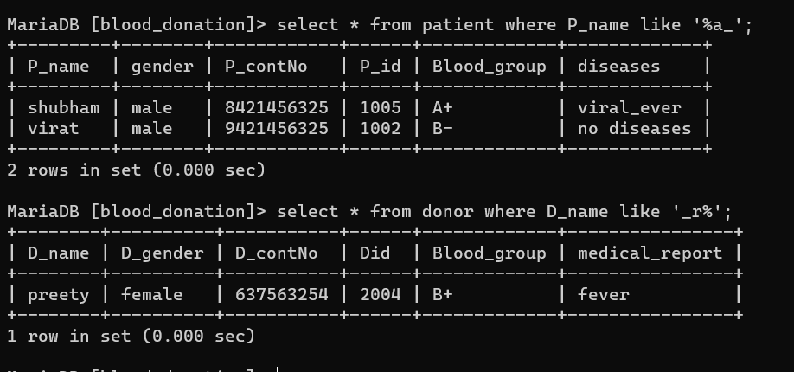
13. Like operator

Slide 28
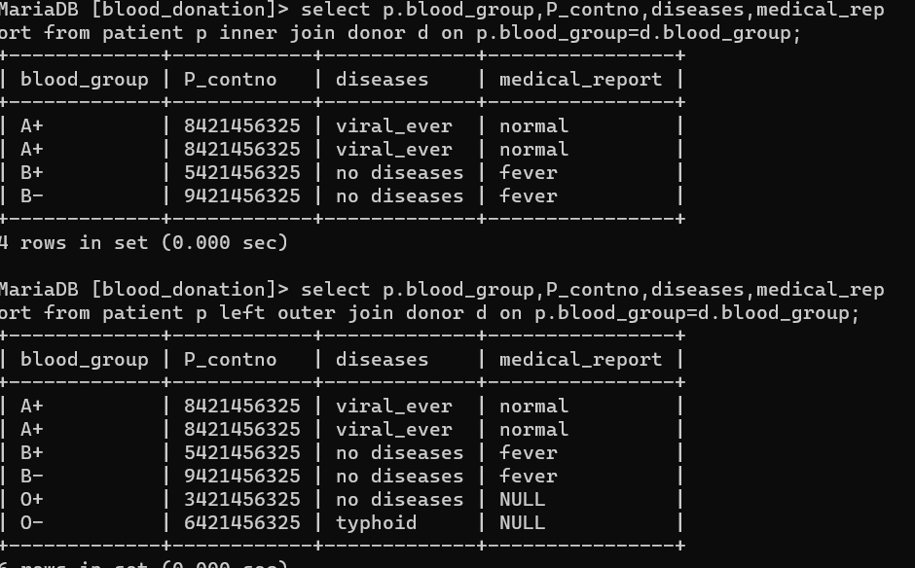
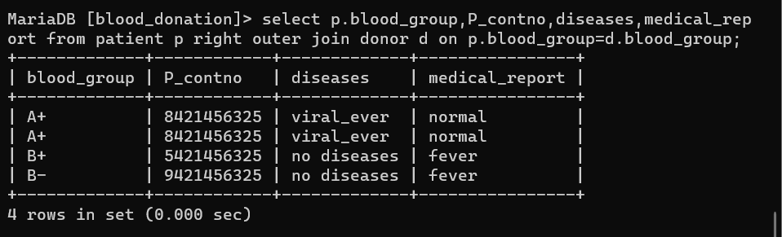
14. Joins

Slide 29
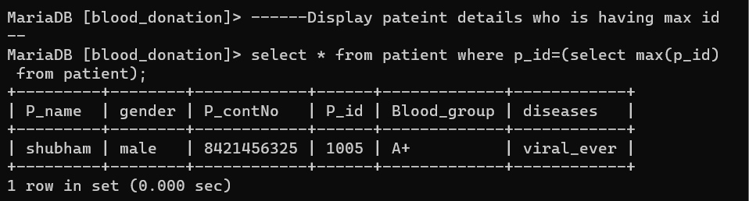
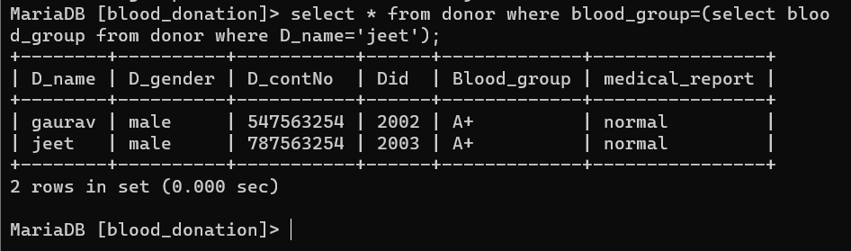
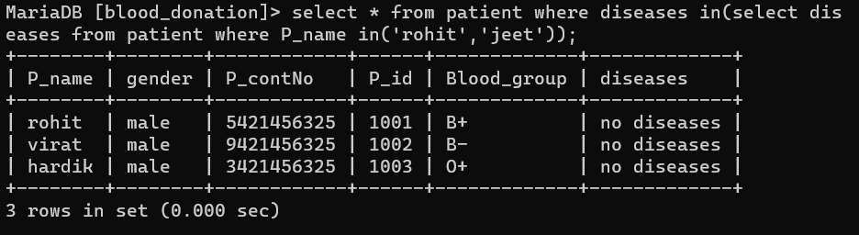
15. Subquery

Slide 30
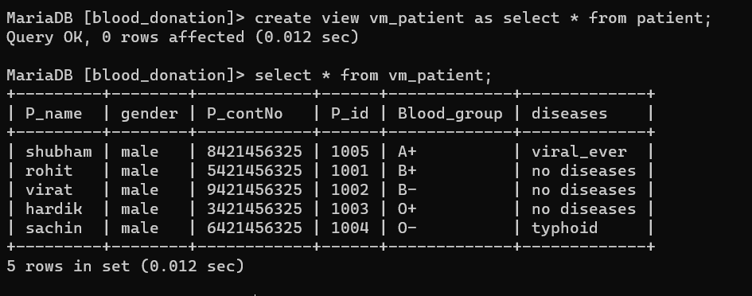
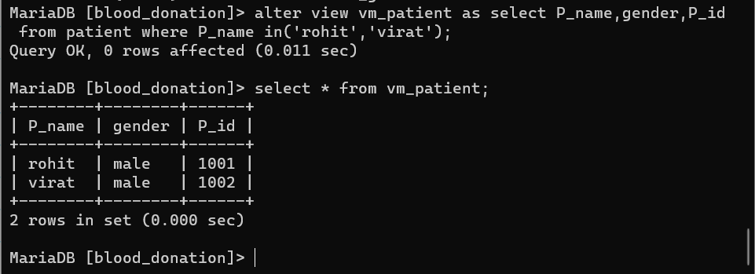
16. views

Slide 31
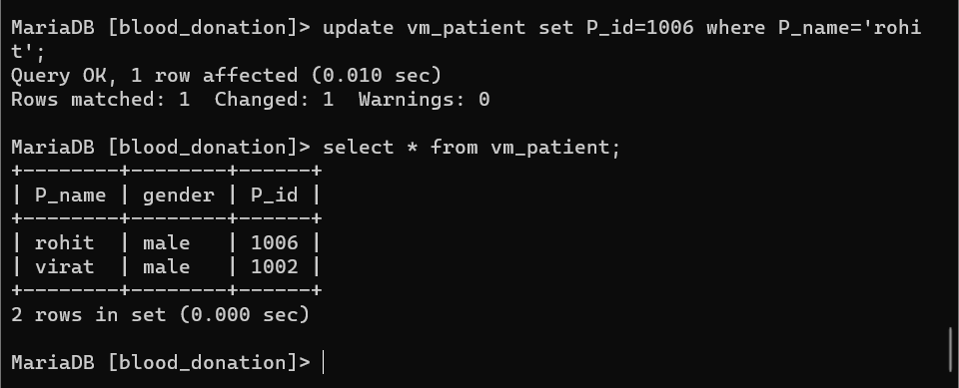
16.views

