Slide 1

CSL7170: Graph theoretic Algorithms
School Redistricting: Wiping unfairness from the map
Presented By:
Gaurav Sangwan (B20AI062)
Neielotpal Rao (B20EE038)

Slide 2


Paper Overview
This paper was authored by Ariel Procaccia (Harvard), Issac Robinson (University of Oxford), Jamie Tucker-Foltz (Harvard) and submitted to Proceedings of the 2024 Annual ACM-SIAM Symposium on Discrete Algorithms (SODA), 2024.
This paper focuses on the problem of designing an equitable school redistricting map.

Slide 3
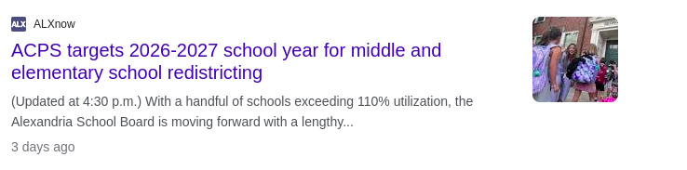
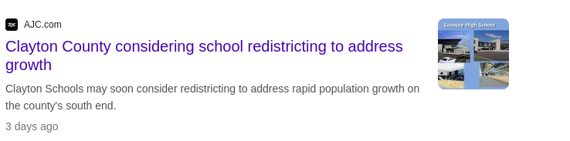
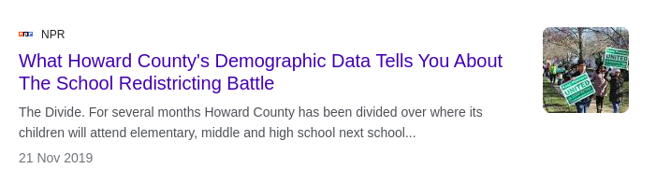
Introduction (Background)
School redistricting is a very common problem which happen in United States and many other countries which are rapidly developing.
In algorithmic literature, Political redistricting which is somewhat similar but more rarefied than school redistricting.

Slide 4
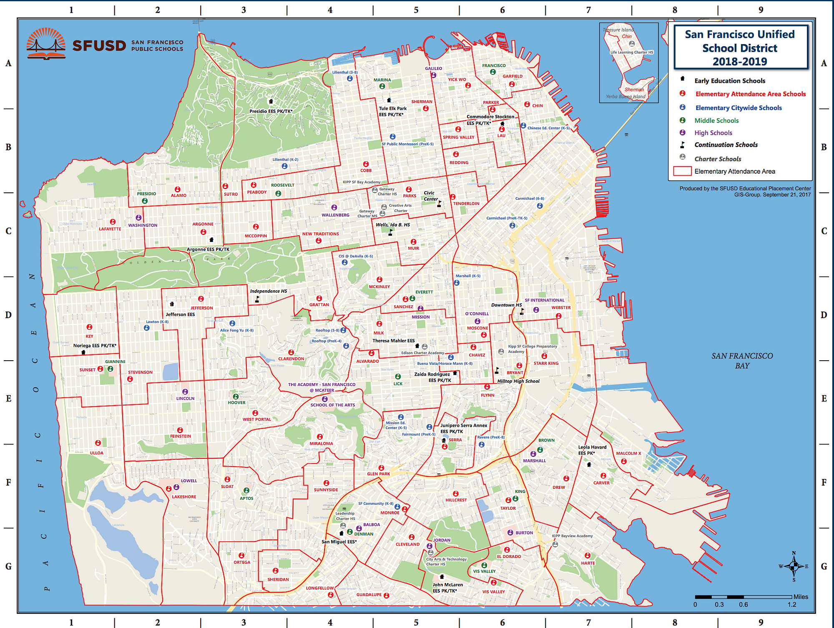
Problem Understanding
We want a fair division methodology to the prob elm of school redistricting.
It is when a municipality needs to redesign their school attendance zone.
  Such that, each zone contains one school which is where the students in that zone are assigned to attend.
Fairness to what??
  Fairness in this case arises because not all schools can be of fair quality.
  Fairness(Equity) could be obtained based on income level and/or race.

Slide 5
Desiderata and Contributions
The two main desires/goals that authors proposes are:
  Equality among demographic groups.
  Proximity of student to their schools.
Existing results and algorithms for finding proportional allocations satisfying feasibility constraints.
  They have adopted notion of proportionality for fair division and modified it appropriately for our setting/problem.

Slide 6
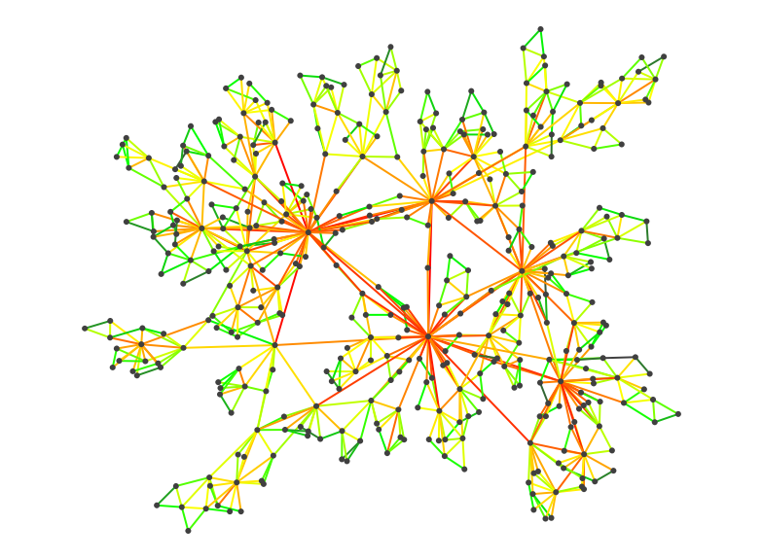
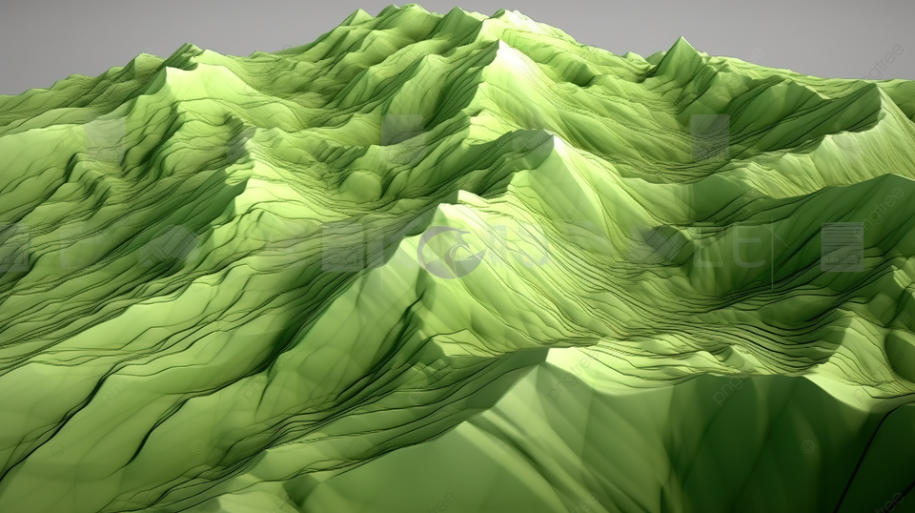


Roadmap/Reduction
Topological existential theorem
Graph Model
We are here
The End
School system saved
Cake cutting

Slide 7
Comparision with previous work
This paper studies a novel constrained variant of fair division with respect to OXS Valuation functions.
Because only by addition of 1 constraint to fair division problem makes it quite a different problem than the original problem (in terms of what is possible and what is not).
Paper claims that this is the first paper on fair division for school redistricting, and as such it does not presume to entirely capture the real-world nuance of the problem.
Their goal is to gain an initial understanding of the possibility of provable fairness in this domain

Slide 8
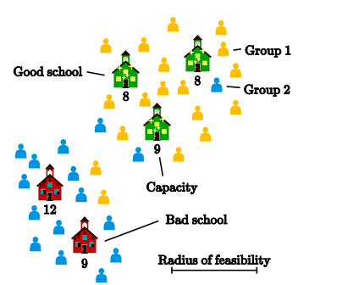
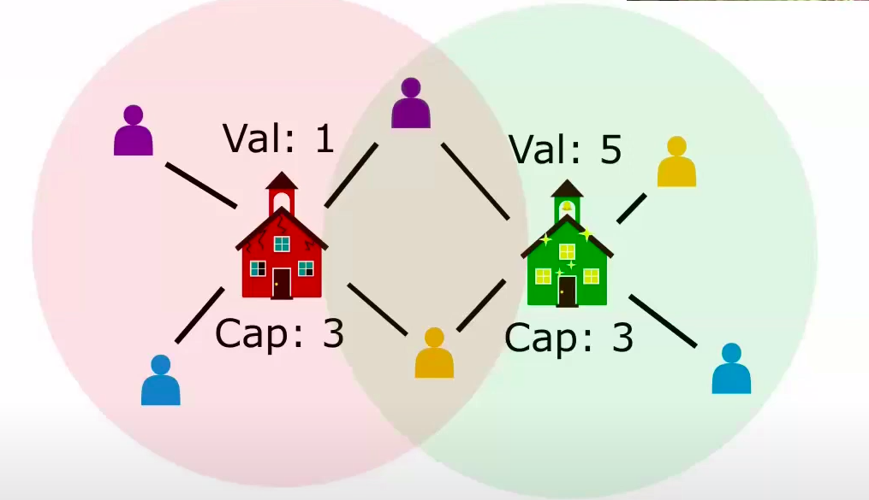
Model Formulation
Instance of our school redistricting problem:
  Set of n students partitioned into g disjoint groups.
  Set of m schools each with a value vk and capacity ck.
  Bipartite feasibility graph between students and schools.

Slide 9
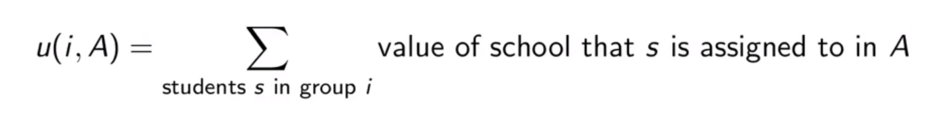
Model Formulation
All students must be assigned, utility of group ii under allocation A is
This u(i,A) is a utility assignment function which is also known as OXS valuation function.
  It have been studied earlier also but this paper further adds the constraint that all students must be assigned.

Slide 10
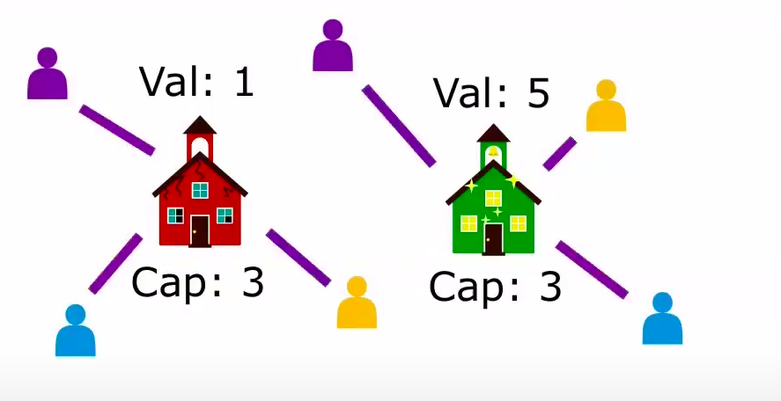
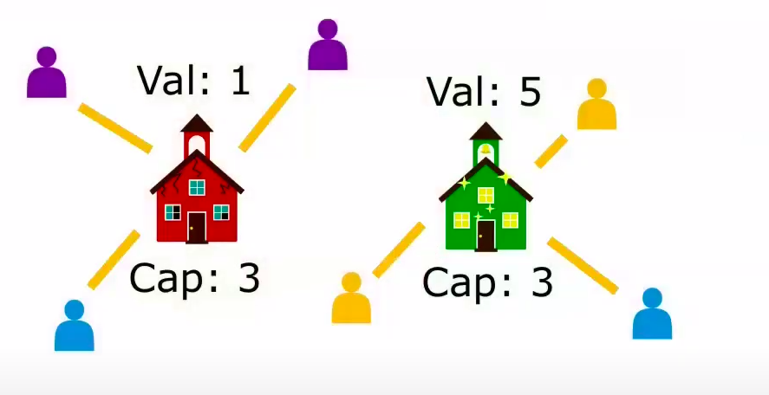
Model Formulation

Slide 11
Fairness & Proportionality
Main way of quantifying fairness action studied in this paper is Proportionality.
As mentioned earlier:
  G – # of groups
  N - # of students
  M - # of schools
  Vk – Value of school k
  Ck - Capacity of school k
Definition:
An allocation A is proportional if for any group I and feasible solution A’.

Slide 12
Fairness and Proportionality
But since proportional allocations doesn’t always exists in this model so we will weaken the original definition of proportionality in 2 ways and call it t-proportionality:
  Value based weakening
    We will allow an additive gap in utility
  Capacity based weakening
    A violates the capacities by a total of t extra seats.
    And then we try to figure out how small can we make t.
Theorem: Getting a t-proportional allocation may require

Slide 13
Main Results
In practice we expect g to be very small.
  Ω(g) lower bound on proportionality is not horrible.
Main Theorem:
  In any instance of school redistricting problem with g groups, there exists an O(g.log(g))-proportional allocation that can be found in polynomial time for any constant number of groups g.
Caveat/Warning:
  Runtime is exponential in g.
  They give O(n⁴) for g = 2 and O(n¹⁰) for g = 3.
Theorem: In any instance of school redistricting problem with g ε {2,3} we can find O(1)-proportional allocation in time O(n²logn).

Slide 14
Some important lemmas and theorems
This paper have utilised the following 3 lemma’s and/or theorem to come up with an appropriate reduction and reach the end goal
  Cake Cutting Problem.
  Mountain Climbing Lemma.
  Ridge Climbing Lemma.

Slide 15
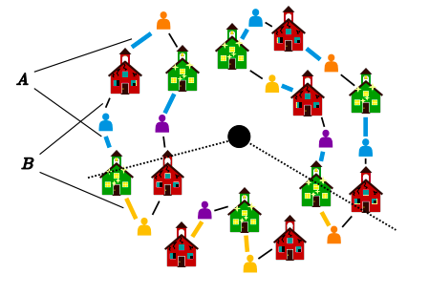
Cake cutting problem
Cake cutting problem also falls under the umbrella of fair division.
It deals with the question of how to divide a heterogeneous resource (like a cake with different flavors) among several people with differing preferences in a way that is considered fair by everyone.
Illustration of how they have used cake cutting problem in school redistricting.

Slide 16
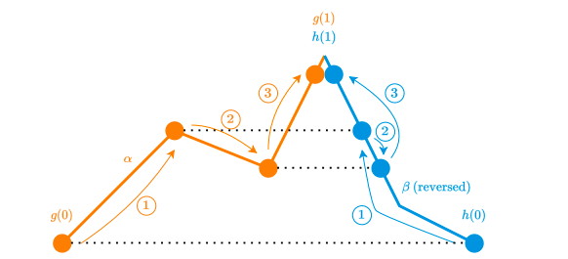
Mountain Climbing Lemma
Two climbers have too climb a mountain together, one starts from the left and other from the right.
They have to reach the summit together and must always have the same elevation as other.
Mountain climbing lemma, states that the above constraint while climbing or reaching summit is always possible and thus they incorporate this for the reduction of problem.

Slide 17
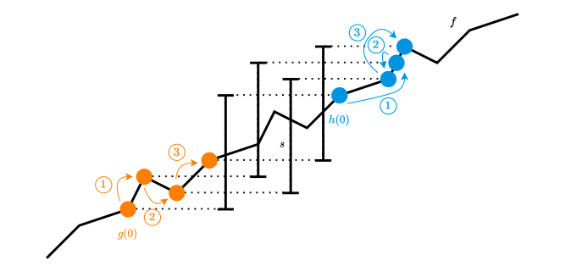
Ridge Climbing Lemma
Both climbers must climb the same periodically
Increasing function f while maintaining the same difference s in elevation.

Slide 18
Algorithm Overview
Algorithm :
  For g = 1, compute and return the optimal allocation using perfect matching in bipartite graph as mentioned in paper.
  Otherwise, arbitrarily partition groups into two sub-groups of size ceiling(g/2) and floor(g/2).
  Recursively compute fair allocations for both sub-groups.
  Compare the allocations, cutting cake in several places to transition between two matchings.
  Note: Last step reduces to a variant of consensus halving with negative valuations.
Runtime: O(n^{c}) where c = most number of cuts needed at any step <= 4g-2 (by using Stromquist-Woodall theorem, 1985)
T-proportionality guarantee: Total number of cuts, O(g.log(g)) by master theorem.

Slide 19
Contributions / Conclusion
Contributions:
  New fair division problem capturing some key aspects of school redistricting
    OXS valuations with constraints that all individuals must be assigned.
  Existence proofs, algorithms and lower bounds for approximate proportionality.
  New application of Mountain Climbing Lemma, which is deemed to be very important for fair division as mentioned in Pedgen and Frieze, SODA 2023.

Slide 20
Open ended Questions
More realistic constraints for school redistricting:
  Contiguity
    As of now we don’t care about if the school is close or not
  Heterogeneous preferences
Stronger fairness axiom than proportionality, as it is a weak axiom.
  Author’s tried with envy freeness (motivated from cake cutting problem) but the results obtained were very weak.
Close the gap between Ω(g) and O(g.log(g))
  This Question is more of an existential question.
Improve the running time
  Can we have an algorithm which can be polynomial time in g?

Slide 21
Thank You!
Questions

