Slide 1
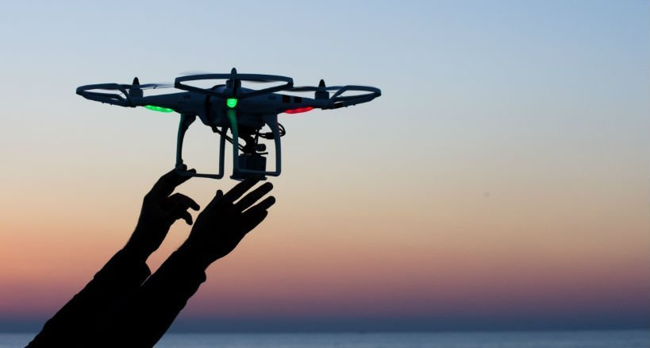
Address Plate Recognition and Delivery System using Drone

Slide 2
Basic Idea and Motivation
Reduce delivery time using drones
Can be used for
speedy delivery of temperature & time-sensitive commodities like blood, organs
perishable goods like flowers/milk
delivery to remote areas
Fully autonomous to reduce/eliminate human control
Feed real-time video to controlling station (image processing takes place here)

Slide 3
Literature survey
Amazon Prime Air (in USA & UK on Dec 7 2016)
UPS Airlines (in USA)
Drone Delivery Canada Corp. (in Canada)
No such autonomous drone delivery system exists in India !!!!! Huge scope for research !!!!
The Directorate General of Civil Aviation (DGCA)
Drone Regulation 1.0
Drone Policy 2.0 (January 2019)
Favorable conditions for Drone Aviation in India....Finally !!

Slide 4
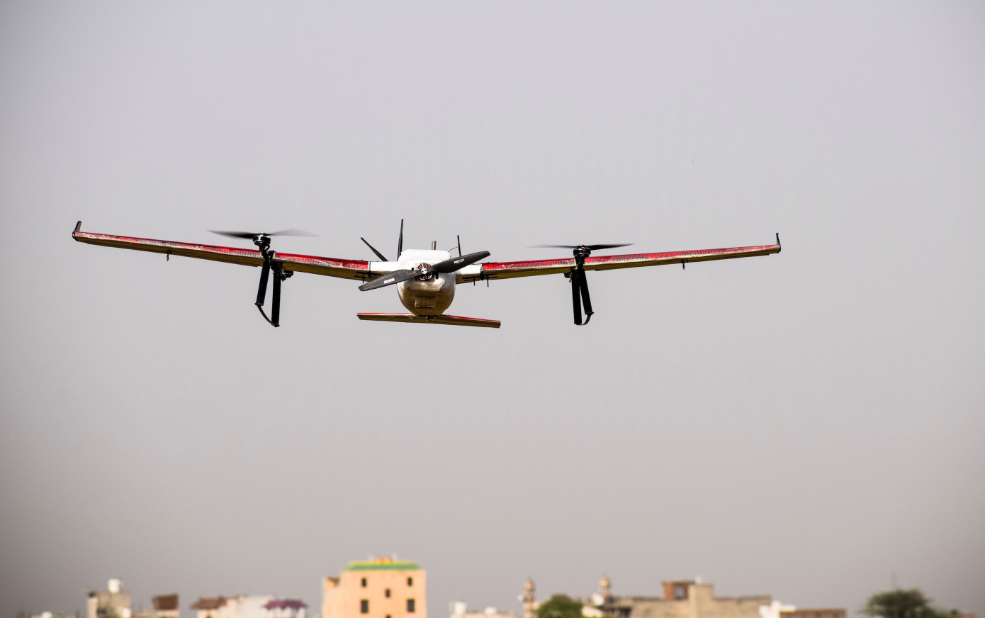
What is happening in India ?
Zomato successfully tested a payload delivery from a hybrid drone
covered 5 km in 10 minutes
carried a payload of 5 kg
hit a peak speed of 80 kmph
Research was backed by Ant Financial and Delivery Hero and local drone startup TechEagle

Slide 5
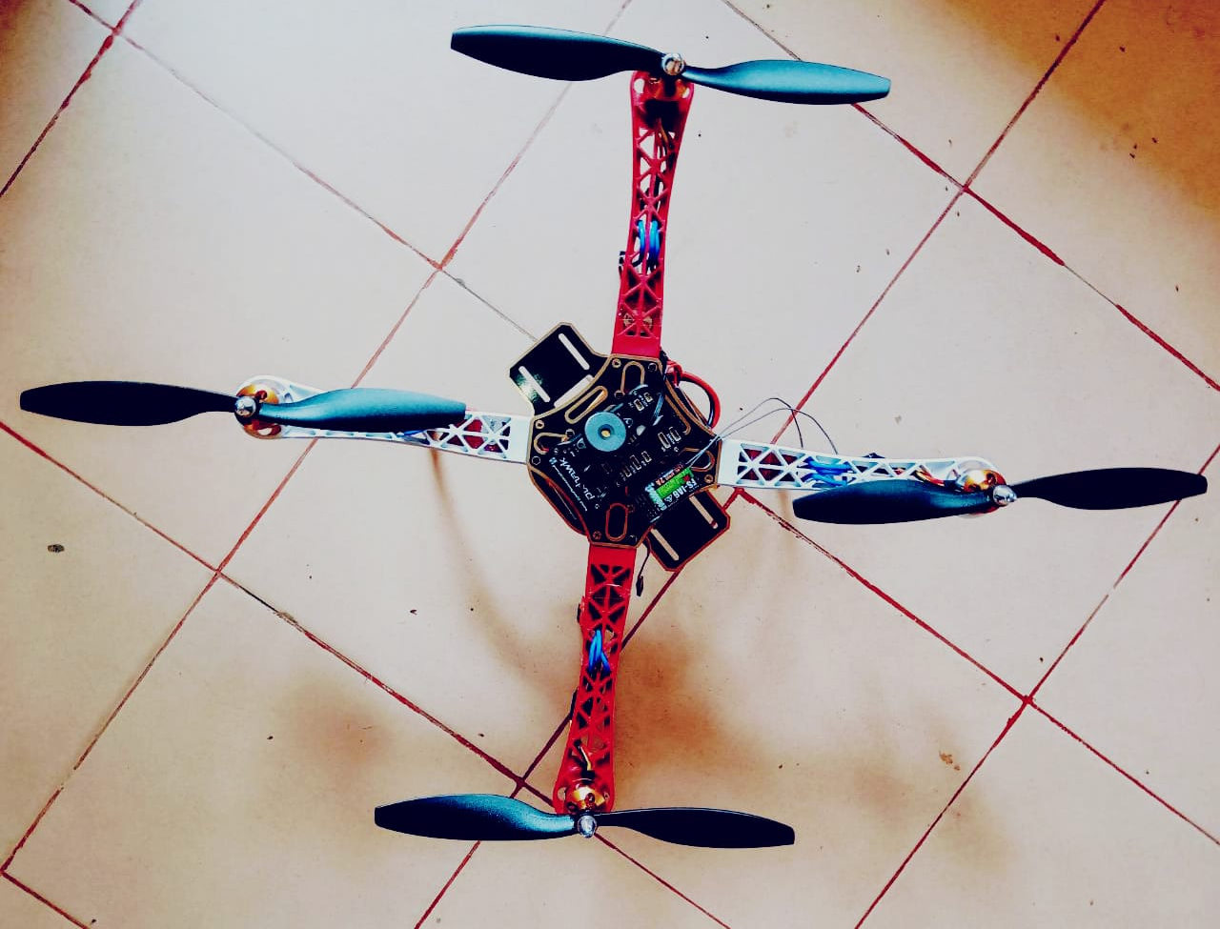
Meet SkyNet 1.0

Slide 6
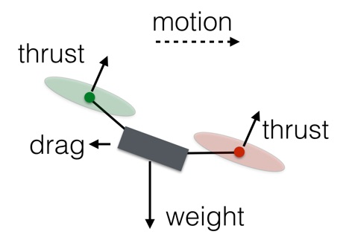
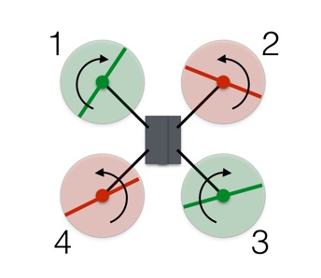
Working Principle
Forwards & Sideways
Vertical motion - climb, descend, hover
Image source: https://www.wired.com/2017/05/the-physics-of-drones/

Slide 7
Thrust to Weight Ratio
It is the ratio of thrust to the weight of drone
Should be atleast 2 : 1
The greater the ratio, the easier it is to fly & handle the drone

Slide 8
Components Used
Motors
Electronic Speed Controllers(ESC)
Drone Frame
RC Receiver
Li-Po Battery
Telemetry
Flight Controller(FC)
GPS 8M
Power Distribution Board(PDB)
Camera
APM 2.8

Slide 9
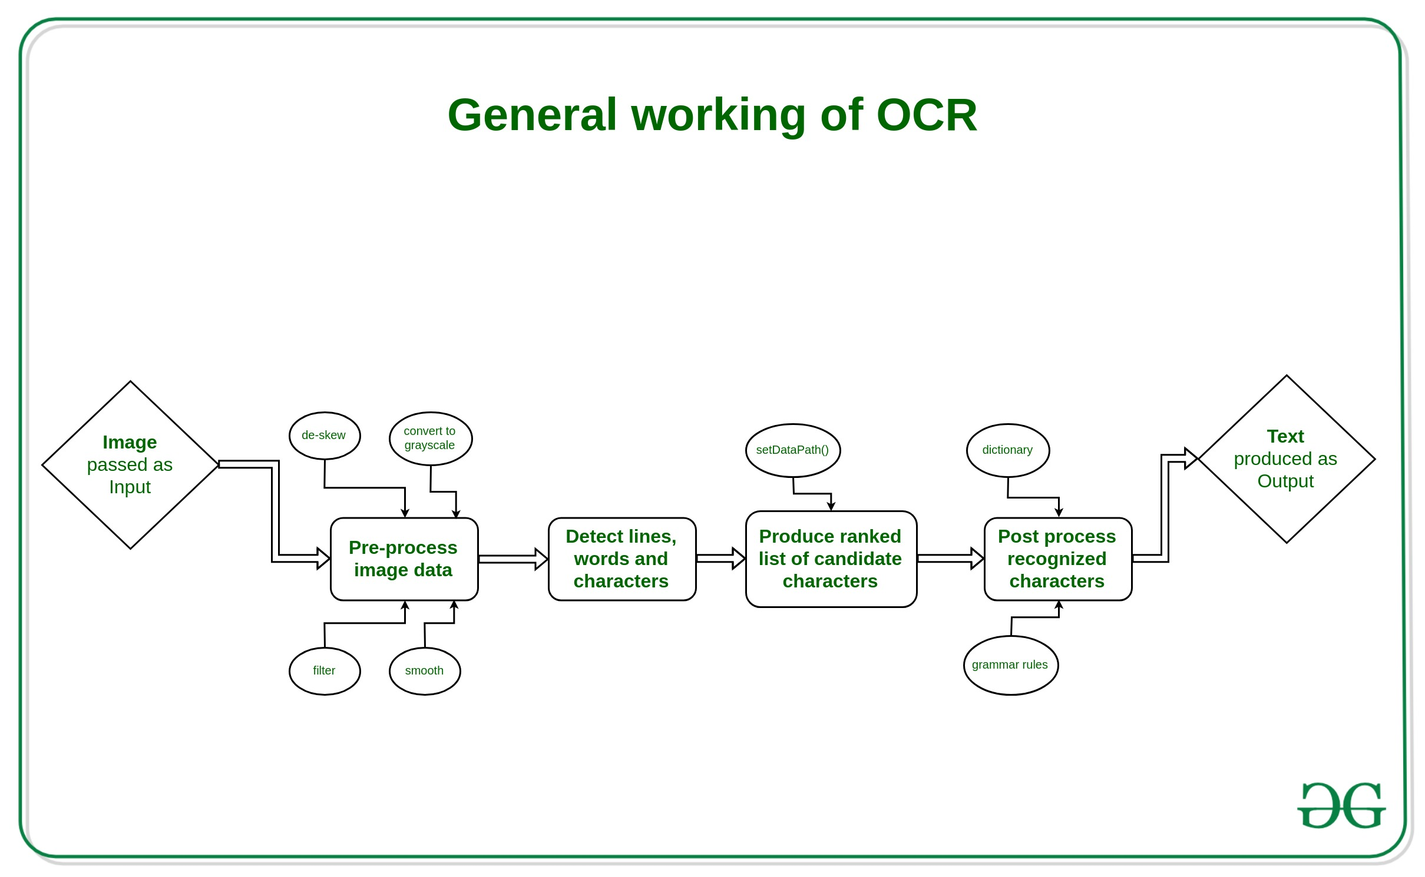
Image source: GeeksForGeeks
Optical Character Recognition

Slide 10
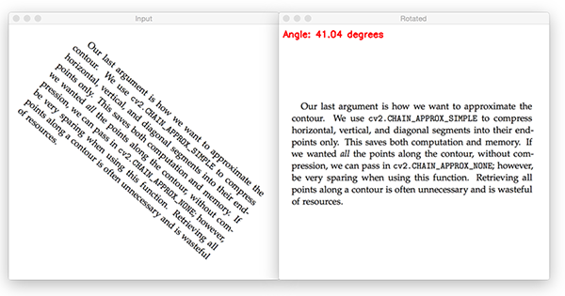
Pre-processing Image Data
deskew an image
Detecting the block of text in the image.
Computing the angle of the rotated text.
Rotating the image to correct for the skew.
Image source: https://www.pyimagesearch.com/2017/02/20/text-skew-correction-opencv-python/

Slide 11
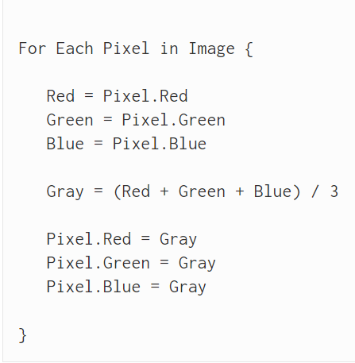
Grayscale conversion
All grayscale algorithms fundamentally do:
Get the red, green, and blue values of a pixel
Use maths to turn those numbers into a single gray value
Replace the original red, green, and blue values with the new gray value

Slide 12
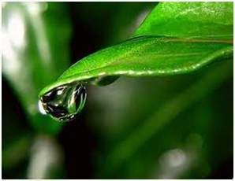
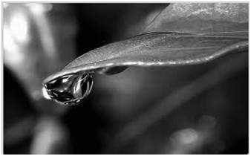
Grayscale conversion
Image Source: Digital Image Processing - Tutorialspoint

Slide 13
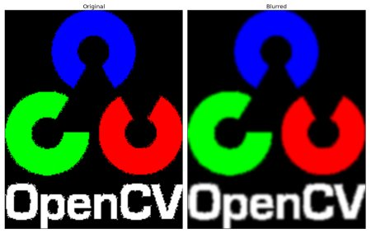
Image Smoothing
After applying Gaussian Filter
It is a method of improving quality of the image
Removes high frequency content like noise
Popular algorithms include:
Mean Filtering
Gaussian Filtering
Median Filtering
Image source: https://opencv-python-tutroals.readthedocs.io/en/latest/py_tutorials/py_imgproc/py_filtering/py_filtering.html

Slide 14
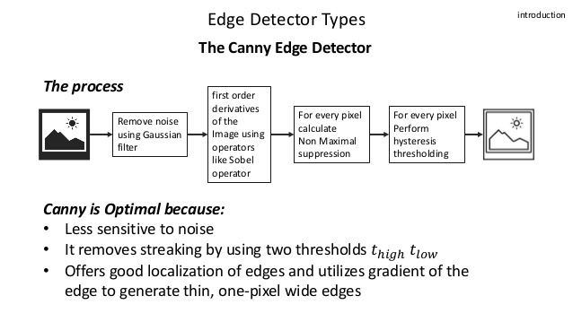
Canny Edge Detection
Image Source: Slideshare.net

Slide 15
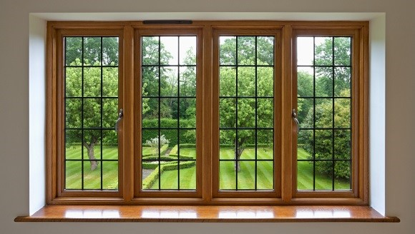
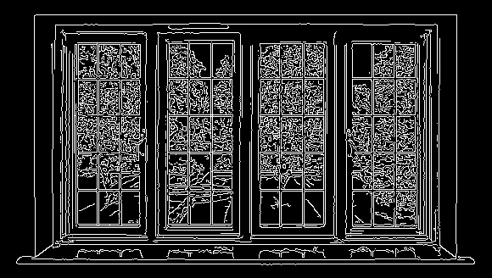
Canny edge detection example
Image Source: https://www.tutorialspoint.com/opencv/opencv_canny_edge_detection.htm

Slide 16
Text Extraction
Tesseract OCR
Free
Open-Source
developed by Google
runs on Windows, Linux & MAC OS X
high character accuracy
works best on images having DPI of at least 300dpi, otherwise the accuracy is reduced
works by recognizing character patterns

Slide 17
Let's take a look at some text extraction using Tesseract

Slide 18
Accuracy
Tesseract is not always accurate
Recommended images of atleast 300 dpi
If dpi < 300, Tesseract automatically uses any value and estimates the resolution
Leading to inaccurate results
Here is an Example.......

Slide 19
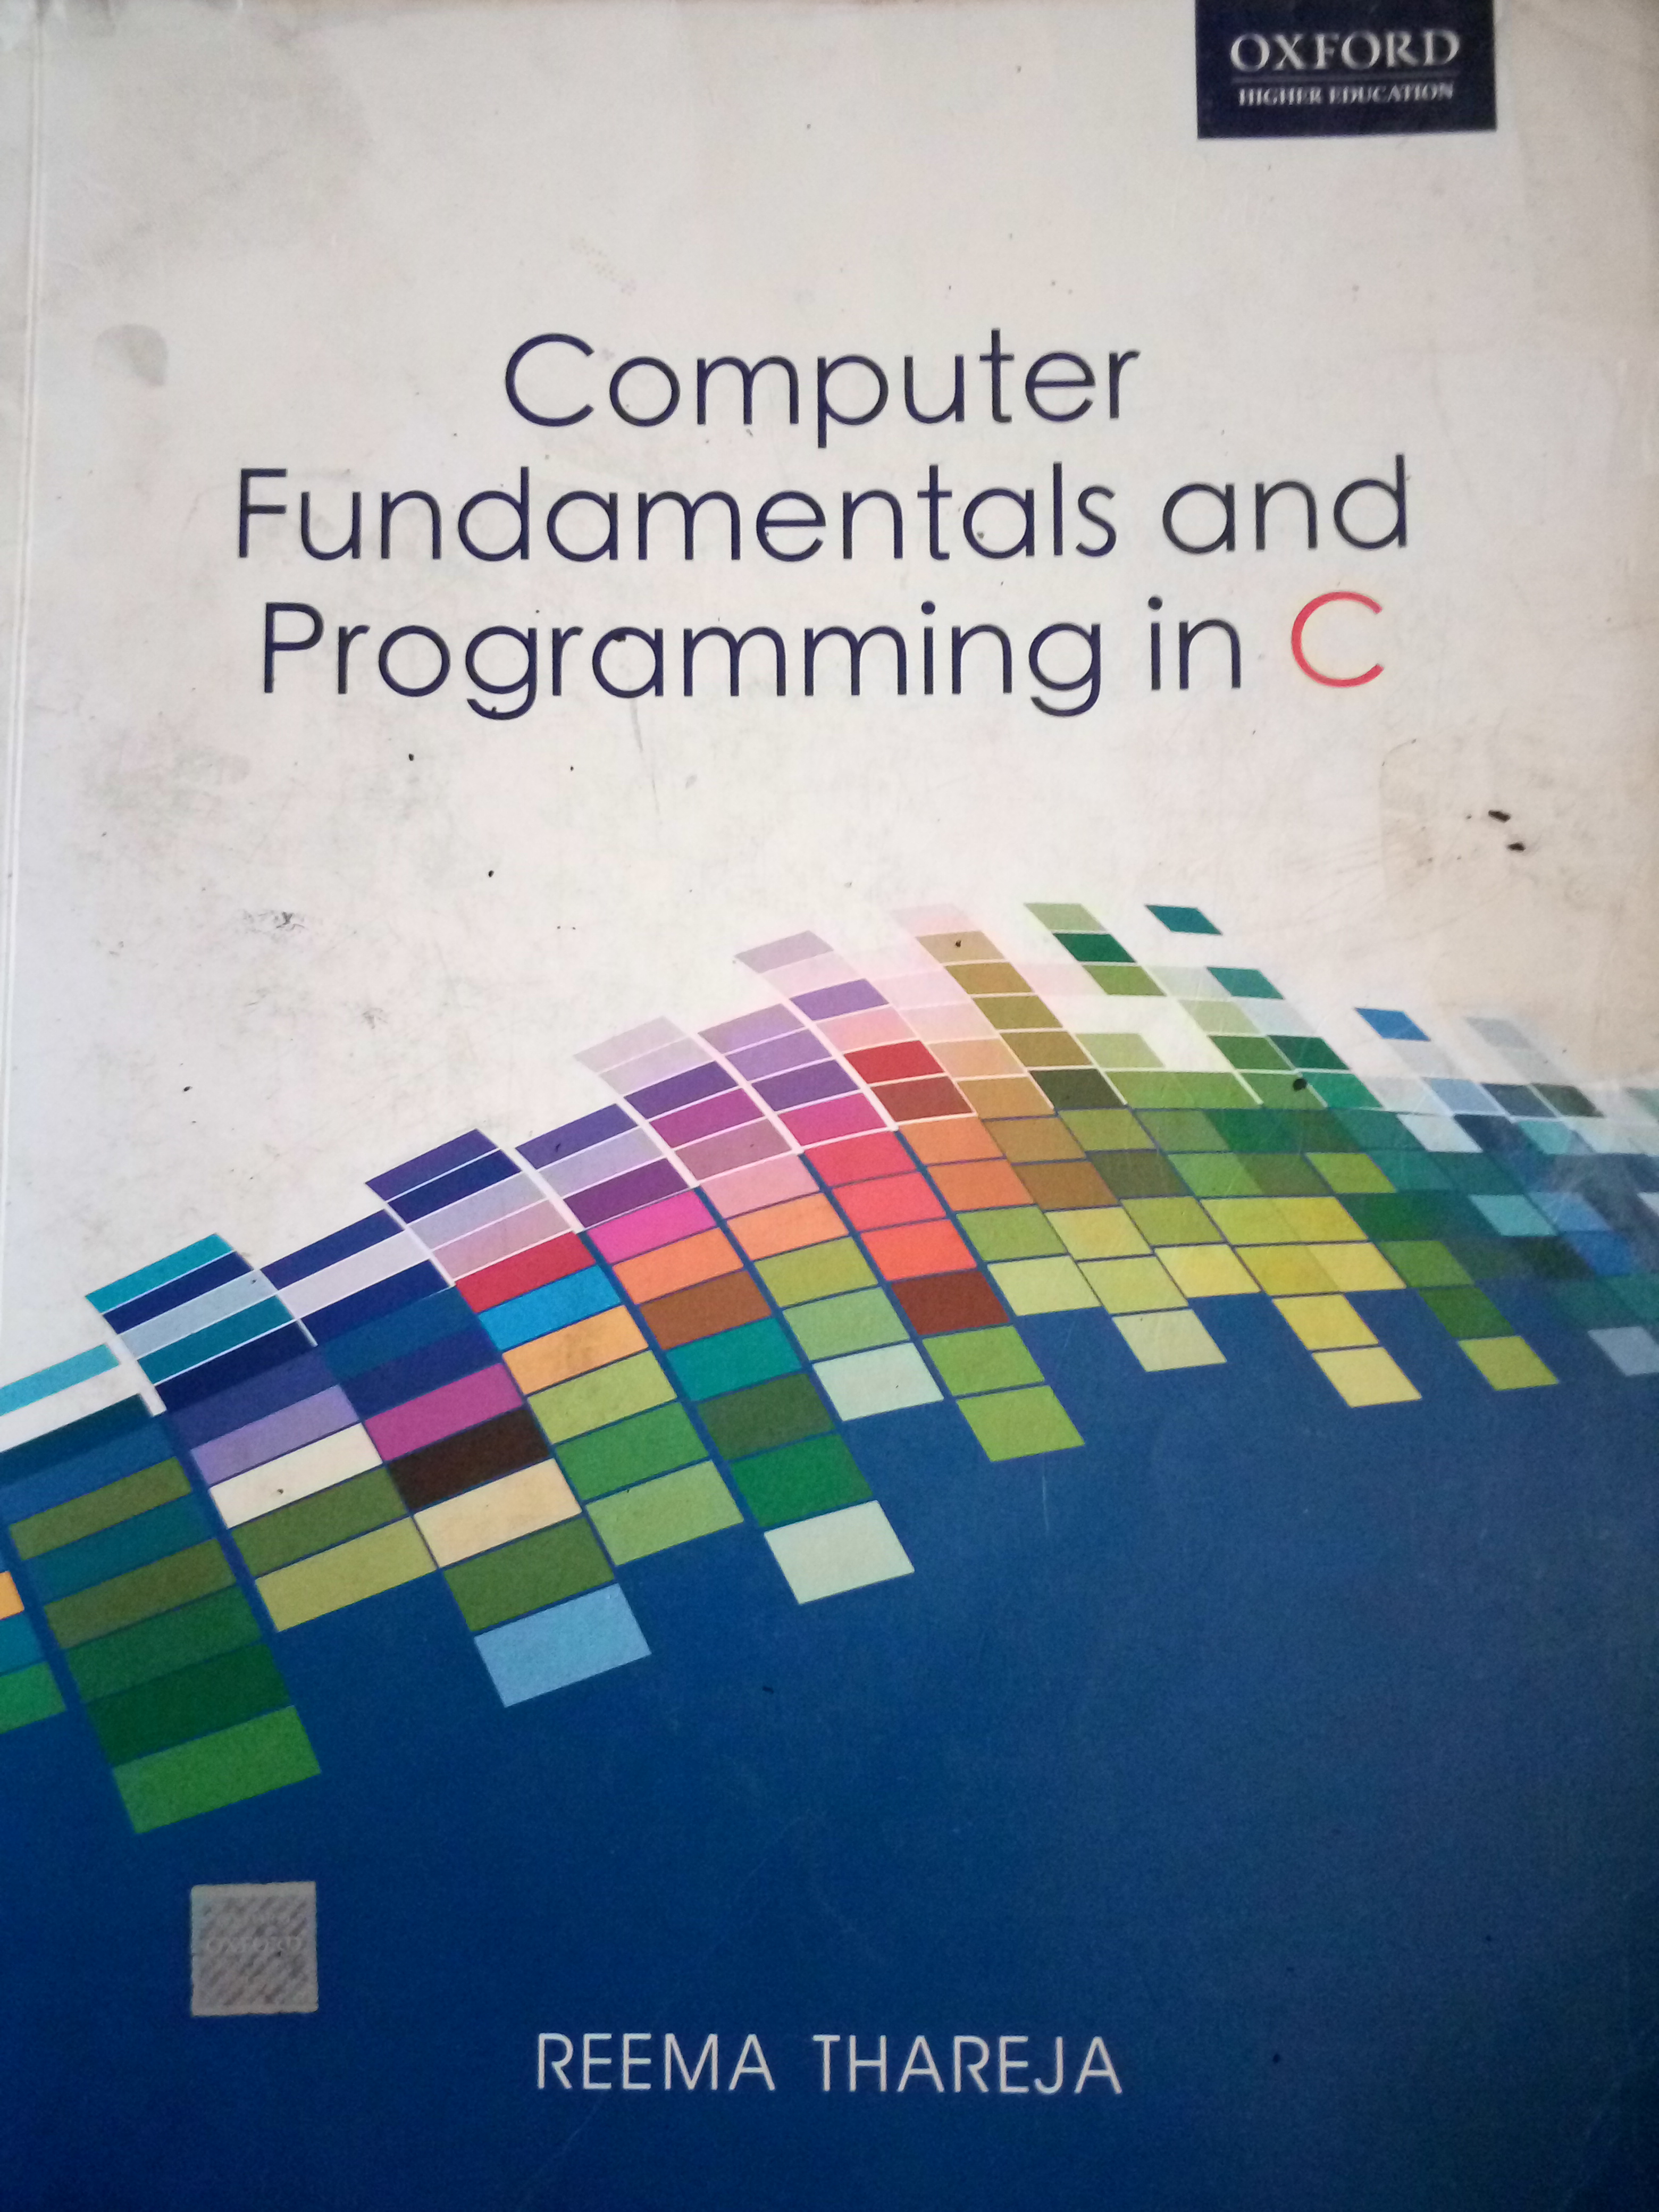
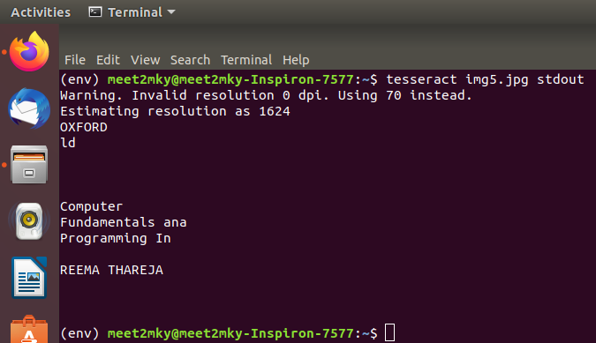
Accuracy = 76% (approx.)

Slide 20
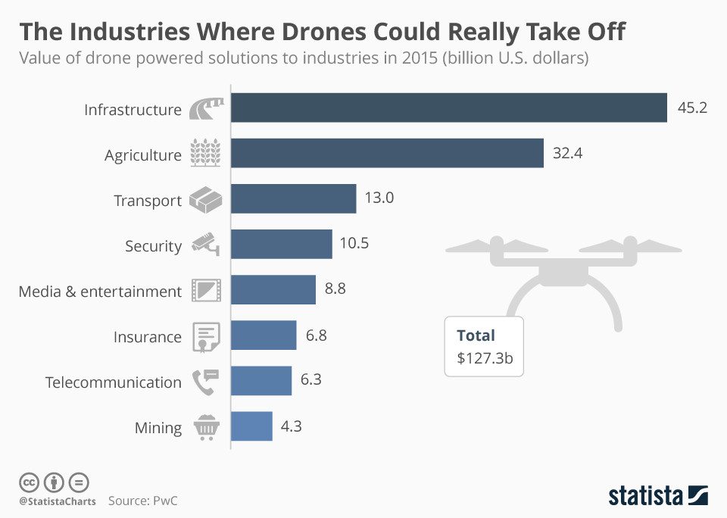
Future Scope

Slide 21
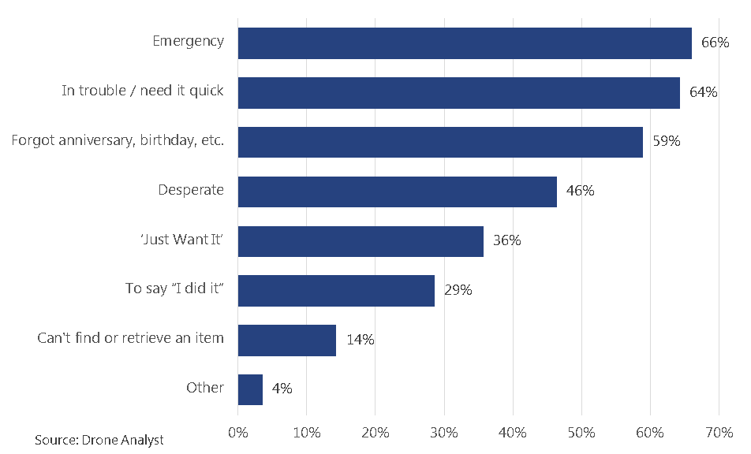
A survey on situations which favor Drone Delivery

Slide 22
Future Scope in India
Situation has improved recently
Huge potential for drone aviation in India
Easily evade traffic to ensure delivery to remote or rural areas
A number of govt. agencies and PSUs have started experimenting & using drones
a variety of applications
lots of scope for improvement

Slide 23
References
https://www.pyimagesearch.com/2017/02/20/text-skew-correction-opencv-python/
https://www.tutorialspoint.com/opencv/opencv_canny_edge_detection.htm
Ray Smith, “An Overview of the Tesseract OCR Engine”
K.N. Natei Journal of Engineering Research and Application ISSN : 2248-9622, Vol. 8, Issue5 (Part -V) May 2018, pp 27-33
https://opencv-python-tutroals.readthedocs.io/en/latest/py_tutorials/py_imgproc/py_filtering/py_filtering.html
http://www.tannerhelland.com/3643/grayscale-image-algorithm-vb6/

Slide 24
THANK YOU !!!!!

