Slide 1

Compiled by:
Gaurav Sarraf

Slide 2
Fun Facts:
Founded in 1997 – used to send DVD’s via Mail
Started streaming only in 2007
First production – 2013: “House Of Cards”
Serves 117.58 million in 190 Countries
Streams 190 million hours of content everyday – 15 TB/sec
97 Billion hours of content streamed already
First app was written fully in Java and Js, took 40 minutes to startup

Slide 3
Netflix Stack
Node.js – Edge Services
Restify – Https request handling server side
React js – Web Apps client side
Falcor – Databases: MySQL, Cassandra
Rxjs – AJAX, user interaction
AJAX - Asynchronous JavaScript and XML

Slide 4
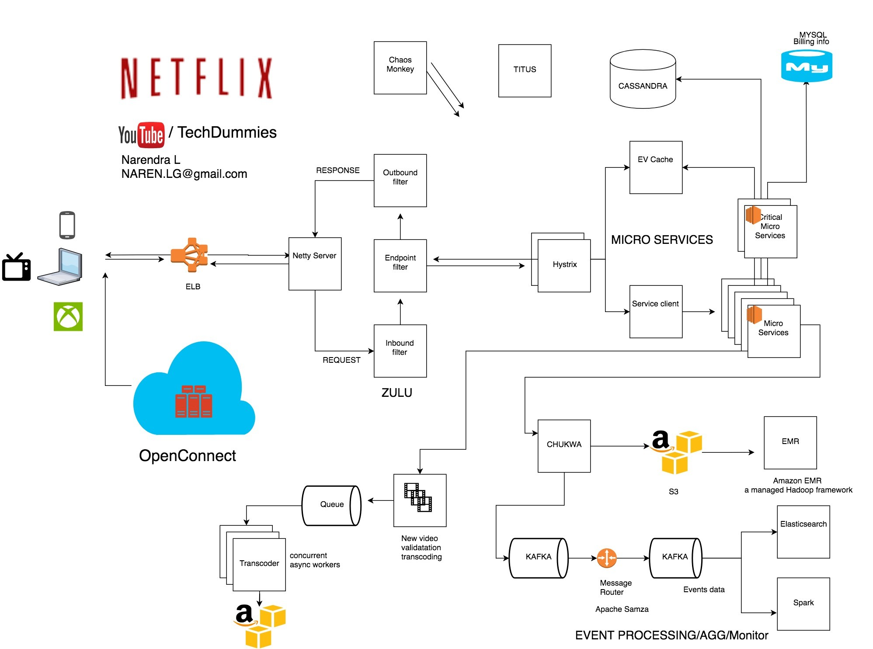


Slide 5
Cloud options & Overview
Operates in Two Cloud Services:
Amazon Web Services
Open Connect – CDN
Three major components:
Open Connect – CDN
Backend – AWS
Client -You

Slide 6
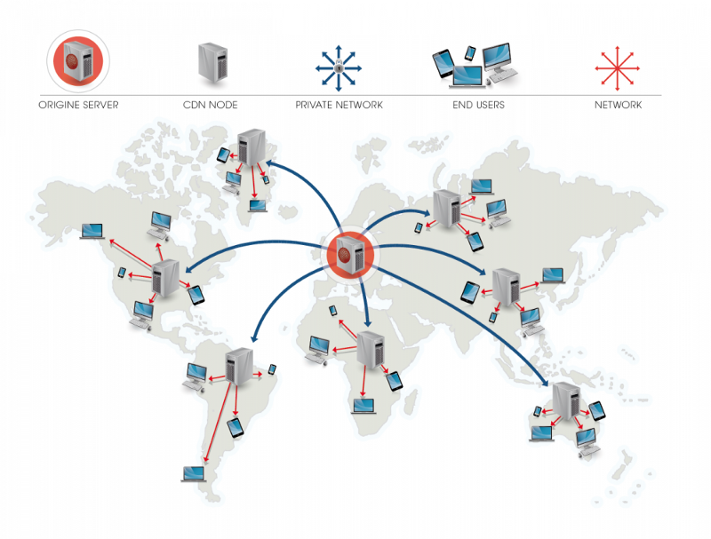
Content Delivery Network

Slide 7
Elastic Load Balancer
I1
ZI
LB
I2
Round Robin Algorithm
Load Balancing
I3
I4
LB
Z2
LB
I5
I6
Z3
LB
I7
I8

Slide 8
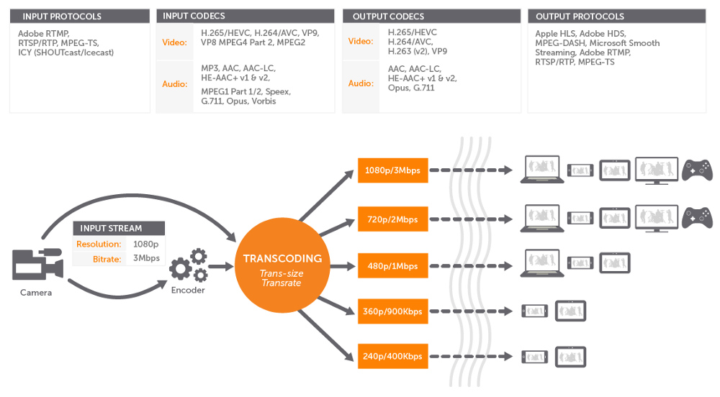
Video Transcoding & Encoding
1,200 versions of each video
for adaptive bit rate streaming.

Slide 9
ZUUL
Outbound
Filter
Response
Dynamic Routing
Gateway Services
Monitoring
Security
Application:
Shared Traffic
Load Test
Test new Services
Filter Bad Requests
Netty Server
Endpoint
Filter
ELB
Services
Inbound
Filter
Request

Slide 10
Hystrix
Processing critical API’s
Stateless transaction processing
Applications:
Timing calls > time
Reject Req when busy
Disconnection
Fall Back response
Metrics – data mining
S1
S4
Endpoint
S2
S3
S2
S6
S5
S7

Slide 11
EV Cache
Based on Mem-Cache
Runs on SSD’s
Open Connect Appliance
Each cache service has 300TB of space
Advantages:
Throughput
Latency
Reduced cost, by using SSD instead of RAM
Zones
Cluster1
Cluster 2
I1
I1
I1
I2
I3
R/W
R/W
Cache
client
Cache
client
Origin Server

Slide 12
Database Management
MySQL – RDBMS
Cassandra – NoSQL
On AWS
Cached on Big CDN’s
W:R::9:1
Scheduled jobs for backup (zip)
Captures 90TB of data daily
Advantages:
Highly available
Scalable
Lage data
Master
MySQL
Master
MySQL
Sync & Copy
RR
RR
RR

Slide 13
Ingesting data & Processing
Apache Kafka
Real time processing
Streaming services
High-throughput
Low-latency
Apace Chukwa
Distributed Computing
Hadoop Distributed File System (HDFS)
MapReduce
Highly Scalable
700 billion events
13TB everyday
Usage:
Video viewing activity
UI Activity
Error Logs
Performance Events
Troubleshooting

Slide 14
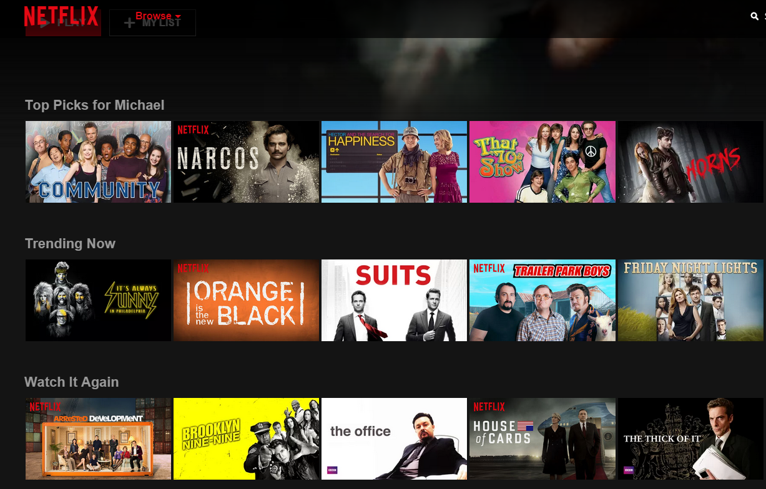
Artificial Intelligence
SPARK – AWS
Artwork Personalization
Recommendations
Collaborative Filtering
Content based filtering
Applications:
Sorting
Classification
Row selection
Relevance rank

Slide 15
Open Connect
Free of charge to ISP’s
Highly Available: redundant systems for everything
Local ISP server boxes
Small OCA
Big OCA
Multiple Level Indexing
Even small OCA is able to processes 13,000 HD file request simultaneously
Internet
ISP
OCA

Slide 16
Live Streaming
Software
Encoder
Adaptive Bit-rate
Multi-protocol format
Hardware
Encoders
CDN Edge Server
Open Connect
Akamai
Client
Media Players
IP-Camera
Restream Service to:
YouTube,Facebook
Other CDN
Browser
WebRTC
Publisher
Server
Viewer

Slide 17
See What’s Next

