Slide 1
AWS Machine learning certification
Modeling module

Slide 2
Modeling - agenda
Topics to be covered for exam
Sagemaker
AWS services
Sample QUESTIONS
LINKS

Slide 3
TOPICS TO BE COVERED FOR EXAM
Deep learning(RNN,CNN,ACTIVATION functions)
Deep learning on ec2 and emr
Regularization for DL
L1 and l2 regularization
Validation metrics

Slide 4
sagemaker
Following algos in sagemaker
Linear learner
Xgboost
Seq2seq
Deepar
Blazing text
Object2vec
Automatic model tuning
Apache spark in sagemaker

Slide 5
AWS services
Comprehend
Translate
Transcribe
Polly
Rekognition
Forecast
Lex
Others

Slide 6
comprehend
natural-language processing (NLP) service that uses machine learning to uncover information in unstructured data
Uncover valuable insights from your text
Train models on your own data
Organize documents by topics
Support for general and industry specific text

Slide 7
translate
neural machine translation service that delivers fast, high-quality, affordable, and customizable language translation
localize content such as websites and applications for your diverse users
Highly Accurate & Continuously Improving
Easy to Integrate into Your Applications
Customizable and Cost effective
Scalable and versatile

Slide 8
transcribe
add speech to text capabilities to their applications
recorded speech needs to be converted to text before it can be used in applications
Create easy-to-read transcriptions
Ensure customer privacy
Increase accuracy with customized transcriptions
Filter specific words

Slide 9
polly
service that turns text into lifelike speech, allowing you to create applications that talk, and build entirely new categories of speech-enabled products
Polly’s text-to-speech (TTS) service uses advanced deep learning technologies to synthesize natural sounding human speech
Natural sounding voices
Store & redistribute speech
Real-time streaming
Customize & control speech output
Low cost

Slide 10
rekognition
makes it easy to add image and video analysis to your applications using proven, highly scalable, deep learning technology that requires no machine learning expertise to use
you can identify objects, people, text, scenes, and activities in images and videos, as well as detect any inappropriate content

Slide 11
forecast
Amazon Forecast is a fully managed service that uses machine learning to deliver highly accurate forecasts.
50% more accurate forecasts with machine learning
Reduce forecasting time from months to hours
Create virtually any time series forecast
Secure your business data and peace of mind

Slide 12
lex
service for building conversational interfaces into any application using voice and text
automatic speech recognition (ASR) for converting speech to text
natural language understanding (NLU) to recognize the intent of the text
Seamless AWS integrations with AWS Lambda and Amazon CloudWatch

Slide 13
SAmPLE QUESTIONS

Slide 14


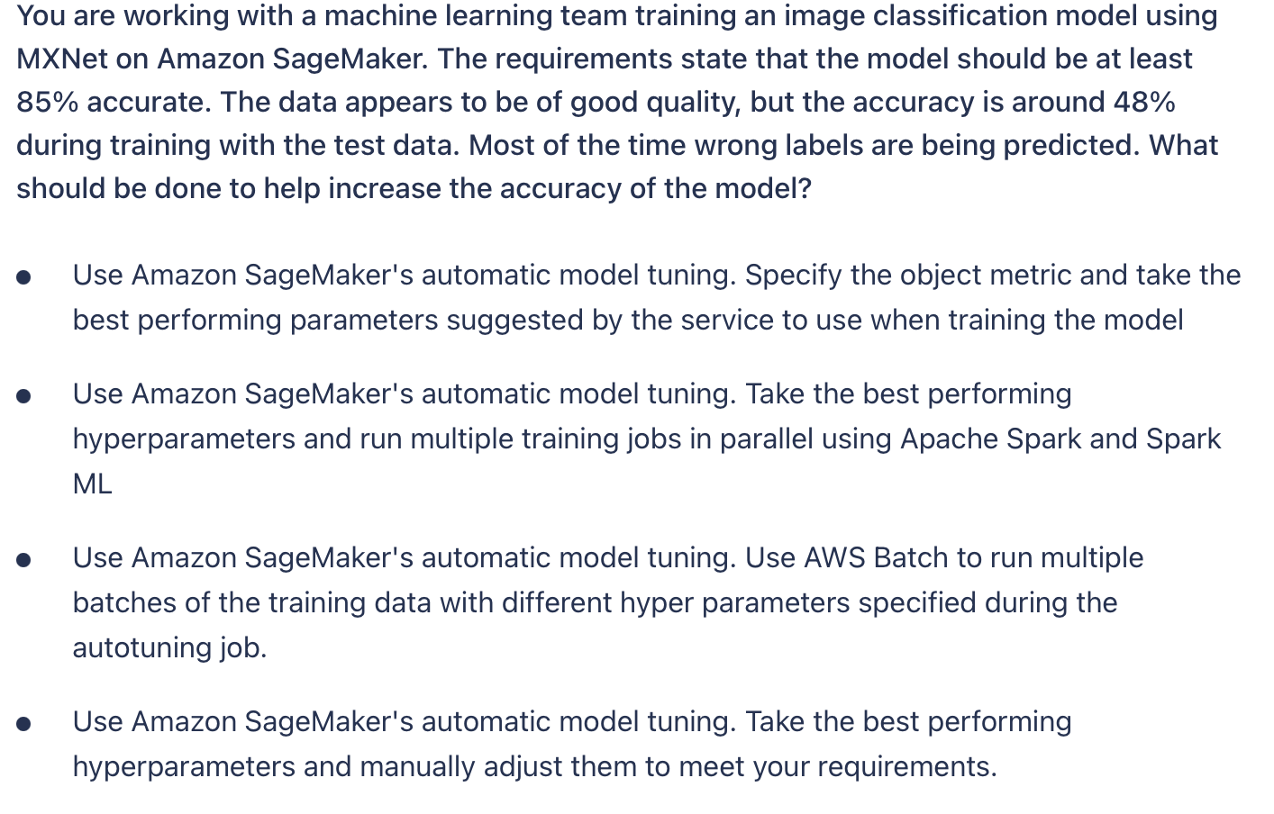
Notes:
Option:1
A Hyperparameter Tuning job launches multiple training jobs, with different hyperparameter combinations, based on the results of completed training jobs.

Slide 15
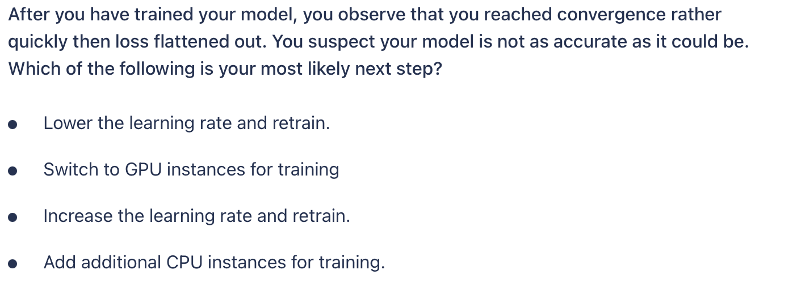
Notes:
Option 1
Lowering the learning rate will allow the training process to make smaller adjustments, potentially allowing it to converge on a better, more accurate place.

Slide 16
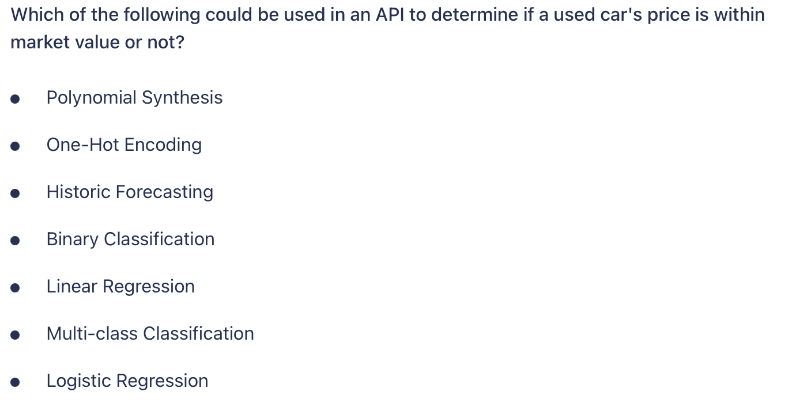
Notes:
Option 4 and 6
This problem is asking us to choose from two possible options. Both logistic regression and binary classification could do this depending on what type of data we are supplied.
This problem is asking us to choose from two possible options. Both logistic regression and binary classification could do this depending on what type of data we are supplied.

Slide 17
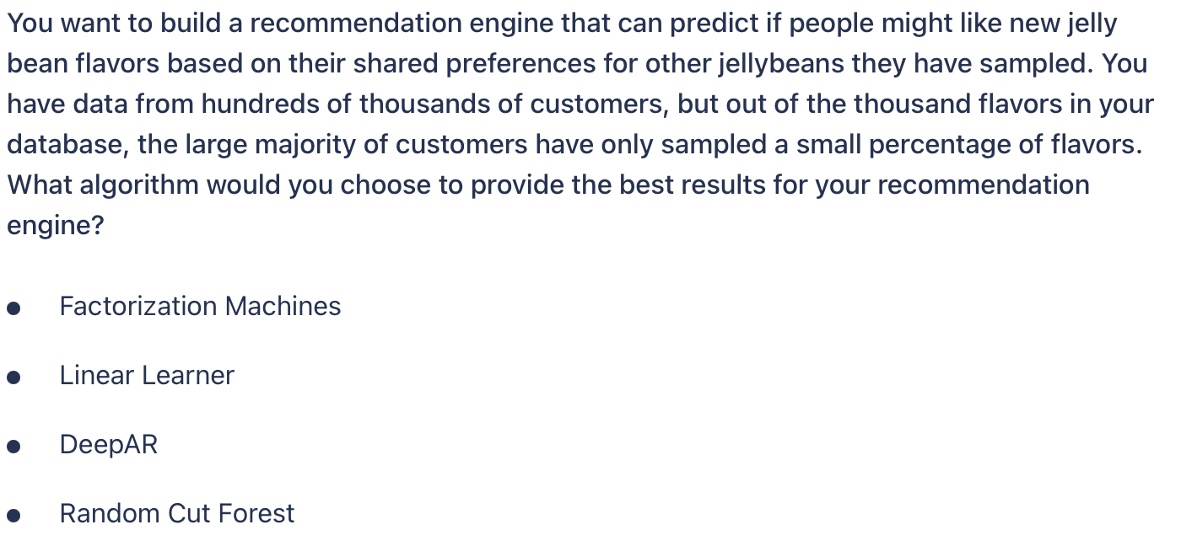
Notes:
Option 1
In this use case, we have very sparse data. Although we have lots of customer feedback, it is limited to only a few flavors for each customer. This is a case where a Factorization Machines strategy would be a good fit as it works best with sparse dimensions but with large datasets.

Slide 18
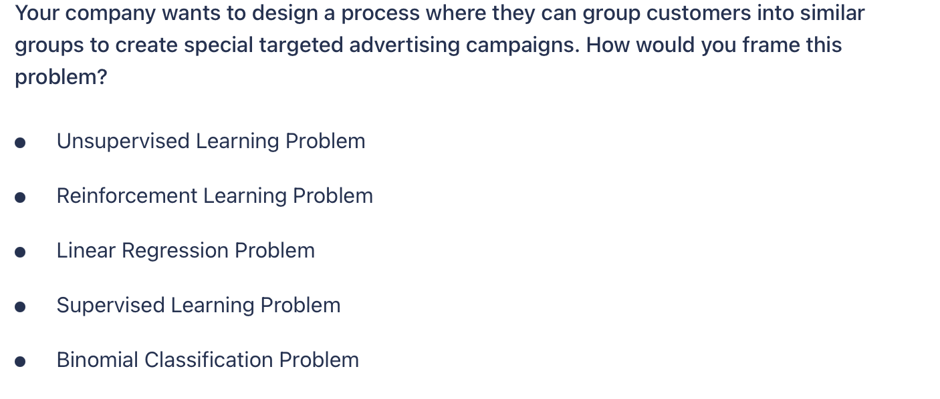
Notes:
Option 1
This problem sounds like a clustering task, which is a form of Unsupervised Learning.

Slide 19
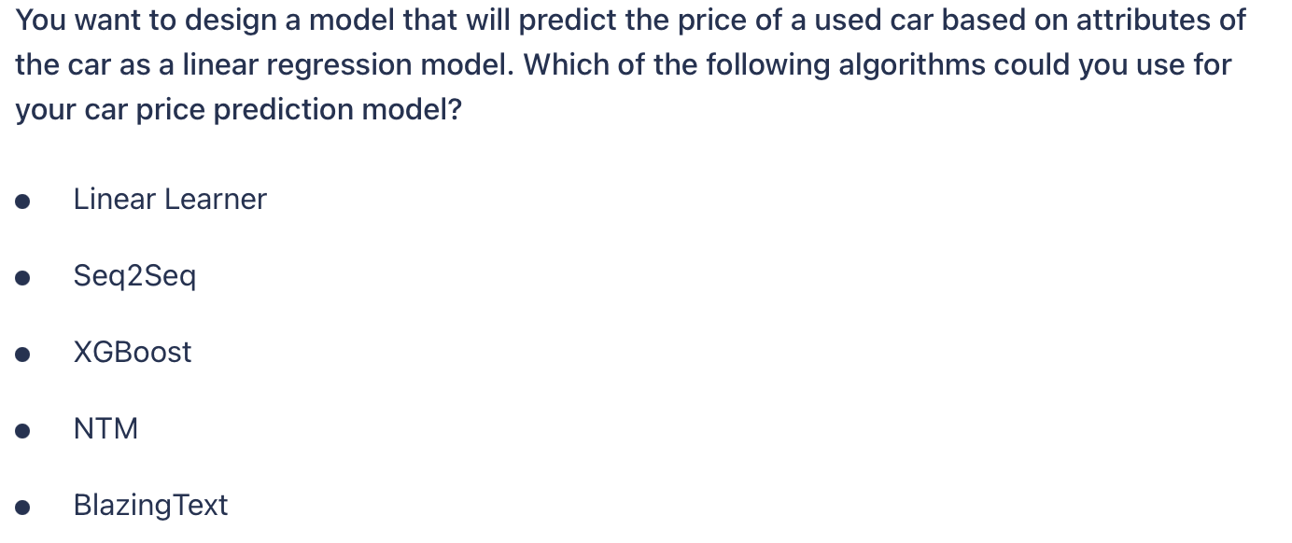
Notes:
Option 1 and 3
Linear Learner and XGBoost are two algorithms most closely identified with the use case of a linear regression problem.

Slide 20
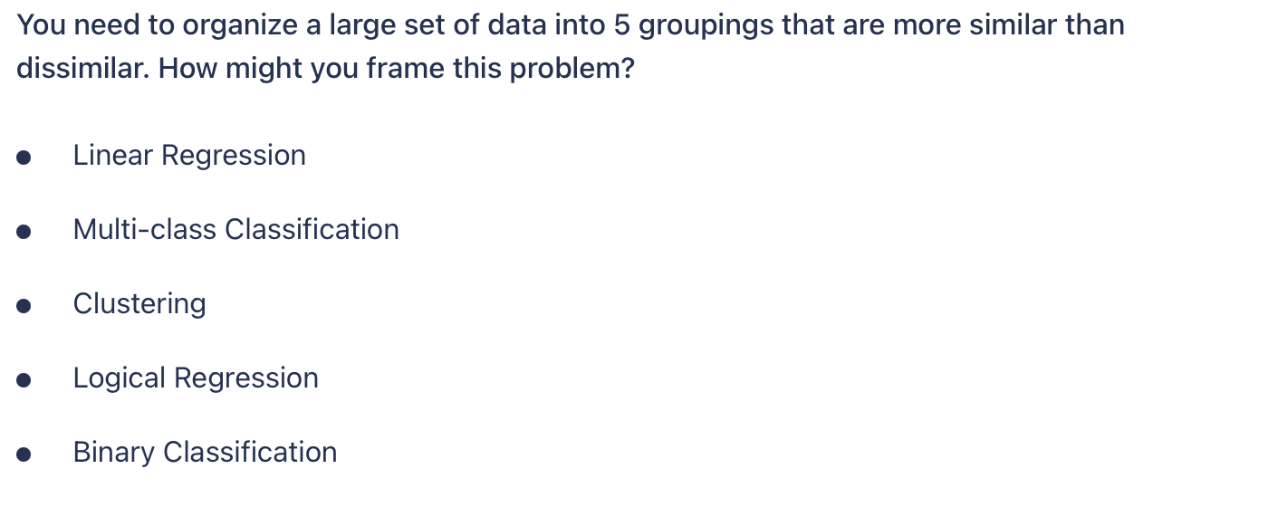
Notes:
Option 3
Clustering is an unsupervised method that can be used to group data into groupings which are more similar than they are different.

Slide 21
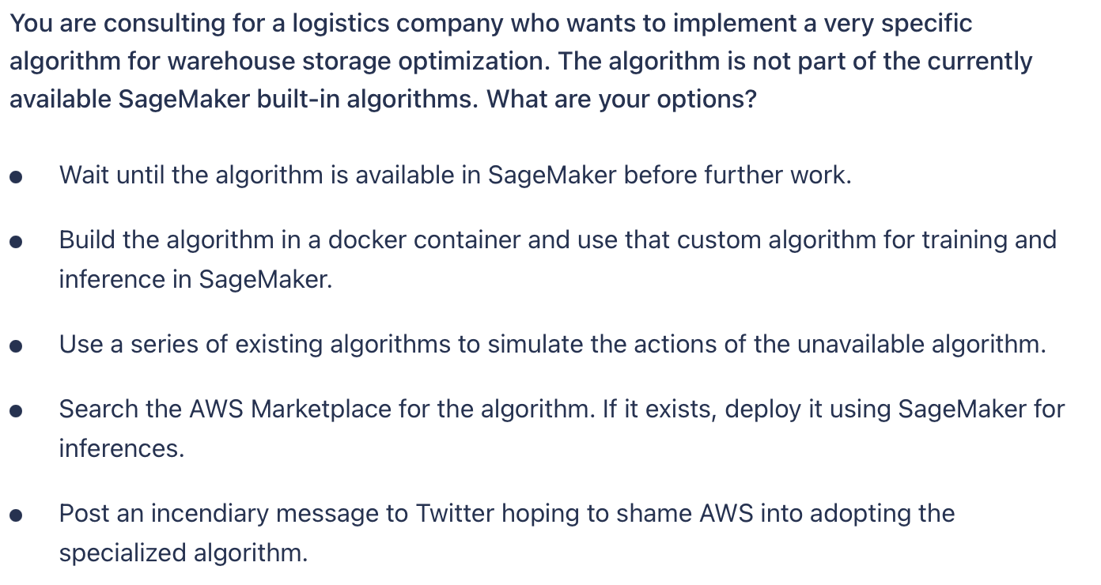
Notes:
Option 2 and 4
If SageMaker does not support a desired algorithm, you can either bring your own or buy/subscribe to an algorithm from the AWS Marketplace.

Slide 22
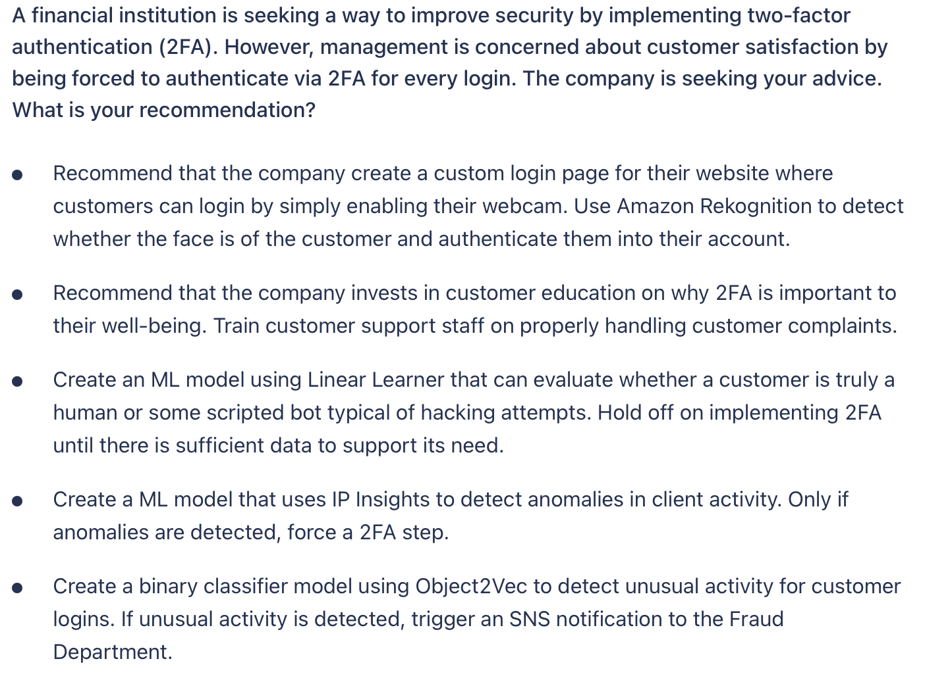
Notes:
Option 4
IP Insights is a built-in SageMaker algorithm that can detect anomalies as it relates to IP addresses. In this case, only enforcing 2FA where unusual activity is detected might be a good compromise between security and ease-of-use. While using facial recognition might be a tempting alternative, it can easily be bypassed by holding up a picture of some customer and it would not be true multi-factor authentication.

Slide 23
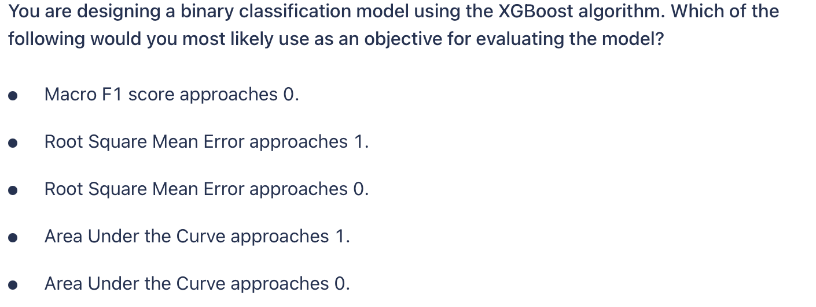
Notes:
Option 4
For binary classification problems, the AUC or Area Under the Curve is an industry-standard metric to evaluate the quality of a binary classification machine learning model. AUC measures the ability of the model to predict a higher score for positive examples, those that are “correct,” than for negative examples, those that are “incorrect.” The AUC metric returns a decimal value from 0 to 1. AUC values near 1 indicate an ML model that is highly accurate.

Slide 24
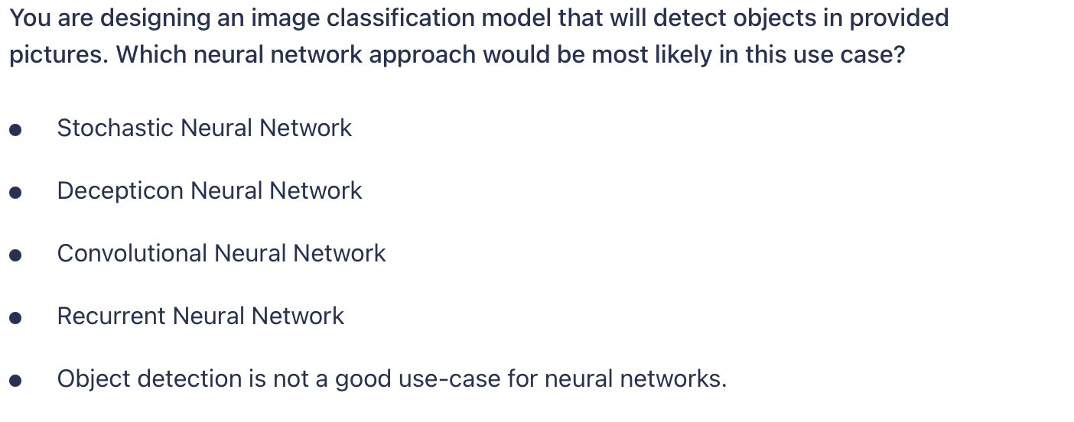
Notes:
Option 3
Convolutional Neural Networks are most commonly associated with image and signal processing. Recurrent Neural Networks are most commonly used with text or speech use-cases where sequence prediction is key.

Slide 25
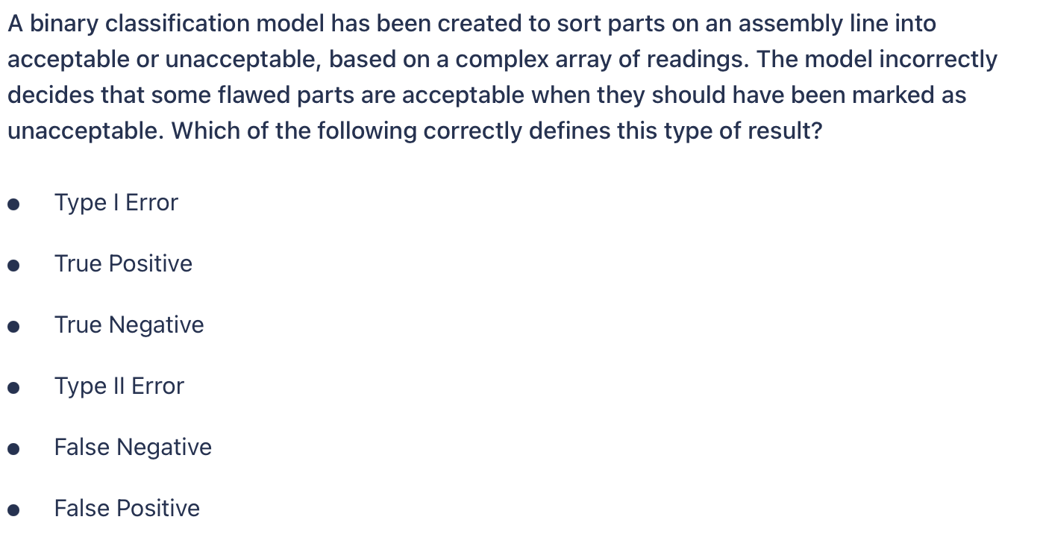
Notes:
Option 4 and 5
A false negative is when a model does not properly flag something that is should have. In this case, the flawed parts that got through as good parts were incorrectly identified as ok when they were bad. A false negative is also known as a Type II error.

Slide 26
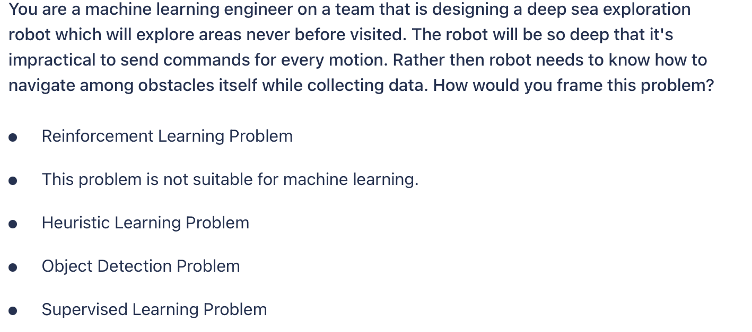
Notes:
Option 1
This problem would best be addressed as a Reinforcement Learning problem. Supervised Learning or Object Detection requires training data which is unavailable as this location has never been visited.

Slide 27
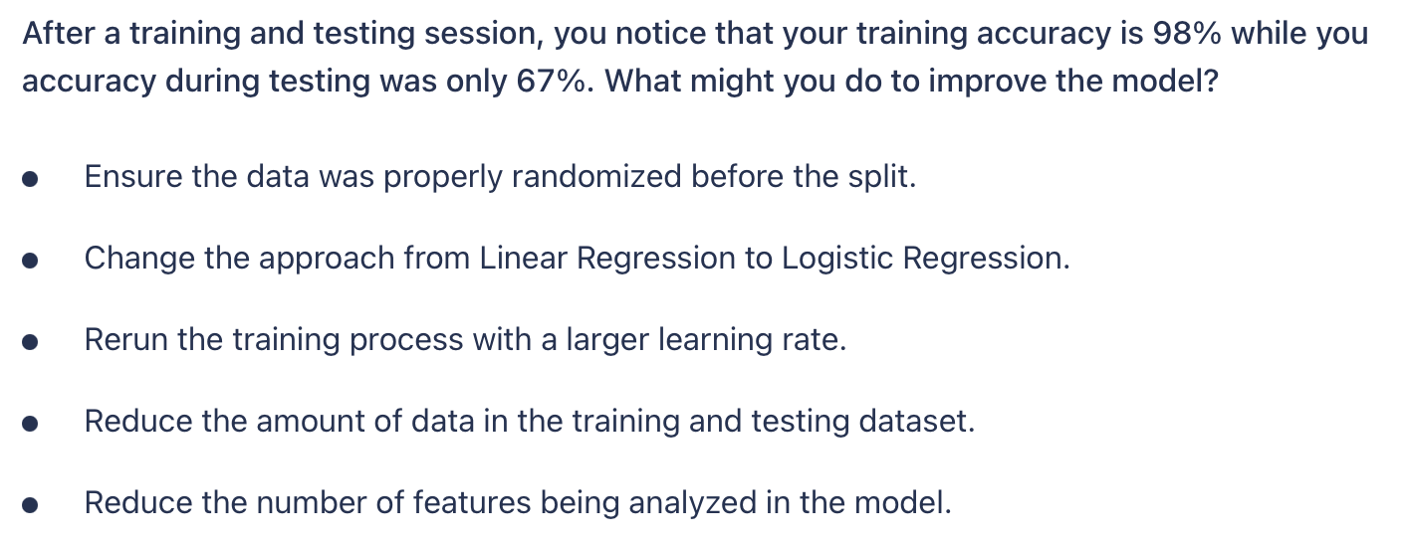
Notes:
Option 1 and 5
When training accuracy is high and testing accuracy is low, it usually indicates overfitting or insufficient randomization across the training and testing datasets. You can randomize the data and try training again or maybe use a cross-validation method like k-fold. For overfitting, one suggestion is to reduce the number of features in the model.

Slide 28
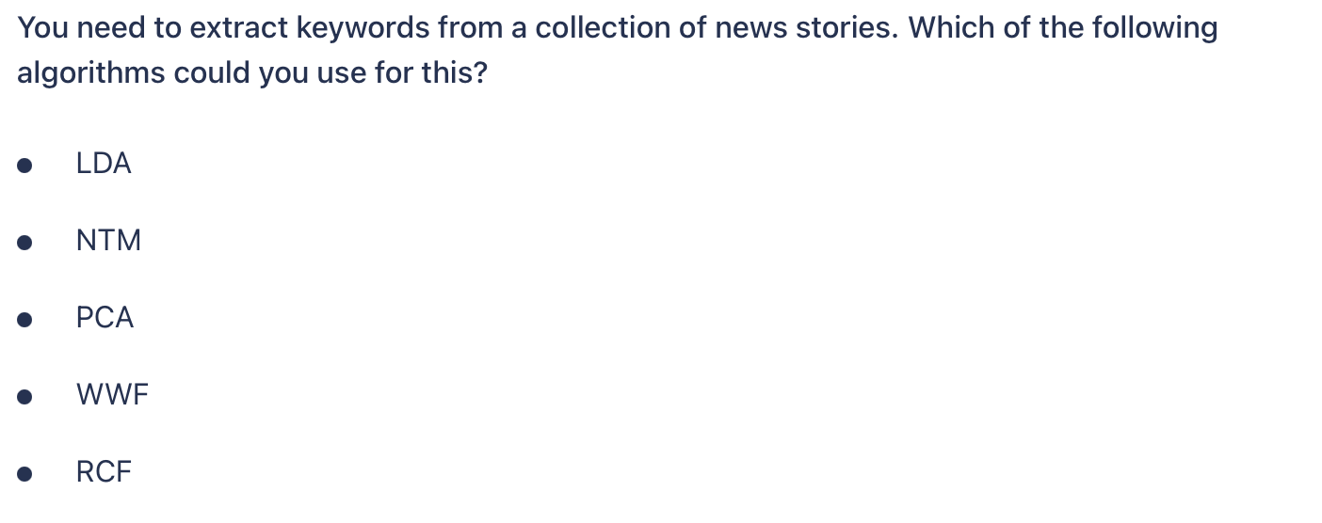
Notes:
Option 1 and 2
Latent Dirichlet Allocation (LDA) and Neural Topic Model (NTM) algorithms both can perform topic extraction from bodies of text but each use a slightly different method.

Slide 29
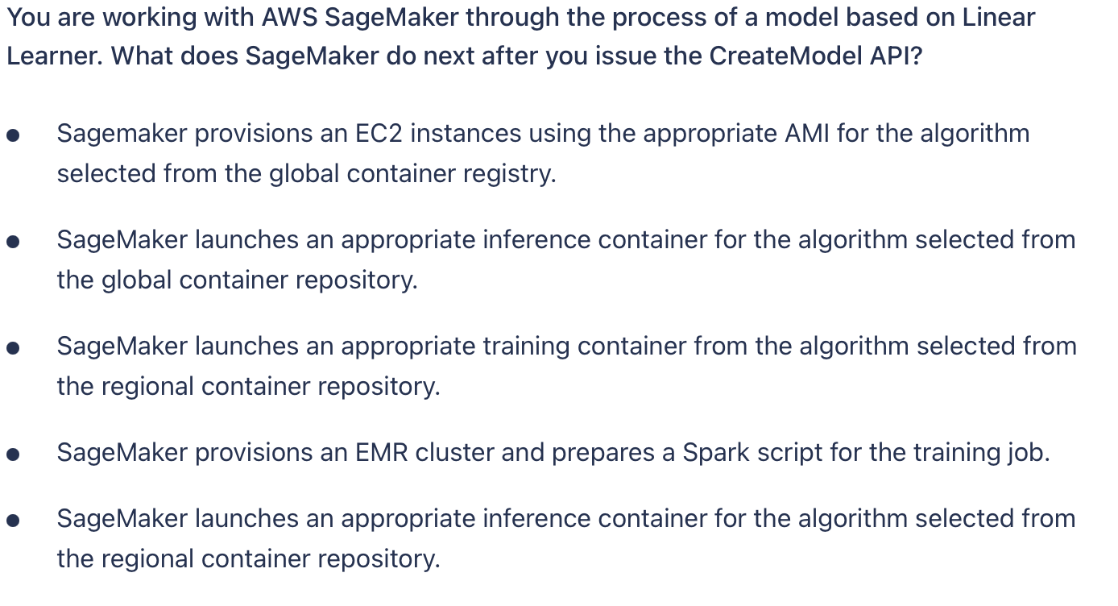
Notes:
Option 5
CreateModel API call is used to launch an inference container. When using the built-in algorithms, SageMaker will automatically reference the current stable version of the container.

Slide 30
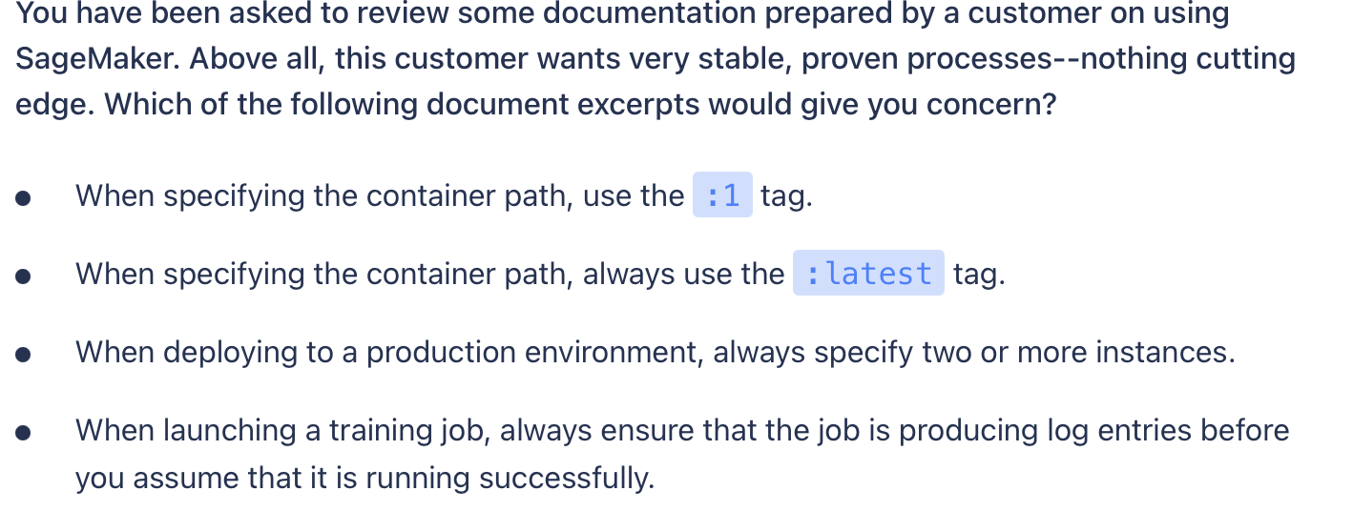
Notes:
Option 2
Using the :latest tag means that as soon as any update is made to the container, it will be active in production. This is an issue if you need to have stability, where you would want to ensure that only the version of the image you specify is running.

Slide 31
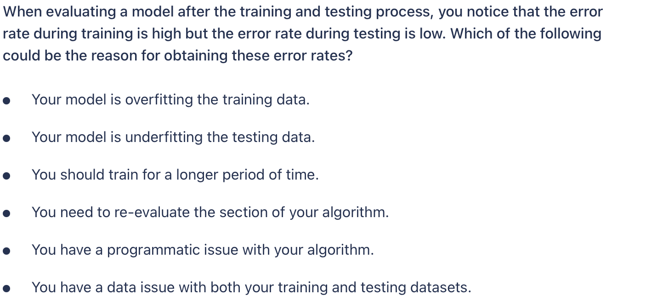
Notes:
Option 5 and 6
When training error is high and testing error is low, this is highly unusual as it infers that the model is somehow predicting better than the data which was used to train the model. This is usually an indicator of a data issue or some systemic problem in the algorithm.

Slide 32
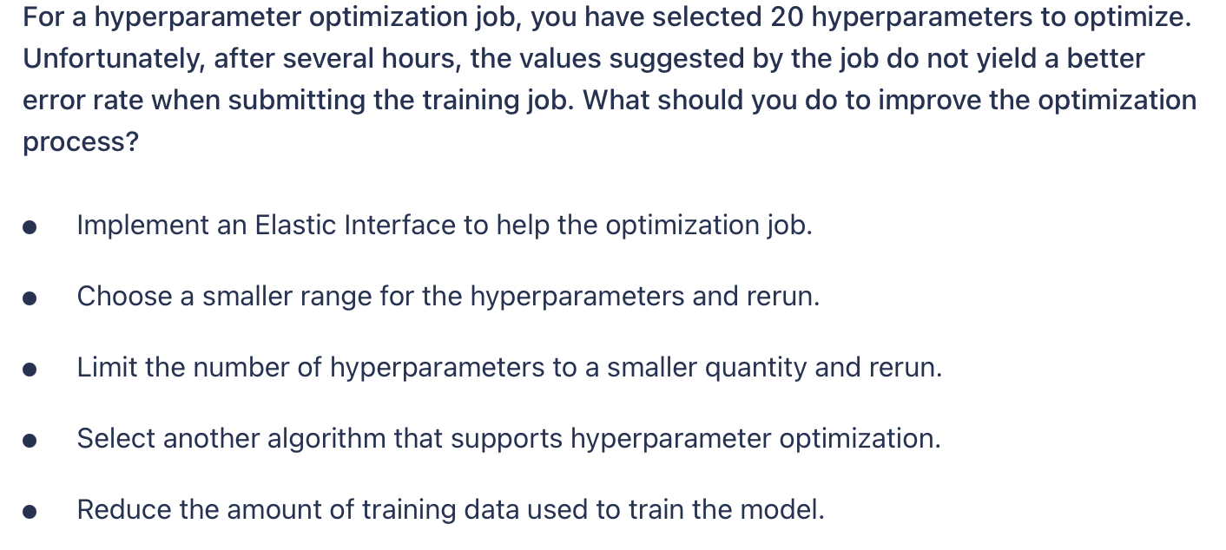
Notes:
Option 2 and 3
When performing hyperparameter optimization jobs, it is suggested to use a smaller rather than larger set of target hyperparameters and choose a narrower range for the target values.

Slide 33
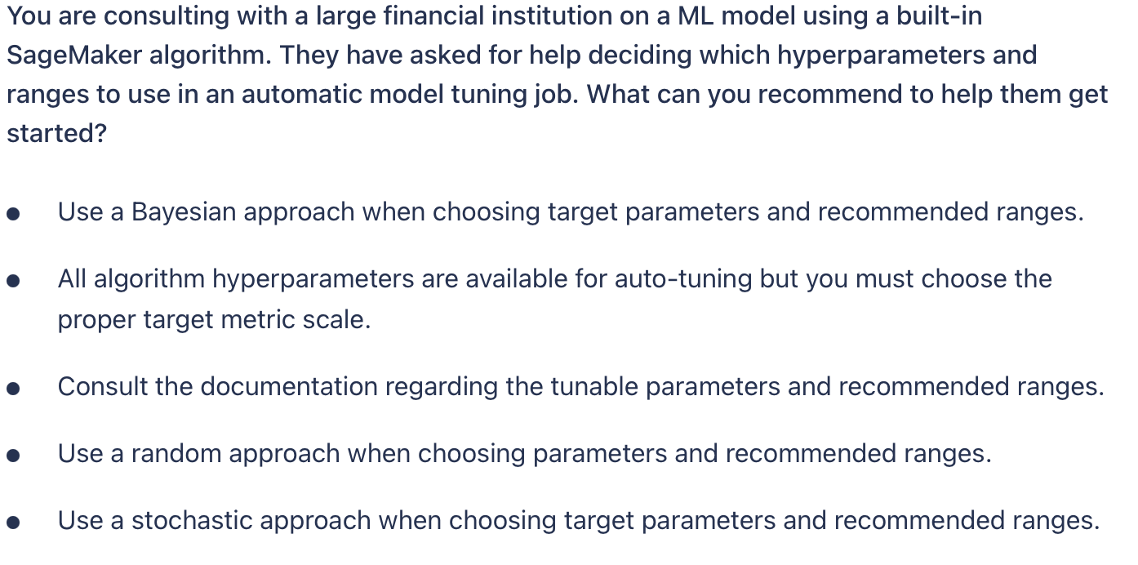
Notes:
Option 3
Not all algorithm metrics are able to be used as optimization metrics. You should consult the documentation on the specific algorithm to determine which hyperparameters are able to be tuned.

Slide 34
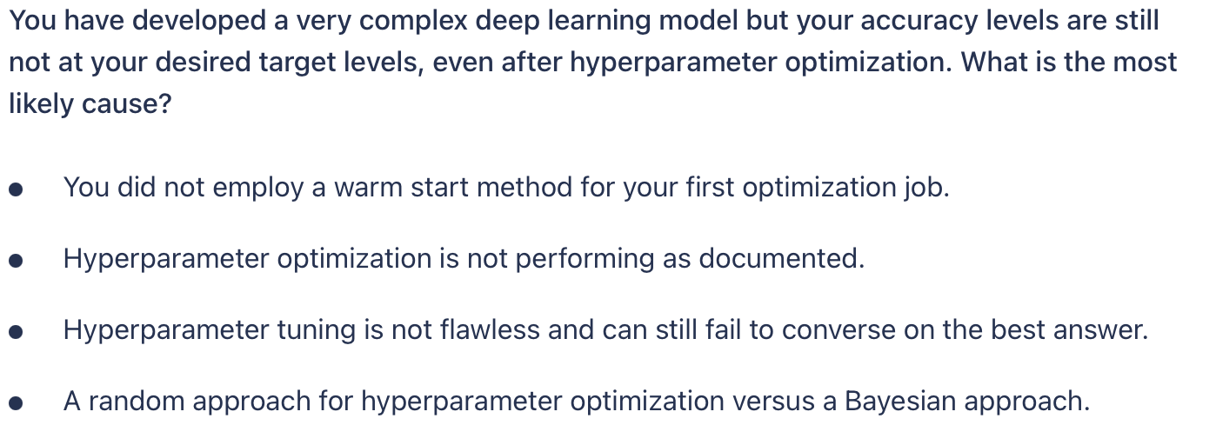
Notes:
Option 3
Hyperparameter tuning can accelerate your productivity by trying many variations of a model, focusing on the most promising combinations of hyperparameter values within the ranges that you specify. However, it's still possible that the tuning job will fail to converge on the best answer, even if the best possible combination of values is within the range that you choose. You should not over-rely on automatic tuning for optimization but rather include it as part of a scientific approach.

Slide 35
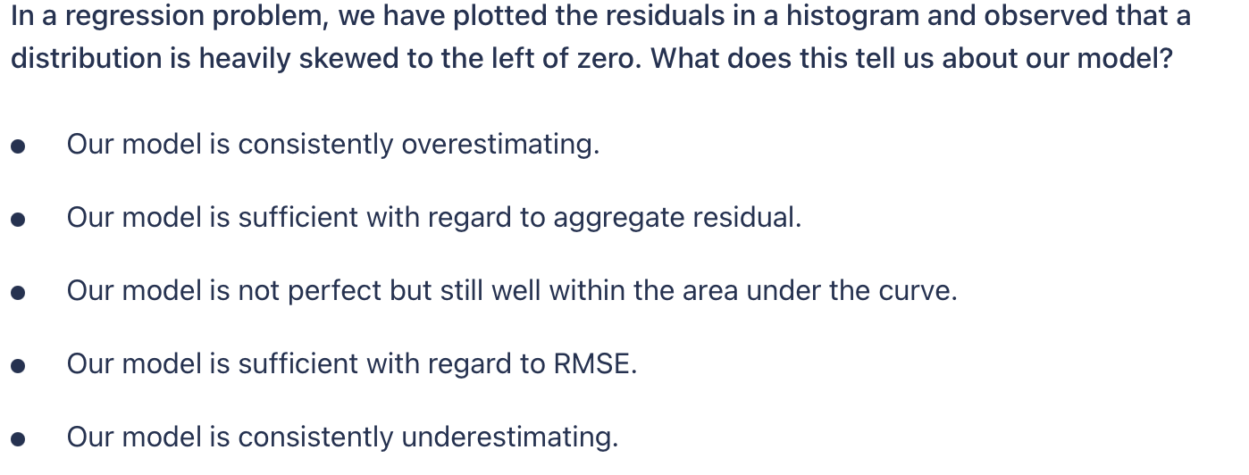
Notes:
Option 1
The residual is commonly defined as the actual value minus the predicted value. If most of our residuals are negative numbers, that means that our predicted values are mostly more than the actual values. This means that our model is consistently overestimating.

Slide 36
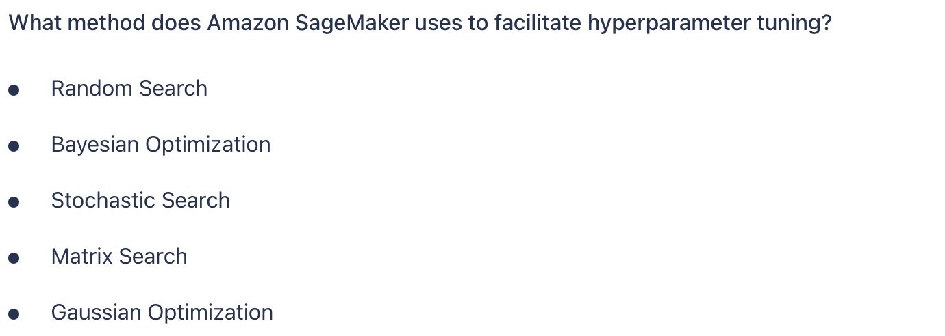
Notes:
Option 2
Amazon SageMaker uses Bayesian optimization for automatic hyperparameter tuning.

Slide 37
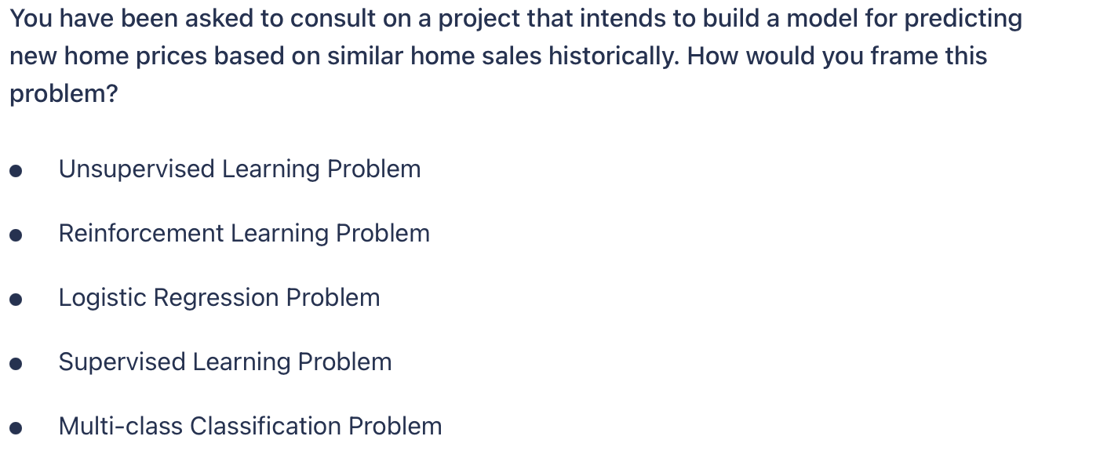
Notes:
Option 3
If we are given historical data and asked to build a model to predict future values, this most closely resembles a Supervised Learning problem, likely using a Linear Regression approach

Slide 38
Useful links
https://ibm-learning.udemy.com/course/aws-machine-learning/
https://ibm-learning.udemy.com/course/aws-machine-learning-practice-exam/
https://ibm-learning.udemy.com/course/aws-certified-machine-learning-specialty-full-practice-exams/
https://ibm-learning.udemy.com/course/amazon-web-services-machine-learning/
https://ibm-learning.udemy.com/course/aws-machine-learning-a-complete-guide-with-python/

Slide 39
Useful links
https://d1.awsstatic.com/training-and-certification/docs-ml/AWS-Certified-Machine-Learning-Specialty_Sample-Questions.pdf
https://towardsdatascience.com/how-i-prepared-for-the-aws-machine-learning-speciality-certification-10834924d192
https://medium.com/@adam.dejans/my-path-to-passing-the-aws-machine-learning-certification-e8fc45ad7762

