Slide 1


Introduction to Google Colab
The Most Underrated Tool for Python Development
A Comprehensive Guide

Slide 2

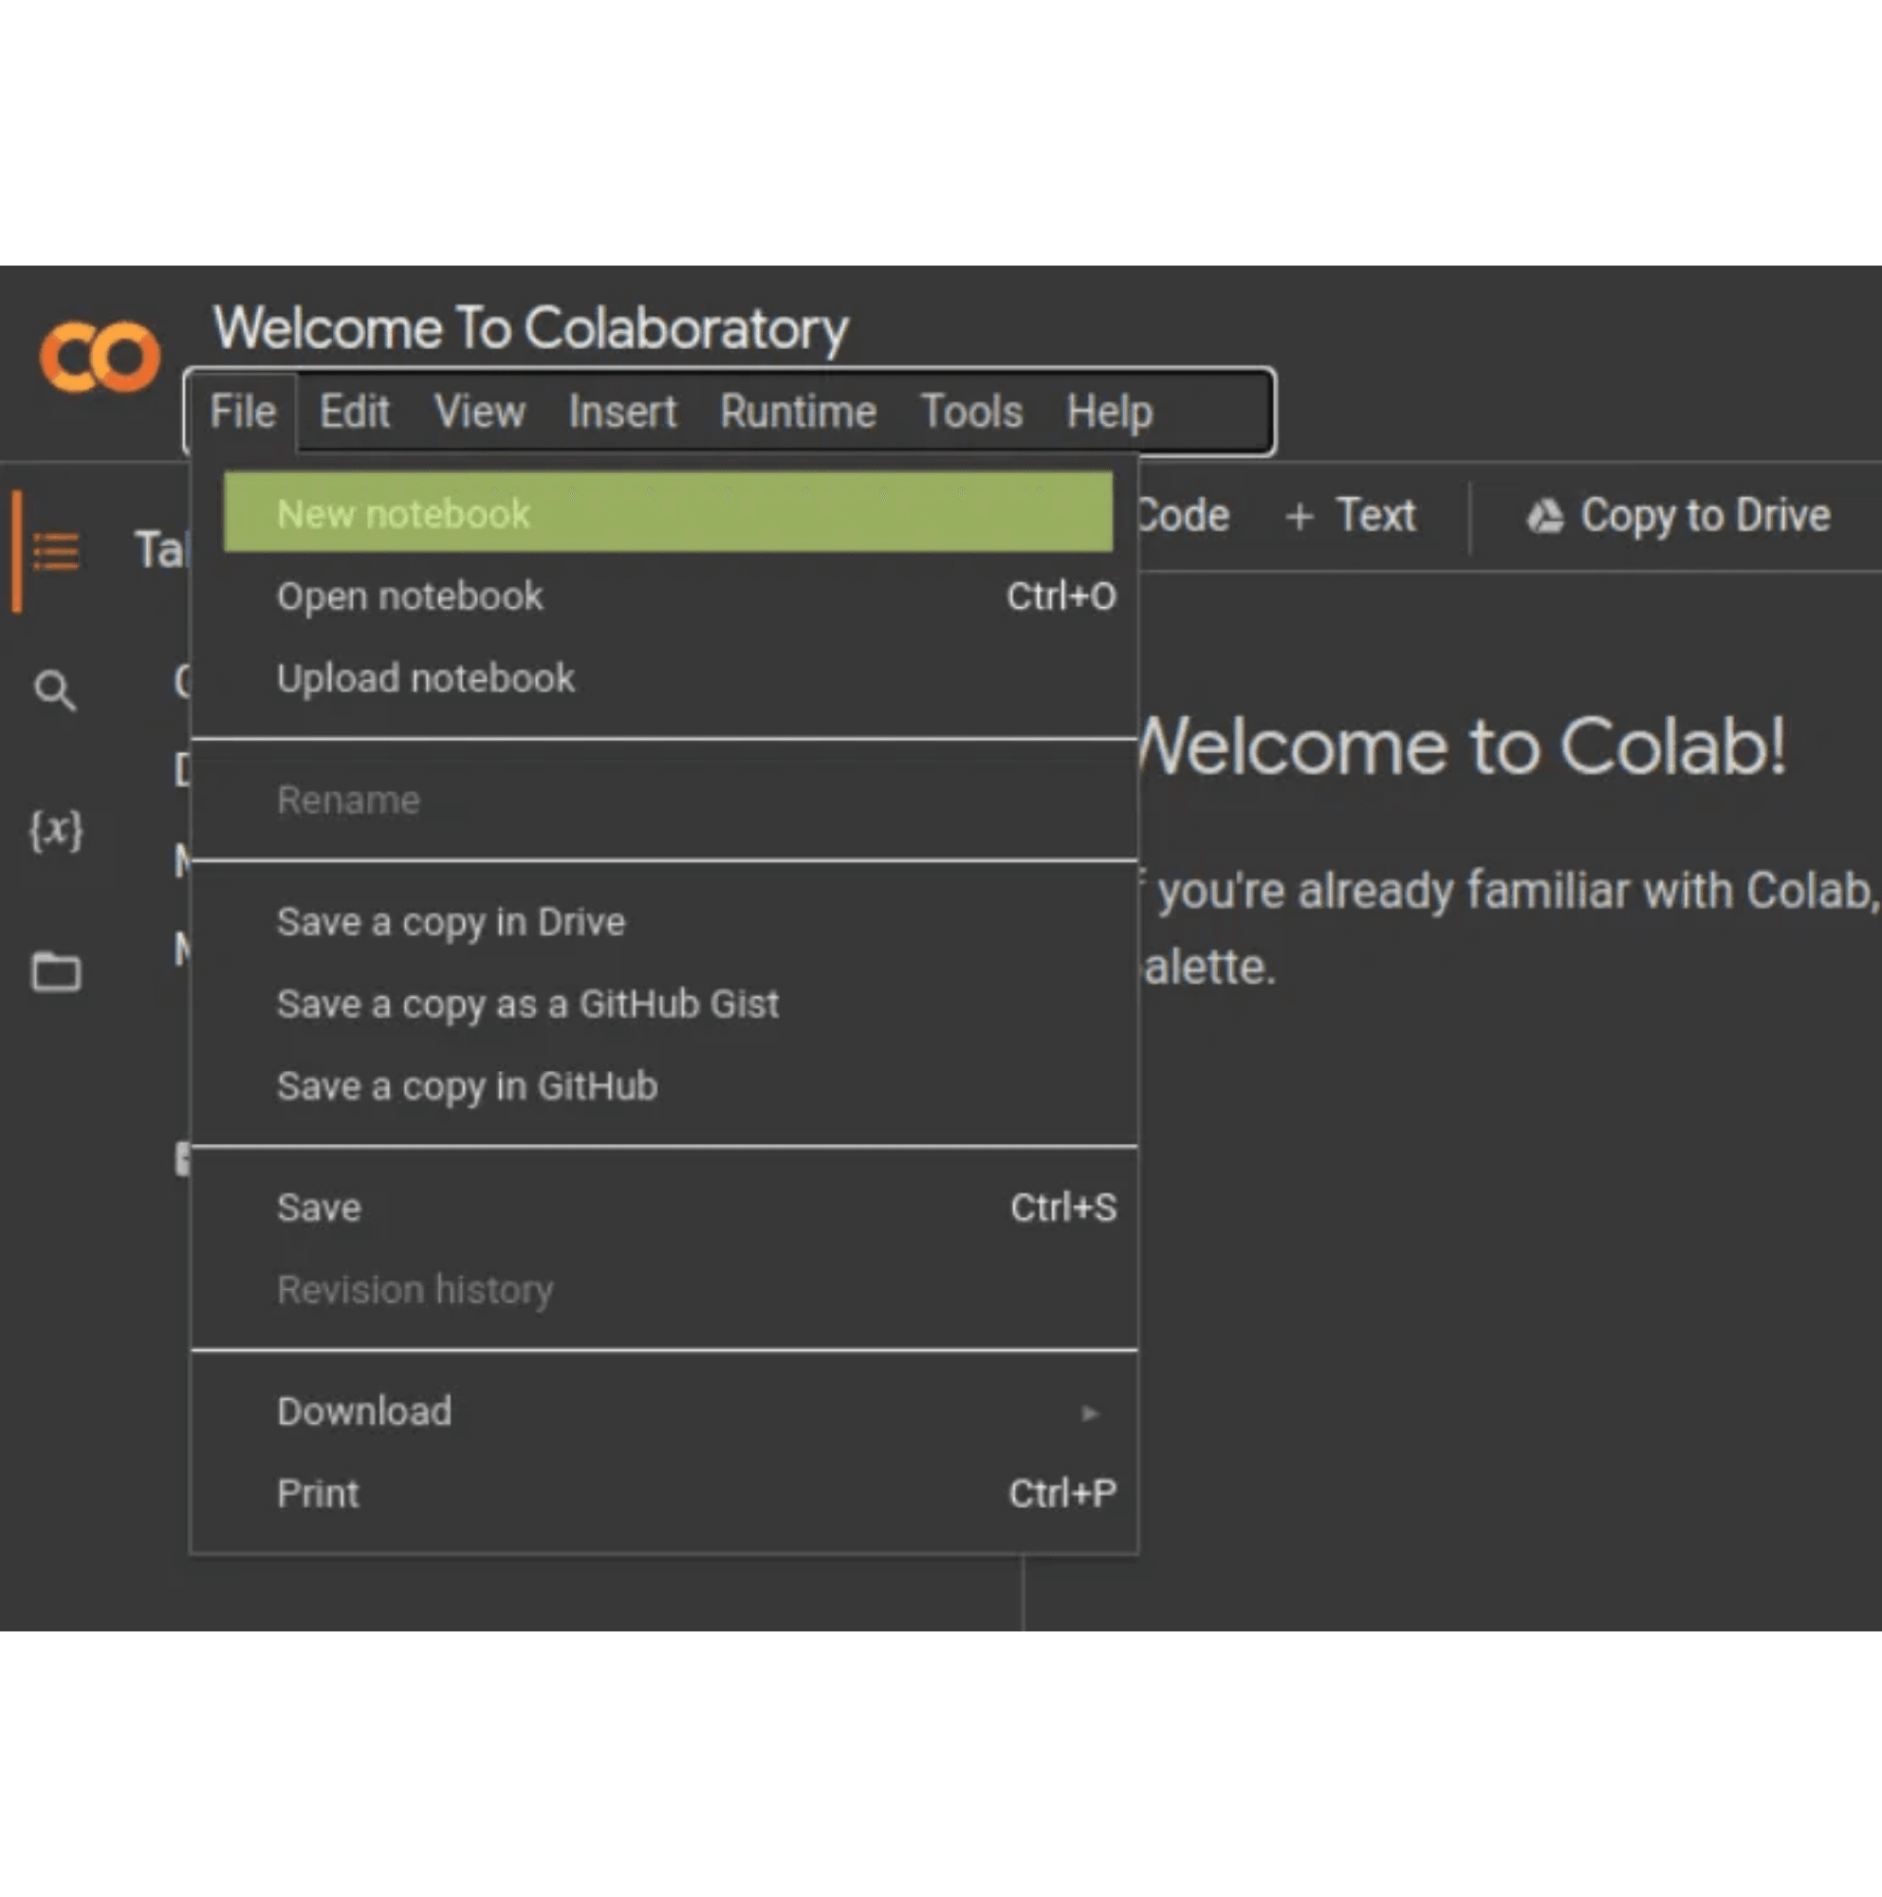
What Makes Google Colab Special
Google Colab is one of the most underrated tools in the developer ecosystem
Cloud-based runtime environment accessible from anywhere
Works seamlessly on phones, tablets, iPads, and computers
No installation or setup required - just open and start coding
Free access to computing resources including GPUs and TPUs
Built on the familiar Jupyter notebook interface
A powerful development environment without any local setup

Slide 3


Runtime Capabilities and Tricks
Google Colab offers powerful runtime features that enhance your workflow
Multiple runtime types: Standard, GPU-accelerated, and TPU-enabled
Session management: Save and restore your work automatically
Resource monitoring: Track RAM and disk usage in real-time
Package installation: Install any Python library on-the-fly
Runtime tricks: Reconnect, restart, and manage sessions efficiently
PRO TIP: You can customize your runtime environment for specific project needs

Slide 4
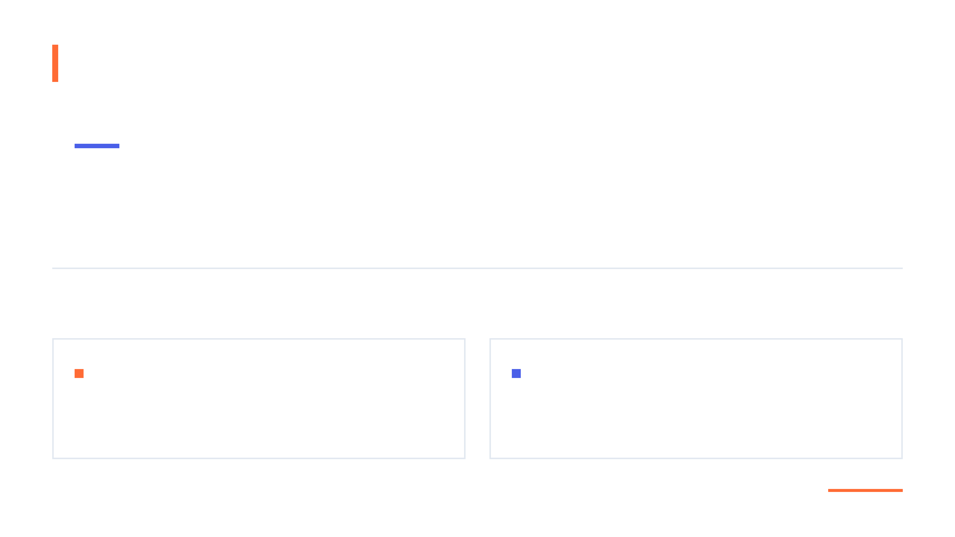
Language Support
Primary Focus: Python
Google Colab supports multiple programming languages, but Python is the most widely used and has the richest ecosystem with the best integration with Colab's features. This tutorial concentrates on Python development.
Also Supported:
Julia
R
High-performance numerical computing language designed for scientific and technical computing with speed comparable to C.
Statistical computing and graphics language widely used in data analysis, statistical modeling, and visualization.

Slide 5

Getting Started with Colab
Creating your first Google Colab notebook is simple
01
02
Go to Google Drive
Click New → More → Google Colaboratory
Navigate to drive.google.com
Find it in the New menu
03
04
If you don't see Colaboratory
Your new notebook opens immediately
Click Connect more apps and search for it
Ready to code right away!
Your notebooks are automatically saved to your Google Drive

Slide 6

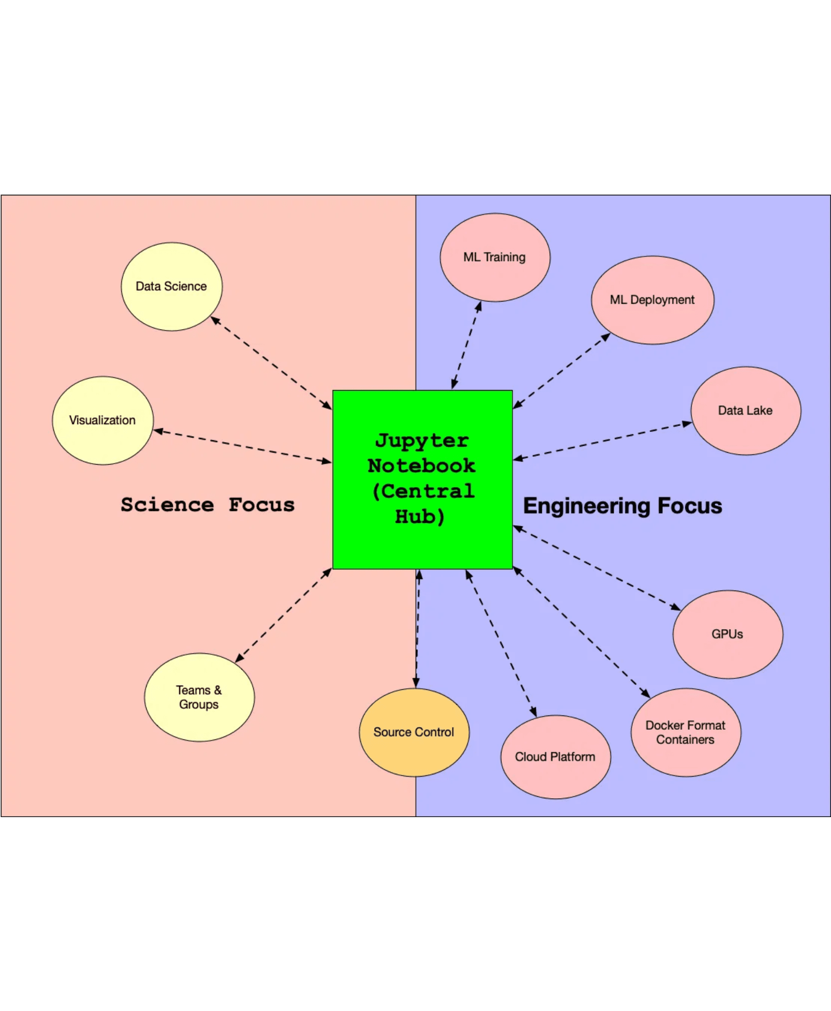
Q: If we have Jupyter, why should I use Google Colab?
A: Parallel execution and cloud advantages
Key differences:
Run multiple notebook versions simultaneously without conflicts
No local resource limitations - use cloud computing power
Collaboration features: Share and co-edit notebooks in real-time
Pre-installed libraries and frameworks
Access from any device without setup
Jupyter is great for local work, but Colab excels in flexibility and accessibility

Slide 7

Q:
Can I use Google Colab with AI?
A:
Yes! Gemini integration is a game-changer
Built-in Gemini AI for code assistance and generation
Get code suggestions and explanations instantly
Debug errors with AI-powered insights
Generate boilerplate code and functions automatically
Natural language to code conversion
This native AI integration significantly accelerates development workflow

Slide 8

ANSWER
Free tier is sufficient for most users
Free Version
Adequate for learning, prototyping, and moderate workloads
QUESTION
Is Google Colab free or paid?
Colab Pro
Enhanced resources for power users ($9.99/month)
Colab Pro+
Maximum resources and priority access ($49.99/month)
Recommendation: Start with free tier — upgrade only when you hit resource limits

Slide 9

QUESTION
How long can I use a Colab runtime?
ANSWER
According to the official FAQ:
"In the version of Colab that is free of charge, notebooks can run for at most 12 hours, depending on availability and your usage patterns."
"Runtimes will time out if you are idle."
BEST PRACTICE: Save your work frequently and be mindful of idle time to avoid losing progress

Slide 10
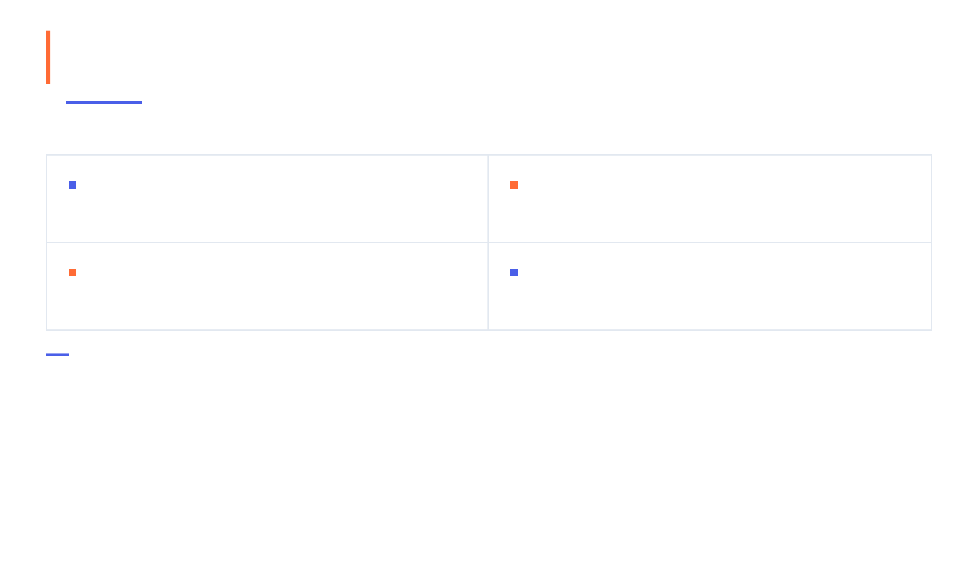

Q: What if I need it to read files?
A: Multiple options for file access
Mount Google Drive
Upload Files
Access your entire Drive storage directly from your notebook
Direct upload to the runtime environment for immediate use
Download from URLs
Connect to Cloud Storage
Fetch data directly from the internet using wget or Python
AWS S3, Google Cloud Storage, and other cloud platforms
We'll explore mounting drives and file uploads in detail in upcoming sections

Slide 11

Next Steps
Summary and Next Steps
Google Colab empowers developers with accessible cloud computing
Practice creating notebooks
Key Takeaways:
Free, cloud-based Python development environment
Explore runtime options
Accessible from any device with a browser
Experiment with file operations
Built-in AI assistance with Gemini
Flexible file management options
12-hour runtime sessions with generous free tier
Start exploring Google Colab today!

Slide 12
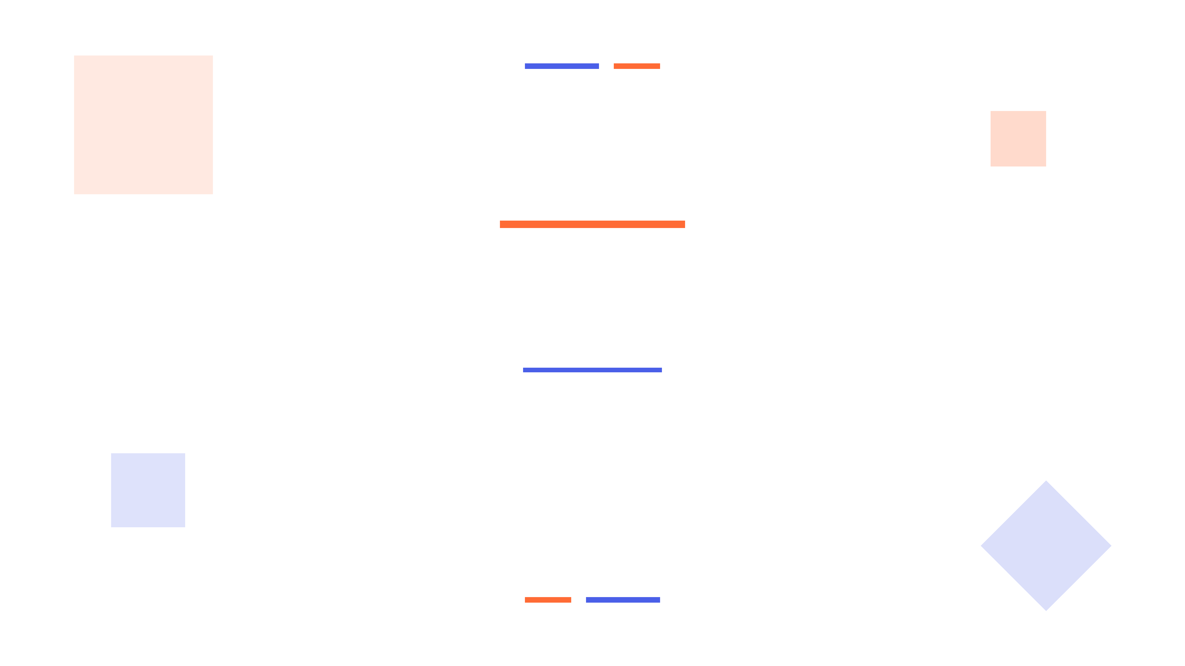
Thank You
Questions?
Start exploring Google Colab today!
colab.research.google.com

