Slide 1
Securing the Cloud Storage
Hanisha Anil Mohinani

Slide 2
OVERVIEW
- Currently, the majority of users and businesses rely on the cloud for data storage.
- Data privacy and integrity are significant concerns with public cloud storage services such as Google Drive and Dropbox.
- Ensuring secure data transfer and storage is essential.
- This is accomplished by encrypting data using various methods, including symmetric and asymmetric encryption techniques.

Slide 3

PROBLEM STATEMENT
- Aim: Develop a secure cloud storage application.
- The application should secure all files uploaded to the cloud.
- Only members of the Secure Cloud Storage Group will be able to decrypt the files.
- A symmetric key will be generated for each group to encrypt and decrypt the data.
- Concern: What if the symmetric key is not securely transmitted to the group members?

Slide 4
POSSIBLE THREATS
- An eavesdropper can perform a man-in-the-middle attack to read, alter, or delete information in the payload.
- This threat is especially serious when a symmetric key is involved.
- How can we prevent this?

Slide 5
SOLUTION AND ARCHITECTURE
- Implement another layer of encryption to protect the symmetric key from attacks.
- Use asymmetric encryption to secure the symmetric key.
- The sender encrypts the symmetric key with the recipient's public key.
- The recipient decrypts the symmetric key using their private key.

Slide 6
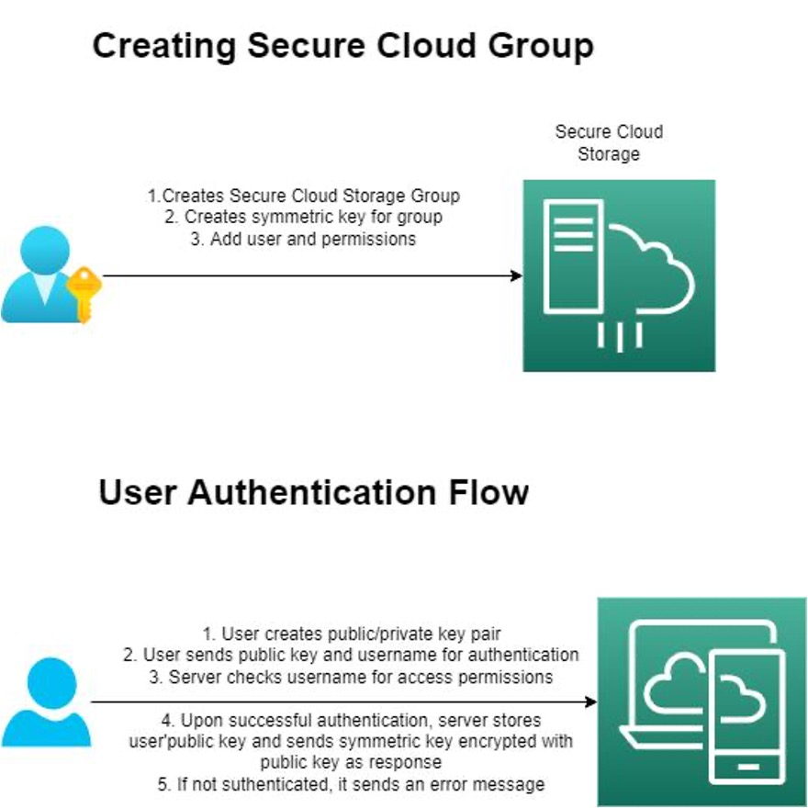
Fig. 1

Slide 7
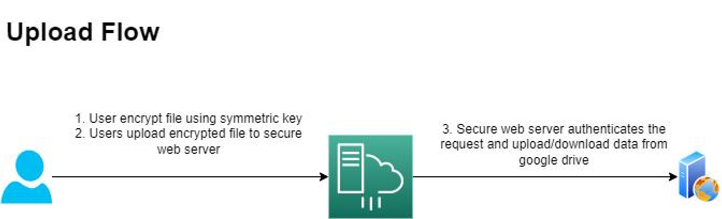
Fig. 2

Slide 8
ADDITIONAL USE CASES
- What if a user is removed from the group?
- How can we prevent the removed user from accessing the data?
- Two possible solutions:
- Broadcast a new symmetric key to the group.
- Transmit the symmetric key on demand.
- Is the process the same when a new user is added?

Slide 9
IMPLEMENTATION DETAILS
•Programming Language : Python
•Asymmetric cryptography : 2048 bits long RSA key
•Symmetric cryptography : SHA -256

Slide 10
FUTURE ENHANCEMENTS
- Develop a graphical user interface version of the application.
- Implement a master server class to manage all content and traffic on the cloud storage.

