Slide 1
Project presentation and justification
CollabSphere - A Remote Team Collaboration Platform
Team-8
Praneet Avhad (ID: 40279347)
Vaibhav Diwan (ID: 40279252)
Soham Sakaria (ID: 40275636)
Gaurav Sharma (ID: 40284996)
Yashesh Sorathia (ID: 40267022)

Slide 2
Agenda
01
02
03
04
Introduction
Market Analysis
Feasibility
Solution
05
06
07
08
Project plan
Risk Analysis
Budget overview
Conclusion

Slide 3
01
Introduction

Slide 4
—Steve Jobs
“You cannot mandate productivity, you must provide the tools to let people become their best.”

Slide 5
Introduction
Challenges in Remote Team Collaboration:
Globalized work environments face coordination issues across time zones.
Fragmented communication leads to scattered conversations and inefficiencies.
Lack of integrated tools reduces productivity and delays task resolution.
Limitations of Existing Platforms:
No centralized system for ticket management and task tracking.
Manual task creation increases overhead and risk of human error.
Solution:
Comprehensive Collaboration Platform: A centralized solution integrating communication, task management, and automation to address inefficiencies in remote team workflows.
Enhanced Team Productivity: By combining real-time and asynchronous communication with customizable workflows, the platform bridges gaps caused by fragmented tools and processes, ensuring seamless coordination.

Slide 6
02
Market Analysis

Slide 7
Market Analysis
High Adoption Rates: Over 80% of Fortune 1000 companies adopted remote collaboration tools during the pandemic.
Target Segments: Remote teams, government agencies, and SMEs demand secure, scalable, and customizable solutions.
Critical Challenges: Poor communication leads to increased stress (52%) and project delays (44%), highlighting unmet needs.
Psychographic Trends: 75% of virtual workers find collaboration tools enhance effectiveness, and 62% are considering remote roles.
Customization & Automation: Strong demand for workflow automation and adaptable tools to fit diverse processes.
Diverse Use Cases: Solutions must cater to different workflows like Agile, Waterfall, and custom team structures.
Growth Potential: Rising reliance on platforms like Zoom and Slack indicates significant market opportunities for innovative collaborative tools.

Slide 8
03
Feasibility

Slide 9
Feasibility Report
Technical Feasibility:
Technologies like React, Node.js, and cloud infrastructure support the platform's development.
Security and scalability can be ensured using proven frameworks and best practices.
Operational Feasibility:
The platform enhances workflows and addresses collaboration challenges for remote teams.
Training programs and integration strategies tackle potential user resistance.
Economic Feasibility:
High market demand with projected growth in the remote collaboration sector.
Positive ROI expected within 2–3 years through subscription-based revenue.
Secure funding through venture capital and angel investors.

Slide 10
Feasibility Report
Development in Phases
Begin with planning, design, and testing to ensure a solid foundation.
Deploy in a production environment with training and support for users.
User-Centric Development
Gather user feedback continuously to shape the platform.
Make iterative updates to improve usability and functionality.

Slide 11
04
Solution Highlights

Slide 12
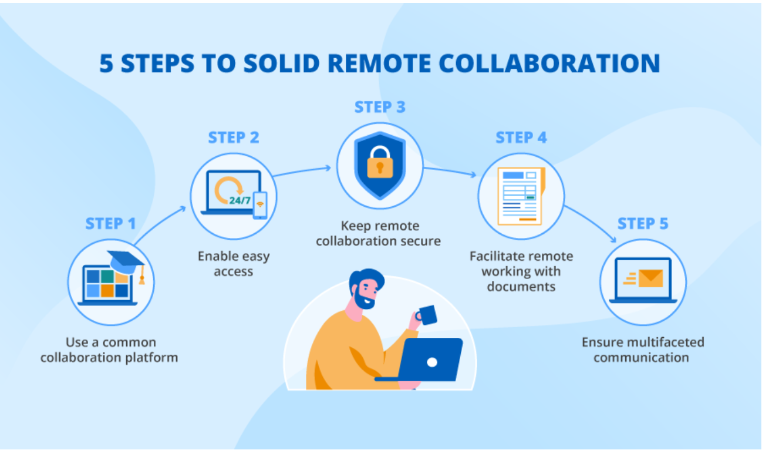
Key Unique Selling Points of Our Collaboration Platform
All-in-One, Customizable Collaboration Hub
Unified Communication Real-time and asynchronous messaging to keep teams aligned across time zones.
Integrated Ticket Management Track, assign, and resolve tasks and issues with ease—no task left behind.
Customizable Workflows Optimize workflows to align with team needs, ensuring seamless project execution and efficient task management
Automation & Third-Party Integrations Automate tasks and integrate with tools like GitHub and Zapier for seamless productivity.
Collaborative Document Editing Real-time editing, version control, and cloud storage ensure teams always work with the latest files.
Analytics & Reporting Gain actionable insights into team performance and project progress with customizable reports.
Mobile Accessibility Stay connected and productive with a fully-featured mobile app—anytime, anywhere.

Slide 13
05
Project Plan

Slide 14
Project Plan
Timeline: 18 months with 10 key deliverables.
Key Phases:
Project Initiation
Research & Requirement Analysis
Platform Design
Frontend & Backend Development
Integration & Enhancements
Testing & Quality Assurance
Documentation & Training
Deployment
Monitoring & Feedback Collection
Maintenance & Optimization
Milestones:
Project Kickoff
Requirement Analysis Completion
Design Phase Completion
Development Completion
Deployment and Maintenance
Resource Allocation:
Human Resources: Project Managers, Developers, QA Engineers, Designers.
Technical Tools: Development frameworks, testing platforms, and cloud resources.

Slide 15
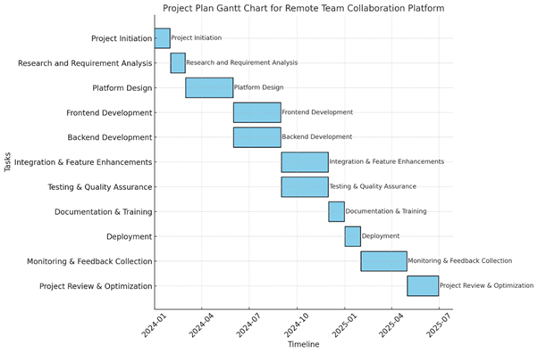

Slide 16
06
Risk Analysis

Slide 17
Risk Analysis
Risk Management Overview
Technical Risks: Integration challenges with third-party applications (e.g., Github, Zapier), data security concerns, and scalability issues.
Operational Risks: User adoption resistance, system downtime, and customization complexities.
Economic Risks: Rising development costs and lower-than-expected ROI.
Strategies
Enhanced Security: Encryption, MFA, compliance audits.
User Training: Guides, training programs, feedback loops.
Scalable Cloud Solutions: Seamless handling of user demand.
Maintenance & Backups: Minimize downtime with regular updates.
Budget Planning: Contingency funds for unforeseen costs.
Performance Tracking: Ensure ROI with productivity metrics.

Slide 18
07
Budget Analysis

Slide 19
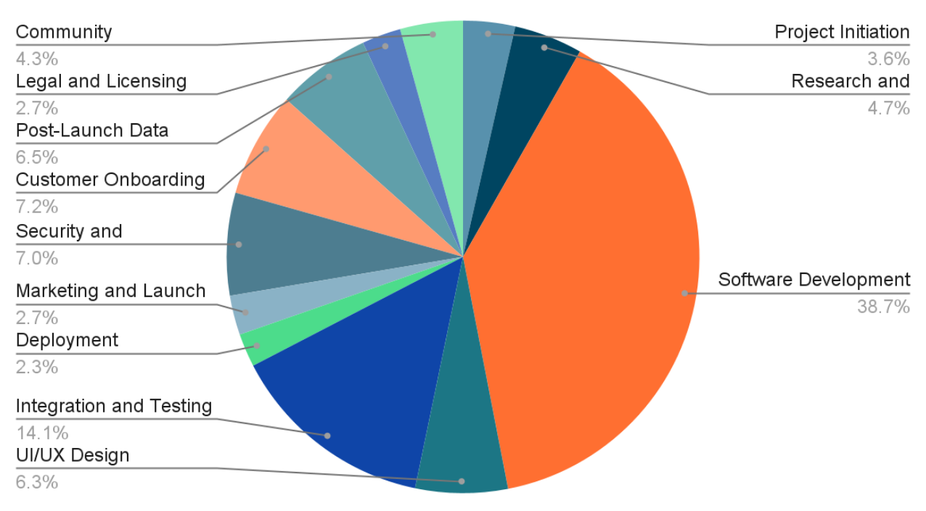
Budget Overview
After thorough evaluation of our idea, the estimated budget for the product is CA$596,722

Slide 20
08
Conclusion

Slide 21
Conclusion
In today's increasingly interconnected and remote-driven work environment, our platform stands as a game-changer, addressing critical gaps in team collaboration and project management. It offers a unified, streamlined solution for modern remote teams.
Our thorough market analysis highlights a rising demand for centralized collaboration tools, with research showing that fragmented workflows and communication tools result in a 30% drop in team productivity on average.
By embracing this platform, we not only streamline how teams communicate and manage tasks but also set a new benchmark for collaboration technology in the remote work era.

Slide 22
THANK YOU
We are open to questions and discussions!

