Slide 1
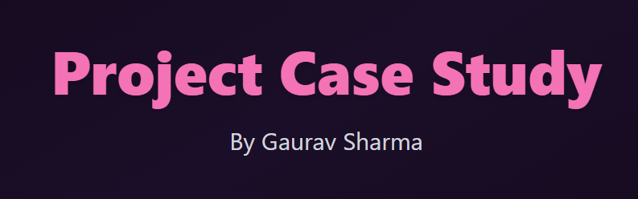

Slide 2
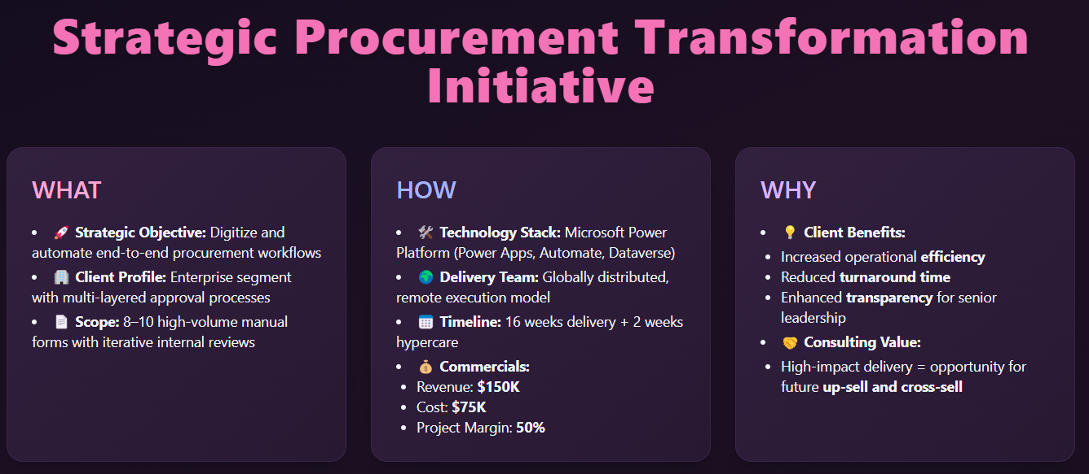

Slide 3
Strategic Procurement Transformation Initiative
WHAT
Client Profile: Enterprise segment with multi-layered approval processes
Scope: 8–10 high-volume manual forms with iterative internal reviews
HOW
Delivery Team: Globally distributed, remote execution model
Timeline: 16 weeks delivery + 2 weeks hypercare
Commercials:
Revenue: $150K
Cost: $75K
Project Margin: 50%
WHY
Consulting Value - High-impact delivery = opportunity for future up-sell and cross-sell
Strategic Objective: Digitize and automate end-to-end procurement workflows
Technology Stack: Microsoft Power Platform (Power Apps, Automate, Dataverse)
Client Benefits - Increased operational efficiency, Reduced turnaround time, Enhanced transparency for senior leadership

Slide 4
Client Kickoff Meeting Strategy
Purpose of the Meeting
Align vision, scope, and delivery model
Establish trust and rapport
Set expectations for communication, governance, and success
Pre-Meeting Preparation
Review contract, scope, and stakeholders
Understand client org chart and decision-makers
Prepare: draft charter, RACI, delivery roadmap, and SharePoint/Teams
Kickoff Agenda Highlights
Introductions & roles
Project overview & strategic importance
Delivery plan & methodology
Roles, responsibilities & escalation
Communication & cadence
Key milestones & invoicing
Open discussion
Post-Meeting Actions
Distribute Minutes of Meeting (MOM)
Confirm decisions and next steps
Launch collaboration workspace
Send invites for regular status reviews

Slide 5
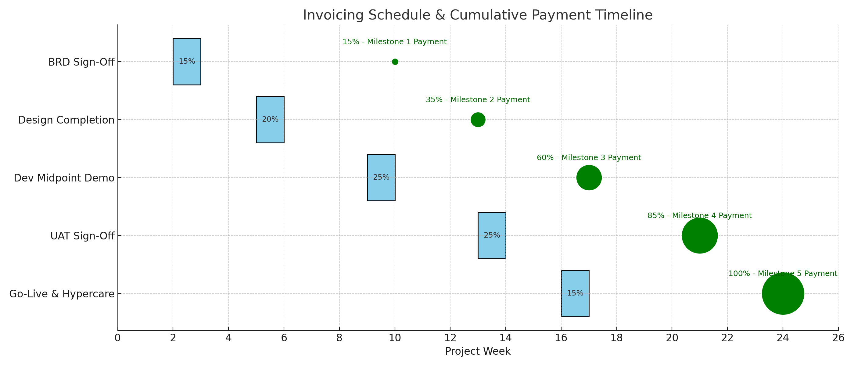
Invoicing & Payment Milestone Strategy

Slide 6
Strategy to Win Customer Confidence Early
Deliver Quick Wins
Identify 1–2 high-impact forms or workflows to complete in first 2–3 weeks
Use working demos to show tangible progress early
Prioritize areas with visible bottlenecks or user pain
Proactive & Transparent Communication
Set a cadence of weekly status reports and bi-weekly demos
Share progress dashboards with delivery %, risks, and invoices
Keep stakeholders looped in, even on delays — show control
Establish a Partnership Mindset
Position the project as “our” success, not just delivery
Use discovery conversations to understand their “why” — not just “what”
Anticipate questions, offer solutions proactively
Put the Right Faces Forward
Assign a dedicated SPOC to the client for consistency
Bring in SMEs for specific sessions (e.g., Power Platform expert)
Let leadership meet your delivery lead early to show commitment

Slide 7
Project Health & Financial Reporting to Senior Management
Project Health Overview
Scope – % completed vs baseline
Schedule – On time / delayed milestones
Progress – Sprint/phase completion %, burn-down chart
Risks & Issues – Open vs resolved, high severity flags
Invoicing Status
Milestones Delivered – vs expected
Invoices Raised – Amount & date
Payments Received – With expected vs actual delays
Overdue Invoices – Highlighted (if any)
Profitability Snapshot
Revenue Recognized (to date)
Cost Incurred – Internal burn reports
Profit Margin – % actual vs planned
Resource Utilization – Billable vs non-billable hours

Slide 8
Project Audit: Key Challenges Identified
Project Delays
Client introduced critical new requirements
Existing BRDs on hold pending updates
Currently 2 weeks behind schedule due to integration issues
Budget Overruns
10% overrun reported in first few weeks
Main cause: Extended hours for resolving integration complexities
Quality Concerns
Early testing indicates performance issues
Risks missing client's high-performance benchmarks
Communication Gaps
Inconsistent updates between teams
Resulting in duplicate efforts and unclear ownership

Slide 9
Strategy to address challenges
Bringing the Project Back on Track
Split BRDs into Phase 1 (signed-off items) and Phase 2 (new requirements)
Use agile sprints to fast-track critical forms and workflows
Parallelize development and testing efforts where possible
Add buffer to the new timeline to manage complexity and uncertainty
Set up sprint-level tracking with burn-down charts
Budget Realignment Without Scope Compromise
Raise formal change request for newly introduced requirements
Reassign tasks to best-fit resources to increase efficiency
Reduce non-billable overheads: fewer meetings, focused reviews
Track time and effort using time-sheet tools to control burn
Work with finance to forecast cash flow and margin realization
Quality Assurance Strategy
Involve QA from sprint 1 (shift-left approach)
Set performance benchmarks early, align with client standards
Conduct peer reviews before code merges
Implement automated regression testing for repeatable validations
Include UAT checkpoints and performance testing in each sprint
Communication and Documentation Improvements
Daily standups to align cross-location teams
Weekly stakeholder updates and steering committee reviews
Centralize documentation in SharePoint with version control
Define and implement a RACI matrix
Use Teams/Planner for real-time visibility and ownership

Slide 10
