Slide 1
Library Management System
CSCI 5448
Sanketh, Tauseef, Gaurav, Nicholas

Slide 2
Structure of presentation
Framework/Tools used
Walk-through Demo 1
Walk-through Demo 2
Design Pattern Used - Bridge
Design Pattern Used - MVC

Slide 3
Framework/Tool used
ASP.NET Framework.
C# as our Object Oriented language.
Visual Studio as our IDE.
MS SQL as our Relational Database.

Slide 4
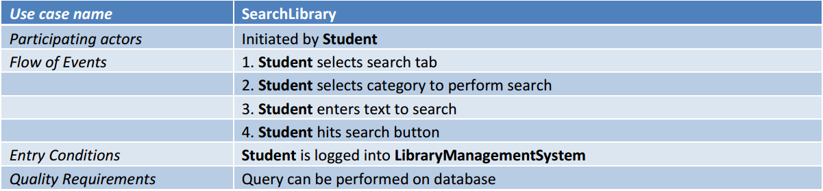
Walk-through Demo 1
Below is one of the Use cases we had in our Part 2. Let's see a live demo of that.

Slide 5
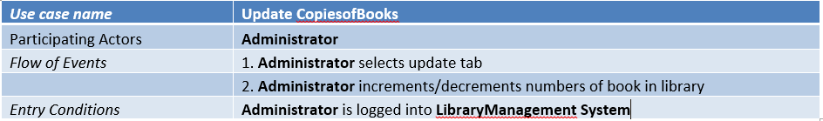
Walk-through Demo 2
Below is another Use case we had in our Part 2. Let's see a live demo of that.

Slide 6
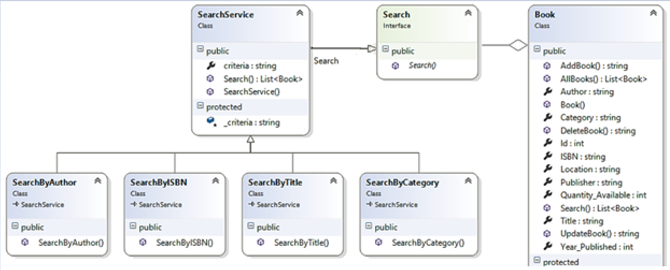
Design Pattern used - Strategy
We have used Strategy pattern in Search interface

Slide 7
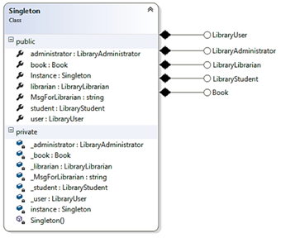
Design Pattern used - Singleton
Also we have used the Singleton pattern to have a single ready instance of all our basic models available at runtime so that we would not have to instantiate each of them every time the controller is called

Slide 8
Thank you

