Slide 1
UNIT – I : HTML
Basics Of HTML
Formatting And Fonts
Commenting Code
Colour
Hyperlink
Lists
Tables
Images
Forms
XHTML
Meta Tags
Character Entities
Frames And Frame Sets
Browser Architecture And Web Site Structure.
Overview And Features Of Html5

Slide 2
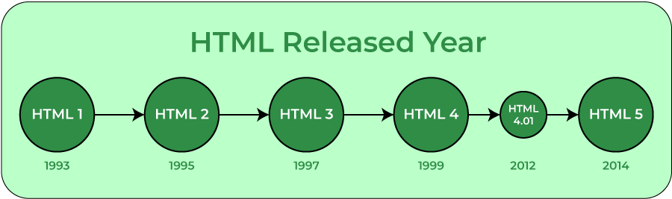
INTRODUCTION
What is HTML?
HTML stands for HyperText Markup Language. It is used to design web pages using the markup language. HTML is the combination of Hypertext and Markup language. Hypertext defines the link between the web pages and markup language defines the text document within the tag that define the structure of web pages. HTML was created by Tim Berners-Lee in 1991. The first-ever version of HTML was HTML 1.0, but the first standard version was HTML 2.0, published in 1995.
What is HTML used for ?
HTML is used to create the structure of web pages that are displayed on the World Wide Web (www). It contains Tags and Attributes that are used to design the web pages. Also, we can link multiple pages using Hyperlinks.

Slide 3
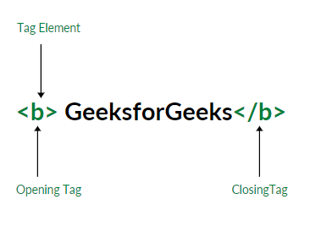
Elements and Tags: HTML uses predefined tags and elements which tell the browser how to properly display the content. Remember to include closing tags. If omitted, the browser applies the effect of the opening tag until the end of the page.

Slide 4
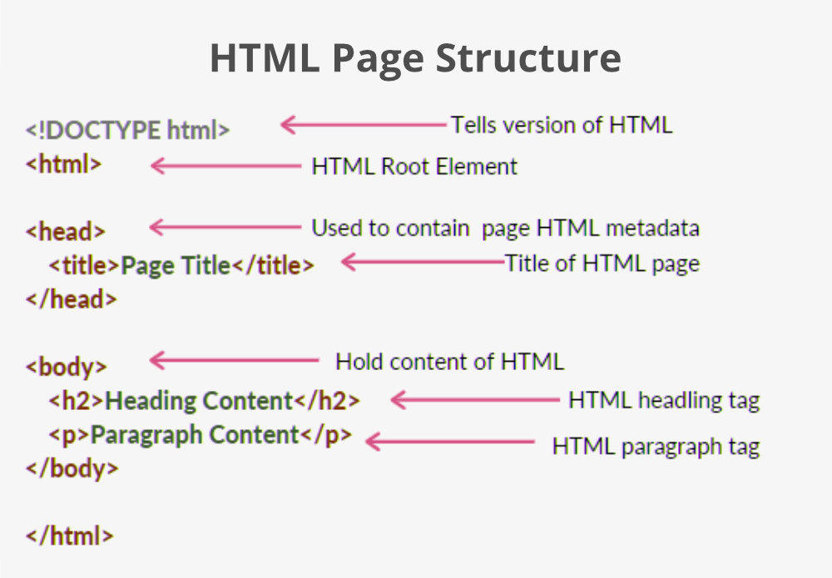
HTML Basic Format Page Structure
The basic structure of an HTML page is laid out below. It contains the essential building-block elements (i.e. doctype declaration, HTML, head, title, and body elements) upon which all web pages are created.

Slide 5
<!DOCTYPE html>: This is the document type declaration (not technically a tag). It declares a document as being an HTML document. The doctype declaration is not case-sensitive.
<html>: This is called the HTML root element. All other elements are contained within it.
<head>: The head tag contains the “behind the scenes” elements for a webpage. Elements within the head aren’t visible on the front-end of a webpage. HTML elements used inside the <head> element include:
<style>-This html tag allows us to insert styling into our webpages and make them appealing to look at with the help of CSS.
<title>-The title is what is displayed on the top of your browser when you visit a website and contains title of the webpage that you are viewing.
<base>-It specifies the base URL for all relative URL’s in a document.
<noscript>– Defines a section of HTML that is inserted when the scripting has been turned off in the users browser.
<script>-This tag is used to add functionality in the website with the help of JavaScript.
<meta>-This tag encloses the meta data of the website that must be loaded every time the website is visited. For eg:- the metadata charset allows you to use the standard UTF-8 encoding in your website. This in turn allows the users to view your webpage in the language of their choice. It is a self closing tag.
<link>– The ‘link’ tag is used to tie together HTML, CSS and JavaScript. It is self closing.
<body>: The body tag is used to enclose all the visible content of a webpage. In other words, the body content is what the browser will show on the front-end.
An HTML document can be created using any text editor. Save the text file using .html or .htm. Once saved as an HTML document, the file can be opened as a webpage in the browser.

Slide 6
Features of HTML:
It is easy to learn and easy to use.
It is platform-independent.
Images, videos, and audio can be added to a web page.
Hypertext can be added to the text.
It is a markup language.
Why learn HTML?
It is a simple markup language. Its implementation is easy.
It is used to create a website.
Helps in developing fundamentals about web programming.
Boost professional career.
Advantages:
HTML is used to build websites.
It is supported by all browsers.
It can be integrated with other languages like CSS, JavaScript, etc.
Disadvantages:
HTML can only create static web pages. For dynamic web pages, other languages have to be used.
A large amount of code has to be written to create a simple web page.
The security feature is not good.

Slide 7
HTML EDITORS
HTML text editors are used to create and modify web pages. HTML codes can be written in any text editors including the notepad. One just needs to write HTML in any text editor and save the file with an extension “.html” or “.htm”. Some of the popular HTML text editors are given below:
Notepad
Notepad++
Sublime Text 3
Atom
GeeksforGeeks IDE

Slide 8
HTML Comments
There are three types of comments in HTML which are:
Single-line comment (!– Hello --> )
Multi-lines comment ( !– Hello
This is multi-line
comment --> )
Using <comment> tag ( <comment> Hello </comment> )
HTML HEADINGS
These tags help us to give headings to the content of a webpage. These tags are mainly written inside the body tag. HTML provides us with six heading tags from <h1> to <h6>. Every tag displays the heading in a different style and font size.
Most HTML heading tag that we use :-
Heading 1 (<h1> --- </h1> )
Heading 2
Heading 3

Slide 9
HTML Paragraph:
These tags help us to write paragraph statements on a webpage. They start with the <p> tag and ends with </p>.
HTML Break:
These tags are used for inserting a single line type break. It does not have any closing tag. In HTML the break tag is written as <br>.
Example-
<p> Hello this is first <br>
line.
</p>
HTML Horizontal Line:
The <hr> tag is used to break the page into various parts, creating horizontal margins with help of a horizontal line running from the left to right-hand side of the page. This is also an empty tag and doesn’t take any additional statements.
Example-
<p> Hello this is first line </p>
<hr>
<p> Hello This is Second Line </p>

Slide 10
Align attribute:
The <p> tag specifically supports the alignment attribute and allows us to align our paragraphs in left, right, or center alignment.
<p align = “value”>
<pre> tag: We have seen how the paragraph tag ignores all the changes of lines and extra spaces within a paragraph, but there is a way to preserve this by the use of the <pre> tag. It also contains an opening and a closing tag. It displays a text within a fixed height and width and preserves the extra lines and spaces we use.
<pre> Content </pre>

Slide 11
HTML Text Formatting:
HTML facilitates the ability for formatting text just like we do in MS Word or any text editing software.
Making text bold or strong: We can make the text bold using the <b> tag. The text that needs to be made bold must be within <b> and </b> tag. We can also use the <strong> tag to make the text strong by <strong> and </strong> tag.
Making text Italic or emphasize: The <i> tag is used to italicise the text. It opens with <i> and ends with </i> tag. The <em> tag is used to emphasize the text. It opens with <em> and ends with </em> tag.
Highlighting a text: It is also possible to highlight a text in HTML using the <mark> tag. It has a opening tag <mark> and a closing tag </mark>.
Making a text Subscript or Superscript: The <sup> element is used to superscript a text and the <sub> element is used to subscript a text. They both have an opening and a closing tag.
Making text smaller: The <small> element is used to make the text smaller by writing it in <small> and </small> tag.
Striking through the text: The <del> element is used to strike through the text marking the part as deleted. It also has an opening and a closing tag.
Adding a text: The <ins> element is used to underline a text marking the part as inserted or added. It also has an opening and a closing tag.

Slide 12
HTML Fonts:
The font tag is having three attributes called size, color, and face to customize your fonts.
Set Font Size: The range of accepted values is from 1(smallest) to 7(largest). The default size of a font is 3.
<font size= “1”> Hello </font>
Set Font Face: You can set font face using face attribute but be aware that if the user viewing the page doesn't have the font installed, they will not be able to see it.
<font face = “Times New Roman” size = “5”> Hello </font>
Set Font Color: You can set any font color you like using color attribute. You can specify the color that you want by either the color name or hexadecimal code for that color.
<font color = “red” > Hello </font>
Set Background Color: The two main basic parts to add color through HTML are the background of browser display and the text.
<body bgcolor = “value”> </body>

Slide 13
HTML Quotation:
The Quotation elements in HTML are used to insert quoted texts in a web page, that is portion of texts different from the normal texts in the web page. Below are some of the most used quotation elements of HTML:
<q> element: The <q> element is used to set a set of text inside the quotation marks. It has both opening and closing tags.
<p> <q> This is a quote </q> </p>
<blockquote> element: Instead of putting the text in quotes, it adds space before the start of the sentence, with this tag. We can also indent the start of the new paragraph. It has both opening and closing tags.
<p> <blockquote> This is a quote </blockquote> </p>
<address> element: We can define an address in a webpage and the text put inside the address tag will be emphasized. Usually line break is added before and after the address tag and content inside this tag is generally renders in italic format.
<address>
<p> Address: <br>
Graphic Era University< br>
Clement Town, Dehradun </p>
</address>

Slide 14
<abbr> element: It is used to define a text as an acronym or abbreviations. The title attribute can be used to show the full version of the abbreviation/acronym when you hover the mouse over the <abbr> element.
<p> Welcome to <abbr title = “Graphic Era University” > GEU </abbr> </p>
<bdo> element: It is used to define a bidirectional override which means that, the text written from right to left or left to right. It is used to over-ride the current text direction. It takes an attribute “rtl” to display the text from right to left.
<p> <bdo dir = “rtl”> It is used to define a bidirectional override </bdo> </p>
<cite> element: This element is used to define a title of a work and emphasizes a text.
<p> Hello <cite> HTML </cite> is first unit of Full Stack Web Development </p>

Slide 15
HTML LINKS
What is a link?
It is a connection from one web resource to another. A link has two ends, An anchor and direction. The link starts at the “source” anchor and points to the “destination” anchor, which may be any Web resource such as an image, a video clip, a sound bite, a program, an HTML document or an element within an HTML document. You will find many websites or social media platforms ( Like YouTube, Instagram ) which link an image to a URL or a text to a URL etc.
<a href = “url”> Text Link </a>
href: The href attribute is used to specify the destination address of the link used. "href" stands for Hypertext reference.
Text link: The text link is the visible part of the link. It is what the viewer clicks on.
Changing Link Colors in HTML
Different types of links appear in different formats such as:
An unvisited link appears underlined and blue in color by default.
A visited link appears underlined and purple in color by default.
An active link appears underlined and red in color by default.

Slide 16
HTML Links - The target Attribute
By default, the linked page will be displayed in the current browser window. To change this, you must specify another target for the link.
The target attribute specifies where to open the linked document. The target attribute can have one of the following values:
_self: Default. Opens the document in the same window/tab as it was clicked
_blank: Opens the document in a new window or tab
_parent: Opens the document in the parent frame
_top: Opens the document in the full body of the window
Syntax –
<a href=“url“ target="_blank"> Target attributes </a>
Creating a Bookmark Link for a Webpage
A bookmark is a link that can be used to jump to specified portion of a webpage. Bookmarks are very useful if a webpage is quite long.
Steps to create a bookmark are: 1. Using the id attribute, create a bookmark.
<h2 id =“ T1”> Topic 1 </h2>
2. Add the specified portion of the webpage to the bookmark.
<p> <a href = “#T1” > Jump to topic 1 </a> </p>

Slide 17
Using Image as a Link in HTML
An image can be used to create a link to a specified URL. When the viewer clicks on the link, it redirects them to another page.
Syntax - <a href=”url”>
<img src=”file address (on device or on web)” alt=”_” style=”width:__ ; height:__ ; border:__”>
</a>
img src stands for image source ( i.e. URL or file address )
Creating a download link in HTML A text link of a pdf, doc or zip file can be created to make it downloadable.
<a href = “url“ download> Download PDF File </a>
Link to an Email Address
Use mailto inside the href attribute to create a link that opens the user's email program.
<a href="mailto:someone@example.com">Send email</a>

Slide 18
<
HTML IMAGES
The <img> tag is used to add or embed the images to a webpage/website. The “img” tag is an empty tag, which means it can contain only a list of attributes and it has no closing tag.
Syntax - <img src="url" alt="some_text" width=“ " height=“ ">
Attributes you can use in image:
Align
Title
Border
Image as a link
Adding gif as image (src = “a.gif”)
Specify the path
Alternate text

Slide 19
HTML LISTS
A list is a record of short pieces of related information or used to display the data or any information on web pages in the ordered or unordered form.
Unordered List
An unordered list starts with the <ul> tag. Each list item starts with the <li> tag. The list items will be marked with bullets (small black circles) by default:
Syntax- <ul> // <ul style="list-style-type:disc;">
<li>Coffee</li>
<li>Tea</li>
<li>Milk</li>
</ul>
Ordered List
An ordered list starts with the <ol> tag. Each list item starts with the <li> tag. The list items will be marked with numbers by default:
Syntax- <ol> // <ol type= "A">
<li>Coffee</li>
<li>Tea</li>
<li>Milk</li>
</ol>

Slide 20
Description List
A description list is a list of terms, with a description of each term. The <dl> tag defines the description list, the <dt> tag defines the term name, and the <dd> tag describes each term.
Syntax- <dl>
<dt>Coffee</dt>
<dd>- black hot drink</dd>
<dt>Milk</dt>
<dd>- white cold drink</dd>
</dl>

Slide 21
HTML Tables
HTML Table is an arrangement of data in rows and columns, or possibly in a more complex structure. Tables are widely used in communication, research, and data analysis. Tables are useful for various tasks such as presenting text information and numerical data. Tables are used to create databases.
An HTML table is defined with the “table” tag. Each table row is defined with the “tr” tag. A table header is defined with the “th” tag. By default, table headings are bold and centered. A table data/cell is defined with the “td” tag.
Syntax- <table>
<tr>
<th>Company</th>
<th>Contact</th>
<th>Country</th>
</tr>
<tr>
<td>Alfreds Futterkiste</td>
<td>Maria Anders</td>
<td>Germany</td>
</tr>
<tr>
<td>Centro comercial Moctezuma</td>
<td>Francisco Chang</td>
<td>Mexico</td>
</tr>
</table>
th | th | th
td | td

Slide 22
Vertical Table Headers
To use the first column as table headers, define the first cell in each row as a <th> element:
Example- <table>
<tr>
<th>Firstname</th>
<td>Jill</td>
<td>Eve</td>
</tr>
<tr>
<th>Lastname</th>
<td>Smith</td>
<td>Jackson</td>
</tr>
<tr>
<th>Age</th>
<td>94</td>
<td>50</td>
</tr>
</table>
Firstname | Jill | Eve
Lastname | Smith | Jackson
Age | 50 | 94

Slide 23
Header for Multiple Columns/ Rows
You can have a header that spans over two or more columns. To do this, use the colspan/rowspan attribute on the <th> element:
Example- <table>
<tr>
<th colspan="2">Name</th>
<th>Age</th>
</tr>
<tr>
<td>Jill</td>
<td>Smith</td>
<td>50</td>
</tr>
<tr>
<td>Eve</td>
<td>Jackson</td>
<td>94</td>
</tr>
</table>
Name |  | Age
Jill | Smith | 50
Eve | Jackson | 94

Slide 24
Table Caption
You can add a caption that serves as a heading for the entire table. To add a caption to a table, use the <caption> tag.
Example- <table style="width:100%">
<caption>Monthly savings</caption>
<tr>
<th>Month</th>
<th>Savings</th>
</tr> Monthly savings
<tr>
<td>January</td>
<td>$100</td>
</tr>
<tr>
<td>February</td>
<td>$50</td>
</tr>
</table>
Month | Savings
January | $100
February | $50

Slide 25
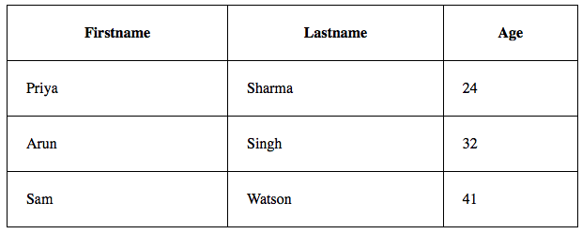
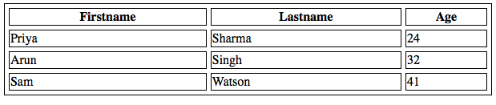
Cell Padding & Cell Spacing
Cell padding specifies the space between the cell content and its borders.
Cell spacing specifies the space between the cells.

Slide 26
Block and Inline Elements
Every HTML element has a default display value, depending on what type of element it is. There are two display values: block and inline.
Block Level Elements: A block-level element always starts on a new line. A block-level element always takes up the full width available (stretches out to the left and right as far as it can).
Two commonly used block elements are: <p> and <div>.
Inline Elements: An inline element does not start on a new line. An inline element only takes up as much width as necessary.
E.g. <span>

Slide 27
HTML FORMS:
An HTML form is used to collect user input. For example, a user wants to buy a bag online, so he/she has to first enter their shipping address in the address form and then add their payment details in the payment form to place an order.
The <form> element is a container for different types of input elements, such as: text fields, checkboxes, radio buttons, submit buttons, etc.
Form elements-
These are the following HTML <form> elements:
<label>: It defines label for <form> elements.
<label for="fname">First name:</label>
<select>: It is used to create a drop-down list. The <option> elements defines an option that can be selected.
<select id="cars" name="cars"> <option value="volvo">Volvo</option> <option value="saab">Saab</option> </select>
By default, the first item in the drop-down list is selected. To define a pre-selected option, add the selected attribute to the option: <option value="fiat" selected>Fiat</option>
Use the size attribute to specify the number of visible values:
<select id="cars" name="cars" size="3">

Slide 28
The <input> Element
The HTML <input> element is the most used form element. It is used to get input data from the form in various types such as text, password, email, etc by changing its type.
<label for="fname">First name:</label><br> <input type="text" id="fname" name="fname"><br>
<label for="pwd">Password:</label><br> <input type="password" id="pwd" name="pwd">
<input type="radio" id="html" name="fav_language" value="HTML"> <label for="html">HTML</label><br>
<input type="checkbox" id="vehicle1" name="vehicle1"> <label for="vehicle1"> I have a bike</label><br>
<input type="submit" value="Submit">
<input type="reset">
<input type="button" onclick="alert('Hello World!’)” value="Click Me!">
Type | Description
<input type="text"> | Displays a single-line text input field
<input type="radio"> | Displays a radio button (for selecting one of many choices)
<input type="checkbox"> | Displays a checkbox (for selecting zero or more of many choices)
<input type="submit"> | Displays a submit button (for submitting the form)
<input type="button"> | Displays a clickable button

Slide 29
<textarea>: It is used to get input long text content.
<textarea name="message" rows="10" cols="30"> The cat was playing in the garden. </textarea>
<fieldset>: It is used to draw a box around other form elements and group the related data.
The <legend> element defines a caption for the <fieldset> element.
<fieldset> <legend>Personalia:</legend> <label for="fname">First name:</label><br> <input type="text" id="fname" name="fname" value="John"><br> <label for="lname">Last name:</label><br> <input type="text" id="lname" name="lname" value="Doe"><br><br> <input type="submit" value="Submit"> </fieldset>
<button>: It defines a clickable button to control other elements or execute a functionality.
<button type="button" onclick="alert('Hello World!')">Click Me!</button>

Slide 30
<datalist>: It is used to specify pre-defined list options for input controls. The <datalist> element specifies a list of pre-defined options for an <input> element.
Users will see a drop-down list of the pre-defined options as they input data. The list attribute of the <input> element, must refer to the id attribute of the <datalist> element.
<input list="browsers"> <datalist id="browsers"> <option value="Internet Explorer"> <option value="Firefox"> <option value="Chrome"> <option value="Opera"> <option value="Safari"> </datalist>

Slide 31
HTML Input Attributes
The value Attribute: The input value attribute specifies an initial value for an input field:
<input type="text" id="fname" name="fname" value="John">
The readonly Attribute: A read-only input field cannot be modified (however, a user can tab to it, highlight it, and copy the text from it).
<input type="text" id="fname" name="fname" value="John" readonly>
The disabled Attribute : The input disabled attribute specifies that an input field should be disabled. A disabled input field is unusable and un-clickable.
<input type="text" id="fname" name="fname" value="John" disabled>
The size Attribute : The input size attribute specifies the visible width, in characters, of an input field. The default value for size is 20.
<input type="text" id="fname" name="fname" size="50">
The maxlength Attribute : The input maxlength attribute specifies the maximum number of characters allowed in an input field.
<input type="text" id="pin" name="pin" maxlength="4" size="4">
The min and max Attributes : The input min and max attributes specify the minimum and maximum values for an input field. The min and max attributes work with the following input types: number, range, date, datetime-local, month, time and week.
<input type="date" id="datemax" name="datemax" max="1979-12-31">
<input type="date" id="datemin" name="datemin" min="2000-01-02">
<input type="number" id="quantity" name="quantity" min="1" max="5">

Slide 32
The multiple Attribute : The input multiple attribute specifies that the user is allowed to enter more than one value in an input field. The multiple attribute works with the following input types: email, and file.
<input type="file" id="files" name="files" multiple>
The placeholder Attribute: The short hint is displayed in the input field before the user enters a value.
<input type="tel" id="phone" name="phone“ placeholder="123-45-678“>
The required Attribute : The input required attribute specifies that an input field must be filled out before submitting the form.
<input type="text" id="username" name="username" required>

Slide 33
HTML Frames and Frameset:
It is used to divide your browser window into multiple sections where each section can load a separate HTML document.
A collection of frames in the browser window is known as frameset.
Syntax-
<frameset>
<frame>
<frame>
</frameset>

Slide 34
Frameset Attribute List :
Attribute | Description | Syntax & Example
rows | used to defines number of rows in the frameset and the size of each rows. | rows="20%,60%,20%"
cols | used to defines number of column in the frameset and the size of each columns. | cols="25%,50%,25%"
border | used to defines border width of frameset. | border="5"
bordercolor | used to set color of border between frames | bordercolor="blue"

Slide 35
Frames Attribute List :
Attribute | Description | Syntax & Example
src | used to give the file or page URL that should be loaded in the frame. | src="page1.html"
name | used to give a name to a frame. It is useful to identify a frame to load a document using link’s target. | name="left-frame"
noresize | used to disable frame window resize | noresize="noresize"
marginwidth | Specify the width of space between left & right of frame’s border & its content. | marginwidth=“10”
marginheight | Specify the width of space between top & bottom of frame’s border & its content. | marginheight=“10”
scrolling | Controls the appearance of scrollbars that appears on the frame. Values: yes, no, auto | Scrolling = “no”

Slide 36
HTML <meta> Tag:
The metadata means information about data. It specifies page description, keyword, copyright, language, author of document, etc.
The metadata doesn’t display on the webpage, but it is used by search engines browser and other web services which scan the site or webpage to know about it.
This tag is an empty element because it only has an opening tag and no closing tag, but it carries information within its attribute.
The <meta> tag is placed within the <head> tag, and it can be used more than one times in a document.
Syntax- <meta attribute-name =“value”>
Following are some specific syntax of meta tags which shows the different use of meta tags:
<meta charset = “utf-8”> : It defines the character encoding. This value means it will support to display ay language.
<meta name = “keyword” content = “HTML, CSS, JavaScript”> : It specifies list of keyword used by search engines.

Slide 37
Character Entities:
A set of characters used to represent few characters reserved by HTML, especially invisible characters or characters difficult to type out using a regular keyboard.
HTML provides some entity names & entity numbers to use these symbols.
Syntax-
&entity_name;
OR
&#entity_number;
If you use less than(<) or greater than(>) signs in your text, browser might mix them with tags.
Some useful symbols with their entity name & numbers are:
Less than (<): &lt | &#60
Non-breaking space: &nbsp | &#160
Greater than(>): &gt | &#62
Ampersand(&): &amp| &#38
Double Quotation mark(“): &quot | &#34
Single Quotation mark(‘) : &apos | &#39

Slide 38
XHTML
XHTML = HTML + XML
XHTML ( EXtensible HyperText Markup Language), developed by World Wide Consortium (W3C) in 2000, is the more extended version of the popular HTML. It is the same HTML but defined as an XML application, which combines the advantages of both HTML and XML.
XHTML retains all the features of HTML but introduced more strict rules for creating pages, which allows you to make sites independent of the display device and browser. It means that the site will be correctly displayed in all modern browsers and platforms like computers, smartphones, PDAs, etc.
Benefits of XHTML
The fact that in XHTML all tags must be closed and nested correctly makes the code look much cleaner.
XHTML uses less bandwidth, which reduces cost especially if your site has thousands of pages.
Thanks to being well-formed, XHTML documents are easily transported to wireless devices, Braille readers and other specialized web environments.
XHTML works with CSS to create web pages easily.

Slide 39
XHTML SYNTAX
All documents must have a DOCTYPE.
All tags must be in lower case.
All tags must be closed. Eg. <img src =“ “ alt =“ “/>
All documents must be properly formed.
All attributes must be added properly.
Attributes cannot be shortened. Eg. <option selected = “ selected”>
All tags must be properly nested.
Attributes values must be quoted.

Slide 40
DIFFERENCE BETWEEN HTML & XHTML
HTML | XHTML
HTML stands for Hypertext Markup Language. | XHTML stands for Extensible Hypertext Markup Language.
It was developed by Tim Berners-Lee. | It was developed by W3C i.e World Wide Web Consortium.
It was developed in 1991. | It was released in 2000.
It is extended from SGML. | It is extended from XML and HTML.
All tags and attributes are not necessarily to be in lower or upper case. | In this, every tag and attribute should be in lower case.
Doctype is not necessary to write at the top. | Doctype is very necessary to write at the top of the file.
It is not necessary to close the tags in the order they are opened. | It is necessary to close the tags in the order they are opened.
While using the attributes it is not necessary to mention quotes. For e.g. <Geeks>. | While using the attributes it is mandatory to mention quotes. For e.g. <Geeks=”GFG”>.
Filename extension used are .html, .htm. | Filename extension are .xhtml, .xht, .xml.
Lewd structure is used in HTML | It contains a very strict structure.

