Slide 1
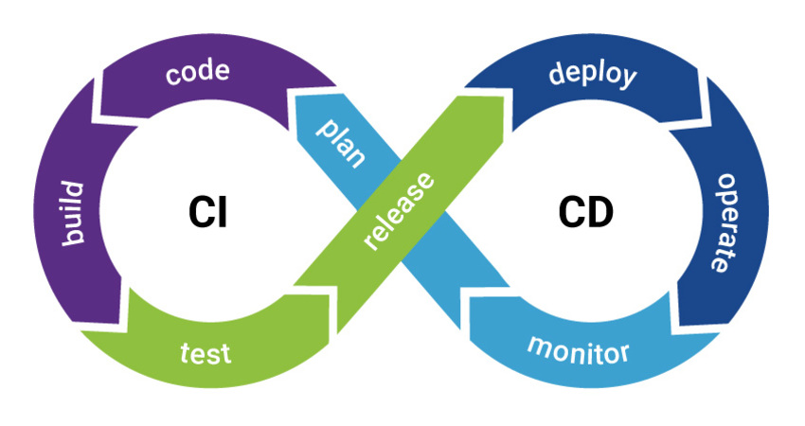
CI/CD - A Revolutionary Tool for Delivery
By Gaurav Singh Verma

Slide 2






Current Challenges of Deployment Life Cycle
 | Merging/ compiling and identifying errors are time consuming task, which takes developer time |  | Manually creation of infrastructure leads to human errors and configuration failures
 | Manual unit testing is sometimes time consuming and prone to vulnerability |  | Manual Post implementation checks are not affective as the down time is increased due to that
 | Manual Deployment is a time consuming task which means more time to market new features |  | Response time is low while doing rollback if any bug is found in post implementation checks

Slide 3
Why do we need CI/CD?
Effects of the Current Challenges
Delays in development life cycle.
Unit testing are sometimes ignored due to development delays.
Deployment challenges, as the operations implementation team might not have thorough knowledge of the application.
Infrastructure changes and configuration issues between the non-production and production environment.
Manual post implementation checks/ status takes time for a huge application.
Errors/ delays in rollback if the implementation team faces issues.

Slide 4
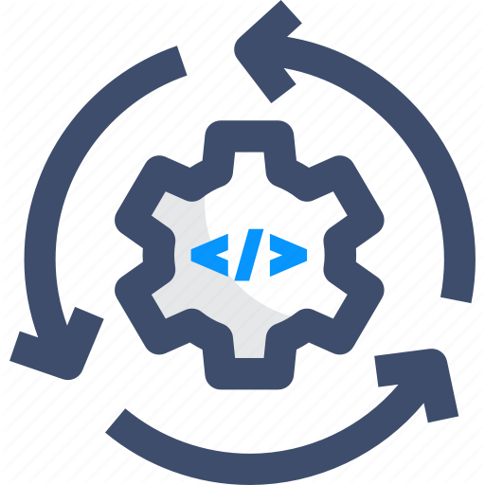


Continuous Integration/Continuous Deployment approach
 | Continuous Integration (CI): is a process of automatic merging and compiling of code whenever a code is checked-out by multiple developers. We can also automate and configure unit testing
 | Continuous Deployment (CD): is an automated process of deploying the code to production with some automated steps for configurations and deployment
 | CI/ CD approach: focuses on software-development and delivery life cycles underlining tools that emphasize automation

Slide 5
CI/CD Benefits
Automated integration means less time to develop and no issues from developer codes
Bugs/ issues can be avoid in production as we use automated unit testing
Less time to market, as the deployment time gets reduced due to automated steps for deployment.
Infrastructure creation/ configuration automation helps in Zero issues and no configuration drift.
Down time gets reduced and early detection of issues while automated smoke testing is in place
This approach can quickly redo all the changes and the infrastructure is back to its original state without affecting the users

