Slide 1
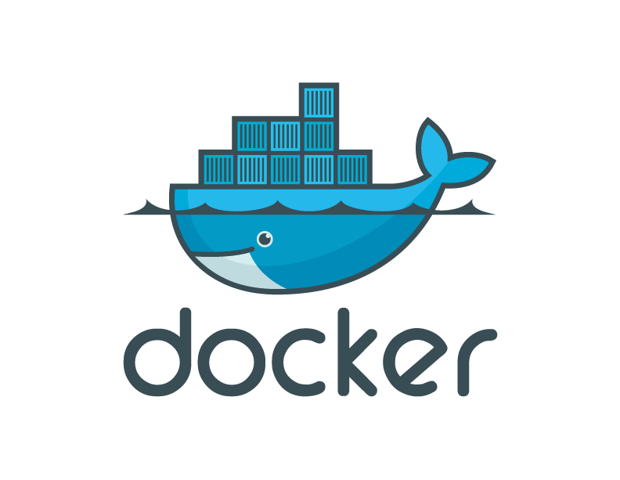
Docker, Containers, and the Future of Application Delivery

Slide 2
What is Docker
A Linux-only virtual environment (VE) tool, not a Virtual Machine (VM)
Informally like a light weight Virtual Machine
Provides container based isolated virtual environments
Natively supports Linux but provides Docker Toolbox to support other OS also like Windows, Mac etc.
Provides repository for images https://hub.docker.com/
Light-weight, resource efficient and cost effective
Easily portable and provides consistent environment

Slide 3
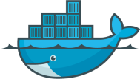
Contents
The challenge
The solution
Why Docker and Containers Matter?
How They Work?
Alternative/Complementary Approaches

Slide 4

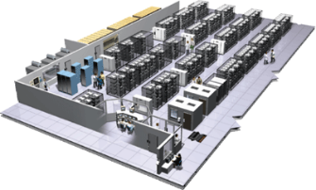
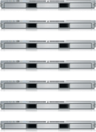
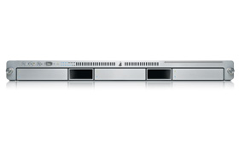
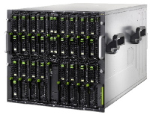

The Challenge
User DB
Static website
postgresql + pgv8 + v8
Queue
Analytics DB
nginx 1.5 + modsecurity + openssl + bootstrap 2
Do services and apps interact appropriately?
Redis + redis-sentinel
hadoop + hive + thrift + OpenJDK
Multiplicity of Stacks
Background workers
Web frontend
Python 3.0 + celery + pyredis + libcurl + ffmpeg + libopencv + nodejs + phantomjs
Ruby + Rails + sass + Unicorn
API endpoint
Python 2.7 + Flask + pyredis + celery + psycopg + postgresql-client
Production Cluster
Development VM
Public Cloud
Multiplicity of hardware environments
QA server
Can I migrate smoothly and quickly?
Disaster recovery
Customer Data Center
Contributor’s laptop
Production Servers

Slide 5
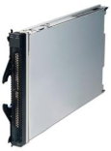
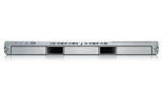
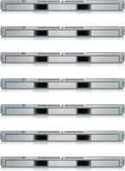

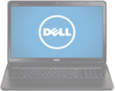
Results in N X N compatibility nightmare
? | ? | ? | ? | ? | ? | ?
? | ? | ? | ? | ? | ? | ?
? | ? | ? | ? | ? | ? | ?
? | ? | ? | ? | ? | ? | ?
? | ? | ? | ? | ? | ? | ?
? | ? | ? | ? | ? | ? | ?
Static website
Web frontend
Background workers
User DB
Analytics DB
Queue
 | Development VM | QA Server | Single Prod Server | Onsite Cluster | Public Cloud | Contributor’s laptop | Customer Servers

Slide 6
A real life analogy…

Slide 7
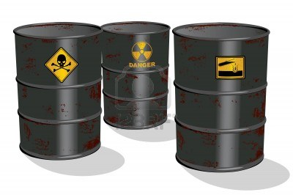
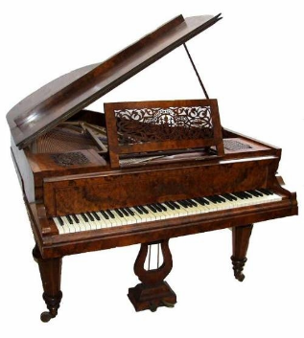

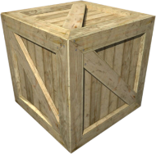
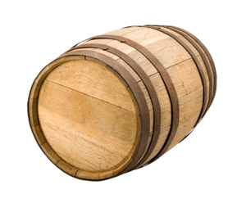
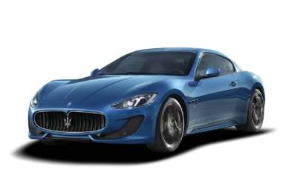
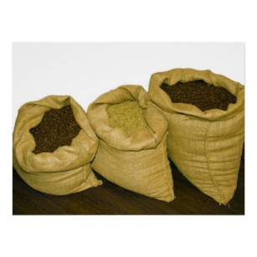



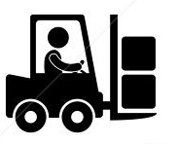
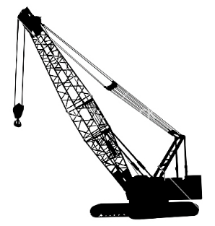
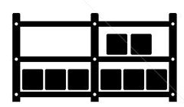

Cargo Transport Pre-1960
Do I worry about how goods interact (e.g. coffee beans next to spices)
Multiplicity of Goods
Multipilicity of methods for transporting/storing
Can I transport quickly and smoothly
(e.g. from boat to train to truck)

Slide 8
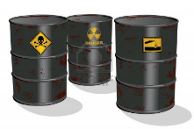

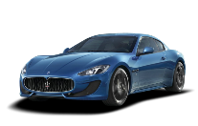


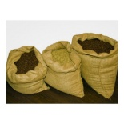


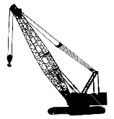



NxN Matrix
 | ? | ? | ? | ? | ? | ? | ?
 | ? | ? | ? | ? | ? | ? | ?
 | ? | ? | ? | ? | ? | ? | ?
 | ? | ? | ? | ? | ? | ? | ?
 | ? | ? | ? | ? | ? | ? | ?
 | ? | ? | ? | ? | ? | ? | ?

Slide 9
Contents
The challenge
The solution
Why Docker and Containers Matter?
How They Work?
Alternative/Complementary Approaches

Slide 10

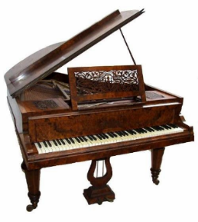

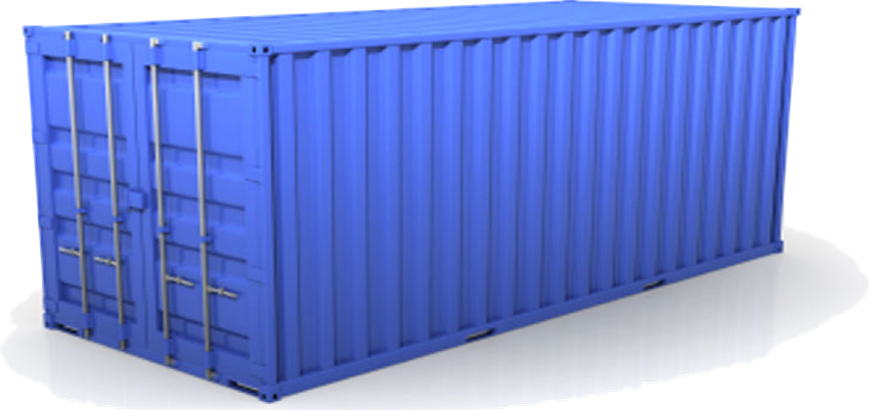
Solution: Intermodal Shipping Container
Do I worry about how goods interact (e.g. coffee beans next to spices)
Multiplicity of Goods
A standard container that is loaded with virtually any goods, and stays sealed until it reaches final delivery.
…in between, can be loaded and unloaded, stacked, transported efficiently over long distances, and transferred from one mode of transport to another
Can I transport quickly and smoothly
(e.g. from boat to train to truck)
Multiplicity of methods for transporting/storing

Slide 11


This eliminated the NXN problem…

Slide 12
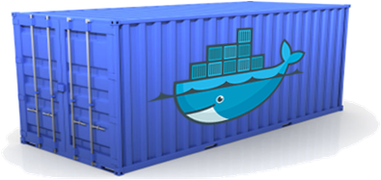
Docker is a shipping container system for code
Static website
User DB
Web frontend
Queue
Analytics DB
Do services and apps interact appropriately?
Multiplicity of Stacks
An engine that enables any payload to be encapsulated as a lightweight, portable, self-sufficient container…
…that can be manipulated using standard operations and run consistently on virtually any hardware platform
Multiplicity of hardware environments
Can I migrate smoothly and quickly
Development VM
QA server
Customer Data Center
Public Cloud
Production Cluster
Contributor’s laptop

Slide 13

Docker solves the NXN problem
Static website
Web frontend
Background workers
User DB
Analytics DB
Queue
 | Development VM | QA Server | Single Prod Server | Onsite Cluster | Public Cloud | Contributor’s laptop | Customer Servers

Slide 14
Contents
The challenge
The solution
Why Docker and Containers Matter?
How They Work?
Alternative/Complementary Approaches

Slide 15
Why containers matter
 | Physical Containers | Docker
Content Agnostic | The same container can hold almost any type of cargo | Can encapsulate any payload and its dependencies
Hardware Agnostic | Standard shape and interface allow same container to move from ship to train to semi-truck to warehouse to crane without being modified or opened | Using operating system primitives (e.g. LXC) can run consistently on virtually any hardware—VMs, bare metal, openstack, public IAAS, etc.—without modification
Content Isolation and Interaction | No worry about anvils crushing bananas. Containers can be stacked and shipped together | Resource, network, and content isolation. Avoids dependency hell
Automation | Standard interfaces make it easy to automate loading, unloading, moving, etc. | Standard operations to run, start, stop, commit, search, etc. Perfect for devops: CI, CD, autoscaling, hybrid clouds
Highly efficient | No opening or modification, quick to move between waypoints | Lightweight, virtually no perf or start-up penalty, quick to move and manipulate
Separation of duties | Shipper worries about inside of box, carrier worries about outside of box | Developer worries about code. Ops worries about infrastructure.

Slide 16
Contents
The challenge
The solution
Why Docker and Containers Matter?
How It Works
Alternative/Complementary Approaches

Slide 17
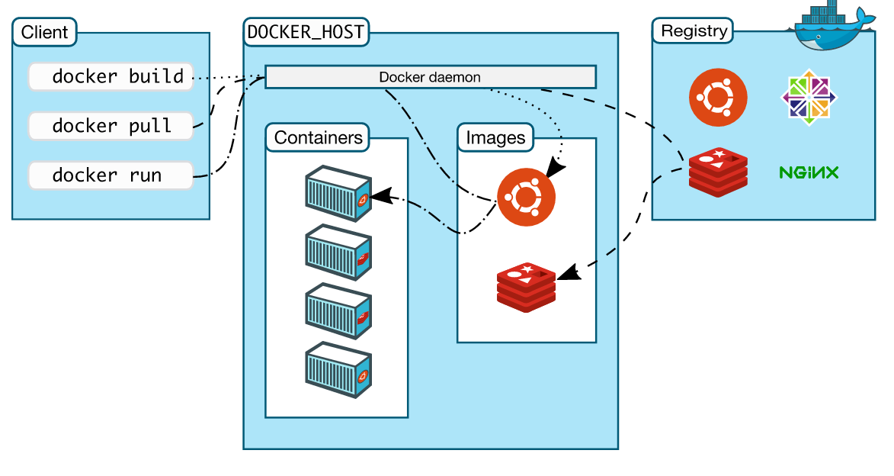
Docker Architecture

Slide 18
Docker sub-system
dockerfile - script containing instruction to assemble an image
Images – a read-only template with instructions for creating a Docker container
Containers - a runnable instance of a Docker image
Daemon - Docker service running on host, manages lifecycle of containers
Client - command line interface (CLI) that accepts the commands passes to Docker daemon
Registry - a library of images, can be public or private.

Slide 19
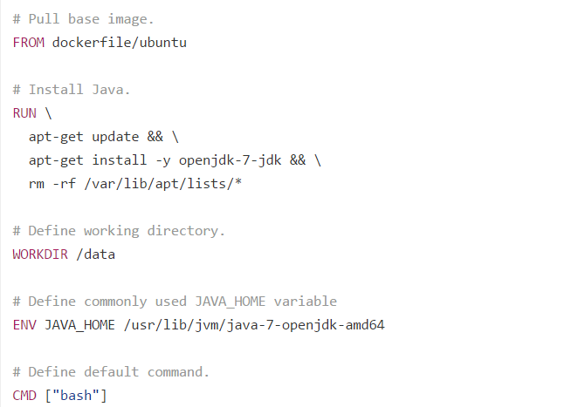
Sample dockerfile – openjdk 7

Slide 20
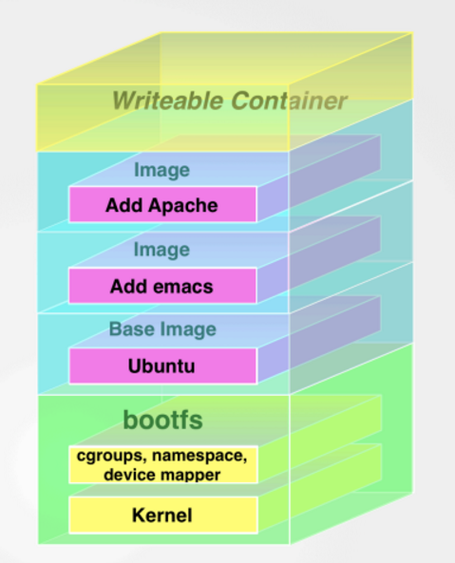
Layer based Image creation - UFS (union file system)

Slide 21
Container life cycle
– Conception
• BUILD an Image from a Dockerfile
– Birth
• RUN (create+start) a container
– Reproduction
• COMMIT (persist) a container to a new image
• RUN a new container from an image
– Sleep
• KILL a running container
– Wake
• START a stopped container
– Death
• RM (delete) a stopped container
– Extinction
• RMI a container image(delete image)

Slide 22
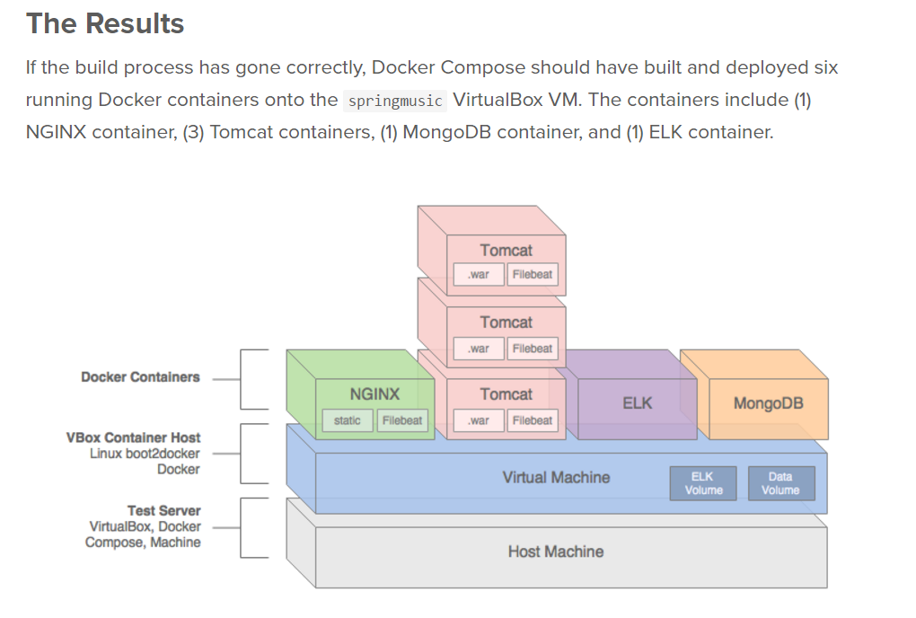
Multi service/container application

Slide 23
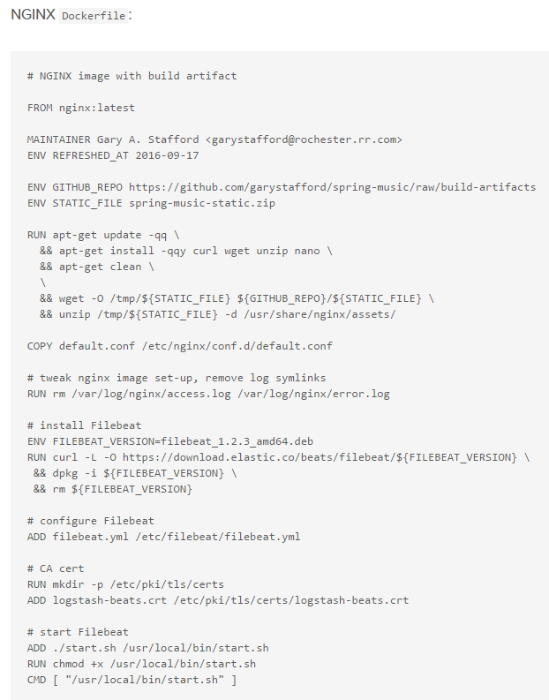
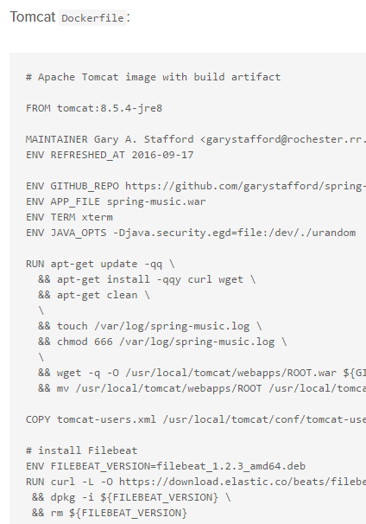
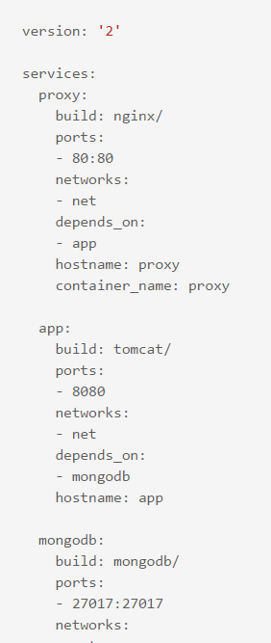
Docker Compose

Slide 24
Why are Docker containers lightweight?
App
A
App
A’
App
B
Containers are isolated,
but share OS and, where
appropriate, bins/libraries
Bins/
Libs
Bins/
Libs
Bins/
Libs
VM
Guest
OS
Guest
OS
Guest
OS
Guest
OS
Guest
OS
App A
App A’
App B
App B’
App B’
App B’
Container
Docker
Hypervisor (Type 2)
Bins/Libs
Bins/Libs
Host OS
Host OS
Server
Server

Slide 25
Containers vs VMs
VMs
Containers
App
A
App
A
App
A’
App
A
App
A
App Δ
Bins/
Libs
Bins/
Libs
Bins/
Libs
Bins/
Libs
Bins/
Guest
OS
Guest
OS
Guest
OS
Guest
OS
Original App
(No OS to take
up space, resources,
or require restart)
Copy of
App
No OS. Can
Share bins/libs
Modified App
Union file system allows
us to only save the diffs
Between container A and container
A’
VMs
Every app, every copy of an
app, and every slight modification
of the app requires a new virtual server

Slide 26
Change Management
Docker
Container
Image Registry
App
A
Push
App Δ
Bins/
Libs
Bins/
Base
Container
Image
Container Mod A’
Container Mod A’’
App Δ
Update
App
A
Bins/
App
A’’
Bins/
Libs
Bins/
Libs
Bins/
Docker Engine
Docker Engine
Host is now running A’’
Host running A wants to upgrade to A’’. Requests update. Gets only diffs

Slide 27
Underlying Technology
Docker is written in GO programming language
Control groups (cgroups) - allow Docker Engine to share available hardware resources to containers and optionally enforce limits and constraints
Built on top of LinuX Containers (LxC)
UFS (union file system) for building Docker images
Natively works on Linux

Slide 28
Why Developers Care
Build once…run anywhere
A clean, safe, hygienic and portable runtime environment for your app.
No worries about missing dependencies, packages and other pain points during subsequent deployments.
Run each app in its own isolated container, so you can run various versions of libraries and other dependencies for each app without worrying
Automate testing, integration, packaging…anything you can script
Reduce/eliminate concerns about compatibility on different platforms, either your own or your customers.
Cheap, zero-penalty containers to deploy services? A VM without the overhead of a VM? Instant replay and reset of image snapshots? That’s the power of Docker

Slide 29
Why Devops Cares?
Configure once…run anything
Make the entire lifecycle more efficient, consistent, and repeatable
Eliminate inconsistencies between development, test, production, and customer environments
All containers start, stop, copy etc. the same way.
Significantly improves the speed and reliability of continuous deployment and continuous integration systems
Because the containers are so lightweight, address significant performance, costs, deployment, and portability issues normally associated with VMs

Slide 30
CI with Docker
Solution already available with tools like Jenkins to have CI working with Docker
This can we achieve with all the tool/sub-system of CI ecosystem running in a separate container.
This can be configured in Docker compose file and all containers can be started at the same time.

Slide 31
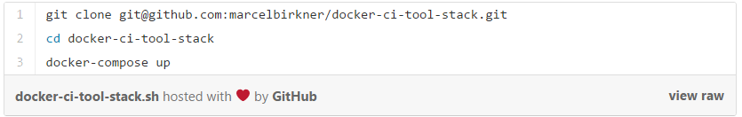
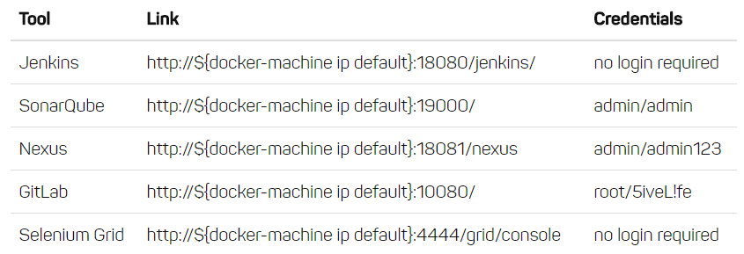
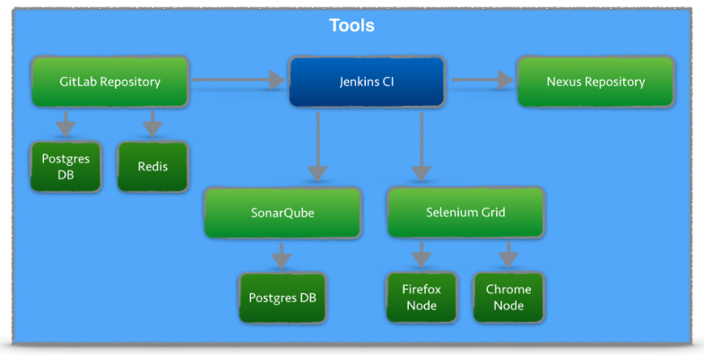
CI with Docker…continue

Slide 32
www.docker.com

