Slide 1

LOAN
ANALYSIS

Slide 2
Brief about DATASET
It contains 25 columns and 30,000 rows.
There are no NA values in the dataset.
Default Payment is our dependent variable, which consist of 2 variables 1 and 0, which describes s/he will pay the loan and s/he will not pay the loan.
The rest columns contain their data like previous payments, gender, qualification, and their credit amount.

Slide 3
STEPS
CHANGING THE COLUMNS TO FACTOR, WHICH CONTAINS FACTOR ELEMENTS.
CHEKING THE BIASNESS IN THE DEPENDENT VARIABLE.
CHANGING GENDER COLUMN ELEMENTS TO THE RELEVANT VALUE
1 STANDS FOR MALE AND 2 STANDS FOR FEMALE.
CHANGING QUALIFICATION COLUMN ELEMENT TO RELEVANT VALUES AS GIVEN
IN THE DESCRIPTION FILE.
VISUALIZING THE DATA.
RANDOMLY SHUFFLING DATA.
REMOVING INSIGNIFICANT COLUMNS
SUBESTTING THE DATASET INTO TEST AND TRAIN DATASET.
APPLYING THE MACHINE LEARNING ALGORITHM TO FIND THE BEST MODEL.

Slide 4
Changing columns to factor
"Gender",
"Academic_Qualification",
"Marital",
"Repayment_Status_Jan“
"Repayment_Status_Feb",
"Repayment_Status_March",
"Repayment_Status_April",
"Repayment_Status_May",
"Repayment_Status_June",
"Default_Payment"
These are columns that are needed to be changed

Slide 5
Changing elements of columns
IN QUALIFICATION COLUMN:
1=UNDERGRADUATE
2=GRADUATE
3=POSTGRADUATE
4=PROFESSIONAL
5=OTHER
6=UKNOWN
IN GENDER COLUMN:
1=MALE
2=FEMALE

Slide 6
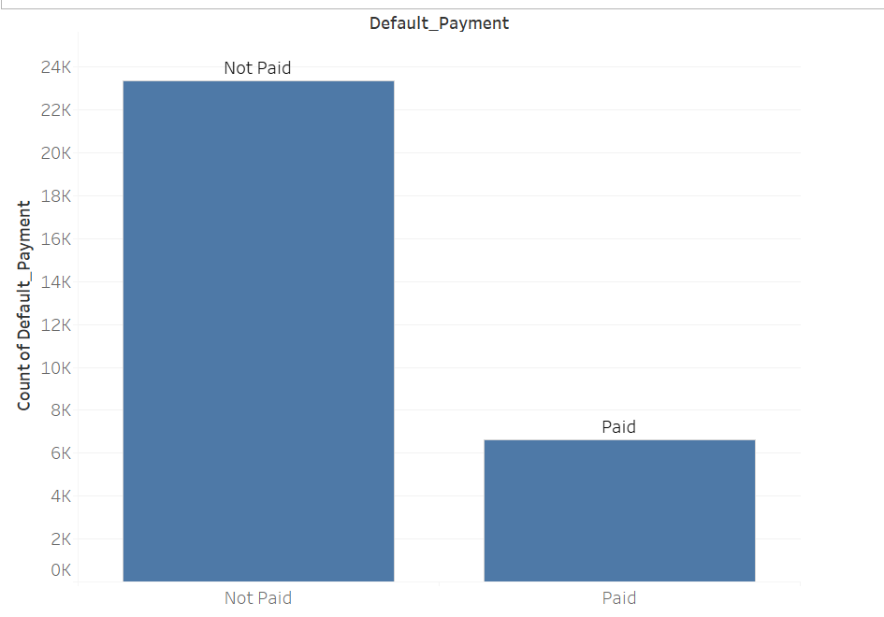
CHECKING THE BIASNESS
0 (Not Paid) IS OCCURING 23364 TIMES IN THE DATASET WHILE 1(Paid) IS OCCURING ONLY 6636 TIMES, CLARLY THERE IS CLASS BIASNESS IN THE MODEL.
23364
6636

Slide 7
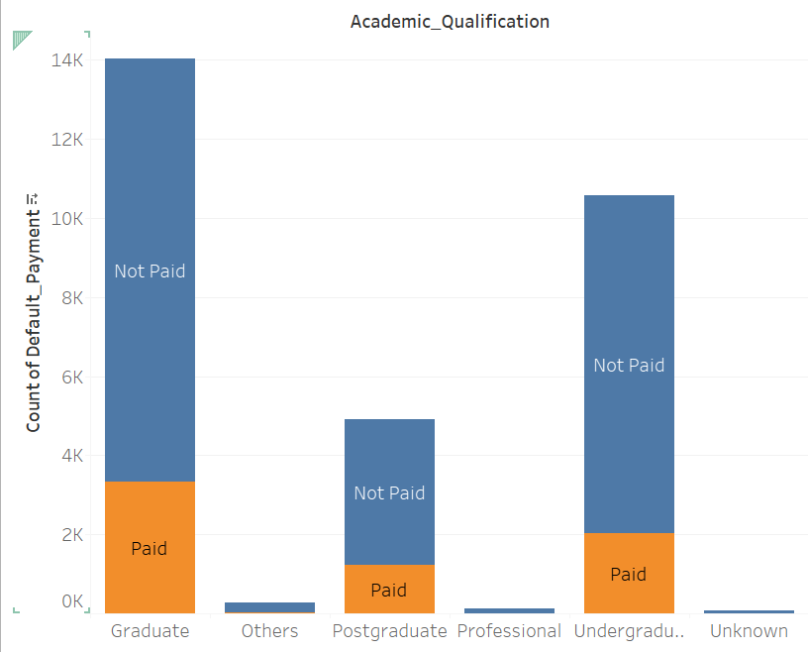
MOSTLY GRADUATE, POSTGRADUATE AND UNDERGRADUATE PERSONS FAILED TO PAY UP THE LOAN.

Slide 8
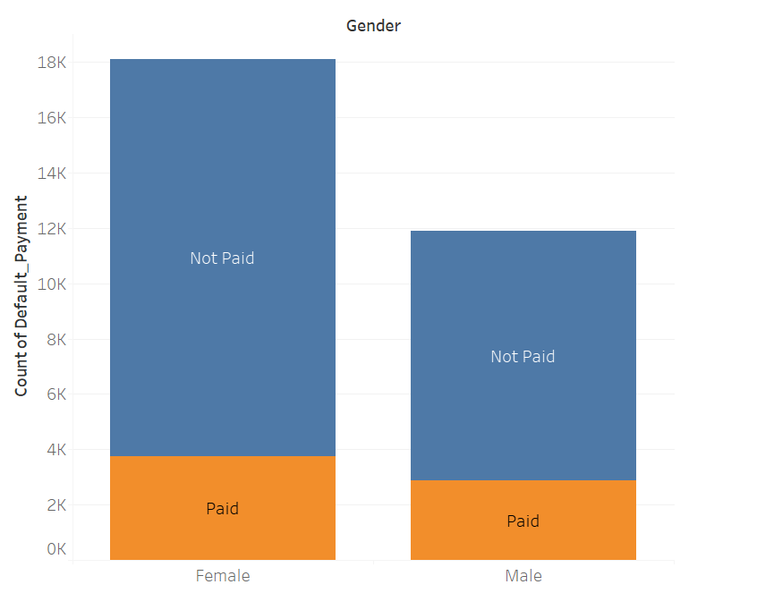
CLEARLY THERE ARE MORE FEMALES WHO FAILED TO PAY THE LOAN.

Slide 9
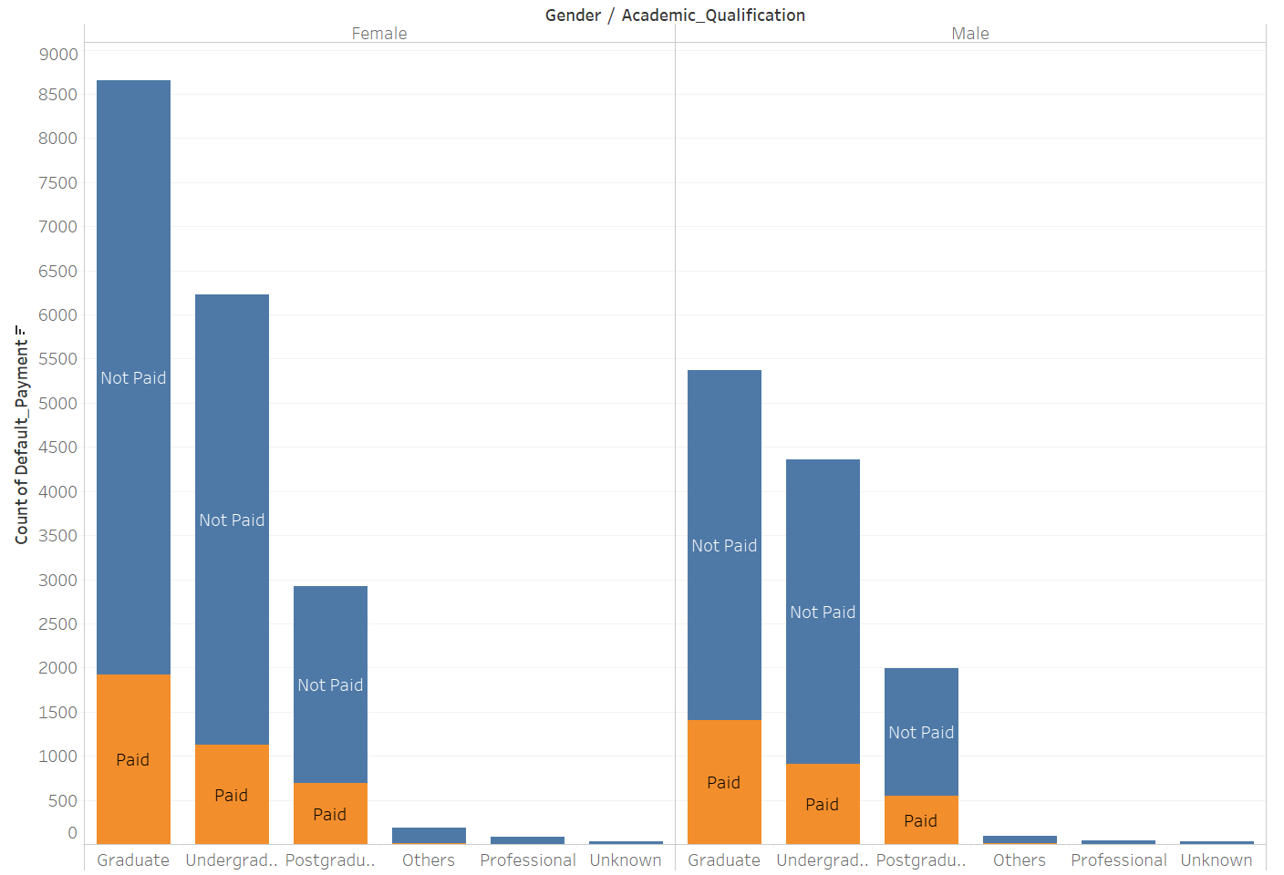

Slide 10
RANDOMLY SHUFFLING DATA TO AVOID Biasness
Sub setting into training and test data set
Training data contains 70% of actual dataset.
Test data contains the 30% of actual dataset.

Slide 11
APPLYING ALGORITHMS
USING LOGISTIC REGRESSION:
ACCURACY OF THE MODEL: 0.8255
USING SVM:
ACCURACY OF THE MODEL:0.8375

