Slide 1


Social Bee
Unleash Your Network

Slide 2
What is SocialBee
Chrome Extension
Like Rapportive
Better

Slide 3
The Problem
Know more about your contacts
Right inside Gmail
Rapportive and other similar solutions only provide information about the contact
We can do More

Slide 4


Leverage your network
Founder
Connections ??
Employee

Slide 5
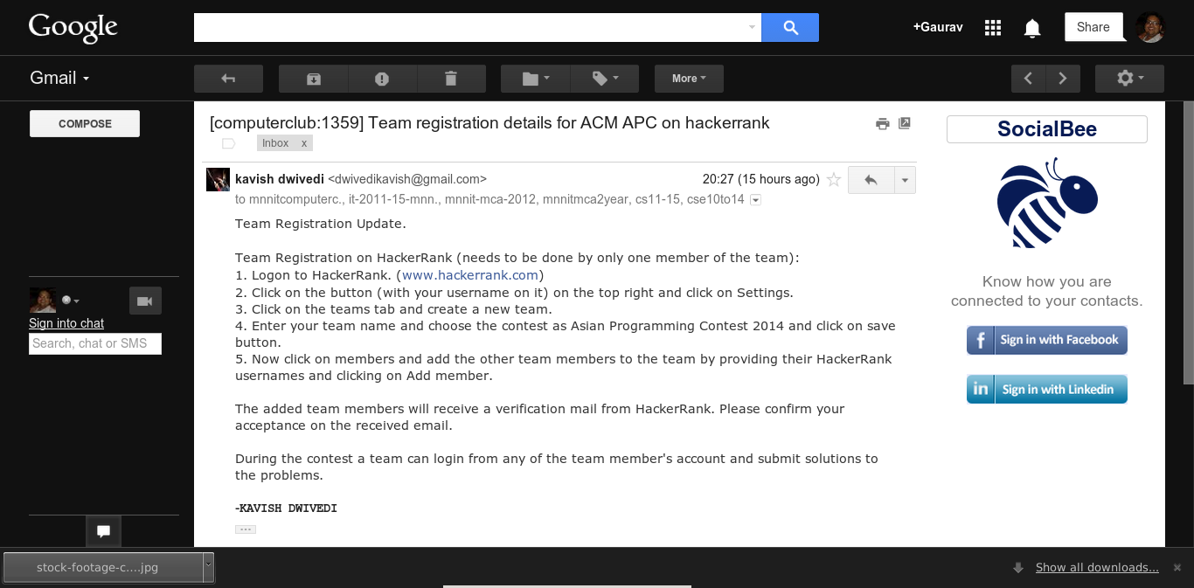
Install SocialBee

Slide 6
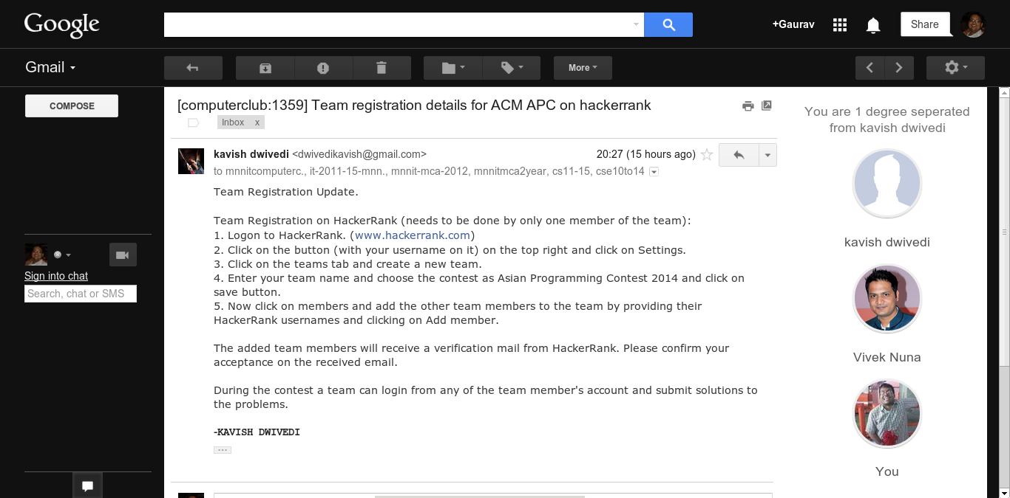
Explore your Network

Slide 7
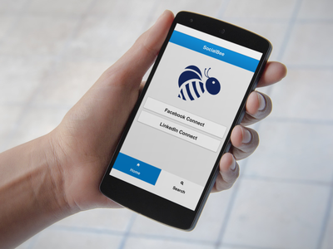
SocialBee on your Phone

Slide 8

Search for People

Slide 9

Explore!

Slide 10
DEMO

Slide 11
Thank You !
Code available at
github.com/gauravtiwari5050/socialbee

