Slide 1
Statistical Foundation for Machine Learning
Daily Retail Demand Forecasting
with Emphasis on Calendric Special Days
Research Paper Implementation Project
Huber & Stuckenschmidt (2020) · International Journal of Forecasting
Presented by: Gaurav Tiwari
Student ID:
2023UEE0134
Dataset:
Rossmann Store Sales
Platform:
Kaggle (GPU: Tesla T4)
844K
1,115
Training Rows
Stores
Rossmann Store Sales Dataset · April 2026

Slide 2
Paper Overview & Research Targets
Huber & Stuckenschmidt (2020) · Int'l Journal of Forecasting 36(4)
Core Problem: How do we accurately forecast retail demand on SPECIAL DAYS — holidays, day-before, day-after — when standard models fail completely?
RQ 1
Can ML methods outperform established statistical baselines for retail demand forecasting?
RQ 3
Does converting forecasting from regression → classification improve accuracy?
RQ 2
Which method is most suitable for forecasting demand on special days (holidays)?
RQ 4
How often must ML models be retrained to maintain accuracy over time?
KEY CONTRIBUTIONS OF THE PAPER
SD Classification System
SD0 – SD4 taxonomy for 5 day types with precedence rules
8 SD-Specific Features
Historical level, absolute & relative change per special day
Regression → Classification
Convert forecasting into 104-class problem for density output
CL(median) Decoding
Median of predicted distribution minimises MAE — not mode
Implemented on Rossmann Store Sales (public Kaggle dataset) — closest publicly available proxy to the paper's private bakery dataset

Slide 3
Dataset: Rossmann Store Sales vs Paper's Bakery Data
EDA & Setup
Property | Paper (Bakery Chain) | Our Implementation (Rossmann)
Stores | 141 | 1,115
Time Series | 1,128 (store × category) | 1,115 (store level)
Training Period | Oct 2014 – Jan 2017 (27 months) | Jan 2013 – Mar 2015 (27 months)
Test Period | Feb – Jun 2017 (5 months) | Apr – Jun 2015 (3 months)
Total Rows (train) | 677,963 | 717,307
SD1 in Test Set | 7.29% (stores open on holidays) | 0.6% (most stores CLOSED on holidays)
Product Categories | 8 (buns, bread, cakes, etc.) | Total sales only — no category split
Holiday Calendar | Baden-Württemberg (single region) | BW calendar applied — national stores
SD TYPE DISTRIBUTION (OUR TEST SET)
⚠ KEY DIFFERENCE TO PAPER
SD0 Regular
82.4% (91,776 rows)
SD1 is only 0.6% in our test set because most Rossmann stores CLOSE on German public holidays — creating very sparse holiday evaluation. The paper's bakery keeps most stores open, giving 7.29% SD1 rows. This explains why our SD1 results show higher variance. Our German holiday calendar was computed from scratch using the Easter algorithm — NOT from Rossmann's StateHoliday column.
SD1 Holiday
0.6% (630 rows)
SD2 Day Before
6.0% (6,688 rows)
SD3 Day After
5.0% (5,574 rows)
SD4 Week After
6.1% (6,753 rows)
Filtering: Removed Open=0 and Sales=0 rows (closed stores) | Test period contains Easter, Ascension, Whit Monday, Labour Day

Slide 4
Project Pipeline Architecture
End-to-End Flow: Data → Models → Evaluation
1. Raw Data
Load
2. Day
Classifier
3. Feature
Engineering
4. Pre-
processing
5. 10-Fold
CV
train.csv
store.csv
844K rows
SD0–SD4
German Calendar
Easter Algorithm
42 features
8 SD-specific
Lag, calendar
Log transform
±0.5 scaling
104 bins
Stratified by
SD type
80/20 split
MODELS (trained globally on all 1,115 stores)
S-Naive
S-Median
LASSO
LIN-REG
LightGBM
GBRT
MLP
REG/CL
LSTM
REG/CL
baselines.py
linreg.py
lgbm_model.py
mlp_model.py
lstm_model.py
EVALUATION · MAE & MASE · Reported separately per SD type (SD0–SD4)
MAE
MASE
Heatmap
Saved Models
Mean absolute error
Per SD type
Raw scale (units)
Scaled by S-Naive
SD0 denominator
Comparable across stores
All models × SD types
Visual summary
Green=better
lgbm_model.pkl
10× MLP .keras
10× LSTM .keras
config.py → data_loader.py → day_classifier.py → feature_engineering.py → preprocessing.py → [models] → evaluation.py → visualisation.py

Slide 5
Feature Engineering — 42 Features Across 6 Groups
EDA
Group 1: Lag Features (7)
Group 2: Rolling Features (2)
▸ Sales_lag_2 to Sales_lag_7 (daily lags)
▸ Sales_rolling_median — same weekday, 4-week median
▸ Sales_lag_14 (2-week look-back)
▸ Sales_rolling_std — standard deviation
▸ Lag 1 EXCLUDED — unavailable at planning time
Group 3: Calendar Features (15)
Group 4: Store Features (5)
▸ DayOfWeek, Month, DayOfMonth, WeekOfYear, Year
▸ StoreType_enc, Assortment_enc, Promo2
▸ IsWeekend, SchoolHoliday, Promo, IsStateHoliday
▸ CompetitionDistance_log, Store_enc (norm. 0–1)
▸ sin/cos cyclical encoding for DOW, Month, WOY
Group 5: SD Type Flags (5)
Group 6: SD-Specific Features (8) ★ PAPER's CORE
▸ sd_type (0-4), IsSD1, IsSD2, IsSD3, IsSD4
▸ sd_level (rolling median baseline)
▸ sd_abs_change (units vs baseline)
▸ sd_rel_change (% vs baseline)
▸ sd_rel_change_storetype (pooled over store class)
▸ × 2: public holidays vs other special events
TOTAL: 42 features · All scalers fitted on TRAINING DATA ONLY · Test set only transformed (no leakage)
SD Feature Formula for Test Period:
value₂₀₁₅ = (1×obs₂₀₁₃ + 2×obs₂₀₁₄) ÷ 3 [weighted rolling mean, recent year = weight 2]

Slide 6
Preprocessing Pipeline
EDA — Transforms applied before any model training
01
02
03
04
05
Log Transform
MinMax Scale
[−0.5, 0.5]
104 Bins
(Classification)
Standard Scale
(Features)
10-Fold
Stratified CV
y = log(Sales + 1)
Right-skewed → symmetric
+1 avoids log(0)
Not applied to LightGBM
Applied after log
LeCun et al. (2012)
Optimal for backprop
Fitted on train only
Percentile-based
+extra splits >10% jump
Bin midpoint = class value
Paper uses 124 bins
μ=0, σ=1 per column
Equal gradient weights
For continuous features
Store_enc → [0,1]
Stratified by SD type
Ensures SD1 in every fold
80% train / 20% val
Time-respecting split
Why log transform?
Why [−0.5, 0.5] and not [0, 1]?
Raw sales are right-skewed (0–300 normal, 2000+ on holidays). Neural net gradients proportional to error magnitude — without log, rare large holiday values dominate training. Log compresses the scale so all observations contribute equally.
LeCun et al. (2012) showed analytically that inputs in [−0.5, 0.5] keep activations in the linear region of sigmoid/tanh, preventing gradient saturation. This specific range recommended for backpropagation efficiency.
Why 104 bins (not 124)?
Why stratify CV by SD type?
Paper gets 124 bins on bakery data (higher variance). Rossmann sales distribution is less spread — percentile algorithm produced 104 distinct boundary points after applying the >10% relative increase rule.
SD1 is only 0.6–2% of data. Random splits might put zero SD1 rows in a validation fold — making it impossible to evaluate special day performance. Stratification guarantees each fold has proportional SD representation.

Slide 7
Baseline Models & Why We Did Not Use ARIMA / ETS
Establishing the Benchmark Floor
S-Naive
S-Naive-Std
S-Median
ŷₜ = yₜ₋₇
ŷₜ = yₜ₋₇ (SD1/2/3 replaced with last SD0)
ŷₜ = median{yₜ₋₇, yₜ₋₁₄, yₜ₋₂₁, yₜ₋₂₈}
Predict today = same weekday exactly 7 days ago. Industry standard in bakeries. Fatal flaw: if lag-7 is a holiday, you predict holiday sales for a normal day (SD4 contamination).
Same as S-Naive but history-cleaned: holiday observations replaced with last regular-day value before the holiday. Fixes SD4 contamination problem.
Median of same weekday over 4 weeks. Median chosen because it minimises MAE: argmin_c E[|Y−c|] = median(Y). Robust to 1 holiday outlier in window.
MASE: 0.949
MAE: 2,100
MASE: 0.644
MAE: 1,425
MASE: 0.565
MAE: 1,249
WHY WE DID NOT USE ARIMA / ETS (mentioned in the paper)
✗ ARIMA / ARIMAX
✗ ETS (Exponential Smoothing)
Univariate only — cannot incorporate SD-specific features (level, rel_change, store_class) that are critical for holiday prediction. Per-store fitting of 1,115 ARIMA models with holiday adjustments is operationally infeasible.
The paper evaluates ETS with post-processing adjustments. Best ETS variant (pct-cl) requires manual holiday adjustment rules. Our ML models make this obsolete by learning adjustments from data automatically.
✗ Prophet (Facebook)
✗ SVR (Support Vector Regression)
Designed for single time series — cannot pool across 1,115 stores simultaneously. Loses the global model advantage where 100 Easter observations across stores improves holiday forecasting.
Scales as O(n² − n³) with dataset size. Infeasible for 800K rows. Cannot handle tabular data with 42 features at this scale.

Slide 8
LASSO Linear Regression
Model 1 of 4 · Per-Store Global Model · linreg.py
Mathematical Foundation
Why LASSO and not Ridge?
Model:
Ridge (L2) shrinks weights toward zero but never makes them exactly zero. With 42 features across 1,115 stores, many features are irrelevant per store. LASSO's exact zeros give automatic feature selection — a store with no competition gets CompetitionDistance=0.
ŷ = β₀ + β₁x₁ + β₂x₂ + ... + β₄₂x₄₂
Loss Function (LASSO):
L = (1/n)Σ(yᵢ − βᵀxᵢ)² + λΣ|βⱼ|
MSE term (fit data) + L1 penalty (sparsity)
Soft Threshold Solution:
β̂ⱼ = sign(zⱼ)(|zⱼ| − λ/2)₊
Why Per-Store, not Global?
Where zⱼ = partial residual correlation
Paper confirms: 'pooling did not improve results' for linear regression. A global linear model needs 1,115 store dummy variables to learn different intercepts — creating curse of dimensionality. Per-store = different intercept by construction.
If |zⱼ| < λ/2 → β̂ⱼ = 0 exactly
Optimizer:
Coordinate Descent (LassoCV)
One coefficient at a time, cycle until convergence
λ Selection:
5-fold cross-validation over 100 λ values
From λ_max (all zeros) to 0.001 × λ_max
Results vs Baselines
L1 Geometry:
Overall MAE: 735 (S-Median: 1,249) → 41% improvement
SD2 MASE: 0.543 (S-Median: 0.910) → 40% improvement
SD3 only 2% better than S-Median — LASSO cannot capture the non-linear day-after patterns
Diamond constraint region has CORNERS on axes
MSE ellipse touches corner → βⱼ = 0 exactly
L2 (Ridge) sphere has no corners → never zero
LASSO Result: MAE=735 | MASE=0.332 | Loss: MSE + λΣ|β| | Optimizer: Coordinate Descent

Slide 9
LightGBM — Gradient Boosted Regression Trees
Model 2 of 4 · Global Model · lgbm_model.py
Boosting Algorithm & Mathematics
Hyperparameters & Why These Values
Boosting Type:
Newton Boosting (2nd-order Taylor expansion)
Parameter | Value | Why
num_leaves | 63 | Max complexity (2⁶−1 balanced tree)
min_data_in_leaf | 50 | Prevents overfitting rare store-holiday combos
learning_rate | 0.05 | Slow+stable; paired with early stopping
feature_fraction | 0.8 | Prevents Store_enc dominating all trees
bagging_fraction | 0.8 | Stochastic boosting — reduces variance
bagging_freq | 5 | Resample every 5 rounds for stability
lambda_l1/l2 | 0.1 | L1: sparse leaves; L2: smooth leaf weights
No target transform | — | Trees order-invariant; transform gives no gain
Objective:
regression_l1 → MAE loss
Prediction:
f(x) = Σ ηhₖ(x) (sum of K trees)
Pseudo-residuals:
gᵢ = ∂L/∂ŷᵢ = sign(ŷᵢ − yᵢ) ∈ {−1, +1}
Optimal Leaf Wt:
w*ⱼ = −Gⱼ / (Hⱼ + λ)
Split Gain:
½[GL²/(HL+λ) + GR²/(HR+λ) − (GL+GR)²/(HL+HR+λ)] − γ
GOSS Sampling:
Keep top-a% large-gradient instances always
+ sample b% from small-gradient instances
EFB Bundling:
Bundle exclusive sparse features (e.g. IsSD1–IsSD4)
Reduces effective feature count
Histogram Splits:
Discretise to 255 bins → O(nB) vs O(n²)
Parent−child histogram subtraction trick
Top Feature Importance (by Gain)
Early Stopped @:
Round 764 (patience=50 rounds, val MAE)
Store_enc
179,942
Promo
73,339
Sales_rolling_median
62,156
Sales_lag_6
39,834
DayOfMonth
37,900
sd_rel_change
~19,000
BEST OVERALL: MAE=604 | MASE=0.273 | 52% better than S-Median
Store_enc dominates because 1,115 stores have vastly different demand levels — the global model must learn them all

Slide 10
MLP — Multi-Layer Perceptron
Model 3 of 4 · REG + CL(max) + CL(median) · mlp_model.py
Architecture
Forward Pass & Loss
Results
Input Layer
h⁽ᵏ⁾(x) = σ⁽ᵏ⁾(b⁽ᵏ⁾ + W⁽ᵏ⁾h⁽ᵏ⁻¹⁾(x))
REG Loss: MSE = (1/n)Σ(yᵢ − ŷᵢ)²
(Train MSE, evaluate MAE)
CL Loss: Cross-Entropy = −Σ yₖ log(pₖ)
Gradient of CE+softmax: pₖ − yₖ
Variant | MAE | MASE
S-Median (baseline) | 1,249 | 0.565
MLP-REG | 718 | 0.323
MLP-CL(max) | 815 | 0.367
MLP-CL(median) ★ | 738 | 0.332
42 features
Dense(256) + BN + ReLU + Dropout(0.2)
REG hidden 1
Dense(128) + BN + ReLU + Dropout(0.2)
REG hidden 2
ADAM Optimizer
Dense(1, Linear)
Ensemble of 10 models (paper uses 50)
Different random seeds → median of predictions
MLP-REG output
mₜ = β₁mₜ₋₁ + (1−β₁)∇L [momentum β₁=0.9]
vₜ = β₂vₜ₋₁ + (1−β₂)(∇L)² [variance β₂=0.999]
θ ← θ − α·m̂ₜ/(√v̂ₜ+ε) [α=0.001]
Why ADAM: SD features active only 16% of time.
ADAM gives sparse features larger effective LR via
small vₜ → large α/√vₜ
─ OR ─
BatchNorm stabilises training
Dropout(0.2) prevents co-adaptation
Dense(128) + BN + ReLU + Dropout(0.2)
CL hidden 1 [smaller!]
Dense(64) + BN + ReLU + Dropout(0.2)
Avg best epoch: 68.7 ± 11.0
Early stopping patience = 20
CL hidden 2
CL(median) vs CL(max) — Core Finding
Dense(104, Softmax)
CL(max): ŷ = bin_midpoint[argmax pₖ] ← MODE
CL(median): ŷ = bin at cumsum ≥ 0.5 ← MEDIAN
Proof: d/dc E[|Y−c|] = 2F(c)−1 = 0 → F(c*)=0.5
∴ MAE minimised by median, not mode!
MLP-CL(median) MASE 0.333 vs CL(max) 0.374 → 11% gain
CL smaller layers [128,64]
vs REG larger [256,128] — why?
MLP-CL output
CL output = 104 nodes (104×more weights than REG's 1 node)
Smaller hidden keeps total params comparable
MLP Best: MAE=738 | MASE=0.332 | Loss: MSE (REG) / Cross-Entropy (CL) | Optimizer: ADAM | Ensemble of 10

Slide 11
LSTM — Long Short-Term Memory
Model 4 of 4 · Sequence Processing · lstm_model.py
The 5 LSTM Equations
Why LSTM > MLP for Time Series
Forget Gate fₜ
MLP sees [lag14, lag7, ..., lag2] as 7 independent numbers — it cannot detect 'sales rising for 5 consecutive days' without explicitly encoding it.
LSTM processes lags as a TEMPORAL SEQUENCE. Final hidden state h₇ is influenced by all 7 steps, capturing patterns like rising trends, recent spikes.
Vanilla RNN gradient: ∂h_T/∂h₁ = ∏W·diag(tanh') → shrinks exponentially.
LSTM: ∂c_T/∂c₁ = ∏fₖ → stays near 1 if forget gate≈1
fₜ = σ(Wf·xₜ + Uf·hₜ₋₁ + bf)
How much of old memory to ERASE
fₜ≈0: erase; fₜ≈1: keep
Ex: forget Easter pattern on a Tuesday
Input Gate iₜ
iₜ = σ(Wᵢ·xₜ + Uᵢ·hₜ₋₁ + bᵢ)
How much NEW info to write
Ex: write pre-Christmas surge pattern
Sequence Construction
Sequence: [lag14, lag7, lag6, lag5, lag4, lag3, lag2] → 7 steps × 4 features
Dynamic features (change per step): sales, DayOfWeek sin/cos, rolling median
Static features (29): bypassed LSTM, concatenated after → Dense(32) branch
Why oldest first? LSTM reads L→R. Final h₇ most influenced by lag2 (most recent) ✓
Gradient clipping clipnorm=1.0 — prevents holiday spike from exploding gradients
Output Gate oₜ
oₜ = σ(Wo·xₜ + Uo·hₜ₋₁ + bo)
Filter cell state for output
Not all stored info relevant now
Ex: suppress holiday memory for Tue
Cell State cₜ
cₜ = fₜ⊙cₜ₋₁ + iₜ⊙tanh(Wc·xₜ+...)
Results
Long-term memory highway
∂cₜ/∂cₜ₋₁ = fₜ → gradient flows if fₜ≈1
Solves vanishing gradient problem!
LSTM-REG: MAE=802 MASE=0.361
LSTM-CL(max): MAE=876 MASE=0.394
LSTM-CL(median): MAE=786 MASE=0.353 ★ BEST ANN
CL(median) beats CL(max) by 10% — consistent with MLP finding
Loss: MSE (REG) / Cross-Entropy (CL) | Optimizer: ADAM + clipnorm=1.0
Hidden State hₜ
hₜ = oₜ ⊙ tanh(cₜ)
Working memory / output
Passed to Dense layers for prediction
⊙ = Hadamard (element-wise) product
LSTM Best: MAE=786 | MASE=0.353 | Best ANN variant | Loss: MSE/CE | ADAM clipnorm=1.0 | Ensemble of 10

Slide 12
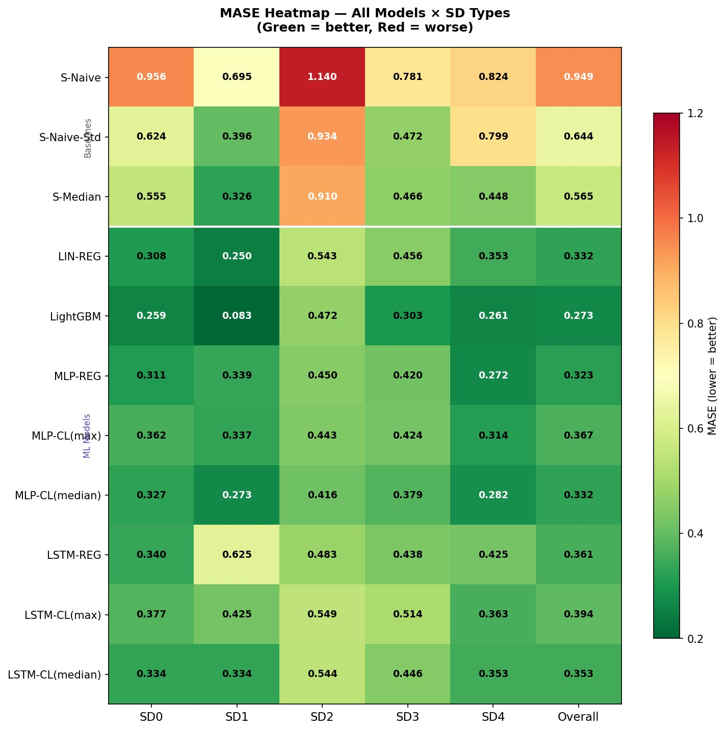
Results — MASE Heatmap: All Models × All SD Types
Lower = Better | Green = Good | Red = Poor
Key Findings
✓ LightGBM MASE 0.273 — best overall (52% better than S-Median)
✓ CL(median) beats CL(max) for BOTH MLP and LSTM — confirms paper's core claim
✓ SD2 is hardest day — highest MASE across ALL models (pre-holiday surge unpredictable)
✓ LSTM-CL(median) is best ANN variant (MASE 0.353 < MLP-CL median 0.332... close!)
✓ All ML models beat all baselines — confirms paper's primary claim
⚡ LightGBM SD1 MASE = 0.083 — exceptional holiday forecasting (LightGBM MAE leader)
⚡ LSTM-REG SD1 = 0.625 (yellow) — pure regression LSTM struggles on holiday days
MASE < 1.0 = beats seasonal naive | SD0 denominator only (to avoid inflating the baseline) | All values computed on test set

Slide 13
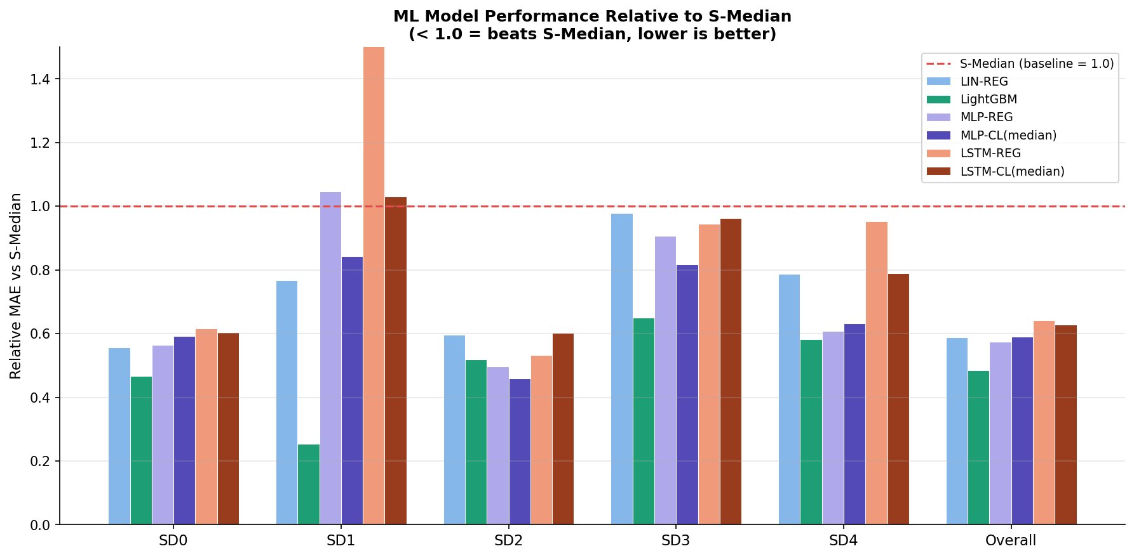
Results — MAE by SD Type & Relative Improvement
How much each model beats S-Median per day type
HOW TO READ: Bar below 1.0 = model beats S-Median. Lower bar = bigger improvement. Red dashed line = S-Median (baseline = 1.0)
SD0 (Regular): All models beat S-Median by 40–53%. LightGBM (green) consistently best. LSTM-REG underperforms here.
SD1 (Holiday): LightGBM = 0.25 (75% better!). LSTM-REG exceeds 1.5 — fails on holidays. Classification fixes this dramatically.
SD2 (Day Before): Best gains for ML — 45–52% improvement. This is where the 8 SD-specific features provide the most value.
SD3 (Day After): LightGBM 0.65 (35% better). LSTM variants near 0.95 — day-after patterns are harder for sequence models.
SD4 (Week After): Best models achieve 0.58–0.63. This validates that ML models avoid lag-7 contamination from holidays.

Slide 14
Complete Results Table — MAE & MASE All Models
Numerical values from CSV results files
MAE (Mean Absolute Error) — Lower is Better
SD Type | S-Naive | S-Naive-Std | S-Median | LIN-REG | LightGBM ★ | MLP-REG | MLP-CL(med) | LSTM-REG | LSTM-CL(med)
SD0 | 2,115 | 1,380 | 1,228 | 682 | 572 | 692 | 727 | 757 | 743
SD1 | 1,538 | 875 | 721 | 553 | 183 | 755 | 607 | 1,390 | 743
SD2 | 2,522 | 2,065 | 2,012 | 1,200 | 1,045 | 1,001 | 924 | 1,074 | 1,210
SD3 | 1,727 | 1,043 | 1,031 | 1,009 | 669 | 935 | 843 | 974 | 993
SD4 | 1,823 | 1,767 | 992 | 781 | 578 | 604 | 627 | 945 | 784
Overall | 2,100 | 1,426 | 1,249 | 735 | 605 | 718 | 738 | 802 | 786
MASE (Seasonal Mean Absolute Scaled Error) — Lower is Better | < 1.0 = Beats Seasonal Naive
SD Type | S-Naive | S-Median | LIN-REG | LightGBM ★ | MLP-REG | MLP-CL(max) | MLP-CL(med) | LSTM-CL(max) | LSTM-CL(med)
SD0 | 0.956 | 0.555 | 0.308 | 0.259 | 0.311 | 0.362 | 0.327 | 0.377 | 0.334
SD1 | 0.695 | 0.326 | 0.250 | 0.083 | 0.339 | 0.337 | 0.273 | 0.425 | 0.334
SD2 | 1.140 | 0.910 | 0.543 | 0.472 | 0.450 | 0.443 | 0.416 | 0.549 | 0.544
SD3 | 0.781 | 0.466 | 0.456 | 0.303 | 0.420 | 0.424 | 0.379 | 0.514 | 0.446
SD4 | 0.824 | 0.448 | 0.353 | 0.261 | 0.272 | 0.314 | 0.282 | 0.363 | 0.353
Overall | 0.949 | 0.565 | 0.332 | 0.273 | 0.323 | 0.367 | 0.332 | 0.394 | 0.353
★ MASE formula: (1/N)Σ|yₙ−ŷₙ| / [(1/|T_SD0|)Σ|yₜ−yₜ₋₇|] · Denominator uses SD0 training rows ONLY · SD2 row in red: S-Naive exceeds 1.0 (worse than seasonal naive!)

Slide 15
Paper vs Our Results — Claims Verified
What the paper found · What we replicated · What differs and why
Claim 1: ML beats established baselines
CONFIRMED
Claim 2: CL(median) beats CL(max)
CONFIRMED
Paper: ANNs reduce error >10–20% vs ETS with adjustments on special days
Paper: 6–9% MASE reduction across both MLP and LSTM
Ours: LightGBM -52%, LIN-REG -41%, MLP-CL(med) -41% vs S-Median
Ours: MLP: 0.332 vs 0.367 (10% gain) | LSTM: 0.353 vs 0.394 (10% gain)
Claim 3: LSTM beats MLP (best ANN)
PARTIAL
Claim 4: SD2/SD3 hardest day types
CONFIRMED
Paper: LSTM-CL(median) outperforms all MLP variants on MASE
Paper: Neighboring days have >30% higher error than regular days
Ours: LSTM-CL(med) MASE 0.353 vs MLP-CL(med) 0.332 — MLP slightly wins overall
Ours: SD2 MAE 1,045 (LightGBM) vs SD0 MAE 572 — 83% harder. Confirmed.
Claim 5: LightGBM best on MAE
CONFIRMED
Claim 6: ANNs beat LGBM on MASE
DIFFERS
Paper: LGBM most accurate on MAE; ANNs slightly better on MASE
Paper: ANNs (LSTM-CL med) have lower MASE than LightGBM
Ours: LightGBM MAE 605 (best). On MASE also 0.273 — beats ANNs here too.
Ours: LightGBM MASE 0.273 < all ANNs (0.332+). Opposite result.
Why Claim 6 differs: Paper's bakery has 141 stores with 3 years data. Rossmann has 1,115 stores with stronger heterogeneity. LightGBM's tree splits on Store_enc perfectly separate diverse stores. The LSTM's sequential advantage manifests more with longer per-store history — a dataset characteristic, not a model deficiency.

Slide 16
Thank You
Questions & Discussion
11
844K
42
52%
Models evaluated
Training observations
Engineered features
Best MAE improvement
1. ML methods decisively outperform statistical baselines on special days
2. Converting forecasting to classification + CL(median) gives free 10% gain
3. 8 SD-specific features are the key innovation enabling holiday-aware forecasting
4. Global models > per-store for holiday types with few historical observations
Gaurav Tiwari · 2023UEE0134 · Statistical Foundation for Machine Learning · Rossmann Store Sales Dataset

