Slide 1

Presentation
on
TRAFFIC SIGN CLASSIFICAION SYSTEM
Project by
Gaurav Topre(103003320181137210017)
Under the Guidance of
Dr. Pallavi Ingale
Dr. Babasaheb Ambedkar Technological University, Lonere-Raigad (MH)
Department of Electronics and Telecommunication Engineering

Slide 2
INDEX
Abstract
Introduction
Problem Statement
Solution Proposed
Future Scope
Conclusion
References

Slide 3

ABSTRACT
The German Traffic Sign Benchmark is a multi-class, single-image classification challenge held at the International Joint Conference on Neural Networks (IJCNN) 2011 and our project is solution on this problem: The upload and classify system that we created solved the problem of recognizing given traffic signs.
The dataset used have special features such as Single-image, multi-class classification problem, More than 40 classes, More than 50,000 images in total, Large, lifelike database.

Slide 4
INTRODUCTION
We have created a webapp using flask framework which is taking test image as input, classifying the uploaded image using classification model in background which was trained by using 38000+ images of various traffic signs categorized on the basis of their names. We have used feature extraction to extract features from available test data.
The webapp which we have created is reading module which is extracted using PICKLE from our train-test file and this web app we are running on local host. The interface of this WebApp is such that firstly it asks for the image by clicking on ‘upload traffic sign image’ which will be classified and it’s name will be displayed on screen after clicking ‘click here to classify traffic sign’ the WebApp will output the name of uploaded Traffic Sign.

Slide 5
PROBLEM STATEMENT
To classify the given Traffic Sign and output it’s meaning.
Display results through an interactive WebApp.

Slide 6
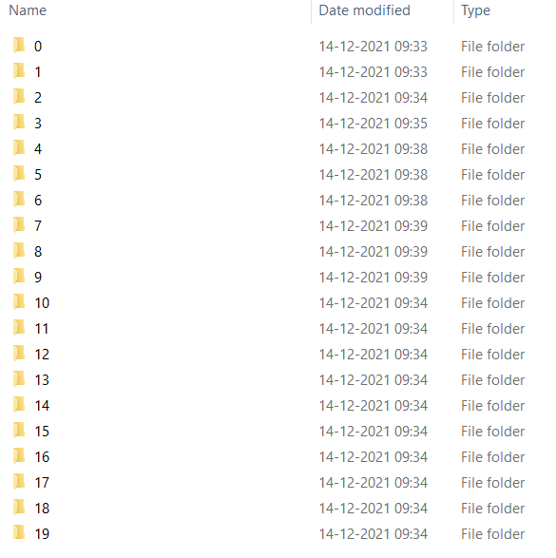
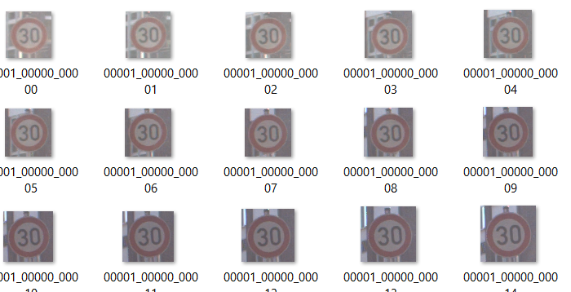
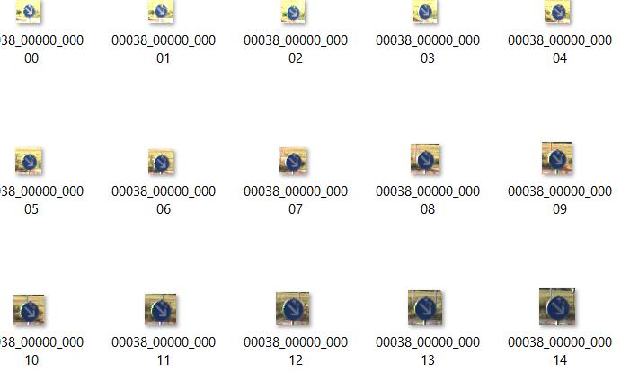
SOLUTION PROPOSED
Online dataset on more than 50000 images was present on kaggle . The dataset we have segregated in categorically on the basis of meaning of that traffic signs, but these segregated data was labeled numerically where each number is having it’s own meaning.
Fig 2 : Folder [0] meaning 30km/hr Speed Limit
Fig 3 : Folder [36] meaning Diversion
Fig 1 : Test Data Folder

Slide 7
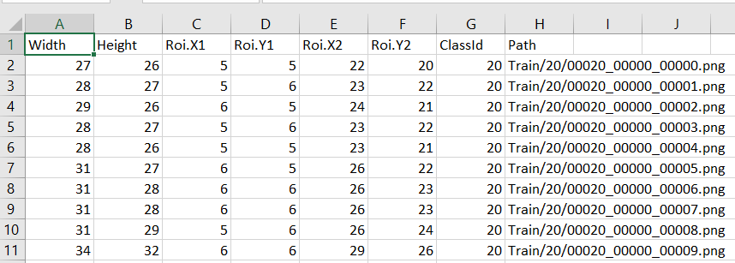
We are also given with the sheet consisting of details regarding train images which consists of several aspects for each image such as width , height and ROIs.
Fig 3 : sheets containing details of test Images
We have converted the available image data into numpy array and this array is now segregated into label and data and in this way we will be preprocessing over data.

Slide 8
Now we are splitting our label and data into train and test using train_test_split in which 20% of data is reserved for testing and remaining 80% is used for training our model.
Fig 4 : Percent of data test-train
After splitting this data we are having training and testing samples as listed in table below.
Data | Data Shape
Training sample for Image Data | (31367, 30, 30, 3)
Testing sample for Image Data | (7842, 30, 30, 3)
Training sample for Labels Data | (31367,)
Testing sample for Labels Data | (7842,)
Table 1 : Shapes of Image and Labels Data

Slide 9
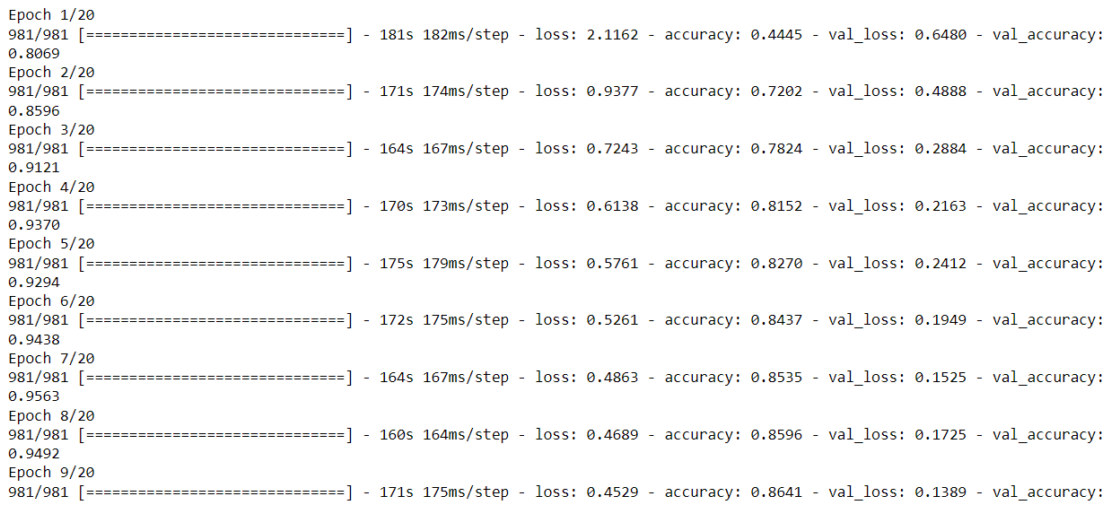
We used ONE HOT ENCODING for representing categorical data. And then we had built sequential model of convolutional neural network. The model we built was compiled in which we run 20 epochs where each epoch consists of 981 samples.
Fig 5 : Compilation of model using 20 Epoch

Slide 10
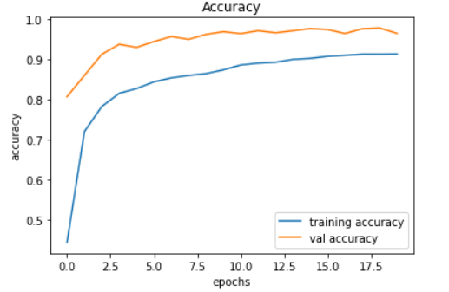
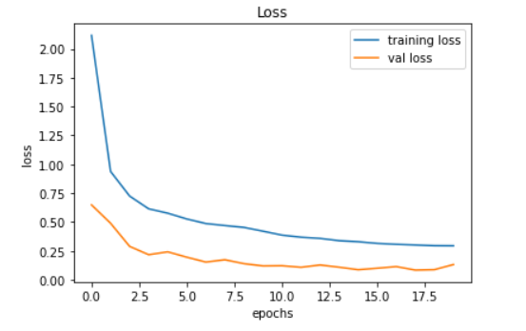
As we can observe in above fig that as epochs are running we can see the growth in accuracy and Validation Accuracy whereas fall in loss and validation loss
Fig 6 : Epochs vs Accuracy
Fig 7 : Epochs vs Loss
From above graphs we can infer that the Accuracy of our model is 94.22% and Validation Accuracy is 98.43%
Whereas loss while training model is 0.05.

Slide 11
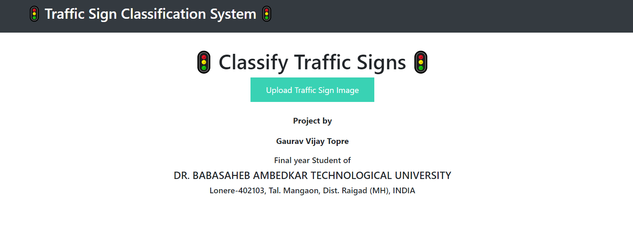
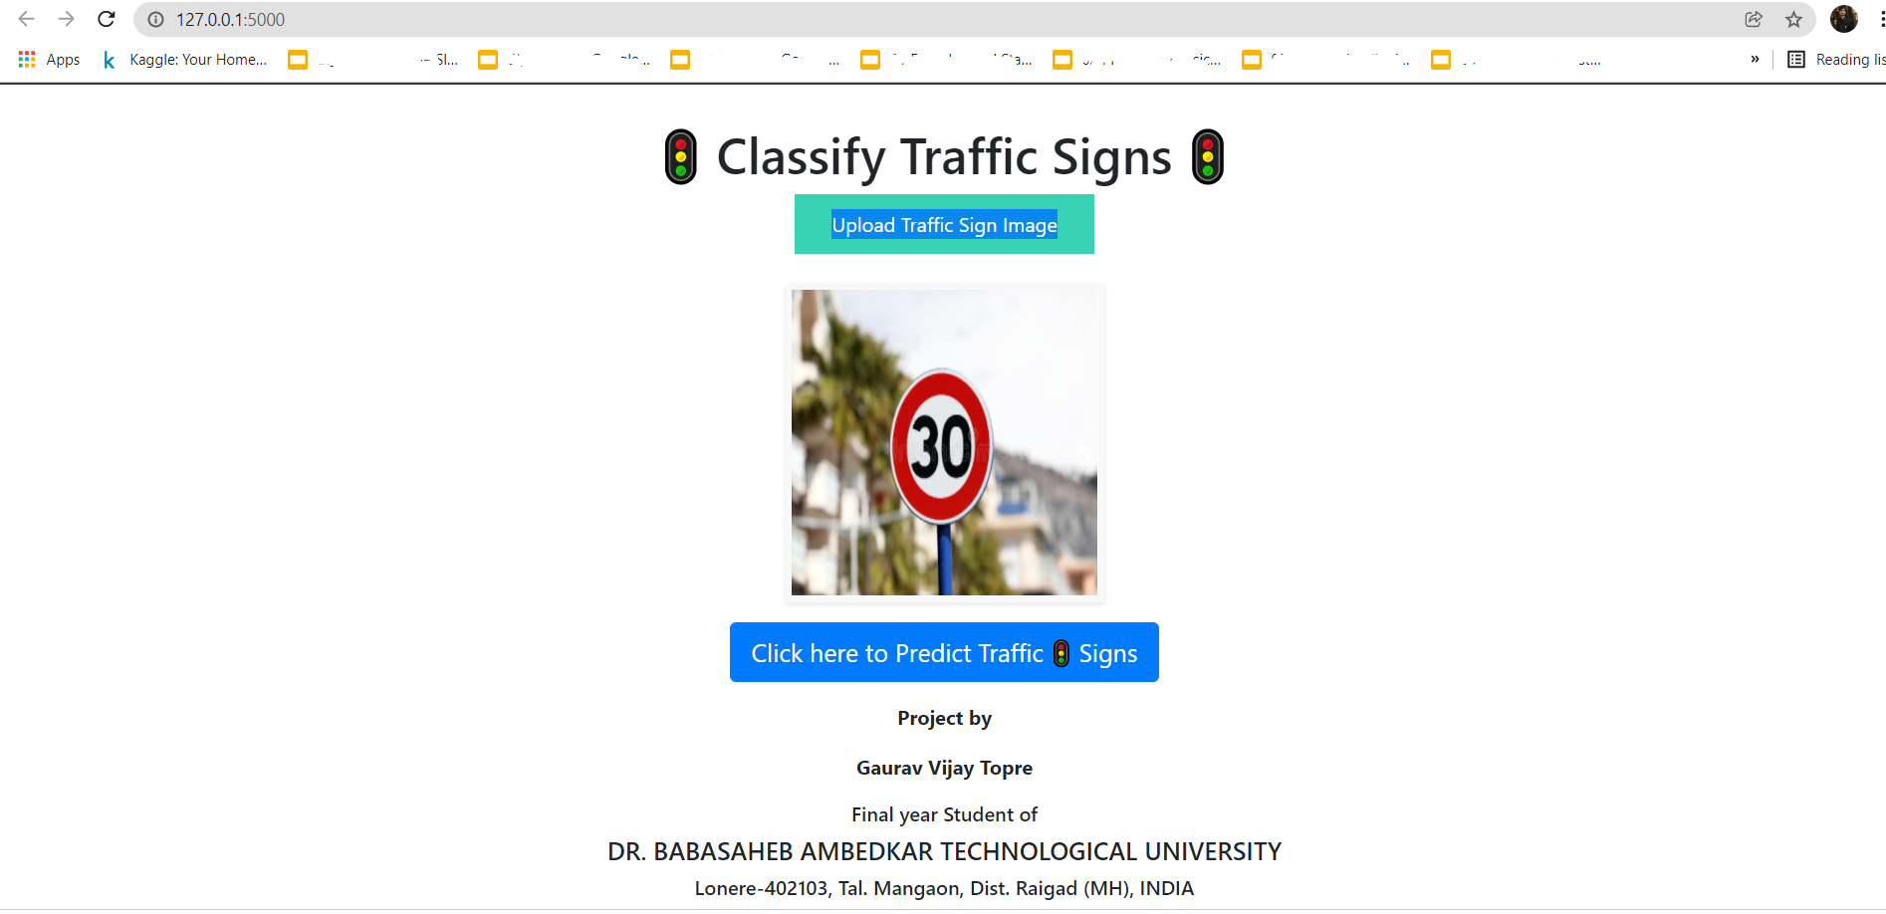
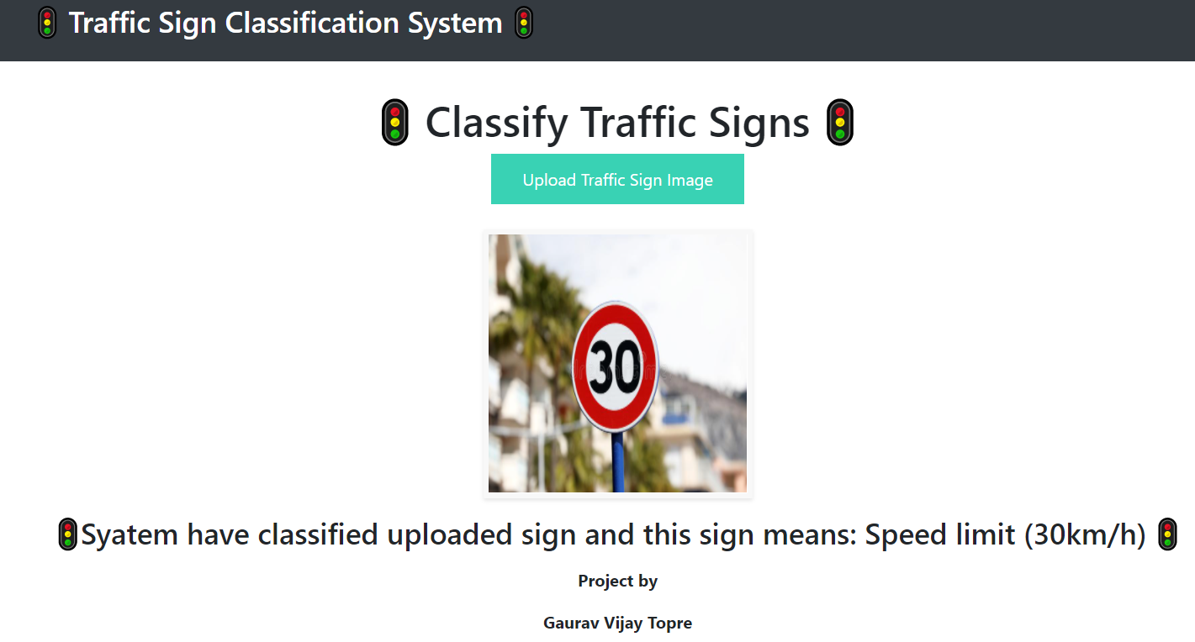
Now using Sklearn module we have saved model which we have later uploaded in python file which framed webapp using Flask Framework. Below are some snips of WebApp we created.
Fig 8 : Initial interface with Upload Image Button
Fig 9: After image upload we get Classify Image Button
Fig 10 : Final Result

Slide 12
FUTURE SCOPE
We can take forward this project in many forms few of them are listed below.
Instead of image upload we can formulate this system for real time data where the camera will click live images
We can train by adding many more categorical samples in our training data.
We can opt for some other CNN model which will present better accuracy.

Slide 13
CONCLUSION
We successfully trained model using 20 epochs
Model is being deployed on WebApp which is giving us accurate classification of Traffic Signs.
This model is giving us more than 94% of accuracy.
The WebApp we built is ready to use in RTO offices and in Driving schools.

Slide 14
REFERENCES
Nattapol Namyang, Suphakant Phimoltares, "Thai Traffic Sign Classification and Recognition System Based on Histogram of Gradients Color Layout Descriptor and Normalized Correlation Coefficient", Information Technology (InCIT) 2020 5th International Conference on, pp. 270-275, 2020.
Bousarhane Btissam, Bouzidi Driss, "Partially Connected Neural Networks for an Efficient Classification of Traffic Signs", Open Innovations Association FRUCT 2021 30th Conference of, pp. 16-23, 2021.
M A A Sheikh, A Kole and T Maity, "Traffic sign detection and classification using colour feature and neural network", International Conference on Intelligent Control Power and Instrumentation, 2016.
M A A Sheikh and S Mukhopadhyay, "Noise tolerant classification of aerial images into manmade structures and natural-scene images based on statistical dispersion measures", IEEE India Conference, pp. 653-658, 2012.
https://github.com/Spidy20

