Slide 1
Literature Review: Credit Card Fraud Detection Using ML
What we review
1
The base paper
Base paper: Tanouz et al., ICICCS 2021
2
Related work
3
Class imbalance
4
Evaluation practice
Gaurav Jain (D12B, Roll 20) | Palash Matani (D12B, Roll 38)
5
Explaining alerts (LIME)
Department of Computer Engineering, VESIT Mumbai
Notes:
This deck covers the literature behind our mini project: the base paper, earlier studies, imbalance techniques, evaluation practice and explainability. A 14-reference list is in the written review.

Slide 2
Related work: trees win, evaluation lags
2011
2014
2015
2018
2021
Bhattacharyya [5]
Random Forest beats SVM and LR
Dal Pozzolo [3]
Drift and alert budget matter
Dal Pozzolo [1]
Under-sampling skews probabilities
Randhawa [6]
Hybrid ensembles beat single models
Tanouz [4]
RF best, but tiny balanced test set
Common pattern: tree ensembles are strong baselines on this data
Notes:
Early work already favoured ensembles. Dal Pozzolo's practitioner view adds three real-world issues: imbalance, drift, and the limited number of alerts humans can check. The ULB dataset comes from this line of work. Randhawa's details (datasets used) should be double-checked against the paper before the viva.

Slide 3
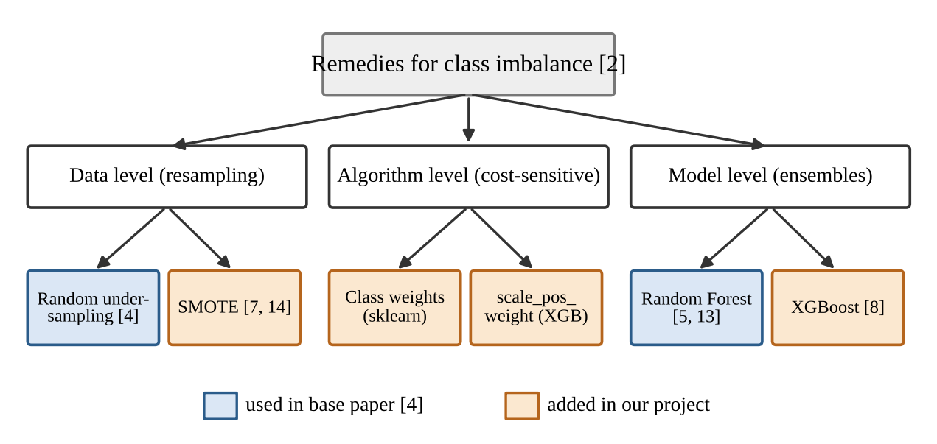
Handling class imbalance
Under-sampling: fast, but drops over 99% of genuine rows [1]
SMOTE: synthetic fraud points; gains vary by model [7, 14]
Class weights: reweight errors, keep all data
XGBoost: boosted trees [8], not in the base paper
Notes:
Blue boxes are what the base paper used; orange boxes are what our project adds. He and Garcia (2009) group remedies into data-level, algorithm-level and model choices.

Slide 4
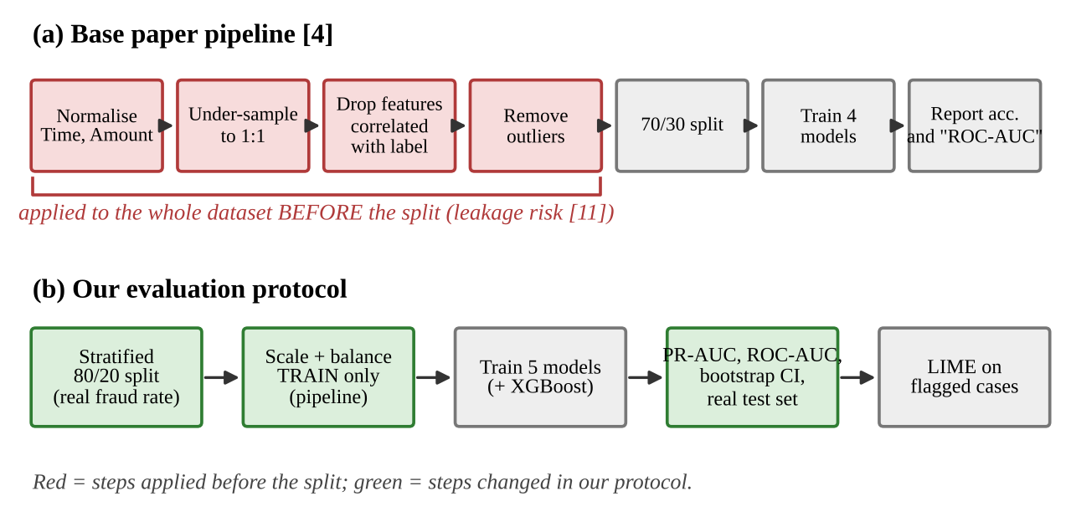
Evaluating rare events properly
PR over ROC [9, 10]: ROC hides weak precision
Split first [11]: label-based steps on train only
Show uncertainty: bootstrap CIs, repeated CV
Notes:
Top row is the base paper as described; red steps use label information before the split, which is leakage risk. Bottom row is our protocol. 'As described in the paper' is the safe phrase, we did not see their code.

Slide 5
Research gap and our contribution
A
Re-implement the paper's pipeline as described
Random Forest | Prec % | Recall % | FP
Paper, as reported | 100.00 | 91.11 | 0
Ours, paper-style (247 rows) | 94.68 | 86.41 | 5
Under-sampling, real test | 4.30 | 91.84 | 2,004
SMOTE, real test | 88.30 | 84.69 | 11
B
Re-evaluate 4 models + XGBoost: split first, real test set, PR-AUC with CI
C
Explain flagged cases with LIME
Real test set: 56,962 transactions, 98 fraud. FP = false alarms.
The paper's near-perfect precision does not survive a realistic test set
Notes:
Gap: the base paper has no real-rate test set, no probability-based metrics and no uncertainty. Our table shows the same model across settings. The ~124 rows for the paper is our estimate, not stated by the paper.

