Slide 1
Credit Card Fraud Detection: Re-testing a Published Pipeline
0.17%
Reproducing Tanouz et al. (ICICCS 2021) on the Kaggle ULB dataset, then fixing its evaluation
of 284,807 card transactions are fraud
99.83%
accuracy of a model that always says genuine
Gaurav Jain (D12B, Roll 20) | Palash Matani (D12B, Roll 38)
Department of Computer Engineering, VESIT Mumbai
Notes:
Problem: fraud is rare (492 of 284,807). Always predicting genuine is 99.83% accurate and catches nothing, so accuracy is useless here. Our base paper is Tanouz et al. 2021. We reproduce it, find evaluation problems, fix them, and add SMOTE, XGBoost and LIME.

Slide 2
What the base paper does
Prepare
Normalise, under-sample 1:1, drop correlated features, remove outliers
Split
70/30 train-test split of the prepared data
Train
Decision Tree, Random Forest, Logistic Regression, Naive Bayes
Report
Accuracy, precision, recall, F1 and "ROC-AUC"
Model (as reported by the paper) | Acc % | Prec % | Recall % | F1 % | ROC-AUC %
Decision Tree | 91.12 | 86.95 | 88.88 | 87.91 | 90.64
Random Forest (best) | 96.77 | 100.00 | 91.11 | 95.34 | 95.55
Logistic Regression | 95.16 | 95.34 | 91.11 | 93.18 | 94.28
Naive Bayes | 95.16 | 100.00 | 86.66 | 92.85 | 93.33
Source: Tanouz et al. [4], reported results
Notes:
The paper compares four classifiers and reports Random Forest as best: 96.77% accuracy, 100% precision, 91.11% recall. Note the order: all preparation happens before the split. Numbers on this slide are copied from the paper.

Slide 3
Four weaknesses we found
1
Tiny, balanced test set
Scores imply about 124 test rows (our estimate); the real fraud rate is 0.17%.
2
Split comes last
Under-sampling, feature drop and outlier removal see all labels first.
3
"ROC-AUC" is balanced accuracy
Identical for all 4 models in our reproduction.
4
Models differ by a few errors
Our 247-row test set: 19 to 26 mistakes per model, no confidence intervals.
Notes:
The 124-row figure is our own estimate: we solved for confusion matrices consistent with all four reported rows. Say 'we estimated', not 'the paper says'. In our own paper-style run (247 rows) the hard-label ROC-AUC equals balanced accuracy for every model. Errors per model on our 247-row set: RF 19, DT 23, LR 24, NB 26.

Slide 4
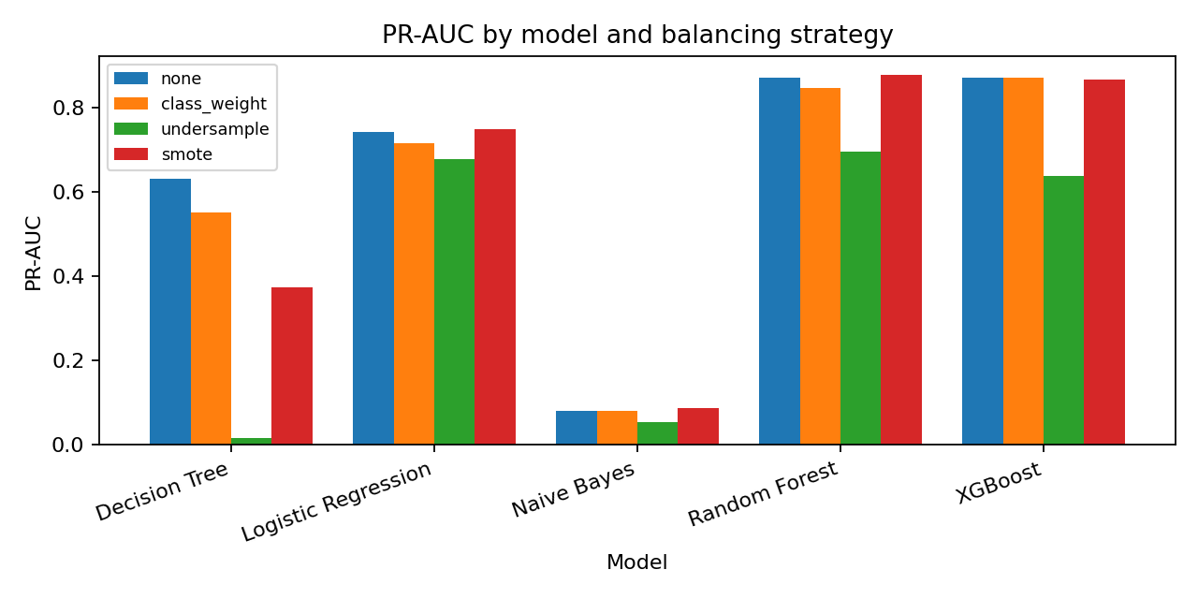
Re-test on a realistic test set
4.3%
Random Forest precision with the paper's under-sampling: 2,004 false alarms
88.3%
Random Forest + SMOTE on the same test set: 11 false alarms
PR-AUC (95% CI): RF + SMOTE 0.880 (0.815 to 0.933), RF alone 0.873, XGBoost 0.872. Intervals overlap, so there is no clear winner.
Test set: 56,962 transactions, 98 fraud
Notes:
Same Random Forest, same real-rate test set. Paper-style under-sampling gives 4.3% precision: about 22 false alarms for every fraud caught. SMOTE or no balancing gives 80%+ precision. But RF+SMOTE, RF alone and XGBoost have heavily overlapping confidence intervals, so do not claim SMOTE or XGBoost is clearly better. Decision Tree gets worse with SMOTE (see chart).

Slide 5
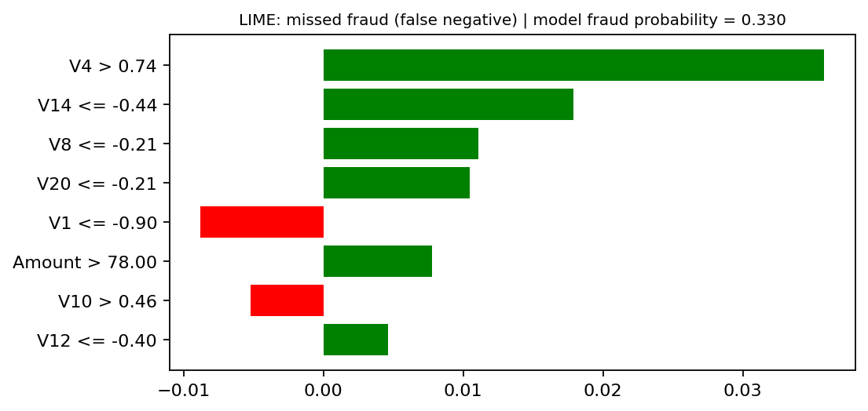
Conclusions
The paper's near-perfect precision does not hold at the real fraud rate
Balancing helps a lot, but SMOTE vs class weights vs nothing is not clearly different
LIME: the missed fraud has the same drivers as a caught one, only a lower score
LIME on a missed fraud (probability 0.33); a caught fraud scored 0.99 with the same top features
Limits: one dataset (2 days), anonymised PCA features, one random split. Next: time-ordered split, cost-based threshold.
Notes:
V1 to V28 are anonymised PCA components, so LIME says which component mattered, not what it means in business terms. Lowering the decision threshold could catch the 0.33 case, but it would add false alarms. Be honest about the limits: one dataset, one random split.

