Slide 1
ENTERPRISE ARCHITECTURE · HEALTHCARE VIEW TEMPLATES
Thirty-six views,
drawn once
Empty ArchiMate 4 templates for a provider engagement: what each view is for, which elements belong on it, which sheets feed it, and the mistake people make.
36
42
6
0
views, each drawn once
elements, 11 relationships
nobody has a viewpoint for
licensed content reproduced
TEMPLATE · EXAMPLE CONTENT MARKED ILLUSTRATIVE THROUGHOUT
Driehoek Health Group and Rietvlei District Health Service are invented providers. Every drawing here is an example of the shape, not of your estate.
Healthcare EA · View templates
Thotnr Consulting · Healthcare starter pack · October 2026
1
Notes:
WHAT TO SAY
Say what the pack is before anyone asks: thirty-six reusable view templates for a provider engagement, each drawn once so the shape is settled, and each naming the sheets that populate it. Then say the fourth tile out loud, because it governs everything after it: no text, table or figure from any licensed specification or code system is reproduced anywhere in this pack.
QUESTION TO EXPECT
'Can we just use these?' Yes, and regenerate them from your own repository. A view is a query, and an edited export is how a repository and a picture come to disagree.

Slide 2
HOW TO READ THESE TEMPLATES
Drawn once, so the shape is settled
Four rules, and the fourth one governs every slide after it.
THE QUERY, NOT THE ANSWER
THE STANDARD NAME IS USED
THE SHEETS ARE NAMED BY NUMBER
A view is a query
`Service`, not a prefix
O15 and O19, by number
Each template is the shape of a question. Regenerate it from your own repository; never edit an exported picture.
Element names in ArchiMate 4 are unprefixed. Write “a `Service` in the application layer”, because the layer is a placement.
Two sheets are named after element types that do not exist. Quote the number and describe the element in prose.
WHAT IS DRAWN ON EVERY CANVAS, AND WHAT IS NOT
Every canvas carries an example drawn from one of two invented providers, at the smallest size that still makes the argument — six to nine elements, three grid columns. The example exists to settle the shape of the view and the direction of its relationships. It is not a reference model, it is not your estate, and the numbers in it describe nobody.
AND THE RULE THAT GOVERNS THE WHOLE PACK
No text, table, figure, code, code description, profile or conformance statement from any licensed specification, terminology or classification is reproduced here. Standards are named where naming them is the point; nothing is quoted from them. Where a view needs a code system, it carries a `Business Object` for the system and its edition, and the content of that system stays where its licence put it.
Healthcare EA · View templates
Thotnr Consulting · Healthcare starter pack · October 2026
2
Notes:
WHAT TO SAY
Make the fourth rule explicit early. A pack like this is where licensed content leaks into a client deliverable, and the discipline is to name a standard and never quote it.
QUESTION TO EXPECT
'Can we paste the code list in?' No. Model the system and the edition; licence the content.

Slide 3
THE THIRTY-SIX VIEWS · PART ONE
Thirty-six views across the phases
Six of them have no standard viewpoint behind them, and those six are the healthcare-specific ones.
No. | View | Viewpoint, or invented
01 | Organisation view | Organization
02 | Principles view | Motivation
03 | Obligations in force view | Motivation
04 | Goal realisation view | Goal realization
05 | Stakeholder and concern view | Stakeholder
06 | Requirements realisation view | Requirements realization
07 | Capability map, level 1 | Capability map
08 | Value stream view | Value stream
09 | Resource map view | Resource map
No. | View | Viewpoint, or invented
10 | Referral to treatment, end to end | Business process co-operation
11 | Order to result, closed loop | Business process co-operation
12 | Role and authority to write | Organization
13 | Service offering view | Product
14 | A pathway against a protocol version | Business process co-operation
15 | Conceptual data model view | Information structure
16 | The record across three layers | Information structure
17 | Mastering authority view | Information structure
18 | Classification inheritance view | Information structure
Healthcare EA · View templates
Thotnr Consulting · Healthcare starter pack · October 2026
3
Notes:
WHAT TO SAY
Run the index quickly. The six invented views are the six the notation has no place for, and they are the six new sheets the repository needs.
QUESTION TO EXPECT
'Why thirty-six and not twenty-five?' Twenty-five viewpoints is a catalogue. These are the views a provider engagement actually asks for.

Slide 4
THE THIRTY-SIX VIEWS · PART TWO
Thirty-six views across the phases
Six of them have no standard viewpoint behind them, and those six are the healthcare-specific ones.
No. | View | Viewpoint, or invented
19 | Consent, scoped and dated | Invented — none covers it
20 | Disclosure event view | Invented — none covers it
21 | Retention clock view | Invented — none covers it
22 | Application landscape view | Application structure
23 | A seam, and what actually governs it | Application co-operation
24 | Application usage view | Application usage
25 | Identity resolution service view | Service realization
26 | Code system and edition | Invented — none covers it
27 | Measure definition view | Invented — none covers it
No. | View | Viewpoint, or invented
28 | Technology view | Technology
29 | Deployment and hosting view | Implementation and deployment
30 | The regulated device | Invented — none covers it
31 | Shared services the organisation does not own | Technology usage
32 | The read-only record and the degraded path | Technology usage
33 | Gaps between plateaux | Migration
34 | Work packages and deliverables | Project
35 | Transition overview | Implementation and migration
36 | Layered slice, one value stream end to end | Layered
Healthcare EA · View templates
Thotnr Consulting · Healthcare starter pack · October 2026
4
Notes:
WHAT TO SAY
Run the index quickly. The six invented views are the six the notation has no place for, and they are the six new sheets the repository needs.
QUESTION TO EXPECT
'Why thirty-six and not twenty-five?' Twenty-five viewpoints is a catalogue. These are the views a provider engagement actually asks for.

Slide 5
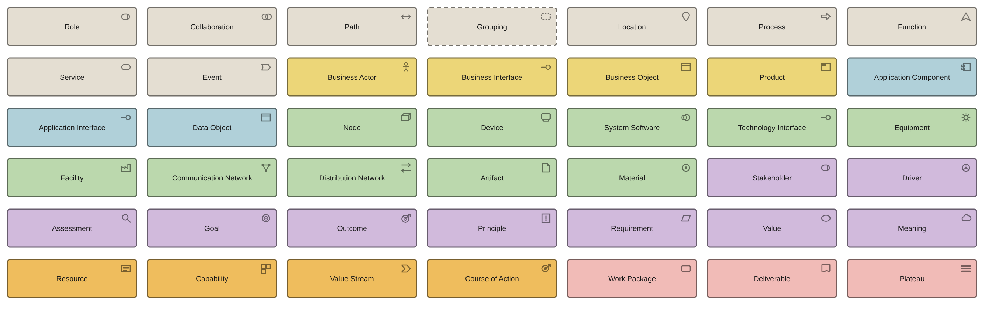
THE VOCABULARY
Forty-two elements, and nothing else
Nine of them are unprefixed and take their layer from where they are placed. There is no element for a date, a version, a period or a number.
THE FIVE NAMES THIS INDUSTRY GETS WRONG, AND WHAT TO WRITE INSTEAD
There is no layer-prefixed service element — write “a `Service` in the application layer”. There is no `Constraint` — use `Requirement` with a restrictive statement. There is no `Contract` — the agreement is a `Business Object`, its counterparty a `Business Actor` and the obligation it creates a `Requirement`. There is no metric element and `Value` is not a number. And there is no layer-prefixed `Role`: a clinical coder, an admitting officer, a data steward and a system account are all plain `Role`.
Healthcare EA · View templates
Thotnr Consulting · Healthcare starter pack · October 2026
5
Notes:
WHAT TO SAY
Spend a minute here. The names in circulation are wrong, and the material the client hands you already has them wrong — including two sheets of the supplied repository, which are named after element types that do not exist.
QUESTION TO EXPECT
'Does it matter?' A model built on a pre-version-4 name will not import.

Slide 6
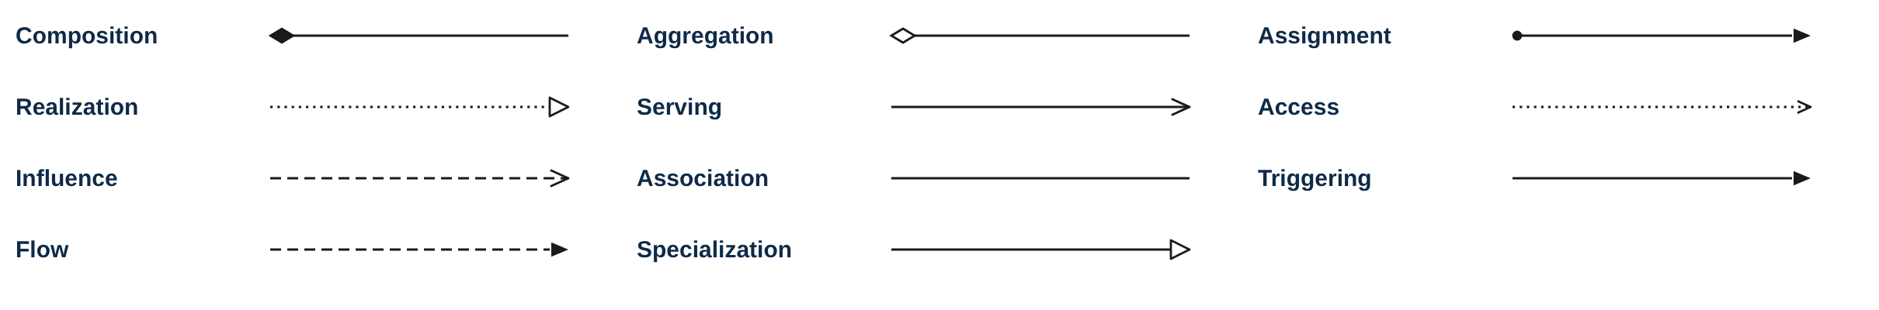
THE GRAMMAR
Eleven relationships, and what each one asserts
Two spellings are the specification's own strings and are written its way inside backticks: `Realization` and `Specialization`.
THE ONE TO WATCH, AND THE ONE THAT MAKES A CLEAN REPOSITORY WORTHLESS
`Association` carries everything the other ten cannot, which is why it accumulates. Name every association on the view or it asserts nothing. And the notation permits relationships to be derived: a chain of structural relationships from A to B makes a single relationship from A to B valid, and a tool will confirm it. That is the mechanism by which a repository passes every integrity check and says nothing — a relationship can resolve perfectly at both ends and pair two objects with nothing to do with each other.
Healthcare EA · View templates
Thotnr Consulting · Healthcare starter pack · October 2026
6
Notes:
WHAT TO SAY
Read the derivation point aloud. It is the single most useful thing in the pack, because the repository in front of the client is in exactly that condition.
QUESTION TO EXPECT
'How do we find them?' Three questions: does the subject of one end appear in the other end's name; would the owner of one end recognise the other; and if the relationship were deleted, would anybody notice.

Slide 7
FOUR RULES TO SETTLE BEFORE ANYBODY DRAWS
Four conventions, each an hour to agree and a rebuild to skip
They are conventions rather than notation, and every one of them is lost in an export if it is not written down.
01
Record the layer as a property
Because `Service`, `Process`, `Function`, `Event`, `Role` and `Collaboration` are unprefixed, the layer exists only as a position in a view and a fill colour. An export loses it, and a spreadsheet populated from an export loses it. Carry a layer property on every unprefixed element, set it on creation, and validate it.
02
Put valid-from and valid-to on anything whose identity includes a period
There is no time on an element. A tariff that applies from 1 April, a protocol version in force on the date of care, a registration that lapses in March and a consent that expires are all effective-dated, and the absence of those two properties is a modelling defect rather than an omission.
03
Model the type, and say which system holds the instance
A `Device` element is a kind of device, not a particular one; the same applies to a protocol and its versions, and to a practitioner and their registrations. What the architecture model owns is the statement that both exist and which system holds each.
04
Name an element for what it is, not for the sheet it came from
A generated row whose description reads “externally consumable service realising clinical care delivery” is a sentence with a capability name dropped into it. Promoting it preserves the emptiness and gives it a reference number. Rename, or do not import.
Healthcare EA · View templates
Thotnr Consulting · Healthcare starter pack · October 2026
7
Notes:
WHAT TO SAY
Four conventions, an hour each. The fourth is the one that keeps generated content out of a repository that people will later trust.
QUESTION TO EXPECT
'Can the tool enforce these?' The first one, yes. The others are review disciplines.

Slide 8
WHAT THESE VIEWS CANNOT SAY
Six limits, and the same remedy every time
Each is a place an architect reaches for something and finds nothing. In every case: record it as a property, and say on the view that you have.
The limit | What it costs in a provider | The remedy
There are no attributes | Classification, retention, code system, device risk class and protocol version are all tool properties | Print them on the view, or the view says nothing
There is no cardinality | A conceptual data model drawn only in this notation loses every cardinality in it | Maintain the model with cardinalities, then draw it
There is no time on an element | Effective dating is the most pervasive requirement in South African health data | Valid-from and valid-to properties, everywhere
Type and instance cannot be told apart | A device model and a device instance, a protocol and its versions, a lot and its recall | Model the type; name the system of record
There is no state machine | “Sent but not acknowledged” is the state that makes a referral auditable | A `Business Object` with its states documented, and a `Requirement`
There are no swimlanes | The lane boundary is where the handoff fails, and the handoff is almost always the finding | Change notation: draw level two in BPMN
SAY IT ON THE VIEW, IN WORDS
A view that cannot carry a fact should say so on its face rather than imply the fact is absent. One line in the view notes — what is not shown here, and where it is held instead — is the difference between a view a reviewer trusts and a view a reviewer quietly stops reading.
Healthcare EA · View templates
Thotnr Consulting · Healthcare starter pack · October 2026
8
Notes:
WHAT TO SAY
Six limits, one remedy. The fifth is the one that surprises people: there is no way to express a state an object can be in, and the state is usually the finding.
QUESTION TO EXPECT
'Is this a weakness of the notation?' It is a boundary. The remedy is a property and a sentence, not a different tool.

Slide 9
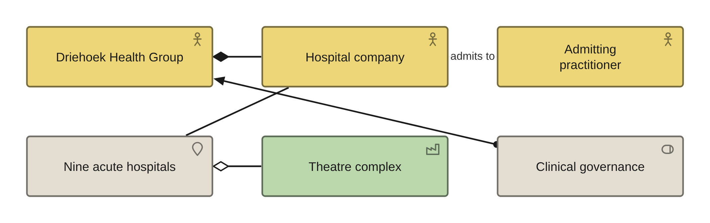
PRELIMINARY AND PHASE A · VIEW 01 OF 36
Organisation view
ARCHIMATE 4 VIEWPOINT: ORGANIZATION
FOR
CANVAS
The sponsor, to agree which legal entities this engagement covers and which it does not
ELEMENTS IT MAY CONTAIN
Business Actor, Role, Location, Facility, Grouping
RELATIONSHIPS
Composition, Aggregation, Assignment, Association
POPULATED FROM
O09, O10, O11, O12 — and the two roles item 2 creates
WHAT THIS VIEW CANNOT SHOW
Which entity employs which clinician, and that the repository holds no clinical organisation unit and no clinician among its actors or roles
THE MISTAKE PEOPLE MAKE
Drawing the group as one actor. In a private group the hospital does not employ the doctors, so one episode of care involves several legal entities and the view has to show the boundary between them.
Healthcare EA · View templates
Thotnr Consulting · Healthcare starter pack · October 2026
9
Notes:
WHAT TO SAY
Start here because the entity boundary decides how many records exist for one episode. Ask who employs the admitting practitioner and watch the room disagree.
QUESTION TO EXPECT
'Is this not just an org chart?' No — an org chart has no legal entities on it.

Slide 10
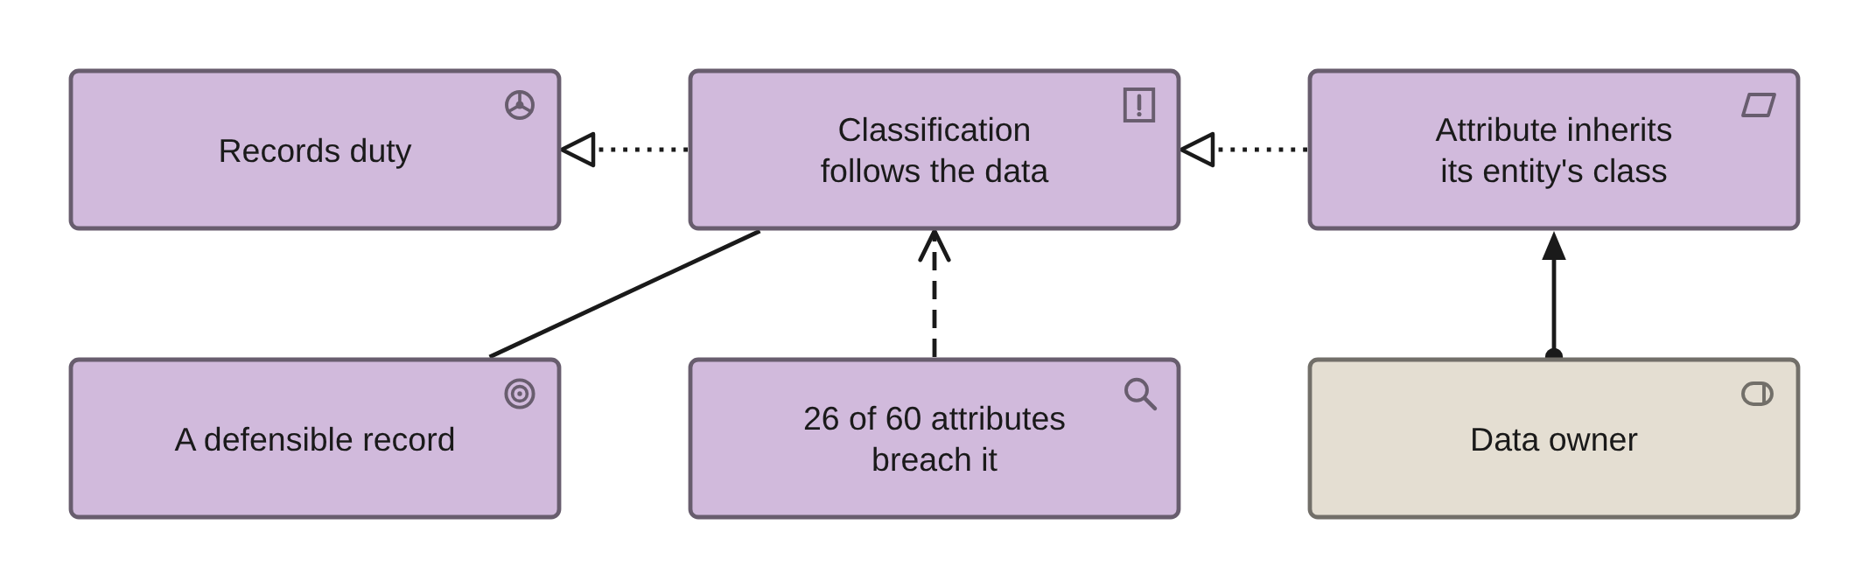
PHASE A · VIEW 02 OF 36
Principles view
ARCHIMATE 4 VIEWPOINT: MOTIVATION
FOR
CANVAS
The architecture board, to agree what a principle is for and what it is not
ELEMENTS IT MAY CONTAIN
Principle, Requirement, Driver, Goal
RELATIONSHIPS
Realization, Influence, Association
POPULATED FROM
O05 Principle, O06 Requirement, O01 Driver
WHAT THIS VIEW CANNOT SHOW
Whether anybody has ever been refused anything on the strength of a principle
THE MISTAKE PEOPLE MAKE
Writing an aspiration as a principle. A principle that nobody could breach is decoration; the repository's own PRN-14 says classification is a property of the data, and 26 of 60 attributes breach it.
Healthcare EA · View templates
Thotnr Consulting · Healthcare starter pack · October 2026
10
Notes:
WHAT TO SAY
A principle earns its place when a project has been refused on it. Ask for one example.
QUESTION TO EXPECT
'Who approves principles?' Name the body, and put the date of approval on the element.

Slide 11
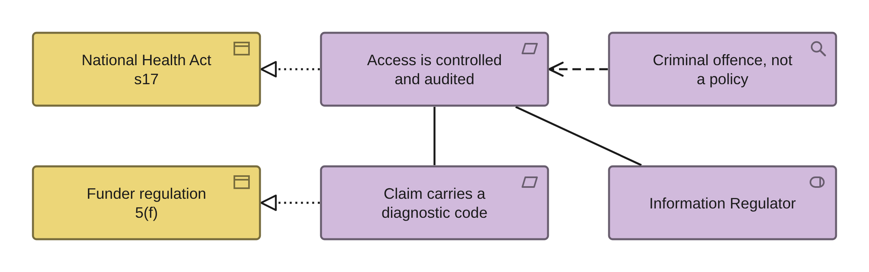
PHASE A · VIEW 03 OF 36
Obligations in force view
ARCHIMATE 4 VIEWPOINT: MOTIVATION
FOR
CANVAS
The executive, to separate what is mandated today from what a future statute might mandate
ELEMENTS IT MAY CONTAIN
Driver, Requirement, Assessment, Business Object, Stakeholder
RELATIONSHIPS
Realization, Influence, Association
POPULATED FROM
O01 Driver, O06 Requirement, O08 Assumption, O32 Standard
WHAT THIS VIEW CANNOT SHOW
That a requirement is enforced — only that an instrument exists and somebody has cited it
THE MISTAKE PEOPLE MAKE
Putting an uncommenced statute on the view. No section of the National Health Insurance Act 20 of 2023 is in force; every requirement it would impose is already mandated by something that is.
Healthcare EA · View templates
Thotnr Consulting · Healthcare starter pack · October 2026
11
Notes:
WHAT TO SAY
Two instruments, both in force today, both with an enforcement record. Nothing aspirational goes on this view.
QUESTION TO EXPECT
'What about NHI?' A contingency that validates the work, not the reason for it.

Slide 12
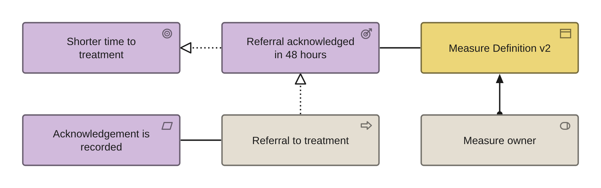
PHASE A · VIEW 04 OF 36
Goal realisation view
ARCHIMATE 4 VIEWPOINT: GOAL REALIZATION
FOR
CANVAS
The sponsor, to see which outcome each goal actually produces and which produce none
ELEMENTS IT MAY CONTAIN
Goal, Outcome, Principle, Requirement, Business Object
RELATIONSHIPS
Realization, Influence, Association
POPULATED FROM
WHAT THIS VIEW CANNOT SHOW
O02 Goal, O03 Objective, O04 Measure — and O70 for the definitions
Whether the number behind an outcome can be reproduced, which is what O70 exists for
THE MISTAKE PEOPLE MAKE
Hanging a number off a Goal. There is no metric element and Value is not a number; the definition is a Business Object and the baseline is a property of it.
Healthcare EA · View templates
Thotnr Consulting · Healthcare starter pack · October 2026
12
Notes:
WHAT TO SAY
Every outcome on this view has a definition object behind it, or it comes off the view.
QUESTION TO EXPECT
'Where is the target?' A property on the definition, not an element.

Slide 13
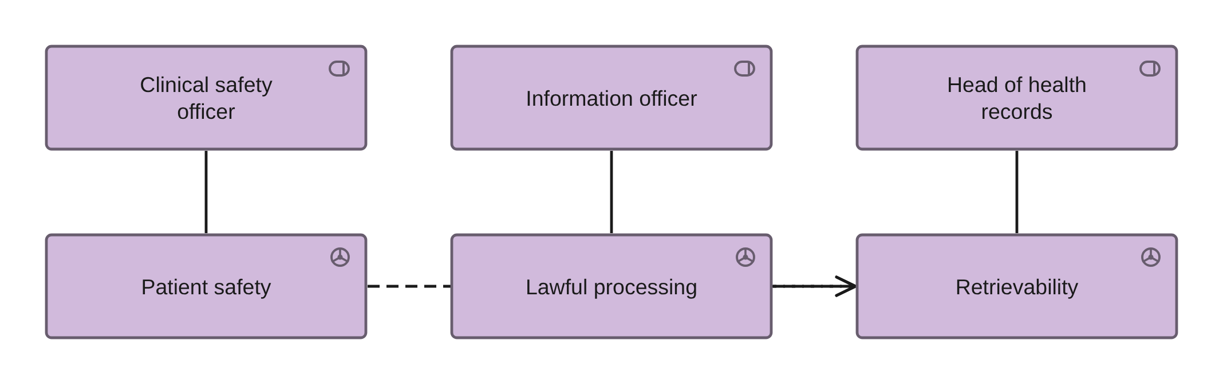
PHASE A · VIEW 05 OF 36
Stakeholder and concern view
ARCHIMATE 4 VIEWPOINT: STAKEHOLDER
FOR
CANVAS
The engagement lead, to show which concerns have an owner and which have none
ELEMENTS IT MAY CONTAIN
Stakeholder, Driver, Assessment, Goal
RELATIONSHIPS
Influence, Association
POPULATED FROM
WHAT THIS VIEW CANNOT SHOW
O10 Actor, O11 Role, O57 Governance Body, O01 Driver
Which stakeholder can stop a go-live, which is the only question the room cares about
THE MISTAKE PEOPLE MAKE
Listing stakeholders without their concerns. A stakeholder with no driver attached is a distribution list, and the two posts that matter most here — a clinical safety officer and a head of health records — exist in no sheet.
Healthcare EA · View templates
Thotnr Consulting · Healthcare starter pack · October 2026
13
Notes:
WHAT TO SAY
Three posts, three drivers. Two of the three posts do not exist in the repository, and creating them is a decision for the committee rather than a modelling act.
QUESTION TO EXPECT
'Who signs this off?' If no name comes back, that is the finding.

Slide 14
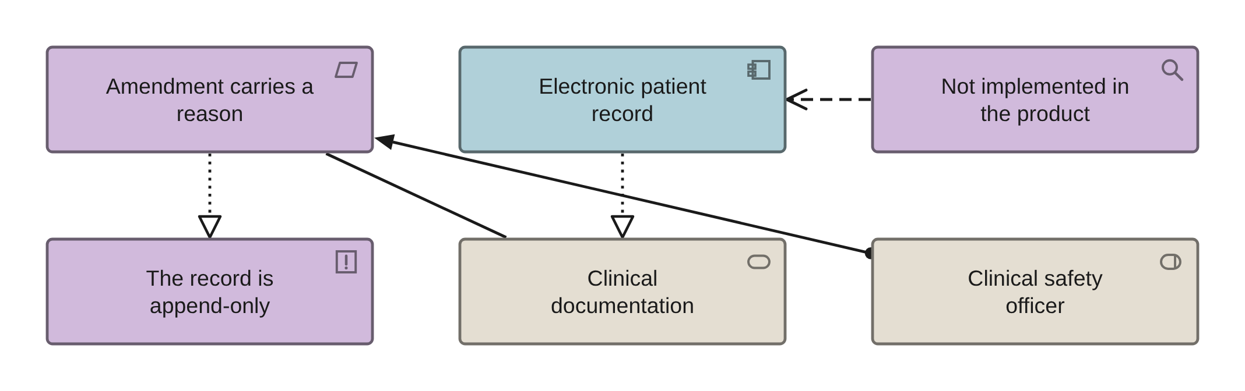
PHASE A · VIEW 06 OF 36
Requirements realisation view
ARCHIMATE 4 VIEWPOINT: REQUIREMENTS REALIZATION
FOR
CANVAS
The design authority, to show what realises each requirement and what realises nothing
ELEMENTS IT MAY CONTAIN
Requirement, Principle, Application Component, Service, Node, Process
RELATIONSHIPS
Realization, Serving, Association
POPULATED FROM
WHAT THIS VIEW CANNOT SHOW
O06 Requirement, O23 Application Component, O55 Building Block, R09
Whether the realisation is real — read three rows aloud as sentences and the join fails by the second
THE MISTAKE PEOPLE MAKE
Trusting a resolved trace. All 32 rows of the repository's requirement-to-building-block sheet reach a block with nothing to do with the requirement, and every one of them resolves.
Healthcare EA · View templates
Thotnr Consulting · Healthcare starter pack · October 2026
14
Notes:
WHAT TO SAY
Pick the one requirement almost no system implements — the reason for an amendment — and show that the trace resolves while the function does not exist.
QUESTION TO EXPECT
'Does our record system do this?' Ask to see an amended note with its reason.

Slide 15
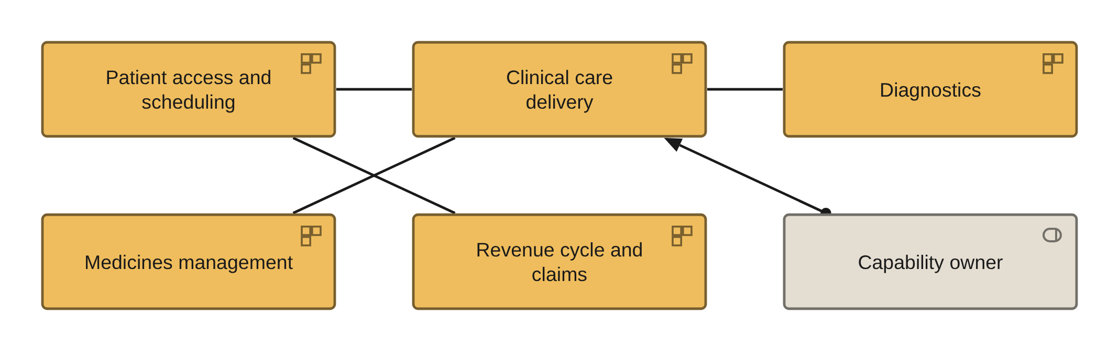
PHASE B · VIEW 07 OF 36
Capability map, level 1
ARCHIMATE 4 VIEWPOINT: CAPABILITY MAP
FOR
CANVAS
The executive, to agree the ten things the organisation does, with an owner for each
ELEMENTS IT MAY CONTAIN
Capability, Resource, Role, Grouping
RELATIONSHIPS
Composition, Aggregation, Assignment
POPULATED FROM
O13 Business Capability — ten level-1 rows, ninety children
WHAT THIS VIEW CANNOT SHOW
Maturity, criticality or an owner — all three are properties, and the owner is the one most often missing
THE MISTAKE PEOPLE MAKE
Drawing level two and three. The repository's 100 rows carry a disposition column that is a pure restatement of the maturity gap, and 36 of 90 children are rated more critically than their parent.
Healthcare EA · View templates
Thotnr Consulting · Healthcare starter pack · October 2026
15
Notes:
WHAT TO SAY
Ten real parents beat thirty generated children. Ask for the owner of each before anybody decomposes anything.
QUESTION TO EXPECT
'Where is the maturity score?' A property, and it needs the assessment date beside it.

Slide 16
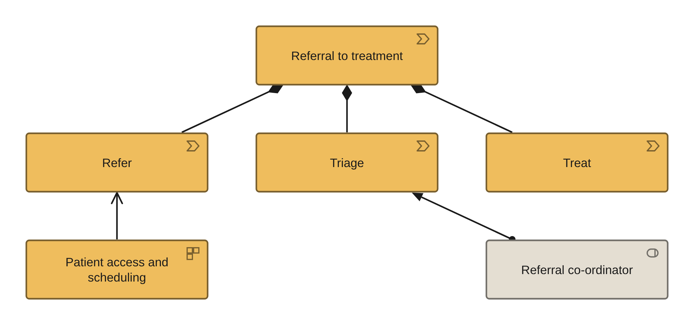
PHASE B · VIEW 08 OF 36
Value stream view
ARCHIMATE 4 VIEWPOINT: VALUE STREAM
FOR
CANVAS
The clinical operations lead, to find the stage with no system behind it
ELEMENTS IT MAY CONTAIN
Value Stream, Capability, Role, Service, Business Object
RELATIONSHIPS
Composition, Serving, Assignment, Association
POPULATED FROM
O14 Value Stream, O16 Business Process, O13 Business Capability
WHAT THIS VIEW CANNOT SHOW
Where the stream crosses an organisational boundary, which is where it actually fails
THE MISTAKE PEOPLE MAKE
Trusting the declared stage count. Against volume 1's own stage names the repository is short by sixteen, and the two rows with no internal discrepancy — where declared equals present — are short by three and four.
Healthcare EA · View templates
Thotnr Consulting · Healthcare starter pack · October 2026
16
Notes:
WHAT TO SAY
Walk one stream and stop at the first stage nobody can name a system for. In a provider there is always one.
QUESTION TO EXPECT
'Which stream first?' The one with the documented clinical harm: order to result.

Slide 17
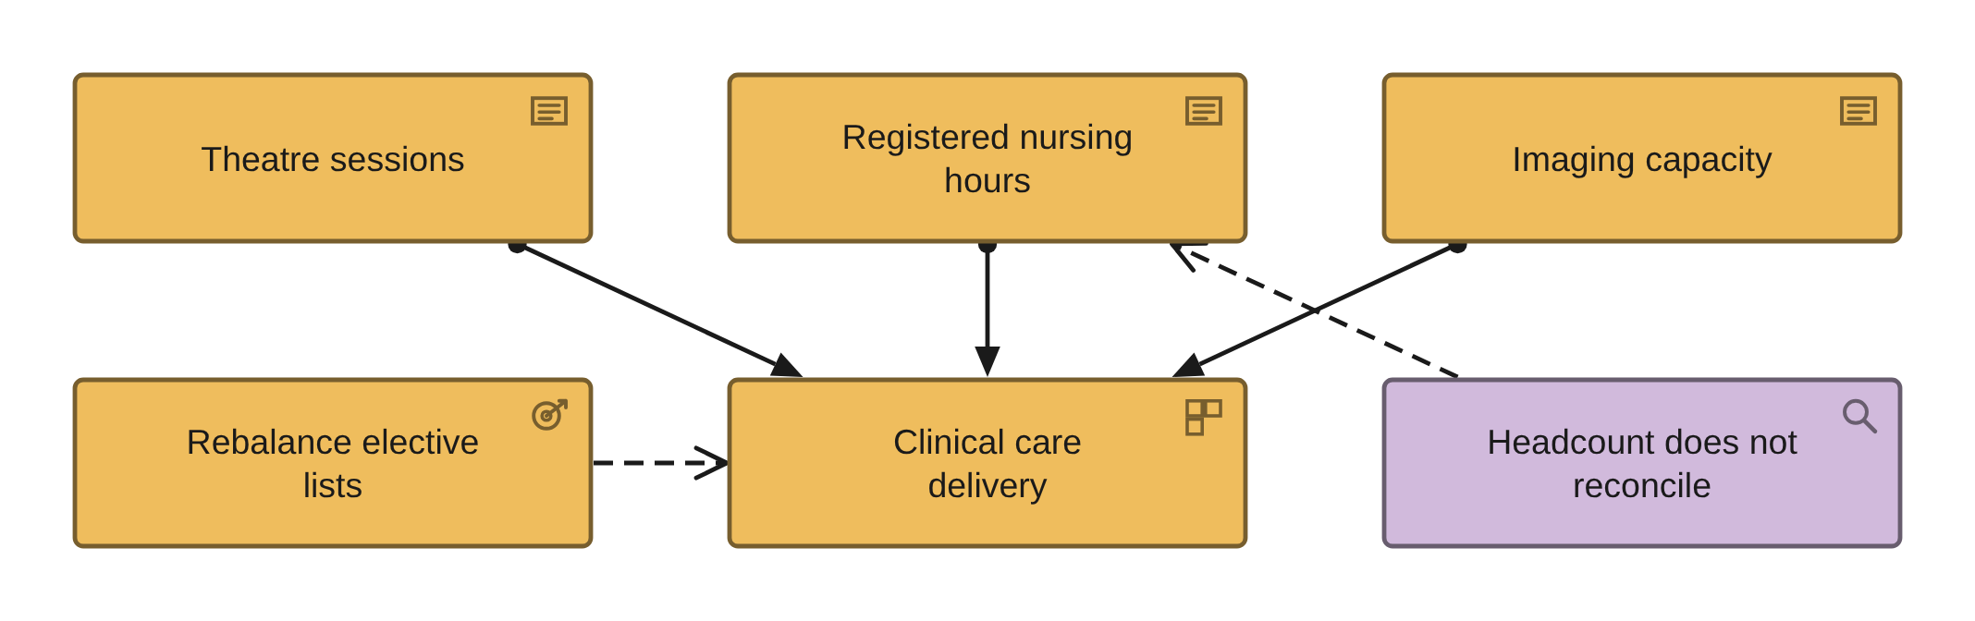
PHASE B · VIEW 09 OF 36
Resource map view
ARCHIMATE 4 VIEWPOINT: RESOURCE MAP
FOR
CANVAS
The chief operating officer, to show what the capabilities are actually made of
ELEMENTS IT MAY CONTAIN
Resource, Capability, Course of Action, Role
RELATIONSHIPS
Assignment, Realization, Association
POPULATED FROM
O13 Business Capability, O09 Organization Unit, O12 Location
WHAT THIS VIEW CANNOT SHOW
Whether a resource is available tonight, which is the only version of the number an operations meeting wants
THE MISTAKE PEOPLE MAKE
Counting a register as a workforce. A nursing register counts registrations, not people at a bedside, and in the repository the unit headcounts sum to 1 607 against a declared scale of 1 769.
Healthcare EA · View templates
Thotnr Consulting · Healthcare starter pack · October 2026
17
Notes:
WHAT TO SAY
Resources are where the capability map stops being a poster. Ask which of the three has a measured availability.
QUESTION TO EXPECT
'Is this not a capacity plan?' No — it is the list of things a capacity plan needs.

Slide 18
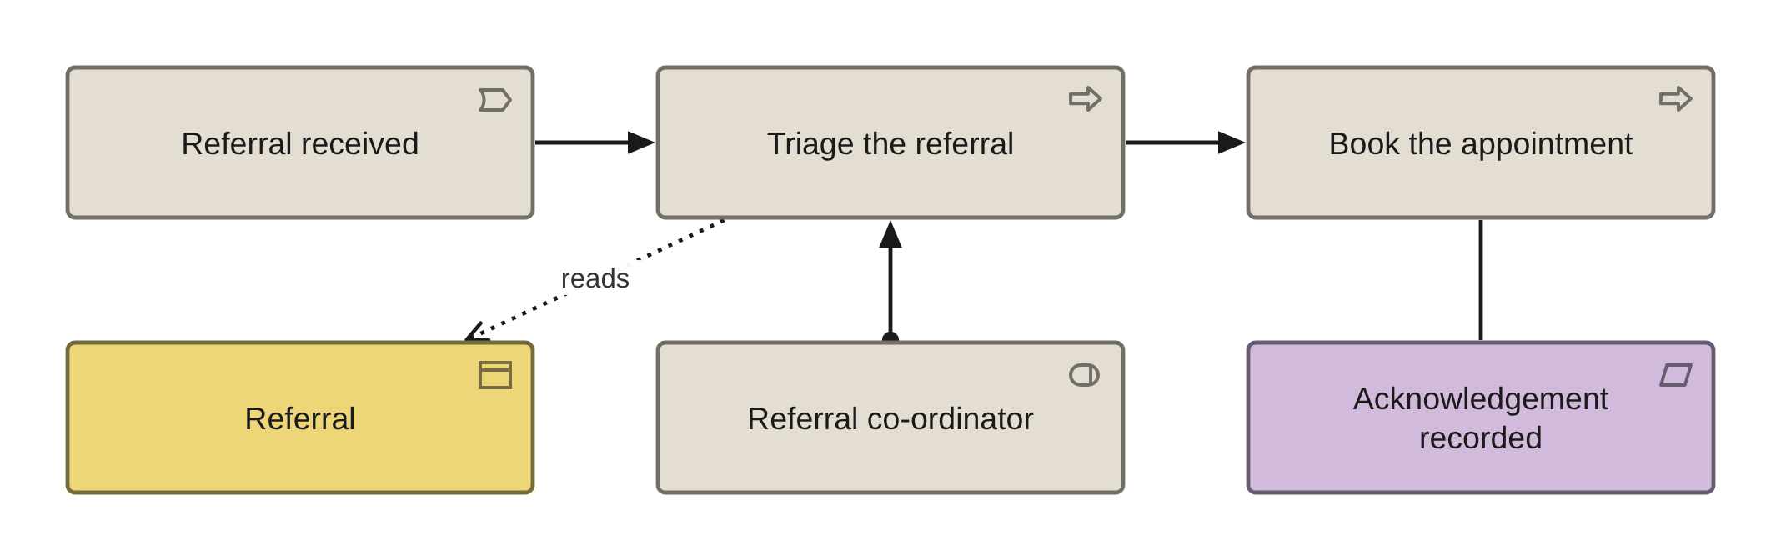
PHASE B · VIEW 10 OF 36
Referral to treatment, end to end
ARCHIMATE 4 VIEWPOINT: BUSINESS PROCESS CO-OPERATION
FOR
CANVAS
The clinical lead and the integration lead together, in one room
ELEMENTS IT MAY CONTAIN
Process, Event, Role, Business Object, Service, Collaboration
RELATIONSHIPS
Triggering, Flow, Assignment, Access, Serving
POPULATED FROM
WHAT THIS VIEW CANNOT SHOW
O16 Business Process, O11 Role, O20 Data Entity, R06 interfaces
A state. 'Sent but not acknowledged' cannot be drawn — hold it as a Business Object with its permitted states documented and a Requirement naming the one that must be recorded
THE MISTAKE PEOPLE MAKE
Drawing the happy path only. The finding is always the handoff: a referral sent and never acknowledged is invisible, and the notation has no state to express it.
Healthcare EA · View templates
Thotnr Consulting · Healthcare starter pack · October 2026
18
Notes:
WHAT TO SAY
The acknowledgement element is the point of the view. Without it the stream has an open end and nobody owns it.
QUESTION TO EXPECT
'How many referrals are unacknowledged?' If nobody can say, that is the baseline.

Slide 19
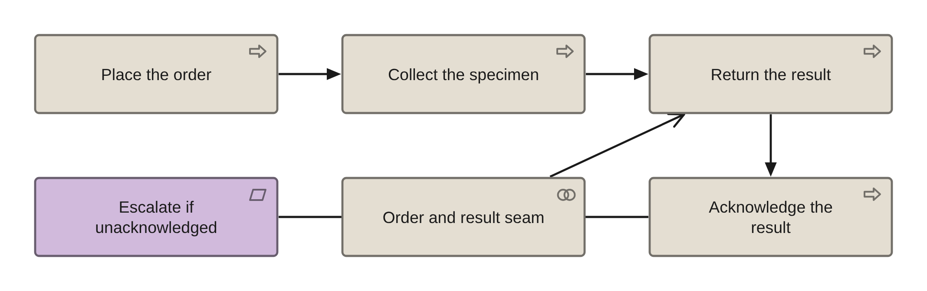
PHASE B · VIEW 11 OF 36
Order to result, closed loop
ARCHIMATE 4 VIEWPOINT: BUSINESS PROCESS CO-OPERATION
FOR
CANVAS
The clinical lead, the laboratory manager and whoever owns the exception queue
ELEMENTS IT MAY CONTAIN
Process, Event, Collaboration, Application Interface, Business Object, Requirement
RELATIONSHIPS
Triggering, Flow, Composition, Serving, Association
POPULATED FROM
WHAT THIS VIEW CANNOT SHOW
O16 Business Process, R06 interfaces, O23 Application Component
The time between authorisation and acknowledgement, which is benchmark two and is a measurement over the data rather than a shape on the view
THE MISTAKE PEOPLE MAKE
Stopping at 'result returned'. The clinical harm in the sourced incidents is in acknowledgement, not delivery, so the loop must close on a clinician having seen it.
Healthcare EA · View templates
Thotnr Consulting · Healthcare starter pack · October 2026
19
Notes:
WHAT TO SAY
This is the path the evidence says to protect first, because pathology and result delivery feature in three of the seven sourced incidents.
QUESTION TO EXPECT
'What happens during a laboratory outage?' Results arrive by telephone, with a correct effective time and no recorded available time.

Slide 20
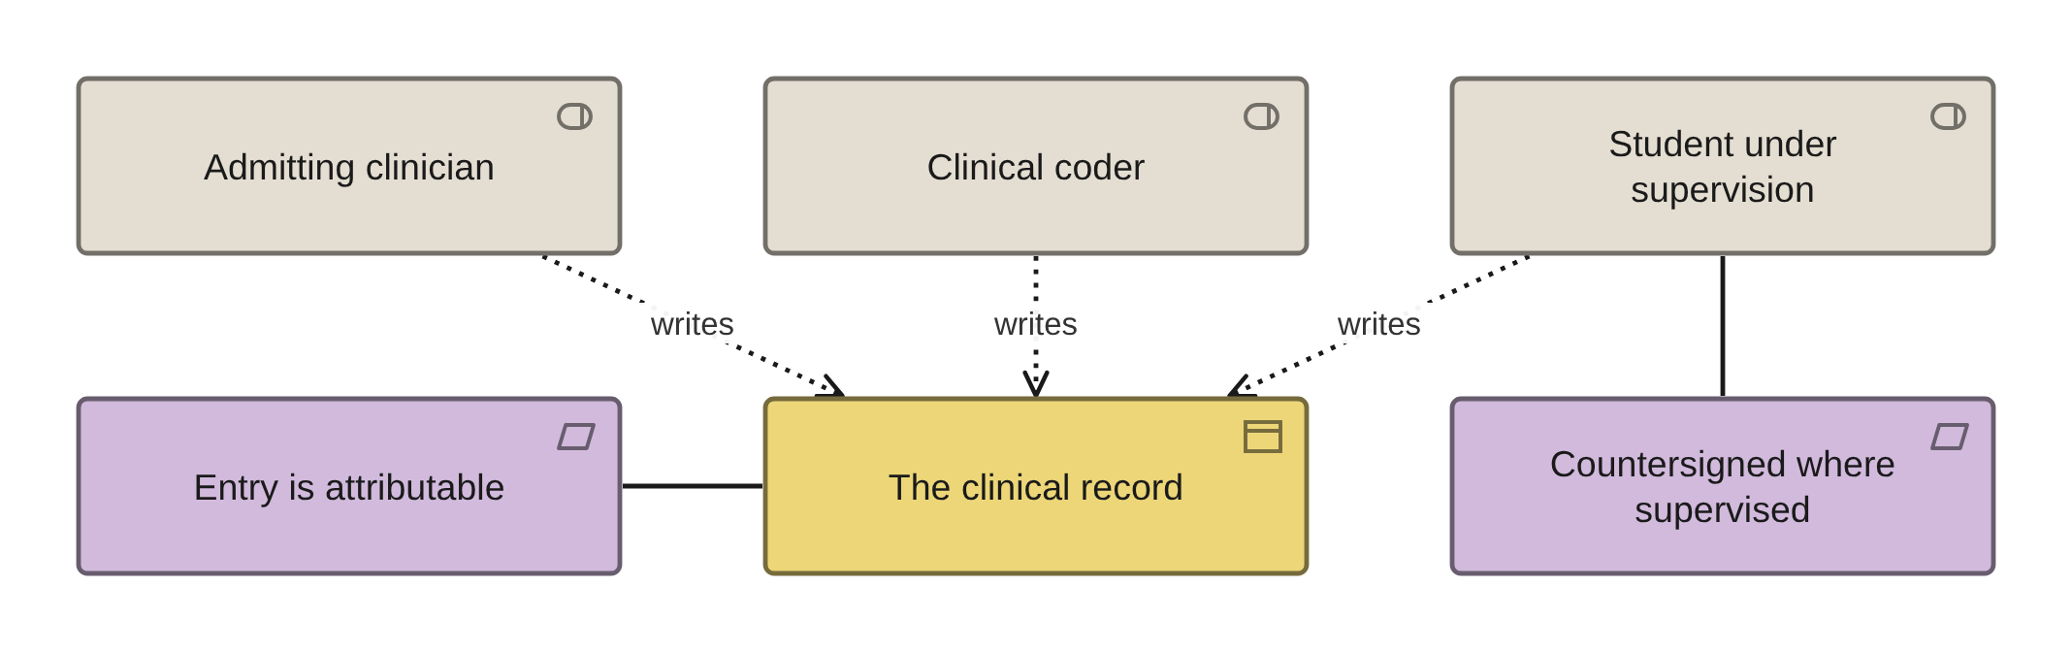
PHASE B · VIEW 12 OF 36
Role and authority to write
ARCHIMATE 4 VIEWPOINT: ORGANIZATION
FOR
CANVAS
The clinical governance lead, to settle who may write in the record and under whose name
ELEMENTS IT MAY CONTAIN
Role, Business Actor, Business Object, Requirement, Process
RELATIONSHIPS
Assignment, Access, Association
POPULATED FROM
O11 Role, O10 Actor, O20 Data Entity, O41 Security Control
WHAT THIS VIEW CANNOT SHOW
Whether a shared login is in use, which only a sample of entries will tell you
THE MISTAKE PEOPLE MAKE
Modelling authorship as a system permission. The professional rule is that an entry is attributable to a person, so a shared login is a conformance failure rather than a security preference.
Healthcare EA · View templates
Thotnr Consulting · Healthcare starter pack · October 2026
20
Notes:
WHAT TO SAY
Three roles, one object, two requirements. The supervised entry is the one every teaching service gets wrong.
QUESTION TO EXPECT
'Can a student write in the record?' Yes, countersigned — and the system must record both names.

Slide 21
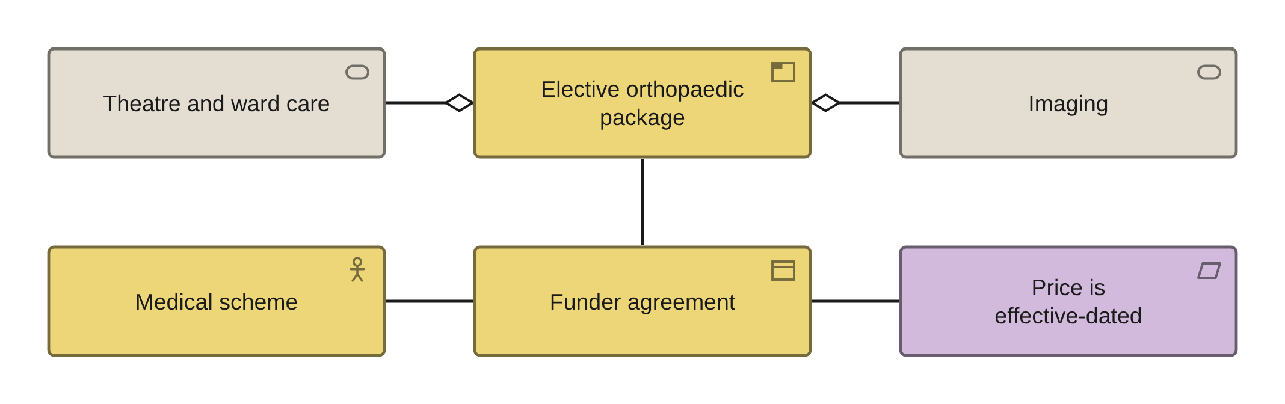
PHASE B · VIEW 13 OF 36
Service offering view
ARCHIMATE 4 VIEWPOINT: PRODUCT
FOR
CANVAS
The commercial lead, to show what is offered, to whom, and at whose price
ELEMENTS IT MAY CONTAIN
Product, Service, Business Object, Business Actor, Requirement
RELATIONSHIPS
Aggregation, Realization, Serving, Association
POPULATED FROM
O18 Product, O15 — ten service rows, by number — and O19 — ten agreements, by number
WHAT THIS VIEW CANNOT SHOW
A price, a tariff or an effective date — all three are properties of the agreement object, and the agreement is a Business Object because there is no contract element
THE MISTAKE PEOPLE MAKE
Putting a price column on the service. There has been no national tariff since 28 July 2010, so price is (funder, provider, service code, effective date) and nothing less.
Healthcare EA · View templates
Thotnr Consulting · Healthcare starter pack · October 2026
21
Notes:
WHAT TO SAY
Name the sheets by number rather than by their titles: two of them are named after element types that do not exist in the notation.
QUESTION TO EXPECT
'What does this cost?' Whatever that funder agreed, on that date.

Slide 22
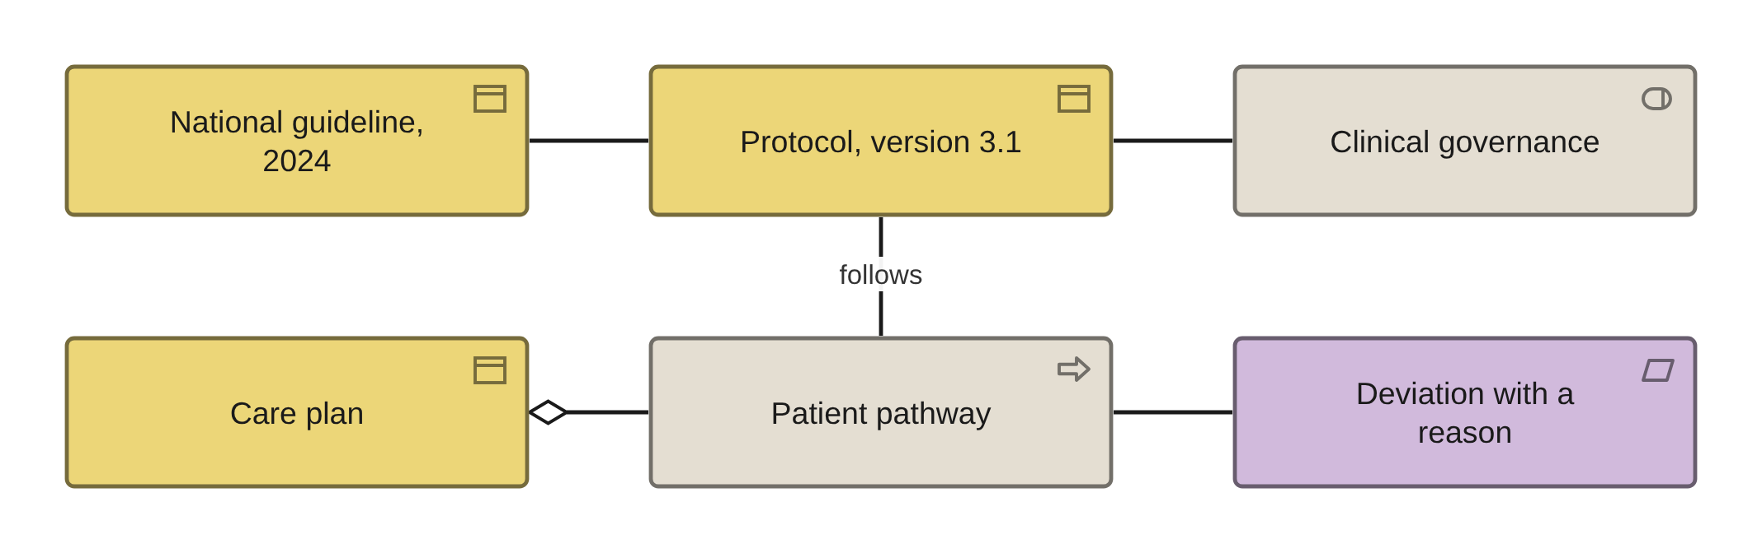
PHASE B · VIEW 14 OF 36
A pathway against a protocol version
ARCHIMATE 4 VIEWPOINT: BUSINESS PROCESS CO-OPERATION
FOR
CANVAS
Clinical governance, to answer whether a patient was managed according to protocol
ELEMENTS IT MAY CONTAIN
Business Object, Process, Role, Requirement
RELATIONSHIPS
Association, Aggregation
POPULATED FROM
WHAT THIS VIEW CANNOT SHOW
O16 Business Process, and the protocol register the repository does not have
The version set. The notation cannot hold a version history, so the model owns the statement that a register exists and which system holds it
THE MISTAKE PEOPLE MAKE
Joining the pathway to the protocol with a Realization. The process does not realise the protocol, it follows it — and the difference between them is the deviation, which is the clinically important fact.
Healthcare EA · View templates
Thotnr Consulting · Healthcare starter pack · October 2026
22
Notes:
WHAT TO SAY
Two properties earn their place on the protocol object: the national source with its version, and the local modification — because a provider that modifies a national guideline has taken on the clinical risk of the modification.
QUESTION TO EXPECT
'Where is the protocol register?' Usually a folder on an intranet with the version in the filename.

Slide 23
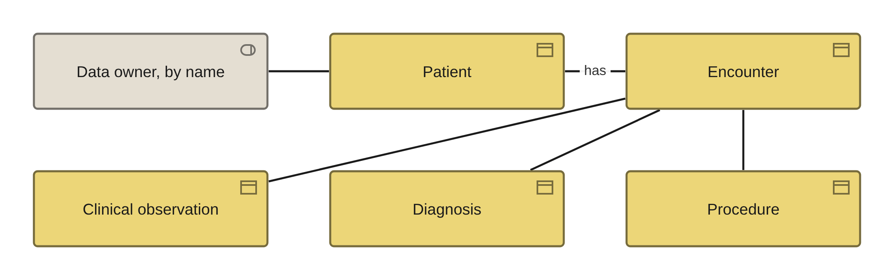
PHASE C · DATA · VIEW 15 OF 36
Conceptual data model view
ARCHIMATE 4 VIEWPOINT: INFORMATION STRUCTURE
FOR
CANVAS
The data owners, to agree what the fourteen entities are before anybody masters them
ELEMENTS IT MAY CONTAIN
Business Object, Data Object, Requirement, Role
RELATIONSHIPS
Association, Realization, Specialization
POPULATED FROM
WHAT THIS VIEW CANNOT SHOW
O20 Data Entity, O36 Data Entity Relationship, O37 Data Attribute
Cardinality, optionality or a key. All three live in the model the view is drawn from
THE MISTAKE PEOPLE MAKE
Reading cardinality off the drawing. Association, Aggregation and Composition carry no multiplicity, so the model has to be maintained with cardinalities and then drawn — the repository records patient to encounter as many-to-many and nothing in a drawing would have caught it.
Healthcare EA · View templates
Thotnr Consulting · Healthcare starter pack · October 2026
23
Notes:
WHAT TO SAY
The same name at the conceptual and the logical level is the commonest modelling error here. Decide which level this view is at and say so on its face.
QUESTION TO EXPECT
'One patient, how many encounters?' The drawing cannot say. The model must.

Slide 24
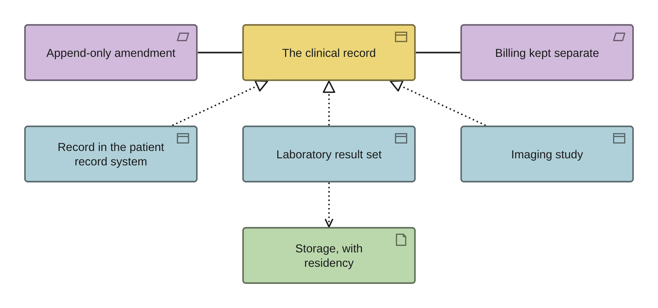
PHASE C · DATA · VIEW 16 OF 36
The record across three layers
ARCHIMATE 4 VIEWPOINT: INFORMATION STRUCTURE
FOR
CANVAS
The medico-legal lead and the chief information officer, in the same room
ELEMENTS IT MAY CONTAIN
Business Object, Data Object, Artifact, Requirement
RELATIONSHIPS
Realization, Access, Association
POPULATED FROM
O20 Data Entity, O21 Logical Data Component, O22 Physical Data Component, O72
WHAT THIS VIEW CANNOT SHOW
Where a copy is, who has read it, or how long retrieval takes — the last of those is the number the medico-legal arithmetic actually runs on
THE MISTAKE PEOPLE MAKE
Drawing one box called 'the record'. It is a legal construct, several data objects and several artifacts — and drawing it as one is why the retrieval problem stays invisible until a plaintiff asks.
Healthcare EA · View templates
Thotnr Consulting · Healthcare starter pack · October 2026
24
Notes:
WHAT TO SAY
Three arguments in one picture: what an electronic record actually means, where retention applies, and that the billing store is a different store.
QUESTION TO EXPECT
'Is the warehouse extract in scope?' If it realises the business object, yes.

Slide 25
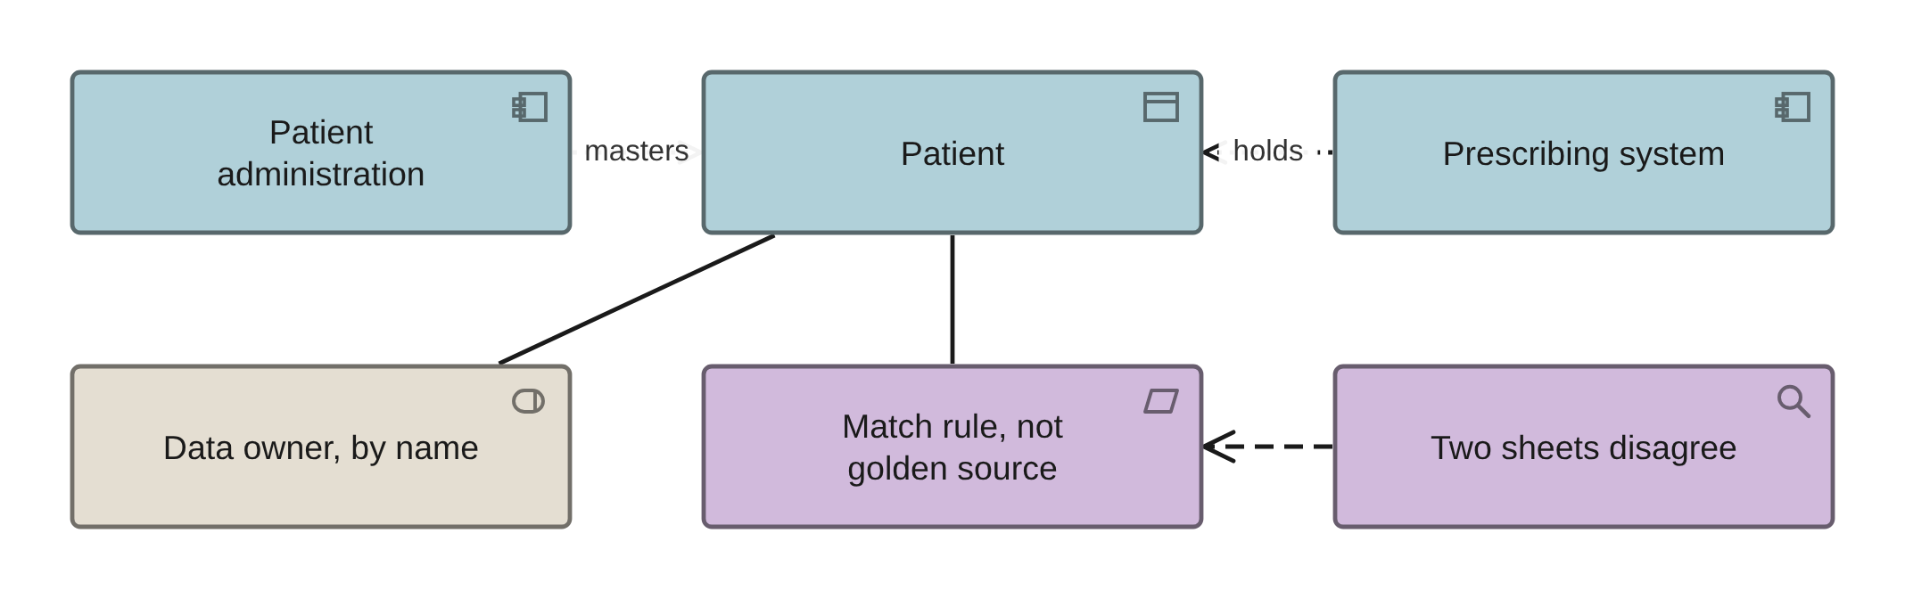
PHASE C · DATA · VIEW 17 OF 36
Mastering authority view
ARCHIMATE 4 VIEWPOINT: INFORMATION STRUCTURE
FOR
CANVAS
The data owners, to settle which system is allowed to be wrong about which entity
ELEMENTS IT MAY CONTAIN
Data Object, Application Component, Requirement, Role
RELATIONSHIPS
Access, Association, Assignment
POPULATED FROM
WHAT THIS VIEW CANNOT SHOW
O20 Data Entity, O43 Master Data Rule, O21 Logical Data Component
Which system is right when two disagree. That is the rule type, and it is a property
THE MISTAKE PEOPLE MAKE
Accepting the sheet. Not one of the fourteen entities is mastered in a system that could own it — the patient sits in the prescribing system, and clinical observations and claims are exactly swapped — and the mastering sheet names a different golden source from the entity sheet for eight of ten rows.
Healthcare EA · View templates
Thotnr Consulting · Healthcare starter pack · October 2026
25
Notes:
WHAT TO SAY
Master system and golden source must agree before anybody leaves the room, or the three sheets disagree again by Friday.
QUESTION TO EXPECT
'Which system is the master?' Name one, and name the rule that resolves a conflict.

Slide 26
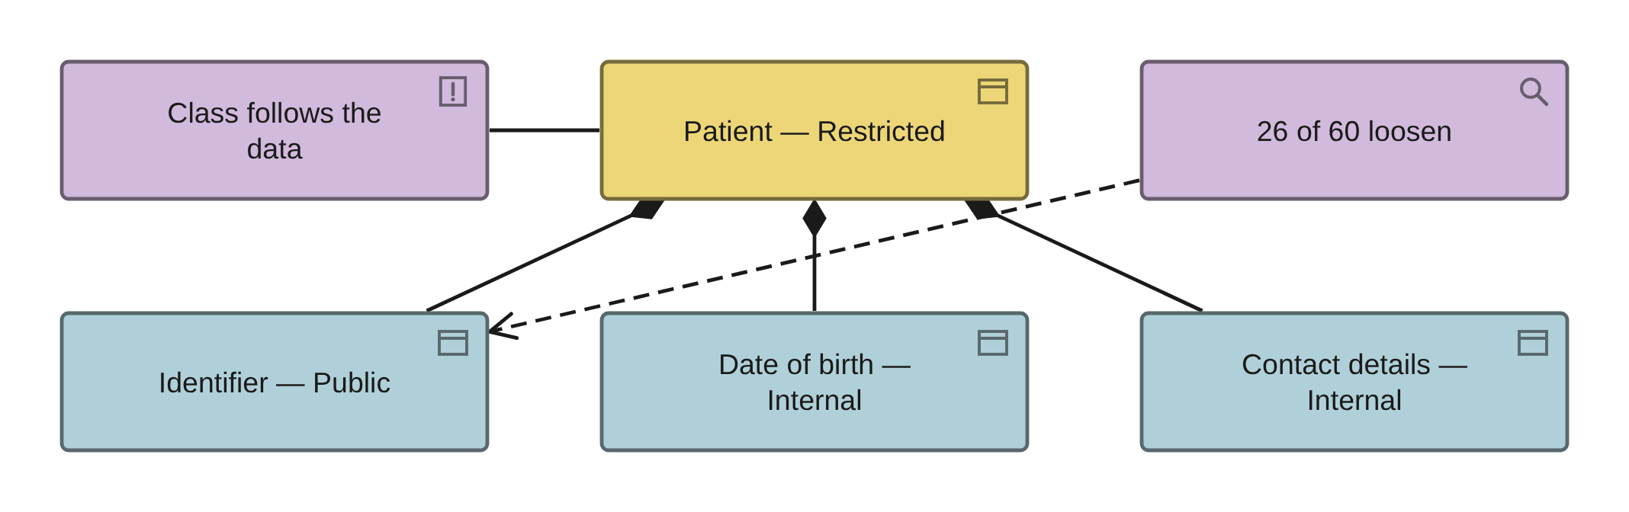
PHASE C · DATA · VIEW 18 OF 36
Classification inheritance view
ARCHIMATE 4 VIEWPOINT: INFORMATION STRUCTURE
FOR
CANVAS
The information officer, to make a misclassification visible in one glance
ELEMENTS IT MAY CONTAIN
Business Object, Data Object, Requirement, Principle, Assessment
RELATIONSHIPS
Composition, Association, Influence
POPULATED FROM
WHAT THIS VIEW CANNOT SHOW
O20 Data Entity, O37 Data Attribute, O05 Principle PRN-14
The classification itself — it is a property, invisible unless the tool is configured to print it, and the first thing lost in an export to a spreadsheet
THE MISTAKE PEOPLE MAKE
Classifying an attribute independently of its entity. Classification inherits downward and never loosens; the repository breaks it in 26 of 60 attributes, including the patient identifier, graded Public beneath a Restricted entity.
Healthcare EA · View templates
Thotnr Consulting · Healthcare starter pack · October 2026
26
Notes:
WHAT TO SAY
Print the classification on the element or the view says nothing. Then read the identifier row aloud.
QUESTION TO EXPECT
'Is Public a real value here?' Only for something the organisation publishes.

Slide 27
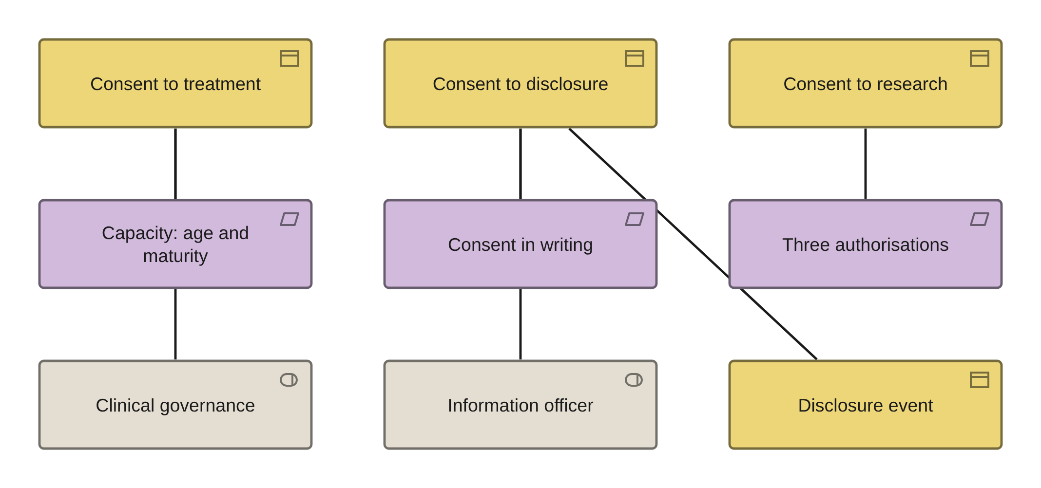
PHASE C · DATA · VIEW 19 OF 36
Consent, scoped and dated
INVENTED: NO STANDARD VIEWPOINT COVERS IT
FOR
CANVAS
The information officer and the admitting clinician, who hold different halves of it
ELEMENTS IT MAY CONTAIN
Business Object, Requirement, Role, Process
RELATIONSHIPS
Association, Access
POPULATED FROM
O67 Consent — created by item 2 — and O20 row 17, which is all the file holds today
WHAT THIS VIEW CANNOT SHOW
Expiry or withdrawal. There is no time on an element, so granted, expiry, withdrawal date and the person withdrawing are all properties — and the last two are the ones most often missing
THE MISTAKE PEOPLE MAKE
One consent object with the word 'and' in its definition. Consent to treatment, to disclosure and to research are three objects with three legal bases and three consequences of withdrawal, and the repository models them as one row.
Healthcare EA · View templates
Thotnr Consulting · Healthcare starter pack · October 2026
27
Notes:
WHAT TO SAY
Three objects, three owners, three constraints. Withdrawal stops the intervention in the first, stops future disclosure in the second, and cannot unsend what was already sent — which is why the fourth object on this view exists.
QUESTION TO EXPECT
'Can a child consent?' Over 12, with sufficient maturity, and the maturity assessment is itself a recorded clinical act with an author and a date.

Slide 28
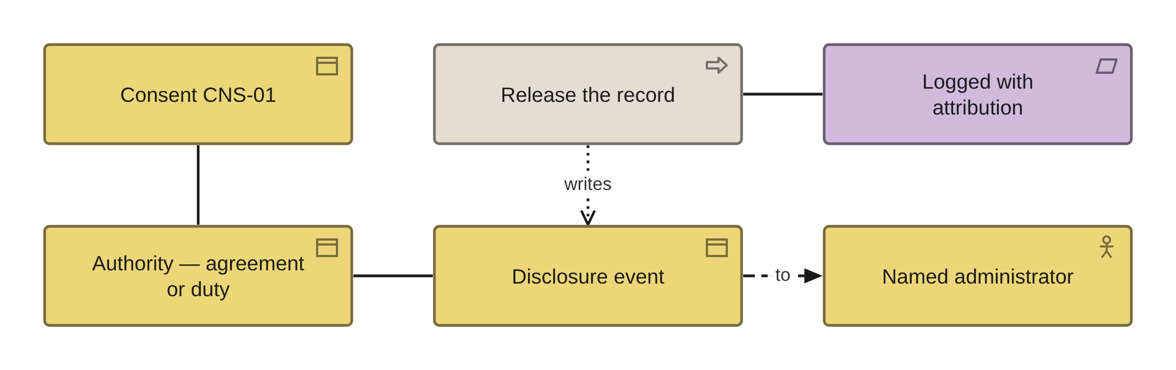
PHASE C · DATA · VIEW 20 OF 36
Disclosure event view
INVENTED: NO STANDARD VIEWPOINT COVERS IT
FOR
CANVAS
The information officer, to answer what left the building, to whom, and on what authority
ELEMENTS IT MAY CONTAIN
Business Object, Business Actor, Process, Requirement, Role
RELATIONSHIPS
Access, Association, Flow
POPULATED FROM
WHAT THIS VIEW CANNOT SHOW
O71 Disclosure Event — created by item 2. Nothing in the 105 sheets records it today
Whether the recipient still holds it, which is why a withdrawal of consent stops future disclosure and cannot unsend what was sent
THE MISTAKE PEOPLE MAKE
Registering only the disclosures somebody already felt uneasy about. The statutory and programmatic returns are most of the volume and are the two least likely to think of themselves as disclosing anything.
Healthcare EA · View templates
Thotnr Consulting · Healthcare starter pack · October 2026
28
Notes:
WHAT TO SAY
Authority and consent reference are a pair. Where the authority is a statutory duty the consent reference is deliberately blank and the authority carries the whole weight.
QUESTION TO EXPECT
'Do we have this?' Interface logging reads Partial, with ten interfaces carrying none.

Slide 29
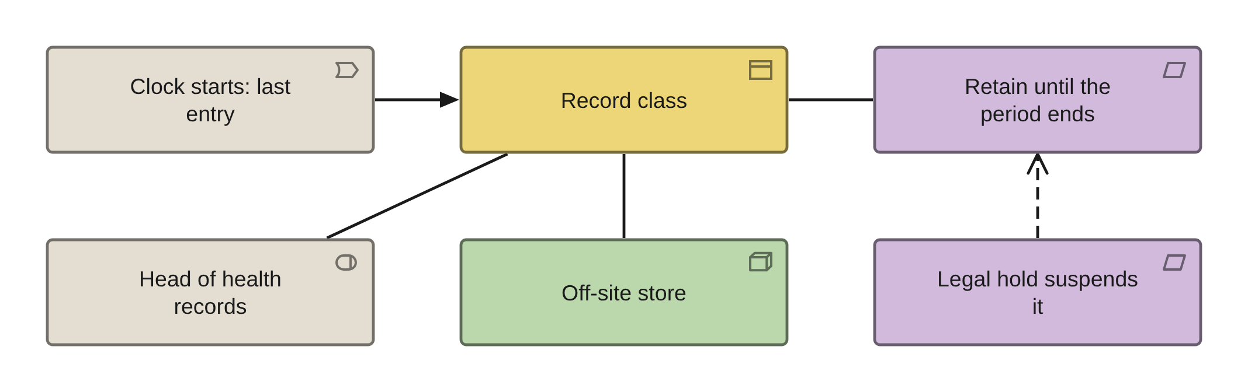
PHASE C · DATA · VIEW 21 OF 36
Retention clock view
INVENTED: NO STANDARD VIEWPOINT COVERS IT
FOR
CANVAS
The head of health records and the legal lead, before anything is modelled
ELEMENTS IT MAY CONTAIN
Business Object, Requirement, Event, Role, Node
RELATIONSHIPS
Association, Triggering, Access
POPULATED FROM
O72 Retention Clock — created by item 2. O20 has no retention column and O37 no retention attribute
WHAT THIS VIEW CANNOT SHOW
The period itself, the clock-start event or the destruction authority. All three are properties, and the authority is the one that is usually empty
THE MISTAKE PEOPLE MAKE
Setting one corporate period. Date of last entry, date of dormancy, date of death and the date a minor reaches majority produce four different destruction dates for the same box, and a single period is unlawfully short for the longest class and needlessly expensive for everything else.
Healthcare EA · View templates
Thotnr Consulting · Healthcare starter pack · October 2026
29
Notes:
WHAT TO SAY
Add the measured retrieval time in Phase D. A retention period with no measured retrieval time is a promise, and the medico-legal arithmetic runs on retrieval.
QUESTION TO EXPECT
'What does the law say?' Nothing. Every period in circulation traces to professional guidance whose own editions disagree.

Slide 30
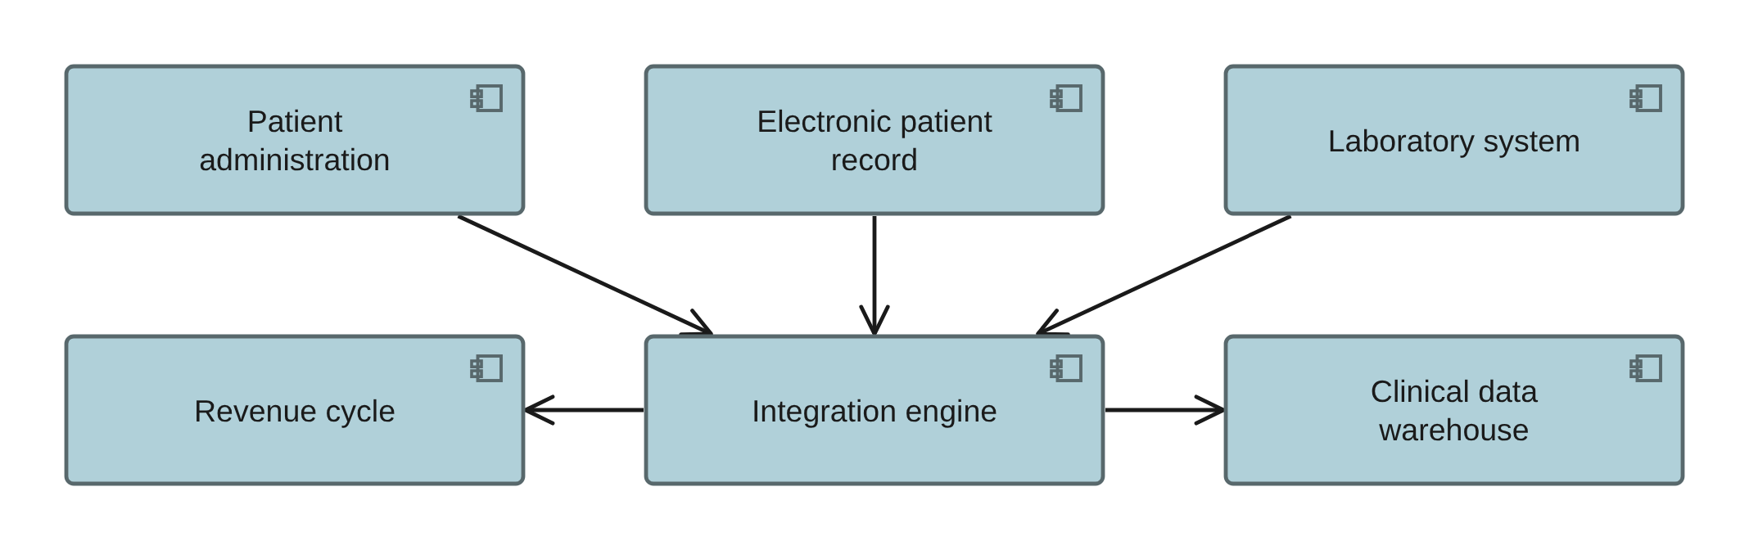
PHASE C · APPLICATION · VIEW 22 OF 36
Application landscape view
ARCHIMATE 4 VIEWPOINT: APPLICATION STRUCTURE
FOR
CANVAS
The chief information officer, to show the estate as twelve components and their seams
ELEMENTS IT MAY CONTAIN
Application Component, Application Interface, Data Object, Grouping
RELATIONSHIPS
Composition, Serving, Access
POPULATED FROM
WHAT THIS VIEW CANNOT SHOW
O23 Application Component, O24 — twelve service rows, by number — R06
Which component is actually used, and by how many people — that is the usage view
THE MISTAKE PEOPLE MAKE
Treating the application inventory as the valuable artefact. In an estate held together by point-to-point feeds the interface inventory is the valuable one, and it is the register most often missing.
Healthcare EA · View templates
Thotnr Consulting · Healthcare starter pack · October 2026
30
Notes:
WHAT TO SAY
Twelve components is a morning's work. The interfaces between them are the quarter.
QUESTION TO EXPECT
'Is the engine a hub?' Ask how many feeds bypass it.

Slide 31
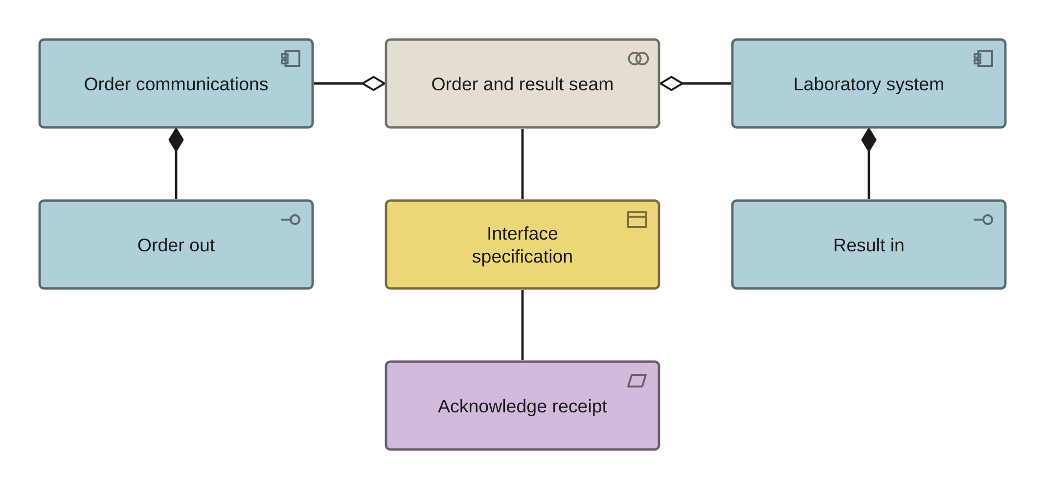
PHASE C · APPLICATION · VIEW 23 OF 36
A seam, and what actually governs it
ARCHIMATE 4 VIEWPOINT: APPLICATION CO-OPERATION
FOR
CANVAS
The integration lead and the supplier, with the interface specification open
ELEMENTS IT MAY CONTAIN
Application Component, Collaboration, Application Interface, Business Object, Requirement
RELATIONSHIPS
Aggregation, Composition, Serving, Association
POPULATED FROM
WHAT THIS VIEW CANNOT SHOW
R06 interfaces — twenty-three rows, fifteen of them mutually inconsistent
Direction, payload, trigger or criticality. All four are properties of the interface specification object, which is a Business Object because there is no contract element
THE MISTAKE PEOPLE MAKE
Writing a standard's name on the arrow. A standard is not a relationship. Most seams are governed by a messaging standard for syntax, code systems for semantics, a conformance profile for constraint, and a local interface specification that is the actual contract — and the last of those is the object to draw.
Healthcare EA · View templates
Thotnr Consulting · Healthcare starter pack · October 2026
31
Notes:
WHAT TO SAY
Read the inconsistency out loud: two direct database reads labelled managed, five managed links that are not logged, eight unmanaged links that produce correlated logs, and two rows whose type is batch and whose frequency is real time.
QUESTION TO EXPECT
'Which standard governs this?' Wrong question. Ask which layers govern it, and what the actual contract is.

Slide 32
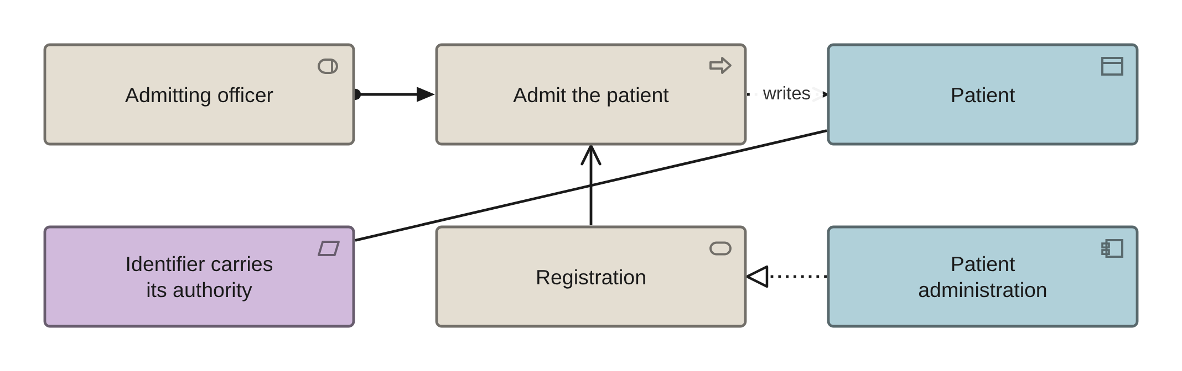
PHASE C · APPLICATION · VIEW 24 OF 36
Application usage view
ARCHIMATE 4 VIEWPOINT: APPLICATION USAGE
FOR
CANVAS
The clinical lead, to show which role touches which system in which stage
ELEMENTS IT MAY CONTAIN
Application Component, Service, Process, Role, Data Object
RELATIONSHIPS
Serving, Assignment, Access
POPULATED FROM
WHAT THIS VIEW CANNOT SHOW
O16 Business Process, O23 Application Component, O24 — by number — R07
Whether anybody logs in. Usage is a measurement, not a relationship
THE MISTAKE PEOPLE MAKE
Trusting a positional join. The repository's support sheet pairs the billing system with emergency care and the patient portal with diagnostic services, and every row of it resolves.
Healthcare EA · View templates
Thotnr Consulting · Healthcare starter pack · October 2026
32
Notes:
WHAT TO SAY
Note the service name: a Service in the application layer. There is no layer-prefixed service element, and writing one tells a reviewer which training material you used.
QUESTION TO EXPECT
'Who uses this?' A role, not a department.

Slide 33
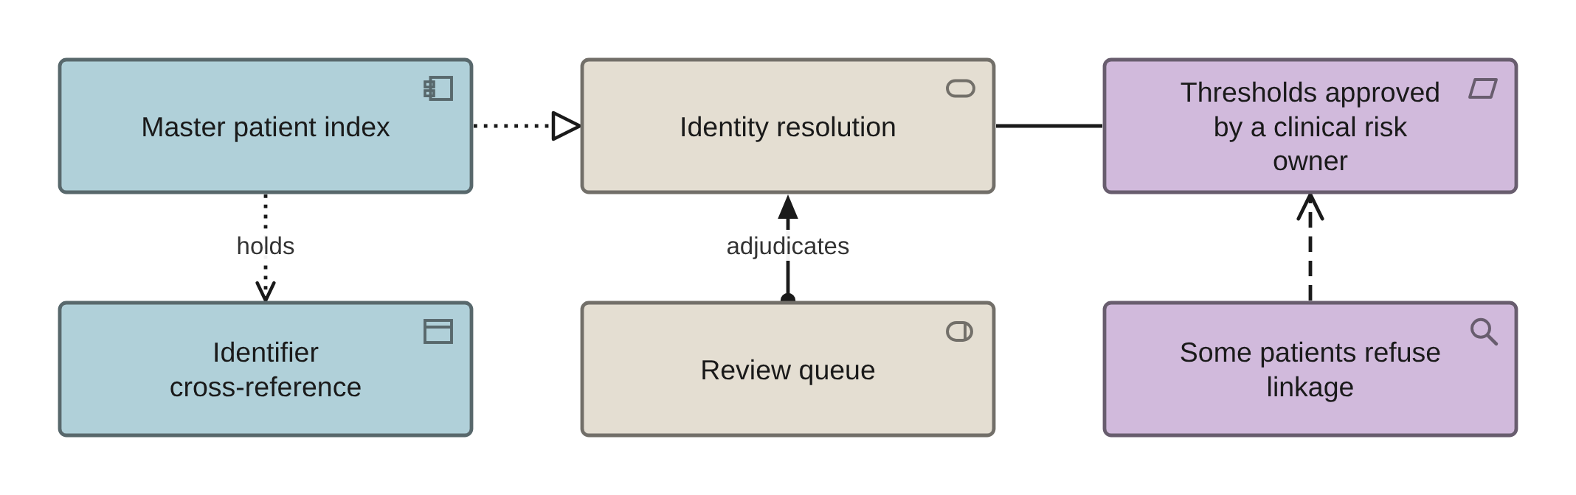
PHASE C · APPLICATION · VIEW 25 OF 36
Identity resolution service view
ARCHIMATE 4 VIEWPOINT: SERVICE REALIZATION
FOR
CANVAS
The clinical risk owner, because the thresholds are a clinical safety decision
ELEMENTS IT MAY CONTAIN
Application Component, Service, Data Object, Role, Requirement, Assessment
RELATIONSHIPS
Realization, Assignment, Access, Influence
POPULATED FROM
WHAT THIS VIEW CANNOT SHOW
O23 Application Component, O43 Master Data Rule, O20 Data Entity
Queue depth and queue age, which are the two operational measures that say whether the index is working at all
THE MISTAKE PEOPLE MAKE
Drawing one box labelled master patient index. There are four components and only three of them are software — the fourth is the review queue, which is a person, and it is the one that gets dropped.
Healthcare EA · View templates
Thotnr Consulting · Healthcare starter pack · October 2026
33
Notes:
WHAT TO SAY
Drawing the service separately from the component is what lets the model say the service may be provided by a national system the organisation does not own.
QUESTION TO EXPECT
'Link or merge?' A merge must be reversible by construction, and a merge is a recorded act with an authority.

Slide 34
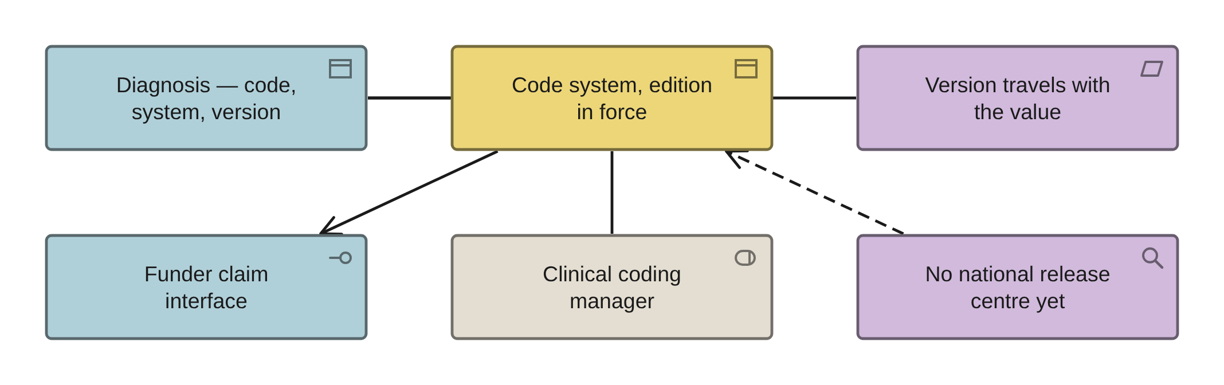
PHASE C · APPLICATION · VIEW 26 OF 36
Code system and edition
INVENTED: NO STANDARD VIEWPOINT COVERS IT
FOR
CANVAS
The clinical coding manager and the claims manager, who will disagree, usefully
ELEMENTS IT MAY CONTAIN
Business Object, Application Interface, Requirement, Role, Data Object
RELATIONSHIPS
Association, Access, Serving
POPULATED FROM
O69 Code System — created by item 2. The file holds one terminology string, repeated verbatim five times, and it is a component name
WHAT THIS VIEW CANNOT SHOW
An effective date. There is no time on an element, so effective-from and effective-to are properties and a code value carries its system and version with it
THE MISTAKE PEOPLE MAKE
One row per code system. Code validity is effective-dated, so it is one row per system per edition in use — and where two editions are live in two systems that is two rows and the difference between them is the finding.
Healthcare EA · View templates
Thotnr Consulting · Healthcare starter pack · October 2026
34
Notes:
WHAT TO SAY
Ask of each system in the room which of three things it is being used as: a terminology for recording what was observed, a classification for counting cases, or a nomenclature naming a payable unit of work.
QUESTION TO EXPECT
'Which one is the standard?' The one a funder will refuse to pay without.

Slide 35
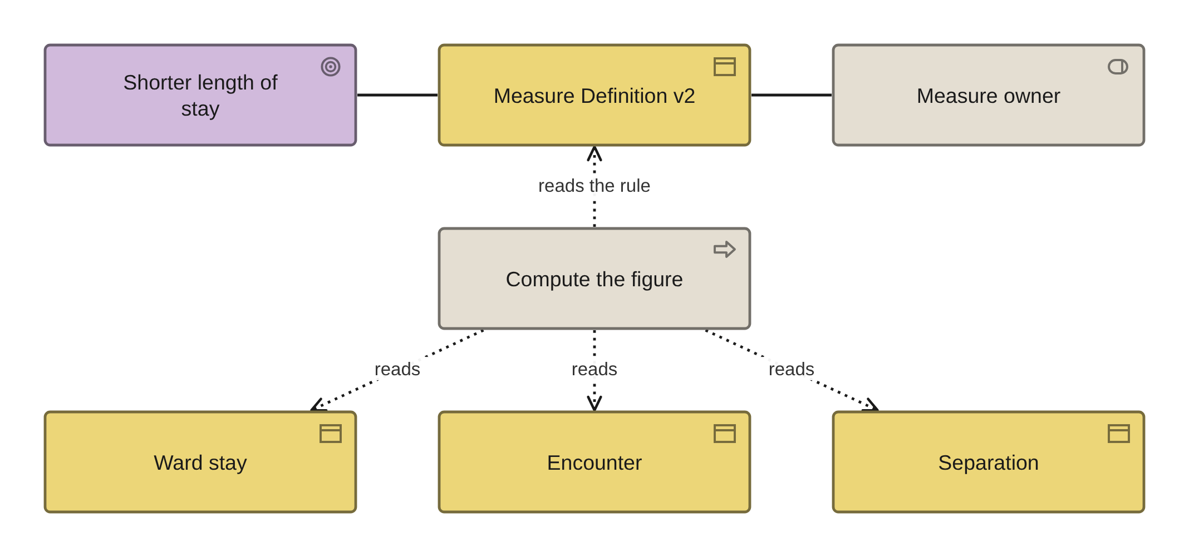
PHASE C · APPLICATION · VIEW 27 OF 36
Measure definition view
INVENTED: NO STANDARD VIEWPOINT COVERS IT
FOR
CANVAS
Whoever builds the board pack, and whoever builds the other version of the same figure
ELEMENTS IT MAY CONTAIN
Business Object, Goal, Process, Role, Requirement
RELATIONSHIPS
Association, Access
POPULATED FROM
O70 Measure Definition — created by item 2 — beside O04 Measure's sixteen rows
WHAT THIS VIEW CANNOT SHOW
The figure itself, or whether two figures are comparable — four defensible theatre utilisation numbers come off one list with no conversion between them
THE MISTAKE PEOPLE MAKE
Putting the number on the goal. There is no metric element and Value is not a number: the definition is an object carrying numerator, denominator, exclusions, boundary rule, version and period, and the baseline is a property of it.
Healthcare EA · View templates
Thotnr Consulting · Healthcare starter pack · October 2026
35
Notes:
WHAT TO SAY
Compute from the lowest-level timestamped facts rather than from a pre-cut aggregate, and write the exclusions as a list a query writer could implement.
QUESTION TO EXPECT
'Why has the number changed?' A definition change is a new version with a date, never an edit in place.

Slide 36
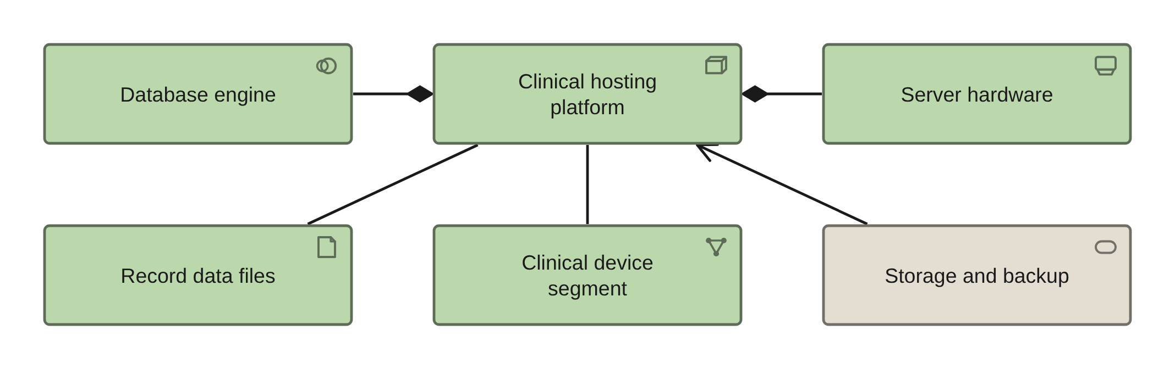
PHASE D · VIEW 28 OF 36
Technology view
ARCHIMATE 4 VIEWPOINT: TECHNOLOGY
FOR
CANVAS
The infrastructure lead, to show what the clinical estate actually runs on
ELEMENTS IT MAY CONTAIN
Node, Device, System Software, Communication Network, Artifact, Service
RELATIONSHIPS
Composition, Assignment, Serving, Association
POPULATED FROM
O26 and O27 — both titles truncated at 31 characters — O48 Environment, O50 Network Link
WHAT THIS VIEW CANNOT SHOW
Whether anything was ever restore-tested. Nine of twelve applications in the repository have never been tested, including both marked Critical
THE MISTAKE PEOPLE MAKE
Filing clinical devices as infrastructure. The repository's nearest structure classes everything as application, storage, network, database, end user or compute, which is why its medical device gateways sit under infrastructure with no risk class.
Healthcare EA · View templates
Thotnr Consulting · Healthcare starter pack · October 2026
36
Notes:
WHAT TO SAY
Note the names: Node, Device and System Software are genuinely layer-specific, and so are the three interface elements. Service, Process, Function, Event, Role and Collaboration are not.
QUESTION TO EXPECT
'Where is the record held?' Follow the artifact, not the component.

Slide 37
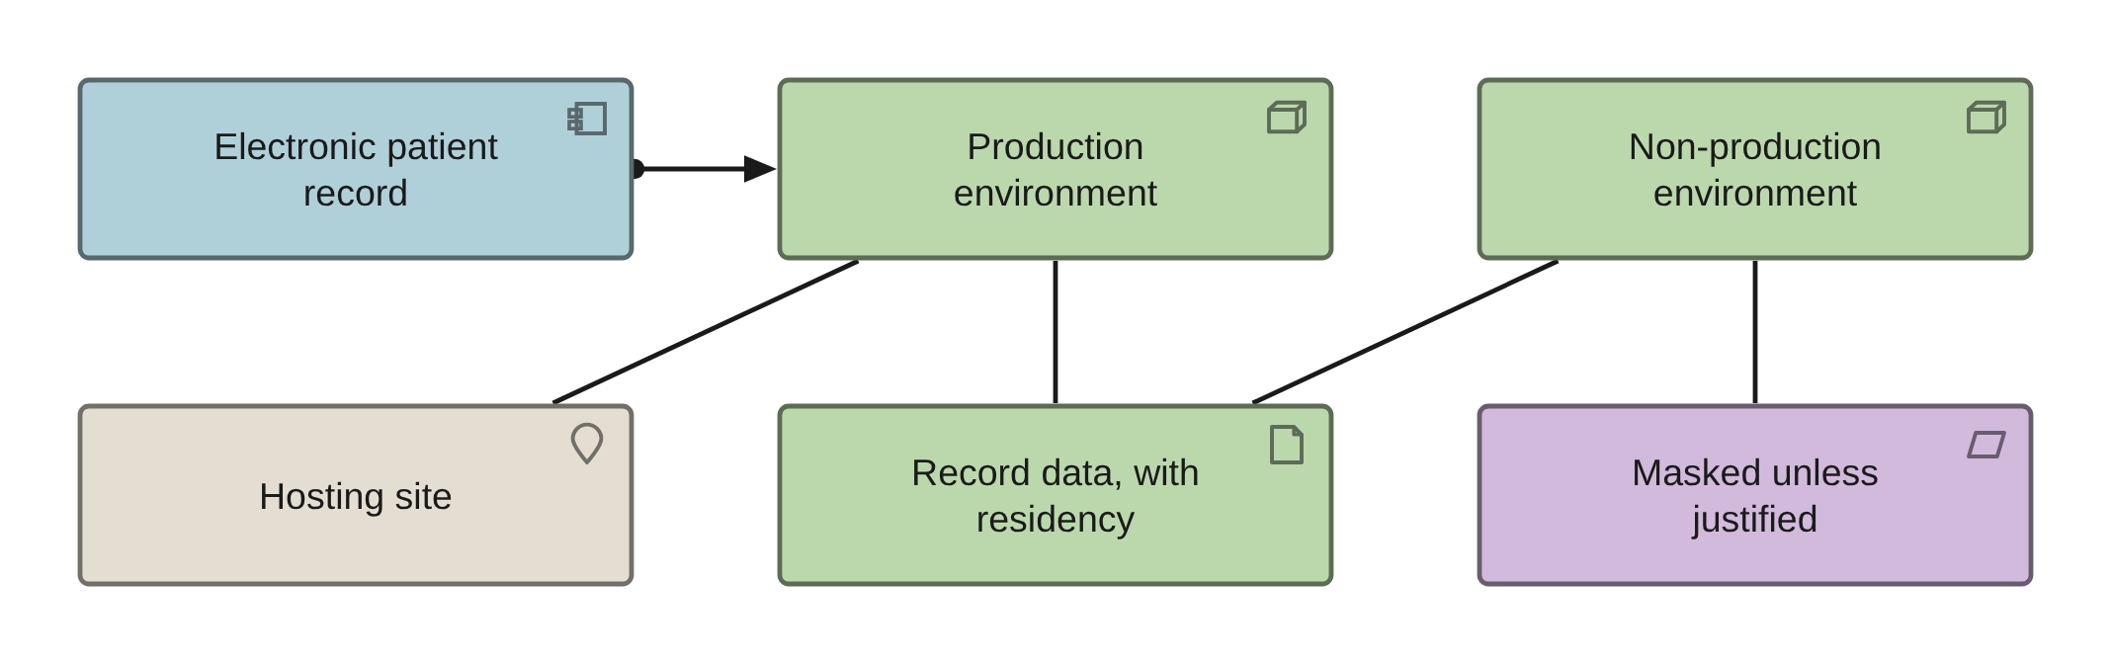
PHASE D · VIEW 29 OF 36
Deployment and hosting view
ARCHIMATE 4 VIEWPOINT: IMPLEMENTATION AND DEPLOYMENT
FOR
CANVAS
The information officer, because hosting location is a lawfulness question here
ELEMENTS IT MAY CONTAIN
Node, Artifact, Application Component, Requirement, Facility, Location
RELATIONSHIPS
Assignment, Association, Composition
POPULATED FROM
WHAT THIS VIEW CANNOT SHOW
O48 Environment, O22 Physical Data Component, O23 Application Component
Residency or encryption — properties on the artifact — and whether a transfer mechanism was ever applied
THE MISTAKE PEOPLE MAKE
Recording the environments without reading them against each other. The repository says production holds no personal data while development, pre-production and test do, on a workbook that also records non-production masking as absent.
Healthcare EA · View templates
Thotnr Consulting · Healthcare starter pack · October 2026
37
Notes:
WHAT TO SAY
Read the environment rows aloud in order. Three of four are internally contradictory about personal data and the refresh process is the same for all of them.
QUESTION TO EXPECT
'Can we host it outside the country?' Two mechanisms, and one of them needs prior authorisation. Record both in the design.

Slide 38
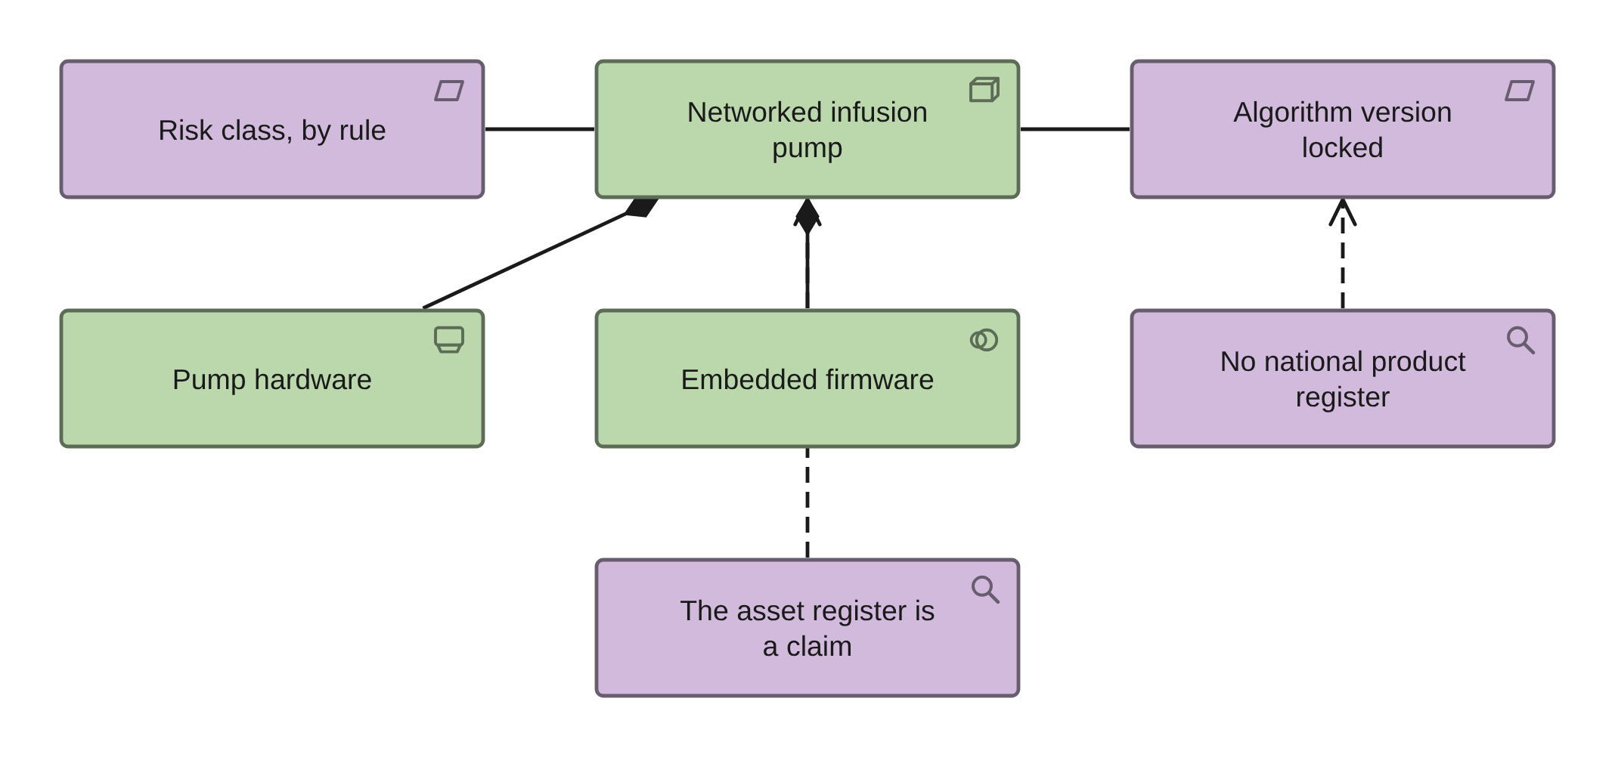
PHASE D · VIEW 30 OF 36
The regulated device
INVENTED: NO STANDARD VIEWPOINT COVERS IT
FOR
CANVAS
Clinical engineering, the networks engineer and the clinical safety officer
ELEMENTS IT MAY CONTAIN
Node, Device, System Software, Requirement, Assessment
RELATIONSHIPS
Composition, Association, Influence
POPULATED FROM
O68 Medical Device — created by item 2. The word calibration appears twice in the whole workbook and risk class once
WHAT THIS VIEW CANNOT SHOW
A type against an instance. A Device element is a kind of device, not a particular one, so serial number, location and last calibration live in the system of record
THE MISTAKE PEOPLE MAKE
One box labelled Device. A regulated device that contains software is a Node composed of a Device and a System Software, tied to Requirement and Assessment — and modelling it as a Device alone loses the regulatory constraint, which is the whole reason it is in the repository.
Healthcare EA · View templates
Thotnr Consulting · Healthcare starter pack · October 2026
38
Notes:
WHAT TO SAY
Two assessments carry facts an architect must not leave implicit: product registration is not yet operating, so the device master cannot be populated from a national register and what you have is the asset register plus the supplier's declarations.
QUESTION TO EXPECT
'What about a recall?' Without the patient link on an implant you can find the stock and not the patients.

Slide 39
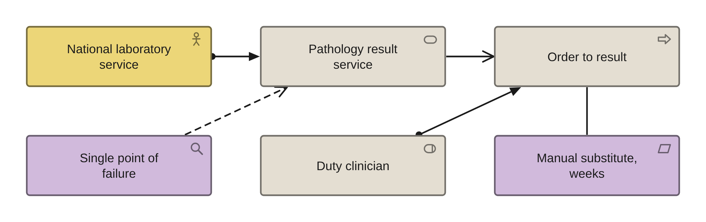
PHASE D · VIEW 31 OF 36
Shared services the organisation does not own
ARCHIMATE 4 VIEWPOINT: TECHNOLOGY USAGE
FOR
CANVAS
The executive, because no facility architecture can mitigate a national dependency
ELEMENTS IT MAY CONTAIN
Business Actor, Service, Process, Role, Assessment, Requirement, Grouping
RELATIONSHIPS
Assignment, Serving, Influence, Association
POPULATED FROM
None. The repository has no sheet for a dependency outside the boundary
WHAT THIS VIEW CANNOT SHOW
How long the substitute holds. That is a Requirement with a stated period, and the evidence says the period is weeks
THE MISTAKE PEOPLE MAKE
Giving an external dependency a recovery objective. A dependency inside the boundary gets an objective; a dependency outside it gets a substitute, and the substitute is a clinical design decision rather than a technical one.
Healthcare EA · View templates
Thotnr Consulting · Healthcare starter pack · October 2026
39
Notes:
WHAT TO SAY
Five questions this view has to answer: who holds the service, what the process does when it stops, how long the substitute holds, what data the substitute loses, and who by name decides to invoke it.
QUESTION TO EXPECT
'Which ones are there?' Four are immediate: public-sector pathology, the claims switch network, national patient identity and chronic medicines dispensing.

Slide 40
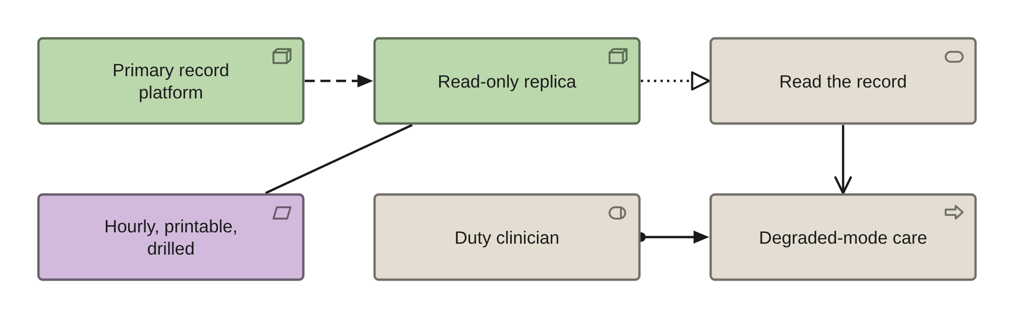
PHASE D · VIEW 32 OF 36
The read-only record and the degraded path
ARCHIMATE 4 VIEWPOINT: TECHNOLOGY USAGE
FOR
CANVAS
The chief information officer and a clinician who has worked a downtime
ELEMENTS IT MAY CONTAIN
Node, Data Object, Service, Process, Role, Requirement
RELATIONSHIPS
Realization, Serving, Access, Association
POPULATED FROM
WHAT THIS VIEW CANNOT SHOW
O49 Resilience Tier — whose tier label carries no information — and O41 Security Control
Currency, which is a property — at least hourly — and whether it has ever been used in anger, which is benchmark eight
THE MISTAKE PEOPLE MAKE
Putting the read-only copy in the same failure domain as the primary. It must be independently reachable, with separate authentication, a separate network path and separate hosting, or it fails with the thing it exists to replace.
Healthcare EA · View templates
Thotnr Consulting · Healthcare starter pack · October 2026
40
Notes:
WHAT TO SAY
The write path can be substituted by paper at a cost in effort. The read path cannot be substituted at all, and it survives far more cheaply than the write path.
QUESTION TO EXPECT
'What is our tier?' In the repository, Tier 1 holds both the loosest and the tightest recovery objective in the file, so the label predicts nothing.

Slide 41
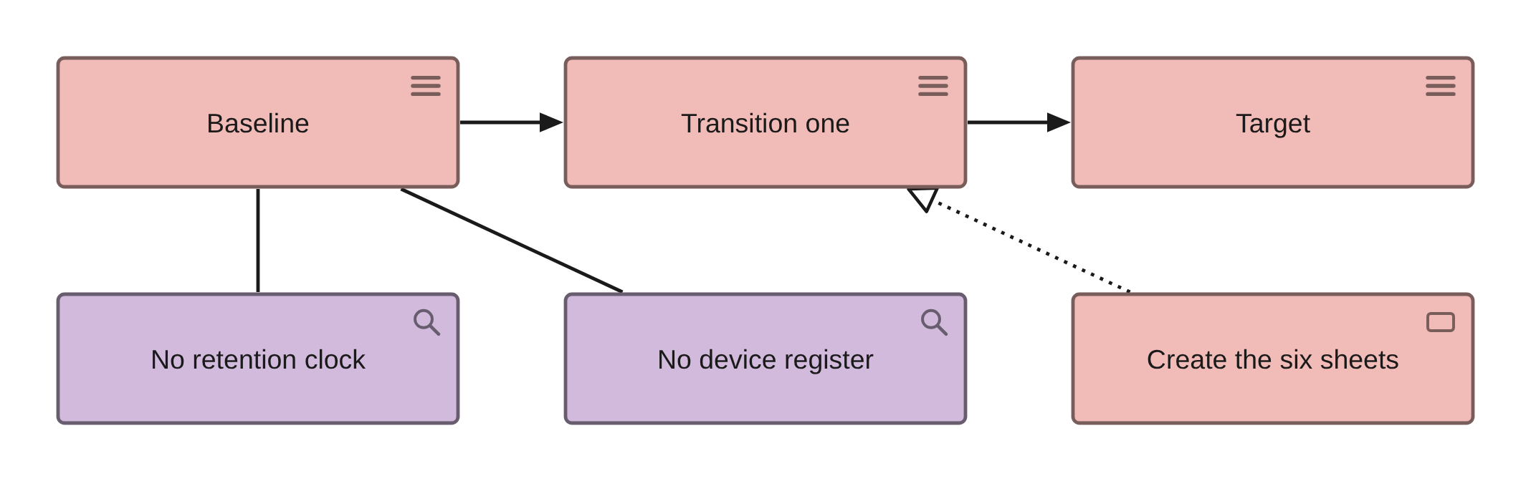
PHASES E TO H · VIEW 33 OF 36
Gaps between plateaux
ARCHIMATE 4 VIEWPOINT: MIGRATION
FOR
CANVAS
The programme board, to show what is actually missing rather than what is funded
ELEMENTS IT MAY CONTAIN
Plateau, Assessment, Grouping, Work Package
RELATIONSHIPS
Association, Triggering, Realization
POPULATED FROM
WHAT THIS VIEW CANNOT SHOW
O29 Gap — two rows — O53 Transition Architecture, O55 Building Block
A gap, as an element. There is none in the forty-two: it is an Assessment held between two Plateau elements
THE MISTAKE PEOPLE MAKE
Reading the gap count. The repository holds two gaps while the same workbook reports ten capabilities with a maturity gap, six standards in breach, three absent controls, six obligations without evidence and a component past support.
Healthcare EA · View templates
Thotnr Consulting · Healthcare starter pack · October 2026
41
Notes:
WHAT TO SAY
Raise the gaps the file already evidences before inventing new ones. The change request asking for unfunded building blocks to become gaps cannot be met on the file's own terms, because no sheet records funding against a building block.
QUESTION TO EXPECT
'Which gap is biggest?' The one with a clinical consequence, not the one with a cost.

Slide 42
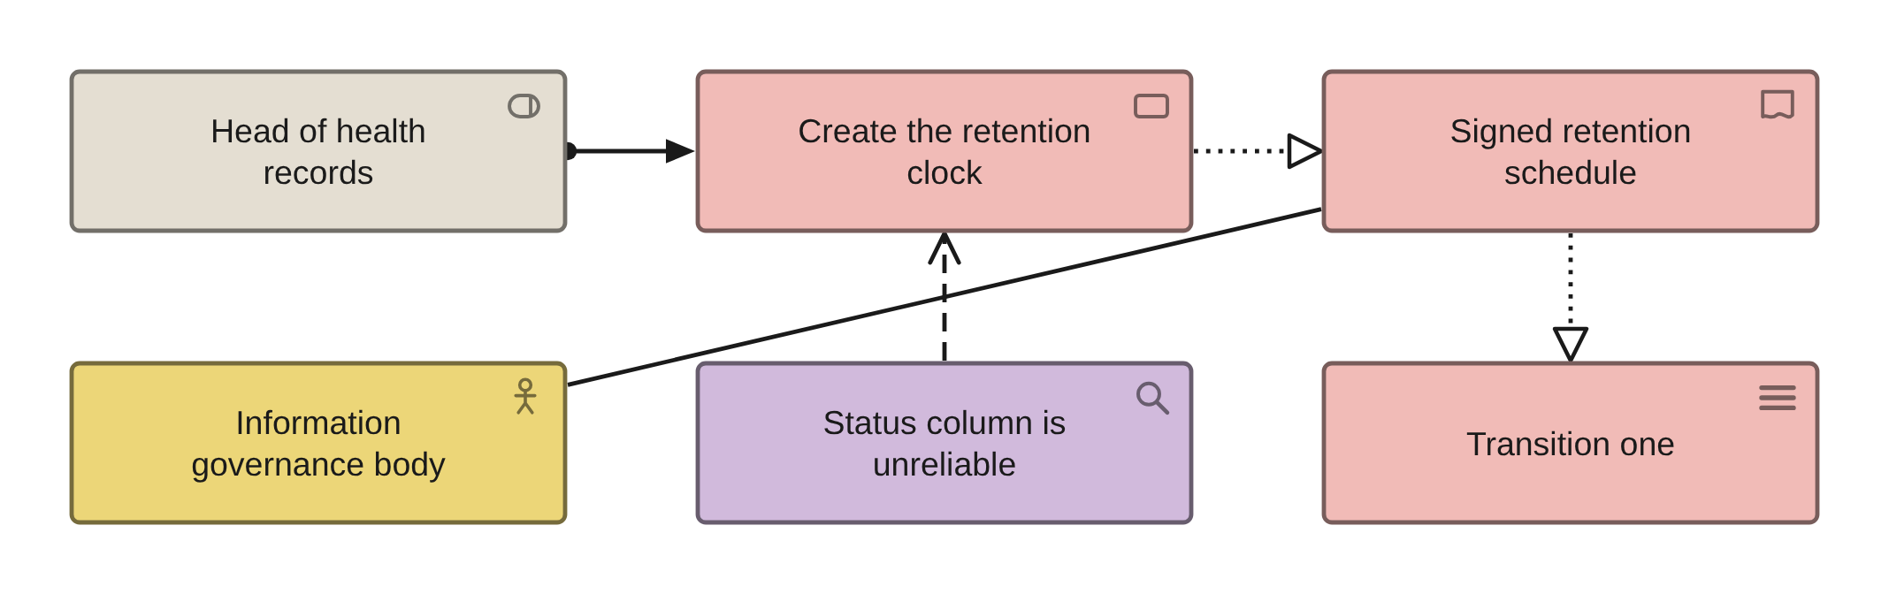
PHASES E TO H · VIEW 34 OF 36
Work packages and deliverables
ARCHIMATE 4 VIEWPOINT: PROJECT
FOR
CANVAS
The programme office, to show what each package actually produces and who signs for it
ELEMENTS IT MAY CONTAIN
Work Package, Deliverable, Business Actor, Role, Plateau
RELATIONSHIPS
Realization, Assignment, Association
POPULATED FROM
O30 Work Package, O31 Deliverable, O56 Project, R13, R14
WHAT THIS VIEW CANNOT SHOW
Cost, or a currency. Every cost in the repository is in US dollars with no rate, no rate date and no base year, in a file whose banner is a South African provider
THE MISTAKE PEOPLE MAKE
Believing the status column. Seven packages read Delivered and three Past end date before any has started, against an earliest start of 2027-01, and one package reads Not started for approval and Delivered for delivery on the same row.
Healthcare EA · View templates
Thotnr Consulting · Healthcare starter pack · October 2026
42
Notes:
WHAT TO SAY
A role signs and a body ratifies. Never put a committee in the signature line.
QUESTION TO EXPECT
'Is it delivered?' Ask for the deliverable and the date somebody accepted it.

Slide 43
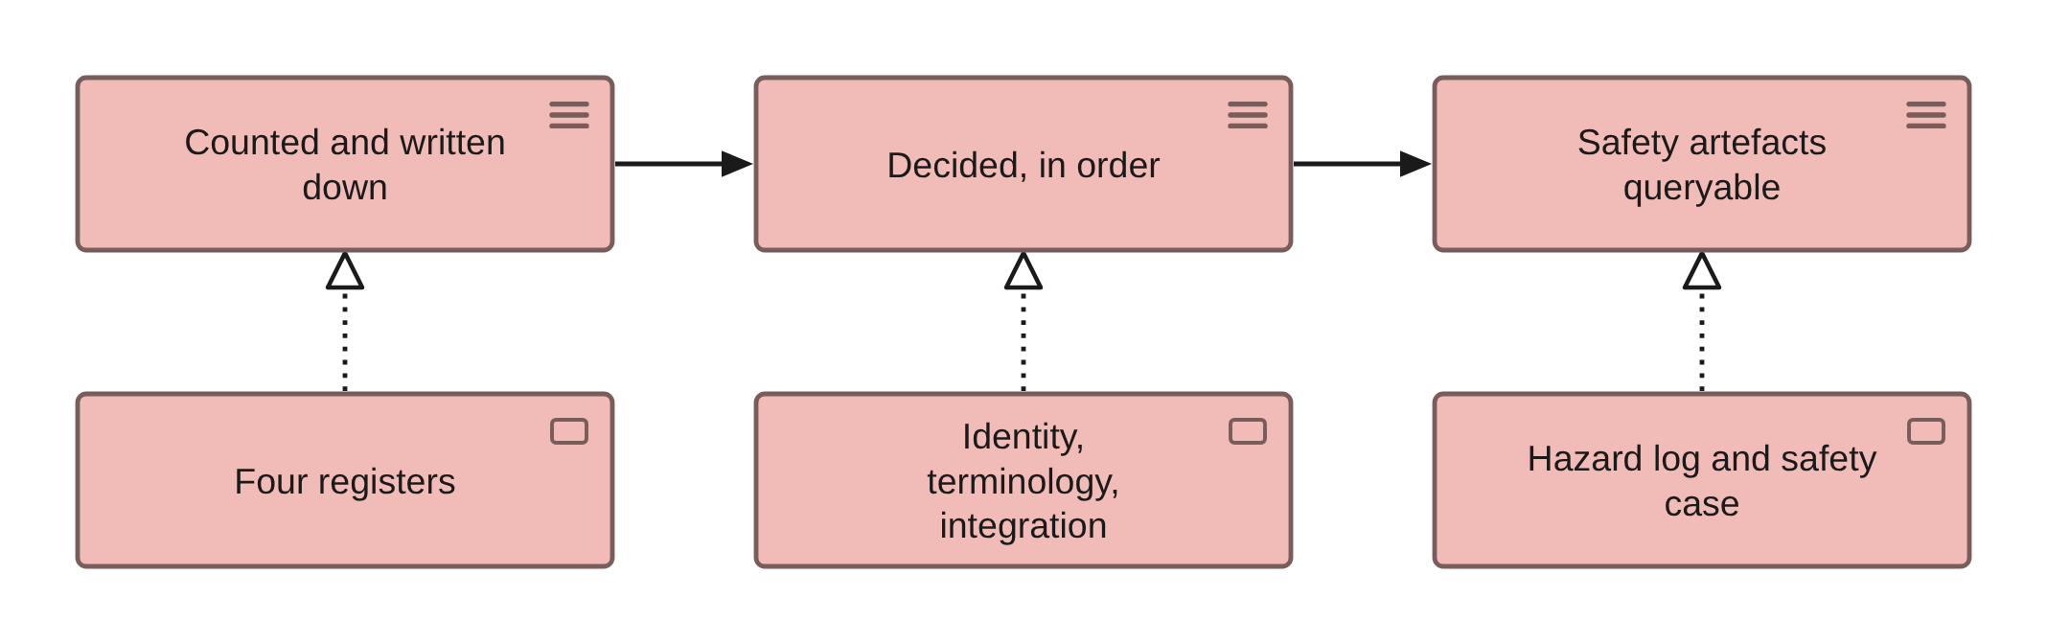
PHASES E TO H · VIEW 35 OF 36
Transition overview
ARCHIMATE 4 VIEWPOINT: IMPLEMENTATION AND MIGRATION
FOR
CANVAS
The executive, to show three states you can stop at rather than a plan on a page
ELEMENTS IT MAY CONTAIN
Plateau, Work Package, Deliverable, Goal, Assessment
RELATIONSHIPS
Triggering, Realization, Association
POPULATED FROM
WHAT THIS VIEW CANNOT SHOW
O53 Transition Architecture, O66 Architecture Increment, O30 Work Package
A date. Plateau is the only temporal construct and it describes a state of the whole estate, not the validity period of anything on it
THE MISTAKE PEOPLE MAKE
Reconciling two time axes that have no origin. The repository dates its increments as Month N with no baseline date anywhere, while its work packages carry absolute dates, and a third sheet uses a relative horizon. Two of the three have no origin.
Healthcare EA · View templates
Thotnr Consulting · Healthcare starter pack · October 2026
43
Notes:
WHAT TO SAY
Each plateau is a stopping point that is useful on its own. An executive who can stop after the first is more likely to fund the second.
QUESTION TO EXPECT
'When is month one?' Nobody knows, and that is the finding to raise rather than a date to invent.

Slide 44
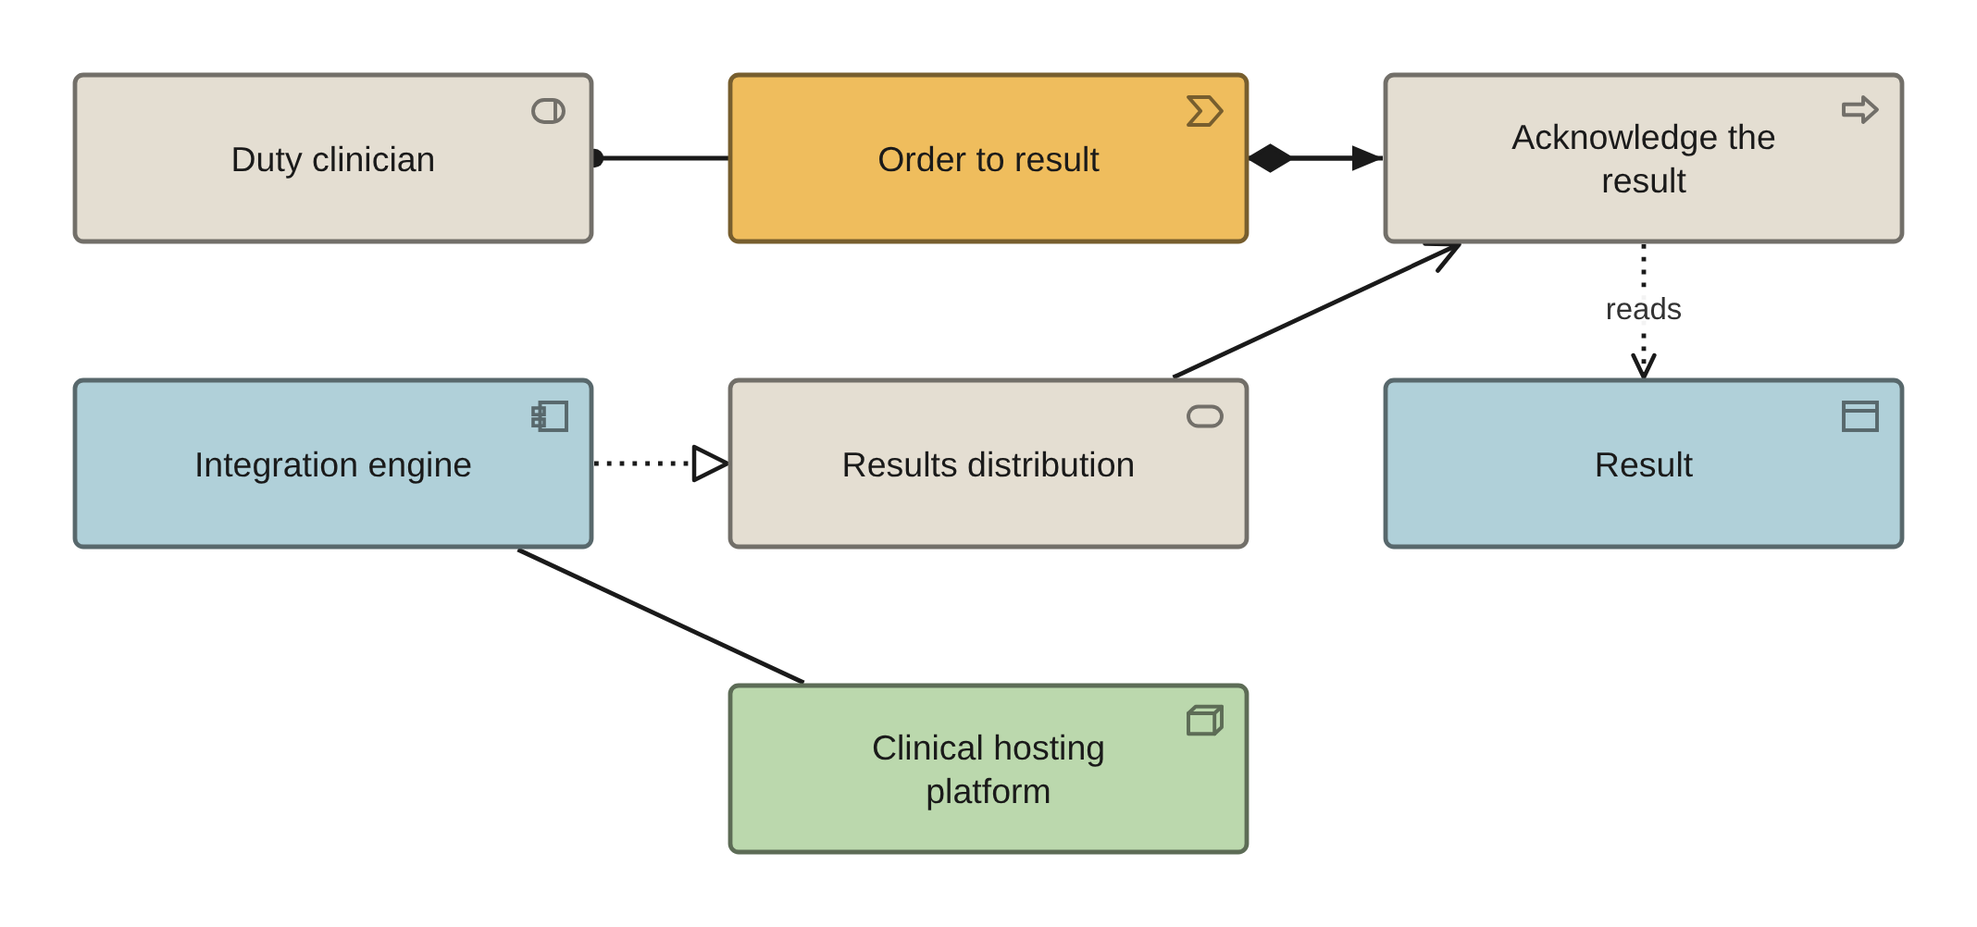
PHASES E TO H · VIEW 36 OF 36
Layered slice, one value stream end to end
ARCHIMATE 4 VIEWPOINT: LAYERED
FOR
CANVAS
Everybody, once — it is the view that finds the stage with no system behind it
ELEMENTS IT MAY CONTAIN
Value Stream, Process, Role, Service, Application Component, Data Object, Node
RELATIONSHIPS
Serving, Assignment, Realization, Access
POPULATED FROM
O14, O16, O11, O23, O20 and R06, in that order
WHAT THIS VIEW CANNOT SHOW
A swimlane. There are none in the notation, and a lane boundary is where the handoff fails — which is why the level-two process models are drawn in BPMN instead
THE MISTAKE PEOPLE MAKE
Drawing the whole estate. One stream, with its stages, the roles that perform them, the applications each stage touches and the data objects each reads and writes. The whole estate on one page is a catalogue, and a catalogue is read once.
Healthcare EA · View templates
Thotnr Consulting · Healthcare starter pack · October 2026
44
Notes:
WHAT TO SAY
If the organisation draws one view from this pack, draw this one, for the stream with the documented clinical harm behind it.
QUESTION TO EXPECT
'Can we see the whole estate like this?' You can. Nobody will maintain it.

Slide 45
THE SIX YOU HAVE TO INVENT
No standard viewpoint covers these six
And they are the same six the notation has no element for, and the same six the repository has no sheet for.
The view | What the notation lacks | The sheet it fills
Consent, scoped and dated | No consent element, and no time on an element | O67 Consent
The regulated device | No way to tell a device model from a device instance | O68 Medical Device
Code system and edition | No code system element, and no effective date | O69 Code System
Measure definition | No metric element, and `Value` is not a number | O70 Measure Definition
Disclosure event | No element for a thing that happened to a record | O71 Disclosure Event
Retention clock | No period, no clock-start event, no destruction authority | O72 Retention Clock
WHY THE SIX GO TOGETHER
Each of the six is a fact a provider's architecture turns on and the notation has no place for: a consent that expires, a device risk class, a code system edition, a measure rule, a disclosure that happened, a retention period. The repository declares six industry types and holds each as one row of the data entity sheet and nowhere else — no attributes, no mastering rule, no building block. Inventing the view and inventing the sheet are the same act, and doing them in the same week is how the two stay in step.
Healthcare EA · View templates
Thotnr Consulting · Healthcare starter pack · October 2026
45
Notes:
WHAT TO SAY
The symmetry is the argument: six views, six sheets, six facts the notation cannot carry. Do not let the room treat them as six separate pieces of work.
QUESTION TO EXPECT
'Can we not just use properties?' You will. The sheet is where the properties live and the view is how somebody checks them.

Slide 46
THE DISCIPLINE THAT KEEPS A VIEW USEFUL
Fifteen elements, three grid columns, one question
A view with no question behind it is maintained by nobody and is wrong within a quarter.
One question per view, written in the view notes
Not a title — a question, in the form somebody actually asked it. If the question cannot be written down, the view should not be drawn, and if two questions fit, draw two views.
Fifteen elements is the ceiling, and three grid columns is the shape
Every canvas in this pack is six to nine elements. Beyond about fifteen a view stops being read and starts being pointed at, and the estate-wide picture is a catalogue rather than an argument.
Name every association, or delete it
`Association` carries everything the other ten relationships cannot, so an unnamed one asserts nothing and survives review by looking busy.
Record the filter: sheet, column, value
A view is a query. Write the filter in the view notes so the next person can regenerate it rather than inherit it, and so a disagreement between the picture and the repository is settled by re-running rather than by argument.
Healthcare EA · View templates
Thotnr Consulting · Healthcare starter pack · October 2026
46
Notes:
WHAT TO SAY
Four disciplines. The last one is the difference between a pack that survives a handover and a folder of pictures nobody dares change.
QUESTION TO EXPECT
'Who maintains these?' Whoever owns the question. If nobody does, retire the view.

Slide 47
NAME IT, NEVER REPRODUCE IT
What may go in a repository, and what may not
This matters more in healthcare than in any other volume in the series, because the standards are richer and the licences are real.
You may | You may not
Name a standard, a terminology or a classification, and record the edition in force | Reproduce its text, its tables, its figures, its codes or its code descriptions
Model a `Business Object` for the code system and carry its edition and dates as properties | Paste a code list, a value set or a mapping table into a repository, a deck or a workbook
Record a licence position — held, in date, by whom — as a fact about the organisation | Treat a licence the organisation holds as permission to redistribute the content
Cite a conformance profile by name and record whether an attestation exists | Quote the profile's constraints or copy its conformance statements
AND THE PRACTICAL CONSEQUENCE FOR A TOOL SELECTION
This volume's research found no verifiable evidence that any enterprise architecture tool ships healthcare reference content as a shipped, maintained, documented artefact — no capability model, no clinical process library, no terminology metamodel extension, no profile catalogue. Assume you are building the healthcare content yourself, and treat any claim of healthcare reference content as a claim to be inspected: ask to see it, ask when it was last updated, and ask who maintains it.
Healthcare EA · View templates
Thotnr Consulting · Healthcare starter pack · October 2026
47
Notes:
WHAT TO SAY
Say this before anybody starts loading content. The leak happens in week two, in a spreadsheet, and it is very hard to take back.
QUESTION TO EXPECT
'But we have a licence.' A licence to use is not a licence to redistribute.

Slide 48
BEFORE YOU RENDER A SHEET
Check whether it is a statement or a join
A view is more persuasive than a sheet. Nine of the repository's relationship sheets are positional joins, and every row of them resolves.
01
Read three rows aloud as sentences
A positional join reads as nonsense by the second one. Human Resources owns Medicines Management. The billing system supports Emergency Care. The patient portal supports Diagnostic Services.
02
Look for the stride
A join built by pairing two lists in row order has a stride: the consumer half of one sheet cycles four applications across fourteen entities in order, which is the identical stride a second sheet uses.
03
Ask whether the owner of one end would recognise the other
The test that needs no tooling and takes one conversation. If the owner of the requirement has never heard of the building block, the row is a join.
04
Re-derive, never repair in place
Copy the sheet to a new tab, keep the original row-4 headers exactly and in order, add evidence, confirmer and date to the right, and leave the original untouched as the record of what was inherited. A retired row is dated, not deleted.
Healthcare EA · View templates
Thotnr Consulting · Healthcare starter pack · October 2026
48
Notes:
WHAT TO SAY
This is the slide that stops a client rendering thirty handsome views over content that means nothing.
QUESTION TO EXPECT
'Can we clean the sheet first?' Re-derive it. The original is evidence.

Slide 49
THE TEST THAT TAKES A MINUTE
A view that disagrees with the repository is wrong, not a variant
Four checks before a view leaves the building, and a rule for what to do when one of them fails.
THE FOUR CHECKS
One: every element on the view exists in the repository with the same reference. Two: every relationship on the view is one of the eleven, and every association is named. Three: the filter is written in the view notes as sheet, column, value — so the view can be regenerated by somebody who has never seen it. Four: the properties the view depends on are printed on it, because a property is invisible unless the tool is configured to print it and is the first thing lost in an export.
AND THE RULE WHEN A CHECK FAILS
Fix the repository, then regenerate. Never fix the picture. An edited export is how a repository and a view come to disagree, and the disagreement is always discovered in front of the person least able to tolerate it.
Last page. The seven capture workshops in the workshop pack are what fill the sheets these views are drawn from; the executive briefing is the argument they support.
Healthcare EA · View templates
Thotnr Consulting · Healthcare starter pack · October 2026
49
Notes:
WHAT TO SAY
Close on the rule rather than the checks. Everybody agrees with the checks and everybody edits the picture.
QUESTION TO EXPECT
'What if the repository is wrong?' Then the view is right about something false, which is worse.

