Slide 1
SOLWAY FREIGHT GROUP · ARCHITECTURE VIEWS
Twenty-five views of
the architecture
Freight and contract logistics — consignments, lanes, depots, fleet, customs and the promise made to the shipper.
One view for each of the twenty-five viewpoints in the ArchiMate 4 Specification. A viewpoint is where you are looking from; a view is what you see.
13
4
5
3
from basic viewpoints
from motivation
from strategy
from implementation
Solway Freight Group is an illustrative organisation. ArchiMate® is a registered trademark of The Open Group.

Slide 2
CONTENTS
Twenty-five views, one per viewpoint
C.1.1
Organization view
C.2.1
Stakeholder view
C.1.2
Application Structure view
C.2.2
Goal Realization view
C.1.3
Information Structure view
C.2.3
Requirements Realization view
C.1.4
Technology view
C.2.4
Motivation view
C.1.5
Layered view
C.3.1
Strategy view
C.1.6
Physical view
C.3.2
Capability Map view
C.1.7
Product view
C.3.3
Value Stream view
C.1.8
Application Usage view
C.3.4
Outcome Realization view
C.1.9
Technology Usage view
C.3.5
Resource Map view
C.1.10
Process Cooperation view
C.4.1
Project view
C.1.11
Application Cooperation view
C.4.2
Migration view
C.1.12
Service Realization view
C.4.3
Implementation and Migration view
C.1.13
Implementation and Deployment view
Each row is a view of Solway Freight Group. The reference is the viewpoint it was created from.

Slide 3
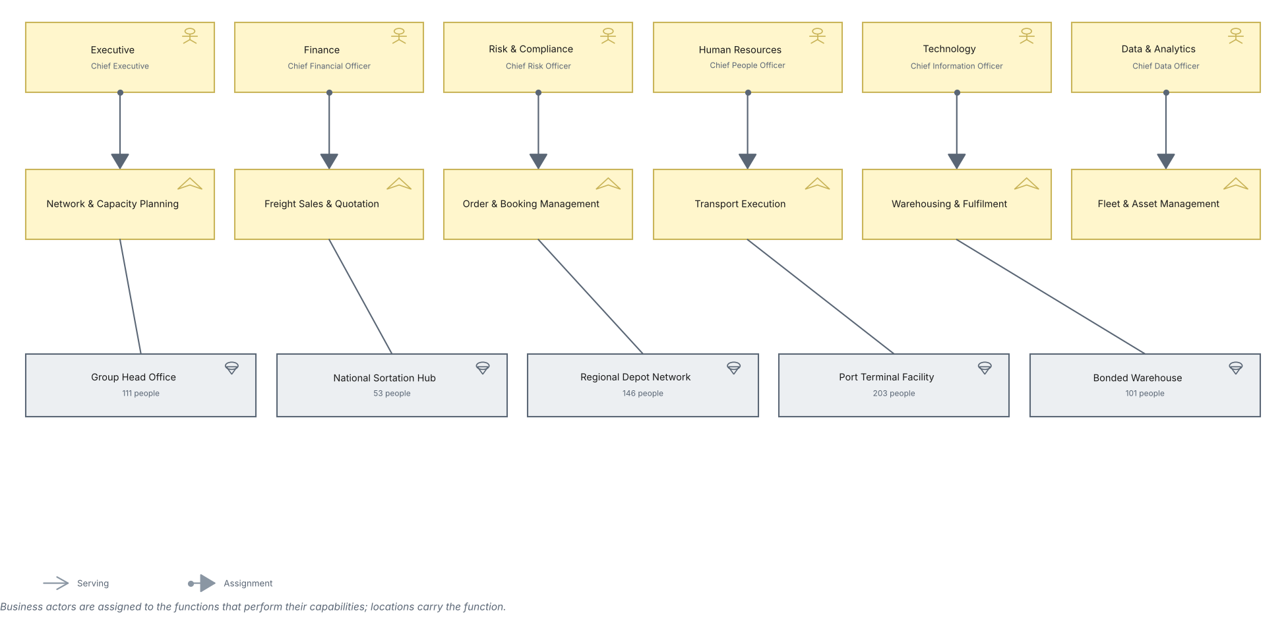
SOLWAY FREIGHT GROUP · BASIC · C.1.1
Organization view
Units, the actors inside them, the capabilities they own and the locations they sit in.
Created using the Organization Viewpoint, C.1.1 of the ArchiMate 4 Specification. Drawn from the Logistics TOGAF content metamodel.

Slide 4
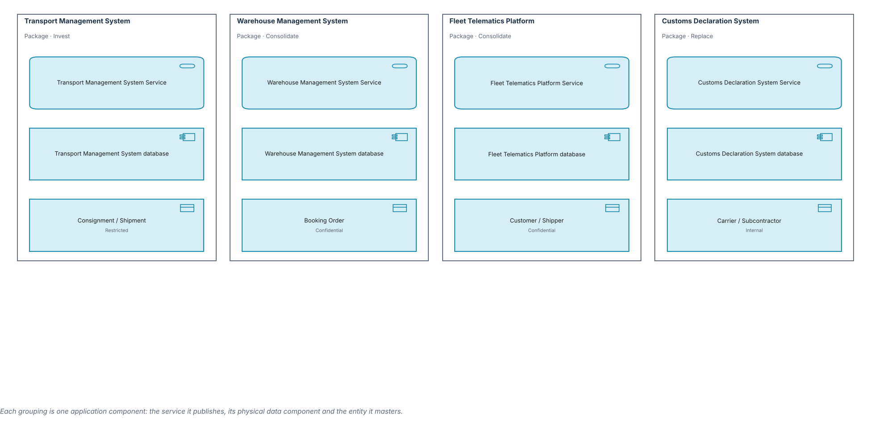
SOLWAY FREIGHT GROUP · BASIC · C.1.2
Application Structure view
The structure of the application estate and the data each component holds.
Created using the Application Structure Viewpoint, C.1.2 of the ArchiMate 4 Specification. Drawn from the Logistics TOGAF content metamodel.

Slide 5
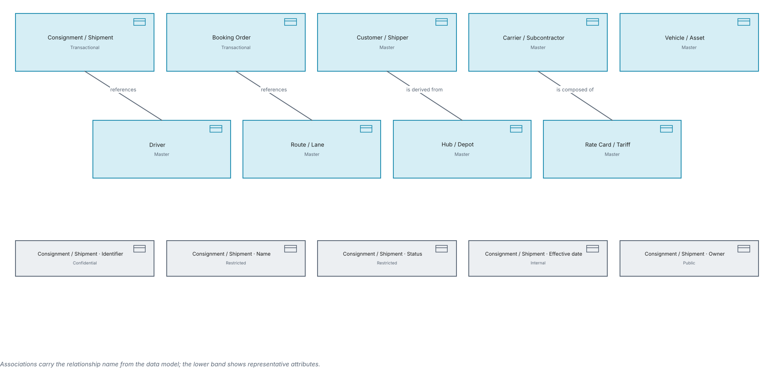
SOLWAY FREIGHT GROUP · BASIC · C.1.3
Information Structure view
Business objects, their class and how they relate across the freight lifecycle.
Created using the Information Structure Viewpoint, C.1.3 of the ArchiMate 4 Specification. Drawn from the Logistics TOGAF content metamodel.

Slide 6
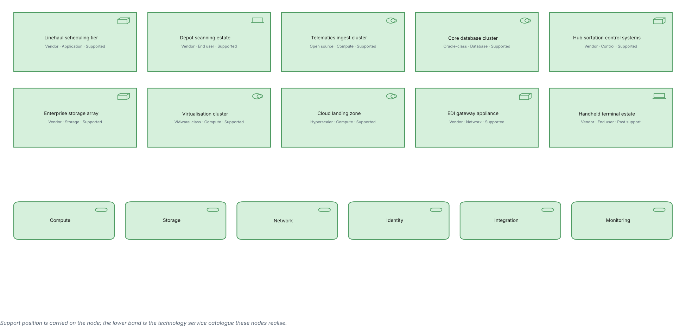
SOLWAY FREIGHT GROUP · BASIC · C.1.4
Technology view
Nodes, devices and system software across the depot and data centre estate, with support position.
Created using the Technology Viewpoint, C.1.4 of the ArchiMate 4 Specification. Drawn from the Logistics TOGAF content metamodel.

Slide 7
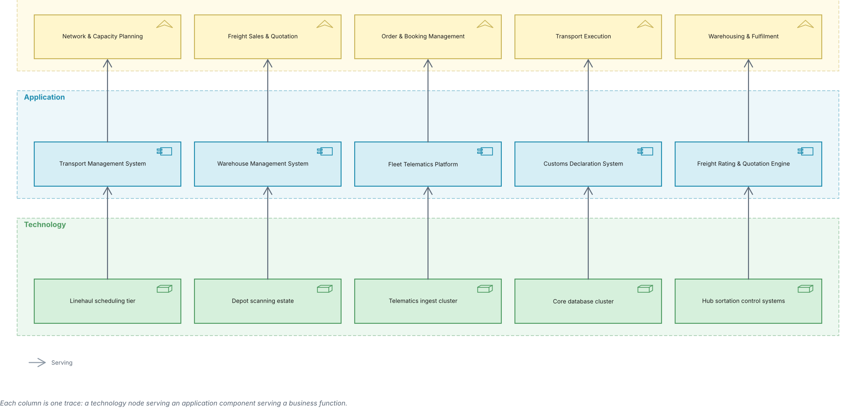
SOLWAY FREIGHT GROUP · BASIC · C.1.5
Layered view
One picture across business, application and technology.
Created using the Layered Viewpoint, C.1.5 of the ArchiMate 4 Specification. Drawn from the Logistics TOGAF content metamodel.

Slide 8
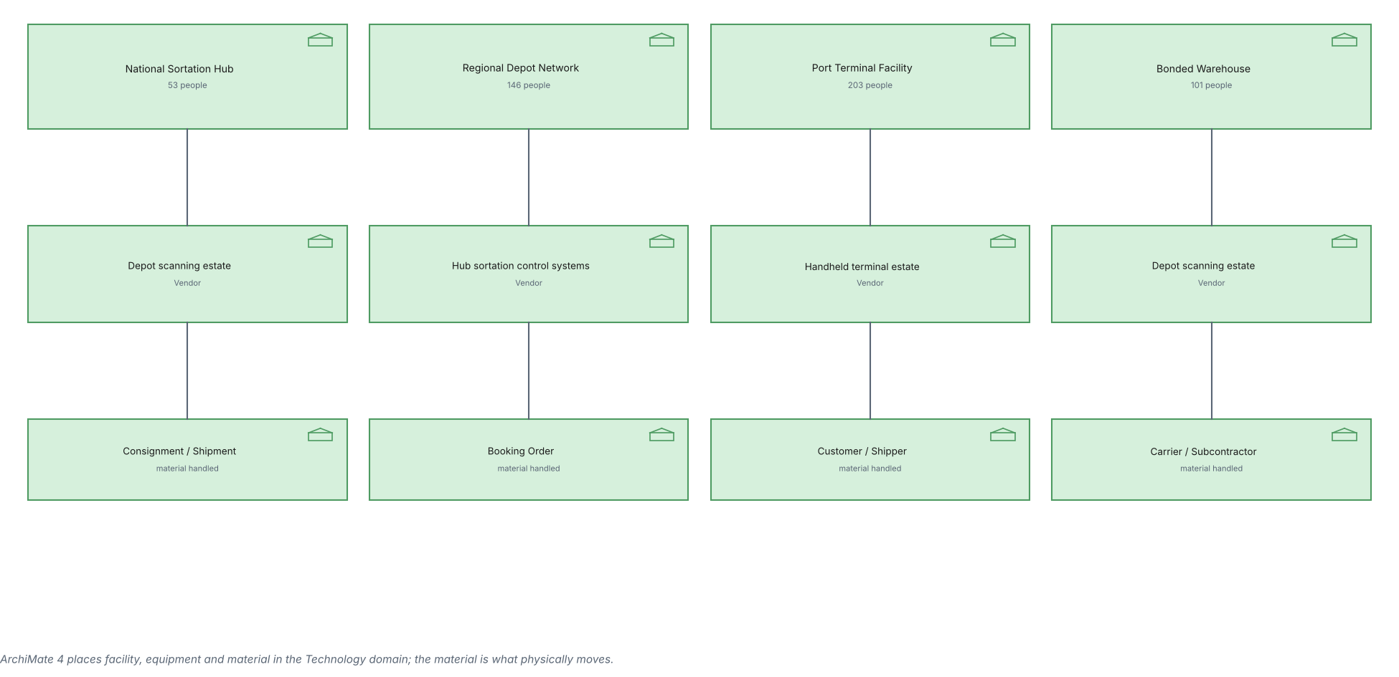
SOLWAY FREIGHT GROUP · BASIC · C.1.6
Physical view
Hubs, depots and terminals, the equipment in them and the freight that moves through.
Created using the Physical Viewpoint, C.1.6 of the ArchiMate 4 Specification. Drawn from the Logistics TOGAF content metamodel.

Slide 9
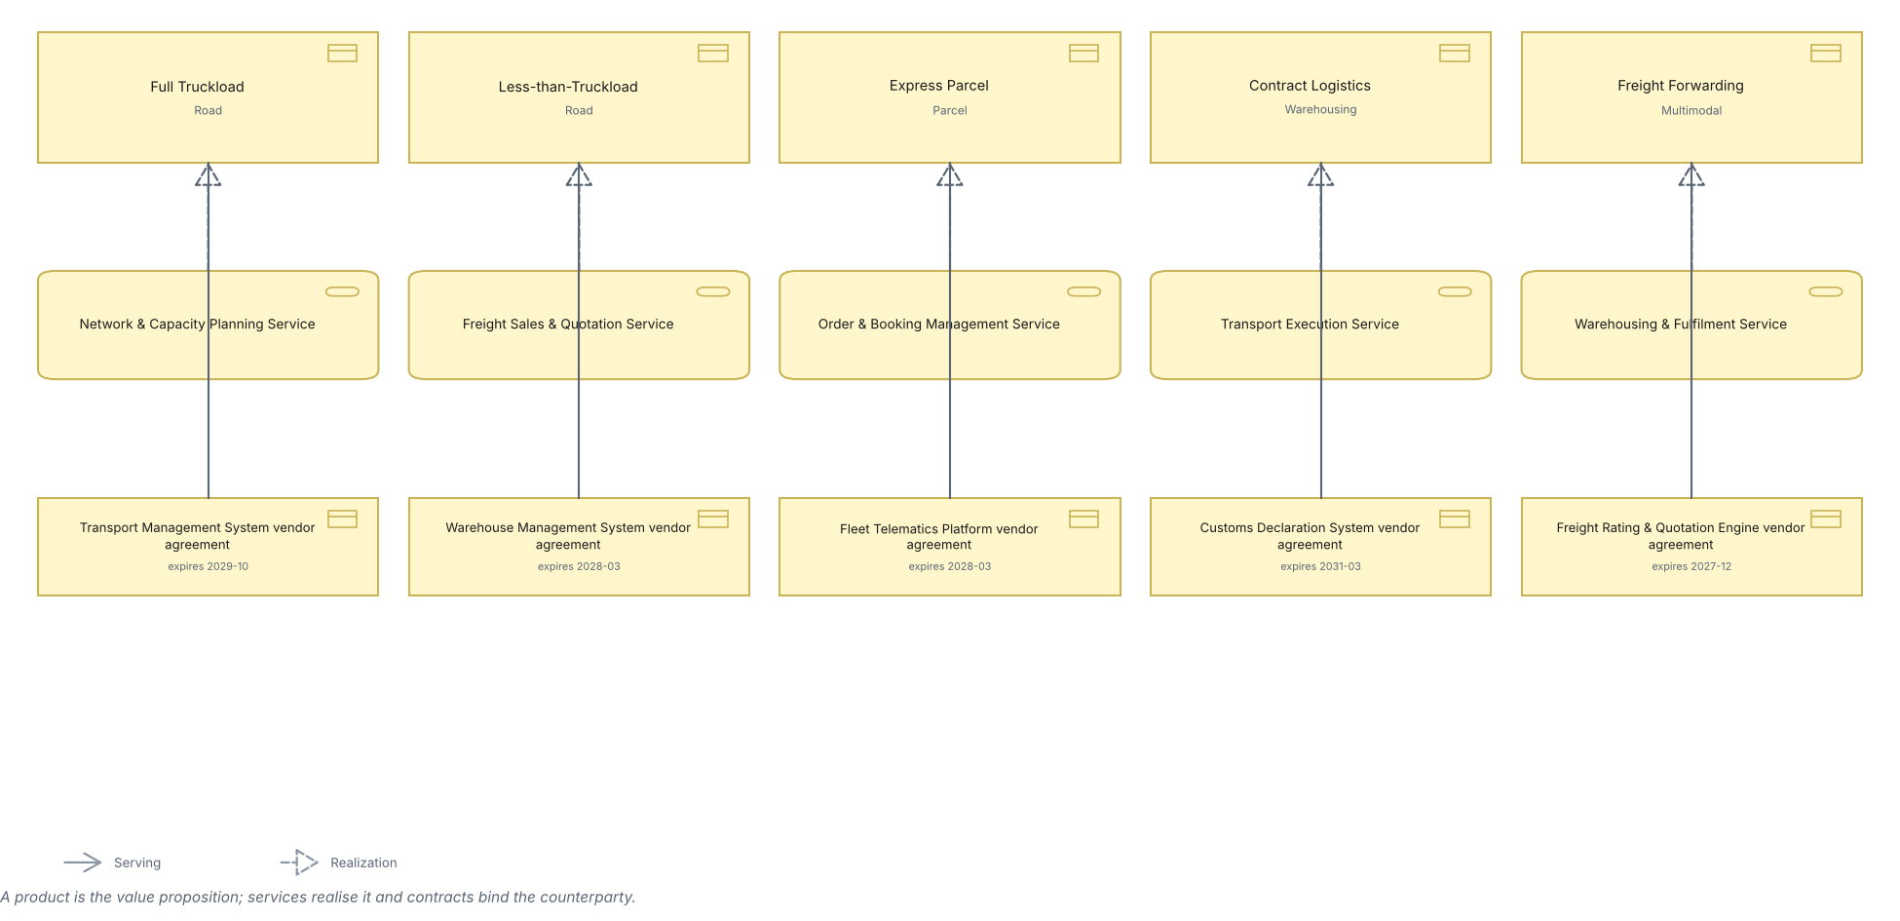
SOLWAY FREIGHT GROUP · BASIC · C.1.7
Product view
The services sold to shippers, what realises them and the contracts behind them.
Created using the Product Viewpoint, C.1.7 of the ArchiMate 4 Specification. Drawn from the Logistics TOGAF content metamodel.

Slide 10
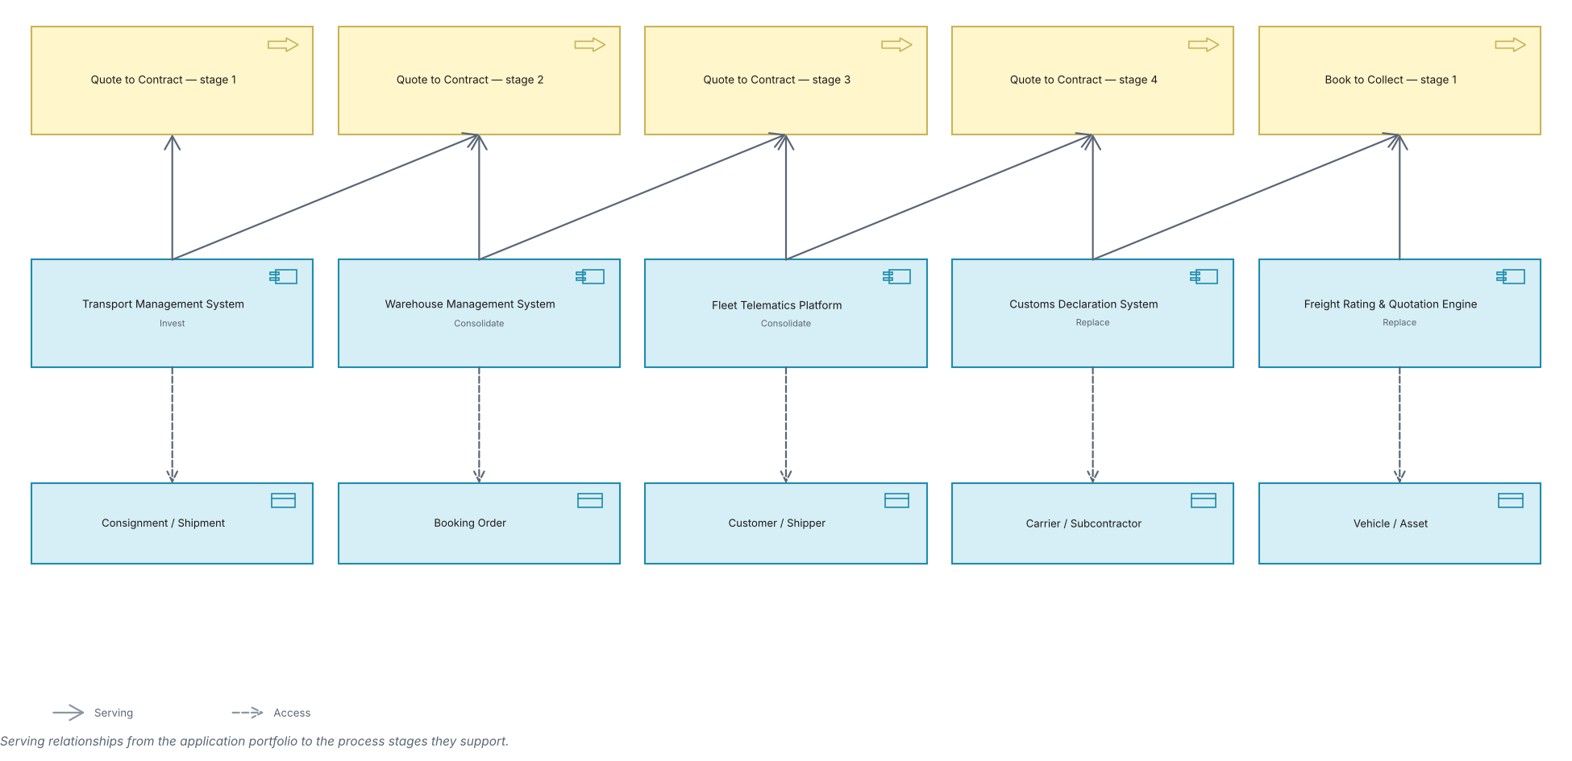
SOLWAY FREIGHT GROUP · BASIC · C.1.8
Application Usage view
How business processes consume application services.
Created using the Application Usage Viewpoint, C.1.8 of the ArchiMate 4 Specification. Drawn from the Logistics TOGAF content metamodel.

Slide 11
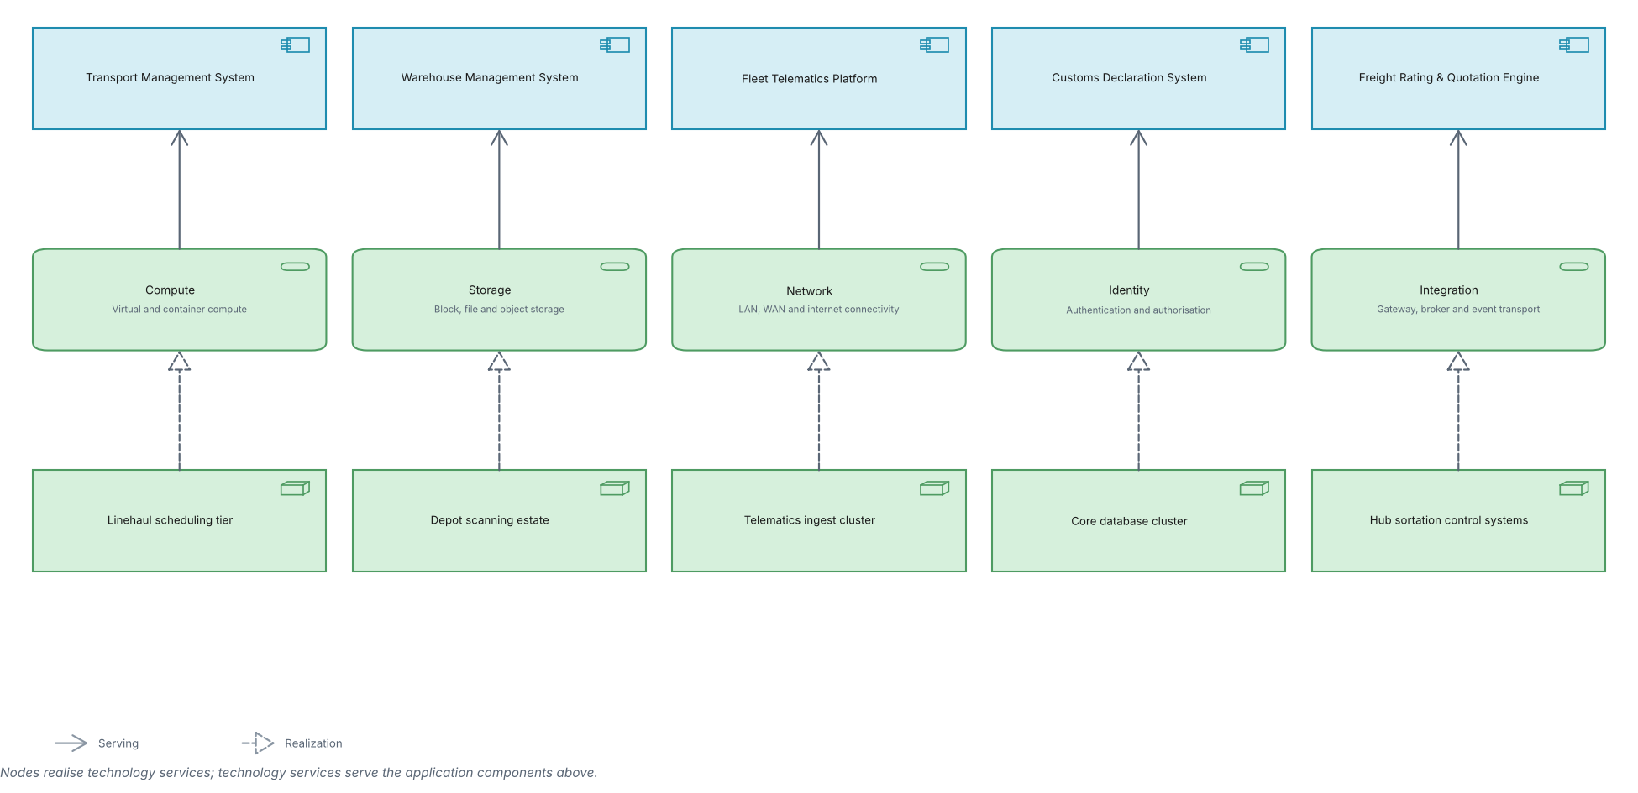
SOLWAY FREIGHT GROUP · BASIC · C.1.9
Technology Usage view
How applications consume technology services.
Created using the Technology Usage Viewpoint, C.1.9 of the ArchiMate 4 Specification. Drawn from the Logistics TOGAF content metamodel.

Slide 12
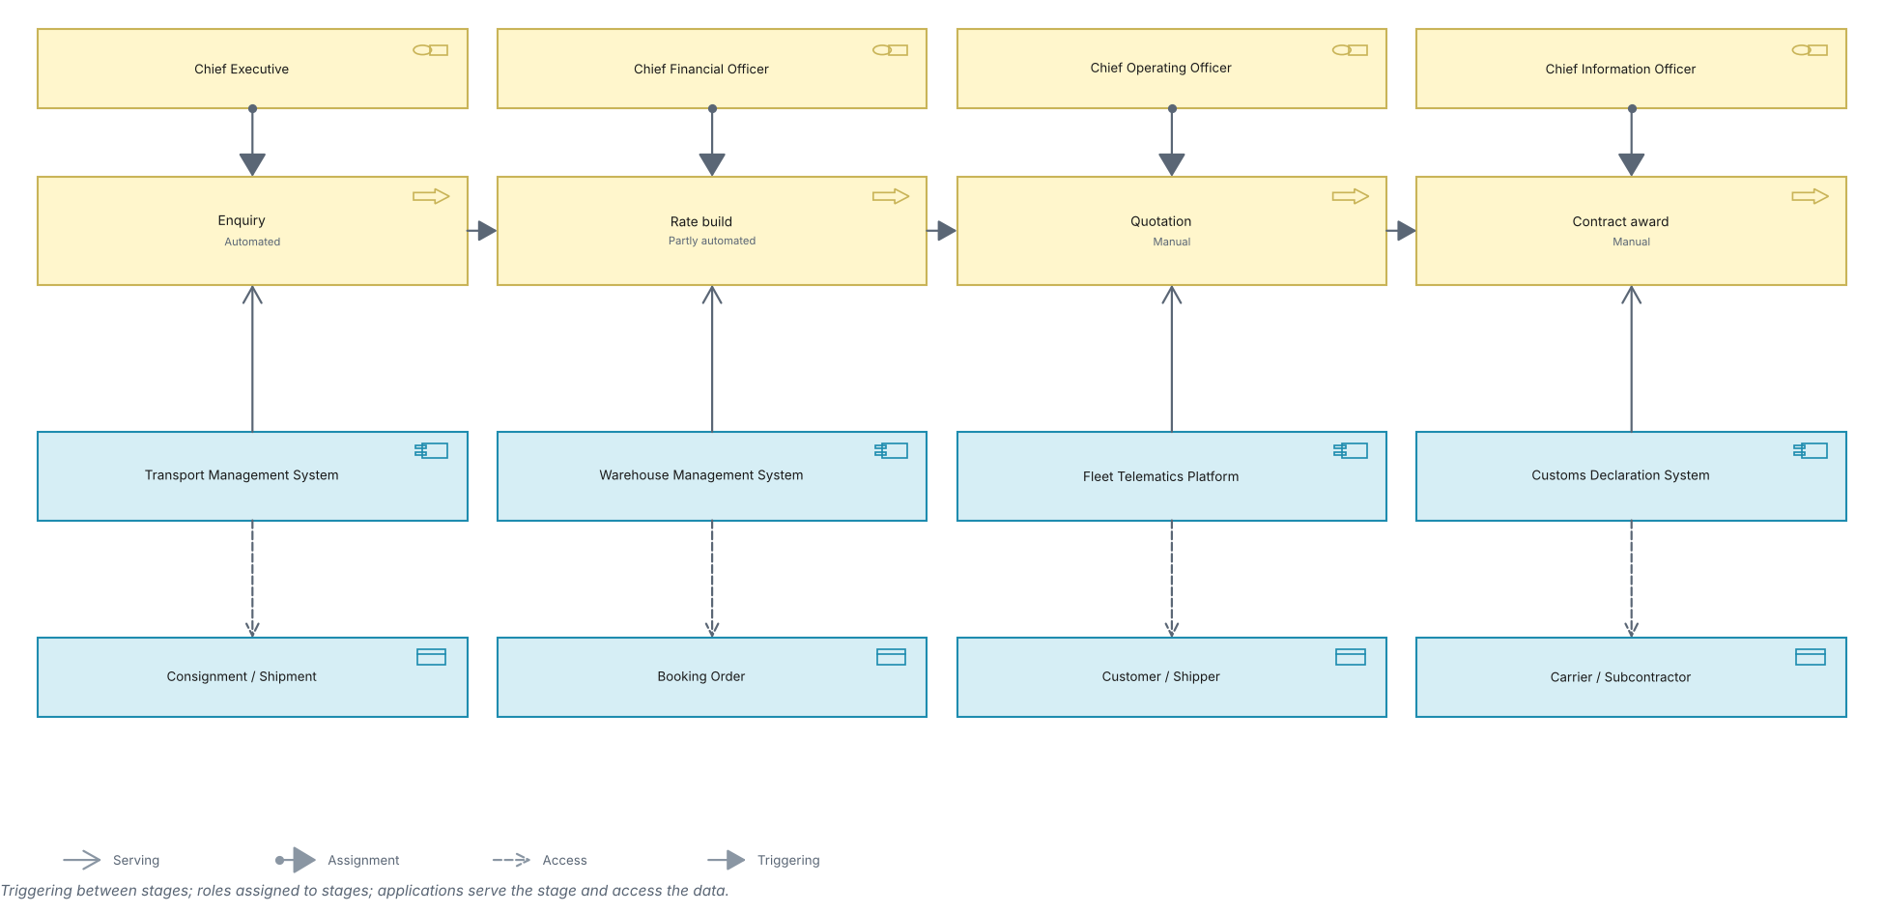
SOLWAY FREIGHT GROUP · BASIC · C.1.10
Process Cooperation view
A value stream end to end, who performs each stage and what it touches.
Created using the Process Cooperation Viewpoint, C.1.10 of the ArchiMate 4 Specification. Drawn from the Logistics TOGAF content metamodel.

Slide 13
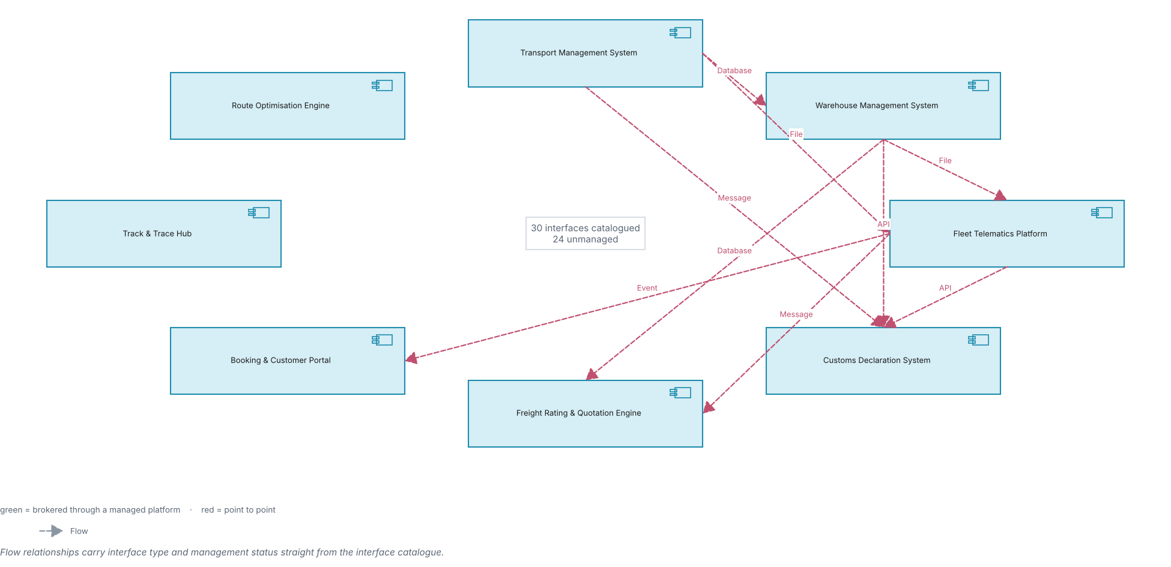
SOLWAY FREIGHT GROUP · BASIC · C.1.11
Application Cooperation view
How applications exchange with one another across the estate.
Created using the Application Cooperation Viewpoint, C.1.11 of the ArchiMate 4 Specification. Drawn from the Logistics TOGAF content metamodel.

Slide 14
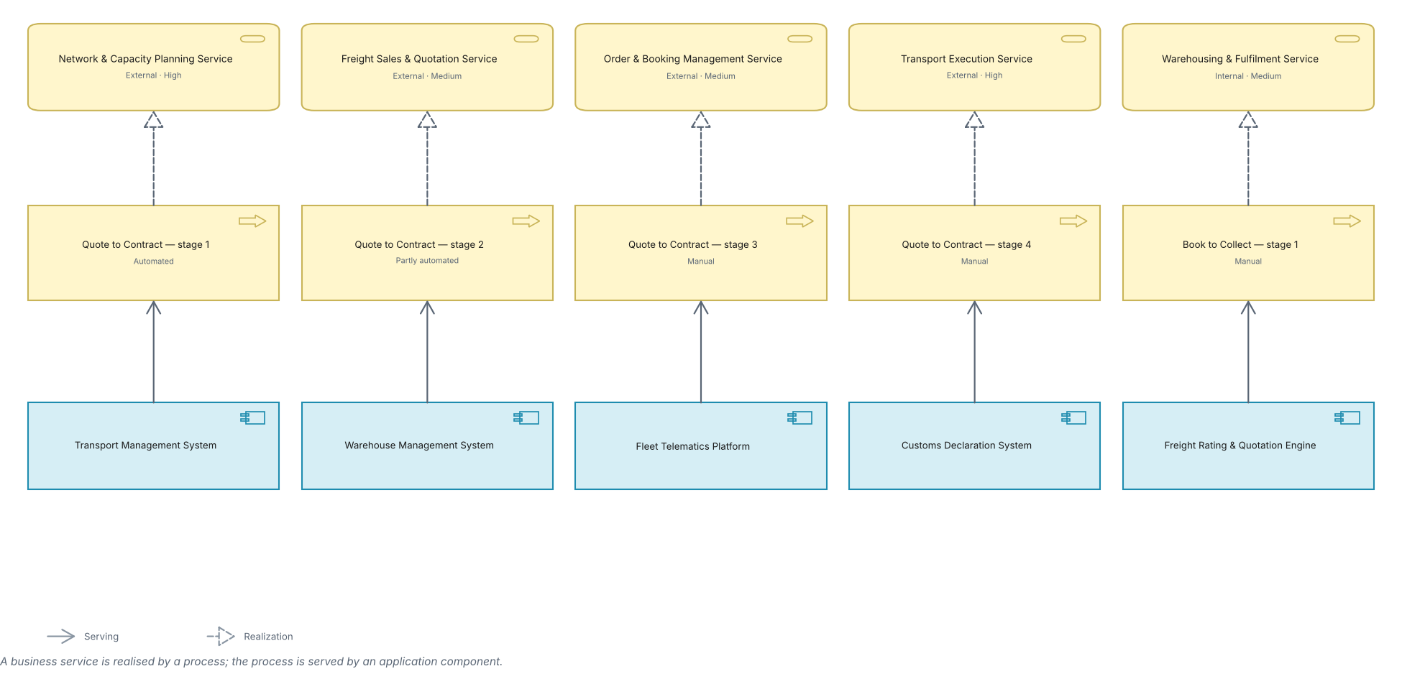
SOLWAY FREIGHT GROUP · BASIC · C.1.12
Service Realization view
How business services are realised by processes and supported by applications.
Created using the Service Realization Viewpoint, C.1.12 of the ArchiMate 4 Specification. Drawn from the Logistics TOGAF content metamodel.

Slide 15
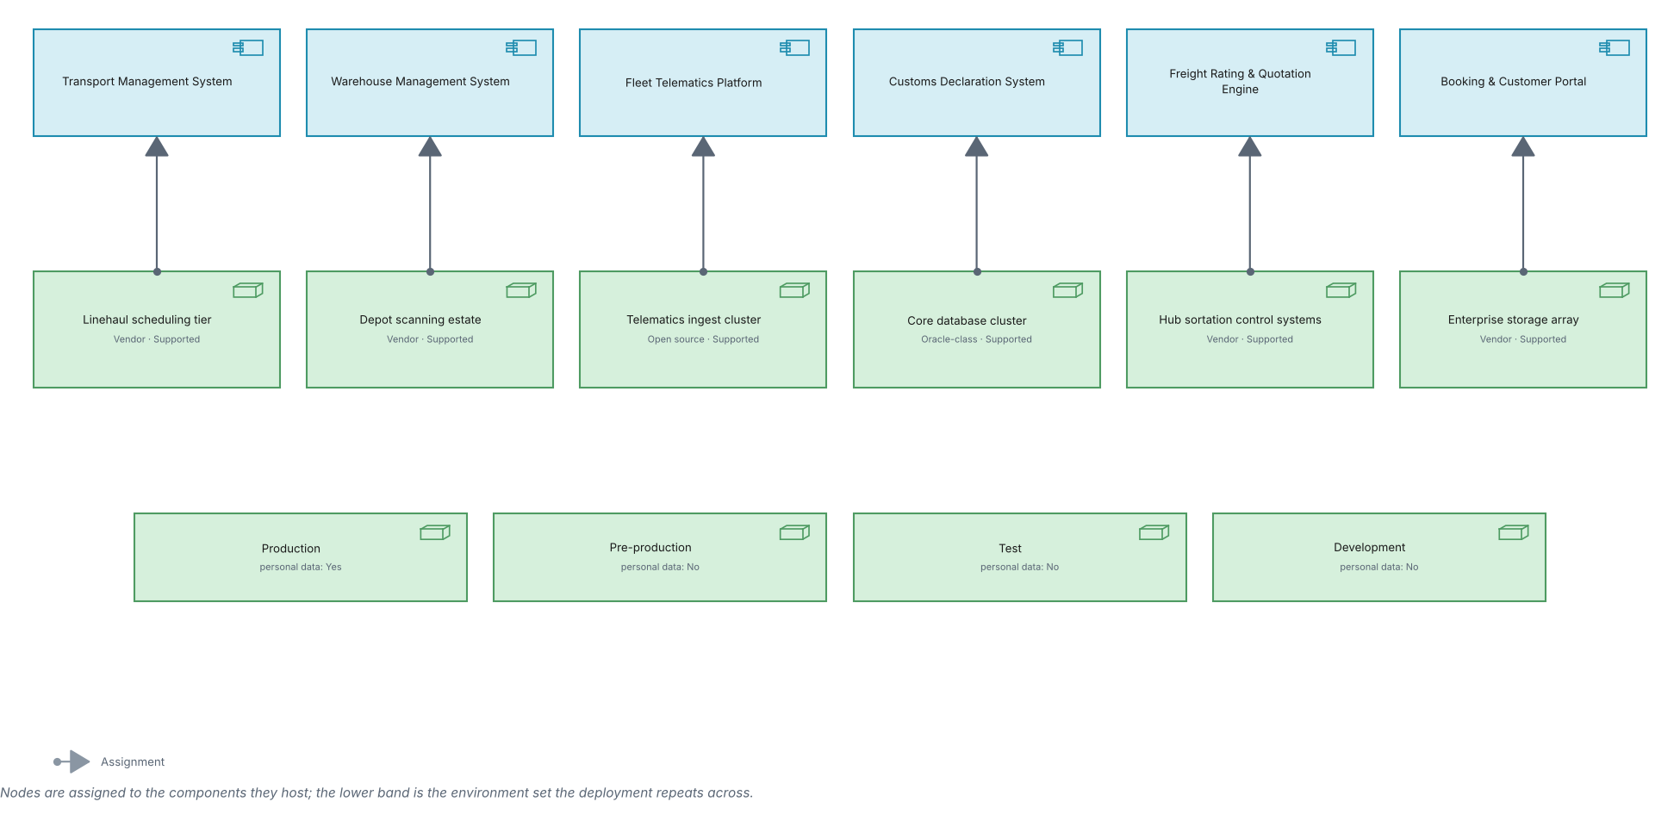
SOLWAY FREIGHT GROUP · BASIC · C.1.13
Implementation and Deployment view
Which nodes host which application components, and across which environments.
Created using the Implementation and Deployment Viewpoint, C.1.13 of the ArchiMate 4 Specification. Drawn from the Logistics TOGAF content metamodel.

Slide 16
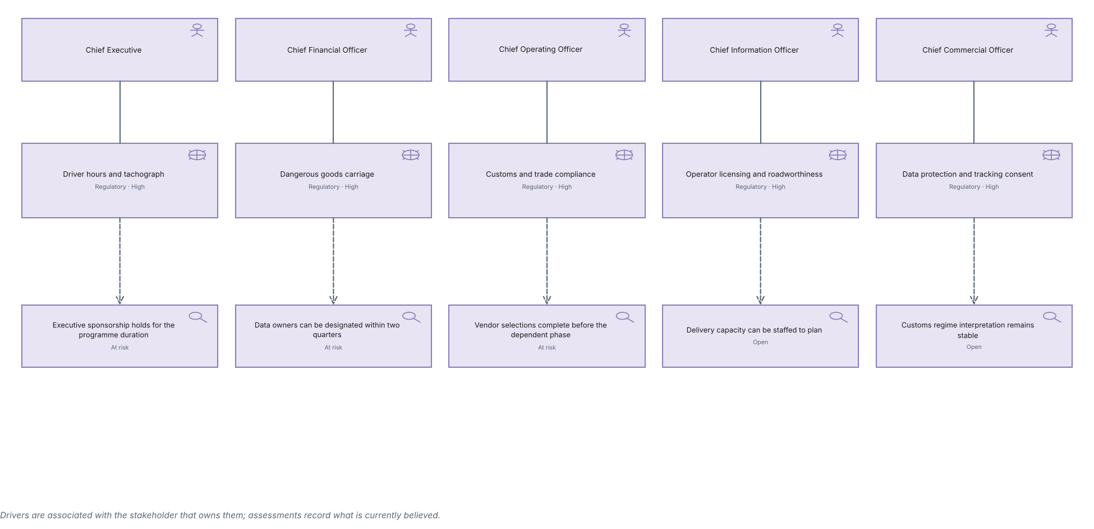
SOLWAY FREIGHT GROUP · MOTIVATION · C.2.1
Stakeholder view
Stakeholders, the drivers they carry and the assessments made against them.
Created using the Stakeholder Viewpoint, C.2.1 of the ArchiMate 4 Specification. Drawn from the Logistics TOGAF content metamodel.

Slide 17
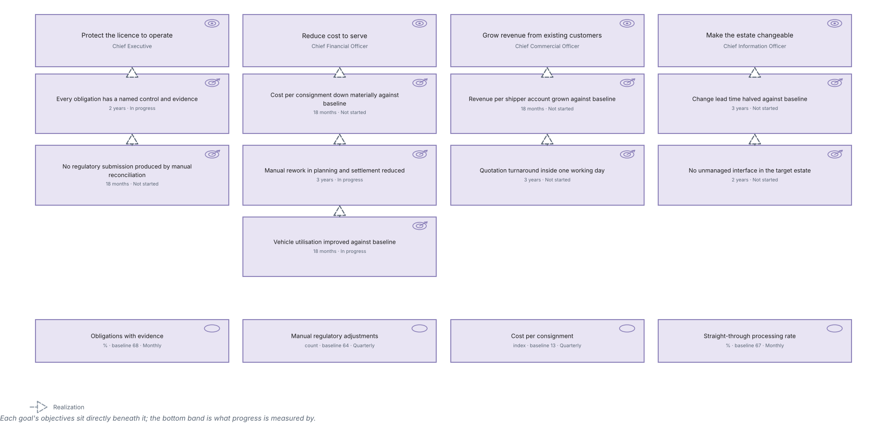
SOLWAY FREIGHT GROUP · MOTIVATION · C.2.2
Goal Realization view
How goals are refined into objectives and what each is measured by.
Created using the Goal Realization Viewpoint, C.2.2 of the ArchiMate 4 Specification. Drawn from the Logistics TOGAF content metamodel.

Slide 18
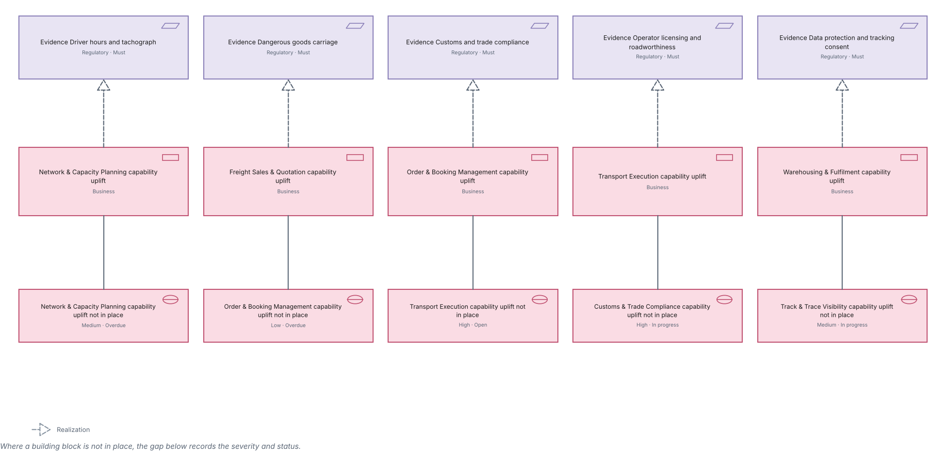
SOLWAY FREIGHT GROUP · MOTIVATION · C.2.3
Requirements Realization view
How requirements are satisfied by building blocks, and where the gaps sit.
Created using the Requirements Realization Viewpoint, C.2.3 of the ArchiMate 4 Specification. Drawn from the Logistics TOGAF content metamodel.

Slide 19
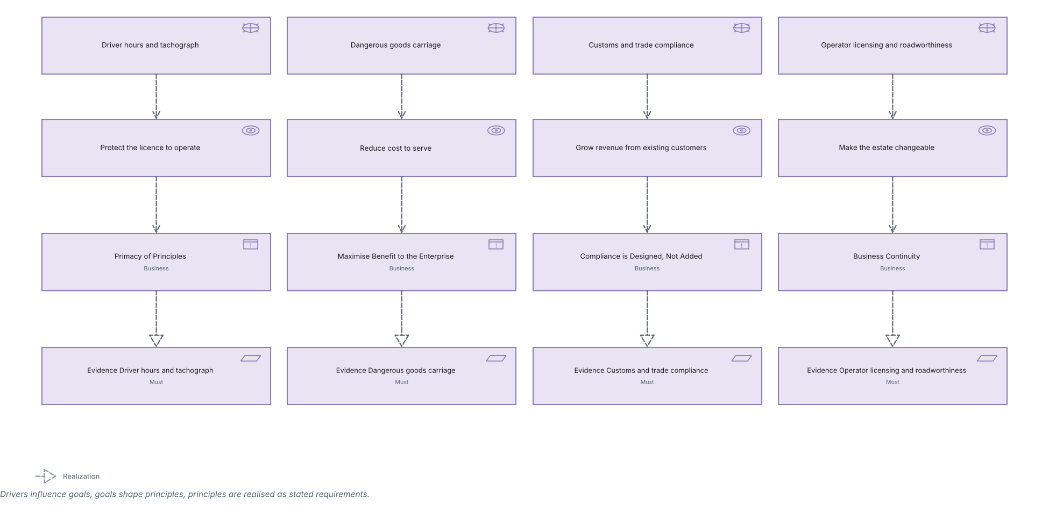
SOLWAY FREIGHT GROUP · MOTIVATION · C.2.4
Motivation view
The full chain: driver to goal to principle to requirement.
Created using the Motivation Viewpoint, C.2.4 of the ArchiMate 4 Specification. Drawn from the Logistics TOGAF content metamodel.

Slide 20
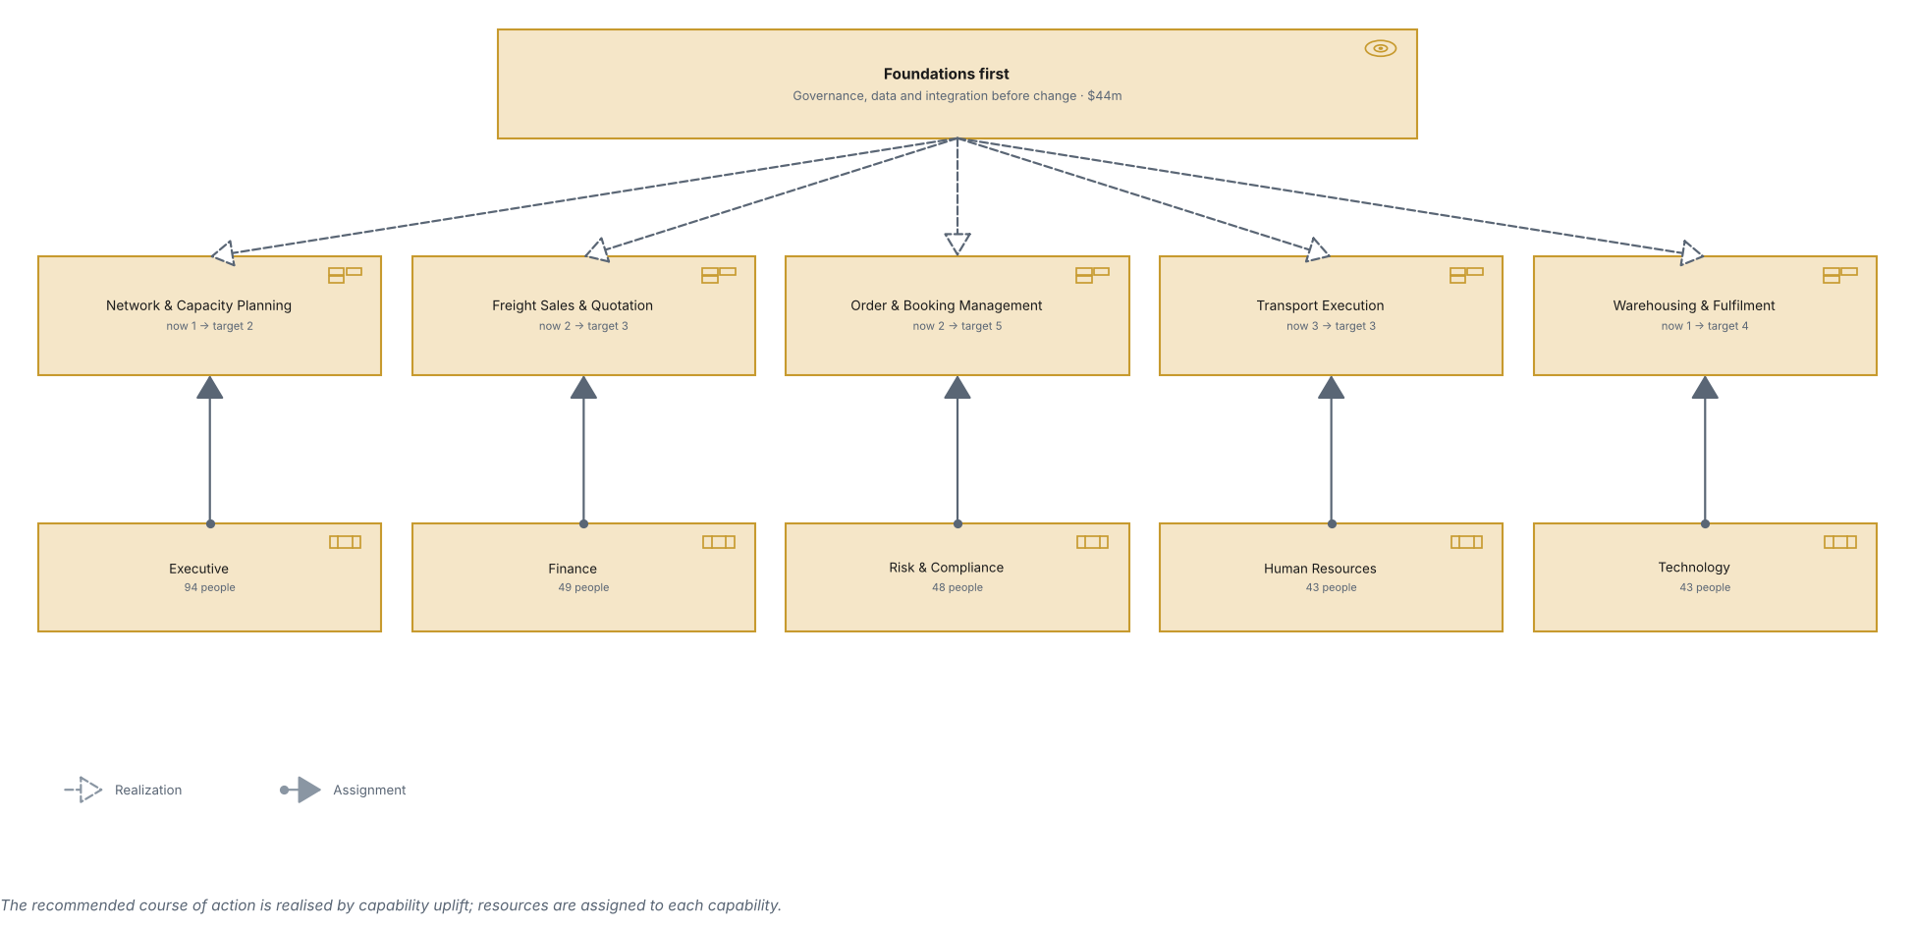
SOLWAY FREIGHT GROUP · STRATEGY · C.3.1
Strategy view
The chosen course of action, the capabilities that realise it and the resources assigned.
Created using the Strategy Viewpoint, C.3.1 of the ArchiMate 4 Specification. Drawn from the Logistics TOGAF content metamodel.

Slide 21
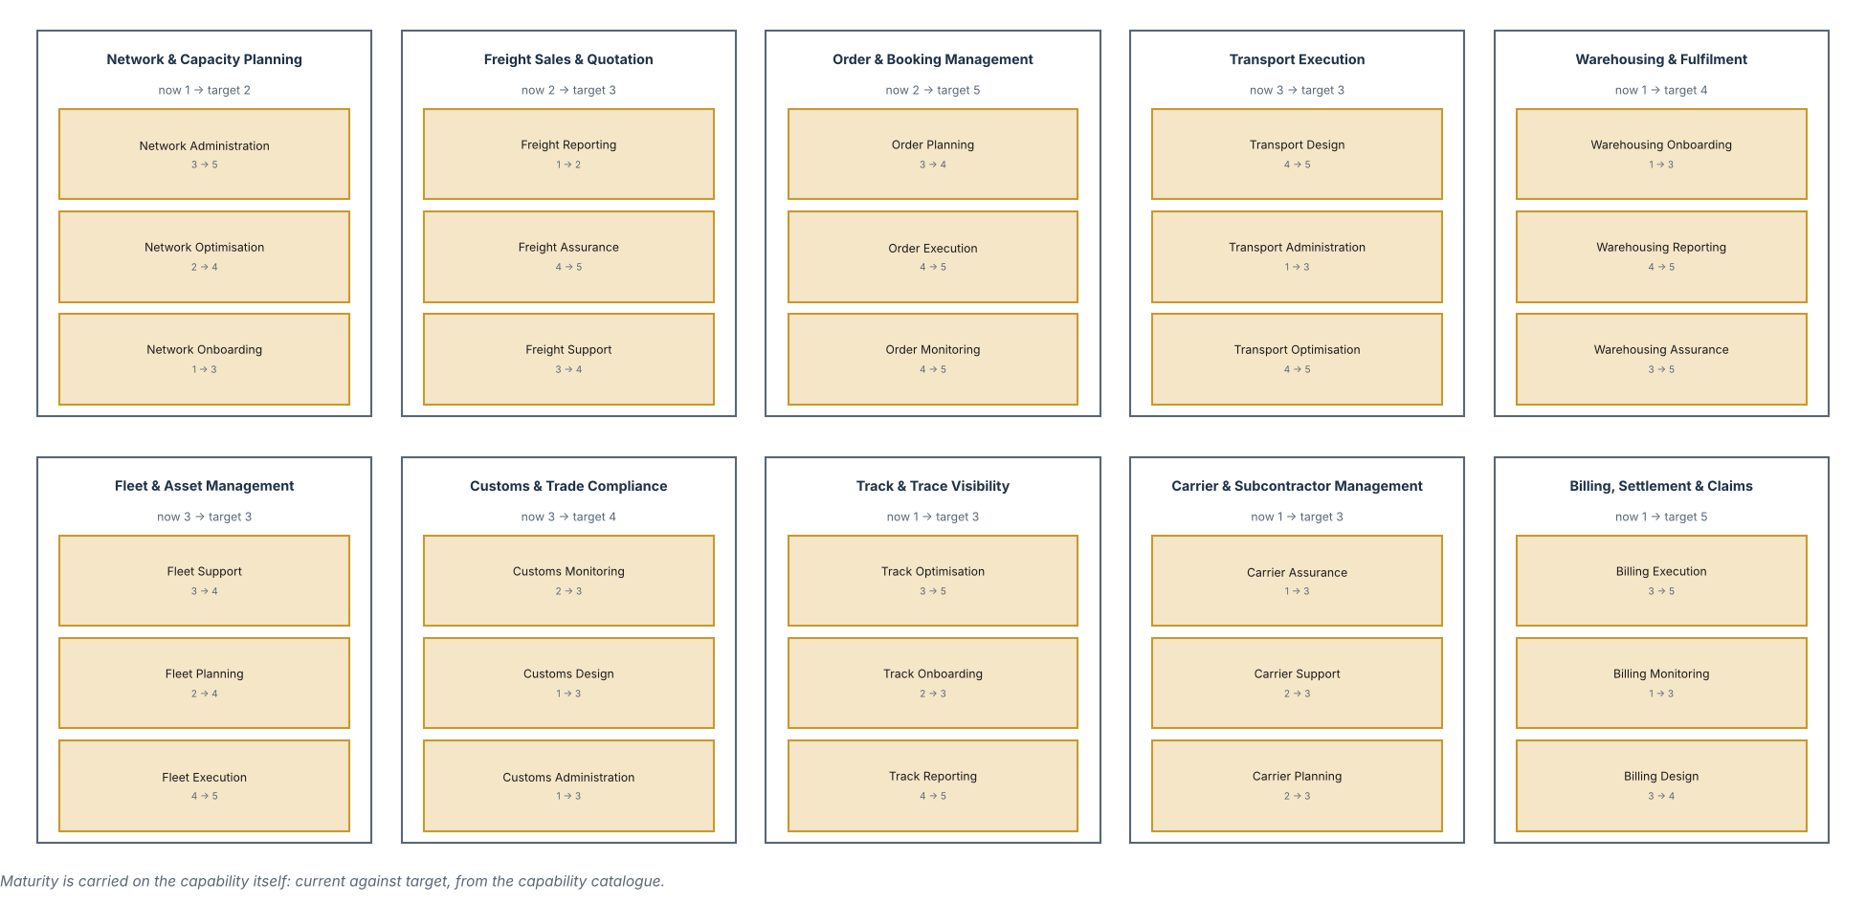
SOLWAY FREIGHT GROUP · STRATEGY · C.3.2
Capability Map view
Ten level 1 capabilities decomposed to level 2, with current and target maturity.
Created using the Capability Map Viewpoint, C.3.2 of the ArchiMate 4 Specification. Drawn from the Logistics TOGAF content metamodel.

Slide 22
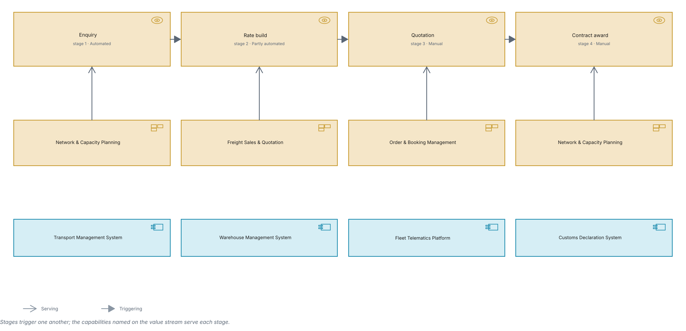
SOLWAY FREIGHT GROUP · STRATEGY · C.3.3
Value Stream view
A value stream, its stages, and the capabilities and applications behind them.
Created using the Value Stream Viewpoint, C.3.3 of the ArchiMate 4 Specification. Drawn from the Logistics TOGAF content metamodel.

Slide 23
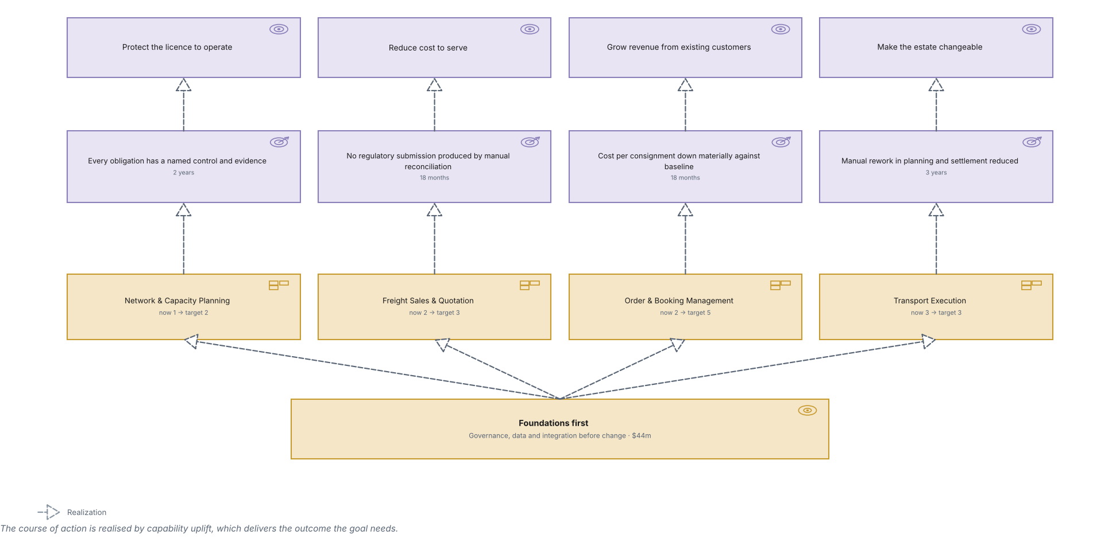
SOLWAY FREIGHT GROUP · STRATEGY · C.3.4
Outcome Realization view
How courses of action and capability uplift deliver outcomes and goals.
Created using the Outcome Realization Viewpoint, C.3.4 of the ArchiMate 4 Specification. Drawn from the Logistics TOGAF content metamodel.

Slide 24
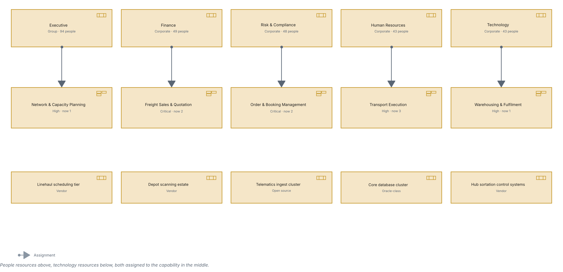
SOLWAY FREIGHT GROUP · STRATEGY · C.3.5
Resource Map view
The resources held and the capabilities they are assigned to.
Created using the Resource Map Viewpoint, C.3.5 of the ArchiMate 4 Specification. Drawn from the Logistics TOGAF content metamodel.

Slide 25
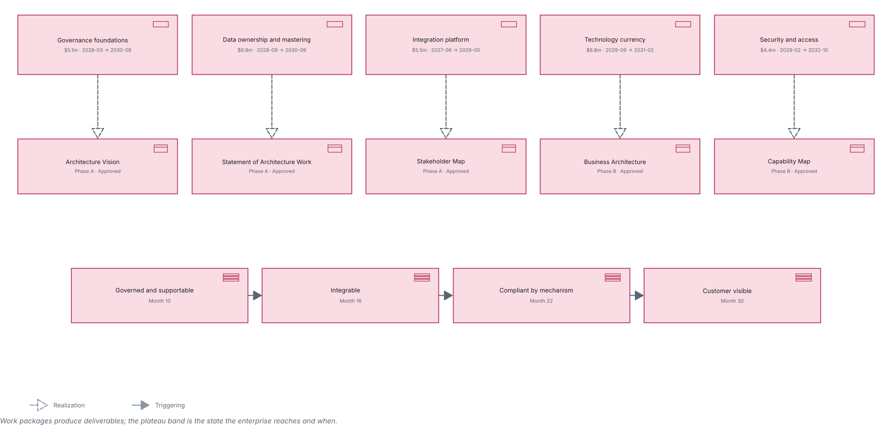
SOLWAY FREIGHT GROUP · IMPLEMENTATION · C.4.1
Project view
Work packages, their deliverables and the plateaus they land.
Created using the Project Viewpoint, C.4.1 of the ArchiMate 4 Specification. Drawn from the Logistics TOGAF content metamodel.

Slide 26
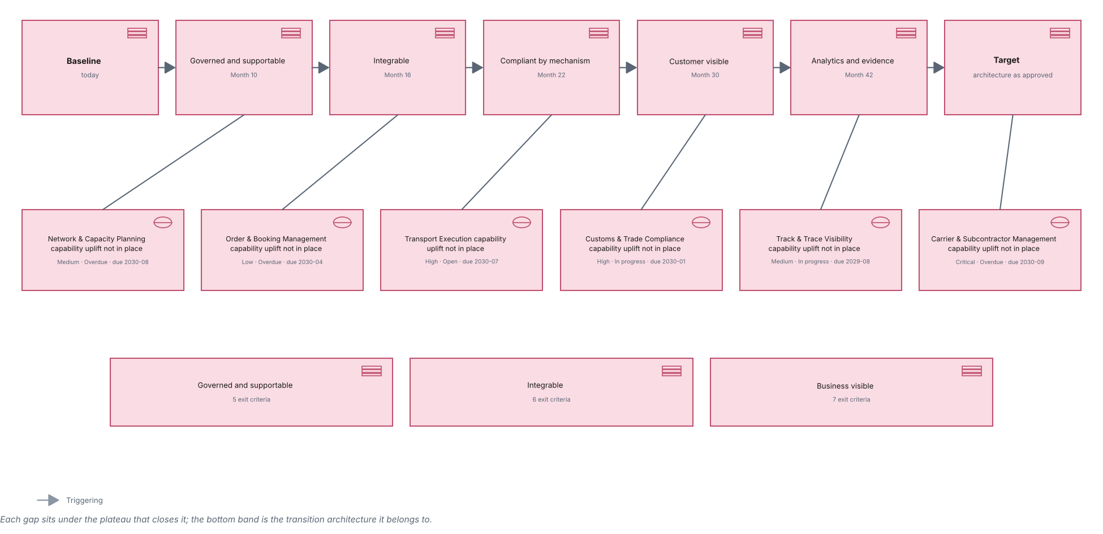
SOLWAY FREIGHT GROUP · IMPLEMENTATION · C.4.2
Migration view
Plateaus from baseline through transition to target, and the gaps between.
Created using the Migration Viewpoint, C.4.2 of the ArchiMate 4 Specification. Drawn from the Logistics TOGAF content metamodel.

Slide 27
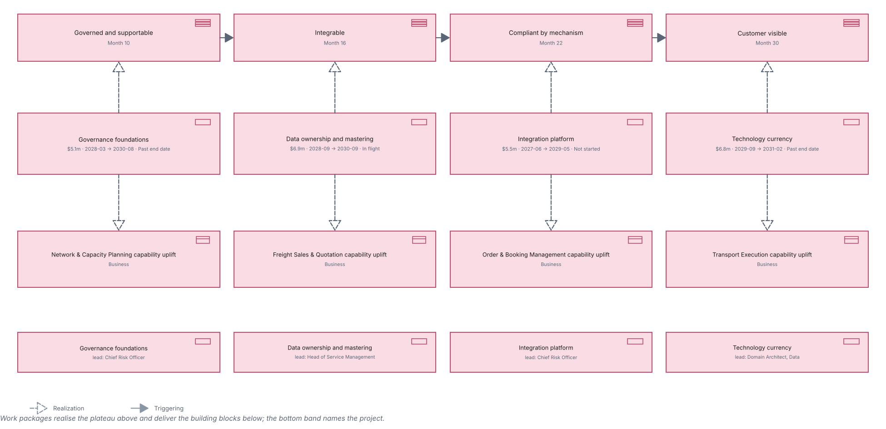
SOLWAY FREIGHT GROUP · IMPLEMENTATION · C.4.3
Implementation and Migration view
Work packages against plateaus, and the building blocks they deliver.
Created using the Implementation and Migration Viewpoint, C.4.3 of the ArchiMate 4 Specification. Drawn from the Logistics TOGAF content metamodel.

