Slide 1
DRAKENSBERG RESOURCES · ARCHITECTURE VIEWS
Twenty-five views of
the architecture
Resource extraction and processing — ore bodies, mine sites, plants and the licences that permit them.
One view for each of the twenty-five viewpoints in the ArchiMate 4 Specification. A viewpoint is where you look from; a view is what you see.
13
4
5
3
from basic viewpoints
from motivation
from strategy
from implementation
Drakensberg Resources is an illustrative organisation. ArchiMate® is a registered trademark of The Open Group.

Slide 2
CONTENTS
Twenty-five views, one per viewpoint
C.1.1
Organization view
C.2.1
Stakeholder view
C.1.2
Application Structure view
C.2.2
Goal Realization view
C.1.3
Information Structure view
C.2.3
Requirements Realization view
C.1.4
Technology view
C.2.4
Motivation view
C.1.5
Layered view
C.3.1
Strategy view
C.1.6
Physical view
C.3.2
Capability Map view
C.1.7
Product view
C.3.3
Value Stream view
C.1.8
Application Usage view
C.3.4
Outcome Realization view
C.1.9
Technology Usage view
C.3.5
Resource Map view
C.1.10
Process Cooperation view
C.4.1
Project view
C.1.11
Application Cooperation view
C.4.2
Migration view
C.1.12
Service Realization view
C.4.3
Implementation and Migration view
C.1.13
Implementation and Deployment view
Each row is a view of Drakensberg Resources. The reference is the viewpoint it was created from, per Appendix C of the ArchiMate 4 Specification.

Slide 3
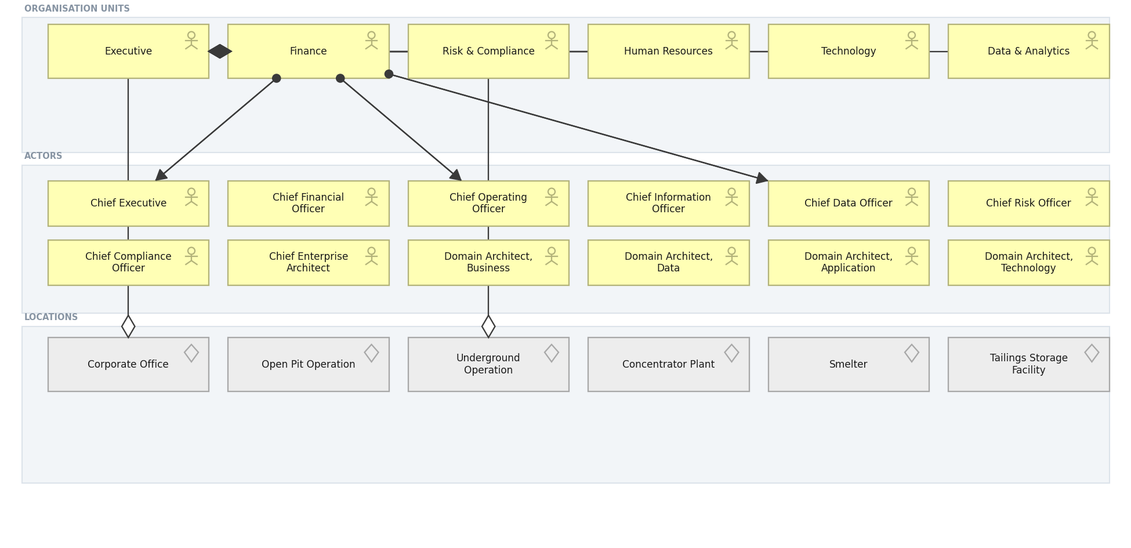
DRAKENSBERG RESOURCES · BASIC · C.1.1
Organization view
Who the organisation is: units, the actors inside them, and where they sit.
Created using the Organization Viewpoint, C.1.1 of the ArchiMate 4 Specification. Drawn from the Minerals Mining metamodel.

Slide 4
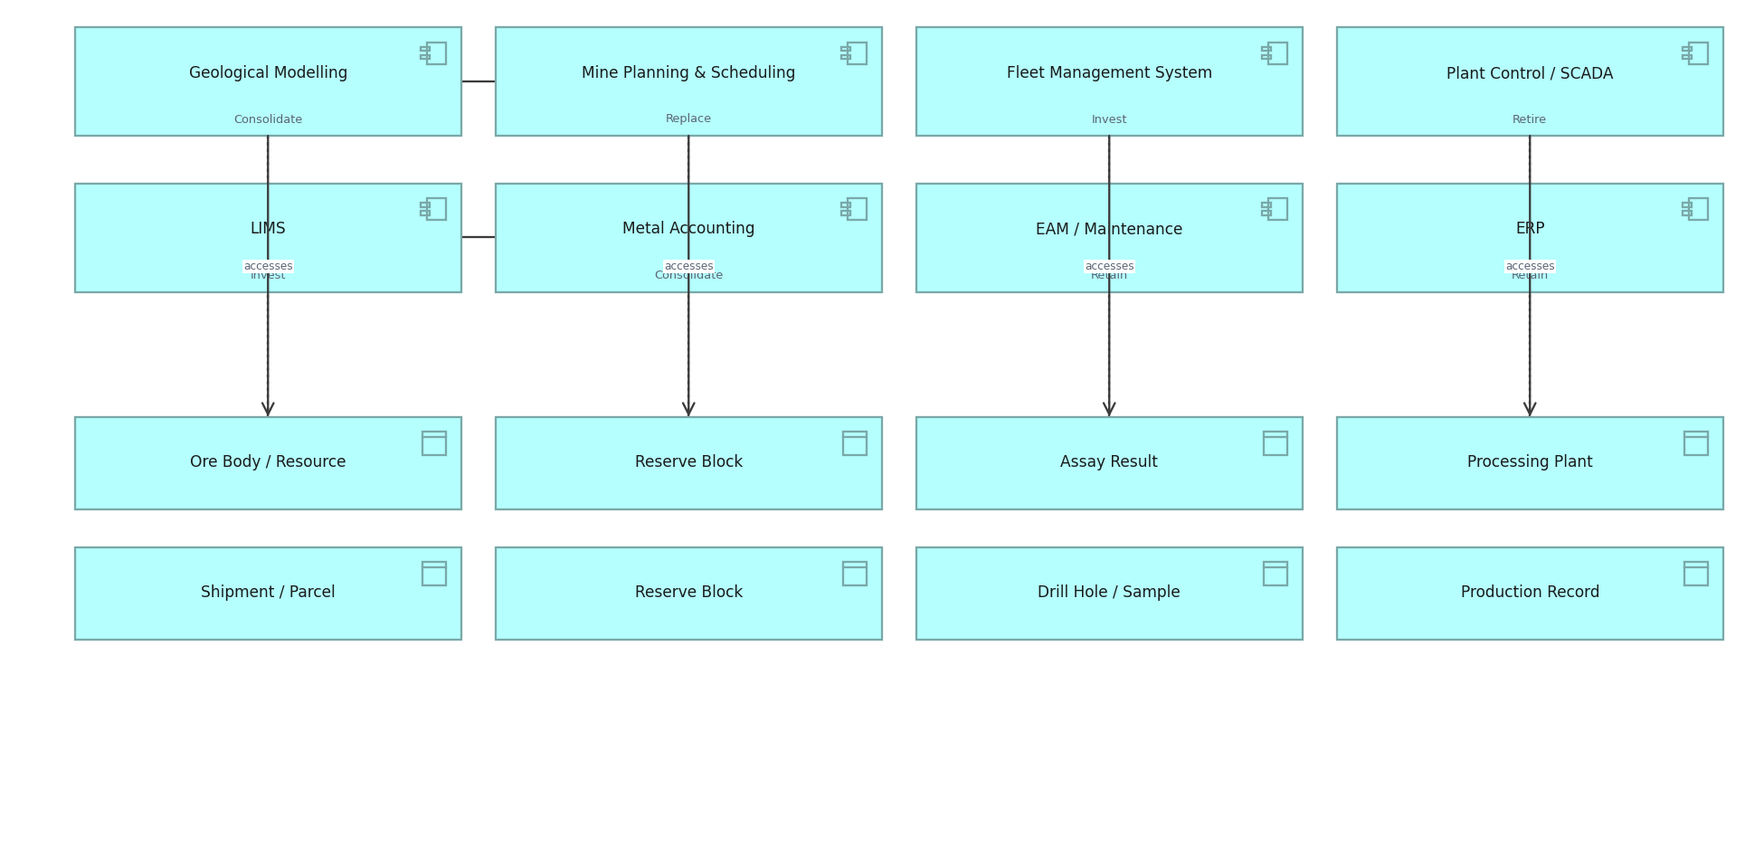
DRAKENSBERG RESOURCES · BASIC · C.1.2
Application Structure view
The structure of the application estate and the data each component holds.
Created using the Application Structure Viewpoint, C.1.2 of the ArchiMate 4 Specification. Drawn from the Minerals Mining metamodel.

Slide 5
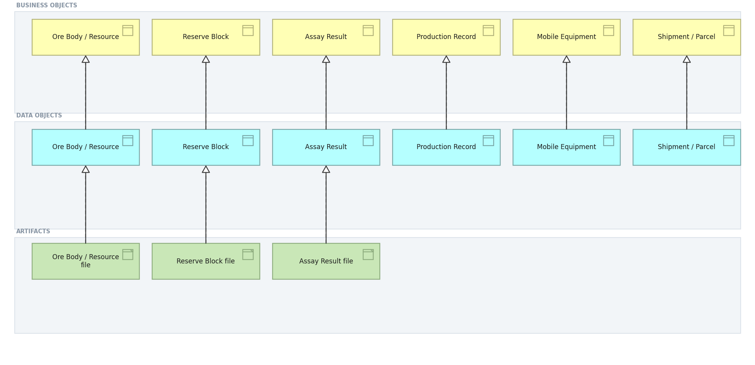
DRAKENSBERG RESOURCES · BASIC · C.1.3
Information Structure view
Business objects, the data objects that realise them, and the artifacts beneath.
Created using the Information Structure Viewpoint, C.1.3 of the ArchiMate 4 Specification. Drawn from the Minerals Mining metamodel.

Slide 6
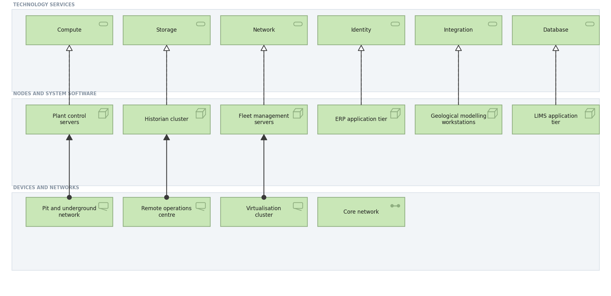
DRAKENSBERG RESOURCES · BASIC · C.1.4
Technology view
Technology services and the nodes, devices and networks that realise them.
Created using the Technology Viewpoint, C.1.4 of the ArchiMate 4 Specification. Drawn from the Minerals Mining metamodel.

Slide 7
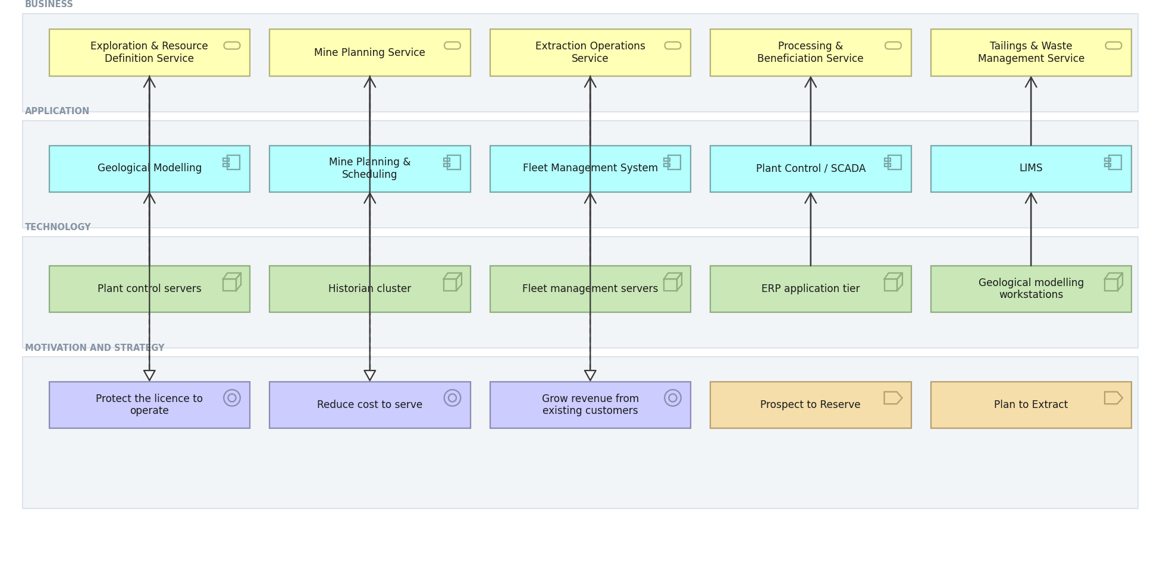
DRAKENSBERG RESOURCES · BASIC · C.1.5
Layered view
One picture across business, application and technology, against motivation and strategy.
Created using the Layered Viewpoint, C.1.5 of the ArchiMate 4 Specification. Drawn from the Minerals Mining metamodel.

Slide 8
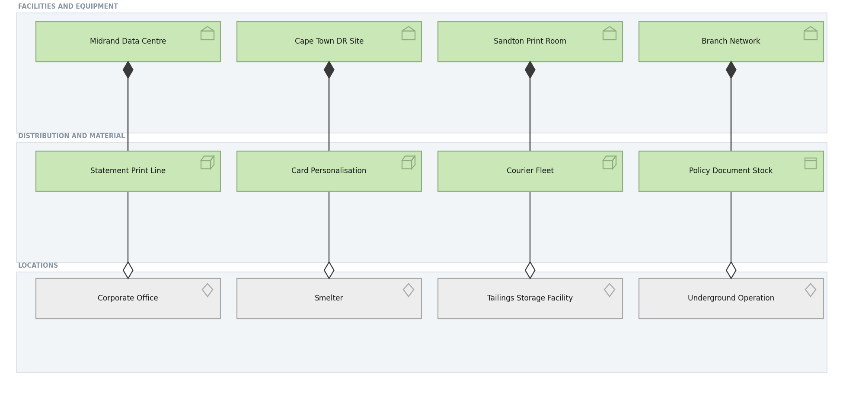
DRAKENSBERG RESOURCES · BASIC · C.1.6
Physical view
Facilities, equipment and material, and the locations they occupy.
Created using the Physical Viewpoint, C.1.6 of the ArchiMate 4 Specification. Drawn from the Minerals Mining metamodel.

Slide 9
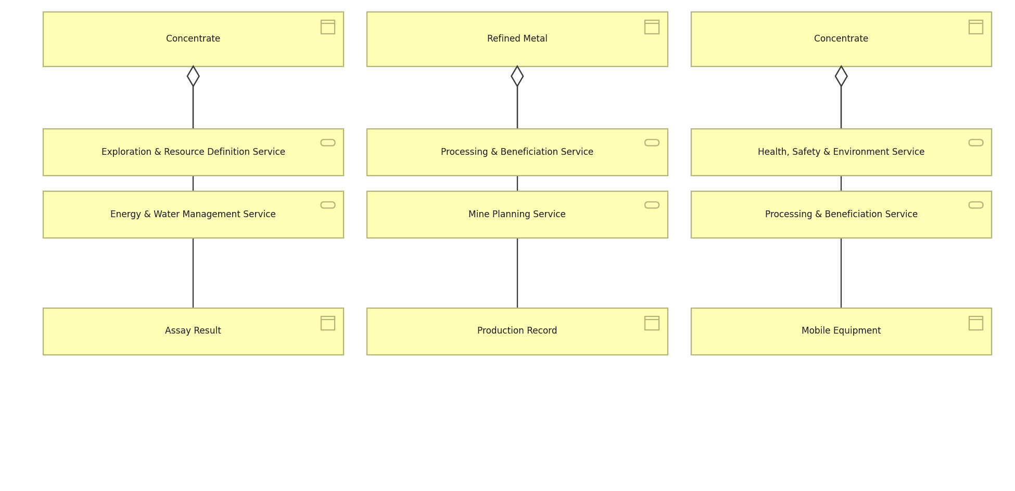
DRAKENSBERG RESOURCES · BASIC · C.1.7
Product view
What Meridian sells, the services each product aggregates and the objects behind it.
Created using the Product Viewpoint, C.1.7 of the ArchiMate 4 Specification. Drawn from the Minerals Mining metamodel.

Slide 10
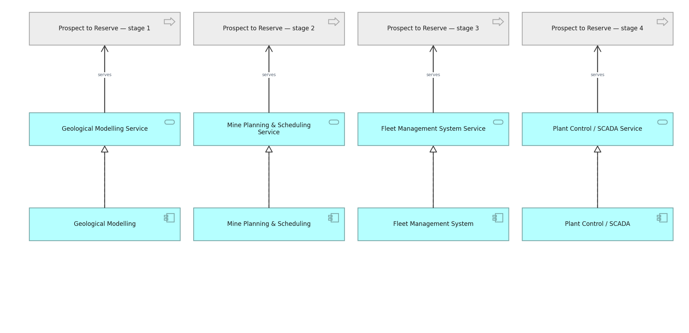
DRAKENSBERG RESOURCES · BASIC · C.1.8
Application Usage view
How business processes consume application services.
Created using the Application Usage Viewpoint, C.1.8 of the ArchiMate 4 Specification. Drawn from the Minerals Mining metamodel.

Slide 11
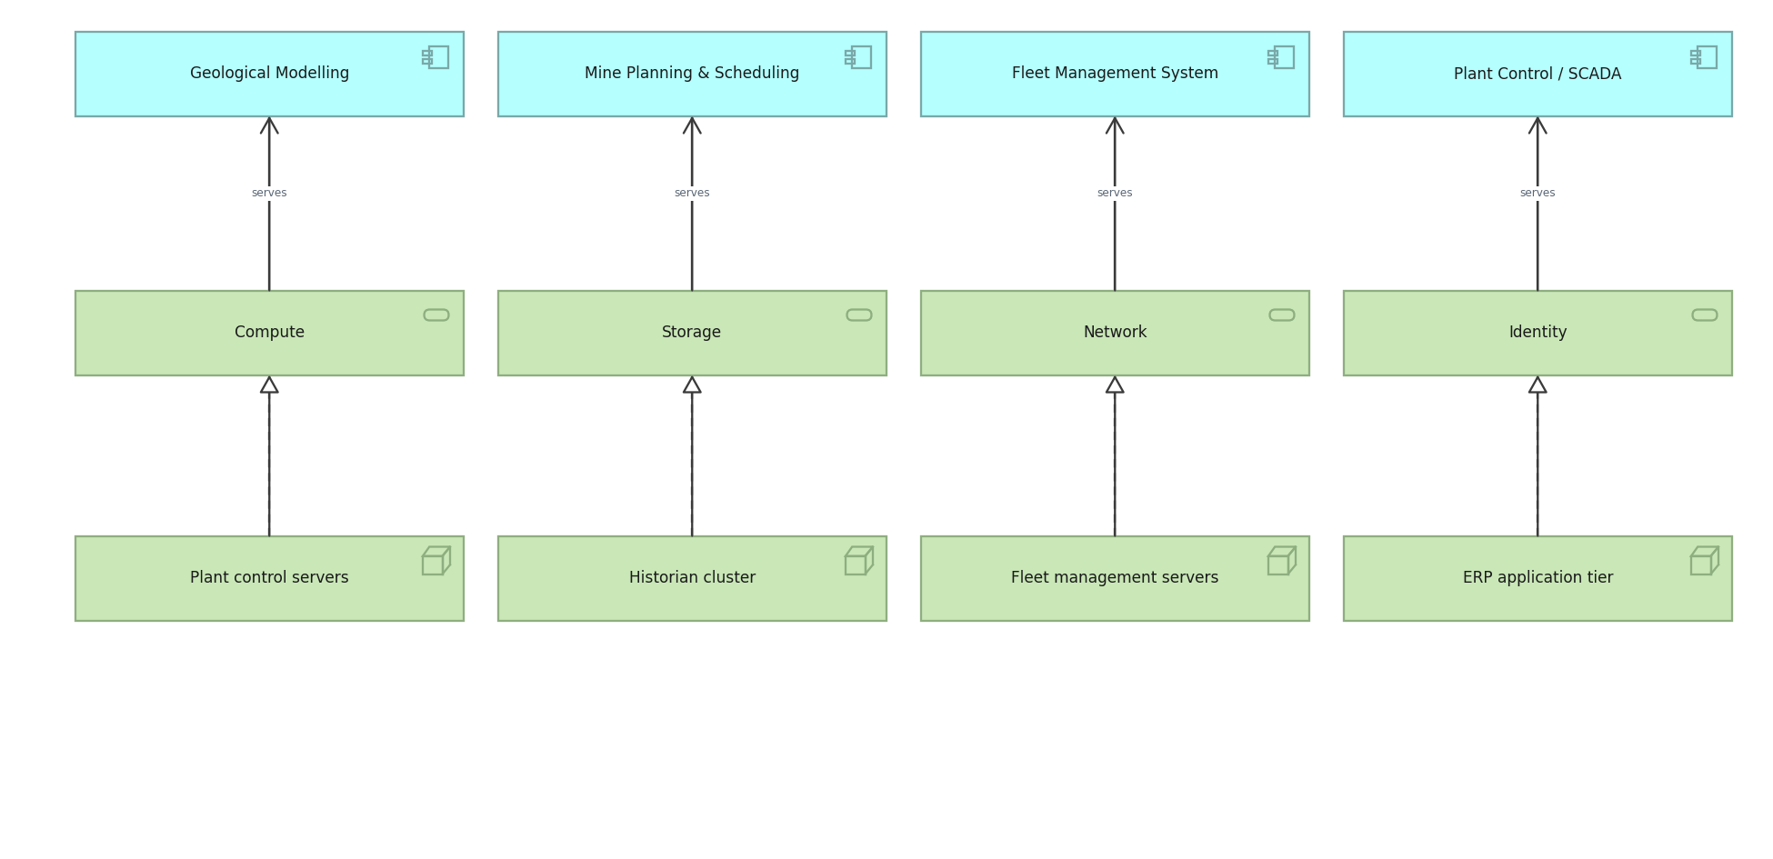
DRAKENSBERG RESOURCES · BASIC · C.1.9
Technology Usage view
How applications consume technology services.
Created using the Technology Usage Viewpoint, C.1.9 of the ArchiMate 4 Specification. Drawn from the Minerals Mining metamodel.

Slide 12
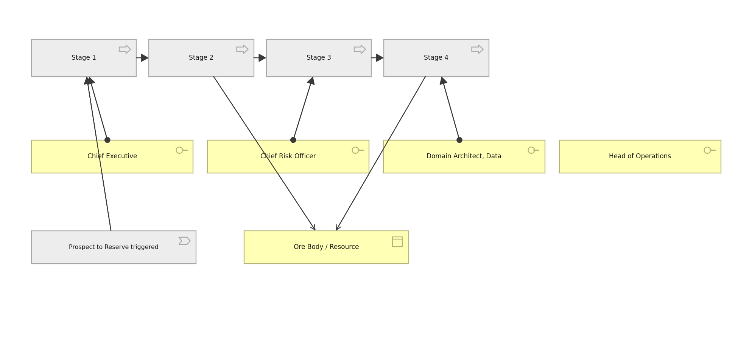
DRAKENSBERG RESOURCES · BASIC · C.1.10
Process Cooperation view
The claim process end to end, who performs each step and what it touches.
Created using the Process Cooperation Viewpoint, C.1.10 of the ArchiMate 4 Specification. Drawn from the Minerals Mining metamodel.

Slide 13
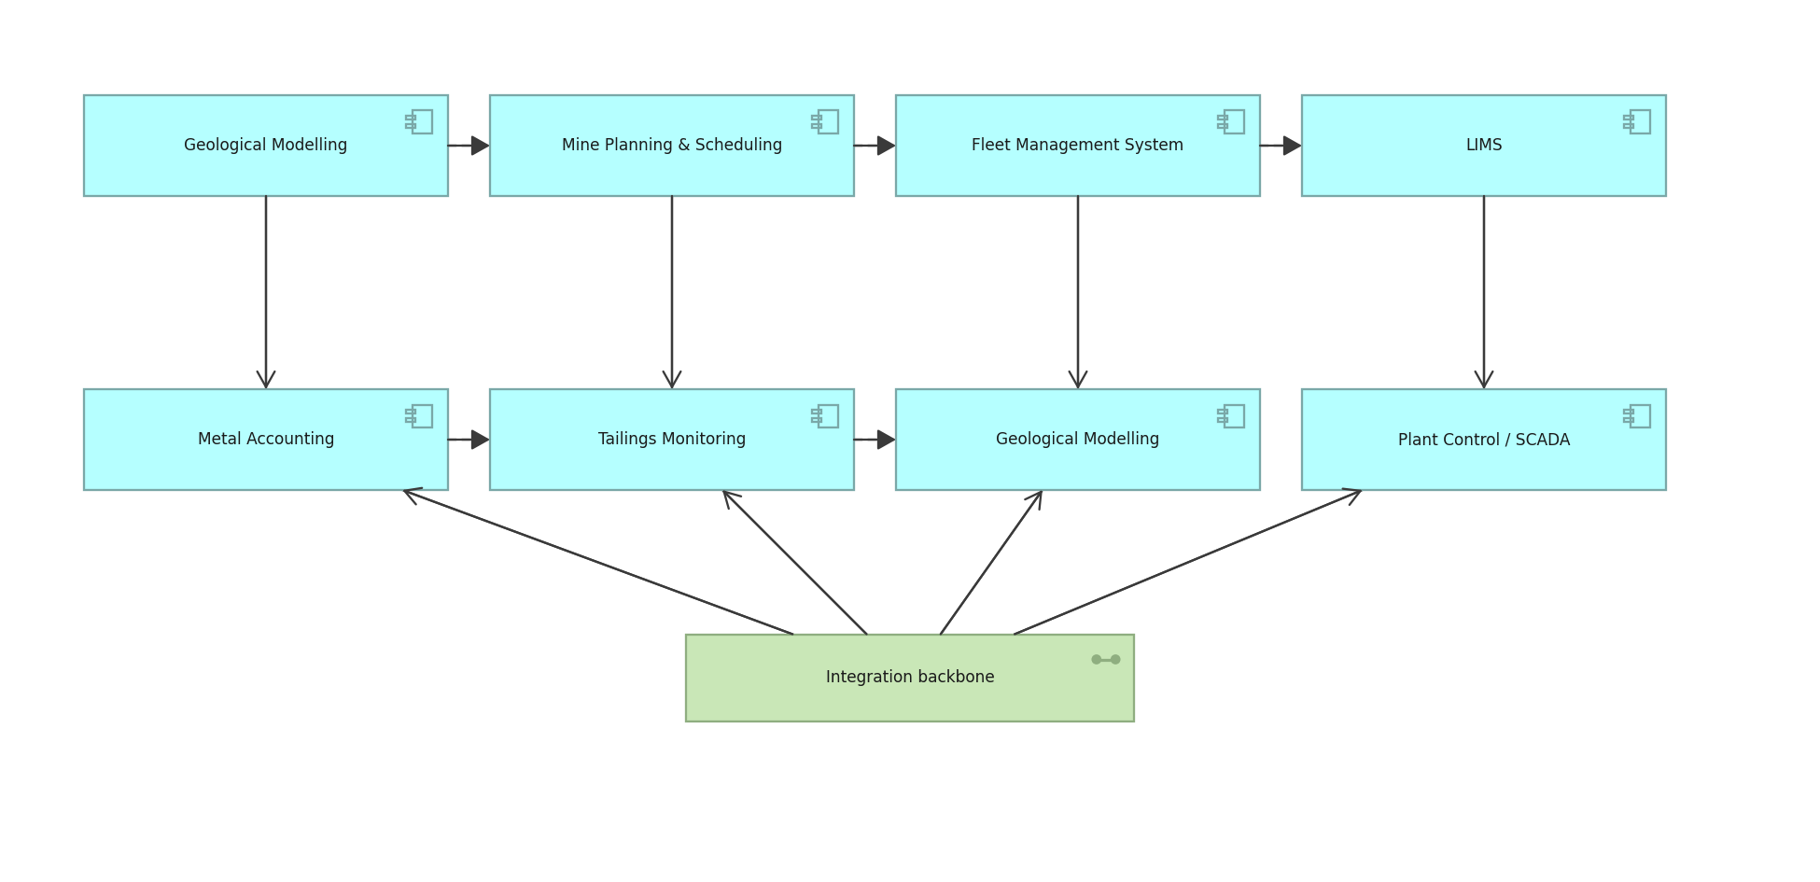
DRAKENSBERG RESOURCES · BASIC · C.1.11
Application Cooperation view
How applications exchange with one another across the estate.
Created using the Application Cooperation Viewpoint, C.1.11 of the ArchiMate 4 Specification. Drawn from the Minerals Mining metamodel.

Slide 14
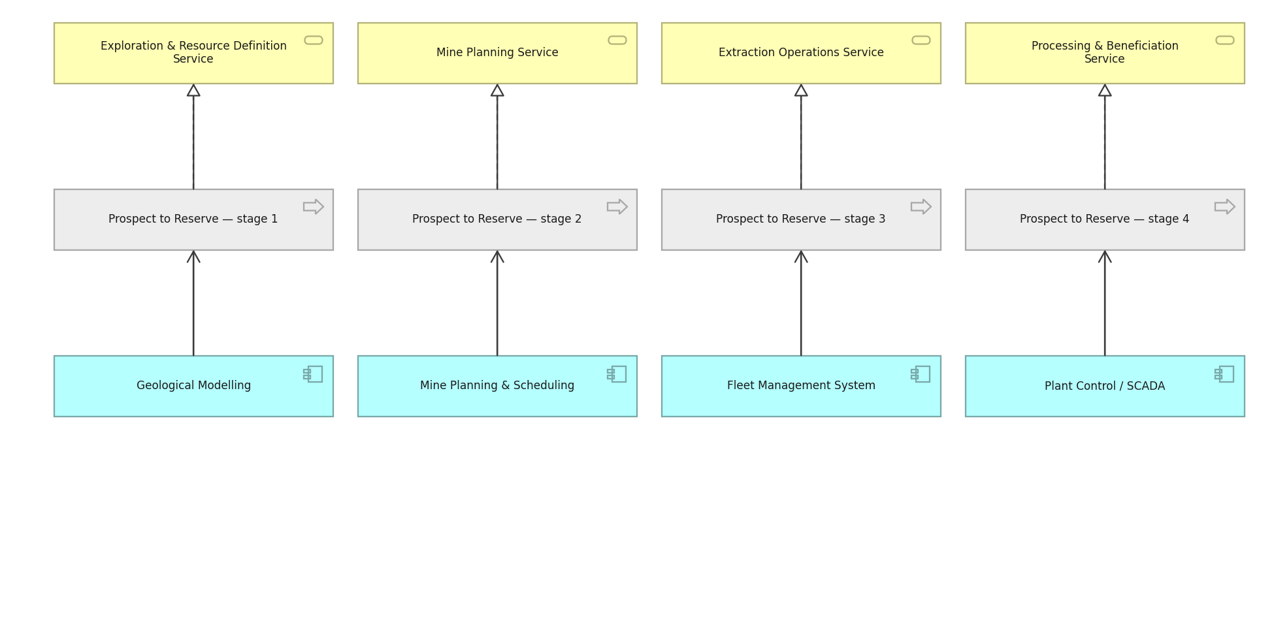
DRAKENSBERG RESOURCES · BASIC · C.1.12
Service Realization view
How business services are realised by processes and supported by applications.
Created using the Service Realization Viewpoint, C.1.12 of the ArchiMate 4 Specification. Drawn from the Minerals Mining metamodel.

Slide 15
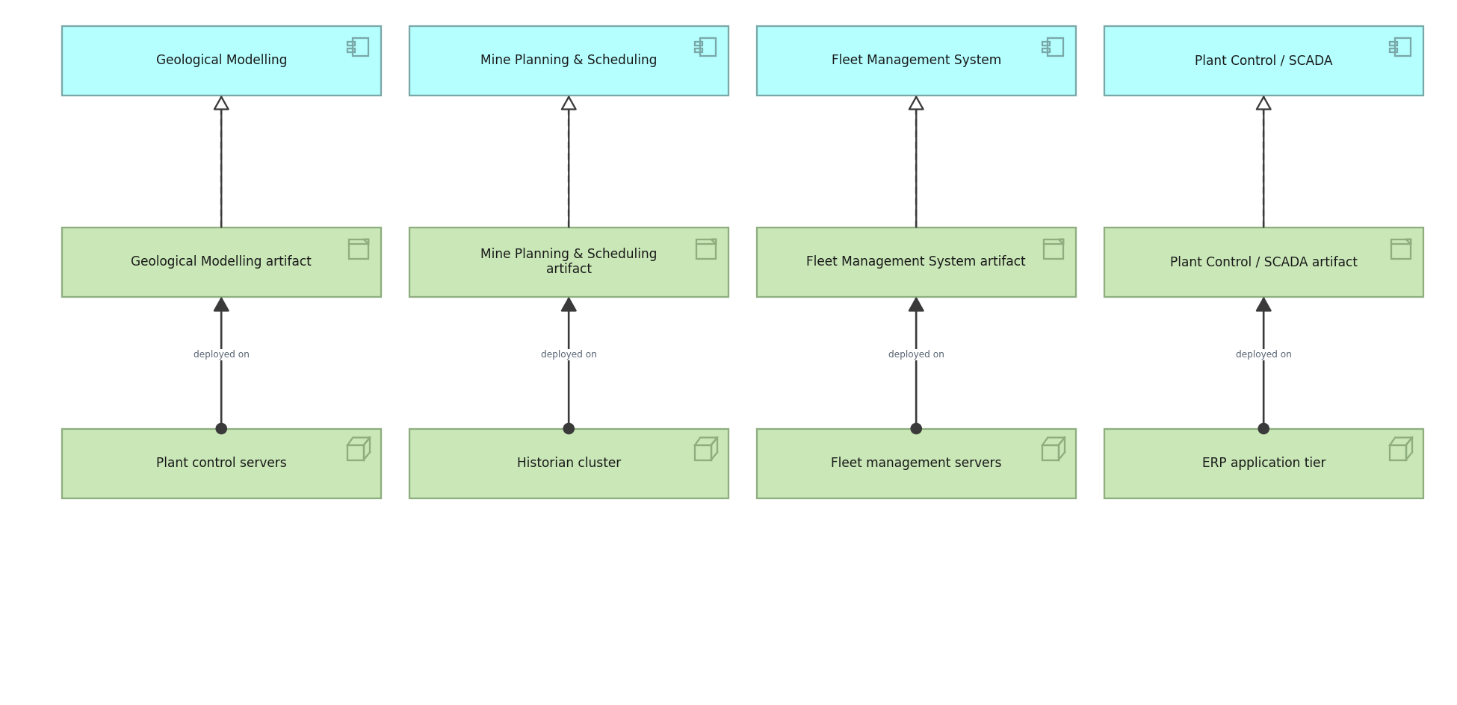
DRAKENSBERG RESOURCES · BASIC · C.1.13
Implementation and Deployment view
Which artifacts realise which applications, and where they are deployed.
Created using the Implementation and Deployment Viewpoint, C.1.13 of the ArchiMate 4 Specification. Drawn from the Minerals Mining metamodel.

Slide 16
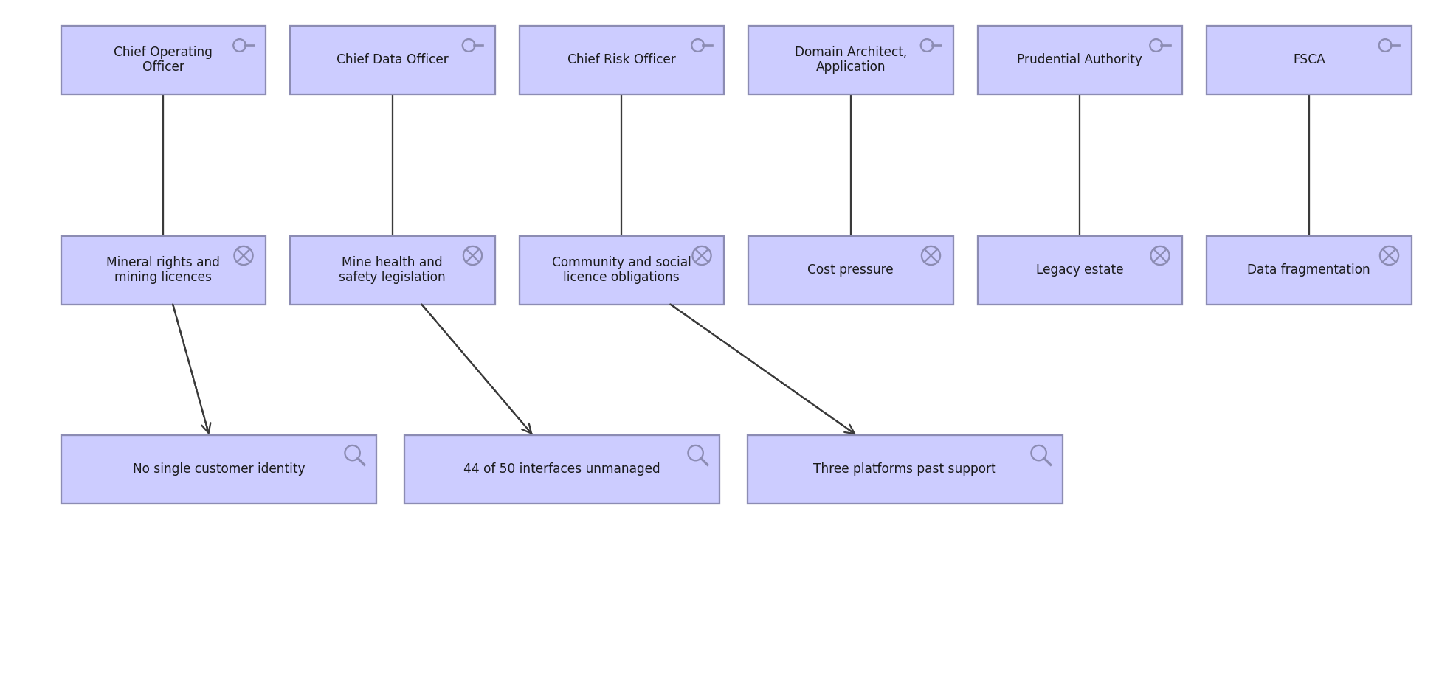
DRAKENSBERG RESOURCES · MOTIVATION · C.2.1
Stakeholder view
Stakeholders, the drivers they care about, and the assessments against them.
Created using the Stakeholder Viewpoint, C.2.1 of the ArchiMate 4 Specification. Drawn from the Minerals Mining metamodel.

Slide 17

DRAKENSBERG RESOURCES · MOTIVATION · C.2.2
Goal Realization view
How goals are refined into outcomes, and the principles that shape them.
Created using the Goal Realization Viewpoint, C.2.2 of the ArchiMate 4 Specification. Drawn from the Minerals Mining metamodel.

Slide 18
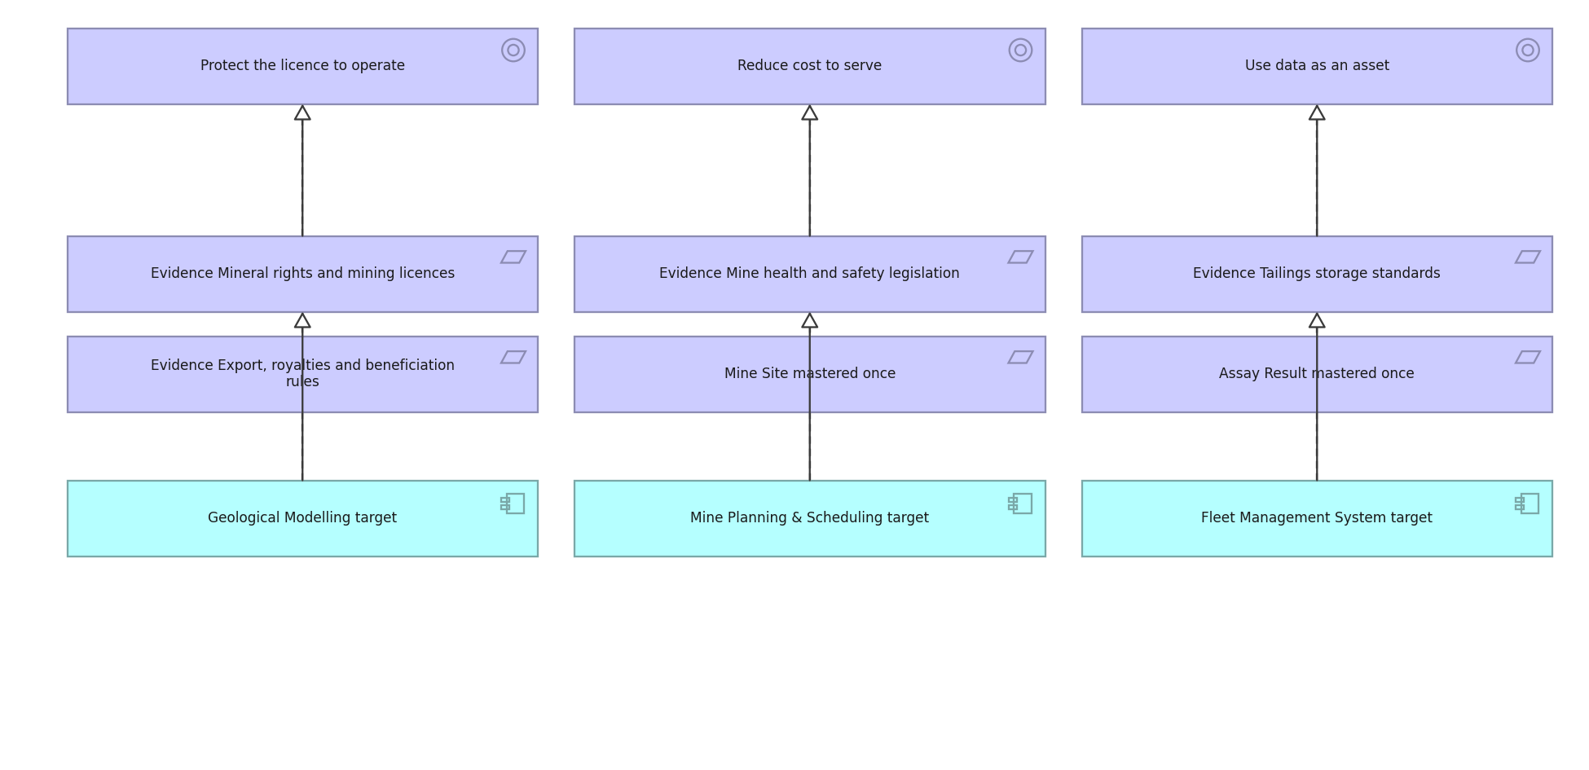
DRAKENSBERG RESOURCES · MOTIVATION · C.2.3
Requirements Realization view
How requirements realise goals and what realises the requirements.
Created using the Requirements Realization Viewpoint, C.2.3 of the ArchiMate 4 Specification. Drawn from the Minerals Mining metamodel.

Slide 19
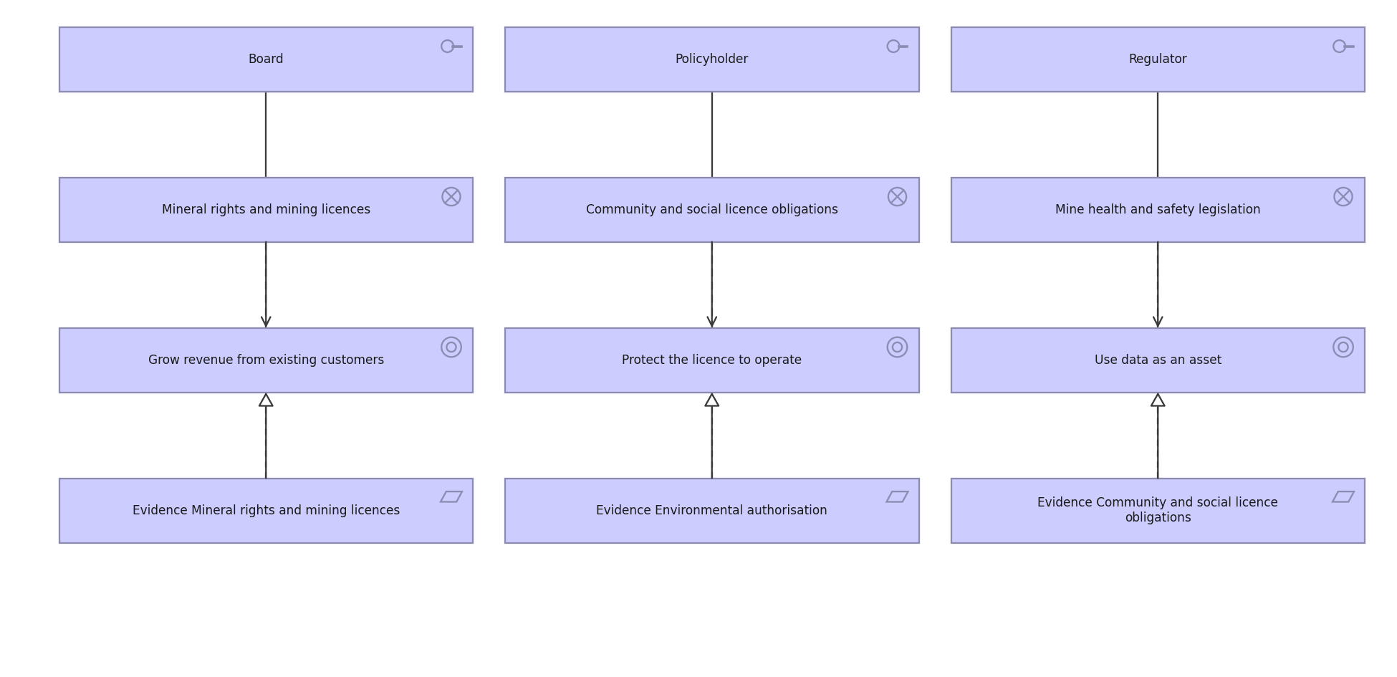
DRAKENSBERG RESOURCES · MOTIVATION · C.2.4
Motivation view
The full motivation chain: stakeholder to driver to goal to requirement.
Created using the Motivation Viewpoint, C.2.4 of the ArchiMate 4 Specification. Drawn from the Minerals Mining metamodel.

Slide 20
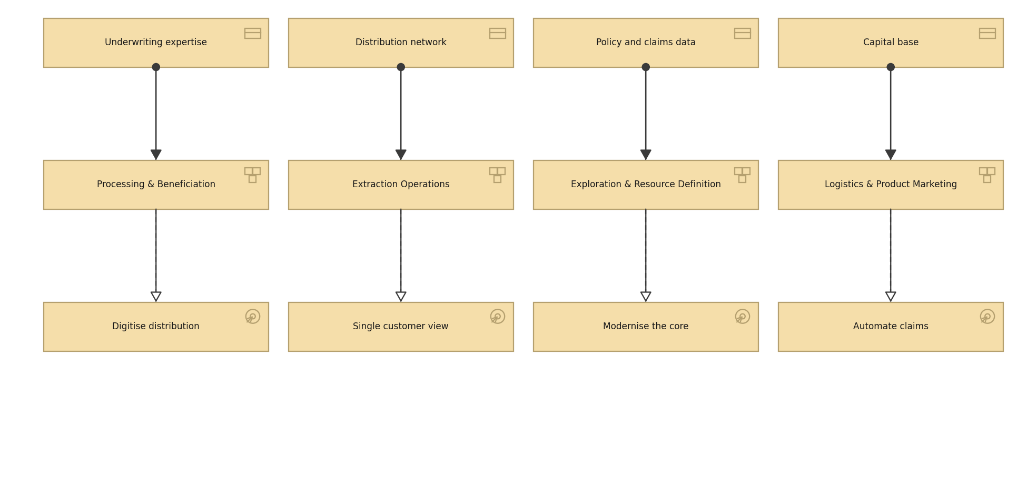
DRAKENSBERG RESOURCES · STRATEGY · C.3.1
Strategy view
Resources, the capabilities they enable and the courses of action chosen.
Created using the Strategy Viewpoint, C.3.1 of the ArchiMate 4 Specification. Drawn from the Minerals Mining metamodel.

Slide 21
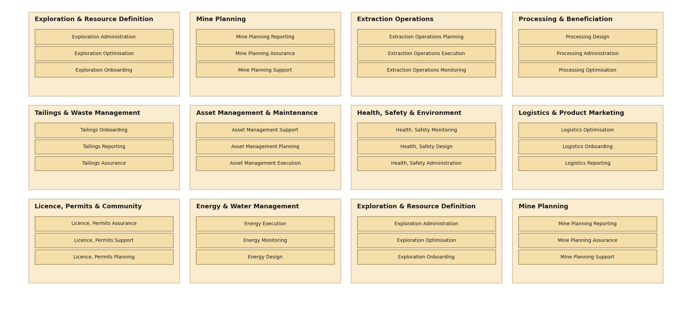
DRAKENSBERG RESOURCES · STRATEGY · C.3.2
Capability Map view
Twelve level 1 capabilities decomposed to level 2.
Created using the Capability Map Viewpoint, C.3.2 of the ArchiMate 4 Specification. Drawn from the Minerals Mining metamodel.

Slide 22
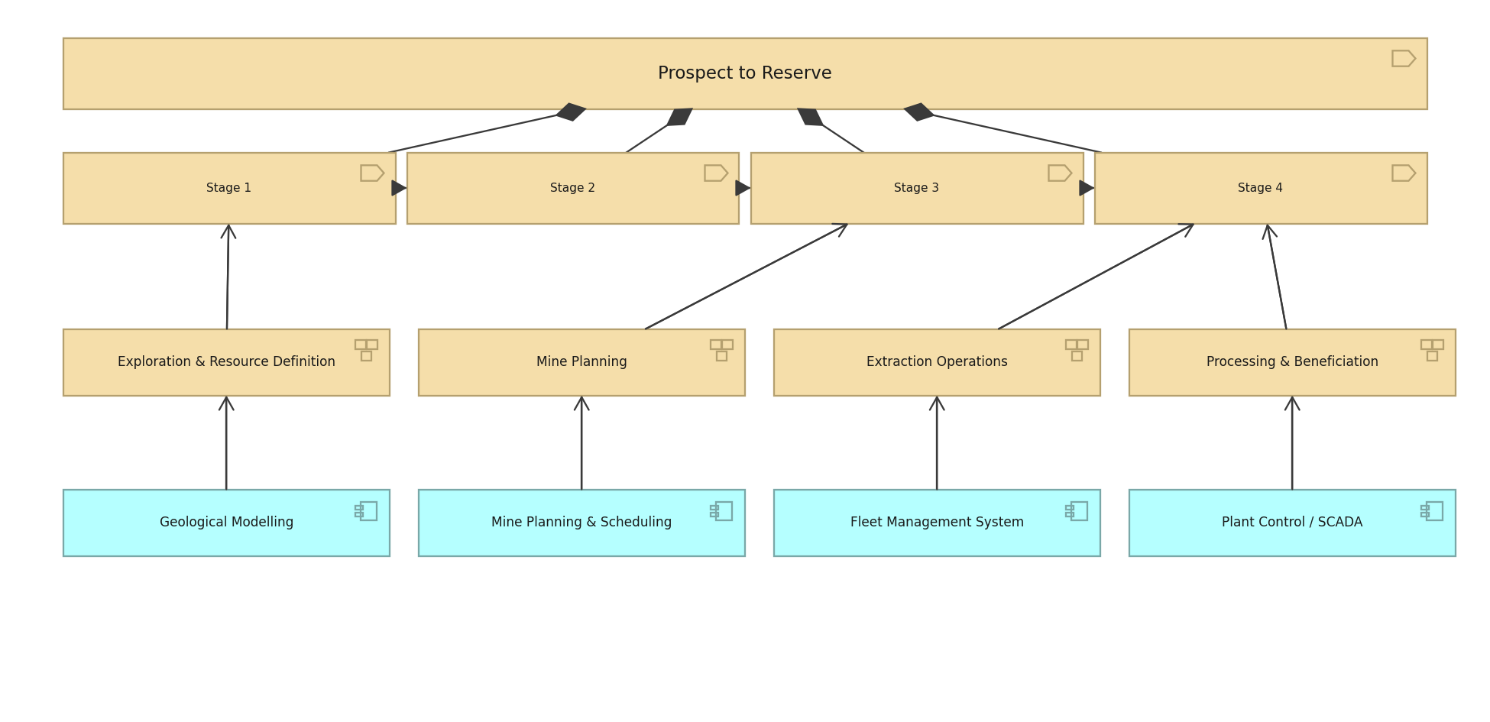
DRAKENSBERG RESOURCES · STRATEGY · C.3.3
Value Stream view
Settle a Claim, its stages, and the capabilities and applications behind them.
Created using the Value Stream Viewpoint, C.3.3 of the ArchiMate 4 Specification. Drawn from the Minerals Mining metamodel.

Slide 23
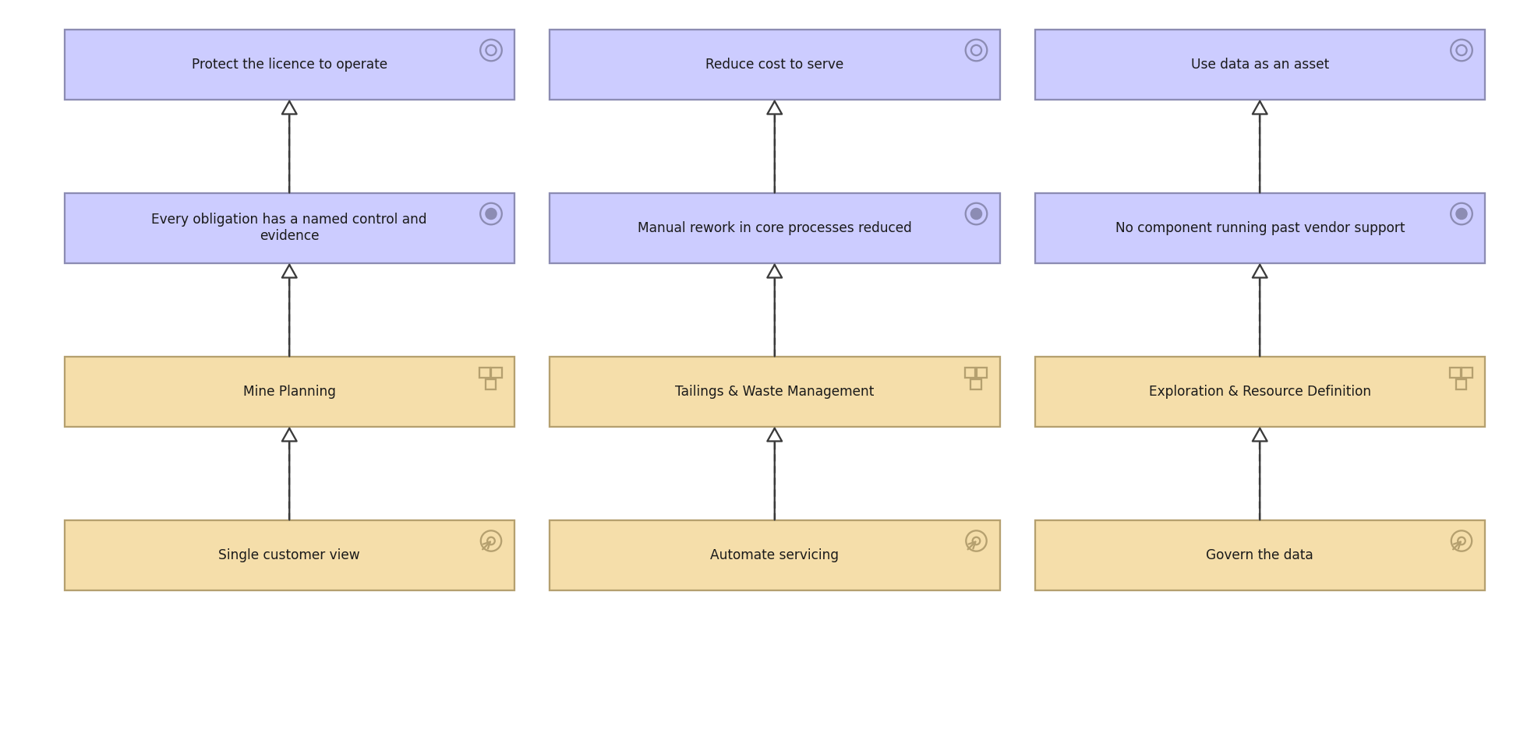
DRAKENSBERG RESOURCES · STRATEGY · C.3.4
Outcome Realization view
How courses of action and capabilities deliver outcomes and goals.
Created using the Outcome Realization Viewpoint, C.3.4 of the ArchiMate 4 Specification. Drawn from the Minerals Mining metamodel.

Slide 24
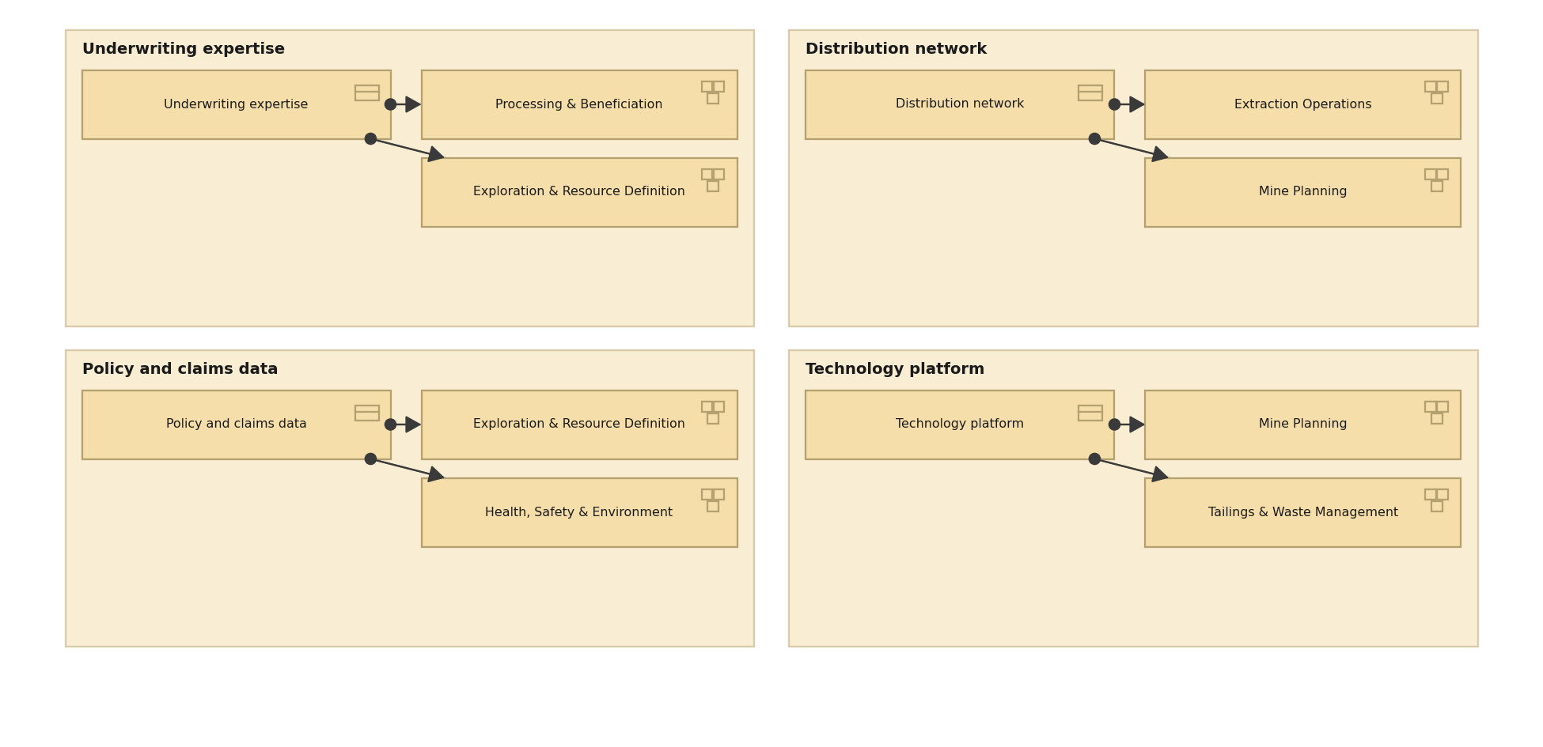
DRAKENSBERG RESOURCES · STRATEGY · C.3.5
Resource Map view
The resources Meridian holds and the capabilities they are assigned to.
Created using the Resource Map Viewpoint, C.3.5 of the ArchiMate 4 Specification. Drawn from the Minerals Mining metamodel.

Slide 25
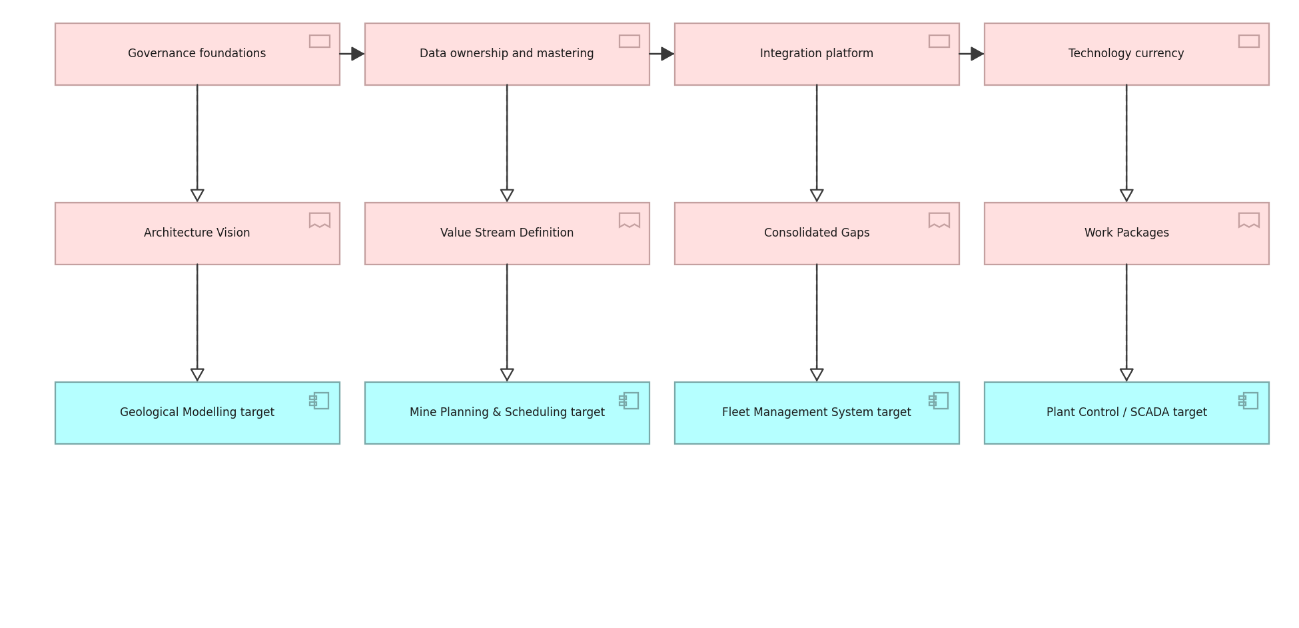
DRAKENSBERG RESOURCES · IMPLEMENTATION · C.4.1
Project view
Work packages, their deliverables and the building blocks they realise.
Created using the Project Viewpoint, C.4.1 of the ArchiMate 4 Specification. Drawn from the Minerals Mining metamodel.

Slide 26
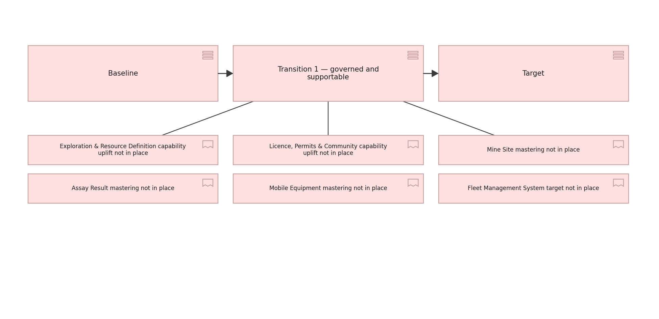
DRAKENSBERG RESOURCES · IMPLEMENTATION · C.4.2
Migration view
Plateaus from baseline through transition to target, and the gaps between.
Created using the Migration Viewpoint, C.4.2 of the ArchiMate 4 Specification. Drawn from the Minerals Mining metamodel.

Slide 27
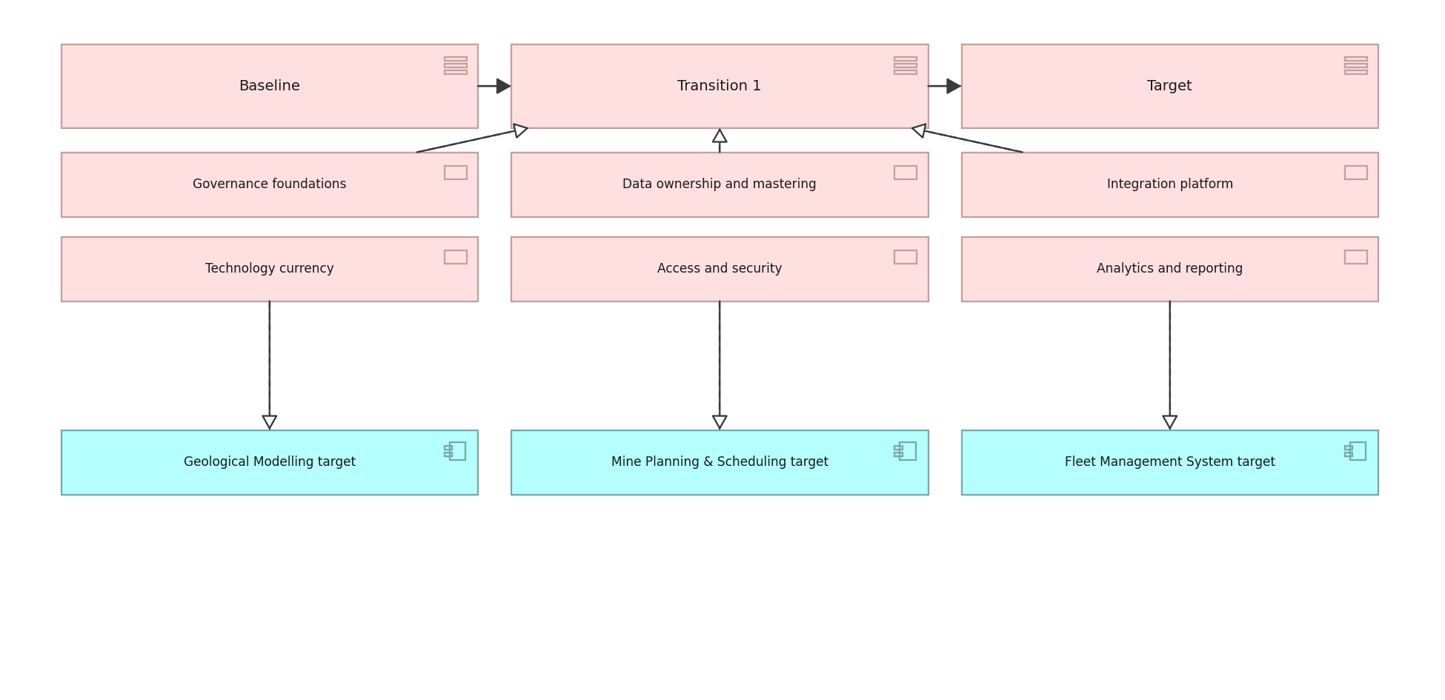
DRAKENSBERG RESOURCES · IMPLEMENTATION · C.4.3
Implementation and Migration view
Work packages against plateaus and the building blocks they deliver.
Created using the Implementation and Migration Viewpoint, C.4.3 of the ArchiMate 4 Specification. Drawn from the Minerals Mining metamodel.

