Slide 1
ARCHIMATE 4 · VIEW TEMPLATES FOR A PHARMACEUTICAL ENGAGEMENT
Thirty-six views,
drawn and named
One view per slide: who it is for, what it may contain, the sheets that populate it, and the column it cannot carry.
36
42
11
3
views, each drawn
elements, no more
relationships
views you must invent
TEMPLATE · EVERY VIEW IS A QUERY, NOT A DRAWING
Sheet references are to Calderon Therapeutics, the invented example repository. It describes no real organisation.
Pharmaceuticals EA · View templates
Thotnr Consulting · Pharmaceuticals starter pack · October 2026
1
Notes:
WHAT TO SAY
Say what the pack is before anyone asks: thirty-six reusable view templates for a pharmaceutical engagement, each drawn once so the shape is settled, and each naming the sheets that populate it.
QUESTION TO EXPECT
'Can we just use these?' Yes, and regenerate them from your own repository. A view is a query, and an edited export is how a repository and a picture come to disagree.

Slide 2
HOW TO READ THESE TEMPLATES
Drawn once, so the shape is settled
Each view is drawn with generic pharmaceutical labels. Replace the labels with your own references; keep the shape, the element set and the honesty about what is missing.
THE QUERY, NOT THE ANSWER
THE STANDARD NAME IS USED
WHAT IT CANNOT SHOW
A view is a selection
Where one applies
On the view, in words
Each slide names the sheets it was built from, so the view can be re-run. Regenerate; never hand-maintain, and never edit the export.
Where an ArchiMate 4 viewpoint covers the view, its name is on the chip. Three of the thirty-six have no standard viewpoint and say so.
Every slide carries the column the picture cannot hold. Write that sentence in the view notes rather than waiting to be asked for it.
THE TWO INVENTED COMPANIES, KEPT APART
Sheet references such as O67 or R06 are to Calderon Therapeutics, the invented example repository that the workbook populates. The worked company in volume 1 is a different invention, Veldtkruin Group. Neither describes a real organisation and their data is never mixed.
AND THE ONE RULE THAT IS SPECIFIC TO THIS INDUSTRY
Decide, for every view, whether it is inside the quality system or outside it, and mark it. A view attached to a validation package, a Site Master File, a submission module or a standard operating procedure is a controlled document, and changing it is a change-control event. The default should be outside, and the exceptions few and named.
Pharmaceuticals EA · View templates
Thotnr Consulting · Pharmaceuticals starter pack · October 2026
2
Notes:
WHAT TO SAY
Make the controlled-document point early. Getting it wrong in the other direction is worse than slowing yourself down: an uncontrolled drawing inside a regulated record is something an inspector will find and ask about.
QUESTION TO EXPECT
'Which of ours are controlled?' Very few should be. Name them, mark the rest 'not a controlled document', and date every export in its own footer.

Slide 3
THE THIRTY-SIX VIEWS · PART ONE
Thirty-six views across the phases
Where a standard ArchiMate 4 viewpoint applies, the view carries its name. The rest are named here and nowhere else.
01
Organisation view
PRELIMINARY AND PHASE A
10
Product identity view
PHASE B
02
Principles view
PHASE A
11
Site and licence view
PHASE B
03
Motivation view
PHASE A
12
Batch-release chain view
PHASE B
04
Goal realisation view
PHASE A
13
Conceptual data model view
PHASE C · DATA
05
Regulatory driver view
PHASE A
14
Information structure view
PHASE C · DATA
06
Capability map, level 1
PHASE B
15
Authority view
PHASE C · DATA
07
Value streams view
PHASE B
16
Dictionary dependency view
PHASE C · DATA
08
Business process co-operation view
PHASE B
17
Retention clock view
PHASE C · DATA
09
Role and authority view
PHASE B
18
Application landscape view
PHASE C · APPLICATION
Pharmaceuticals EA · View templates
Thotnr Consulting · Pharmaceuticals starter pack · October 2026
3
Notes:
WHAT TO SAY
Do not read the list. Point at the three views with no standard viewpoint and say that those three are where this industry differs from every other one in the series.
QUESTION TO EXPECT
'Do we need all thirty-six?' No. Five of them answer most questions in the first quarter: motivation, the capability map, the application landscape, the validated boundary and the layered slice.

Slide 4
THE THIRTY-SIX VIEWS · PART TWO
Thirty-six views across the phases
Where a standard ArchiMate 4 viewpoint applies, the view carries its name. The rest are named here and nowhere else.
19
Interface view
PHASE C · APPLICATION
28
Currency view
PHASE D
20
Application usage view
PHASE C · APPLICATION
29
The validated boundary view
PHASE D
21
Portfolio view
PHASE C · APPLICATION
30
Obligation-to-evidence chain view
PHASE D
22
Validated-system register view
PHASE C · APPLICATION
31
Gaps and building blocks view
PHASES E AND F
23
Clinical and commercial firewall view
PHASE C · APPLICATION
32
Architecture alternatives view
PHASES E AND F
24
Technology view
PHASE D
33
Transition overview view
PHASES E AND F
25
Qualification layer view
PHASE D
34
Implementation and migration view
PHASES E AND F
26
GMP plant boundary view
PHASE D
35
Compliance view
PHASES G AND H
27
Hosting and data-location view
PHASE D
36
Layered slice view
PHASES G AND H
Pharmaceuticals EA · View templates
Thotnr Consulting · Pharmaceuticals starter pack · October 2026
4
Notes:
WHAT TO SAY
The second half is where the pharmaceutical-specific views sit: the validated boundary, the obligation-to-evidence chain and the clinical and commercial firewall. None of them has a standard viewpoint behind it.
QUESTION TO EXPECT
'Why is there no genealogy view?' Because a genealogy is a directed graph of instances with quantities on the edges, and this notation models types.

Slide 5
THE VOCABULARY
Forty-two elements, and what their shape tells you
Shape carries the aspect, fill carries the layer, and nine of the forty-two carry no layer at all.
LAYER-AGNOSTIC
Role
Collaboration
Path
Grouping
Location
Process
Function
Service
Event
BUSINESS
Business Actor
Business Interface
Business Object
Product
APPLICATION
Application Component
Application Interface
Data Object
TECHNOLOGY
Node
Device
System Software
Technology Interface
Equipment
Facility
Communication Network
Distribution Network
Artifact
Material
MOTIVATION
Stakeholder
Driver
Assessment
Goal
Outcome
Principle
Requirement
Value
Meaning
STRATEGY
Resource
Capability
Value Stream
Course of Action
IMPLEMENTATION
Work Package
Deliverable
Plateau
WHAT THE COLOURS AND THE SHAPES ARE DOING
Fill carries the layer and the icon in the top right tells two elements of the same colour apart. Nine elements carry no layer at all and take the neutral fill, which is why Role, Service, Process, Function, Event, Collaboration, Grouping, Location and Path all look alike until you read the icon.
THE THREE THAT MATTER IN A REVIEW
The element is Role: there is no layer-prefixed variant of it, and the same collapse applies to Service, Process, Function, Event and Collaboration. There is no Constraint element, so a constraint is written as a Requirement. And Value is the worth of something to a stakeholder, never a number.
Pharmaceuticals EA · View templates
Thotnr Consulting · Pharmaceuticals starter pack · October 2026
5
Notes:
WHAT TO SAY
Nine of the forty-two carry no layer, which is why the first argument in a review is usually about a word rather than about the architecture. Settle Role, Service and Process in week one.
QUESTION TO EXPECT
'What about Contract?' There is no Contract element in ArchiMate 4. A marketing authorisation models as a Business Object, and what is lost is the contractual semantics — parties, validity and conditions.

Slide 6
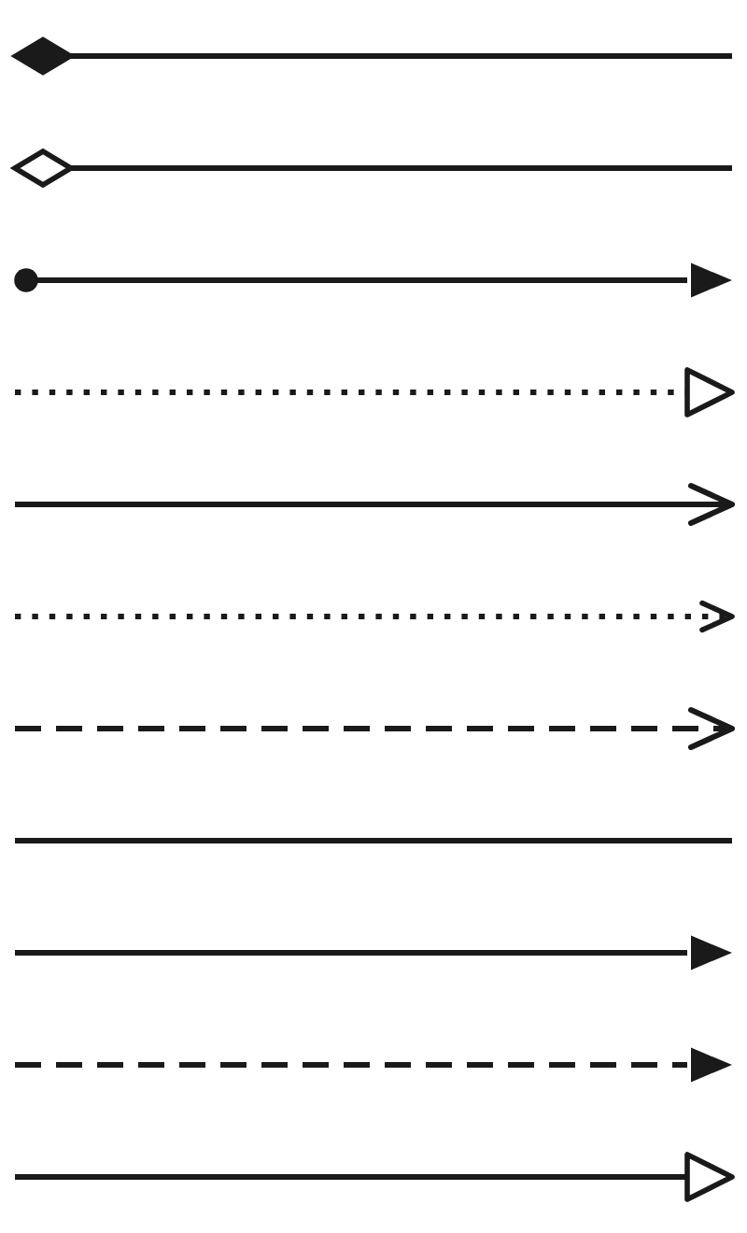
THE GRAMMAR
Eleven relationships, and what each one asserts
The sheet’s direction is the author’s sentence, not the notation’s arrow. Check which way round the sheet reads before you render it.
Composition
The whole is made of these parts, and the part does not outlive the whole
Aggregation
The group contains these, loosely, and a member can belong elsewhere
Assignment
This role or node performs or hosts that behaviour. Every edge is authored
Realization
This more concrete thing makes that more abstract thing real
Serving
This provides something that one needs — the direction is from provider to consumer
Access
This behaviour reads, writes, creates or deletes that object. Type the direction
Influence
This affects the achievement of that. The only edge allowed to be soft
Association
A relation with no stronger name. Label it or it says nothing
Triggering
This causes that to happen next, in time
Flow
Something passes from this to that: information, material or money
Specialization
This is a kind of that, and inherits its relationships
CHECK THE SHEET BEFORE YOU RENDER IT
A relationship sheet is either a statement about the world or a join made in index order. Ten of the twenty-five in the example repository are joins, and rendering one of those puts a wrong claim on a wall, in colour, in front of the person it is wrong about.
Pharmaceuticals EA · View templates
Thotnr Consulting · Pharmaceuticals starter pack · October 2026
6
Notes:
WHAT TO SAY
The useful question in a review is not which arrow but which sentence. Read the edge out loud as a sentence; if it does not make one, the relationship is wrong or the direction is reversed.
QUESTION TO EXPECT
'Does the arrow direction matter?' Yes, and the sheet's column order is not the notation's direction. Check both.

Slide 7
THREE RULES TO SETTLE BEFORE ANYBODY DRAWS
Three notation facts this industry trips over
Each of these has cost a pharmaceutical model its credibility in a review.
ONE
TWO
THREE
The element is Role
There is no Constraint element
Value is not a number
There is no layer-prefixed variant of it in ArchiMate 4. The element that holds Responsible Pharmacist, QA release officer, principal investigator and marketing authorisation holder is called Role and nothing else.
Express the constraint as a Requirement: state the obligation the prohibition implies and move on. "No reporting view may join trial data to sales data" is a Requirement.
There is no metric element. Value is the worth of something to a stakeholder, not a place for 98.5%, a yield or a specification limit. Those belong in a measure definition register.
WHAT THE ROLE RULE ACTUALLY BUYS YOU
Half the arguments about a pharmaceutical model are arguments about whether a thing is a person, a job or a legal accountability. A notation with one word for the job makes the room answer that question, which is why the correction matters more than it sounds.
AND THE TEST THAT KEEPS THE THIRD RULE HONEST
If a client asks for target values on a view — "release in two days", "99% compliance" — put them in the caption or in the register, not in a Value element. The moment a number sits inside a notation element, somebody builds a report that reads it, and the definition behind it does not travel.
Pharmaceuticals EA · View templates
Thotnr Consulting · Pharmaceuticals starter pack · October 2026
7
Notes:
WHAT TO SAY
Say all three on day three of the engagement. An architect who says 'validation state is a property, not an element' early is credible; one still drawing round it in month three is not.
QUESTION TO EXPECT
'Where do we put the limits then?' In the quality system, versioned and approved. A limit on a view is a second, uncontrolled copy of a controlled number.

Slide 8
WHAT THESE VIEWS CANNOT SAY
The loss runs one way, and it is always the same columns
Everything on a view exists in the repository. Much of the repository cannot be drawn, and it is usually the part that decides something.
What cannot be drawn | Why | Where it lives instead
A measure, a baseline, a specification limit | No metric element, and Value is not a number | A measure definition register, and the quality system for a limit
Validation state, GxP class, periodic review date | Properties of an application component | The validated-system register and the review schedule
A retention period | Three of the longest clocks are computations over operational data | A retention register, with the event the clock starts at
A batch genealogy | A directed graph of instances with quantities on the edges | The executed batch records and their export format
A dictionary version inside a coded value | No element carries a version, and none carries supersession | A property on every coded value, and the archived release
A protocol amendment that invalidates structures | There is no versioning relationship, and Specialization is not it | The clinical data model, and a Requirement on the view
Cardinality | Aggregation does not mean one-to-many, whatever the label says | The conceptual data model, in crow’s-foot notation
A governance decision or a change request | A dated controlled record, not a structural element | The decision log and the quality system
SAY IT ON THE VIEW, IN WORDS
Every template in this pack carries the column its picture cannot hold. Write that sentence in the view notes rather than waiting to be asked for it — an architect who names the gap is trusted where one who approximates is corrected later, in public.
Pharmaceuticals EA · View templates
Thotnr Consulting · Pharmaceuticals starter pack · October 2026
8
Notes:
WHAT TO SAY
Collect these in one place because a client will ask, and the answer should be immediate rather than discovered. Saying them out loud in the first fortnight is the fastest way to be believed.
QUESTION TO EXPECT
'Then what is the model for?' For the types, the relationships and the scope. The instances, the numbers and the versions live in registers the model points at.

Slide 9
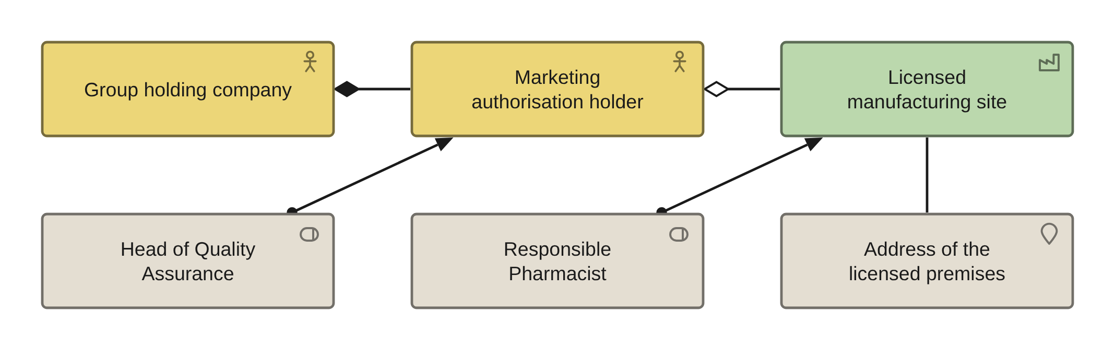
PRELIMINARY AND PHASE A · VIEW 01 OF 36
Organisation view
ARCHIMATE 4 VIEWPOINT: ORGANIZATION
FOR
CANVAS
The sponsor, to agree whose licence this is
ELEMENTS IT MAY CONTAIN
Business Actor, Role, Location, Facility
RELATIONSHIPS
Aggregation, Assignment
POPULATED FROM
O09, O10, O11, O12, O70, R21
WHAT THIS VIEW CANNOT SHOW
That the Responsible Pharmacist is named on the licence, and that there is not more than one per licence
Regenerate from the sheets above. Write the filter in the view notes: sheet, column, value.
Pharmaceuticals EA · View templates
Thotnr Consulting · Pharmaceuticals starter pack · October 2026
9
Notes:
WHAT TO SAY
Say who the view is for before you show it, then name the sheets it came from and the column the picture cannot carry: one Responsible Pharmacist per licence is a rule, not a shape.
QUESTION TO EXPECT
'Is this the org chart?' No. It is the licence structure. The org chart is a different question and a different sheet.

Slide 10
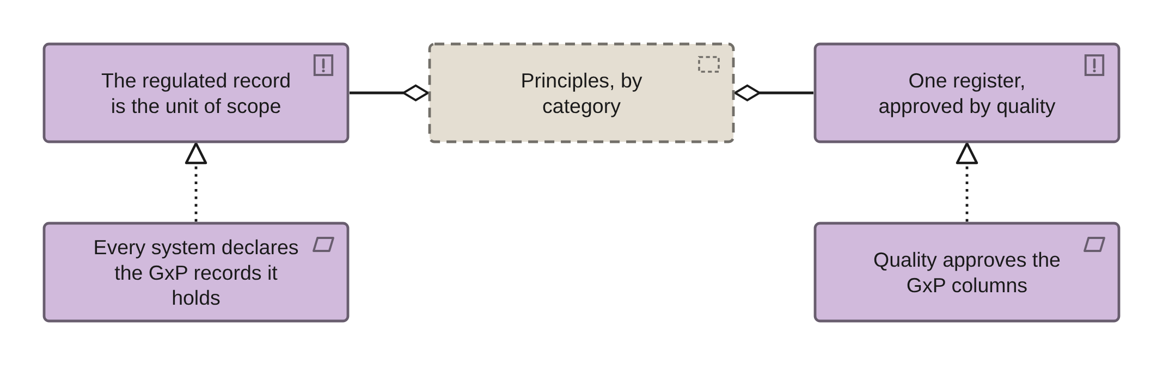
PHASE A · VIEW 02 OF 36
Principles view
ARCHIMATE 4 VIEWPOINT: MOTIVATION
FOR
CANVAS
The architecture board, to adopt them
ELEMENTS IT MAY CONTAIN
Principle, Grouping, Requirement
RELATIONSHIPS
Aggregation, Realization
POPULATED FROM
O05, O06, O64
WHAT THIS VIEW CANNOT SHOW
Whether a principle is draft or approved: status is a property, and a draft principle fails nothing
Group the principles by category, and show the requirement each one generates.
Pharmaceuticals EA · View templates
Thotnr Consulting · Pharmaceuticals starter pack · October 2026
10
Notes:
WHAT TO SAY
Principles that no requirement realises are decoration. Draw the requirement under each one or strike the principle.
QUESTION TO EXPECT
'Who approves these?' The board named on the governance view. If no body exists, that is a finding, not a diagram.

Slide 11
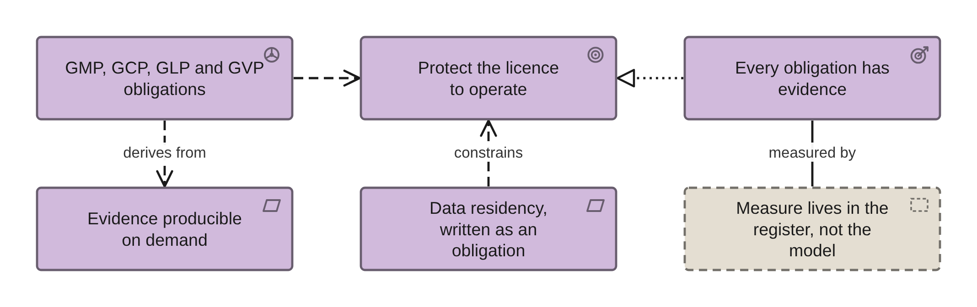
PHASE A · VIEW 03 OF 36
Motivation view
ARCHIMATE 4 VIEWPOINT: MOTIVATION
FOR
CANVAS
The sponsor and the investment committee
ELEMENTS IT MAY CONTAIN
Driver, Goal, Outcome, Requirement, Grouping
RELATIONSHIPS
Influence, Realization, Association
POPULATED FROM
O01, O02, O03, O06, O07 as Requirement, R08, R11
WHAT THIS VIEW CANNOT SHOW
Which guideline version is operative today, and the value of any measure: there is no metric element
The best view in a regulated estate, because the drivers are external, dated and citable.
Pharmaceuticals EA · View templates
Thotnr Consulting · Pharmaceuticals starter pack · October 2026
11
Notes:
WHAT TO SAY
Two of the six boxes exist to show what has no element: there is no Constraint element, and no metric element either.
QUESTION TO EXPECT
'Why is the number in a grey box?' Because Value is not a number. Putting one inside a notation element creates a second, uncontrolled copy of a controlled figure.

Slide 12
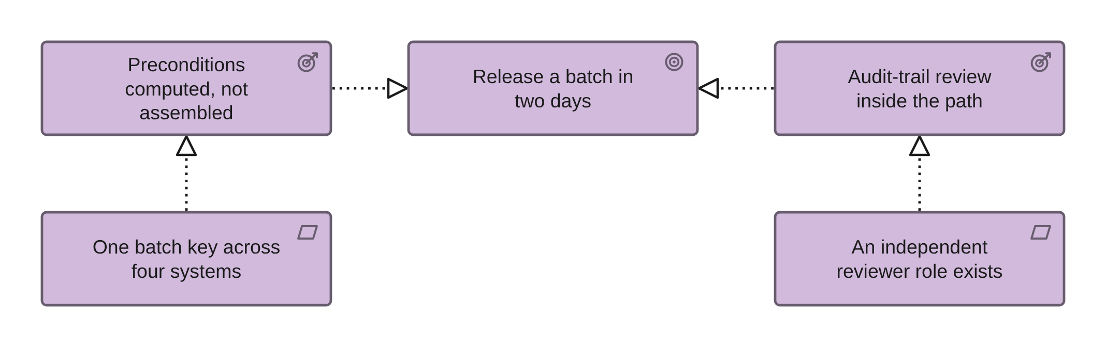
PHASE A · VIEW 04 OF 36
Goal realisation view
ARCHIMATE 4 VIEWPOINT: GOAL REALIZATION
FOR
CANVAS
One sponsor per goal, one view per goal
ELEMENTS IT MAY CONTAIN
Goal, Outcome, Requirement, Principle
RELATIONSHIPS
Realization, Influence
POPULATED FROM
O02, O03, O06, R09, R11
WHAT THIS VIEW CANNOT SHOW
Whether the requirement is testable, which is a property of its wording rather than of the chain
One goal per view. A goal realisation view with six goals on it is a report.
Pharmaceuticals EA · View templates
Thotnr Consulting · Pharmaceuticals starter pack · October 2026
12
Notes:
WHAT TO SAY
The test of this view is whether the sponsor recognises the goal as theirs. If they do not, you have drawn the architect’s goal.
QUESTION TO EXPECT
'Is two days achievable?' Unknown until release lead time is measured rather than asserted. That is a measure, and it belongs in the register.

Slide 13
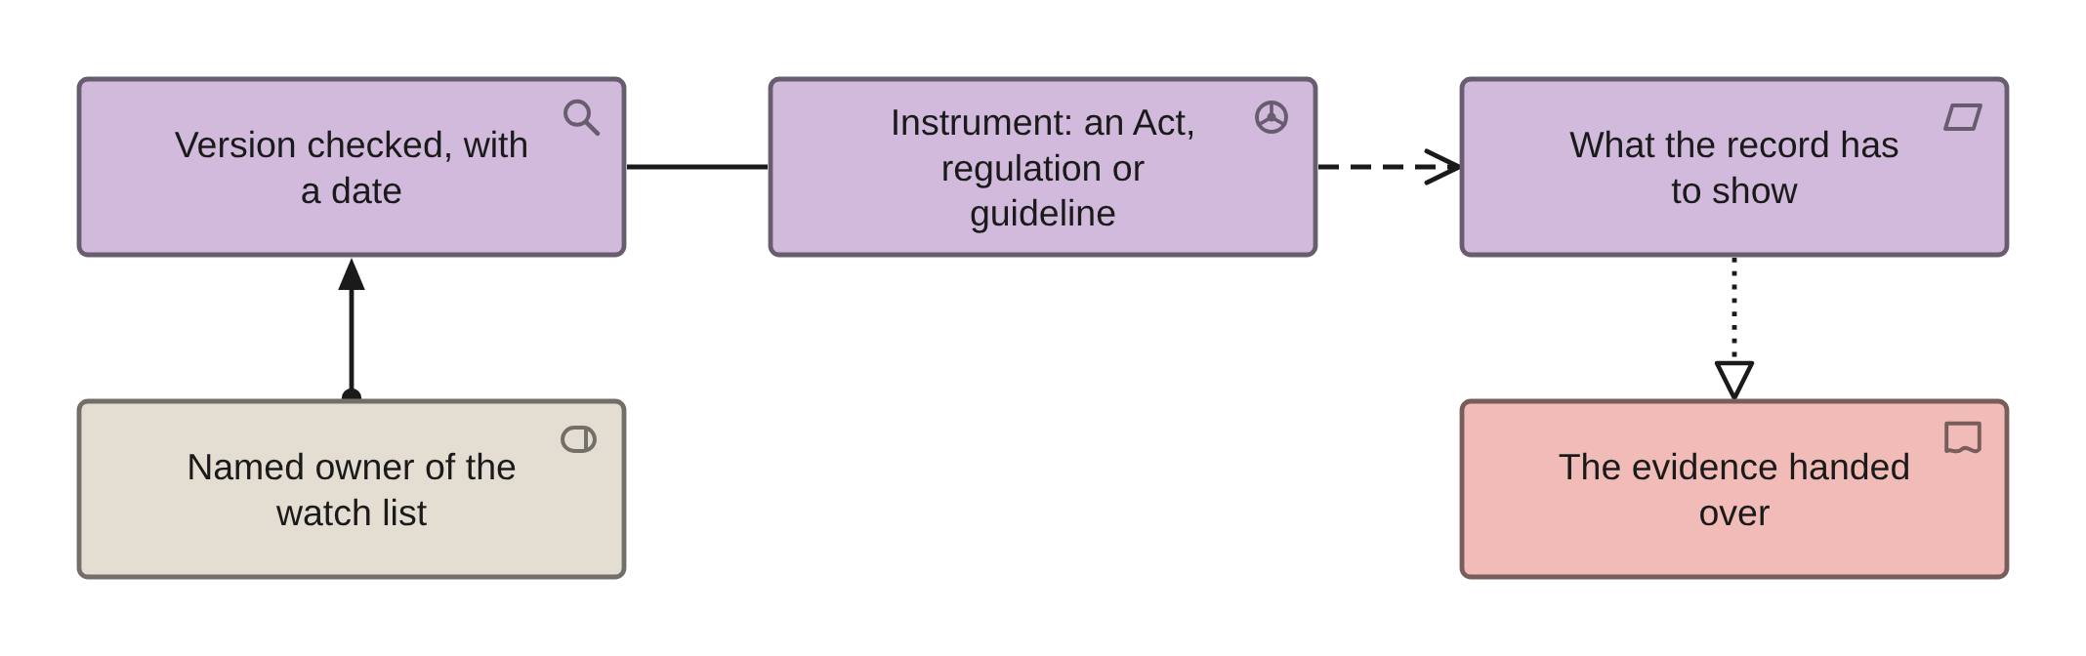
PHASE A · VIEW 05 OF 36
Regulatory driver view
INVENTED: NO STANDARD VIEWPOINT COVERS IT
FOR
CANVAS
The head of regulatory affairs and internal audit
ELEMENTS IT MAY CONTAIN
Driver, Requirement, Assessment, Role
RELATIONSHIPS
Influence, Association, Assignment
POPULATED FROM
O01, O06, O63, O70
WHAT THIS VIEW CANNOT SHOW
The instrument, its provision, its version and its date: all four are properties, and all four are what you will be asked for
Every driver on this view carries an instrument reference and a retrieval date in its properties.
Pharmaceuticals EA · View templates
Thotnr Consulting · Pharmaceuticals starter pack · October 2026
13
Notes:
WHAT TO SAY
A guideline with a five-year validity statement can be republished in five months. Re-checking is a standing job with a named owner.
QUESTION TO EXPECT
'Who watches the inspection scheme for us?' If nobody can be named, this view has done its work in one question.

Slide 14
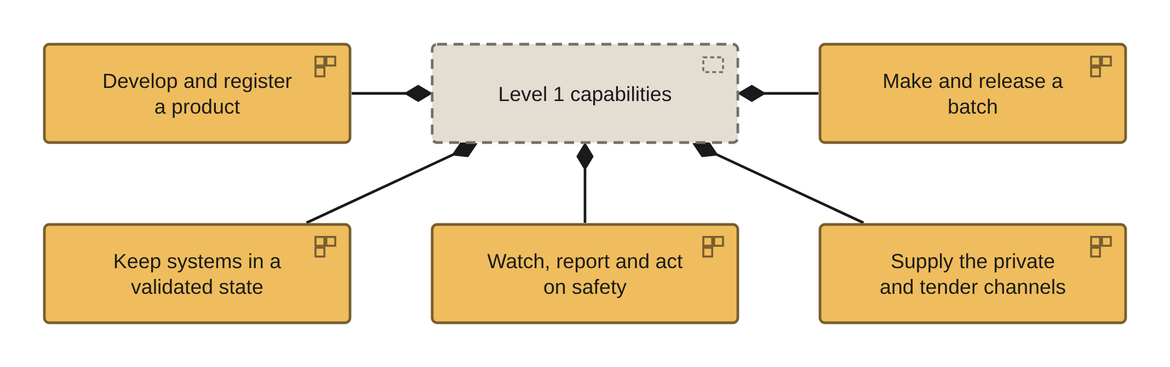
PHASE B · VIEW 06 OF 36
Capability map, level 1
ARCHIMATE 4 VIEWPOINT: CAPABILITY MAP
FOR
CANVAS
The investment committee, against the heat map
ELEMENTS IT MAY CONTAIN
Capability, Grouping, Business Actor
RELATIONSHIPS
Composition, Assignment
POPULATED FROM
O13, R01, R22, and the heat-map report
WHAT THIS VIEW CANNOT SHOW
Current and target scores, which are properties and do not roll up, and that one capability is run twice in two divisions
The tree is drawable from the sheets. The heat is a report over them, not a shape on the view.
Pharmaceuticals EA · View templates
Thotnr Consulting · Pharmaceuticals starter pack · October 2026
14
Notes:
WHAT TO SAY
The third capability is the one no other industry needs, and the one most capability maps in this sector leave out.
QUESTION TO EXPECT
'Where is IT?' It is not a capability. Validation state is, and so is watching the inspection scheme for changes.

Slide 15
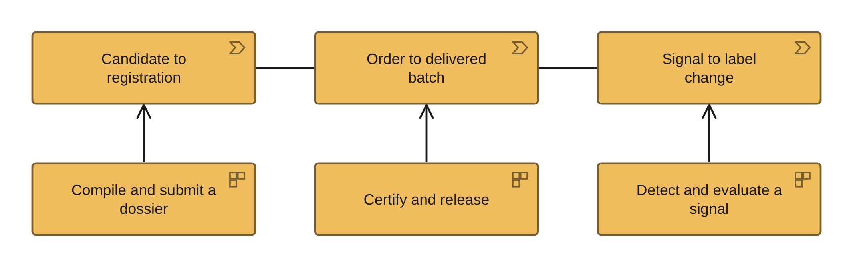
PHASE B · VIEW 07 OF 36
Value streams view
ARCHIMATE 4 VIEWPOINT: VALUE STREAM
FOR
CANVAS
The chief operating officer and the head of supply
ELEMENTS IT MAY CONTAIN
Value Stream, Capability, Outcome
RELATIONSHIPS
Serving, Realization
POPULATED FROM
O14, O13, R02, R03
WHAT THIS VIEW CANNOT SHOW
The decade between spend and revenue: a stream drawn left to right implies a tempo it does not have
Name the stage that closes each stream. If nothing closes it, it is a function, not a stream.
Pharmaceuticals EA · View templates
Thotnr Consulting · Pharmaceuticals starter pack · October 2026
15
Notes:
WHAT TO SAY
Three streams, three different clocks: working days at the regulator, days in the plant, calendar days on the safety obligation.
QUESTION TO EXPECT
'Why is registration not in the order-to-delivery stream?' Because it finishes years earlier and is a different unit of work.

Slide 16
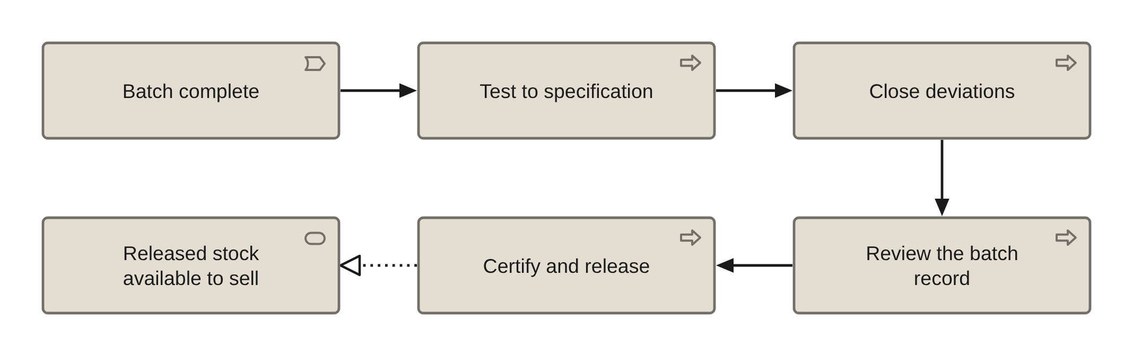
PHASE B · VIEW 08 OF 36
Business process co-operation view
ARCHIMATE 4 VIEWPOINT: BUSINESS PROCESS COOPERATION
FOR
CANVAS
Quality, production and regulatory affairs together
ELEMENTS IT MAY CONTAIN
Process, Service, Event
RELATIONSHIPS
Triggering, Realization, Serving
POPULATED FROM
O15, O16, O17, R04
WHAT THIS VIEW CANNOT SHOW
The hand-off itself. ArchiMate has no swimlanes, which is why level-2 process models are BPMN 2.0
Use this view for which process hands to which. Use BPMN where the hand-off is the point.
Pharmaceuticals EA · View templates
Thotnr Consulting · Pharmaceuticals starter pack · October 2026
16
Notes:
WHAT TO SAY
The four days this process takes are spent in the gaps between the steps, and this notation cannot show a gap.
QUESTION TO EXPECT
'Which step is slowest?' None of them. The waiting is between them, which is why the level-2 model is BPMN with lanes.

Slide 17
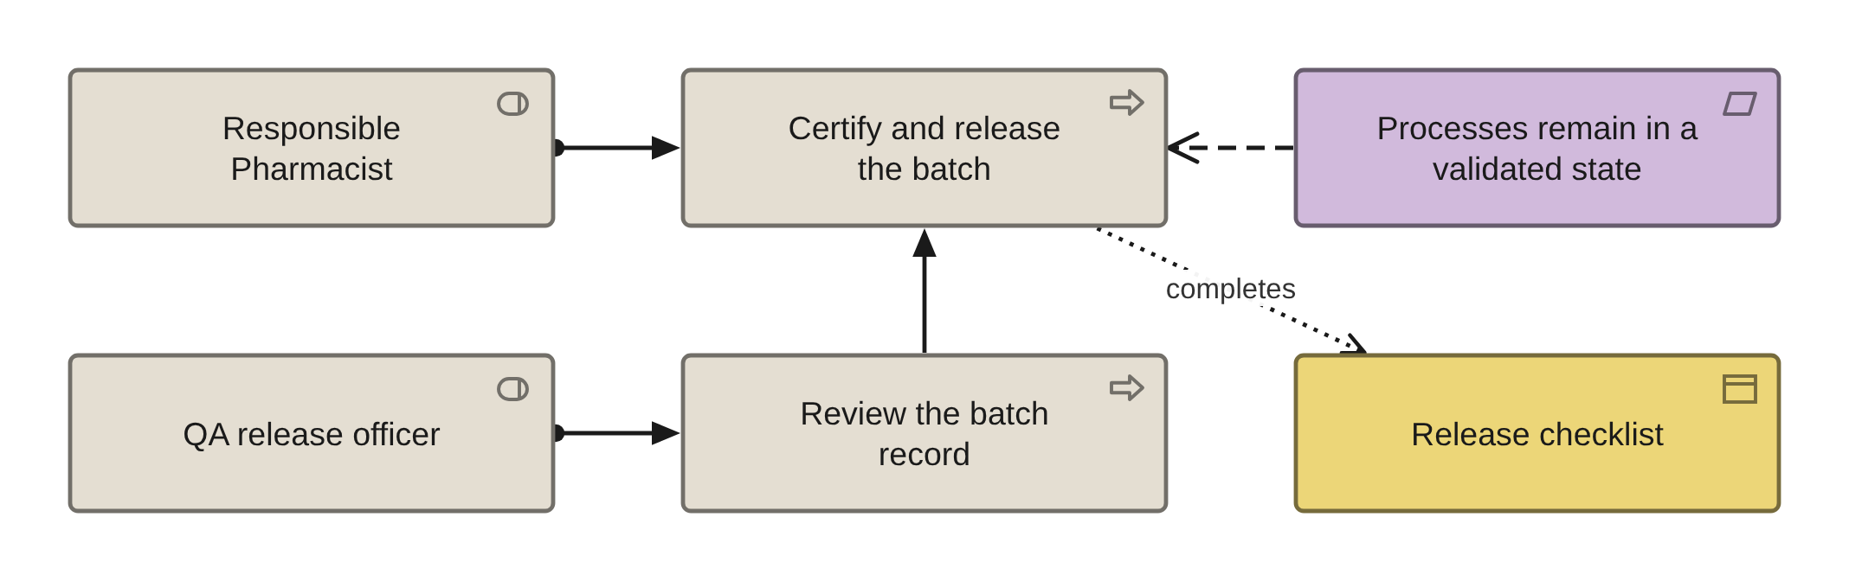
PHASE B · VIEW 09 OF 36
Role and authority view
ARCHIMATE 4 VIEWPOINT: BUSINESS PROCESS COOPERATION
FOR
CANVAS
The head of quality and the chief risk officer
ELEMENTS IT MAY CONTAIN
Role, Process, Requirement
RELATIONSHIPS
Assignment, Influence
POPULATED FROM
O11, O16, O70, R21 reversed
WHAT THIS VIEW CANNOT SHOW
Professional registration, residency and the one-per-licence rule: three properties of the role, none of them a shape
Every edge here is authored. Assignment between a role and a process is a statement somebody signed.
Pharmaceuticals EA · View templates
Thotnr Consulting · Pharmaceuticals starter pack · October 2026
17
Notes:
WHAT TO SAY
The element is Role. There is no layer-prefixed variant of it, and the distinction between the job and the person is the point.
QUESTION TO EXPECT
'Who covers the role on leave?' An access-control design question with a legal consequence, because not more than one is named per licence.

Slide 18
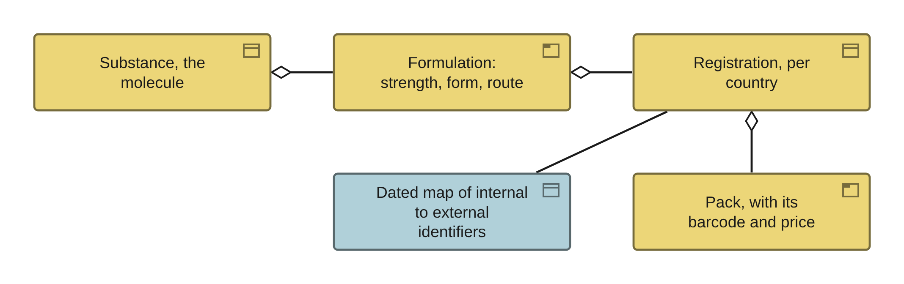
PHASE B · VIEW 10 OF 36
Product identity view
INVENTED: THE NOTATION HAS ONE PRODUCT ELEMENT
FOR
CANVAS
Regulatory affairs, supply chain and commercial, together
ELEMENTS IT MAY CONTAIN
Product, Business Object, Data Object
RELATIONSHIPS
Aggregation, Association
POPULATED FROM
O18, O20, O36, EXT
WHAT THIS VIEW CANNOT SHOW
The cardinality. One molecule carries many registrations and one registration many packs, and Aggregation cannot say so
The real model is the conceptual data model in crow’s-foot notation. This view points at it.
Pharmaceuticals EA · View templates
Thotnr Consulting · Pharmaceuticals starter pack · October 2026
18
Notes:
WHAT TO SAY
When somebody says "we have 180 products", ask which of the four they mean. The answer is usually three different numbers.
QUESTION TO EXPECT
'Can the enterprise system master this?' It may cache it. It must never mint it.

Slide 19
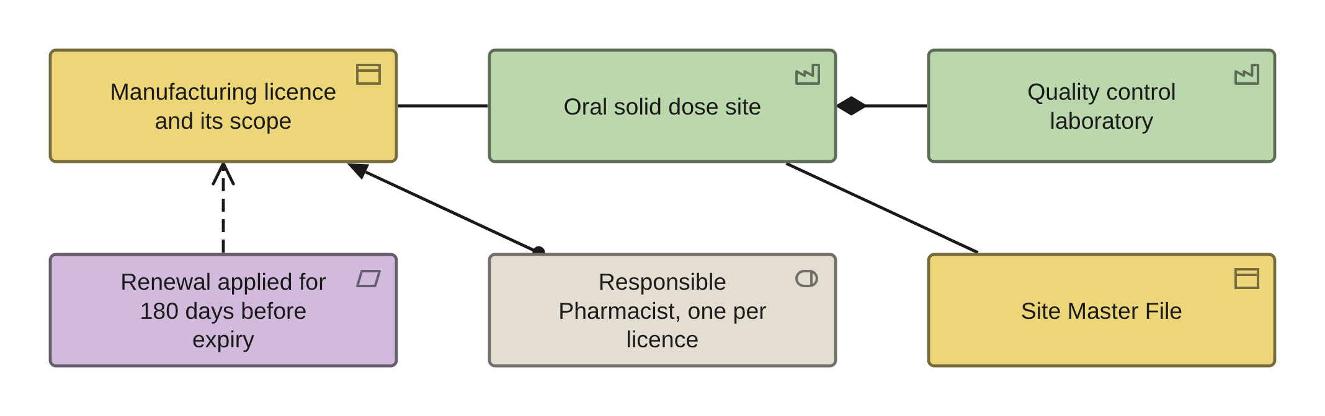
PHASE B · VIEW 11 OF 36
Site and licence view
ARCHIMATE 4 VIEWPOINT: ORGANIZATION
FOR
CANVAS
The operations director, one licence at a time
ELEMENTS IT MAY CONTAIN
Facility, Location, Role, Requirement, Business Object
RELATIONSHIPS
Composition, Assignment, Association
POPULATED FROM
O12, O70, O19, and the licence register
WHAT THIS VIEW CANNOT SHOW
The licence scope lines, the renewal date and the 180-day lead on it: all properties of a register row
A site in the regulatory model is a licensed capability at an address, not a building.
Pharmaceuticals EA · View templates
Thotnr Consulting · Pharmaceuticals starter pack · October 2026
19
Notes:
WHAT TO SAY
The Site Master File is the most accurate description of a site that exists, and most architects have never asked for one.
QUESTION TO EXPECT
'Is the laboratory on the licence?' Read the scope lines. Testing is a scoped activity, not an assumption.

Slide 20
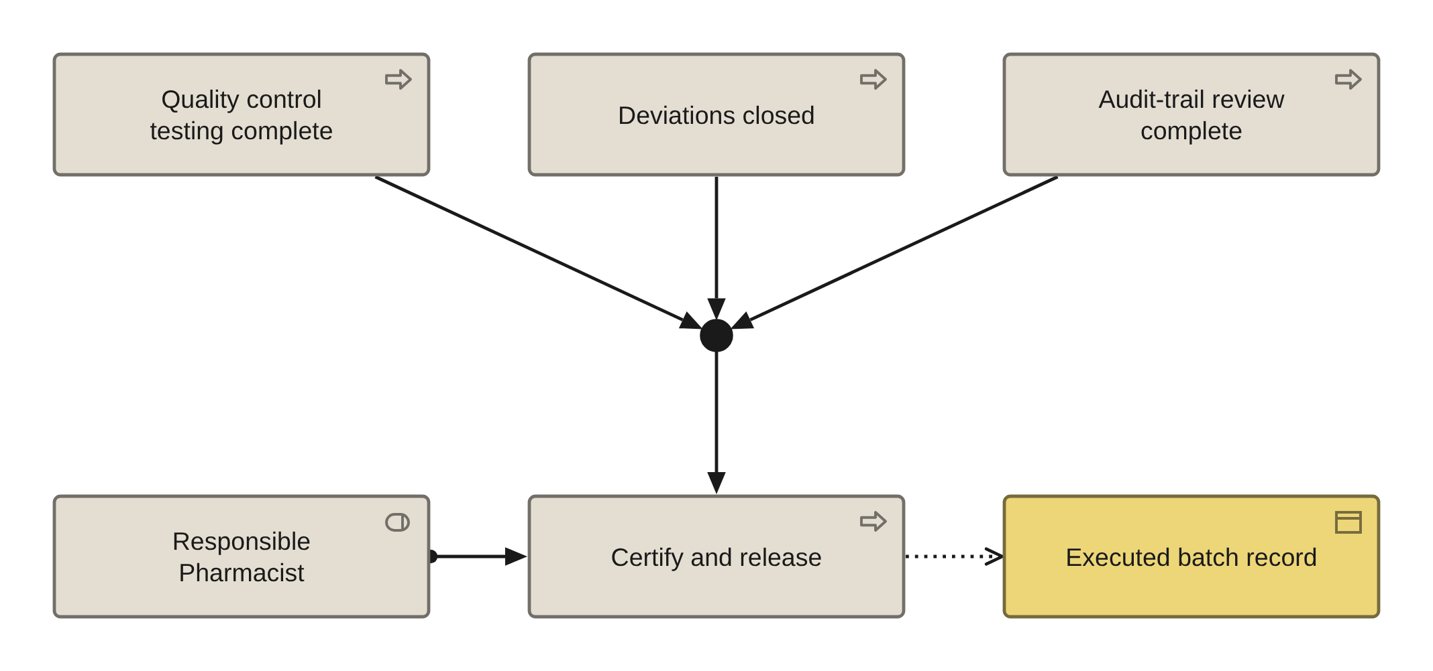
PHASE B · VIEW 12 OF 36
Batch-release chain view
INVENTED: ARCHIMATE HAS NO SWIMLANES
FOR
CANVAS
The Responsible Pharmacist, and nobody signs it but them
ELEMENTS IT MAY CONTAIN
Process, Role, Business Object, Requirement, Junction
RELATIONSHIPS
Triggering, Assignment, Access, Realization
POPULATED FROM
O16, O11, O20, O67, and the level-2 BPMN model
WHAT THIS VIEW CANNOT SHOW
Where the four days go, because the waiting is between the steps. Draw the hand-offs in BPMN 2.0 with lanes
Level-2 process models are BPMN. This view exists to show what the release decision depends on.
Pharmaceuticals EA · View templates
Thotnr Consulting · Pharmaceuticals starter pack · October 2026
20
Notes:
WHAT TO SAY
The and-junction is the honest way to say that all three preconditions hold before the signature, and none of them alone is enough.
QUESTION TO EXPECT
'Is audit-trail review really in the path?' It is where the draft annex is heading, and it has a latency nobody has costed.

Slide 21
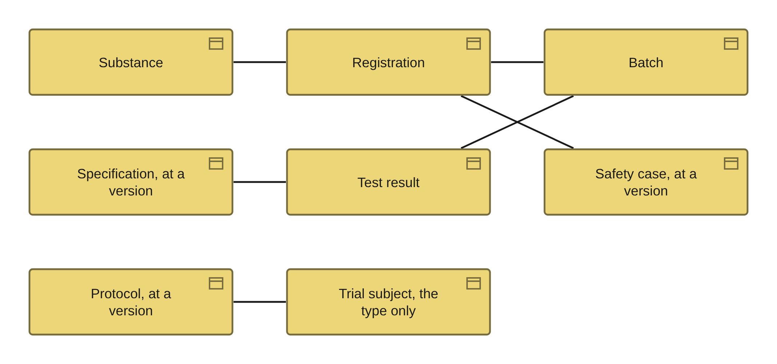
PHASE C · DATA · VIEW 13 OF 36
Conceptual data model view
ARCHIMATE 4 VIEWPOINT: INFORMATION STRUCTURE
FOR
CANVAS
The chief data officer, on the entity set
ELEMENTS IT MAY CONTAIN
Business Object, Data Object, Artifact
RELATIONSHIPS
Association, Realization, Composition
POPULATED FROM
O20, O21, O22, O36, R19
WHAT THIS VIEW CANNOT SHOW
Cardinality, keys, versions and dictionary versions. Draw the real model in crow’s-foot notation beside this one
Business entities and relationships only: no attributes, no keys, no system detail.
Pharmaceuticals EA · View templates
Thotnr Consulting · Pharmaceuticals starter pack · October 2026
21
Notes:
WHAT TO SAY
Subject is a type and never an instance. A view that could identify a subject is a privacy problem, not a style choice.
QUESTION TO EXPECT
'Where is the genealogy?' Not here, and not anywhere in this notation. A genealogy is a graph of instances with quantities on the edges.

Slide 22
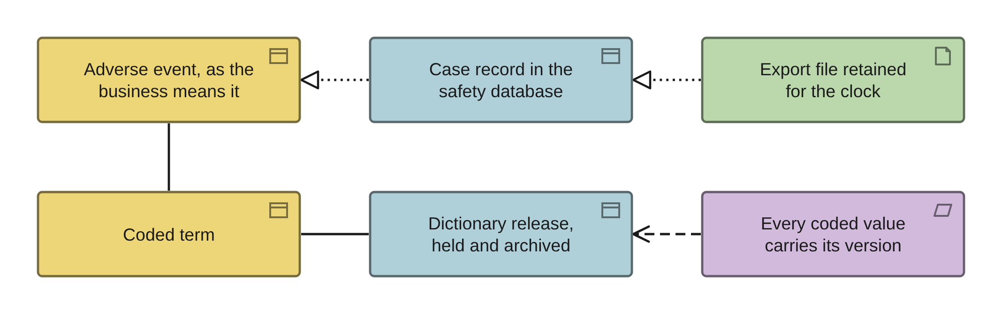
PHASE C · DATA · VIEW 14 OF 36
Information structure view
ARCHIMATE 4 VIEWPOINT: INFORMATION STRUCTURE
FOR
CANVAS
The chief data officer and the integration lead
ELEMENTS IT MAY CONTAIN
Business Object, Data Object, Artifact
RELATIONSHIPS
Realization, Access, Association
POPULATED FROM
O20, O21, O22, O42, R05
WHAT THIS VIEW CANNOT SHOW
Which attribute carries the meaning, and the normalisation rule version that decided an identity
Three layers: what the business means, what a system holds, and what is on the disk.
Pharmaceuticals EA · View templates
Thotnr Consulting · Pharmaceuticals starter pack · October 2026
22
Notes:
WHAT TO SAY
A term coded under one dictionary version does not necessarily mean the same thing under the next. Re-coding history is a project.
QUESTION TO EXPECT
'Can we just upgrade the dictionary?' Only with a plan for the historical data and a medical review of the changed mappings.

Slide 23
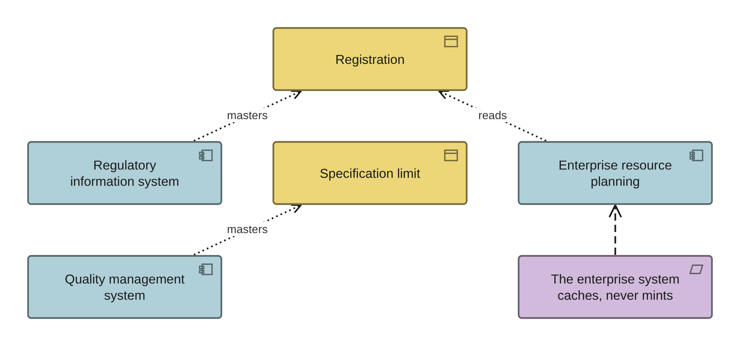
PHASE C · DATA · VIEW 15 OF 36
Authority view
INVENTED: MASTERING IS NOT A STANDARD VIEWPOINT
FOR
CANVAS
The data governance body, to settle the master
ELEMENTS IT MAY CONTAIN
Business Object, Application Component, Requirement
RELATIONSHIPS
Access, typed as master or consumer
POPULATED FROM
O20, O23, O43, R05
WHAT THIS VIEW CANNOT SHOW
That the two sheets disagree. Where the entity sheet and the master-data rule name different sources, the view can only show one
Split the mastering relationship into Access with a direction. A role column is not a relationship property.
Pharmaceuticals EA · View templates
Thotnr Consulting · Pharmaceuticals starter pack · October 2026
23
Notes:
WHAT TO SAY
Three objects are habitually mastered twice: product identity, the serious adverse event, and batch status.
QUESTION TO EXPECT
'Which one wins?' Whichever is authoritative where the fact is asserted. Write it down once and make the other system a consumer.

Slide 24
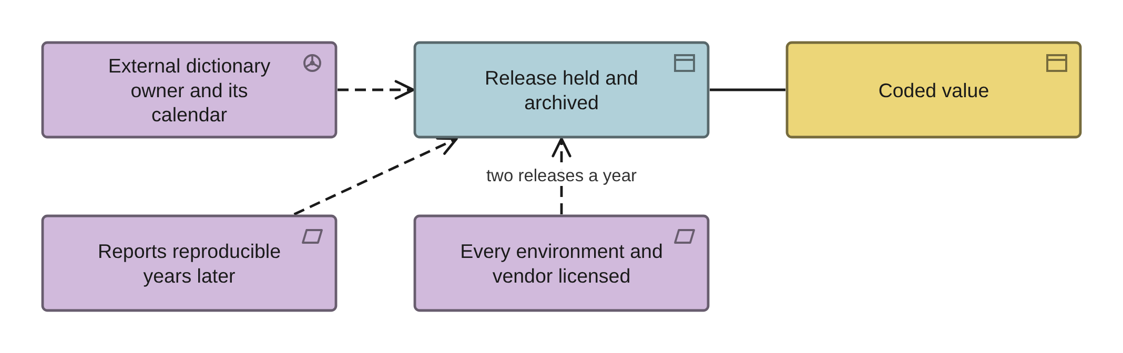
PHASE C · DATA · VIEW 16 OF 36
Dictionary dependency view
INVENTED: AN EXTERNAL LICENSED DEPENDENCY
FOR
CANVAS
The safety lead, the data manager and procurement
ELEMENTS IT MAY CONTAIN
Business Object, Data Object, Requirement, Driver
RELATIONSHIPS
Association, Access, Influence
POPULATED FROM
O20, O42, and the external dependency register
WHAT THIS VIEW CANNOT SHOW
The release calendar, the licence terms and the fee. All three are properties, and the third surprises people latest
These are dependencies with an external owner, not reference data you maintain.
Pharmaceuticals EA · View templates
Thotnr Consulting · Pharmaceuticals starter pack · October 2026
24
Notes:
WHAT TO SAY
A non-production environment may not be allowed to carry the dictionary, and an offshore coding vendor needs its own subscription.
QUESTION TO EXPECT
'Why archive an old release?' Because a report produced in one year must be reproducible in another, and that needs the dictionary of the day.

Slide 25
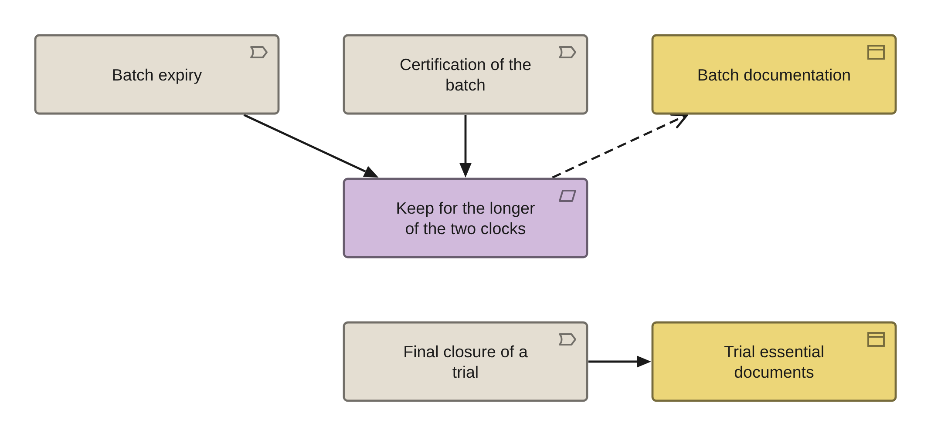
PHASE C · DATA · VIEW 17 OF 36
Retention clock view
INVENTED: A RETENTION PERIOD HAS NO ELEMENT
FOR
CANVAS
The records owner and the head of quality
ELEMENTS IT MAY CONTAIN
Business Object, Requirement, Event
RELATIONSHIPS
Association, Influence, Triggering
POPULATED FROM
O69, O20, and the obligation register
WHAT THIS VIEW CANNOT SHOW
The period itself. Three of the longest clocks are computations over operational data, not durations you can type in
Retention is a join to operational data, not a policy setting. Draw the trigger, not the number.
Pharmaceuticals EA · View templates
Thotnr Consulting · Pharmaceuticals starter pack · October 2026
25
Notes:
WHAT TO SAY
A single corporate retention period is always wrong here. Where an instrument states none, assign one and record the basis.
QUESTION TO EXPECT
'Can we not keep everything?' You can keep it and still fail, because the obligation is that it stays readable and intelligible.

Slide 26
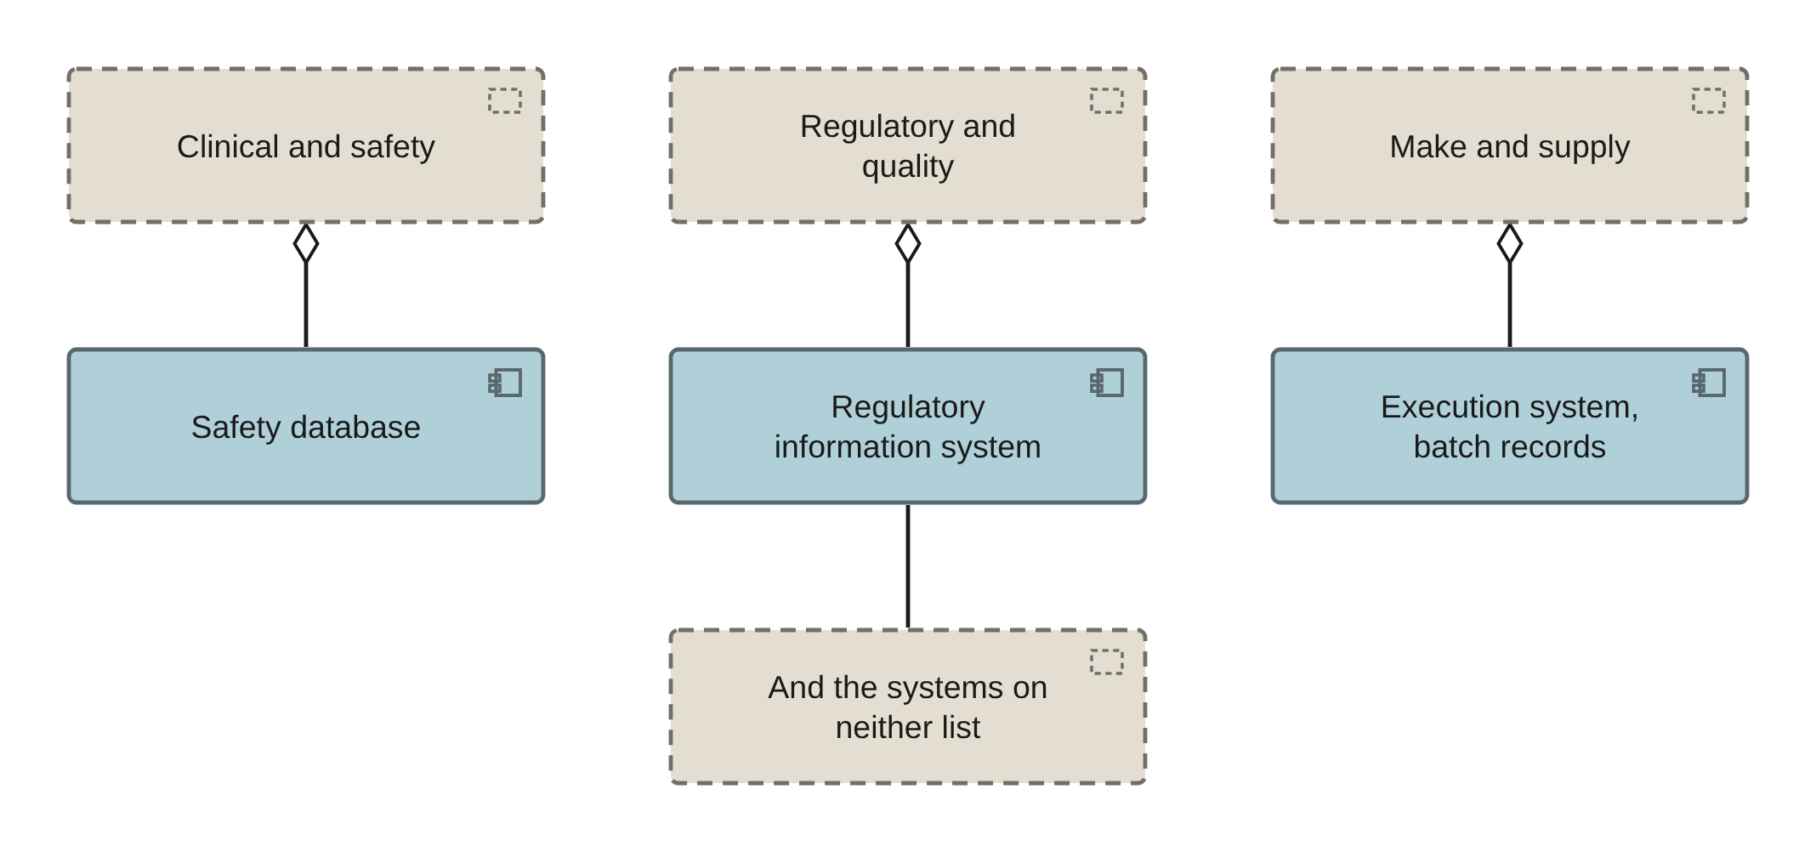
PHASE C · APPLICATION · VIEW 18 OF 36
Application landscape view
ARCHIMATE 4 VIEWPOINT: APPLICATION COOPERATION
FOR
CANVAS
The chief information officer, by domain
ELEMENTS IT MAY CONTAIN
Application Component, Grouping
RELATIONSHIPS
Aggregation, Association
POPULATED FROM
O23, O24, O48, and the portfolio report
WHAT THIS VIEW CANNOT SHOW
Validation state and GxP classification, which are properties of each component and the reason the register is the real artefact
Group by domain, not by vendor. The product name will change and the domain will not.
Pharmaceuticals EA · View templates
Thotnr Consulting · Pharmaceuticals starter pack · October 2026
26
Notes:
WHAT TO SAY
Name systems by what they do, with the product name in brackets. The function outlives the product name by a decade.
QUESTION TO EXPECT
'Is that all of them?' No. The ones on neither the portfolio nor the quality list are where the risk is, and they are not on this view either.

Slide 27
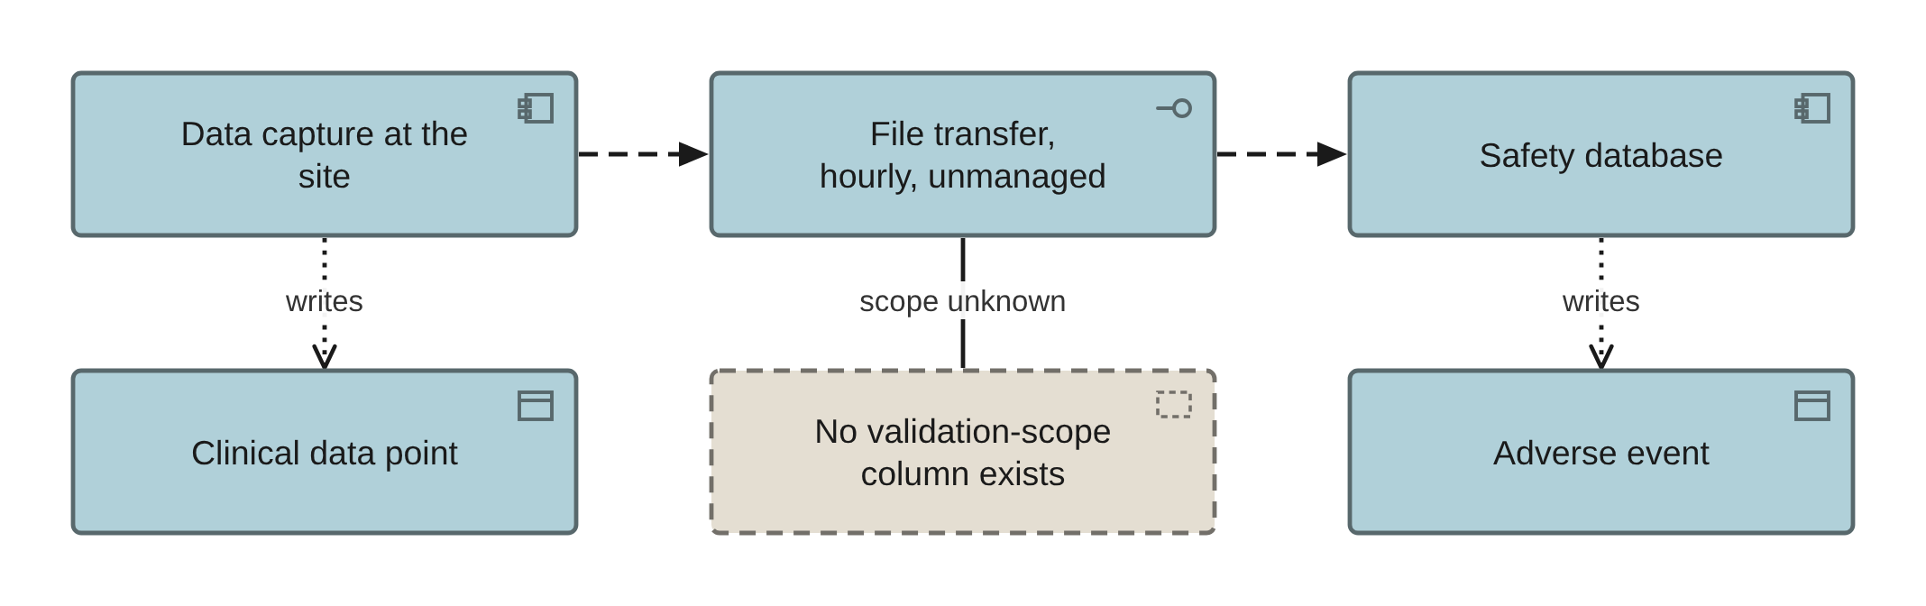
PHASE C · APPLICATION · VIEW 19 OF 36
Interface view
ARCHIMATE 4 VIEWPOINT: APPLICATION COOPERATION
FOR
CANVAS
The integration lead, before any change lands
ELEMENTS IT MAY CONTAIN
Application Component, Application Interface, Data Object, Grouping
RELATIONSHIPS
Flow, Access, Association
POPULATED FROM
O23, O24, R06, and the interface catalogue
WHAT THIS VIEW CANNOT SHOW
Whether the interface is in anybody’s validation scope, because no sheet carries that column
Draw the one path that decides a regulatory outcome, not all thirty-six.
Pharmaceuticals EA · View templates
Thotnr Consulting · Pharmaceuticals starter pack · October 2026
27
Notes:
WHAT TO SAY
This is the route a serious adverse event takes to the system carrying the reporting clock, and the clock starts at first awareness by anyone.
QUESTION TO EXPECT
'Both systems are validated, so the interface is fine?' That is not an answer. Ask for the interface specification of any three.

Slide 28
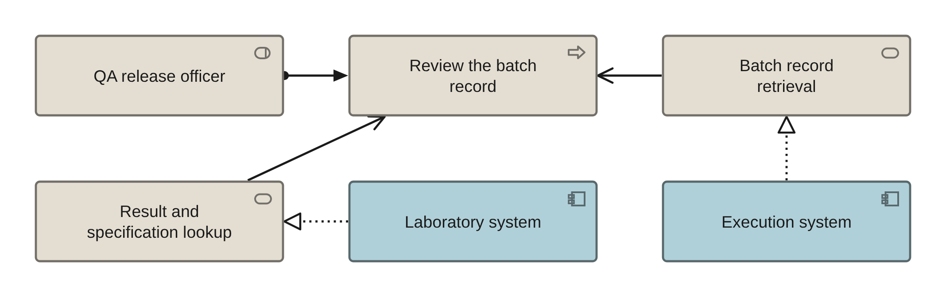
PHASE C · APPLICATION · VIEW 20 OF 36
Application usage view
ARCHIMATE 4 VIEWPOINT: APPLICATION USAGE
FOR
CANVAS
The process owner, one process at a time
ELEMENTS IT MAY CONTAIN
Application Component, Service, Process, Role
RELATIONSHIPS
Realization, Serving, Assignment
POPULATED FROM
O15, O16, O23, O24, R04
WHAT THIS VIEW CANNOT SHOW
Whether the role’s access is segregated from its approval, which is an access-model fact and not a shape
One process per view, with the services it consumes and the role that performs it.
Pharmaceuticals EA · View templates
Thotnr Consulting · Pharmaceuticals starter pack · October 2026
28
Notes:
WHAT TO SAY
If one role both performs and approves, the view is correct and the access model is a finding.
QUESTION TO EXPECT
'Who can see this data?' An access review answers that. This view only says who is supposed to use it.

Slide 29
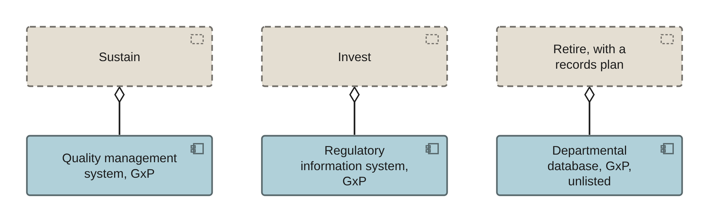
PHASE C · APPLICATION · VIEW 21 OF 36
Portfolio view
ARCHIMATE 4 VIEWPOINT: APPLICATION COOPERATION
FOR
CANVAS
The investment committee, on disposition
ELEMENTS IT MAY CONTAIN
Application Component, Grouping
RELATIONSHIPS
Aggregation
POPULATED FROM
O23, O49, O53, and the portfolio report
WHAT THIS VIEW CANNOT SHOW
Why a component carries its disposition. The reason is a sentence in a register, not a colour
Group by disposition, and keep the GxP ones visibly separate: replacing one is a regulatory project.
Pharmaceuticals EA · View templates
Thotnr Consulting · Pharmaceuticals starter pack · October 2026
29
Notes:
WHAT TO SAY
A GxP system marked Retire needs a records plan before it needs a replacement, because decommissioning is itself a validated activity.
QUESTION TO EXPECT
'Can we retire that one this year?' Not until somebody has said how its records will be read in fifteen years.

Slide 30
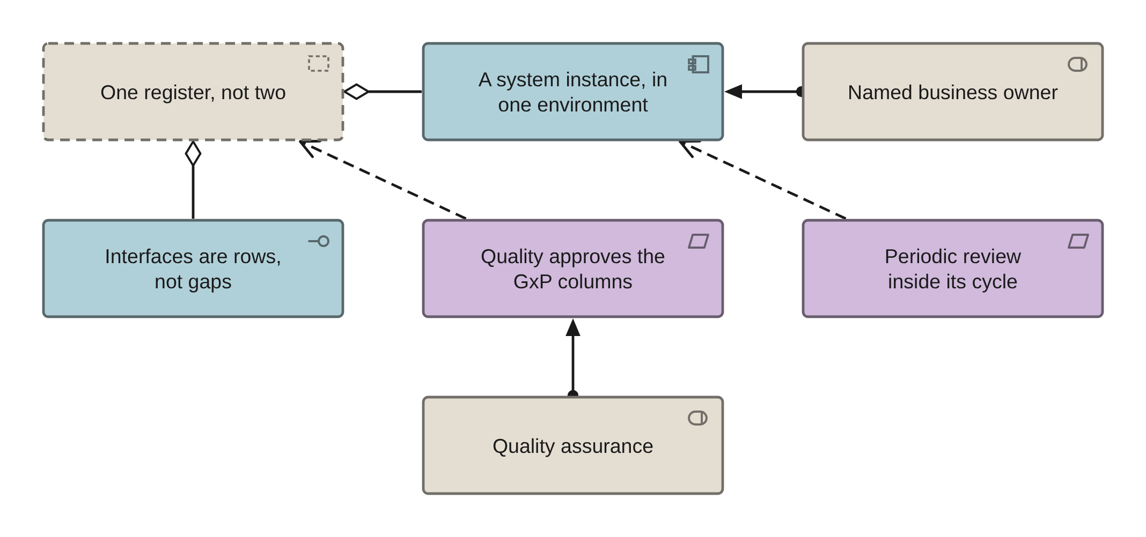
PHASE C · APPLICATION · VIEW 22 OF 36
Validated-system register view
INVENTED: VALIDATION STATE HAS NO ELEMENT
FOR
CANVAS
The validation lead and the chief information officer
ELEMENTS IT MAY CONTAIN
Application Component, Node, Requirement, Role, Grouping
RELATIONSHIPS
Association, Assignment, Influence
POPULATED FROM
O67, O68, O23, O48
WHAT THIS VIEW CANNOT SHOW
Every column that matters. Validation state, GxP class, review date and electronic-record applicability are properties
The register is the deliverable. This view exists to show who approves which columns.
Pharmaceuticals EA · View templates
Thotnr Consulting · Pharmaceuticals starter pack · October 2026
30
Notes:
WHAT TO SAY
The grain is one instance, in one environment, for one defined use. A productive and a test instance are two rows.
QUESTION TO EXPECT
'Do we have one?' If the answer is two, this view is the finding, because the two always disagree.

Slide 31
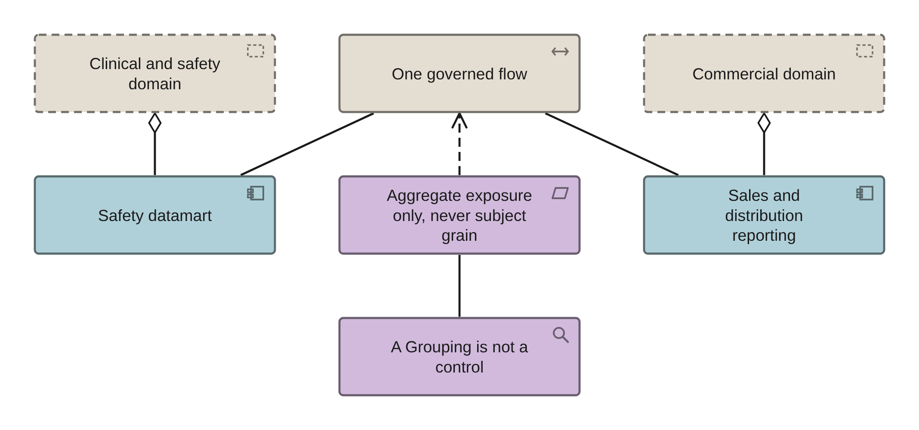
PHASE C · APPLICATION · VIEW 23 OF 36
Clinical and commercial firewall view
INVENTED: NO STANDARD VIEWPOINT COVERS IT
FOR
CANVAS
The chief data officer, the safety lead and legal
ELEMENTS IT MAY CONTAIN
Grouping, Application Component, Path, Requirement, Assessment
RELATIONSHIPS
Aggregation, Association, Flow
POPULATED FROM
O23, O38, O41, O48, R05
WHAT THIS VIEW CANNOT SHOW
That the firewall is holding. A Grouping has no semantics and enforces nothing; only an access review can show it
One governed flow is permitted, with a documented specification and a named approver.
Pharmaceuticals EA · View templates
Thotnr Consulting · Pharmaceuticals starter pack · October 2026
31
Notes:
WHAT TO SAY
There is no single enterprise platform holding clinical, safety and commercial data with uniform access, and a design that proposes one is wrong here.
QUESTION TO EXPECT
'Is a patient-reach dashboard allowed?' Not at a grain that identifies. That is a consent and competition-law problem before it is an architecture one.

Slide 32
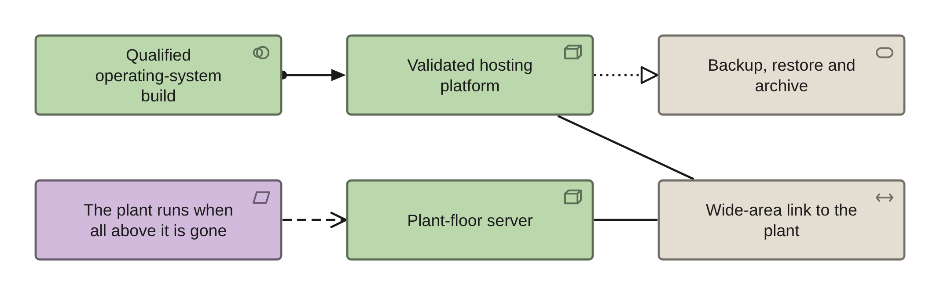
PHASE D · VIEW 24 OF 36
Technology view
ARCHIMATE 4 VIEWPOINT: TECHNOLOGY
FOR
CANVAS
The infrastructure lead
ELEMENTS IT MAY CONTAIN
Node, Device, System Software, Service, Path
RELATIONSHIPS
Realization, Assignment, Serving
POPULATED FROM
O25, O26, O27, O28, O50, R07
WHAT THIS VIEW CANNOT SHOW
Latency, and what survives a link failure. Both are requirements you write, not shapes you draw
Three of the rows on the physical component sheet are standards, and a standard is not a Node.
Pharmaceuticals EA · View templates
Thotnr Consulting · Pharmaceuticals starter pack · October 2026
32
Notes:
WHAT TO SAY
Record whether a restore was tested, not whether backups completed. The second is not evidence of the first.
QUESTION TO EXPECT
'Can the plant move to the central platform?' Not the execution path. It is on the floor because the plant must keep running when the link is gone.

Slide 33
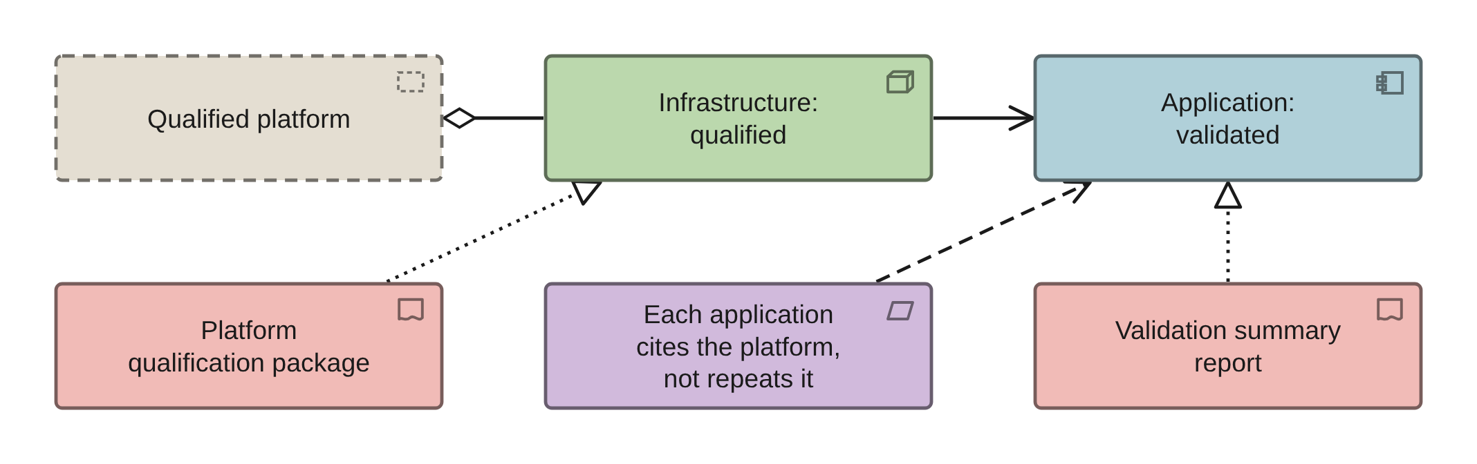
PHASE D · VIEW 25 OF 36
Qualification layer view
INVENTED: QUALIFICATION IS NOT VALIDATION
FOR
CANVAS
The validation lead and the infrastructure lead
ELEMENTS IT MAY CONTAIN
Node, System Software, Requirement, Deliverable, Grouping
RELATIONSHIPS
Realization, Assignment, Influence
POPULATED FROM
O26, O27, O28, O48, O67
WHAT THIS VIEW CANNOT SHOW
The qualification date and its next review. Both are properties of the platform, held in the register
Infrastructure is qualified; applications are validated. The words are not interchangeable.
Pharmaceuticals EA · View templates
Thotnr Consulting · Pharmaceuticals starter pack · October 2026
33
Notes:
WHAT TO SAY
A qualified platform is where most of the available efficiency sits, because every application above it can cite it instead of repeating it.
QUESTION TO EXPECT
'Who owns the platform qualification?' Infrastructure, with quality approving it. If nobody owns it, every application pays for the same evidence twice.

Slide 34
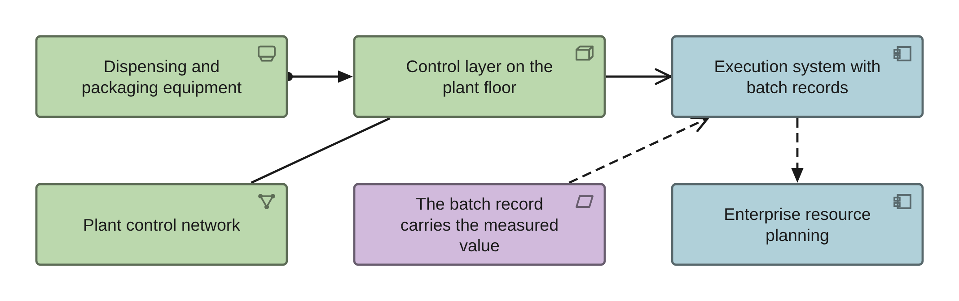
PHASE D · VIEW 26 OF 36
GMP plant boundary view
ARCHIMATE 4 VIEWPOINT: TECHNOLOGY
FOR
CANVAS
The automation engineer and the integration lead
ELEMENTS IT MAY CONTAIN
Device, Node, System Software, Communication Network, Requirement
RELATIONSHIPS
Assignment, Serving, Association
POPULATED FROM
O26, O27, O50, and the plant interface list
WHAT THIS VIEW CANNOT SHOW
Compression and interpolation in the historian. The batch record must carry the measured value, which is a requirement on the interface
Keep this light. In a pharmaceutical engagement the plant is rarely the problem you were hired for.
Pharmaceuticals EA · View templates
Thotnr Consulting · Pharmaceuticals starter pack · October 2026
34
Notes:
WHAT TO SAY
A reviewer who cannot reconcile the batch record against the plant record has a data-integrity question, not a reporting inconvenience.
QUESTION TO EXPECT
'Why is that requirement on the interface?' Because that is where it is otherwise forgotten, and where the value is quietly transformed.

Slide 35
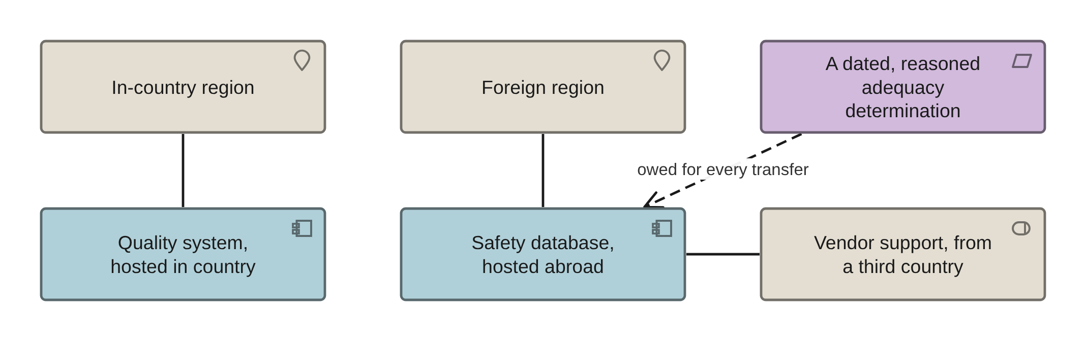
PHASE D · VIEW 27 OF 36
Hosting and data-location view
INVENTED: A CROSS-BORDER TRANSFER HAS NO ELEMENT
FOR
CANVAS
The chief information officer and the privacy officer
ELEMENTS IT MAY CONTAIN
Node, Location, Application Component, Requirement, Grouping
RELATIONSHIPS
Assignment, Association, Influence
POPULATED FROM
O48, O67, and the transfer register
WHAT THIS VIEW CANNOT SHOW
The adequacy determination itself. It is a dated, reasoned document, and this view only shows where one is owed
Data location differs per environment, and vendor support access from a third country is a transfer.
Pharmaceuticals EA · View templates
Thotnr Consulting · Pharmaceuticals starter pack · October 2026
35
Notes:
WHAT TO SAY
Nobody decides adequacy for you. The determination falls to the responsible party, and it is the predicate for an obligation carrying a criminal offence.
QUESTION TO EXPECT
'The data never leaves the region.' Support access from a third country is still a transfer, and a group database abroad can be one too.

Slide 36
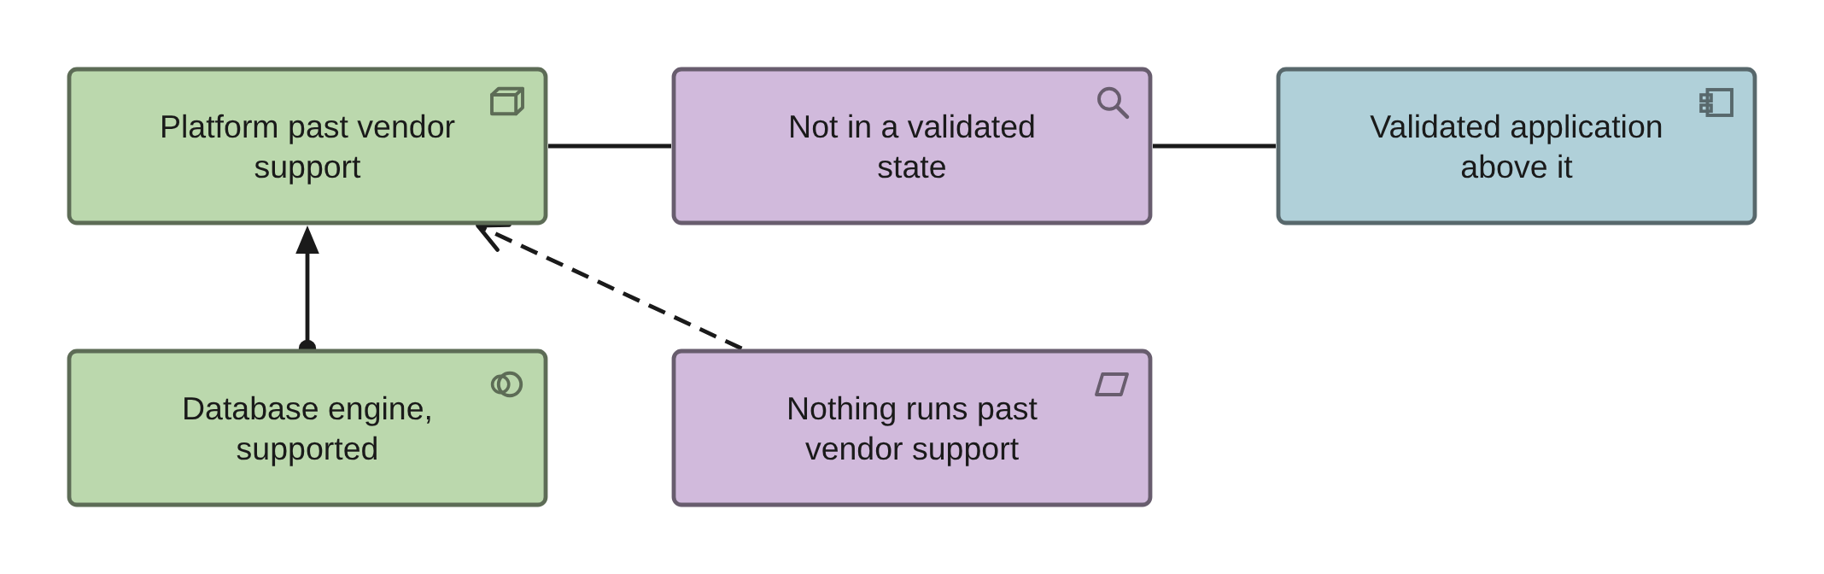
PHASE D · VIEW 28 OF 36
Currency view
ARCHIMATE 4 VIEWPOINT: TECHNOLOGY
FOR
CANVAS
The chief information officer and the chief risk officer
ELEMENTS IT MAY CONTAIN
Node, Device, System Software, Assessment
RELATIONSHIPS
Association
POPULATED FROM
O27, O28, O67, and the support-date register
WHAT THIS VIEW CANNOT SHOW
Why a component is out of support, and what the upgrade would cost in revalidation. Ask the validation lead for the second
A validated system on an out-of-support platform is not in a validated state, and periodic review will say so.
Pharmaceuticals EA · View templates
Thotnr Consulting · Pharmaceuticals starter pack · October 2026
36
Notes:
WHAT TO SAY
Two dates matter and only one is usually recorded: the support end date, and the date the periodic review last looked.
QUESTION TO EXPECT
'Can we just upgrade it?' Not here. That phrase is the folklore this whole pack exists to puncture.

Slide 37
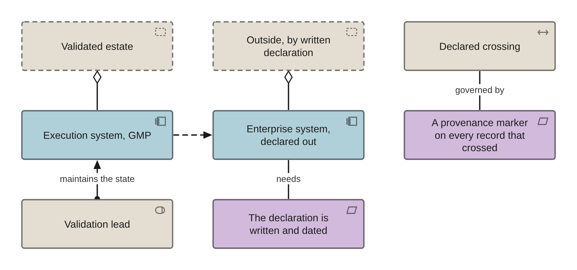
PHASE D · VIEW 29 OF 36
The validated boundary view
INVENTED: THE VIEW THIS INDUSTRY NEEDS MOST
FOR
CANVAS
The validation lead and the architecture board
ELEMENTS IT MAY CONTAIN
Grouping, Application Component, Path, Requirement, Role
RELATIONSHIPS
Aggregation, Association, Flow
POPULATED FROM
O67, O23, O48, R06
WHAT THIS VIEW CANNOT SHOW
Whether the periodic reviews are current. That is a report run from the register, and the view should say where it lives
Declaring something out of scope is a valid architectural act, provided the declaration is written, dated and enforced.
Pharmaceuticals EA · View templates
Thotnr Consulting · Pharmaceuticals starter pack · October 2026
37
Notes:
WHAT TO SAY
The trap is directional. A reporting layer comes into scope the day a trend from it is used to justify a specification.
QUESTION TO EXPECT
'Is the warehouse in scope?' Two tests. Does anyone make a GxP decision from its output, and is that output cited in a regulated record?

Slide 38
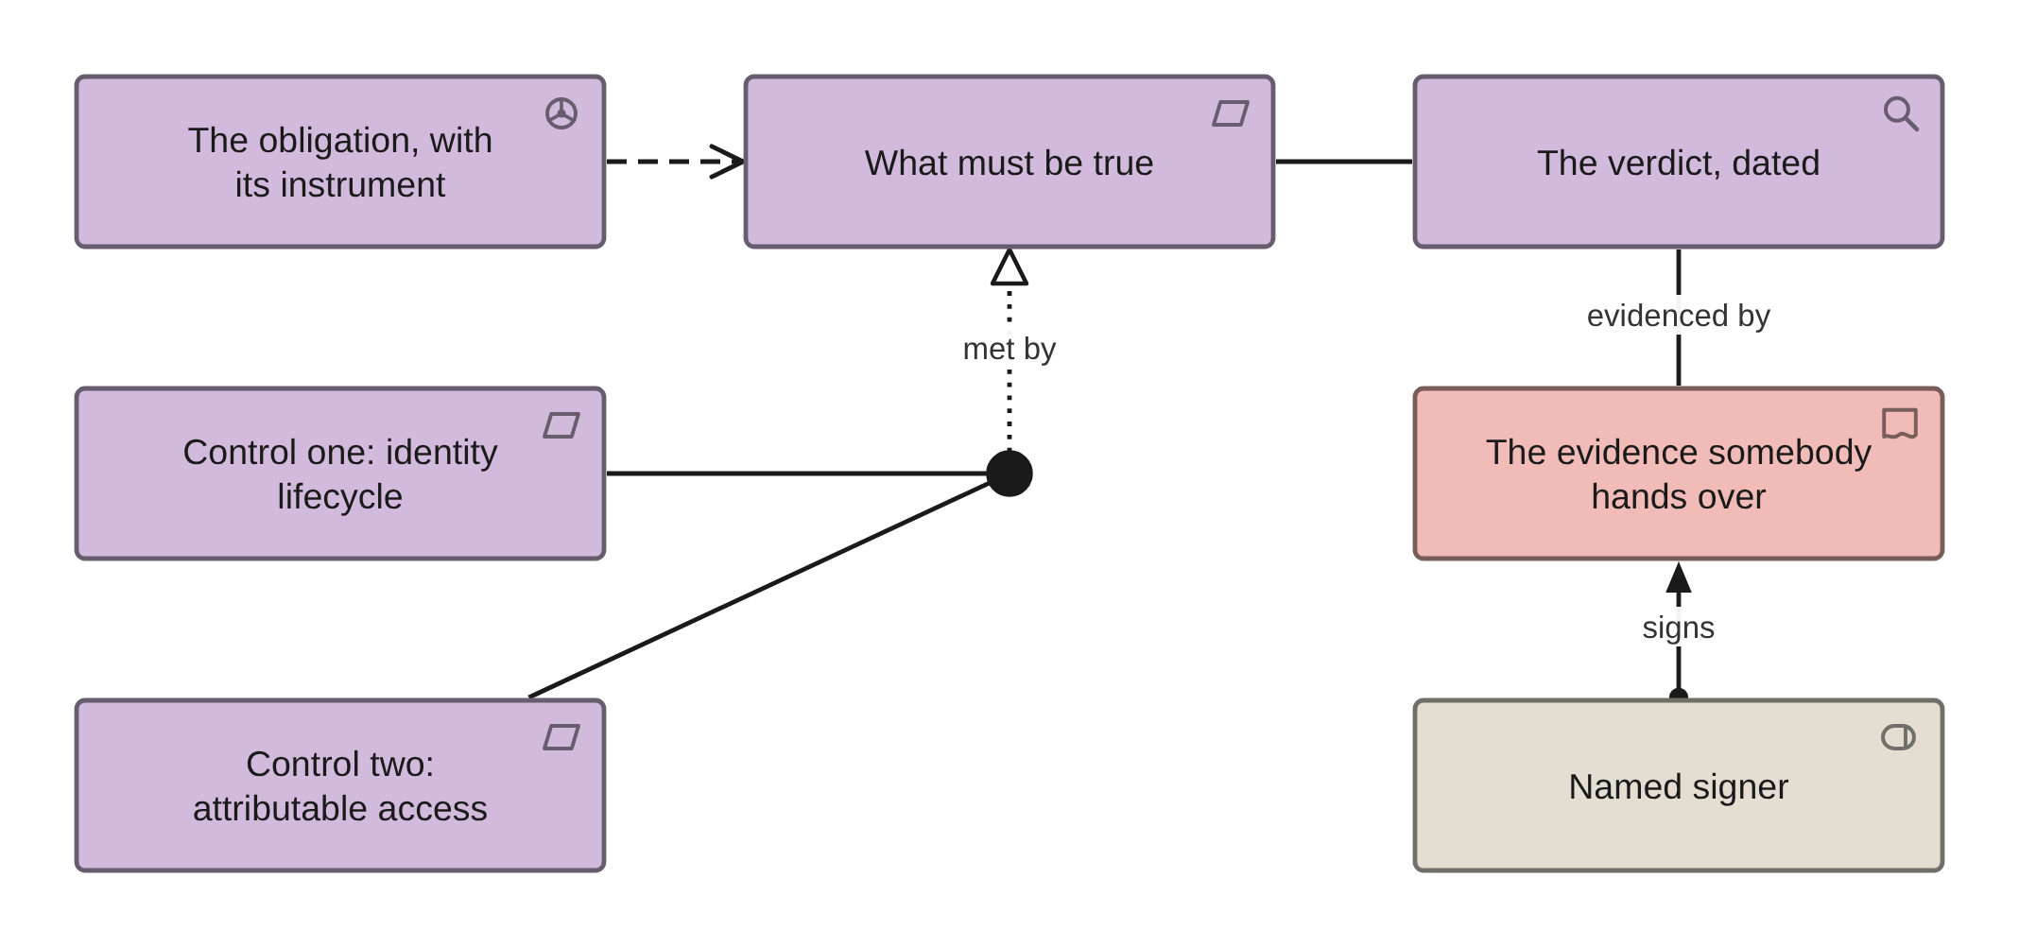
PHASE D · VIEW 30 OF 36
Obligation-to-evidence chain view
INVENTED: NO STANDARD VIEWPOINT COVERS IT
FOR
CANVAS
Internal audit and the head of quality
ELEMENTS IT MAY CONTAIN
Driver, Requirement, Assessment, Deliverable, Role, Junction
RELATIONSHIPS
Influence, Realization, Association, Assignment
POPULATED FROM
O63, O41, O59, R16
WHAT THIS VIEW CANNOT SHOW
Whether the evidence is current. An assessment with no date is a verdict with no shelf life
One obligation needs several controls. An and-junction says so without pretending any one discharges it.
Pharmaceuticals EA · View templates
Thotnr Consulting · Pharmaceuticals starter pack · October 2026
38
Notes:
WHAT TO SAY
An obligation cannot be evidenced by a control the control sheet records as absent. Check the sheet before you render it.
QUESTION TO EXPECT
'We are compliant with that one.' Show me the assessment and its date, and the control behind it on the control sheet.

Slide 39
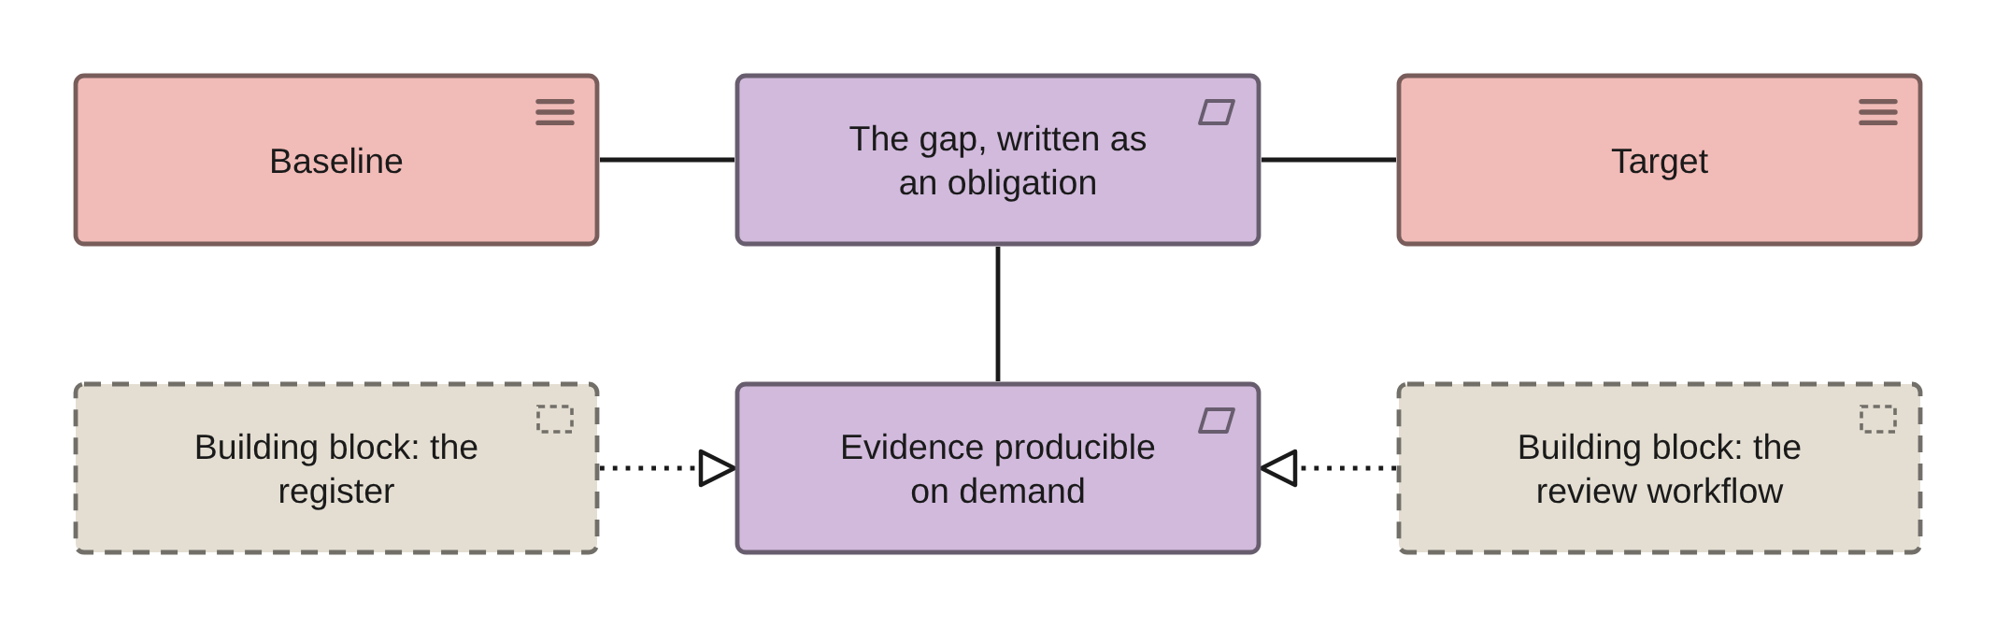
PHASES E AND F · VIEW 31 OF 36
Gaps and building blocks view
ARCHIMATE 4 VIEWPOINT: REQUIREMENTS REALIZATION
FOR
CANVAS
The programme board
ELEMENTS IT MAY CONTAIN
Requirement, Grouping, Plateau
RELATIONSHIPS
Realization, Association
POPULATED FROM
O06, O29, O55, R09
WHAT THIS VIEW CANNOT SHOW
Why a gap exists. A gap is the difference between two plateaus, and the reason is a register row
A building block is a TOGAF concept with no ArchiMate counterpart. Use a Grouping and say so.
Pharmaceuticals EA · View templates
Thotnr Consulting · Pharmaceuticals starter pack · October 2026
39
Notes:
WHAT TO SAY
Where the traceability column is generated by position rather than by assertion, draw the chain and label it generated.
QUESTION TO EXPECT
'Which requirement reaches no block?' Run the traceability report, then check whether its join is a statement or an index order.

Slide 40
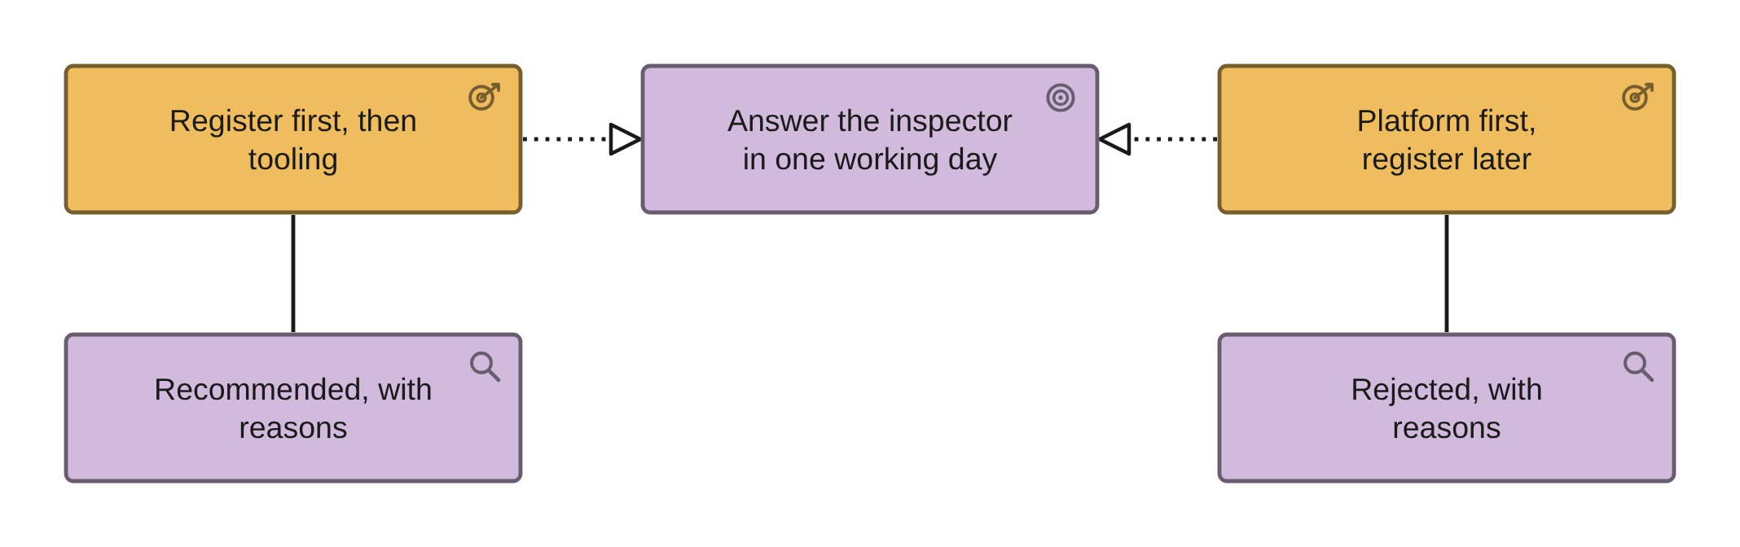
PHASES E AND F · VIEW 32 OF 36
Architecture alternatives view
ARCHIMATE 4 VIEWPOINT: COURSE OF ACTION
FOR
CANVAS
The board, once, and then it is a decision
ELEMENTS IT MAY CONTAIN
Course of Action, Goal, Capability, Assessment
RELATIONSHIPS
Realization, Influence, Association
POPULATED FROM
O54, O02, O13, and the decision log
WHAT THIS VIEW CANNOT SHOW
Cost, and that two alternatives can be live answers at once. Both are register columns
Show the rejected alternatives. A board that cannot see what was rejected cannot tell whether it was considered.
Pharmaceuticals EA · View templates
Thotnr Consulting · Pharmaceuticals starter pack · October 2026
40
Notes:
WHAT TO SAY
A rejected alternative with no recorded reason is an argument you will have again in six months, with different people.
QUESTION TO EXPECT
'Why not the platform first?' Because the business case for a validated system cannot be written before the register says what records it holds.

Slide 41
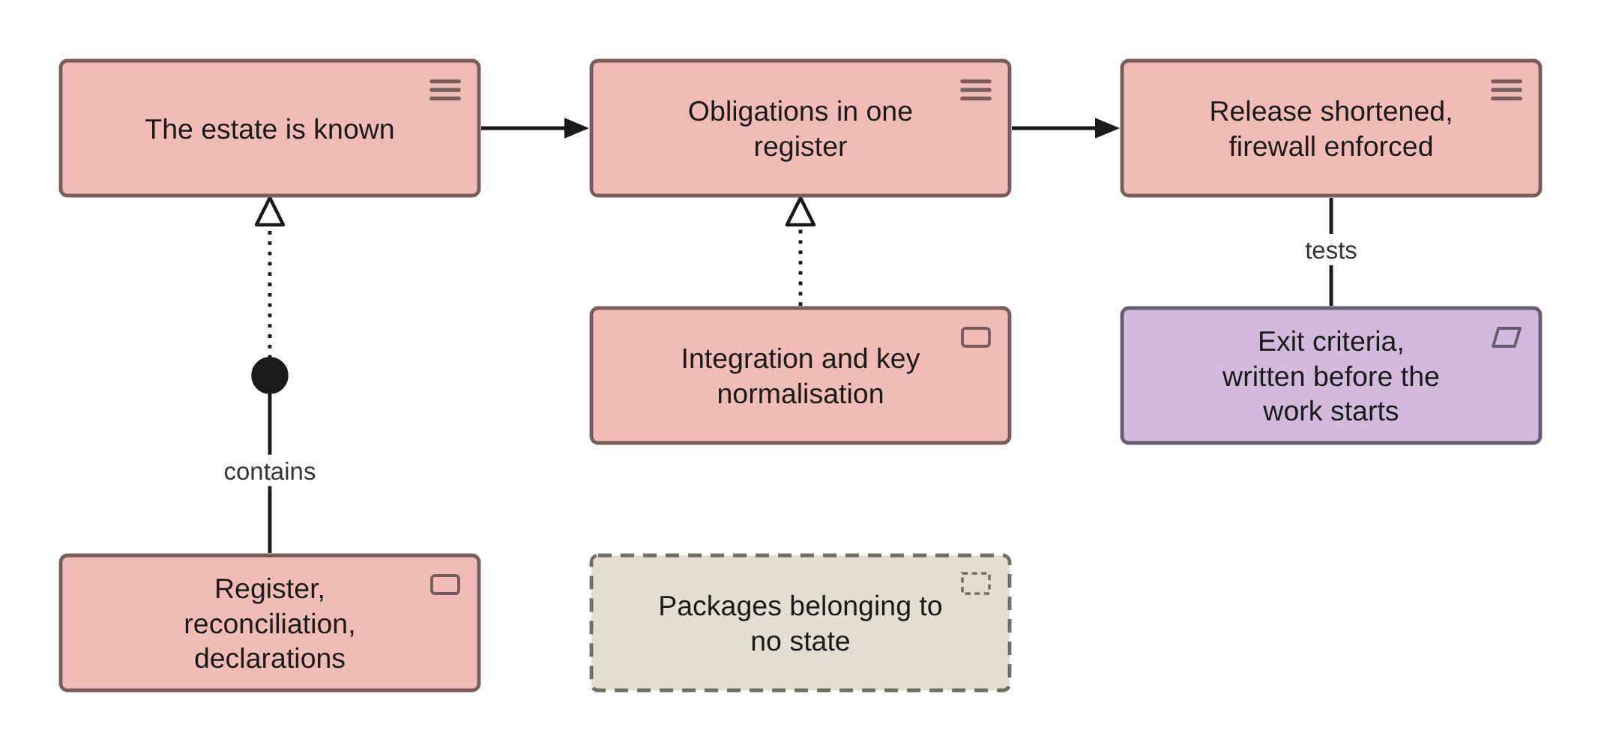
PHASES E AND F · VIEW 33 OF 36
Transition overview view
ARCHIMATE 4 VIEWPOINT: MIGRATION
FOR
CANVAS
The sponsor, on where the group can safely stop
ELEMENTS IT MAY CONTAIN
Plateau, Work Package, Grouping, Requirement
RELATIONSHIPS
Realization, Triggering, Association
POPULATED FROM
O53, O30, O66, R15
WHAT THIS VIEW CANNOT SHOW
Revalidation effort, which is the real cost of every package touching a validated system
A transition state without written exit criteria is a wish with a date on it.
Pharmaceuticals EA · View templates
Thotnr Consulting · Pharmaceuticals starter pack · October 2026
41
Notes:
WHAT TO SAY
Leave the unallocated packages floating. A box connected to nothing is the fastest way to ask a committee which state it is funding.
QUESTION TO EXPECT
'How many states fit in a year?' Ask how many quality person-days the product quality reviews already consume, and answer from what is left.

Slide 42
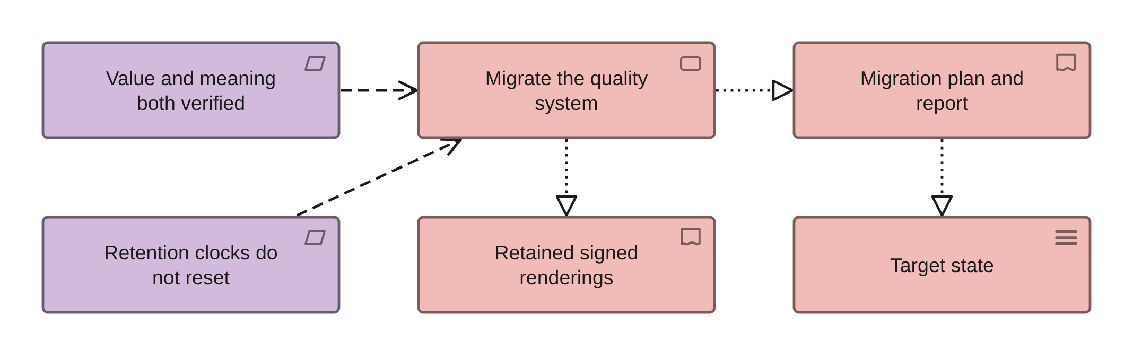
PHASES E AND F · VIEW 34 OF 36
Implementation and migration view
ARCHIMATE 4 VIEWPOINT: IMPLEMENTATION AND DEPLOYMENT
FOR
CANVAS
The programme board, monthly
ELEMENTS IT MAY CONTAIN
Work Package, Deliverable, Plateau, Requirement
RELATIONSHIPS
Realization, Triggering
POPULATED FROM
O30, O31, O39, O56, O66
WHAT THIS VIEW CANNOT SHOW
Revalidation effort and quality assurance capacity, which is the binding constraint rather than budget
Migration is a validation activity. Verification of value and meaning is a Requirement on the package.
Pharmaceuticals EA · View templates
Thotnr Consulting · Pharmaceuticals starter pack · October 2026
42
Notes:
WHAT TO SAY
A record created in one year and migrated in another keeps the earlier obligation. Systems that compute retention from the migration date are wrong by decades.
QUESTION TO EXPECT
'Can we migrate the audit trails?' Rarely faithfully. Export them as a report and retain them alongside, and declare that you did.

Slide 43
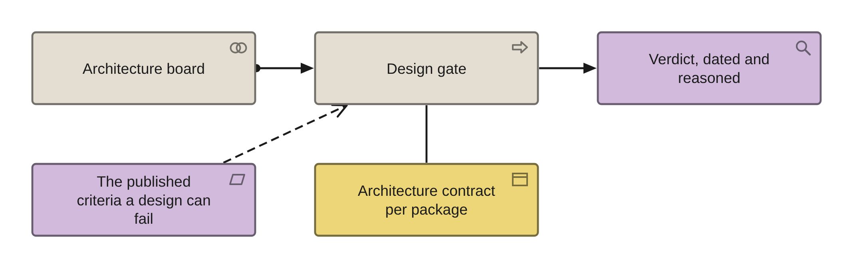
PHASES G AND H · VIEW 35 OF 36
Compliance view
ARCHIMATE 4 VIEWPOINT: IMPLEMENTATION AND DEPLOYMENT
FOR
CANVAS
The architecture board, at each gate
ELEMENTS IT MAY CONTAIN
Assessment, Process, Grouping, Collaboration
RELATIONSHIPS
Association, Triggering, Assignment
POPULATED FROM
O33, O57, O58, O59
WHAT THIS VIEW CANNOT SHOW
The verdict and its evidence, which are properties of the assessment and are often missing
A gate with nothing to assess against cannot be passed. Check the criteria sheet before the gate.
Pharmaceuticals EA · View templates
Thotnr Consulting · Pharmaceuticals starter pack · October 2026
43
Notes:
WHAT TO SAY
If the assessment sheet is empty, the governance regime exists on paper and has never been exercised. That is a finding with a count.
QUESTION TO EXPECT
'Has anything ever failed a gate?' If the answer is nothing has ever been assessed, the gate is a diagram rather than a control.

Slide 44
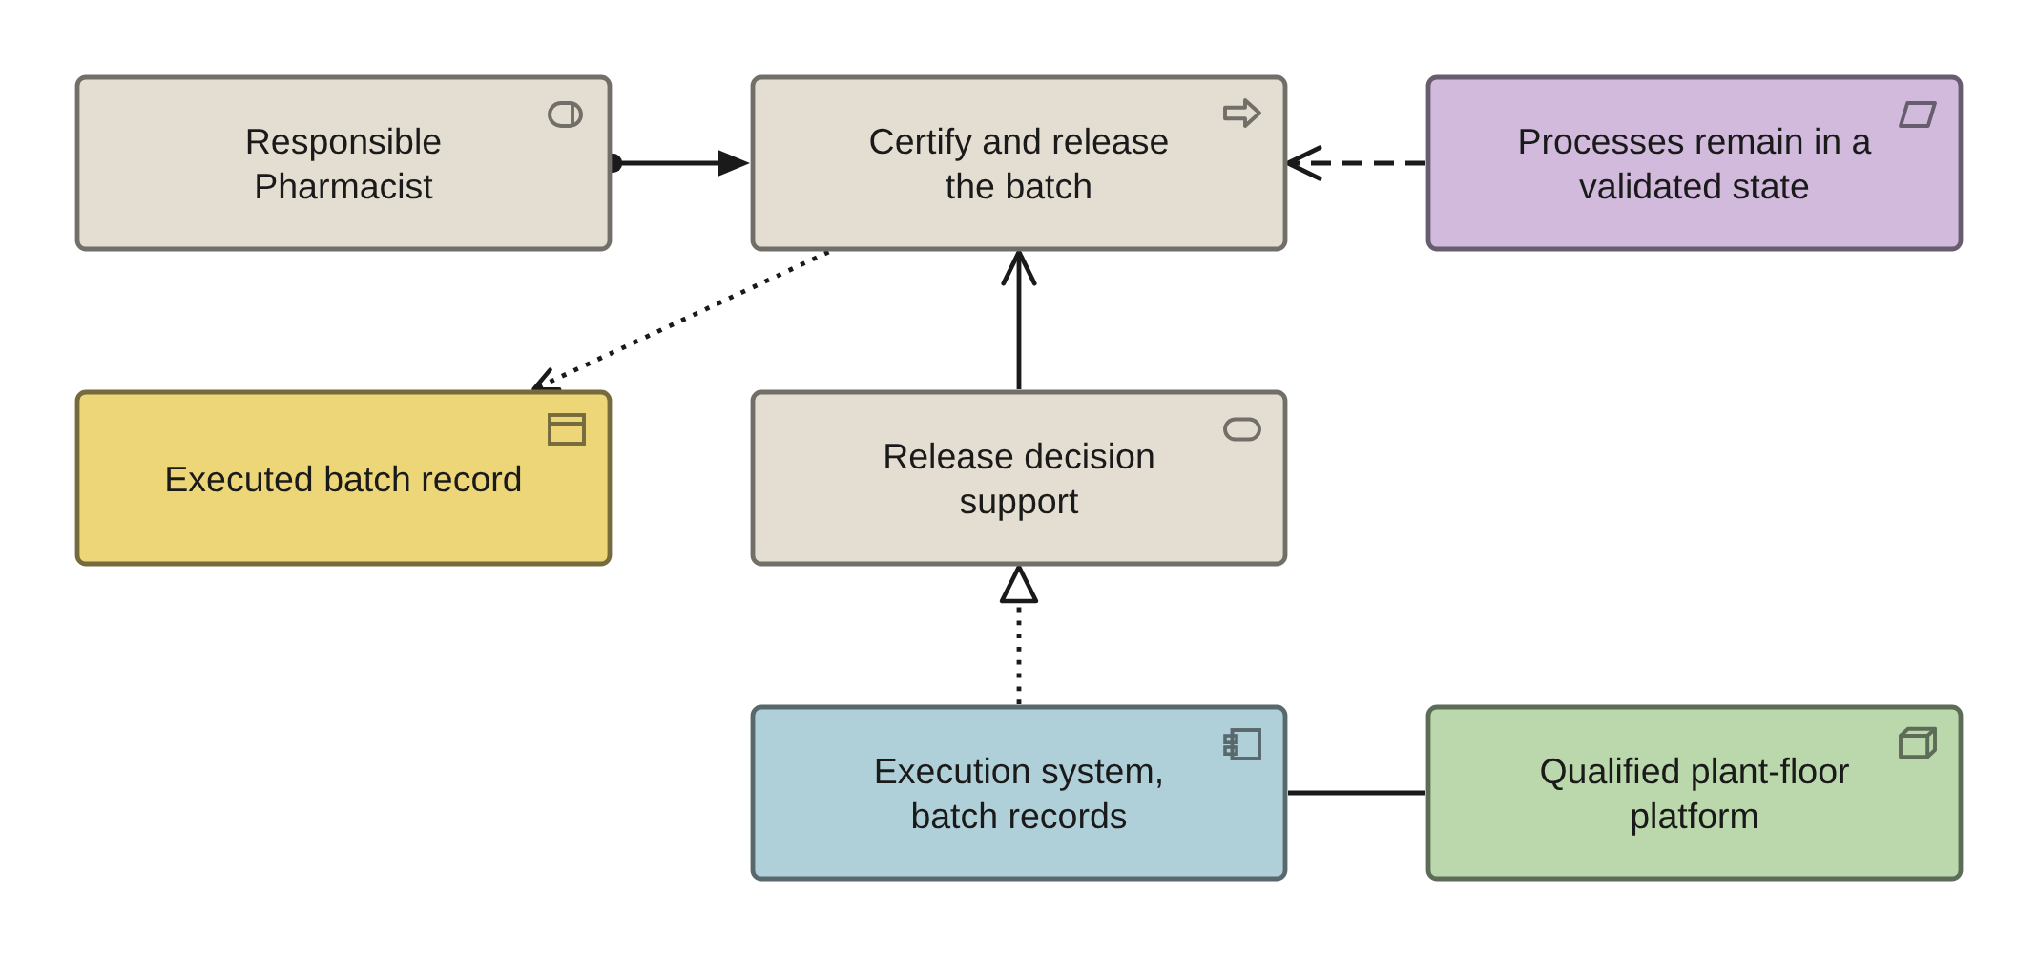
PHASES G AND H · VIEW 36 OF 36
Layered slice view
ARCHIMATE 4 VIEWPOINT: LAYERED
FOR
CANVAS
Any executive, once, as the picture of the whole
ELEMENTS IT MAY CONTAIN
Role, Process, Service, Application Component, Node, Requirement
RELATIONSHIPS
Assignment, Serving, Realization, Influence
POPULATED FROM
O11, O16, O15, O23, O27, O67
WHAT THIS VIEW CANNOT SHOW
Anything at instance level. A layered view is a view of types, and a batch is an instance
Eight elements, one role, one decision. A view that needs forty elements is two views or a report.
Pharmaceuticals EA · View templates
Thotnr Consulting · Pharmaceuticals starter pack · October 2026
44
Notes:
WHAT TO SAY
This is the one slide an executive remembers: one role, one decision, and the layer beneath it that the regulator also reads.
QUESTION TO EXPECT
'Is this the architecture?' It is one slice of it, chosen because the decision at the top has a named person and a legal consequence.

Slide 45
THE THREE YOU HAVE TO INVENT
No standard viewpoint covers these three
Each is named, drawn and numbered in this pack. Name them the same way in your own repository so that two engagements can talk to each other.
VIEW 29
VIEW 23
VIEW 30
The validated boundary
The clinical and commercial firewall
The obligation-to-evidence chain
A Grouping for the validated estate with its members, their GxP classification and validation state as displayed properties, every declared crossing as a Path, and the obligations as Requirements. Fed by the validated-system register and the interface inventory. It cannot show whether the periodic reviews are current: that is a report.
Two Groupings, the governed flows between them as Paths, and a Requirement per flow stating what may and may not be joined. Fed by the application inventory, the access model and the reporting-layer inventory. It cannot show that the firewall is holding. Only an access review can.
The obligation as a Driver, what must be true as a Requirement, the controls behind an and-junction, the verdict as an Assessment and the evidence as a Deliverable with a named signer. Fed by the control objectives, the control register and the compliance assessments. It cannot show whether the evidence is current.
AND A FOURTH THAT IS A REGISTER RATHER THAN A VIEW
The submission-and-commitment view wants to exist and cannot: the dossier is a projection over an append-only log of sequences, and the notation has no fold. Draw the submission as a Deliverable, carry the dossier state as a property, and put the due dates in the obligation register with the licence renewals and the review dates — they are one family, and five trackers is how a commitment gets missed.
Pharmaceuticals EA · View templates
Thotnr Consulting · Pharmaceuticals starter pack · October 2026
45
Notes:
WHAT TO SAY
These three are the pharmaceutical content of the pack. Everything else is a standard viewpoint with this industry's labels on it.
QUESTION TO EXPECT
'Why is the validated boundary not standard?' Because no other industry regulates the system itself, so no general-purpose notation has needed the view.

Slide 46
THE DISCIPLINE THAT KEEPS A VIEW USEFUL
Fifteen elements, not forty
A view stops communicating somewhere between fifteen and twenty-five elements, and in a regulated estate the lower end is right.
ELEMENT COUNT
Every element on a view invites a question with a regulatory consequence. If a view needs forty elements it is two views, or it is a report. The test: can the person whose job the view describes find themselves on it in under ten seconds?
Fifteen, and the ten-second test
NAMING
Roles named as the industry names the job, never as a job title the company invented. Systems named by what they do with the product name in brackets, because the product name changes and the function does not. Processes named verb-first. Objects named with their qualifier, because "product" unqualified means four things.
Agreed in week one, applied to the repository
REGENERATION
The failure is always the same: a view is exported to a slide, the slide is edited, the edited slide becomes the version people quote, and six months later the repository and the circulating picture disagree. Regenerate rather than edit, and date every exported view in its own footer.
A view is a query, not a drawing
AND THE HABIT THAT IS SPECIFIC TO A REGULATED ESTATE
Say what the view cannot show, on the view. The validated-boundary view cannot show whether the periodic reviews are current; the interface view cannot show whose validation scope an interface sits in; the migration view cannot show revalidation effort. Write the sentence rather than waiting to be asked.
Pharmaceuticals EA · View templates
Thotnr Consulting · Pharmaceuticals starter pack · October 2026
46
Notes:
WHAT TO SAY
Agree the naming conventions in week one and write them down. In pharma the ones that pay for themselves are the role names and the qualified object names, because both are arguments the room is already having.
QUESTION TO EXPECT
'Can we have a single big landscape view?' You can have a report. A view with forty components answers no question anybody asked.

Slide 47
INSIDE THE QUALITY SYSTEM, OR OUTSIDE IT?
Decide for every view, and mark it
This question has no analogue in the other volumes of this series.
 | A controlled view | An uncontrolled view
Where it appears | Inside a validation package, a Site Master File, a submission module or a standard operating procedure | In working architecture: a board pack, a design review, a wall
What changing it needs | A change record, an impact assessment, an approval and a document version | A regeneration from the repository, and a new date in the footer
How fast it can change | As fast as the quality system allows, which is correct and slow | As fast as the repository changes
How it is marked | With its document number and version, inside the quality system | With the words "not a controlled document" and a date
How many you should have | Few, and named | Most of them
THE DEFAULT, STATED ONCE
Outside. Most pharmaceutical architecture views should deliberately not be controlled documents, and the exceptions should be few and named.
THE MISTAKE THAT COSTS MORE
An uncontrolled drawing inside a regulated record is something an inspector will find, and they will ask which version was operative on the day.
Pharmaceuticals EA · View templates
Thotnr Consulting · Pharmaceuticals starter pack · October 2026
47
Notes:
WHAT TO SAY
Draw the line explicitly and early. A small number of views are controlled because a regulated document needs them. Everything else is working architecture: dated, versioned in the repository, circulated, and explicitly marked.
QUESTION TO EXPECT
'Who decides?' Quality assurance, with the architect proposing. It is a quality-system question wearing an architecture hat.

Slide 48
BEFORE YOU RENDER A SHEET
Check whether it is a statement or a join
Drawing a defective sheet draws the defect at scale, in colour, in front of the person it is wrong about.
01
Is the relationship sheet a statement about the world, or a join made in index order?
In the example repository ten of the twenty-five are joins. A view generated from one of them puts a false claim on a wall.
02
Do two sheets disagree about the same fact?
Where a deployment sheet and a location sheet contradict each other, two views drawn from one repository will disagree about where a system runs.
03
Does a reference column hold a name rather than a reference?
A name in a reference column renders as a box with no identity, and nobody notices until the second view.
04
Is the sheet empty, and does the view depend on it?
An empty compliance-assessment sheet means the governance regime exists on paper. Draw the gap rather than the regime.
05
Does a column hold a number that has no definition anywhere?
Two sheets giving two values for one measure is not a rendering problem. It is a measure definition register that does not exist yet.
THE RULE UNDERNEATH ALL FIVE
A view is generated, so a defect in the sheet becomes a defect in the picture at the size of a wall. Check the sheet, render, then look at what came out.
Pharmaceuticals EA · View templates
Thotnr Consulting · Pharmaceuticals starter pack · October 2026
48
Notes:
WHAT TO SAY
This slide exists because generated views are trusted more than tables, which is exactly backwards when the underlying join was made by row position.
QUESTION TO EXPECT
'How do we tell?' Open the sheet and read three rows as sentences. A join reads as nonsense by the second one.

Slide 49
THE TEST THAT TAKES A MINUTE
A view that disagrees with the repository is wrong, not a variant
List the references on a published view and look each one up. If an edge is not on a relationship sheet, it was authored on the picture and belongs in the repository or nowhere.
REGENERATE, NEVER HAND-MAINTAIN
THE VIEW CARRIES THE REFERENCE
The picture is an output
Not just the name
An edited export becomes the version people quote, and six months later the two disagree. Date every export in its own footer and name the sheets it came from.
Every element on a published view carries its repository reference. "The safety database" is a conversation; a reference is a row somebody can look up.
AN ELEMENT THE REPOSITORY DOES NOT HOLD
A RECORD ON NO VIEW
Is a change request waiting to be raised
Is a question, not a problem
Drawing it first and recording it later is how a repository falls behind the pictures drawn from it.
Most of the repository is not drawn, and that is correct. Ask what question would need it on a view, and if there is none, leave it in the register.
AND THE LAST WORD, WHICH IS THE FIRST ONE AGAIN
The repository is the record. A view is an argument made from six rows out of eight hundred, and it is the argument that gets a decision taken. Both are needed, and only one of them is authoritative — and it is not the one on the wall.
Pharmaceuticals EA · View templates
Thotnr Consulting · Pharmaceuticals starter pack · October 2026
49
Notes:
WHAT TO SAY
Close on the relationship between the register and the picture. The register answers by filter and formula; the view takes six rows and shows the shape. Only one of them is authoritative.
QUESTION TO EXPECT
'So which do we maintain?' The repository. The views are regenerated from it, which is why every template in this pack names the sheets it came from.

