Slide 1
HALVERSON STORES GROUP · ARCHITECTURE VIEWS
Twenty-five views of
the architecture
Multi-channel retail — SKUs, stores, assortment and the supply chain that fills the shelf.
One view for each of the twenty-five viewpoints in the ArchiMate 4 Specification. A viewpoint is where you look from; a view is what you see.
13
4
5
3
from basic viewpoints
from motivation
from strategy
from implementation
Halverson Stores Group is an illustrative organisation. ArchiMate® is a registered trademark of The Open Group.

Slide 2
CONTENTS
Twenty-five views, one per viewpoint
C.1.1
Organization view
C.2.1
Stakeholder view
C.1.2
Application Structure view
C.2.2
Goal Realization view
C.1.3
Information Structure view
C.2.3
Requirements Realization view
C.1.4
Technology view
C.2.4
Motivation view
C.1.5
Layered view
C.3.1
Strategy view
C.1.6
Physical view
C.3.2
Capability Map view
C.1.7
Product view
C.3.3
Value Stream view
C.1.8
Application Usage view
C.3.4
Outcome Realization view
C.1.9
Technology Usage view
C.3.5
Resource Map view
C.1.10
Process Cooperation view
C.4.1
Project view
C.1.11
Application Cooperation view
C.4.2
Migration view
C.1.12
Service Realization view
C.4.3
Implementation and Migration view
C.1.13
Implementation and Deployment view
Each row is a view of Halverson Stores Group. The reference is the viewpoint it was created from, per Appendix C of the ArchiMate 4 Specification.

Slide 3
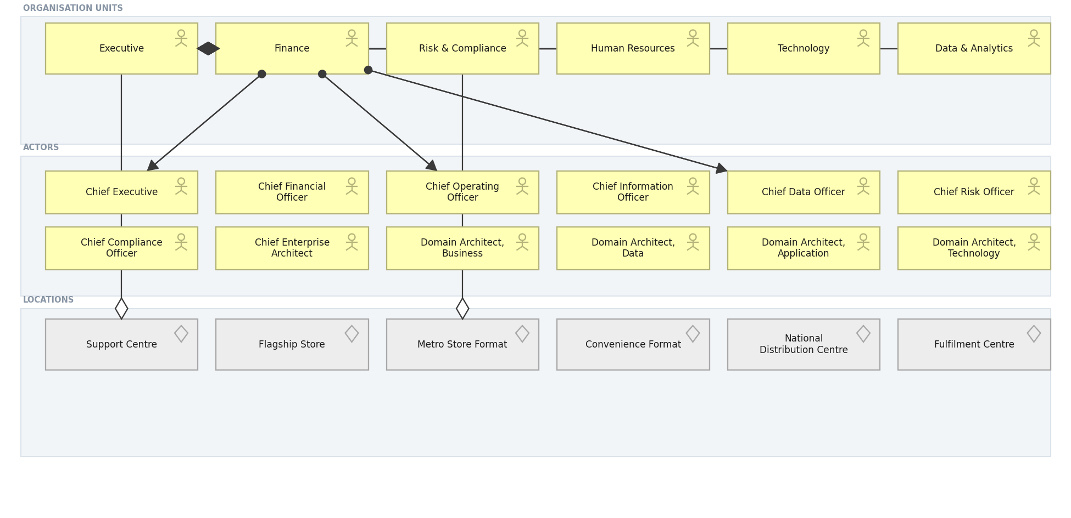
HALVERSON STORES GROUP · BASIC · C.1.1
Organization view
Who the organisation is: units, the actors inside them, and where they sit.
Created using the Organization Viewpoint, C.1.1 of the ArchiMate 4 Specification. Drawn from the Retail metamodel.

Slide 4
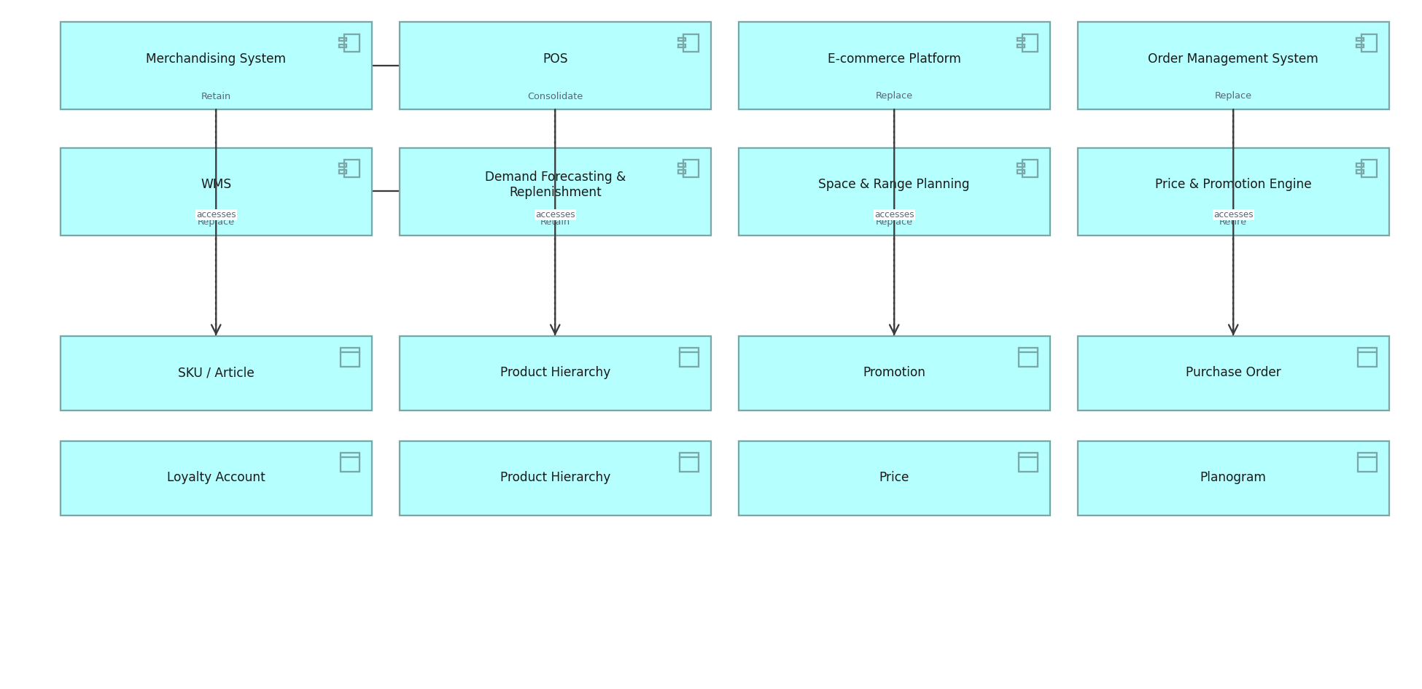
HALVERSON STORES GROUP · BASIC · C.1.2
Application Structure view
The structure of the application estate and the data each component holds.
Created using the Application Structure Viewpoint, C.1.2 of the ArchiMate 4 Specification. Drawn from the Retail metamodel.

Slide 5
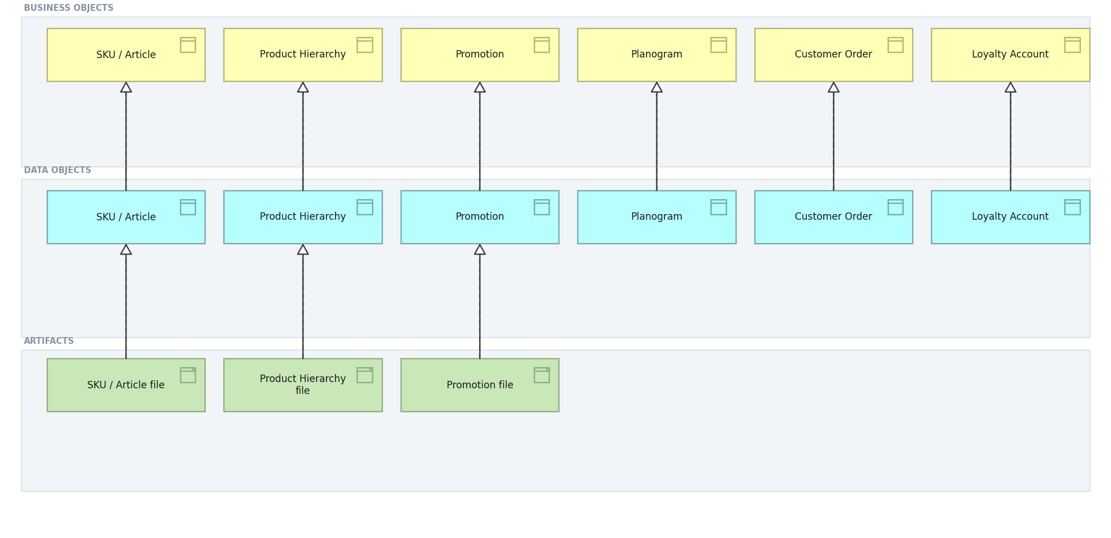
HALVERSON STORES GROUP · BASIC · C.1.3
Information Structure view
Business objects, the data objects that realise them, and the artifacts beneath.
Created using the Information Structure Viewpoint, C.1.3 of the ArchiMate 4 Specification. Drawn from the Retail metamodel.

Slide 6
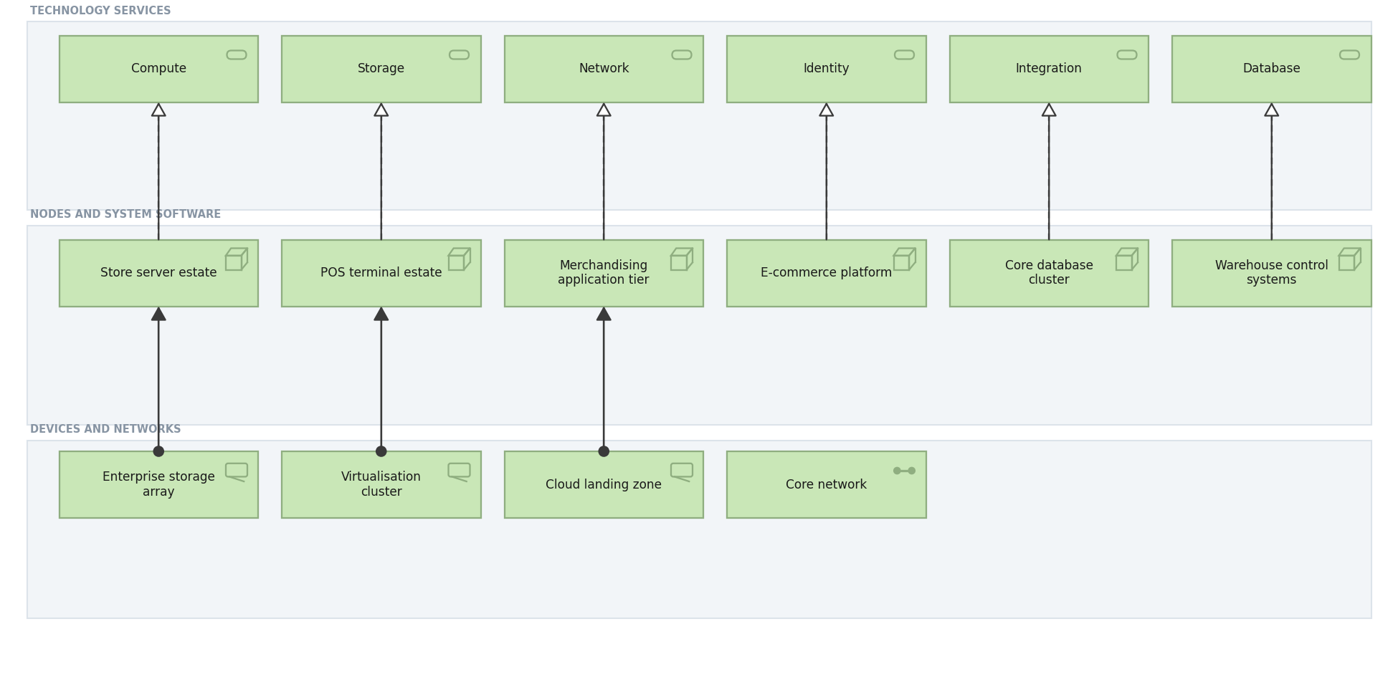
HALVERSON STORES GROUP · BASIC · C.1.4
Technology view
Technology services and the nodes, devices and networks that realise them.
Created using the Technology Viewpoint, C.1.4 of the ArchiMate 4 Specification. Drawn from the Retail metamodel.

Slide 7
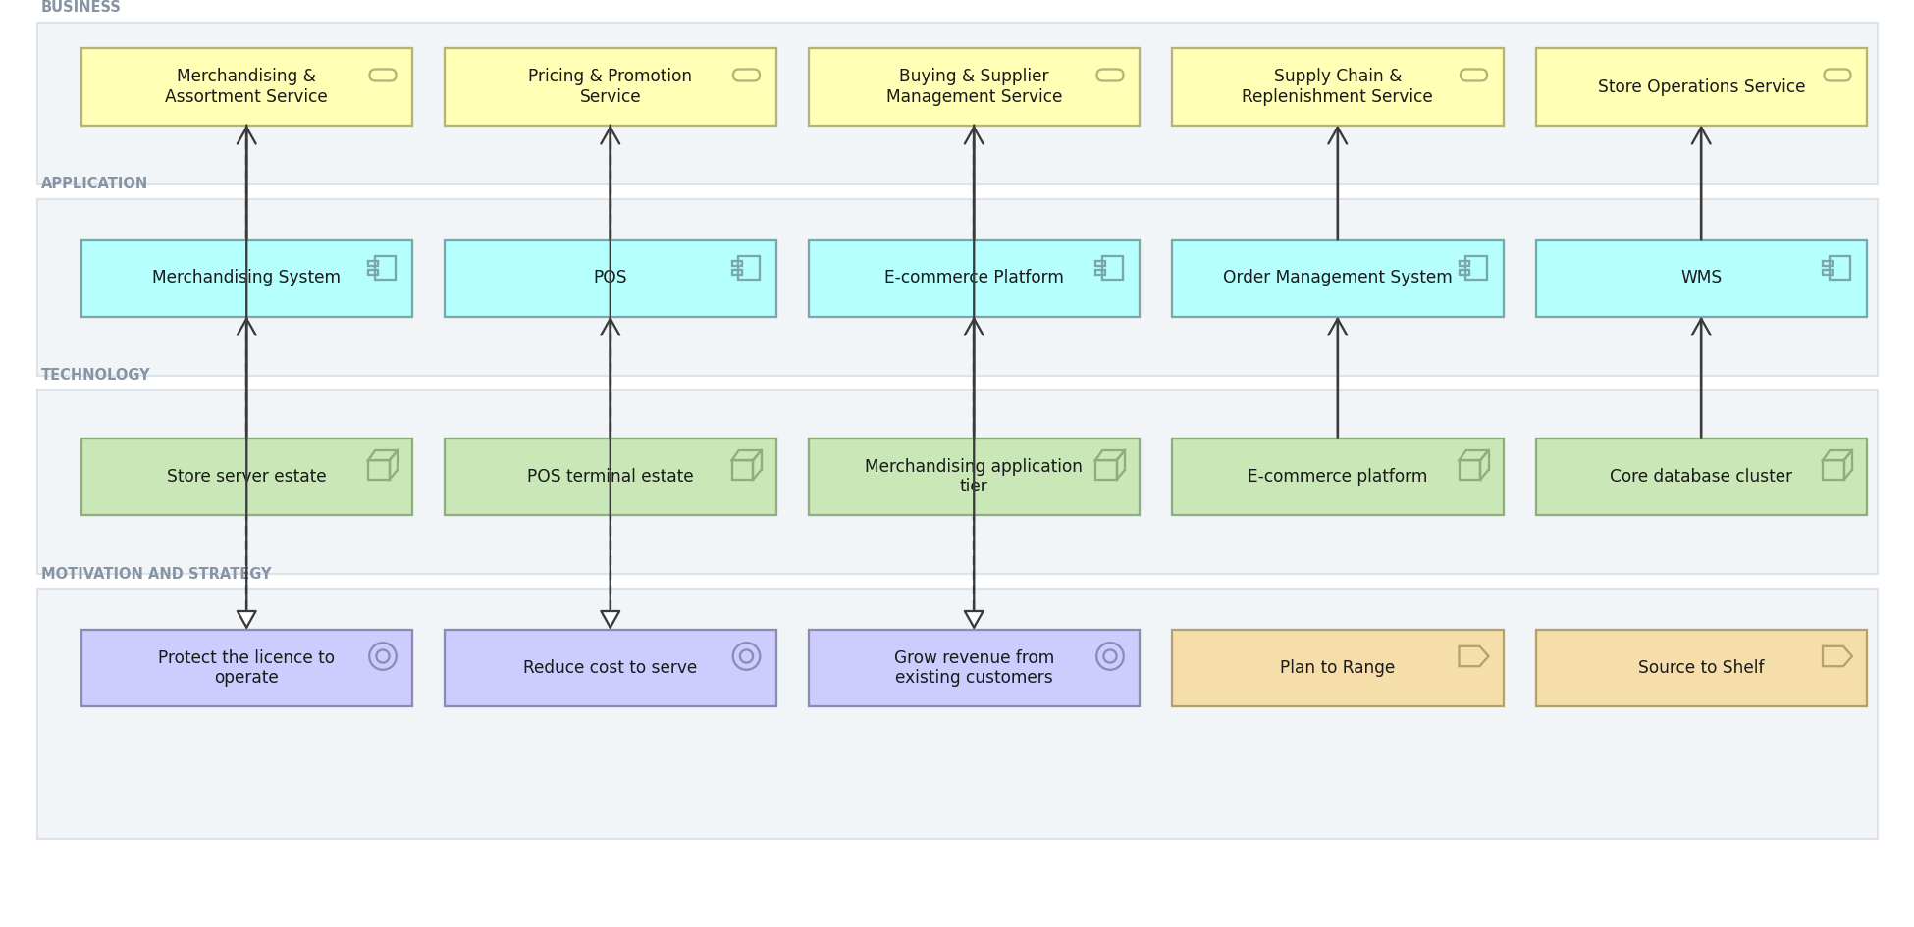
HALVERSON STORES GROUP · BASIC · C.1.5
Layered view
One picture across business, application and technology, against motivation and strategy.
Created using the Layered Viewpoint, C.1.5 of the ArchiMate 4 Specification. Drawn from the Retail metamodel.

Slide 8
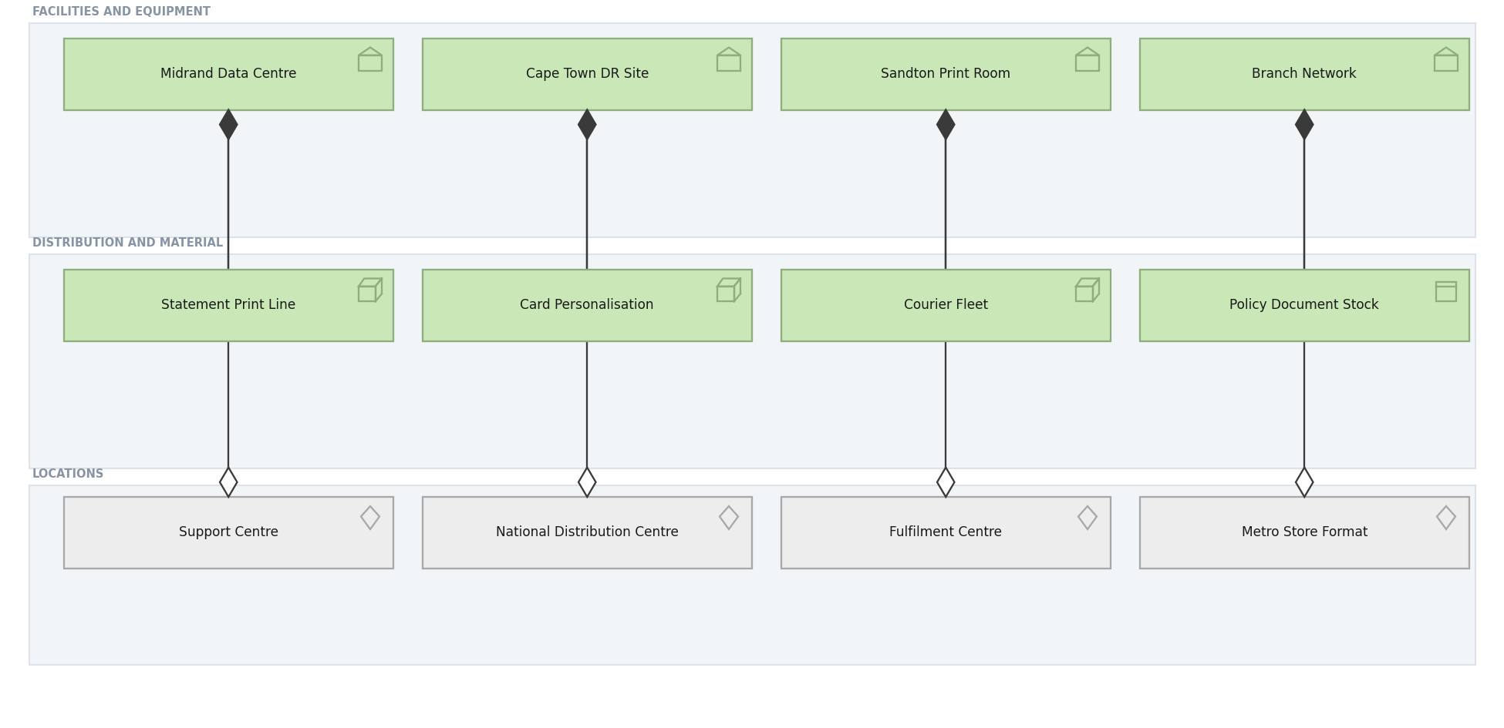
HALVERSON STORES GROUP · BASIC · C.1.6
Physical view
Facilities, equipment and material, and the locations they occupy.
Created using the Physical Viewpoint, C.1.6 of the ArchiMate 4 Specification. Drawn from the Retail metamodel.

Slide 9
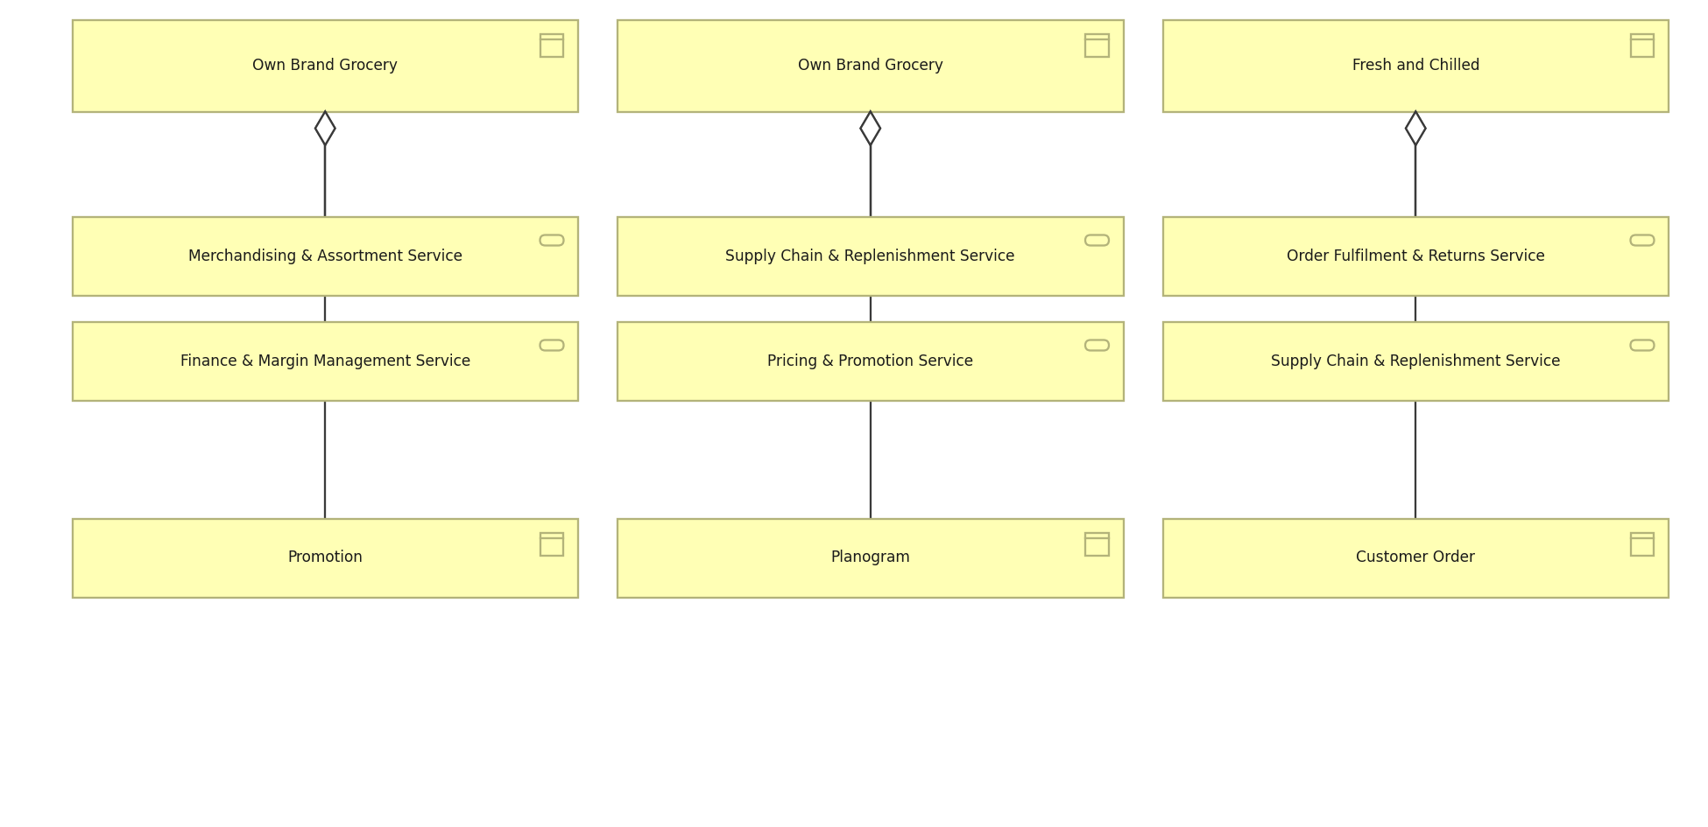
HALVERSON STORES GROUP · BASIC · C.1.7
Product view
What Meridian sells, the services each product aggregates and the objects behind it.
Created using the Product Viewpoint, C.1.7 of the ArchiMate 4 Specification. Drawn from the Retail metamodel.

Slide 10
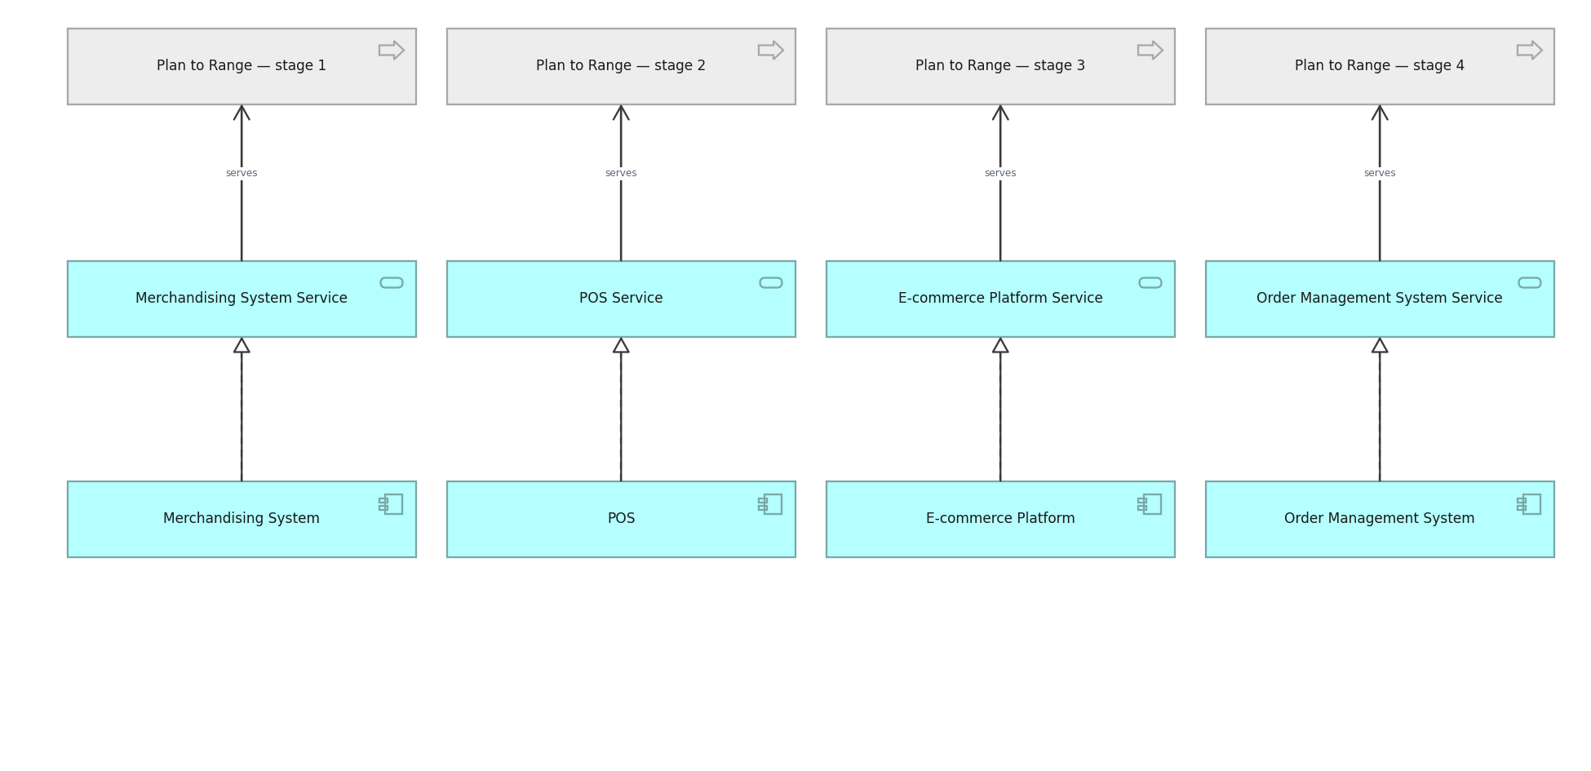
HALVERSON STORES GROUP · BASIC · C.1.8
Application Usage view
How business processes consume application services.
Created using the Application Usage Viewpoint, C.1.8 of the ArchiMate 4 Specification. Drawn from the Retail metamodel.

Slide 11
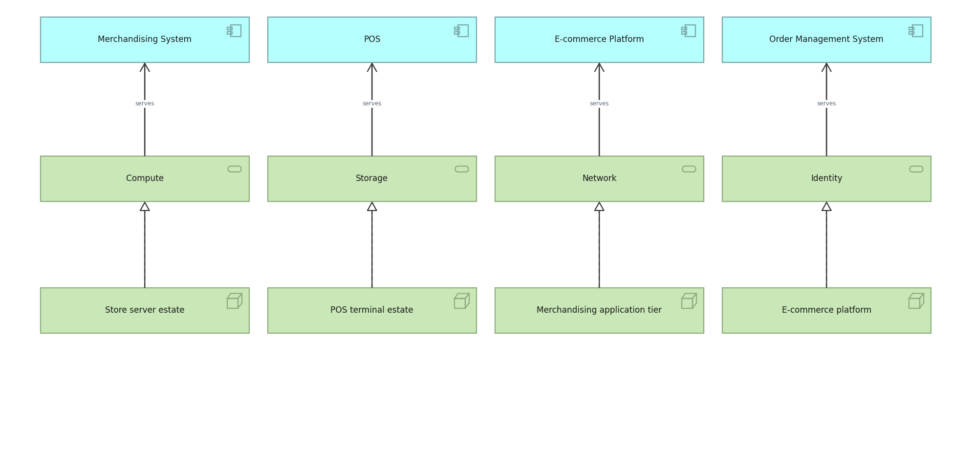
HALVERSON STORES GROUP · BASIC · C.1.9
Technology Usage view
How applications consume technology services.
Created using the Technology Usage Viewpoint, C.1.9 of the ArchiMate 4 Specification. Drawn from the Retail metamodel.

Slide 12
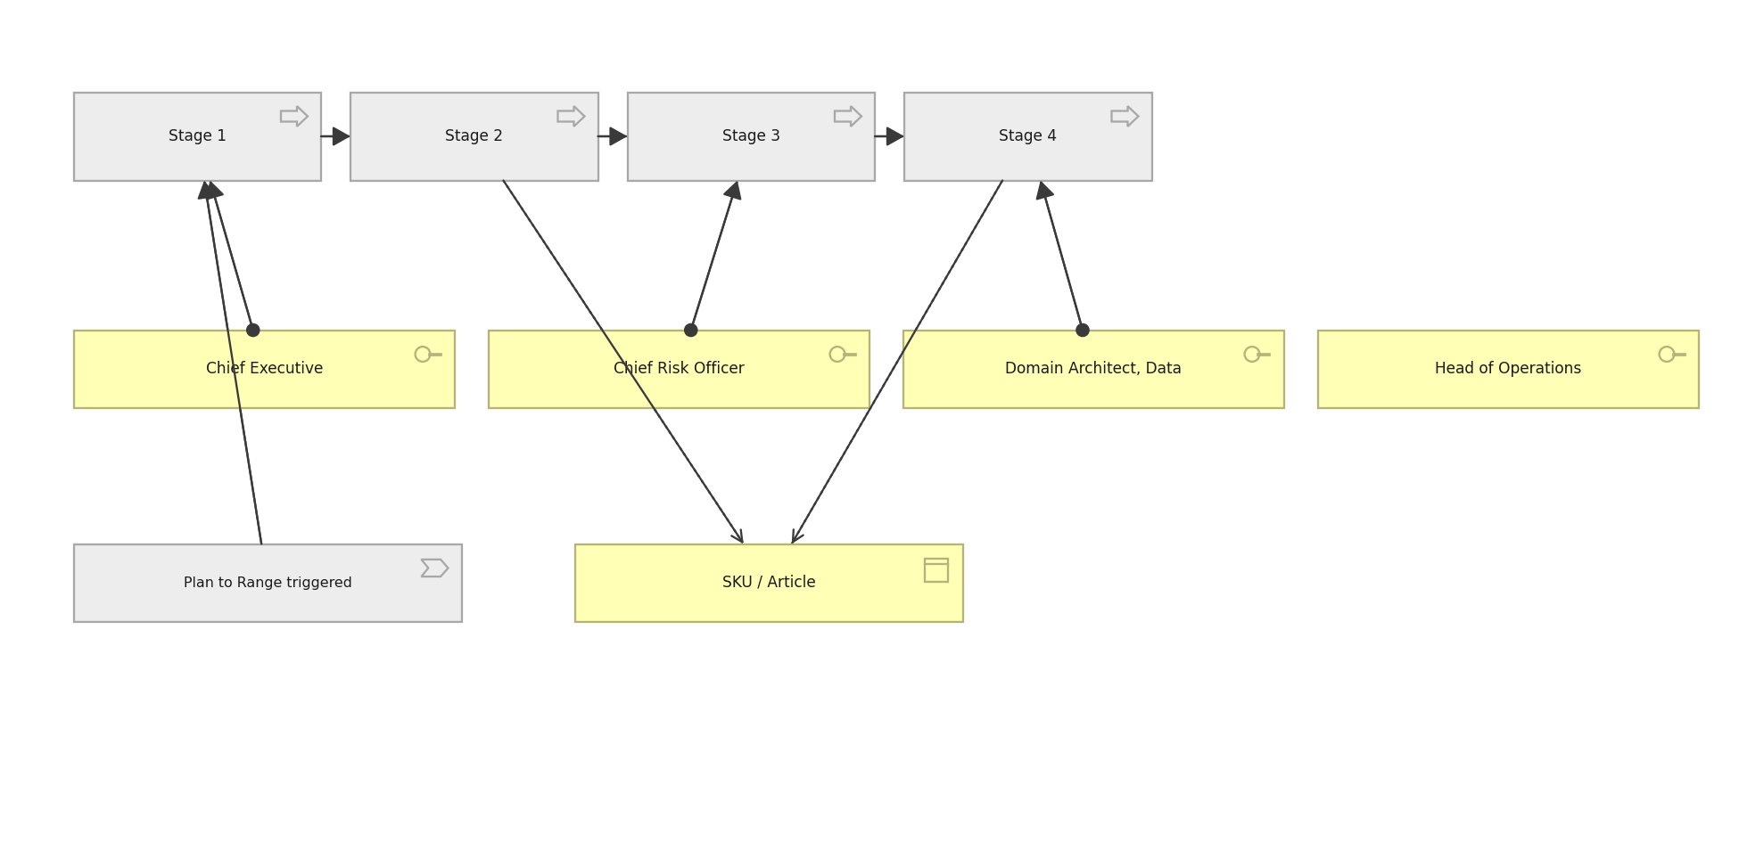
HALVERSON STORES GROUP · BASIC · C.1.10
Process Cooperation view
The claim process end to end, who performs each step and what it touches.
Created using the Process Cooperation Viewpoint, C.1.10 of the ArchiMate 4 Specification. Drawn from the Retail metamodel.

Slide 13
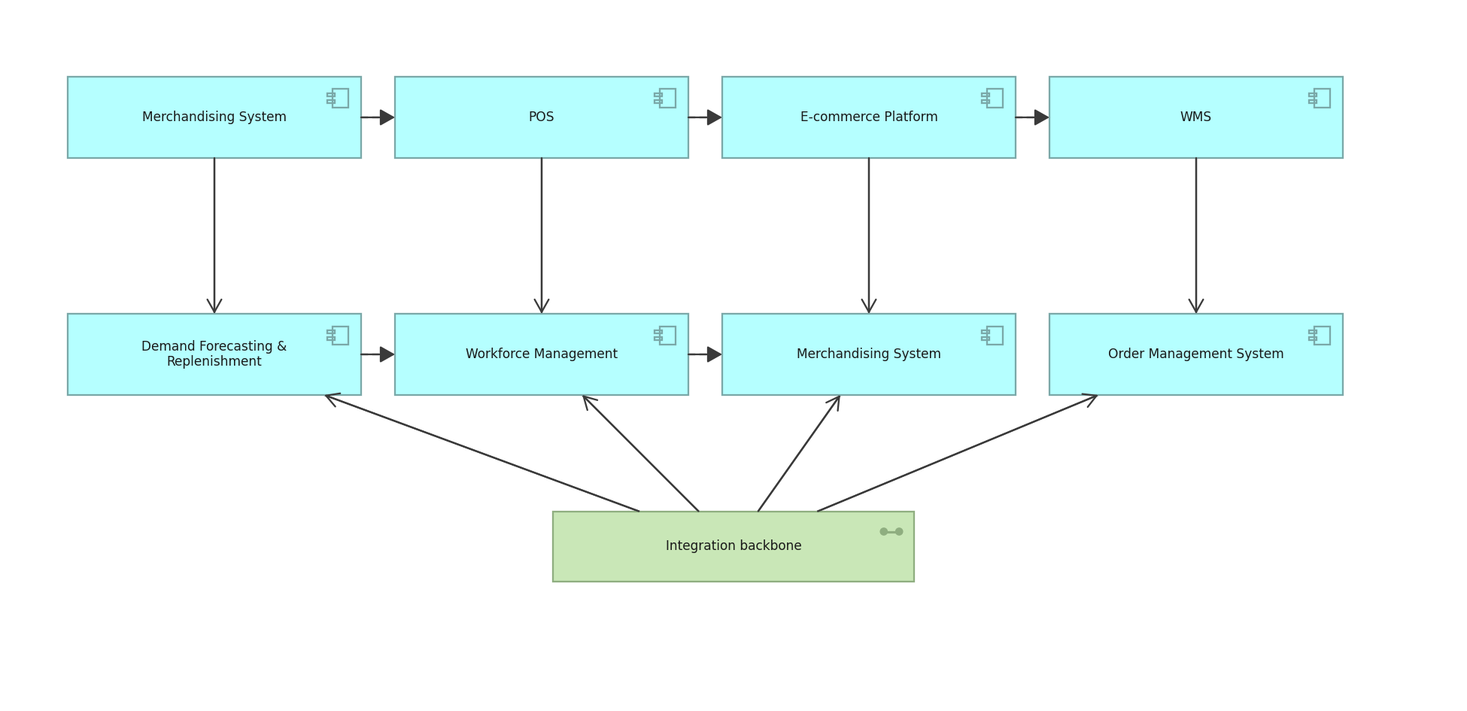
HALVERSON STORES GROUP · BASIC · C.1.11
Application Cooperation view
How applications exchange with one another across the estate.
Created using the Application Cooperation Viewpoint, C.1.11 of the ArchiMate 4 Specification. Drawn from the Retail metamodel.

Slide 14
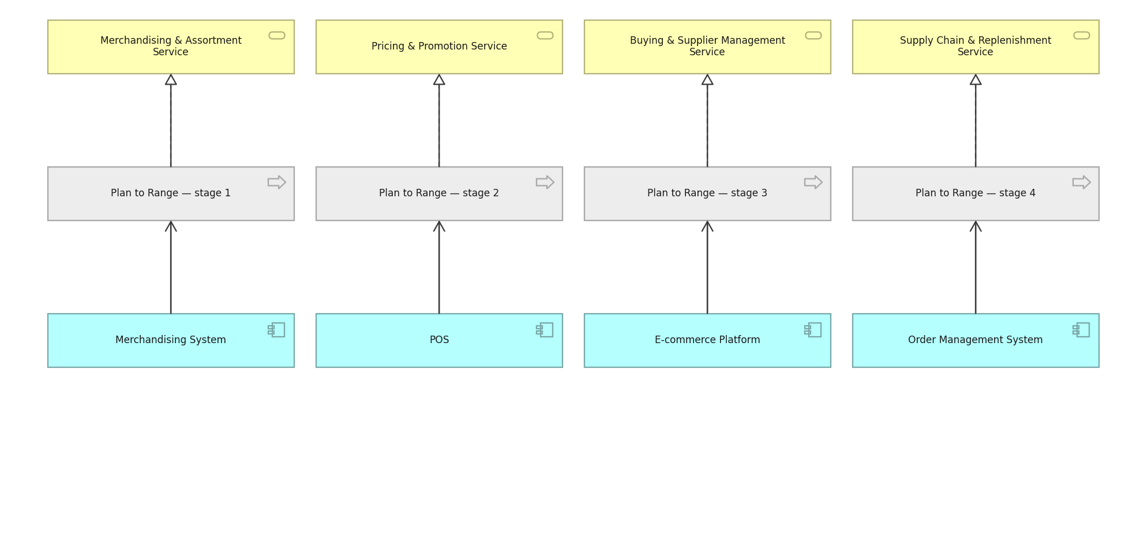
HALVERSON STORES GROUP · BASIC · C.1.12
Service Realization view
How business services are realised by processes and supported by applications.
Created using the Service Realization Viewpoint, C.1.12 of the ArchiMate 4 Specification. Drawn from the Retail metamodel.

Slide 15
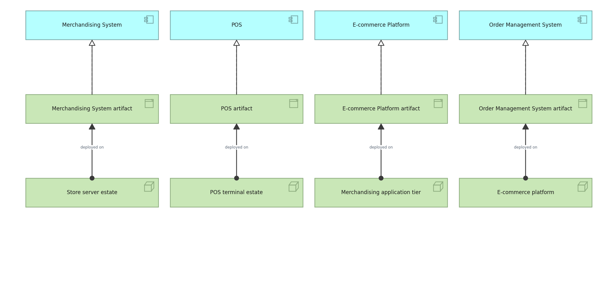
HALVERSON STORES GROUP · BASIC · C.1.13
Implementation and Deployment view
Which artifacts realise which applications, and where they are deployed.
Created using the Implementation and Deployment Viewpoint, C.1.13 of the ArchiMate 4 Specification. Drawn from the Retail metamodel.

Slide 16
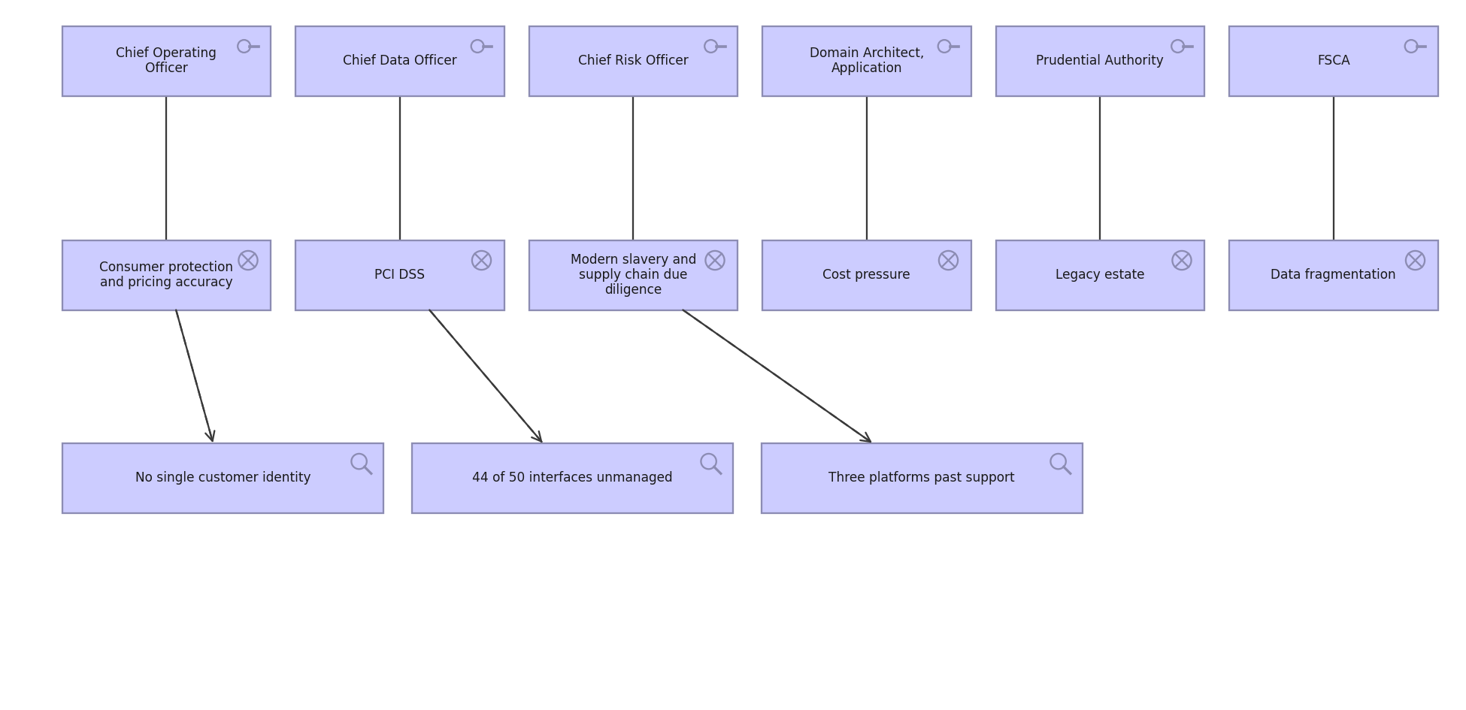
HALVERSON STORES GROUP · MOTIVATION · C.2.1
Stakeholder view
Stakeholders, the drivers they care about, and the assessments against them.
Created using the Stakeholder Viewpoint, C.2.1 of the ArchiMate 4 Specification. Drawn from the Retail metamodel.

Slide 17

HALVERSON STORES GROUP · MOTIVATION · C.2.2
Goal Realization view
How goals are refined into outcomes, and the principles that shape them.
Created using the Goal Realization Viewpoint, C.2.2 of the ArchiMate 4 Specification. Drawn from the Retail metamodel.

Slide 18
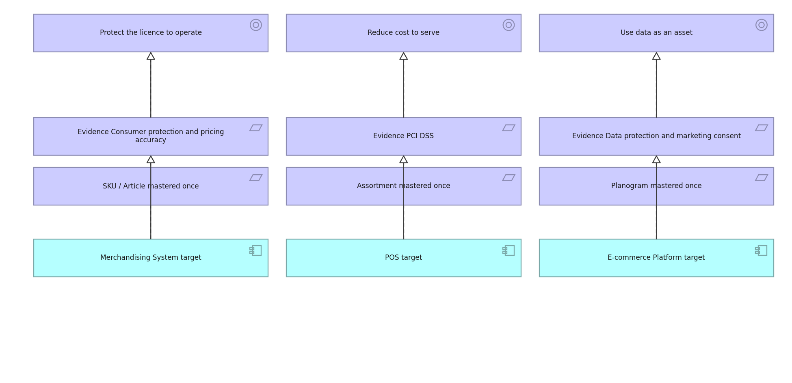
HALVERSON STORES GROUP · MOTIVATION · C.2.3
Requirements Realization view
How requirements realise goals and what realises the requirements.
Created using the Requirements Realization Viewpoint, C.2.3 of the ArchiMate 4 Specification. Drawn from the Retail metamodel.

Slide 19
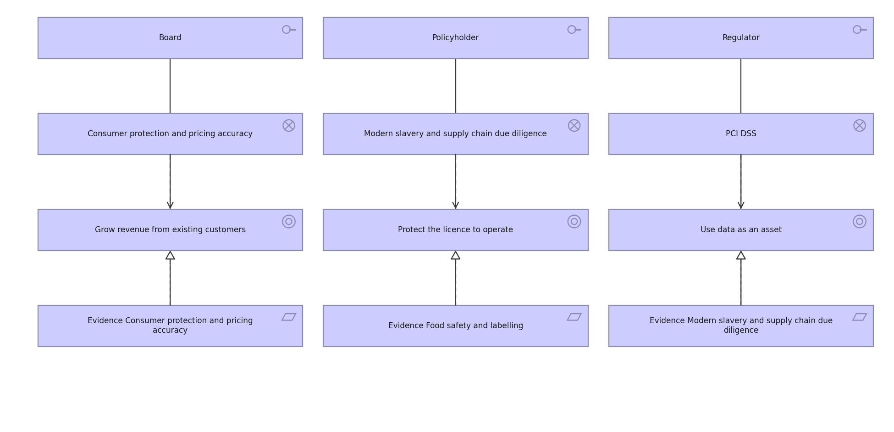
HALVERSON STORES GROUP · MOTIVATION · C.2.4
Motivation view
The full motivation chain: stakeholder to driver to goal to requirement.
Created using the Motivation Viewpoint, C.2.4 of the ArchiMate 4 Specification. Drawn from the Retail metamodel.

Slide 20
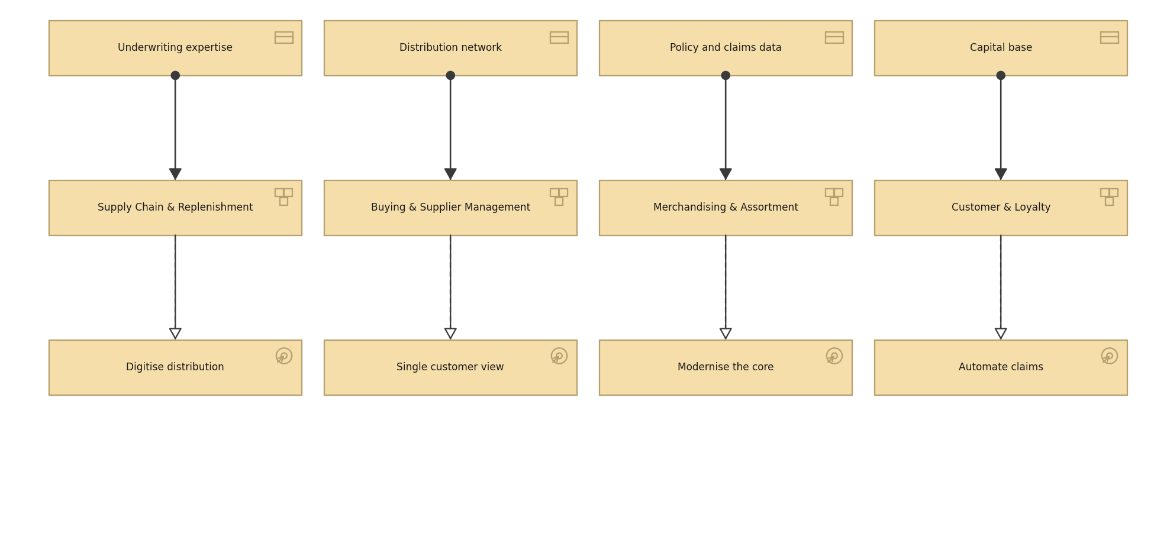
HALVERSON STORES GROUP · STRATEGY · C.3.1
Strategy view
Resources, the capabilities they enable and the courses of action chosen.
Created using the Strategy Viewpoint, C.3.1 of the ArchiMate 4 Specification. Drawn from the Retail metamodel.

Slide 21
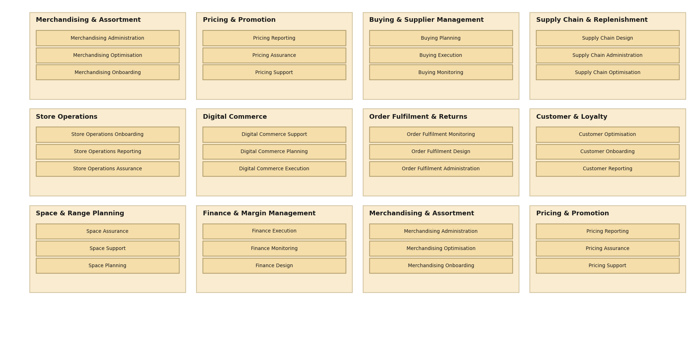
HALVERSON STORES GROUP · STRATEGY · C.3.2
Capability Map view
Twelve level 1 capabilities decomposed to level 2.
Created using the Capability Map Viewpoint, C.3.2 of the ArchiMate 4 Specification. Drawn from the Retail metamodel.

Slide 22
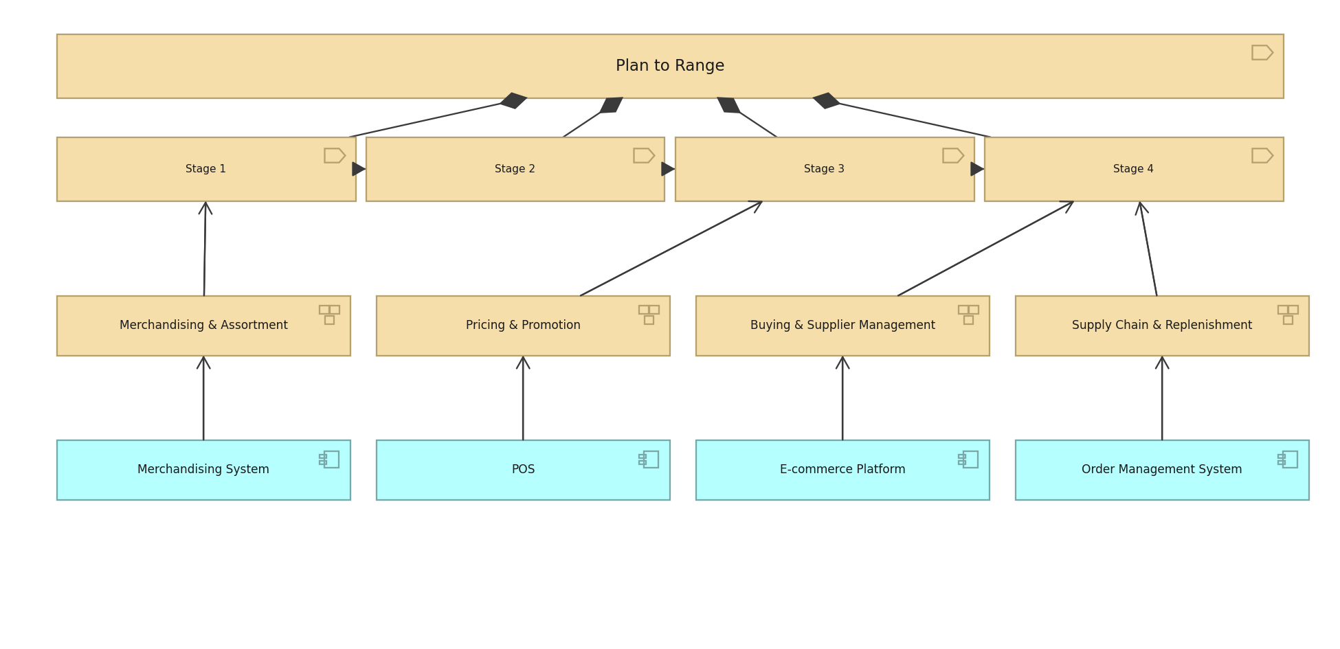
HALVERSON STORES GROUP · STRATEGY · C.3.3
Value Stream view
Settle a Claim, its stages, and the capabilities and applications behind them.
Created using the Value Stream Viewpoint, C.3.3 of the ArchiMate 4 Specification. Drawn from the Retail metamodel.

Slide 23
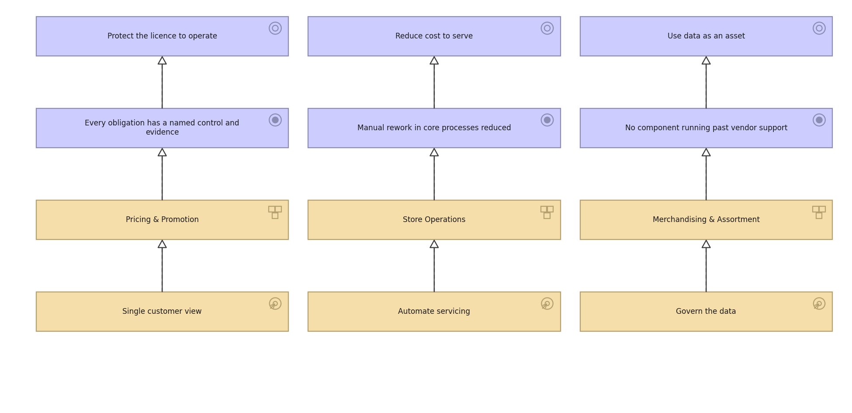
HALVERSON STORES GROUP · STRATEGY · C.3.4
Outcome Realization view
How courses of action and capabilities deliver outcomes and goals.
Created using the Outcome Realization Viewpoint, C.3.4 of the ArchiMate 4 Specification. Drawn from the Retail metamodel.

Slide 24
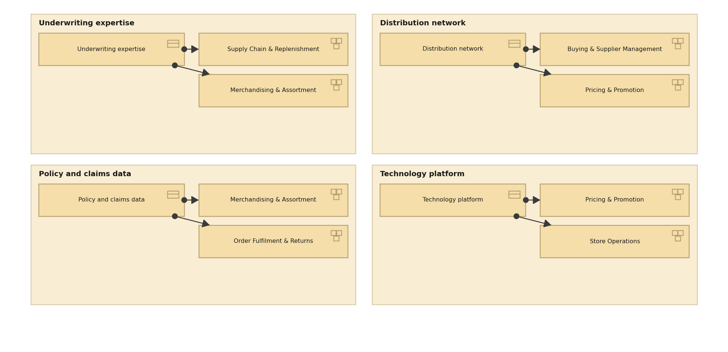
HALVERSON STORES GROUP · STRATEGY · C.3.5
Resource Map view
The resources Meridian holds and the capabilities they are assigned to.
Created using the Resource Map Viewpoint, C.3.5 of the ArchiMate 4 Specification. Drawn from the Retail metamodel.

Slide 25
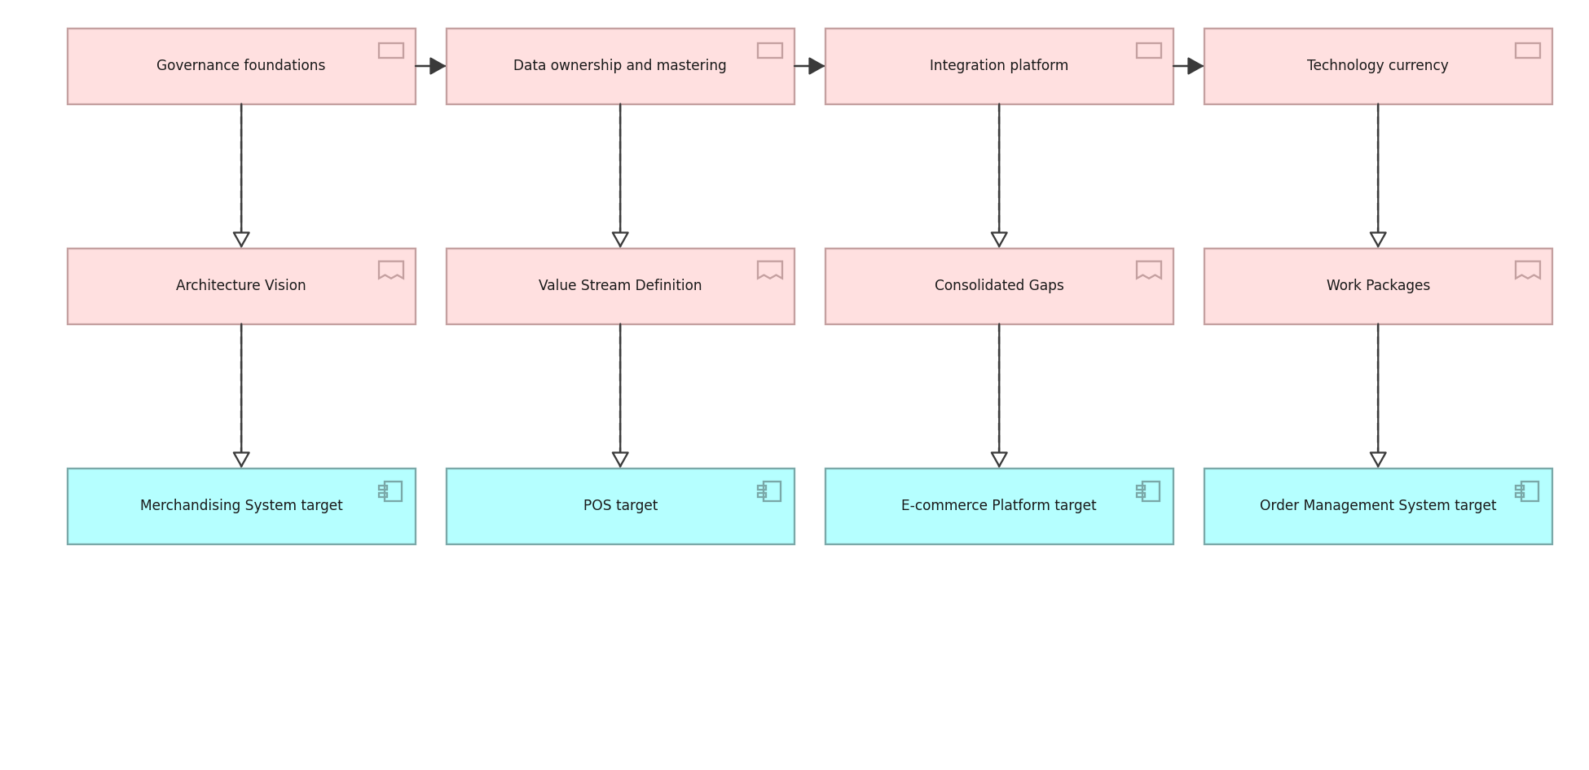
HALVERSON STORES GROUP · IMPLEMENTATION · C.4.1
Project view
Work packages, their deliverables and the building blocks they realise.
Created using the Project Viewpoint, C.4.1 of the ArchiMate 4 Specification. Drawn from the Retail metamodel.

Slide 26
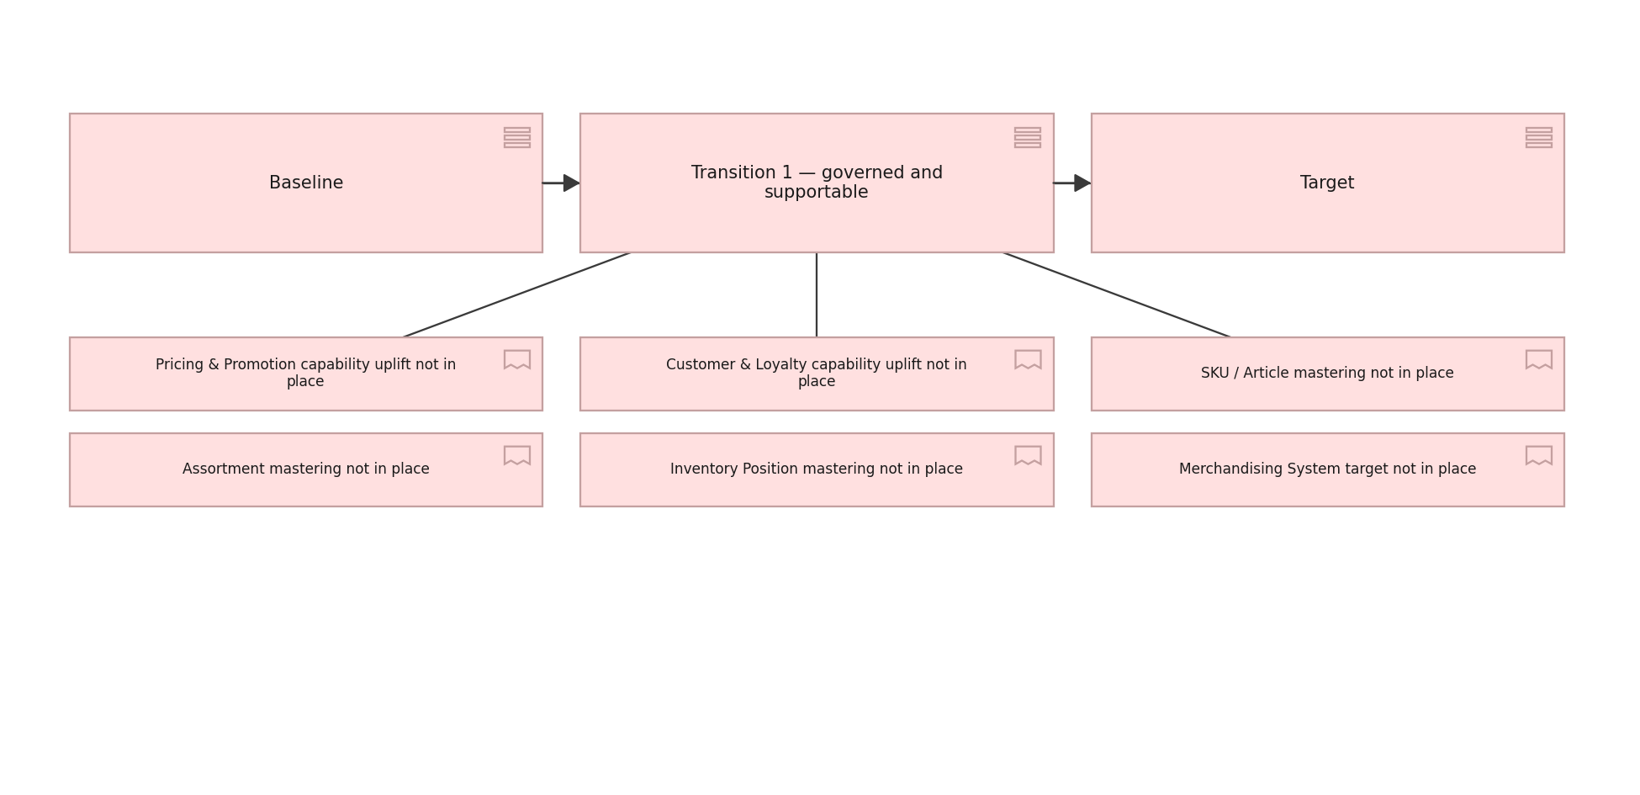
HALVERSON STORES GROUP · IMPLEMENTATION · C.4.2
Migration view
Plateaus from baseline through transition to target, and the gaps between.
Created using the Migration Viewpoint, C.4.2 of the ArchiMate 4 Specification. Drawn from the Retail metamodel.

Slide 27
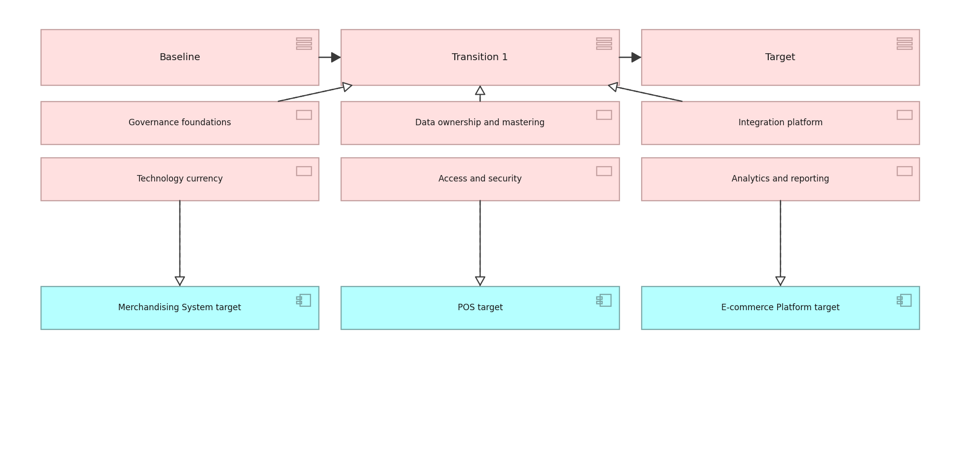
HALVERSON STORES GROUP · IMPLEMENTATION · C.4.3
Implementation and Migration view
Work packages against plateaus and the building blocks they deliver.
Created using the Implementation and Migration Viewpoint, C.4.3 of the ArchiMate 4 Specification. Drawn from the Retail metamodel.

