Slide 1
MERIDIAN ASSURANCE GROUP · ARCHITECTURE VIEWS
Twenty-five views of
the architecture
One view for each of the twenty-five viewpoints defined in the ArchiMate 4 Specification. A viewpoint is where you look from; a view is what you see. These are what Meridian looks like.
13
4
5
3
from basic viewpoints
from motivation
from strategy
from implementation
Illustrative organisation. ArchiMate® is a registered trademark of The Open Group.

Slide 2
CONTENTS
Twenty-five views, one per viewpoint
C.1.1
Organization view
C.2.1
Stakeholder view
C.1.2
Application Structure view
C.2.2
Goal Realization view
C.1.3
Information Structure view
C.2.3
Requirements Realization view
C.1.4
Technology view
C.2.4
Motivation view
C.1.5
Layered view
C.3.1
Strategy view
C.1.6
Physical view
C.3.2
Capability Map view
C.1.7
Product view
C.3.3
Value Stream view
C.1.8
Application Usage view
C.3.4
Outcome Realization view
C.1.9
Technology Usage view
C.3.5
Resource Map view
C.1.10
Process Cooperation view
C.4.1
Project view
C.1.11
Application Cooperation view
C.4.2
Migration view
C.1.12
Service Realization view
C.4.3
Implementation and Migration view
C.1.13
Implementation and Deployment view
Each row is a view of Meridian. The reference is the viewpoint it was created from, per Appendix C of the ArchiMate 4 Specification.

Slide 3
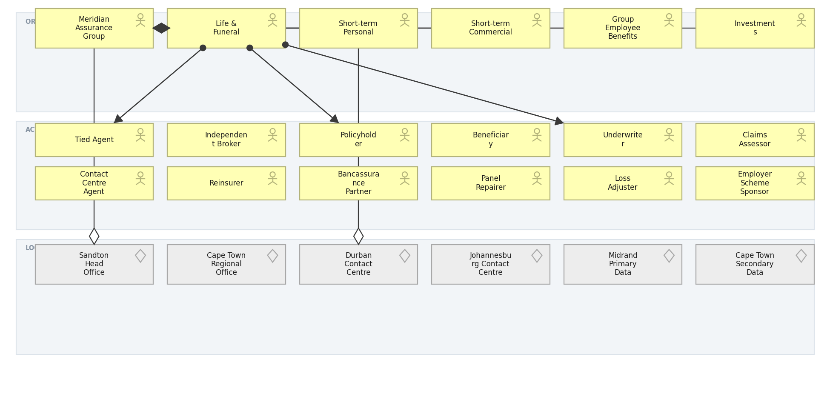
MERIDIAN ARCHITECTURE VIEW · BASIC · C.1.1
Organization view
Who the organisation is: units, the actors inside them, and where they sit.
Created using the Organization Viewpoint, C.1.1 of the ArchiMate 4 Specification. Drawn from the Meridian architecture repository.

Slide 4
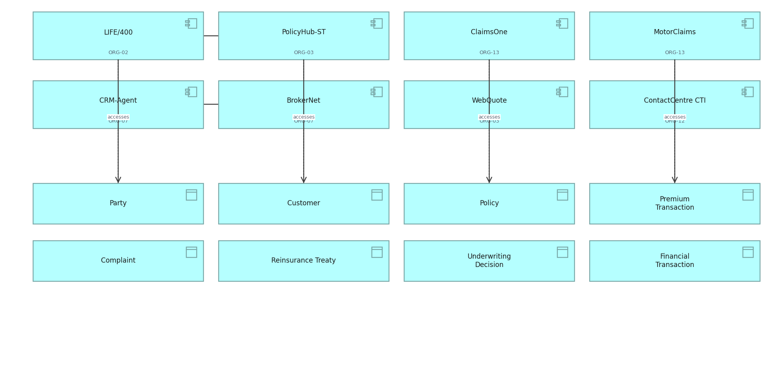
MERIDIAN ARCHITECTURE VIEW · BASIC · C.1.2
Application Structure view
The structure of the application estate and the data each component holds.
Created using the Application Structure Viewpoint, C.1.2 of the ArchiMate 4 Specification. Drawn from the Meridian architecture repository.

Slide 5
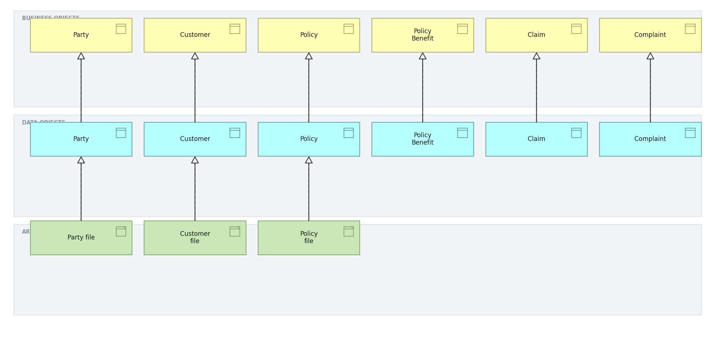
MERIDIAN ARCHITECTURE VIEW · BASIC · C.1.3
Information Structure view
Business objects, the data objects that realise them, and the artifacts beneath.
Created using the Information Structure Viewpoint, C.1.3 of the ArchiMate 4 Specification. Drawn from the Meridian architecture repository.

Slide 6
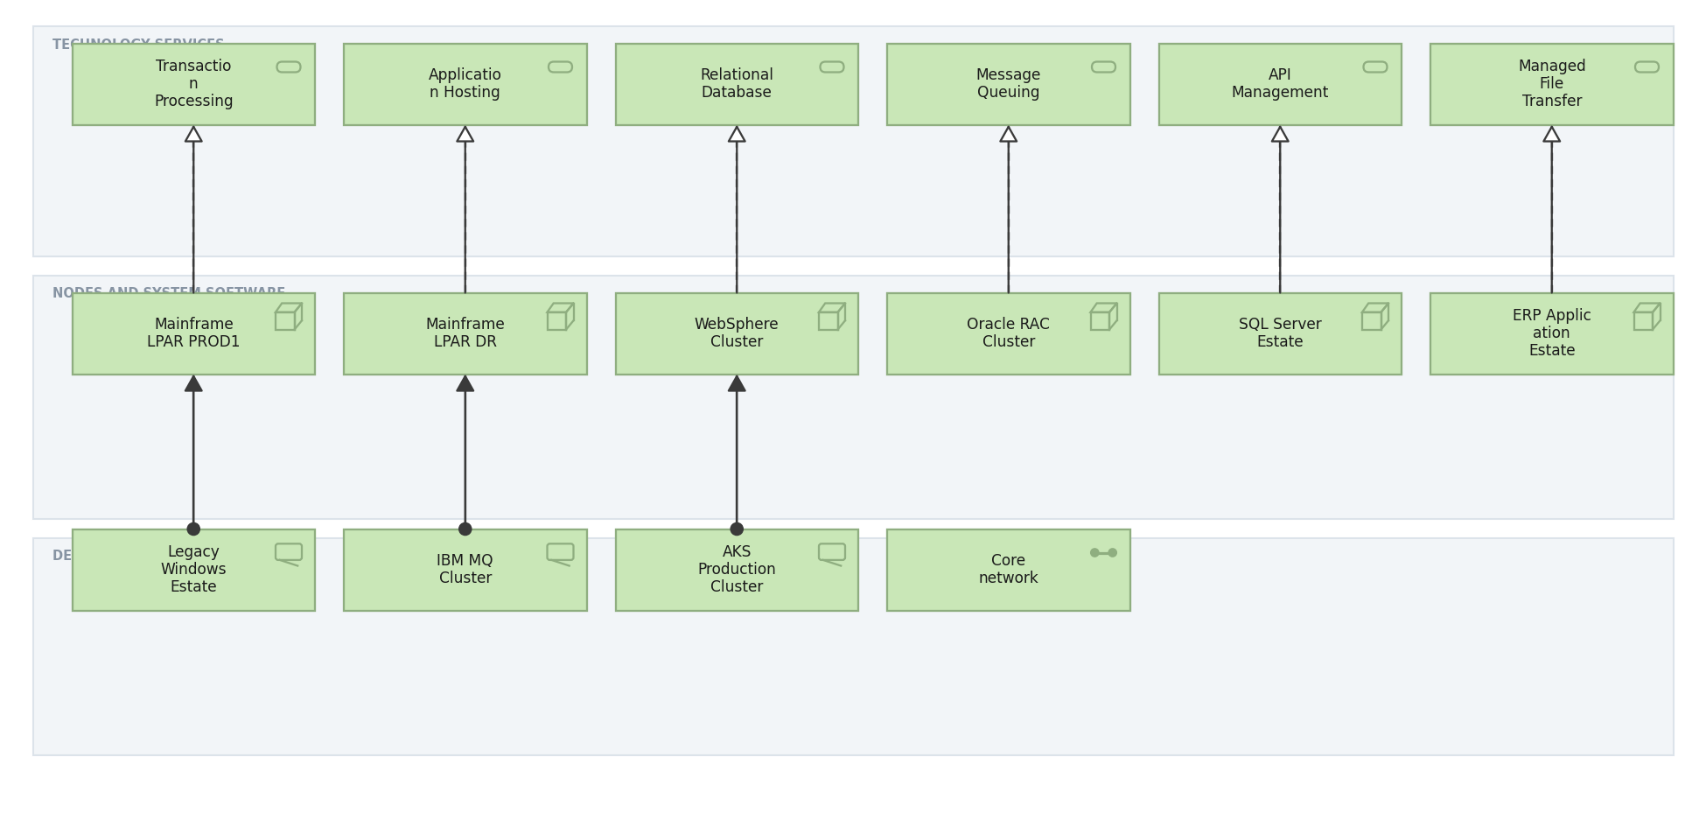
MERIDIAN ARCHITECTURE VIEW · BASIC · C.1.4
Technology view
Technology services and the nodes, devices and networks that realise them.
Created using the Technology Viewpoint, C.1.4 of the ArchiMate 4 Specification. Drawn from the Meridian architecture repository.

Slide 7
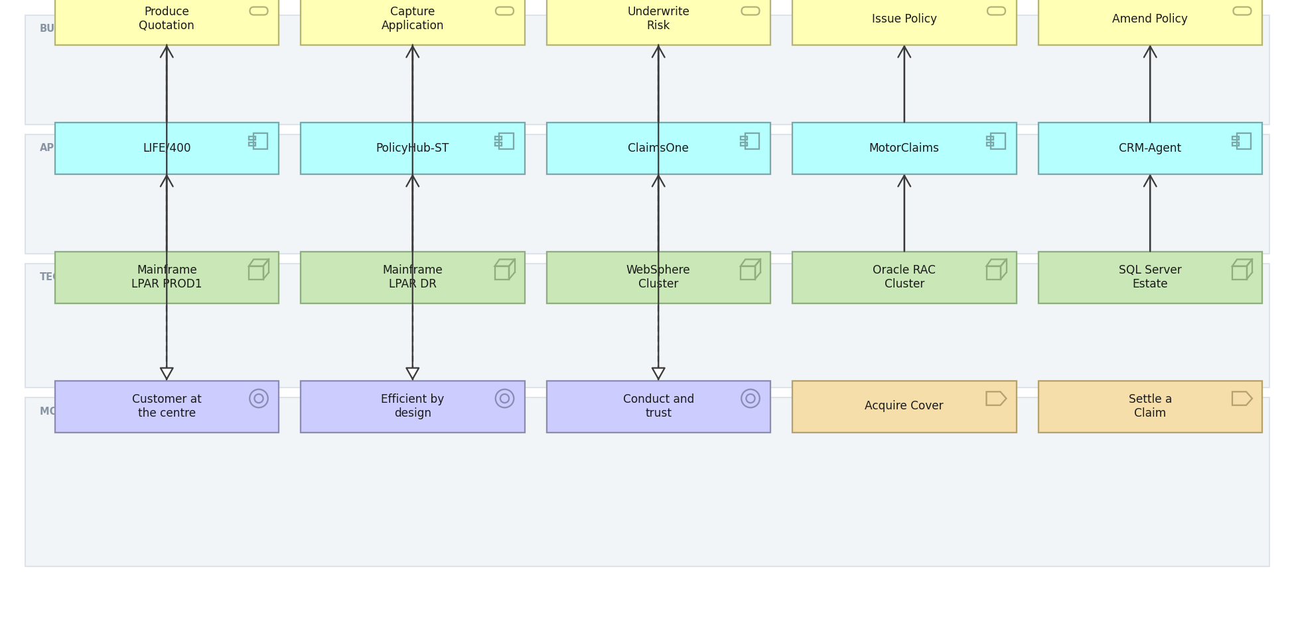
MERIDIAN ARCHITECTURE VIEW · BASIC · C.1.5
Layered view
One picture across business, application and technology, against motivation and strategy.
Created using the Layered Viewpoint, C.1.5 of the ArchiMate 4 Specification. Drawn from the Meridian architecture repository.

Slide 8
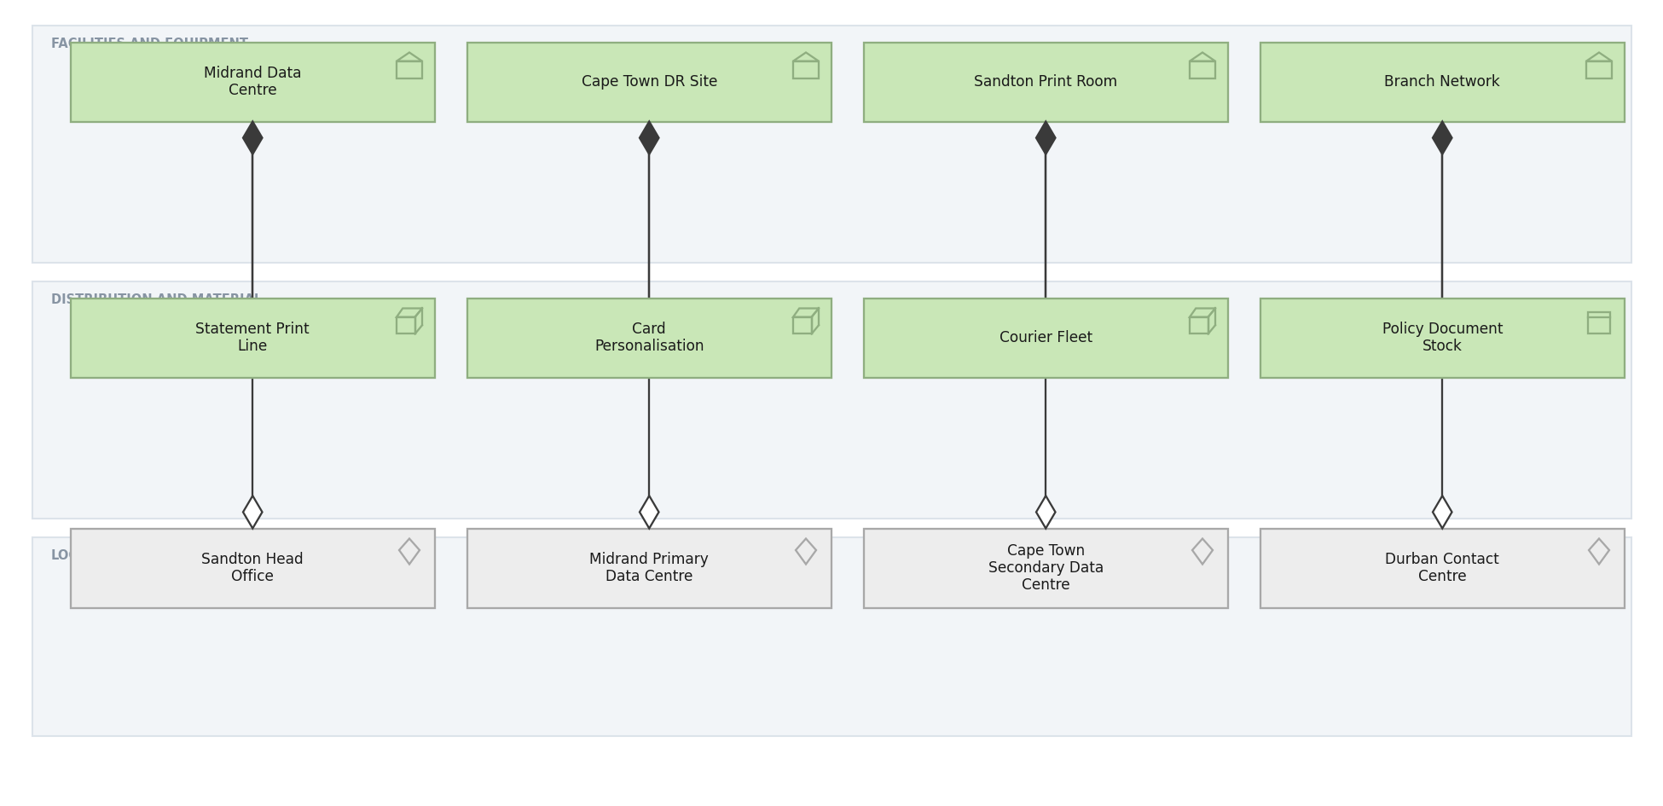
MERIDIAN ARCHITECTURE VIEW · BASIC · C.1.6
Physical view
Facilities, equipment and material, and the locations they occupy.
Created using the Physical Viewpoint, C.1.6 of the ArchiMate 4 Specification. Drawn from the Meridian architecture repository.

Slide 9
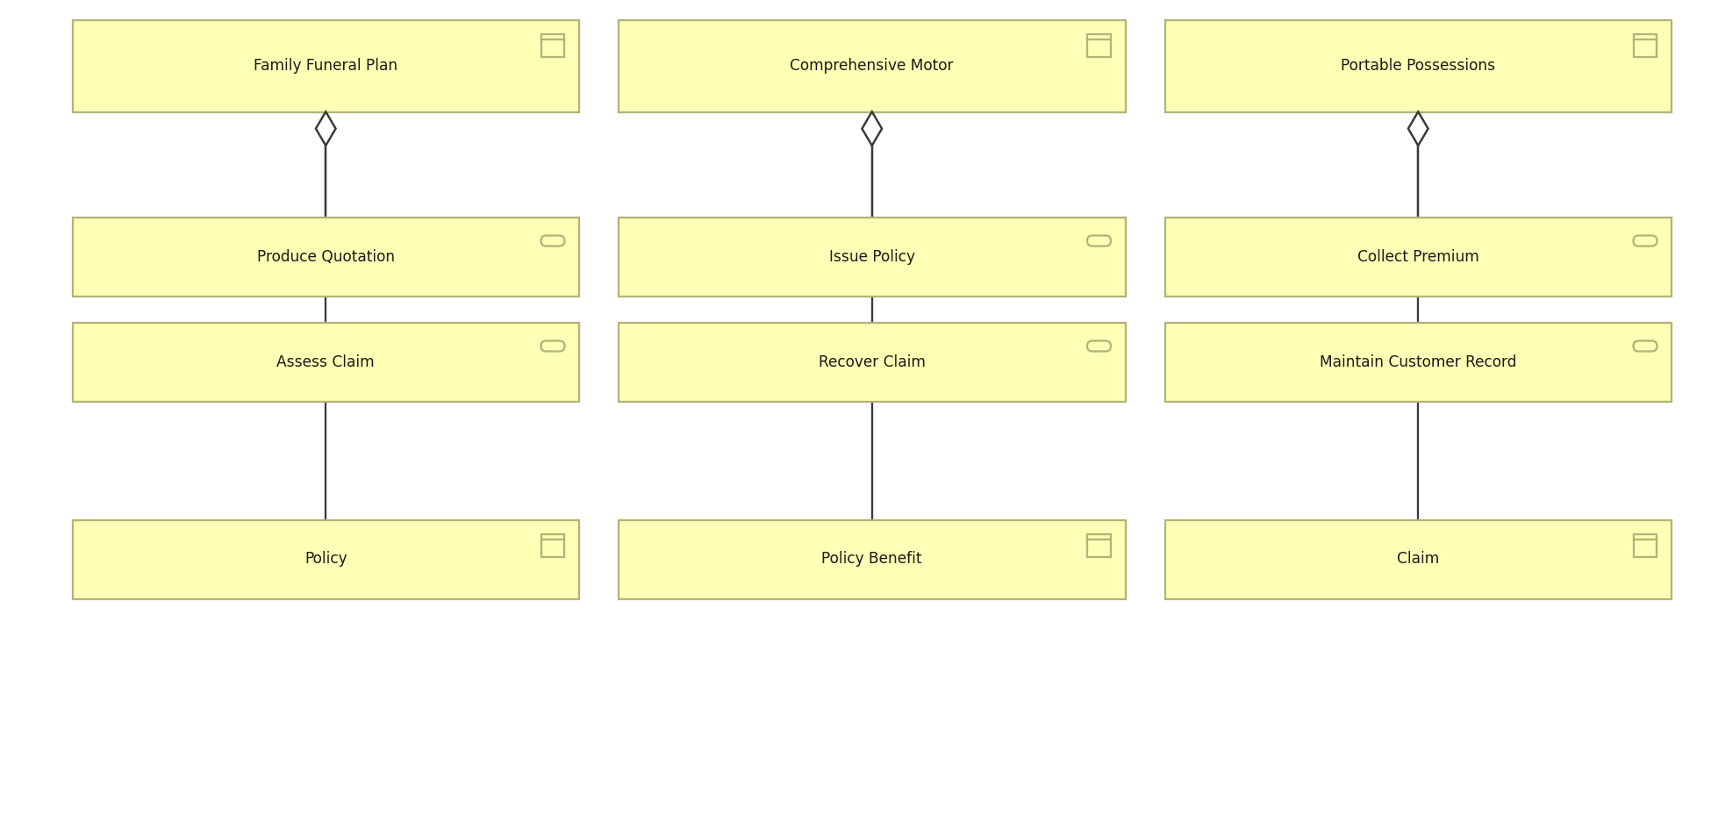
MERIDIAN ARCHITECTURE VIEW · BASIC · C.1.7
Product view
What Meridian sells, the services each product aggregates and the objects behind it.
Created using the Product Viewpoint, C.1.7 of the ArchiMate 4 Specification. Drawn from the Meridian architecture repository.

Slide 10
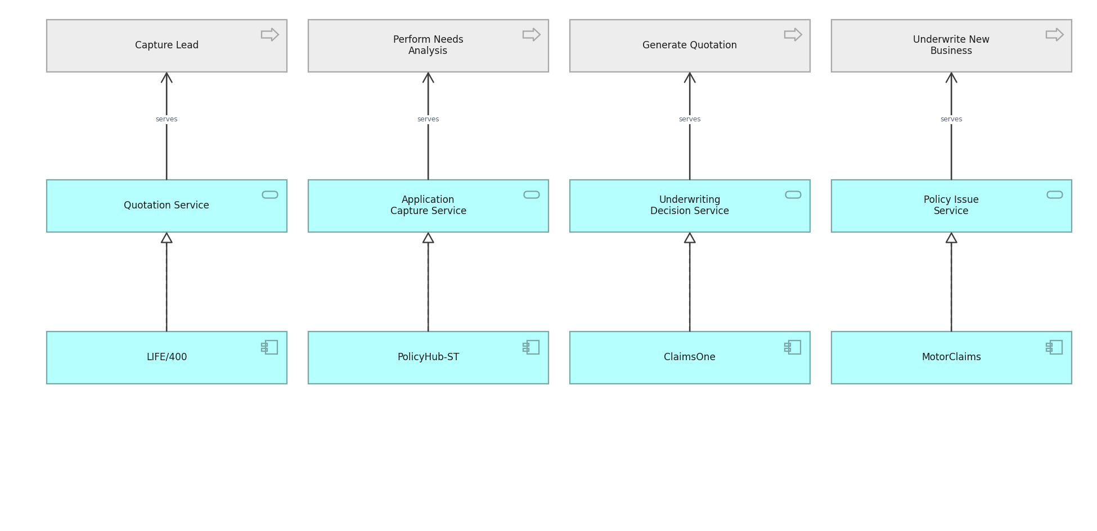
MERIDIAN ARCHITECTURE VIEW · BASIC · C.1.8
Application Usage view
How business processes consume application services.
Created using the Application Usage Viewpoint, C.1.8 of the ArchiMate 4 Specification. Drawn from the Meridian architecture repository.

Slide 11
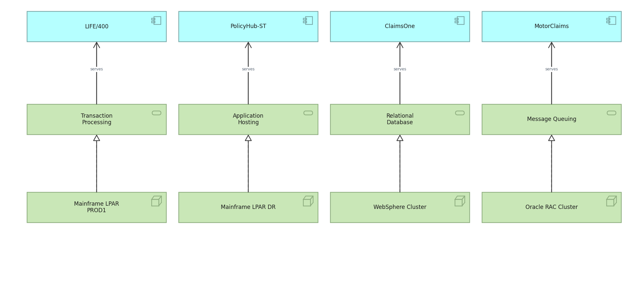
MERIDIAN ARCHITECTURE VIEW · BASIC · C.1.9
Technology Usage view
How applications consume technology services.
Created using the Technology Usage Viewpoint, C.1.9 of the ArchiMate 4 Specification. Drawn from the Meridian architecture repository.

Slide 12
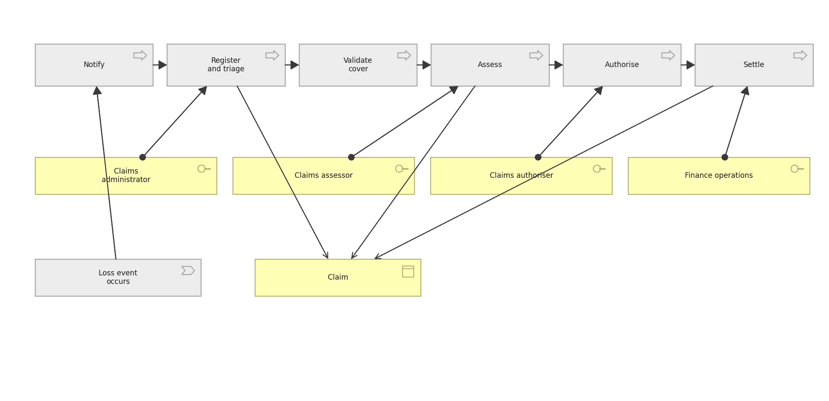
MERIDIAN ARCHITECTURE VIEW · BASIC · C.1.10
Process Cooperation view
The claim process end to end, who performs each step and what it touches.
Created using the Process Cooperation Viewpoint, C.1.10 of the ArchiMate 4 Specification. Drawn from the Meridian architecture repository.

Slide 13
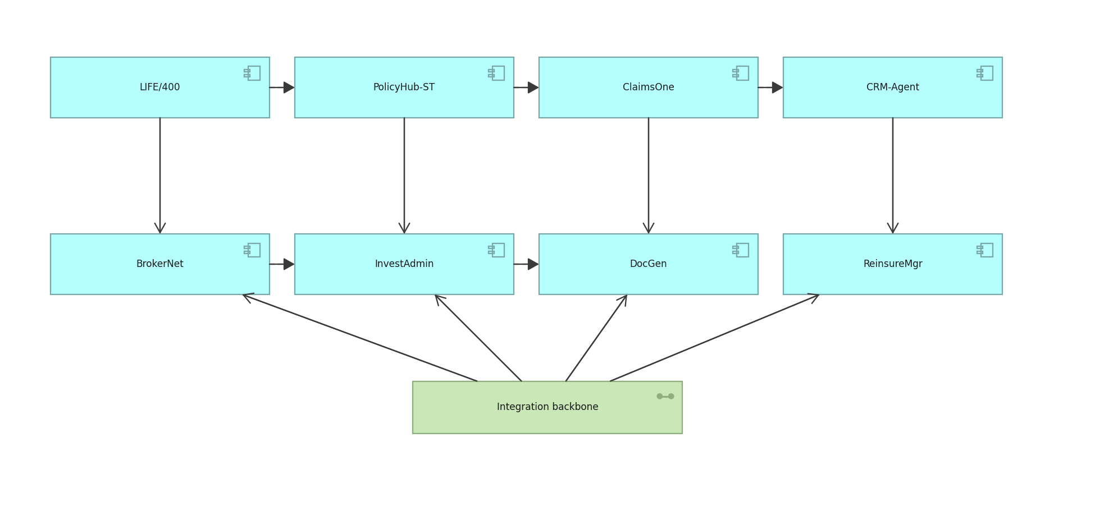
MERIDIAN ARCHITECTURE VIEW · BASIC · C.1.11
Application Cooperation view
How applications exchange with one another across the estate.
Created using the Application Cooperation Viewpoint, C.1.11 of the ArchiMate 4 Specification. Drawn from the Meridian architecture repository.

Slide 14
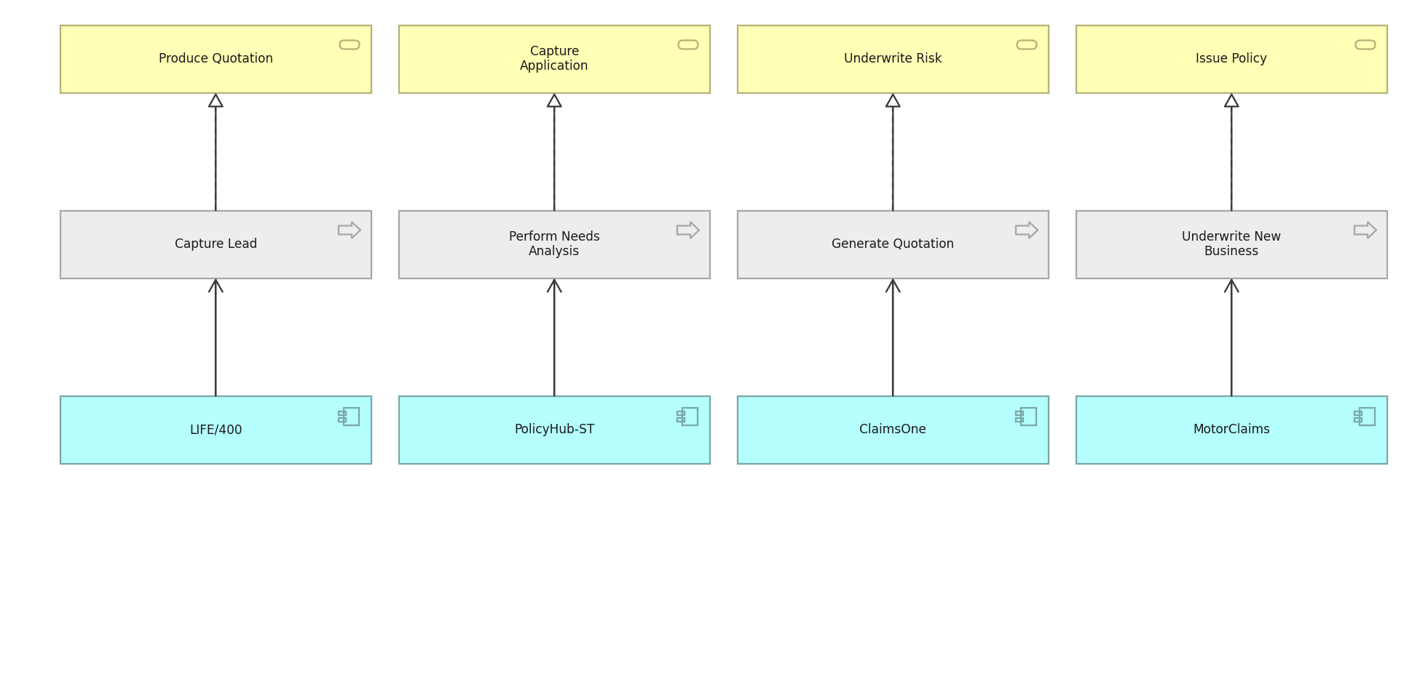
MERIDIAN ARCHITECTURE VIEW · BASIC · C.1.12
Service Realization view
How business services are realised by processes and supported by applications.
Created using the Service Realization Viewpoint, C.1.12 of the ArchiMate 4 Specification. Drawn from the Meridian architecture repository.

Slide 15
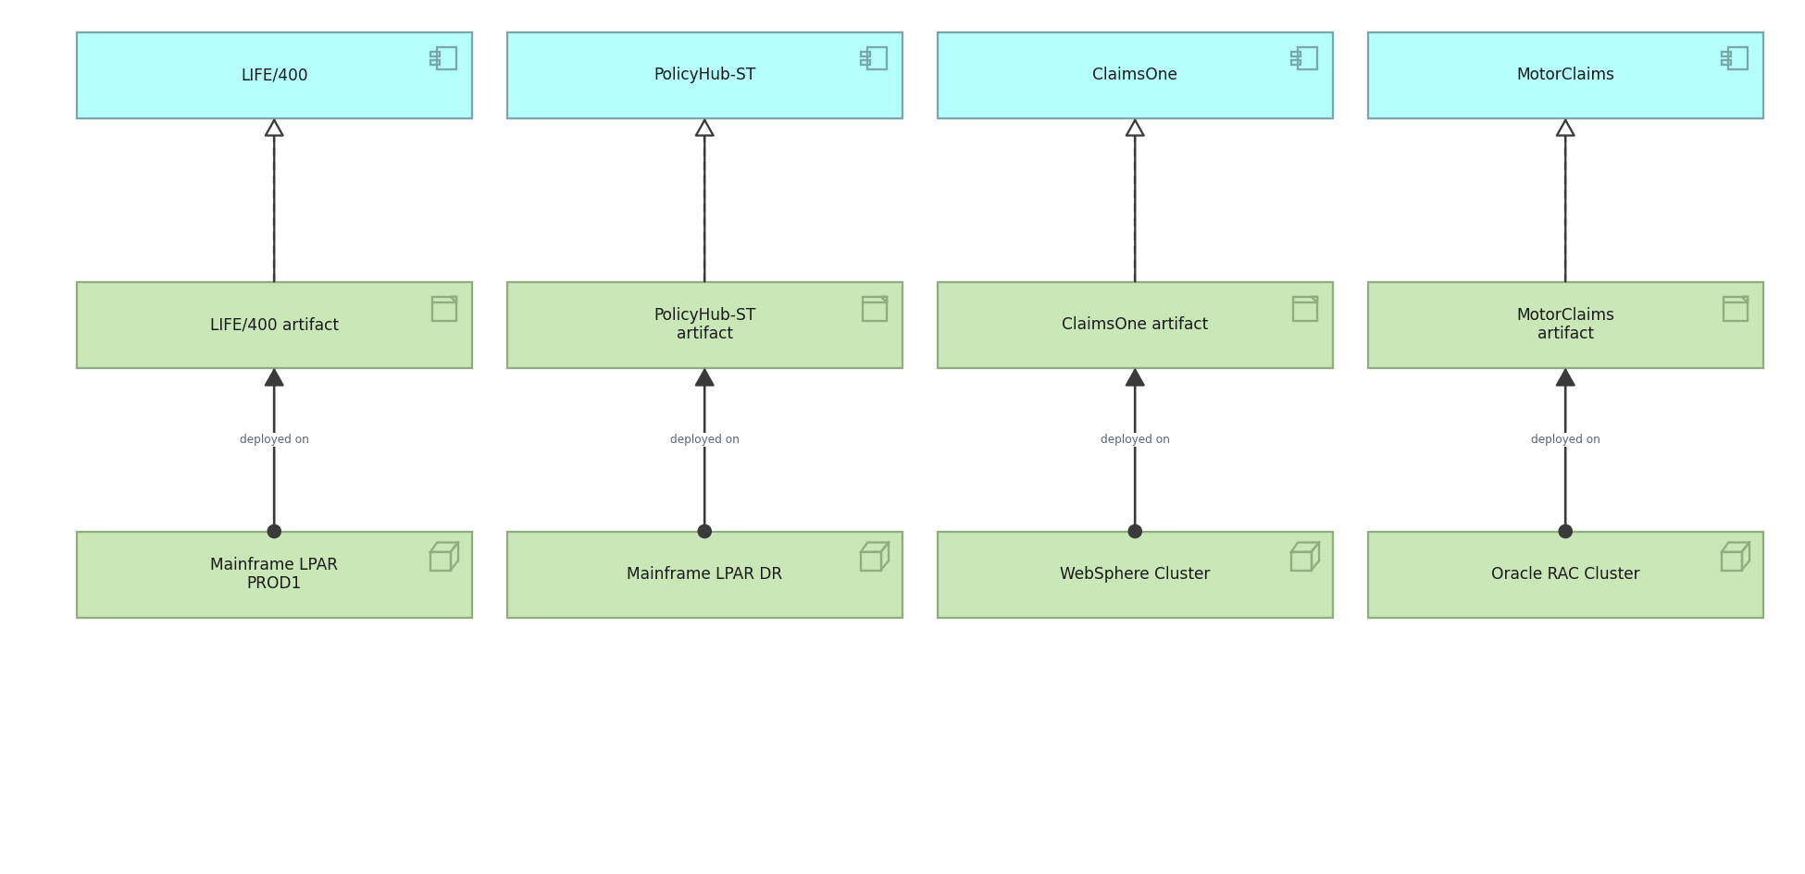
MERIDIAN ARCHITECTURE VIEW · BASIC · C.1.13
Implementation and Deployment view
Which artifacts realise which applications, and where they are deployed.
Created using the Implementation and Deployment Viewpoint, C.1.13 of the ArchiMate 4 Specification. Drawn from the Meridian architecture repository.

Slide 16
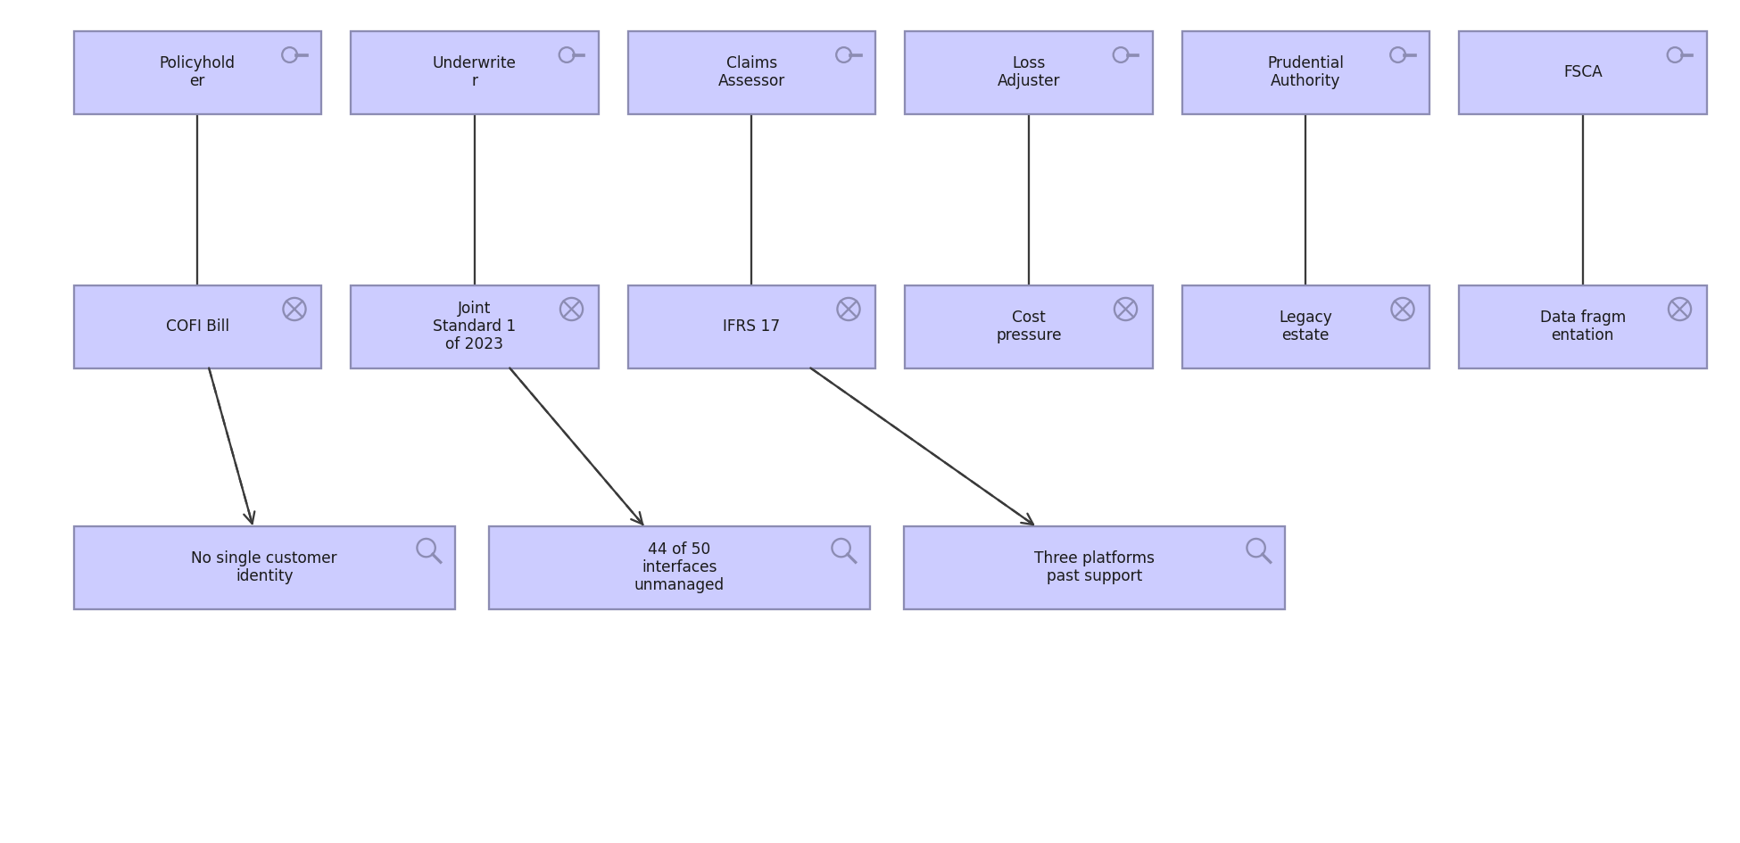
MERIDIAN ARCHITECTURE VIEW · MOTIVATION · C.2.1
Stakeholder view
Stakeholders, the drivers they care about, and the assessments against them.
Created using the Stakeholder Viewpoint, C.2.1 of the ArchiMate 4 Specification. Drawn from the Meridian architecture repository.

Slide 17
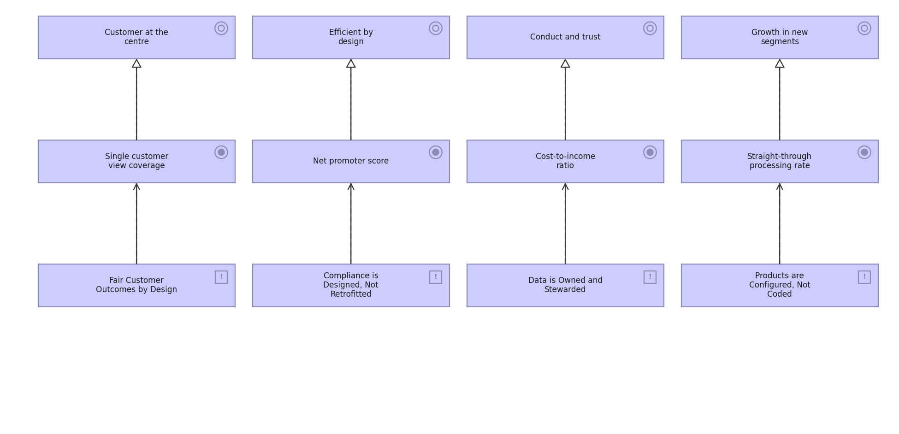
MERIDIAN ARCHITECTURE VIEW · MOTIVATION · C.2.2
Goal Realization view
How goals are refined into outcomes, and the principles that shape them.
Created using the Goal Realization Viewpoint, C.2.2 of the ArchiMate 4 Specification. Drawn from the Meridian architecture repository.

Slide 18
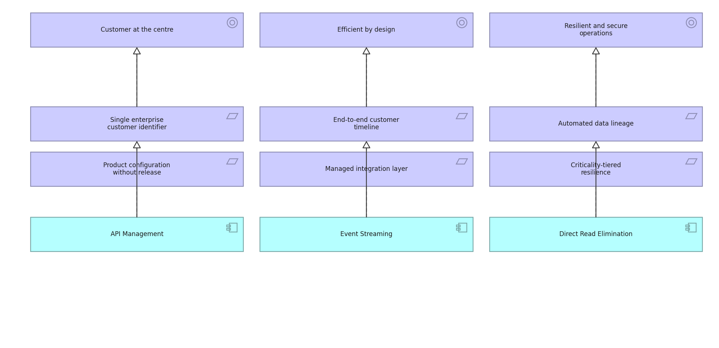
MERIDIAN ARCHITECTURE VIEW · MOTIVATION · C.2.3
Requirements Realization view
How requirements realise goals and what realises the requirements.
Created using the Requirements Realization Viewpoint, C.2.3 of the ArchiMate 4 Specification. Drawn from the Meridian architecture repository.

Slide 19
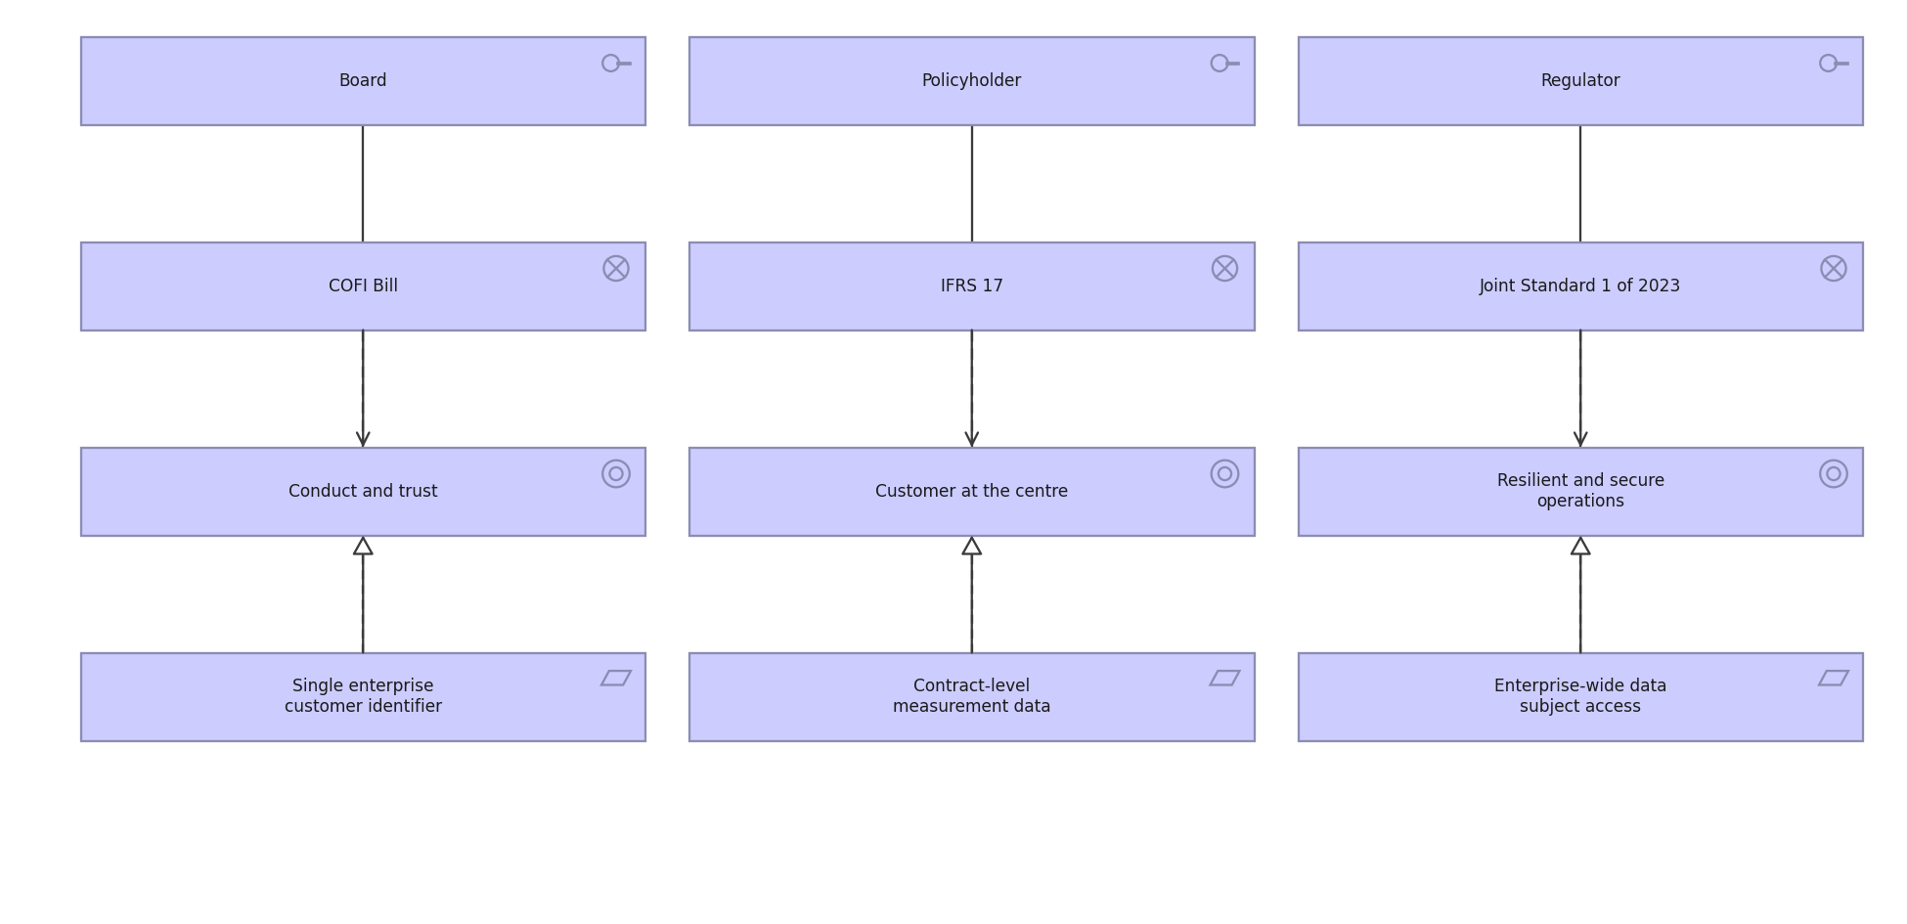
MERIDIAN ARCHITECTURE VIEW · MOTIVATION · C.2.4
Motivation view
The full motivation chain: stakeholder to driver to goal to requirement.
Created using the Motivation Viewpoint, C.2.4 of the ArchiMate 4 Specification. Drawn from the Meridian architecture repository.

Slide 20
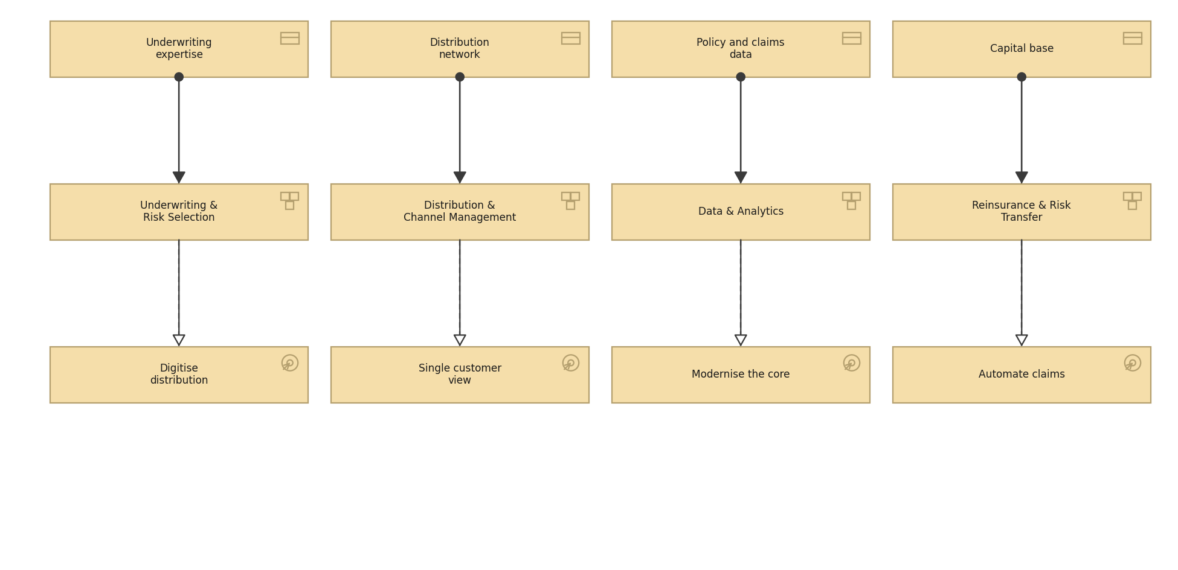
MERIDIAN ARCHITECTURE VIEW · STRATEGY · C.3.1
Strategy view
Resources, the capabilities they enable and the courses of action chosen.
Created using the Strategy Viewpoint, C.3.1 of the ArchiMate 4 Specification. Drawn from the Meridian architecture repository.

Slide 21
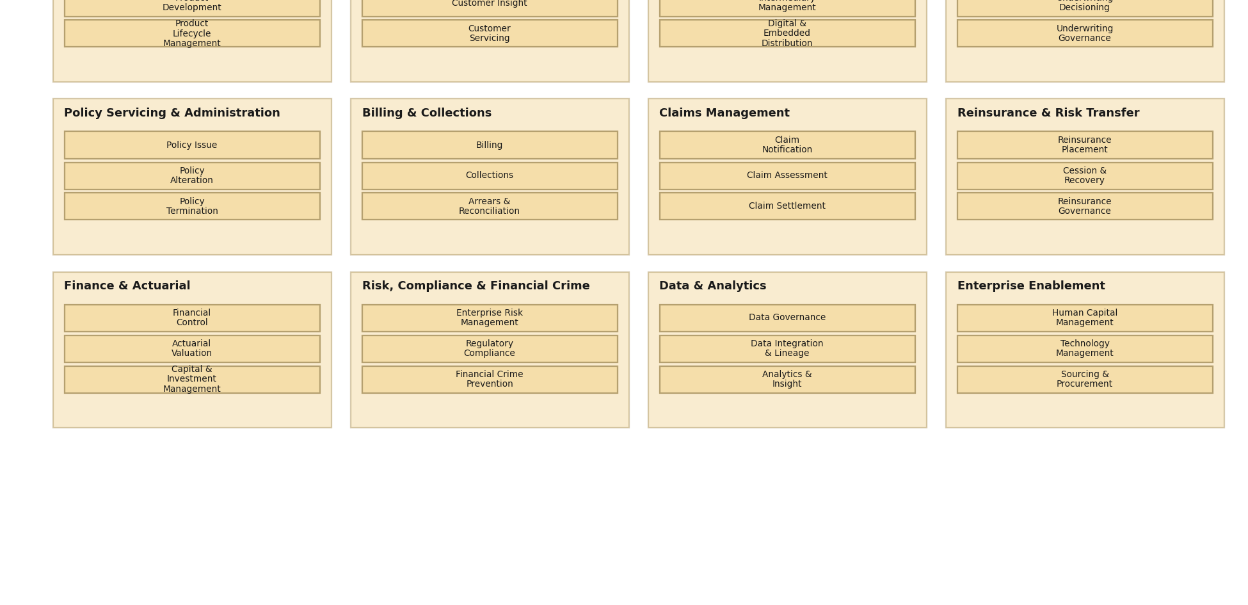
MERIDIAN ARCHITECTURE VIEW · STRATEGY · C.3.2
Capability Map view
Twelve level 1 capabilities decomposed to level 2.
Created using the Capability Map Viewpoint, C.3.2 of the ArchiMate 4 Specification. Drawn from the Meridian architecture repository.

Slide 22
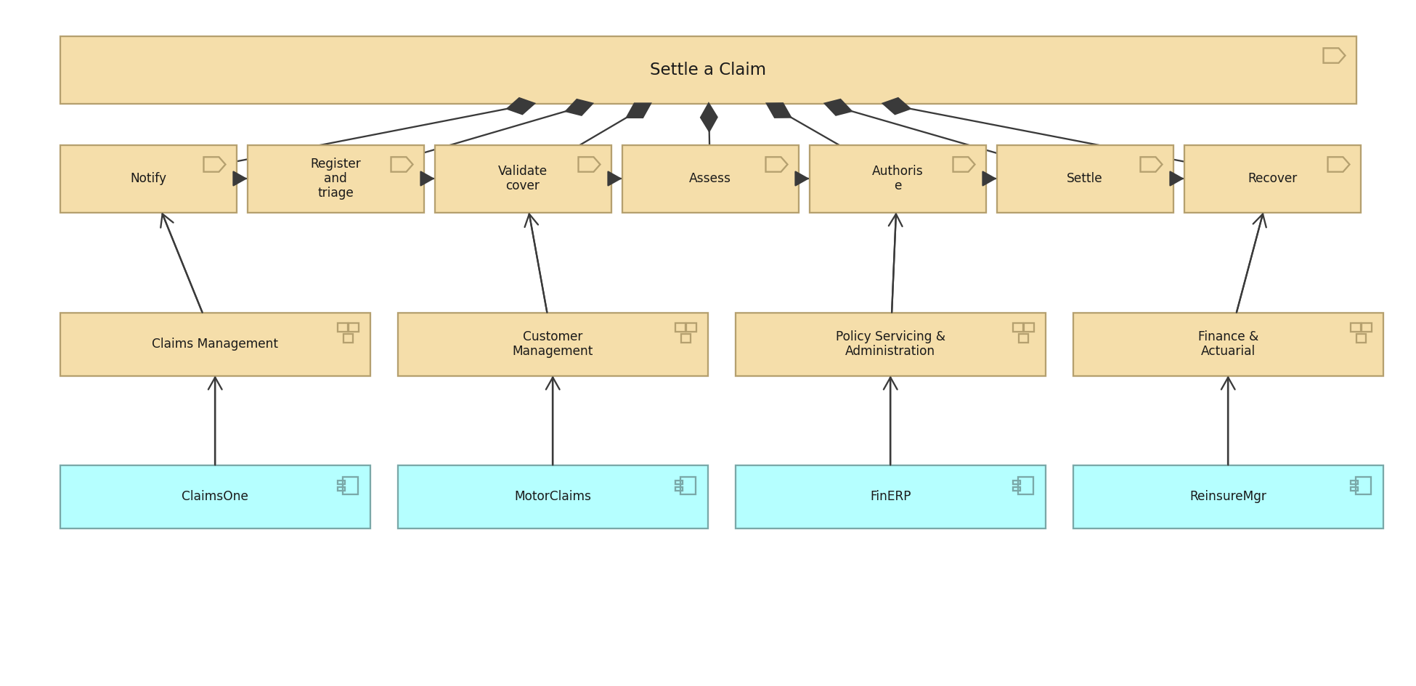
MERIDIAN ARCHITECTURE VIEW · STRATEGY · C.3.3
Value Stream view
Settle a Claim, its stages, and the capabilities and applications behind them.
Created using the Value Stream Viewpoint, C.3.3 of the ArchiMate 4 Specification. Drawn from the Meridian architecture repository.

Slide 23
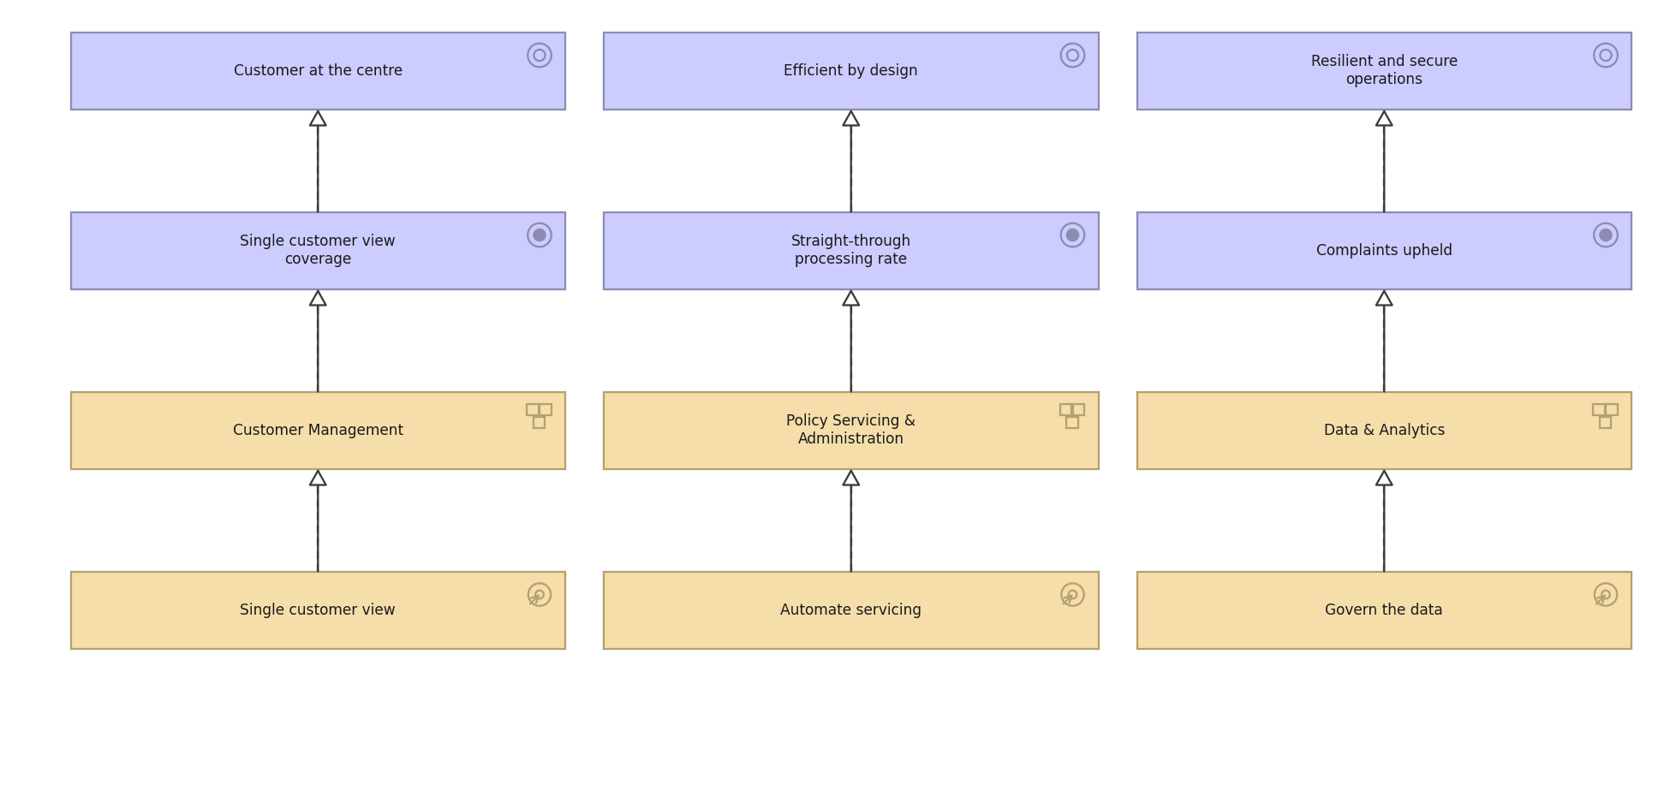
MERIDIAN ARCHITECTURE VIEW · STRATEGY · C.3.4
Outcome Realization view
How courses of action and capabilities deliver outcomes and goals.
Created using the Outcome Realization Viewpoint, C.3.4 of the ArchiMate 4 Specification. Drawn from the Meridian architecture repository.

Slide 24
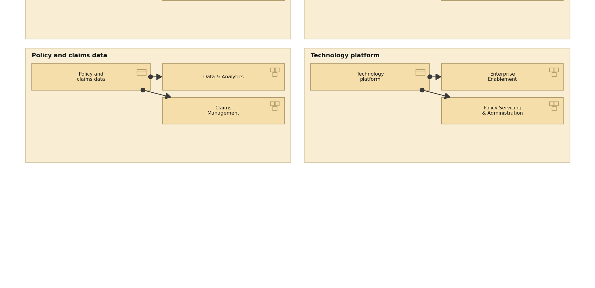
MERIDIAN ARCHITECTURE VIEW · STRATEGY · C.3.5
Resource Map view
The resources Meridian holds and the capabilities they are assigned to.
Created using the Resource Map Viewpoint, C.3.5 of the ArchiMate 4 Specification. Drawn from the Meridian architecture repository.

Slide 25
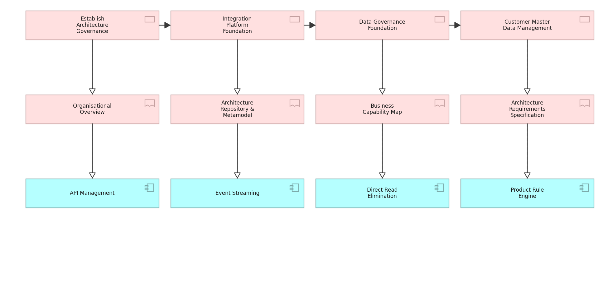
MERIDIAN ARCHITECTURE VIEW · IMPLEMENTATION · C.4.1
Project view
Work packages, their deliverables and the building blocks they realise.
Created using the Project Viewpoint, C.4.1 of the ArchiMate 4 Specification. Drawn from the Meridian architecture repository.

Slide 26
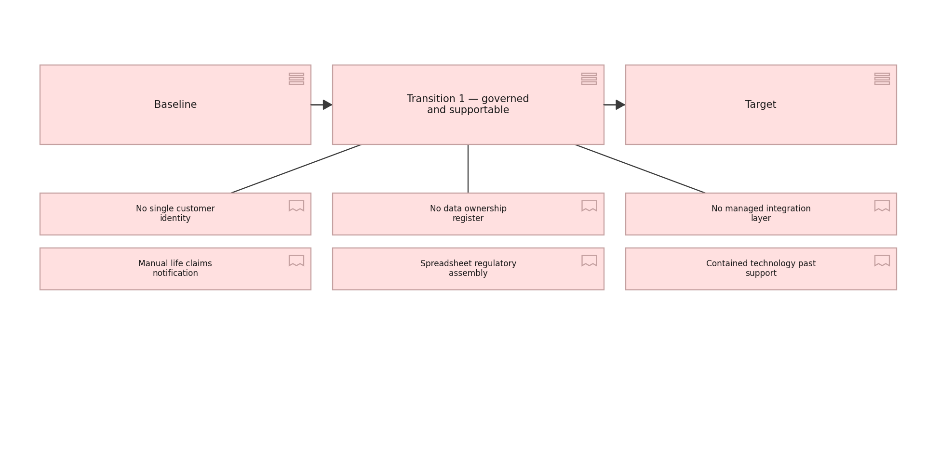
MERIDIAN ARCHITECTURE VIEW · IMPLEMENTATION · C.4.2
Migration view
Plateaus from baseline through transition to target, and the gaps between.
Created using the Migration Viewpoint, C.4.2 of the ArchiMate 4 Specification. Drawn from the Meridian architecture repository.

Slide 27
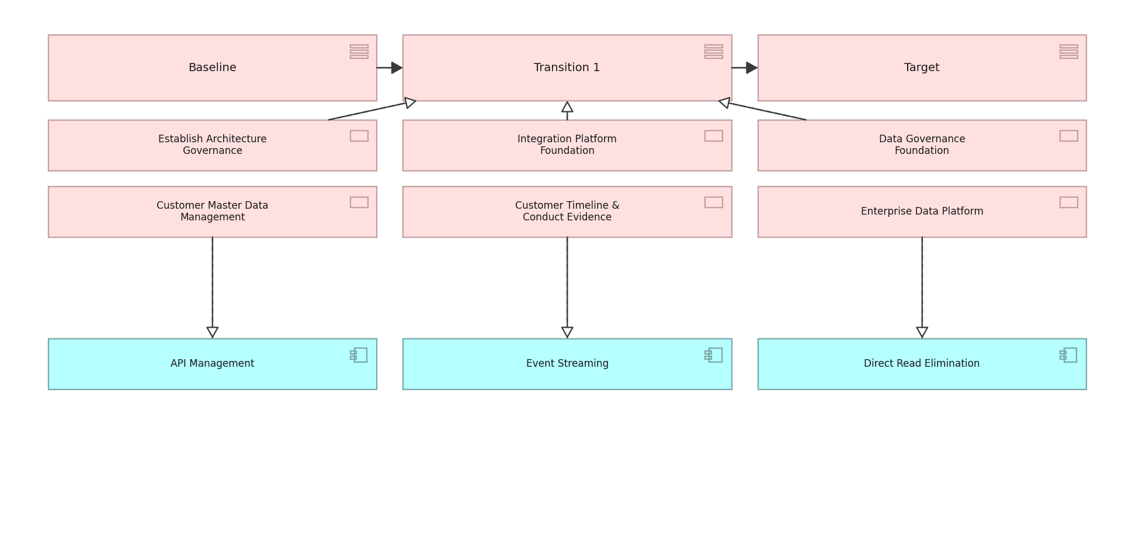
MERIDIAN ARCHITECTURE VIEW · IMPLEMENTATION · C.4.3
Implementation and Migration view
Work packages against plateaus and the building blocks they deliver.
Created using the Implementation and Migration Viewpoint, C.4.3 of the ArchiMate 4 Specification. Drawn from the Meridian architecture repository.

