Slide 1
CALDERON THERAPEUTICS · ARCHITECTURE VIEWS
Twenty-five views of
the architecture
Research, development and manufacture of medicines — compounds, trials, batches and the GxP regime around them.
One view for each of the twenty-five viewpoints in the ArchiMate 4 Specification. A viewpoint is where you look from; a view is what you see.
13
4
5
3
from basic viewpoints
from motivation
from strategy
from implementation
Calderon Therapeutics is an illustrative organisation. ArchiMate® is a registered trademark of The Open Group.

Slide 2
CONTENTS
Twenty-five views, one per viewpoint
C.1.1
Organization view
C.2.1
Stakeholder view
C.1.2
Application Structure view
C.2.2
Goal Realization view
C.1.3
Information Structure view
C.2.3
Requirements Realization view
C.1.4
Technology view
C.2.4
Motivation view
C.1.5
Layered view
C.3.1
Strategy view
C.1.6
Physical view
C.3.2
Capability Map view
C.1.7
Product view
C.3.3
Value Stream view
C.1.8
Application Usage view
C.3.4
Outcome Realization view
C.1.9
Technology Usage view
C.3.5
Resource Map view
C.1.10
Process Cooperation view
C.4.1
Project view
C.1.11
Application Cooperation view
C.4.2
Migration view
C.1.12
Service Realization view
C.4.3
Implementation and Migration view
C.1.13
Implementation and Deployment view
Each row is a view of Calderon Therapeutics. The reference is the viewpoint it was created from, per Appendix C of the ArchiMate 4 Specification.

Slide 3
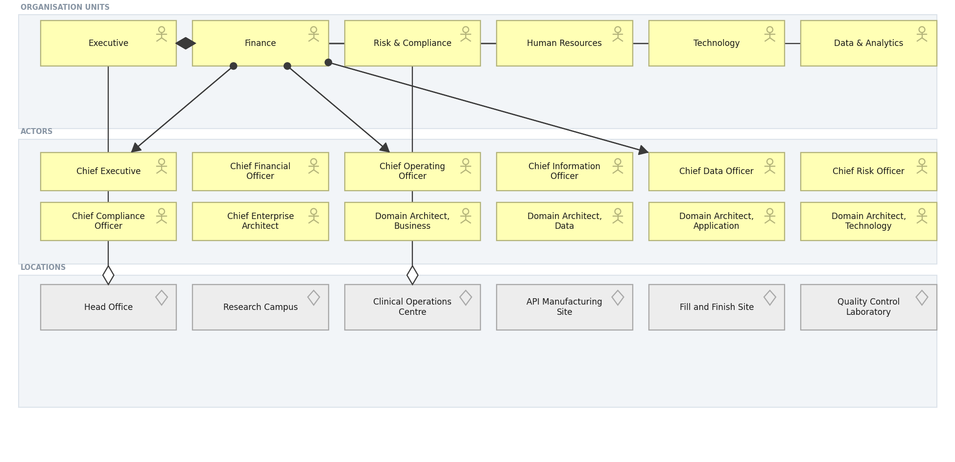
CALDERON THERAPEUTICS · BASIC · C.1.1
Organization view
Who the organisation is: units, the actors inside them, and where they sit.
Created using the Organization Viewpoint, C.1.1 of the ArchiMate 4 Specification. Drawn from the Pharmaceuticals metamodel.

Slide 4
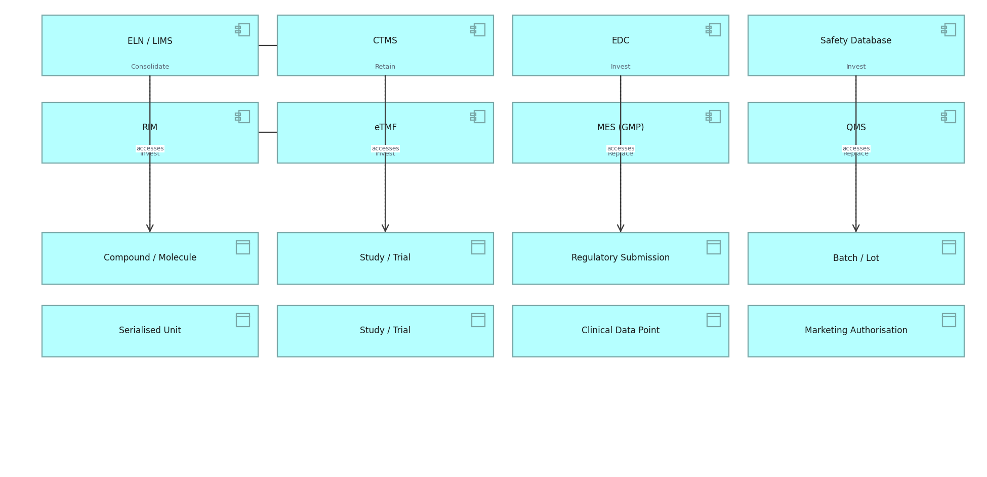
CALDERON THERAPEUTICS · BASIC · C.1.2
Application Structure view
The structure of the application estate and the data each component holds.
Created using the Application Structure Viewpoint, C.1.2 of the ArchiMate 4 Specification. Drawn from the Pharmaceuticals metamodel.

Slide 5
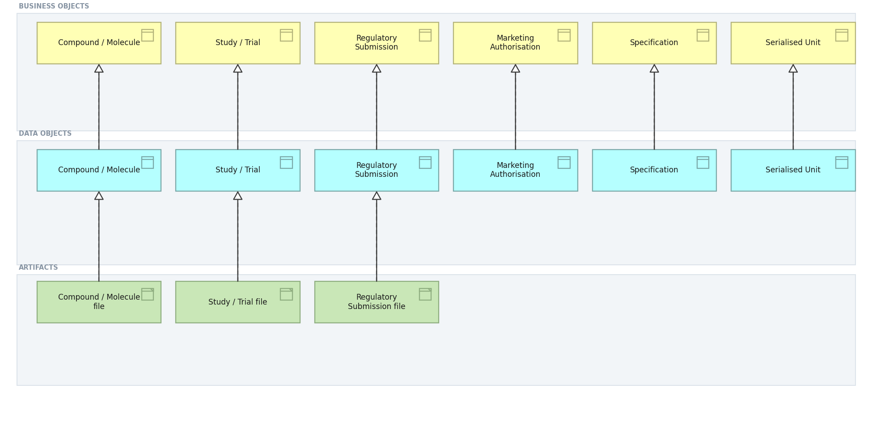
CALDERON THERAPEUTICS · BASIC · C.1.3
Information Structure view
Business objects, the data objects that realise them, and the artifacts beneath.
Created using the Information Structure Viewpoint, C.1.3 of the ArchiMate 4 Specification. Drawn from the Pharmaceuticals metamodel.

Slide 6
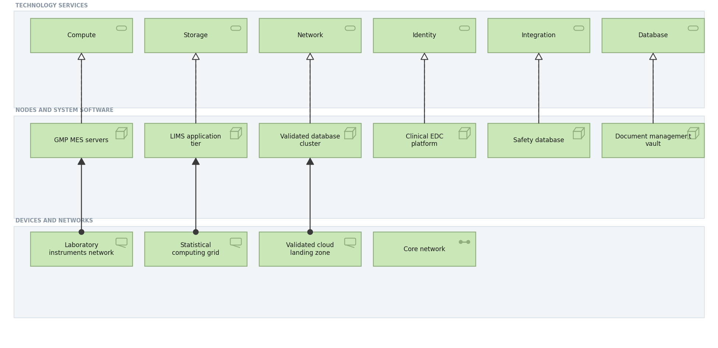
CALDERON THERAPEUTICS · BASIC · C.1.4
Technology view
Technology services and the nodes, devices and networks that realise them.
Created using the Technology Viewpoint, C.1.4 of the ArchiMate 4 Specification. Drawn from the Pharmaceuticals metamodel.

Slide 7
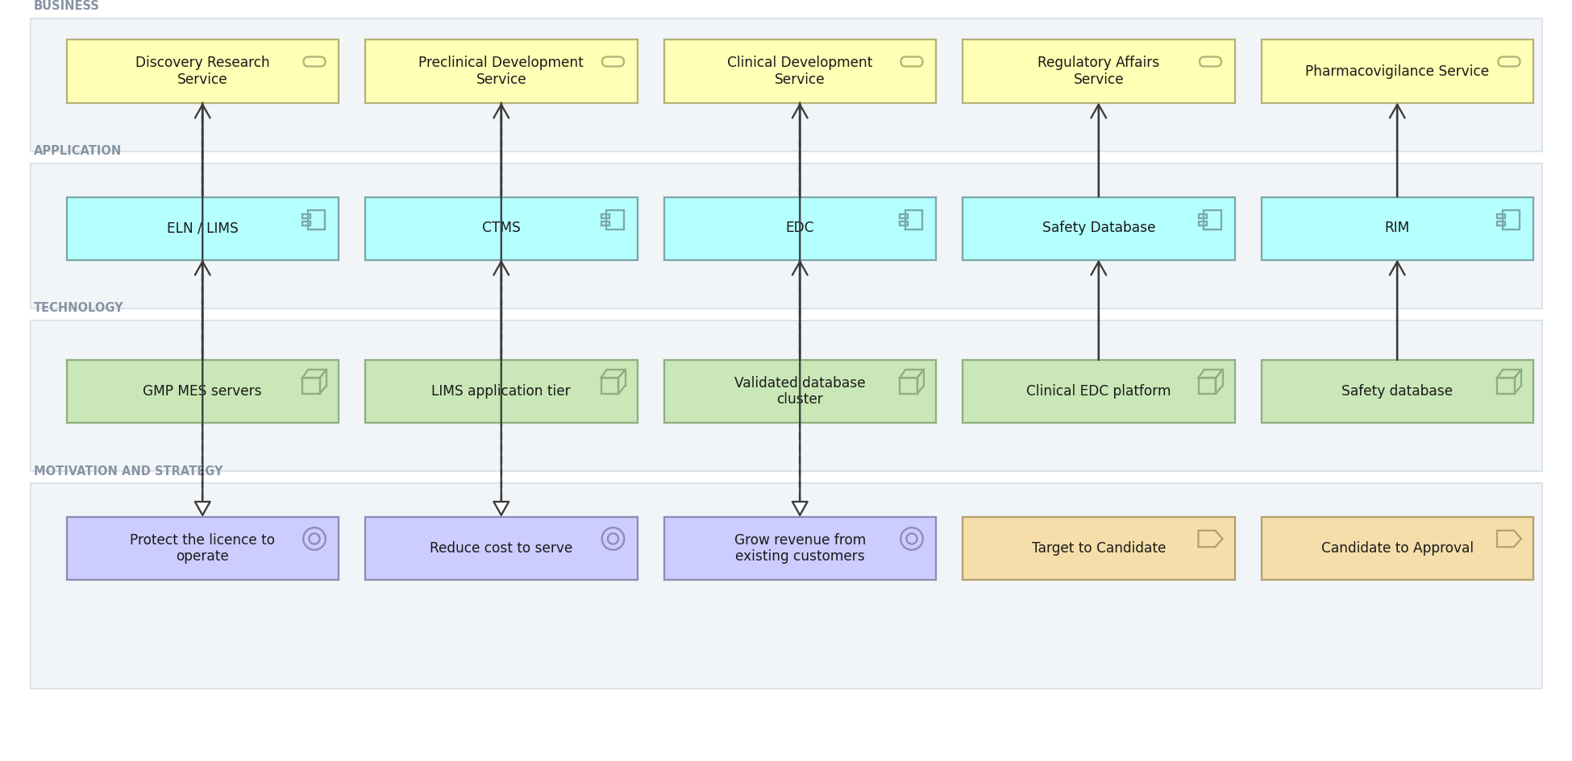
CALDERON THERAPEUTICS · BASIC · C.1.5
Layered view
One picture across business, application and technology, against motivation and strategy.
Created using the Layered Viewpoint, C.1.5 of the ArchiMate 4 Specification. Drawn from the Pharmaceuticals metamodel.

Slide 8
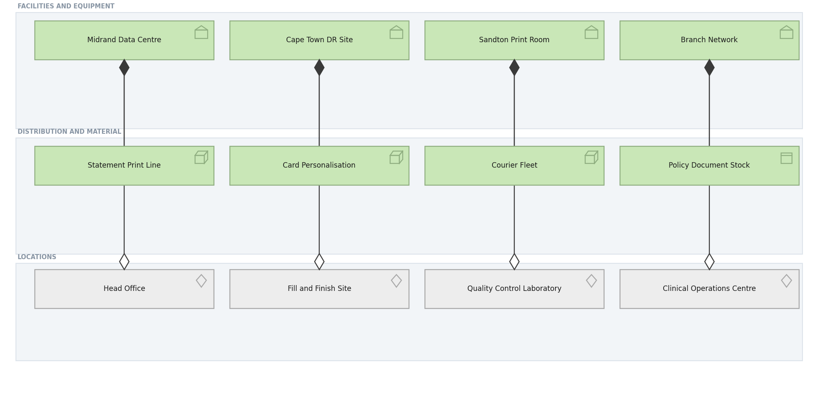
CALDERON THERAPEUTICS · BASIC · C.1.6
Physical view
Facilities, equipment and material, and the locations they occupy.
Created using the Physical Viewpoint, C.1.6 of the ArchiMate 4 Specification. Drawn from the Pharmaceuticals metamodel.

Slide 9
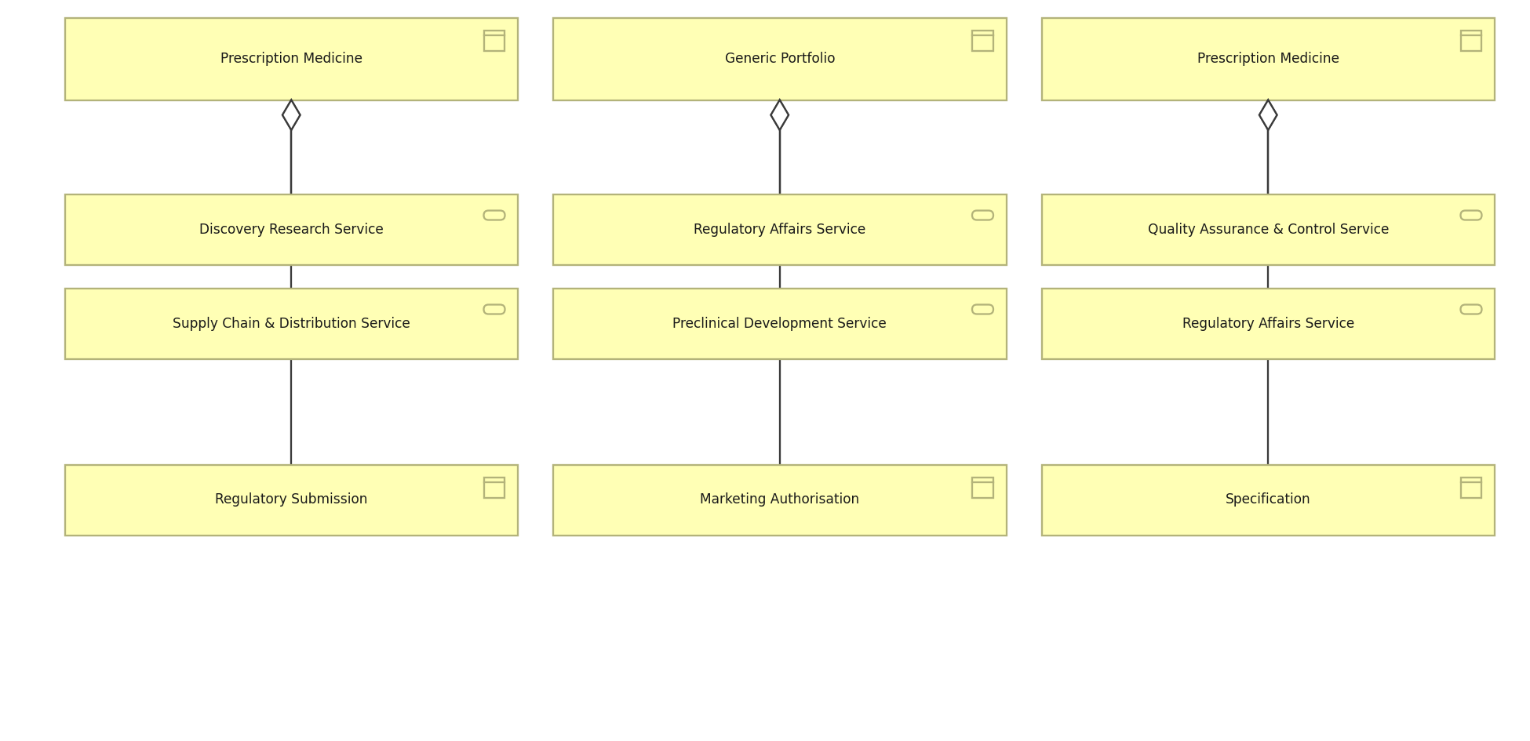
CALDERON THERAPEUTICS · BASIC · C.1.7
Product view
What Meridian sells, the services each product aggregates and the objects behind it.
Created using the Product Viewpoint, C.1.7 of the ArchiMate 4 Specification. Drawn from the Pharmaceuticals metamodel.

Slide 10
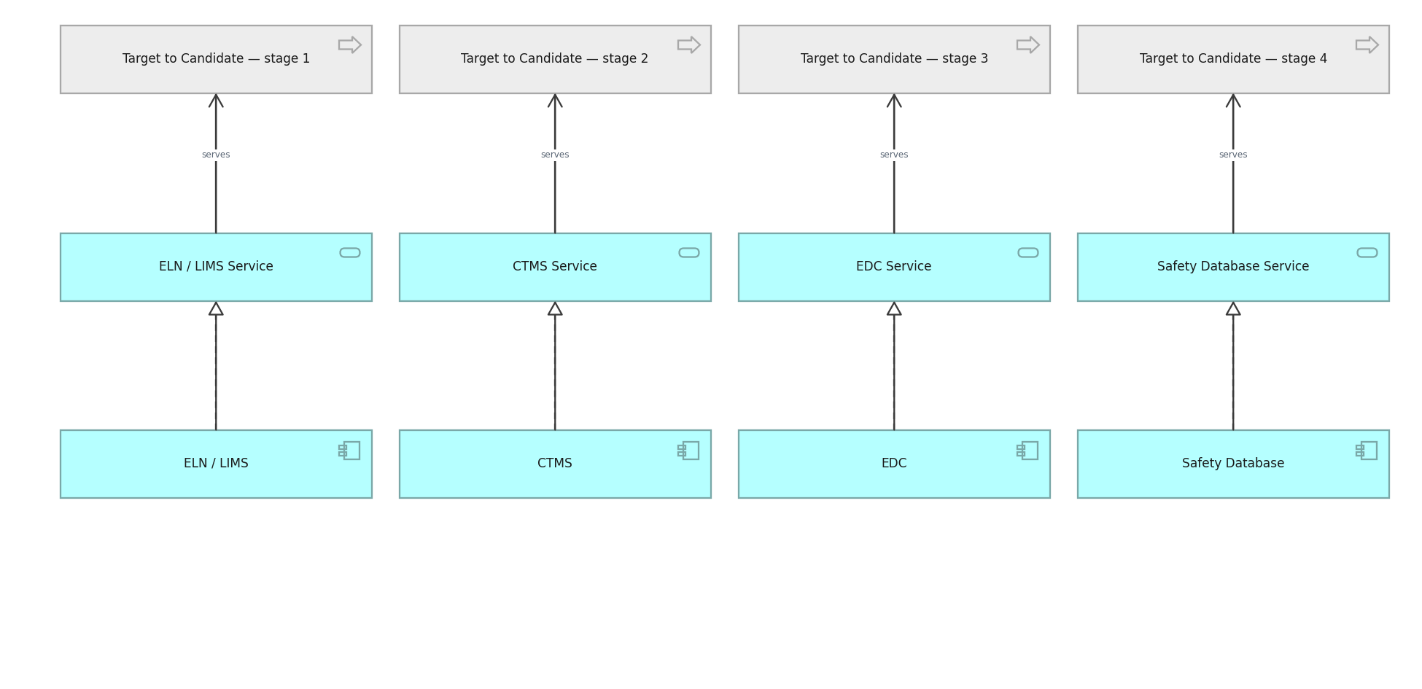
CALDERON THERAPEUTICS · BASIC · C.1.8
Application Usage view
How business processes consume application services.
Created using the Application Usage Viewpoint, C.1.8 of the ArchiMate 4 Specification. Drawn from the Pharmaceuticals metamodel.

Slide 11
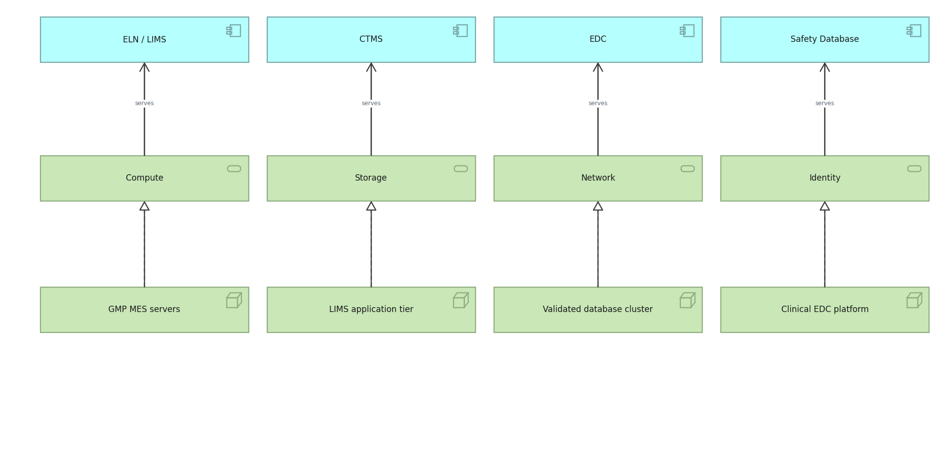
CALDERON THERAPEUTICS · BASIC · C.1.9
Technology Usage view
How applications consume technology services.
Created using the Technology Usage Viewpoint, C.1.9 of the ArchiMate 4 Specification. Drawn from the Pharmaceuticals metamodel.

Slide 12
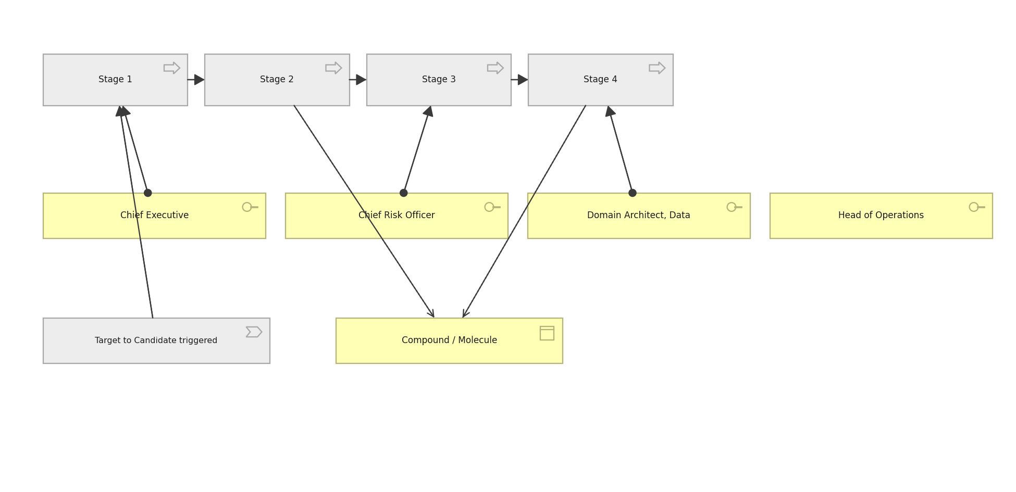
CALDERON THERAPEUTICS · BASIC · C.1.10
Process Cooperation view
The claim process end to end, who performs each step and what it touches.
Created using the Process Cooperation Viewpoint, C.1.10 of the ArchiMate 4 Specification. Drawn from the Pharmaceuticals metamodel.

Slide 13
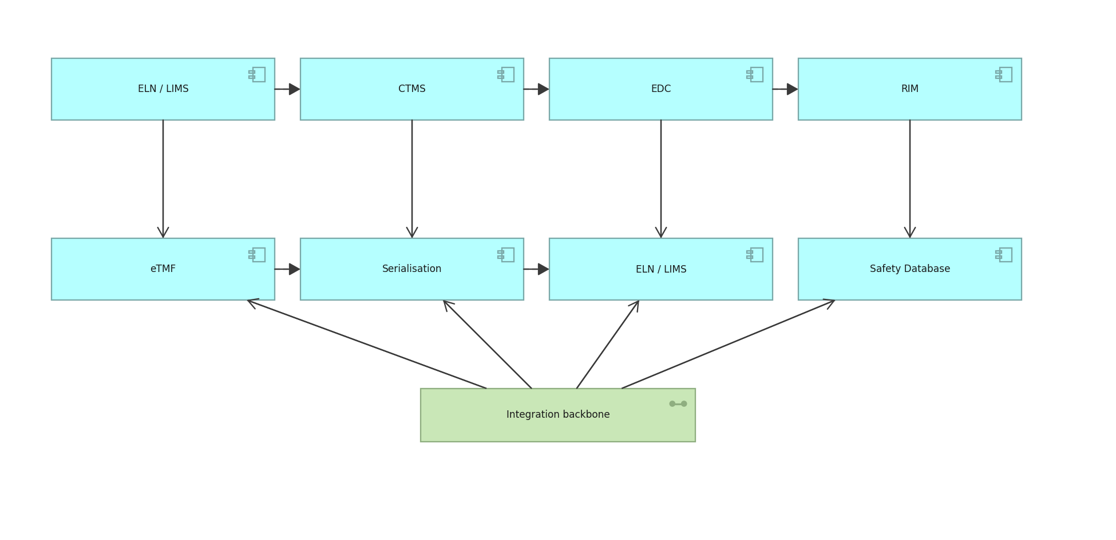
CALDERON THERAPEUTICS · BASIC · C.1.11
Application Cooperation view
How applications exchange with one another across the estate.
Created using the Application Cooperation Viewpoint, C.1.11 of the ArchiMate 4 Specification. Drawn from the Pharmaceuticals metamodel.

Slide 14
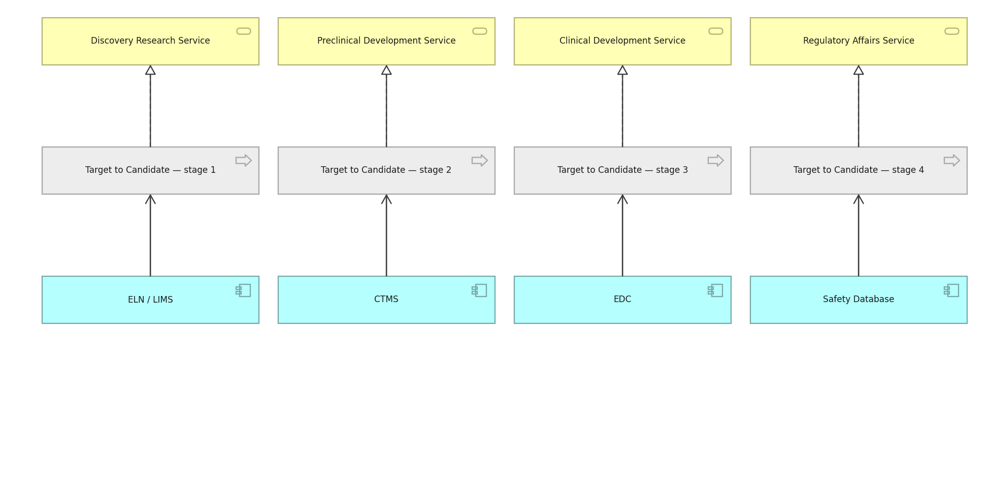
CALDERON THERAPEUTICS · BASIC · C.1.12
Service Realization view
How business services are realised by processes and supported by applications.
Created using the Service Realization Viewpoint, C.1.12 of the ArchiMate 4 Specification. Drawn from the Pharmaceuticals metamodel.

Slide 15
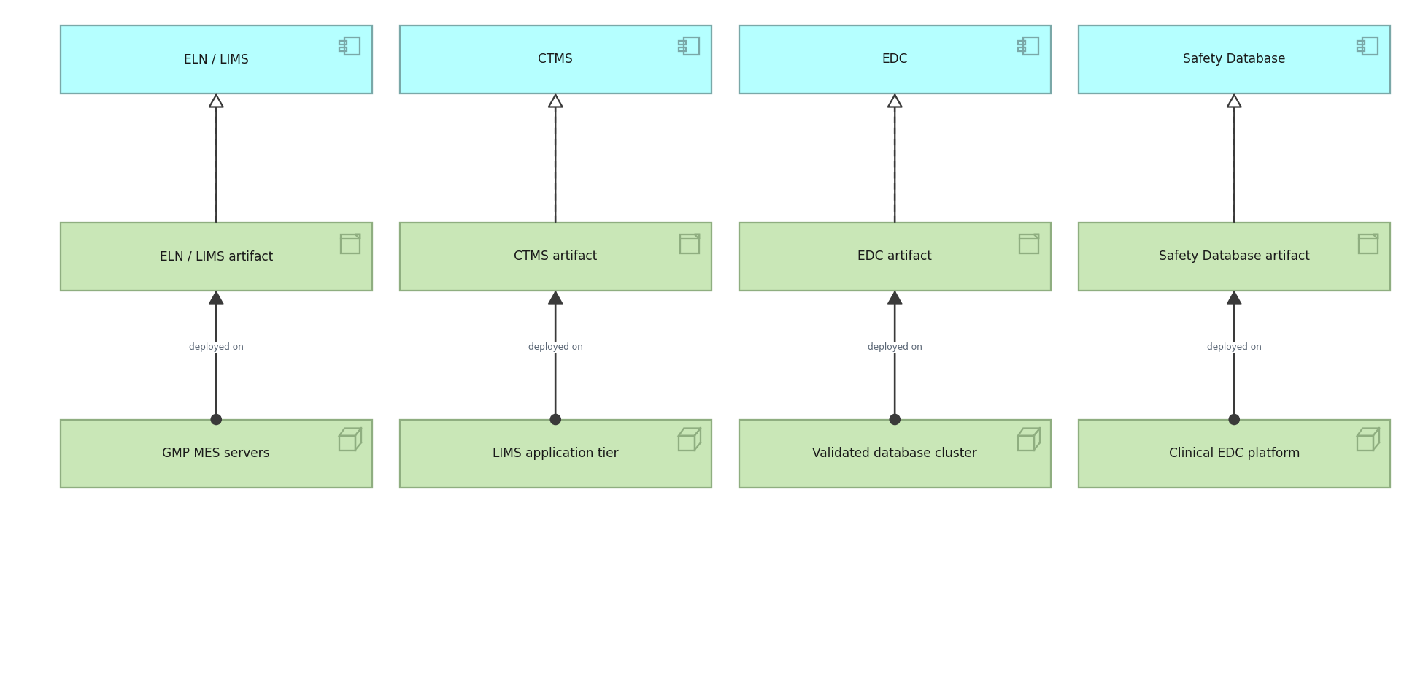
CALDERON THERAPEUTICS · BASIC · C.1.13
Implementation and Deployment view
Which artifacts realise which applications, and where they are deployed.
Created using the Implementation and Deployment Viewpoint, C.1.13 of the ArchiMate 4 Specification. Drawn from the Pharmaceuticals metamodel.

Slide 16
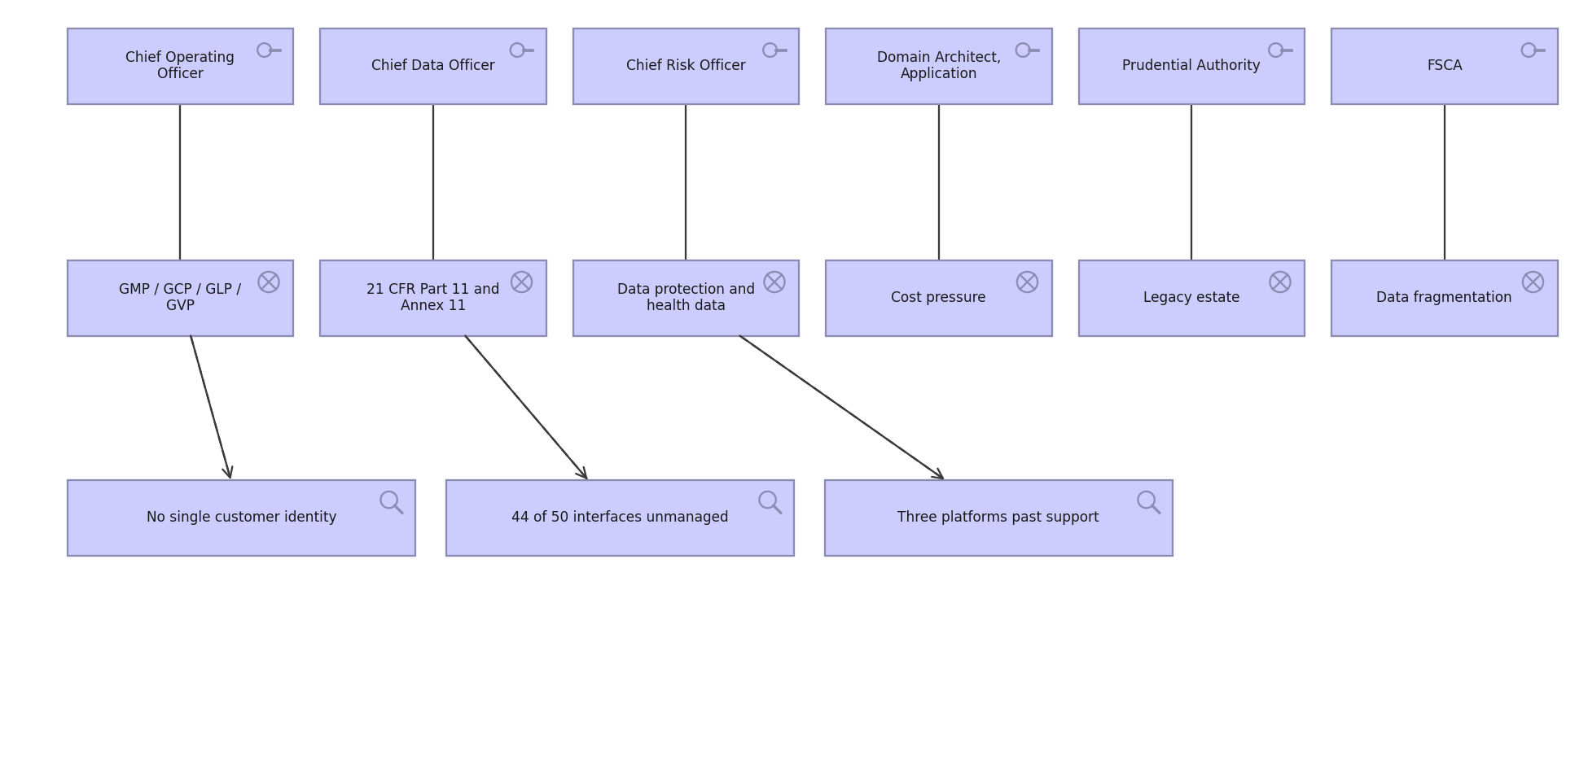
CALDERON THERAPEUTICS · MOTIVATION · C.2.1
Stakeholder view
Stakeholders, the drivers they care about, and the assessments against them.
Created using the Stakeholder Viewpoint, C.2.1 of the ArchiMate 4 Specification. Drawn from the Pharmaceuticals metamodel.

Slide 17

CALDERON THERAPEUTICS · MOTIVATION · C.2.2
Goal Realization view
How goals are refined into outcomes, and the principles that shape them.
Created using the Goal Realization Viewpoint, C.2.2 of the ArchiMate 4 Specification. Drawn from the Pharmaceuticals metamodel.

Slide 18
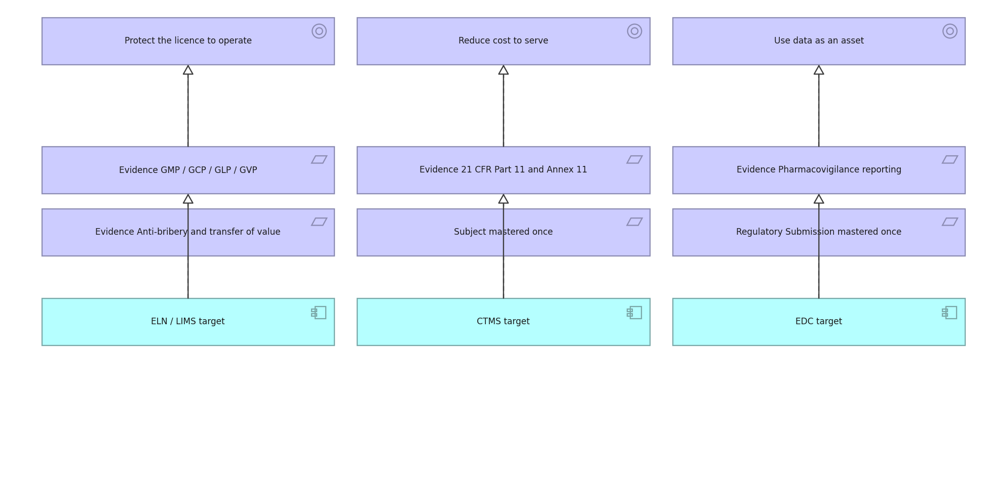
CALDERON THERAPEUTICS · MOTIVATION · C.2.3
Requirements Realization view
How requirements realise goals and what realises the requirements.
Created using the Requirements Realization Viewpoint, C.2.3 of the ArchiMate 4 Specification. Drawn from the Pharmaceuticals metamodel.

Slide 19
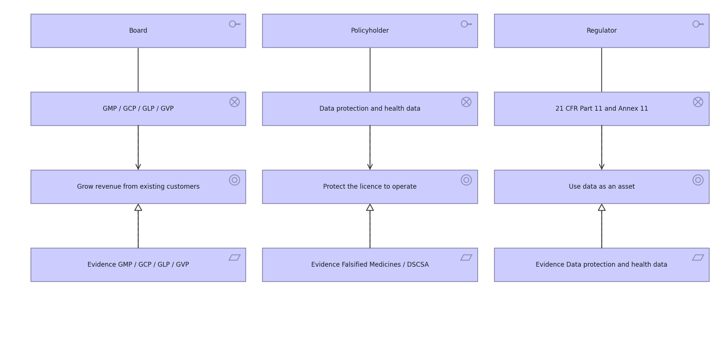
CALDERON THERAPEUTICS · MOTIVATION · C.2.4
Motivation view
The full motivation chain: stakeholder to driver to goal to requirement.
Created using the Motivation Viewpoint, C.2.4 of the ArchiMate 4 Specification. Drawn from the Pharmaceuticals metamodel.

Slide 20
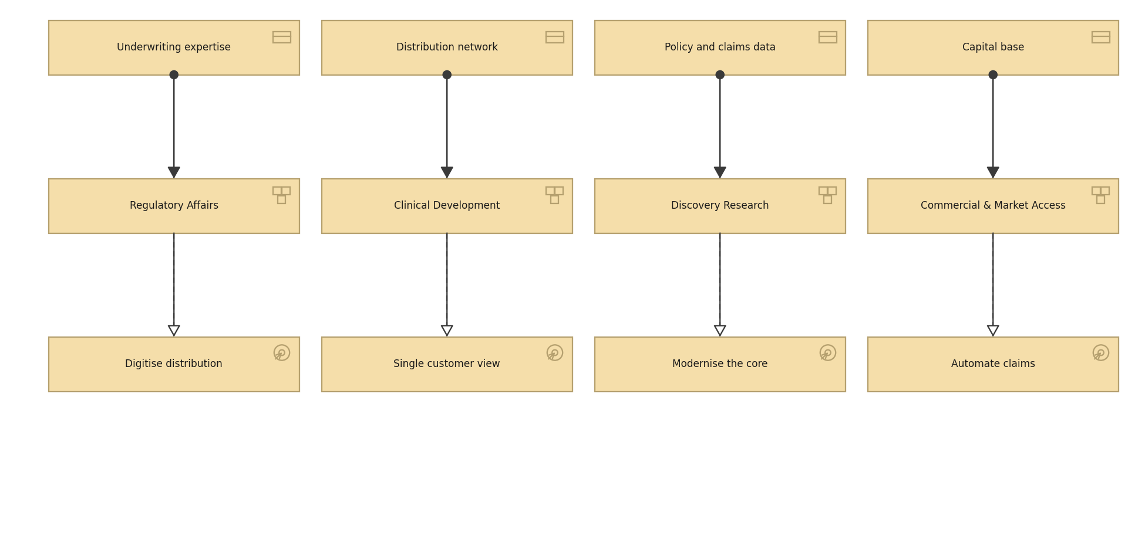
CALDERON THERAPEUTICS · STRATEGY · C.3.1
Strategy view
Resources, the capabilities they enable and the courses of action chosen.
Created using the Strategy Viewpoint, C.3.1 of the ArchiMate 4 Specification. Drawn from the Pharmaceuticals metamodel.

Slide 21
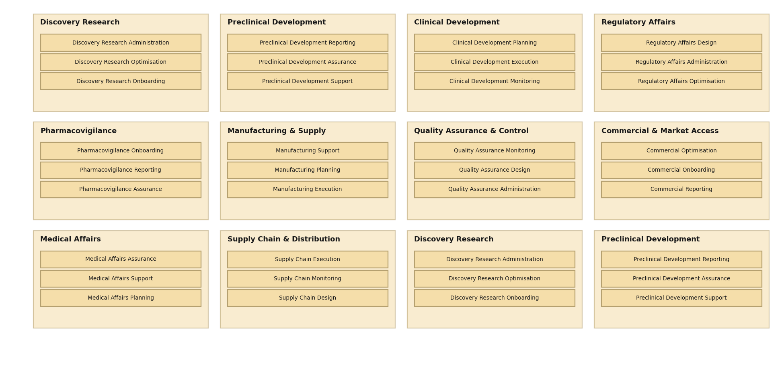
CALDERON THERAPEUTICS · STRATEGY · C.3.2
Capability Map view
Twelve level 1 capabilities decomposed to level 2.
Created using the Capability Map Viewpoint, C.3.2 of the ArchiMate 4 Specification. Drawn from the Pharmaceuticals metamodel.

Slide 22
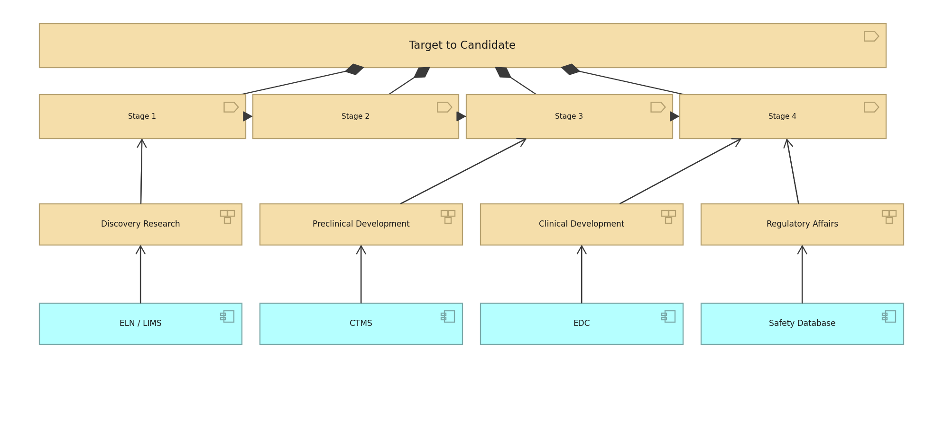
CALDERON THERAPEUTICS · STRATEGY · C.3.3
Value Stream view
Settle a Claim, its stages, and the capabilities and applications behind them.
Created using the Value Stream Viewpoint, C.3.3 of the ArchiMate 4 Specification. Drawn from the Pharmaceuticals metamodel.

Slide 23
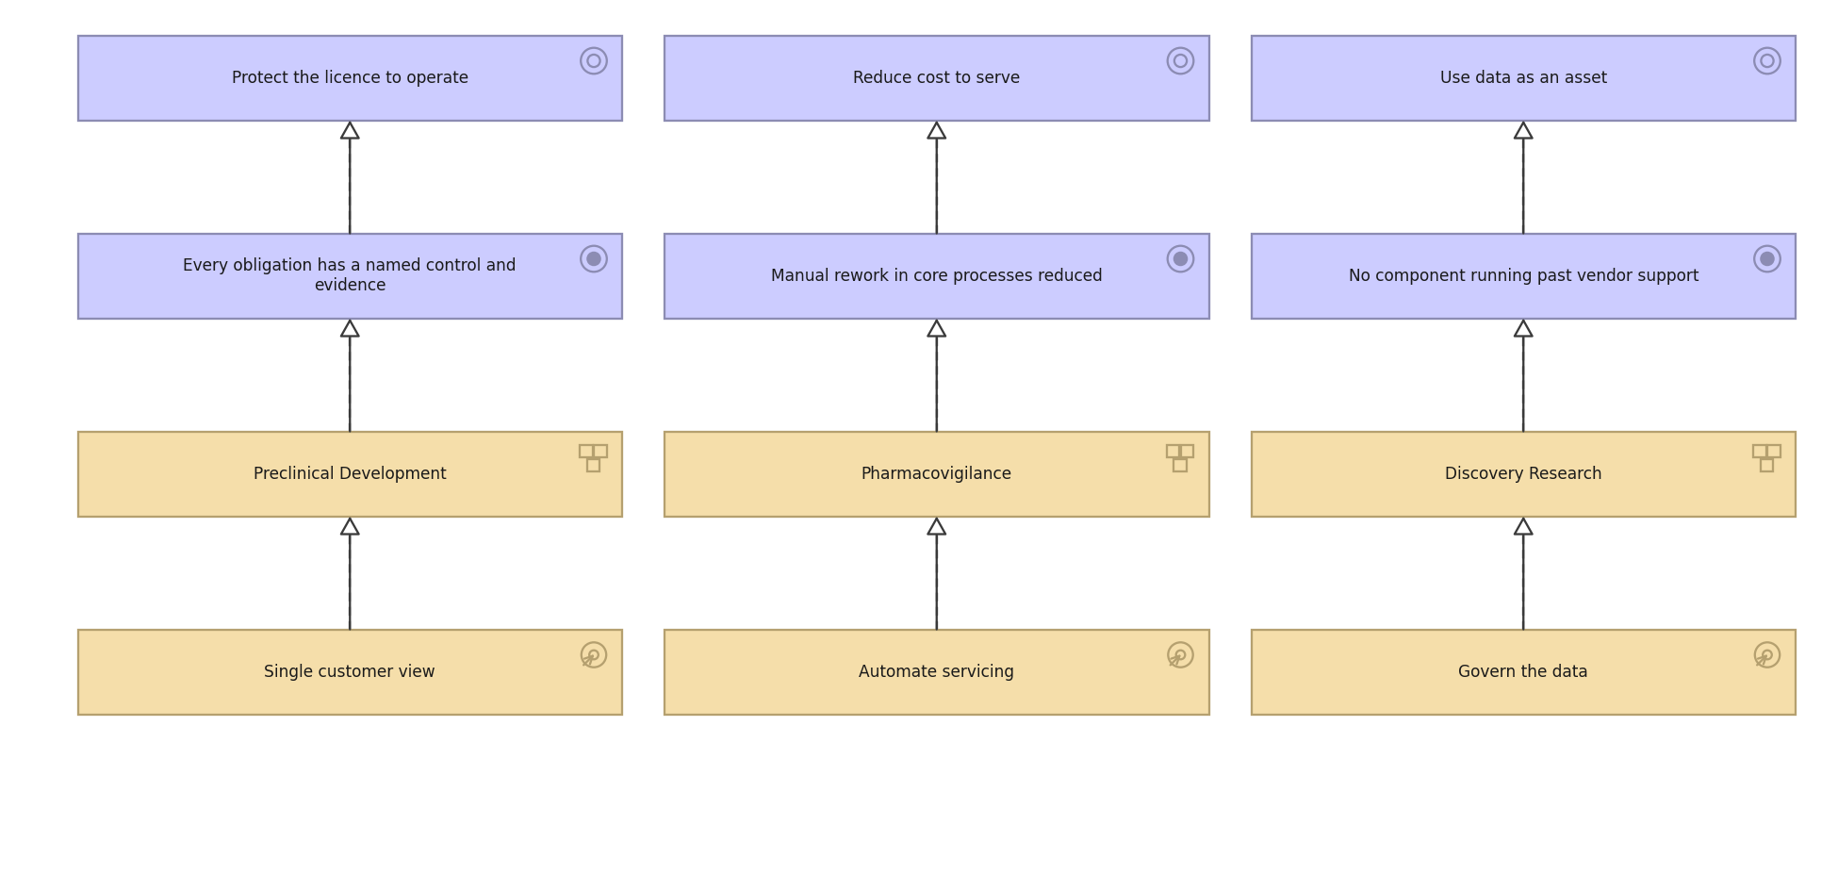
CALDERON THERAPEUTICS · STRATEGY · C.3.4
Outcome Realization view
How courses of action and capabilities deliver outcomes and goals.
Created using the Outcome Realization Viewpoint, C.3.4 of the ArchiMate 4 Specification. Drawn from the Pharmaceuticals metamodel.

Slide 24
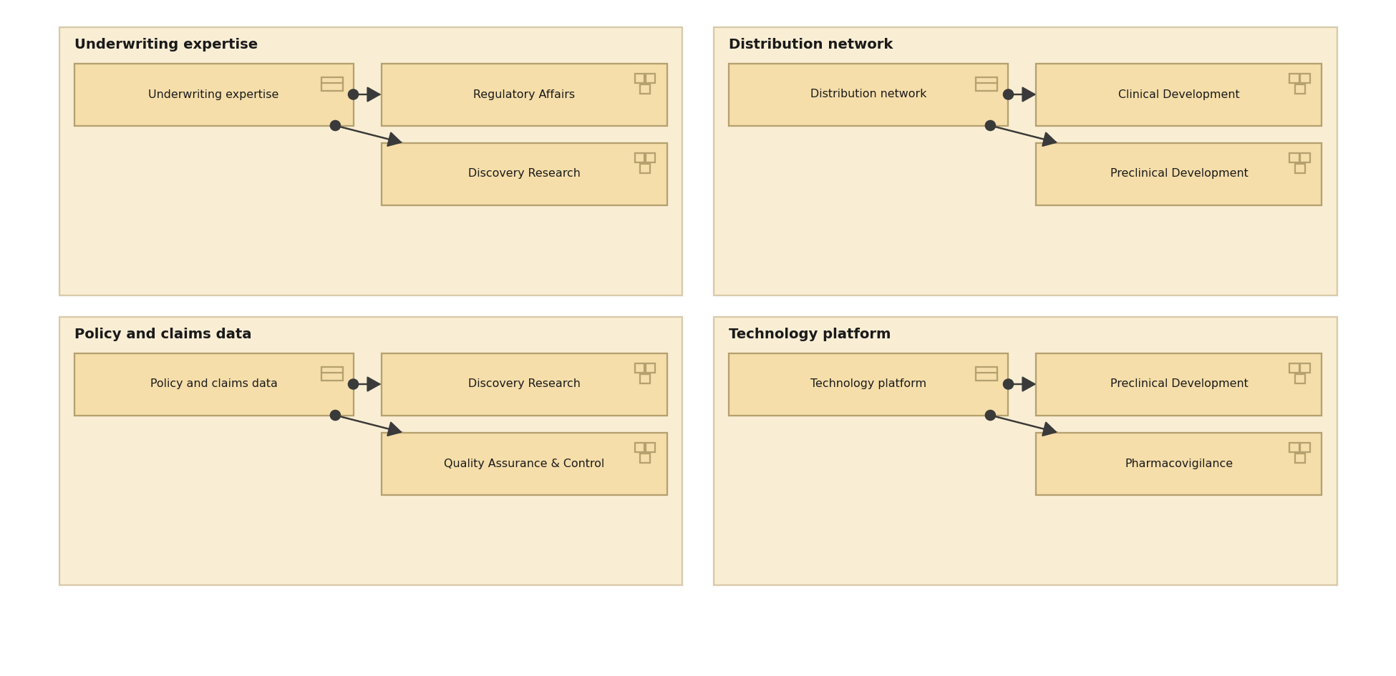
CALDERON THERAPEUTICS · STRATEGY · C.3.5
Resource Map view
The resources Meridian holds and the capabilities they are assigned to.
Created using the Resource Map Viewpoint, C.3.5 of the ArchiMate 4 Specification. Drawn from the Pharmaceuticals metamodel.

Slide 25
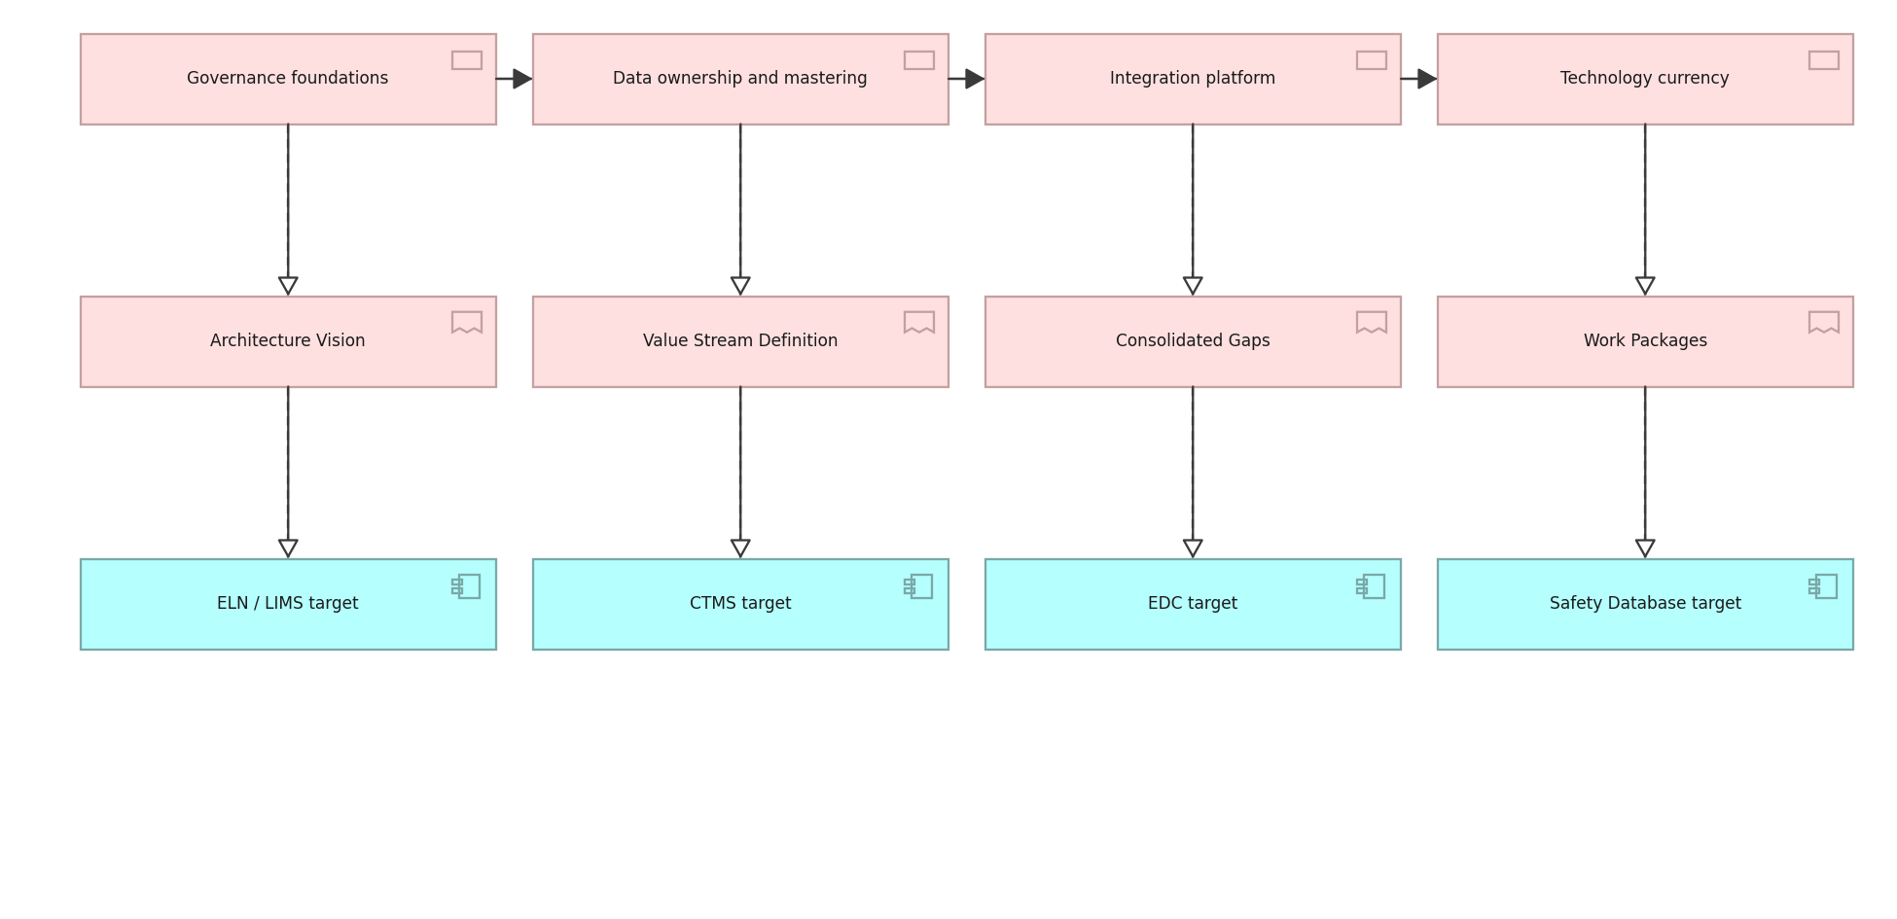
CALDERON THERAPEUTICS · IMPLEMENTATION · C.4.1
Project view
Work packages, their deliverables and the building blocks they realise.
Created using the Project Viewpoint, C.4.1 of the ArchiMate 4 Specification. Drawn from the Pharmaceuticals metamodel.

Slide 26
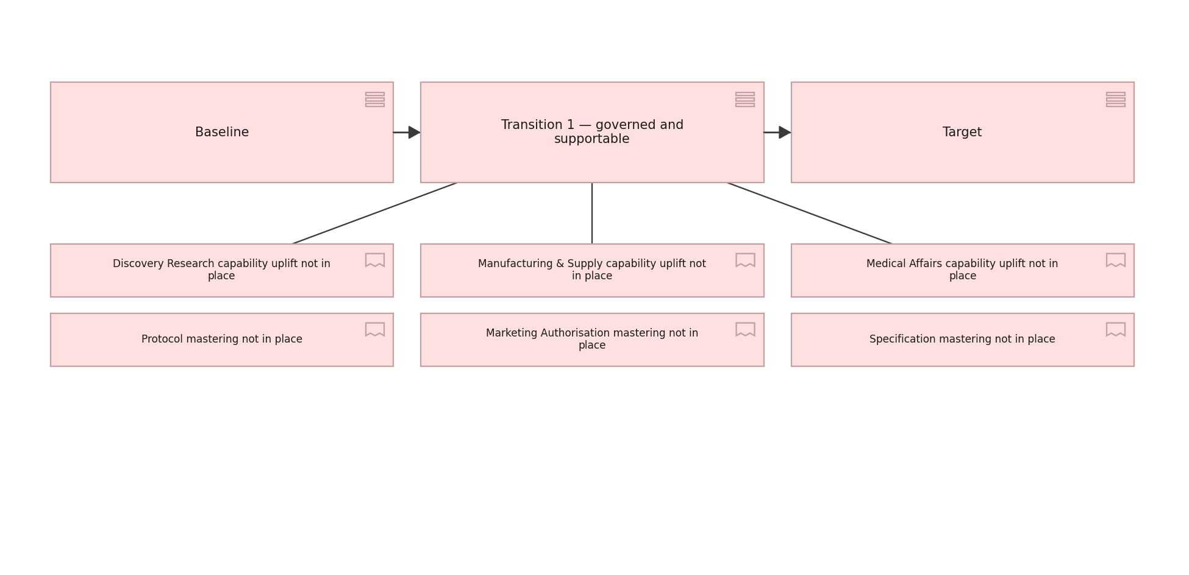
CALDERON THERAPEUTICS · IMPLEMENTATION · C.4.2
Migration view
Plateaus from baseline through transition to target, and the gaps between.
Created using the Migration Viewpoint, C.4.2 of the ArchiMate 4 Specification. Drawn from the Pharmaceuticals metamodel.

Slide 27
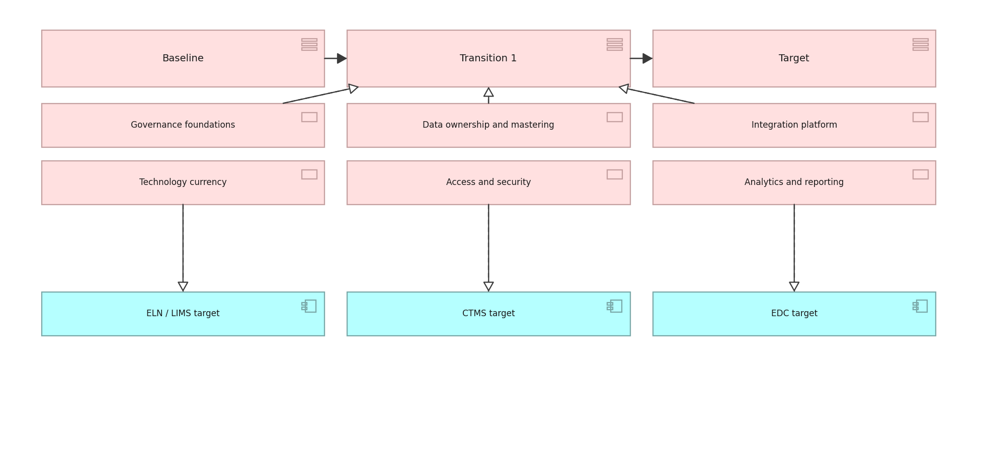
CALDERON THERAPEUTICS · IMPLEMENTATION · C.4.3
Implementation and Migration view
Work packages against plateaus and the building blocks they deliver.
Created using the Implementation and Migration Viewpoint, C.4.3 of the ArchiMate 4 Specification. Drawn from the Pharmaceuticals metamodel.

