Slide 1
Automation Framework Changes

Slide 2
Main Areas of Focus
multiTestRunner – The main changes made in the automation framework are made in multiTestRunner.js. Changes involve running tests differently if they need to unmanage devices, checking for enhanced_osd parameter.
testCaseResultServer – The test case result server now has an endpoint to run app.js on a POST request. The POST request should include a branch value which will be written to the site_id file before the tests run.

Slide 3
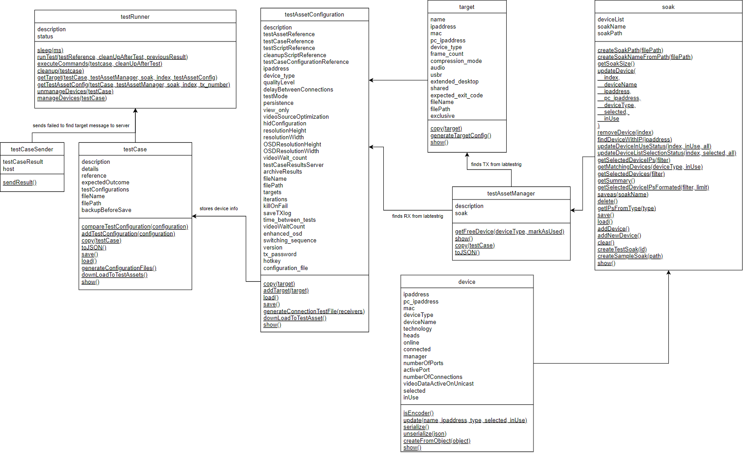

Slide 4
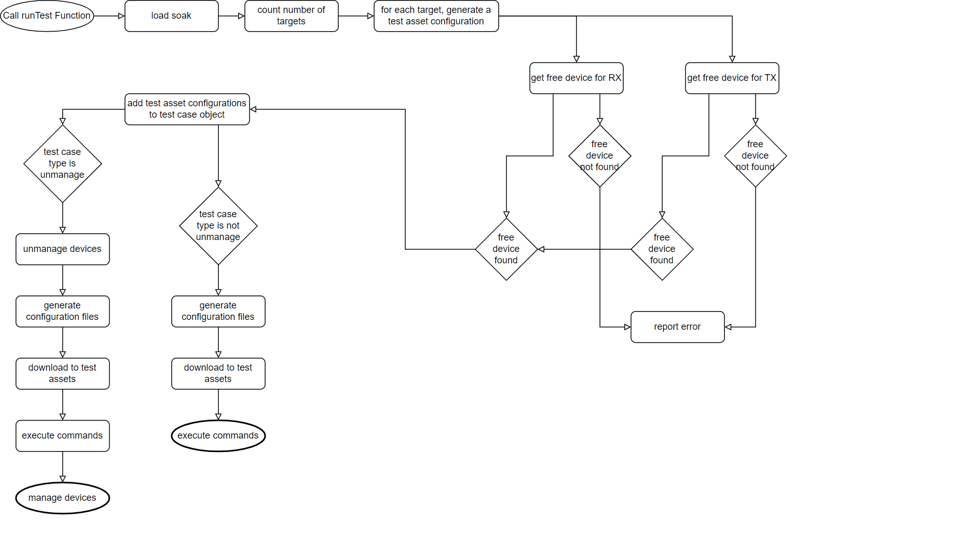

Slide 5
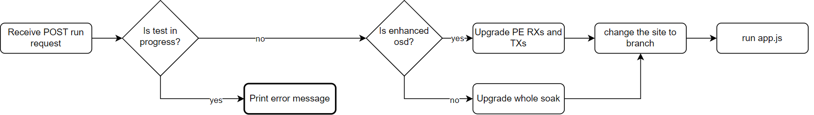
Enhanced OSD functionality
testCaseResultsServer checks branch from POST request
If branch matches enhanced osd branch we get the PE RXs and the TXs
We upgrade the selected devices using the nightly_upgrade.sh script
We run app.js
If the test cases are running on enhanced osd, a value in testAssetConfig will reflect that
This will be processed in the processJSONConfig function from connection_test_common.sh
This parameter will determine how the makeConnection and terminateConnection functions will work.

Slide 6
Enhanced OSD Functionality 2
Previously
Now
Any POST request sent to the REST API would be processed and app.js would run
Each branch would have to be individually configured to send a POST request
Each branch would have to be configured by Micheal to send POST request
List of accepted branches
If POST branch is in the list, it will run the test
Jenkins jobs can all be set up to send request but only accepted branches will run
Saves Jenkins setup time and complexity

Slide 7
Test Case Scripts
INDEX variable in shell scripts is now used to specify which target to use
makeConnection performs a different action if called with the “ENHANCED” string as a parameter (all test case scripts should read makeConnection $ENHANCED instead of just makeConnection)
terminateConnection works similar to makeConnection as mentioned above
check_connection_dual_a and check_connection_single have been merged into one function called check_connection
Set timeout option on curl commands to prevent test cases from getting stuck

Slide 8
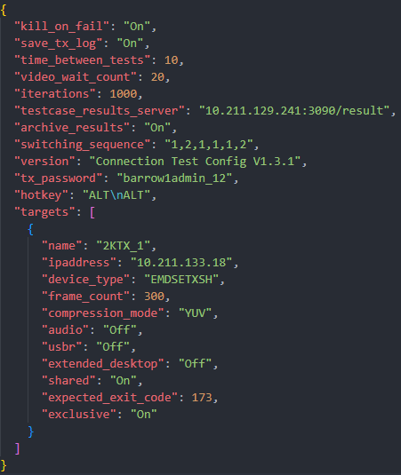
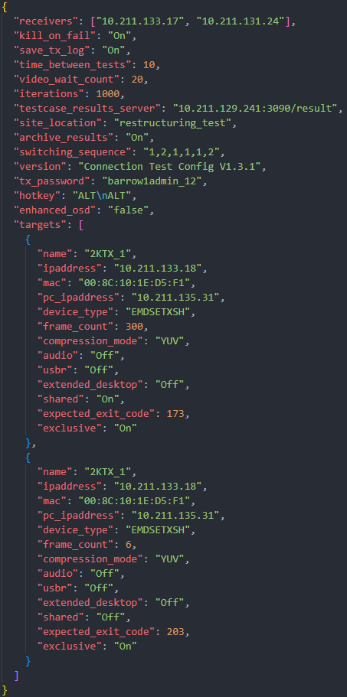
Old test_case_ref_a.json
New test_case_ref_a.json

Slide 9
Restructuring
filePath wasn’t handled correctly across all scripts, in some cases it was assumed to be ./TC${ref}
characterise.js now takes test case type parameter e.g.
npm run testcase connection_cases 1 1 true
Tests should be located in their respective category folders
They should have the filePath value in the testcase_ref.json reflect the new path
New script called category.js to run all tests in a particular category…
npm run type connection_cases true
Now supports multiple tests with the same reference number, if they’re in separate categories. connection_cases 1, audio 1

