Slide 1
Canvas
Multimodal AI Orchestrator
Visual workflow builder for chaining Gemini, Veo, Lyria, and Cloud TTS
Built on Vertex AI · Cloud Run · Firebase
vibe-studio-refactor-440790012685.us-central1.run.app

Slide 2
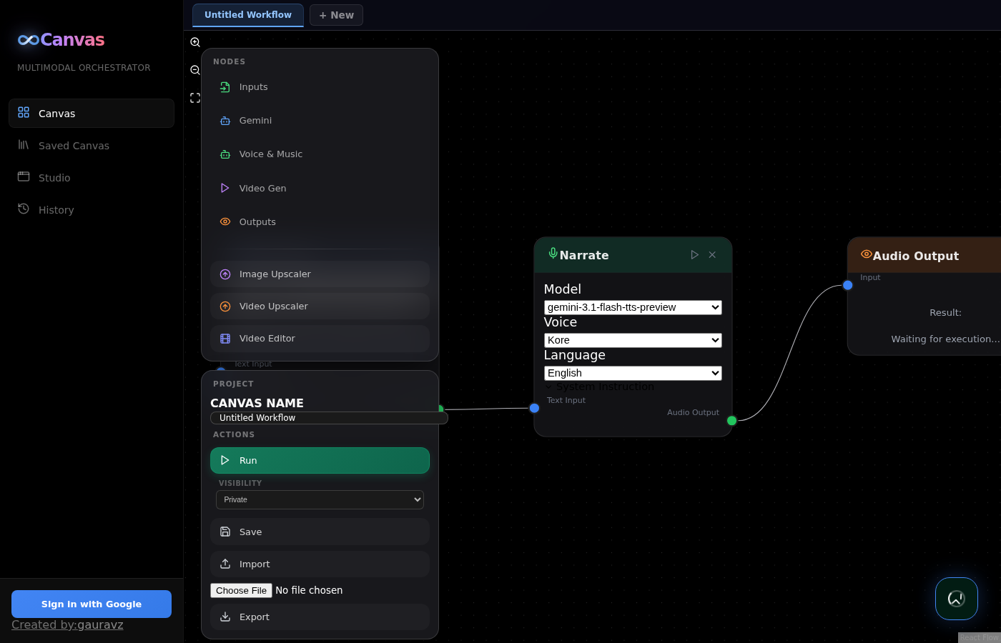
What is Canvas?
A no-code platform for AI media generation pipelines
Build complex AI workflows visually
Drag, drop, and connect AI nodes to chain multiple Vertex AI models. No code, no boilerplate. From idea to finished video in minutes.
Key capabilities
• Visual drag-drop workflow builder
• Multi-modal: text, image, video, audio
• Real-time SSE execution streaming
• Multiple workflow tabs in parallel
• Team collaboration with sharing controls
• Auto-saved asset library
Canvas — Multimodal AI Orchestrator
2

Slide 3
Multiple Workflow Tabs
Work on several projects in parallel — never lose state
• "+ New" creates a new workflow tab
• Click any tab to switch instantly
• Double-click tab name to rename
• "x" to close (can't close last)
• All tabs render simultaneously
• Switch between Canvas / Saved / Assets without losing state
Canvas — Multimodal AI Orchestrator
3

Slide 4
Node Types
Composable building blocks for any pipeline
Category | Nodes | Capabilities
Inputs | Text, Image, Video, Audio | Type or upload content. Video auto-uploads to GCS
Gemini | Gemini Text, Gemini Image | Multimodal text + image generation
Voice & Music | Speech Gen, Lyria Clip, Lyria Pro | TTS (23 langs, 7 voices), 30s clips, full songs
Video | Veo Standard, Extend, Reference, Upscaler | Generate, extend, style-match, 4K upscale
Utility | Image Upscaler, Video Editor | Image enhance, ffmpeg composition
Outputs | Text, Image, Audio, Video | Display and download results
Canvas — Multimodal AI Orchestrator
4

Slide 5
How It Works
From blank canvas to generated content in 5 steps
1
2
3
4
5
Build
Configure
Run
Stream
Save
Drag nodes onto canvas, connect with edges
Set model, voice, language, aspect ratio per node
Click Run — nodes execute in topological order
Results appear in real-time via SSE
All assets auto-saved to Asset Library
Built-in smart error handling
• Failed nodes show red status badge
• Downstream nodes automatically skipped (no cascading false errors)
• Clear error messages at the point of failure
Canvas — Multimodal AI Orchestrator
5

Slide 6
Supported AI Models
All Vertex AI generative models, ready to chain
Capability | Model IDs | Default
Text | gemini-3.1-pro-preview, gemini-3.1-flash-lite-preview, gemini-3-flash-preview | flash-lite
Image | gemini-3.1-flash-image-preview, gemini-3-pro-image-preview, gemini-2.5-flash-image | flash-image
Video | veo-3.1-generate-001, veo-3.1-fast-generate-001, veo-3.1-lite-generate-001 | lite
Music | lyria-3-pro-preview (full songs), lyria-3-clip-preview (30s) | clip
TTS | gemini-3.1-flash-tts-preview, gemini-2.5-flash-preview-tts, gemini-2.5-pro-preview-tts | flash-tts
Image Upscale | imagen-4.0-upscale-preview | —
Video Upscale | veo-3.1-generate-001 (4K, sharpness 0-4) | —
Note: Veo Reference and Extend require non-lite models. Engine auto-upgrades lite → fast when needed.
Canvas — Multimodal AI Orchestrator
6

Slide 7
Text-to-Speech
23 languages · 7 voices · system instructions
23 Languages
7 Voices
System Instructions
English, Spanish, French, German, Italian, Portuguese, Dutch, Polish, Russian, Turkish, Arabic, Hindi, Bangla, Tamil, Telugu, Thai, Indonesian, Vietnamese, Japanese, Korean, Chinese
Kore
Customize speaking style:
Leda
• "Speak cheerfully and with enthusiasm"
• "Use a calm, professional news anchor tone"
• "Whisper softly as if telling a secret"
• "Speak slowly with dramatic pauses"
Puck
Charon
Fenrir
Aoede
Enceladus
Canvas — Multimodal AI Orchestrator
7

Slide 8
Demo Workflows
Three reference pipelines showing the platform's range
Product Ad
Cinema Shot — 3 Cuts
Virtual Try-On
• Inputs: Product photo + Brief + Style
• Pipeline: Stylize → Hero image (4K) + Veo video (4K)
• + Voiceover + Background music
• Editor → Final ad video
• Inputs: Character + Scene
• Pipeline: Char ref → 3 framings (wide/med/close)
• → 3 Veo clips + Lyria Pro score
• Editor → Cinema sequence
• Inputs: Person + Garment + Background + Motion
• Pipeline: VTO → Background swap → Animate
• + Fashion music
• Editor → Fashion reel
Canvas — Multimodal AI Orchestrator
8

Slide 9
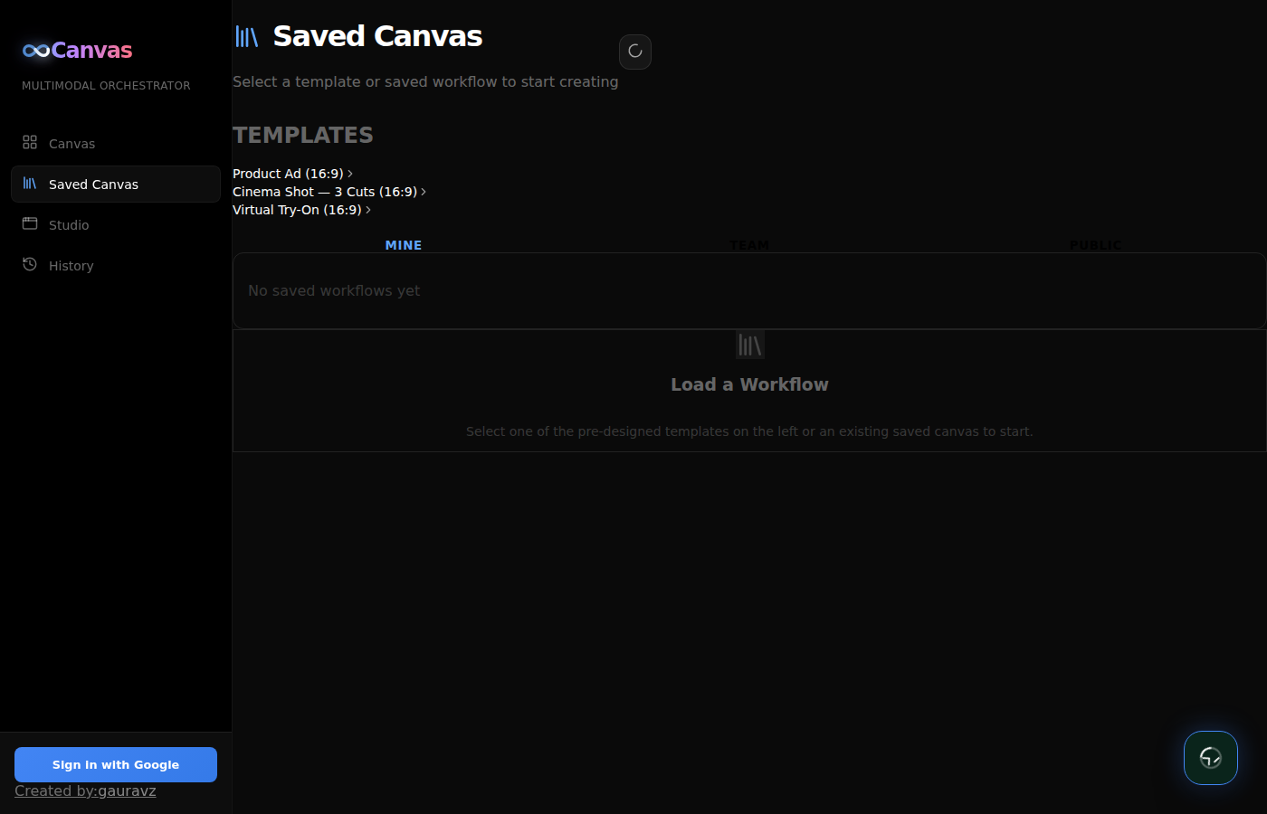
Saved Canvas — Workflow Library
Personal, team-shared, and public workflows
Three views
• Mine — Your private workflows
• Team — Shared by teammates
• Public — Community workflows
Edit workflow
• Click any saved workflow → opens in NEW tab
• Original work in current tab is preserved
• Edit & save updates the same workflow ID
Canvas — Multimodal AI Orchestrator
9

Slide 10
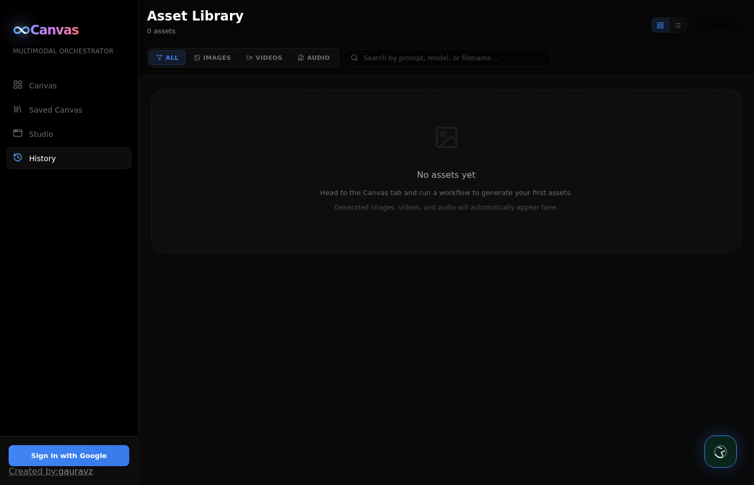
Asset Library
Every generated asset auto-saved with full metadata
• Filter by type: All / Images / Videos / Audio
• Search by prompt text
• Grid or list view toggle
• Expandable prompt display
• Model badges + relative timestamps
• Direct download for any asset
• GCS-backed persistence (survives Cloud Run instance restarts)
Canvas — Multimodal AI Orchestrator
10

Slide 11
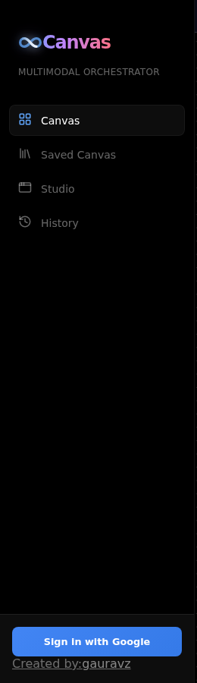
Team Collaboration
Share workflows across your organization
Create & Join Teams
• Click "+" next to Teams in sidebar
• Auto-generated 8-character join code
• Share code with teammates
• Click team code to copy
Workflow Visibility
Level | Who sees it
Private | Only you
Team | All team members
Public | Everyone on platform
Canvas — Multimodal AI Orchestrator
11

Slide 12
Architecture
Modern stack on Google Cloud
Frontend
Request flow
React 18 · Vite · ReactFlow · Firebase Auth
Browser ↓ Firebase ID Token Cloud Run (FastAPI) ↓ verifies token Workflow Engine (DAG executor) ↓ async per-node Vertex AI (Gemini · Veo · Lyria · TTS) ↓ media bytes / GCS URIs Cloud Storage (asset persistence) ↓ on every save Asset Library + GCS metadata sidecar
Backend
FastAPI · SQLAlchemy · SSE Streaming · Pydantic
AI Services
Vertex AI: Gemini · Veo · Lyria · Imagen · TTS
Infrastructure
Cloud Run · Cloud Storage · Firebase · Cloud Build
Canvas — Multimodal AI Orchestrator
12

Slide 13
Security
Enterprise-grade security defaults
Feature | Implementation
Authentication | Firebase Google Sign-In with JWT verification
Authorization | Per-route auth deps, team-based access control
Path Traversal | realpath validation on all file-serving endpoints
XSS Prevention | React state rendering (no innerHTML)
CORS | Configurable origins, no wildcard with credentials
Media Serving | Dedicated /api/media endpoint with sanitized paths
Cache | LRU with 100-entry limit and 30-minute TTL
Error Propagation | Failed nodes auto-skip downstream
Auth Token Refresh | Auto-refreshed via Firebase SDK
Canvas — Multimodal AI Orchestrator
13

Slide 14
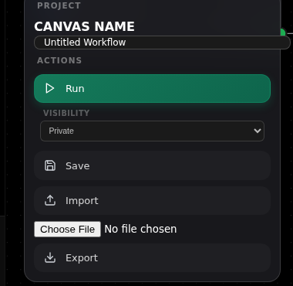
Demo: Product Ad Pipeline
From product photo to finished video ad
1
Upload
Product photo + brief description
2
Generate
Hero image stylized via Gemini 3.1
3
Animate
Veo 3.1 turns image into 8s video
4
Voice
Speech Gen narrates the brief
5
Music
Lyria Clip generates BG music
6
Compose
Video Editor combines all
7
Output
Download 4K finished ad
Canvas — Multimodal AI Orchestrator
14

Slide 15
Use Cases
Real-world applications across industries
Marketing
E-commerce
Media
Product ads, social reels, brand campaigns
Virtual try-on, lookbooks, product showcases
Cinematic shots, character continuity, scoring
Education
Internal Comms
Prototyping
Narrated explainers, multi-language learning content
Localized announcements with TTS in 23 languages
Rapid concept videos for client pitches
Canvas — Multimodal AI Orchestrator
15

Slide 16
Deployment
One command to ship to Cloud Run
Deploy
Environment Variables
$ export GOOGLE_CLOUD_PROJECT=your-project $ ./deploy.sh
Variable | Purpose
GOOGLE_CLOUD_PROJECT | GCP project ID (required)
FIREBASE_PROJECT_ID | Firebase project for auth
VEO_BUCKET | GCS bucket for video assets
ASSETS_BUCKET | GCS bucket for asset persistence
CORS_ORIGINS | Allowed frontend origins
VITE_FIREBASE_API_KEY | Frontend Firebase web key
Requirements
• GCP project with Vertex AI enabled
• Firebase project (for Google sign-in)
• GCS bucket for video/asset storage
• Cloud Run + Cloud Build APIs enabled
• ~2GB memory, 1 CPU per instance
Canvas — Multimodal AI Orchestrator
16

Slide 17
What's Next
Roadmap items in evaluation
Workflow versioning
Scheduled execution
Git-like history for workflow changes
Run workflows on a timer or webhook trigger
Public API
Custom nodes
Expose workflows as REST endpoints
Plugin system for user-defined node types
Real-time collaboration
Cost tracking
Multi-user editing on the same workflow
Per-workflow API cost estimation
Canvas — Multimodal AI Orchestrator
17

Slide 18
Thank you.
Try Canvas now
vibe-studio-refactor-440790012685.us-central1.run.app
Owner: gauravz@google.com
Repo: github.com/gauravz7/canvas
Docs: github.com/gauravz7/canvas/blob/main/docs/USER_GUIDE.md

