Slide 1
GenMedia SxS
Evaluator Guidelines
Side-by-side blind evaluation of generative media models
Google | Internal Only

Slide 2
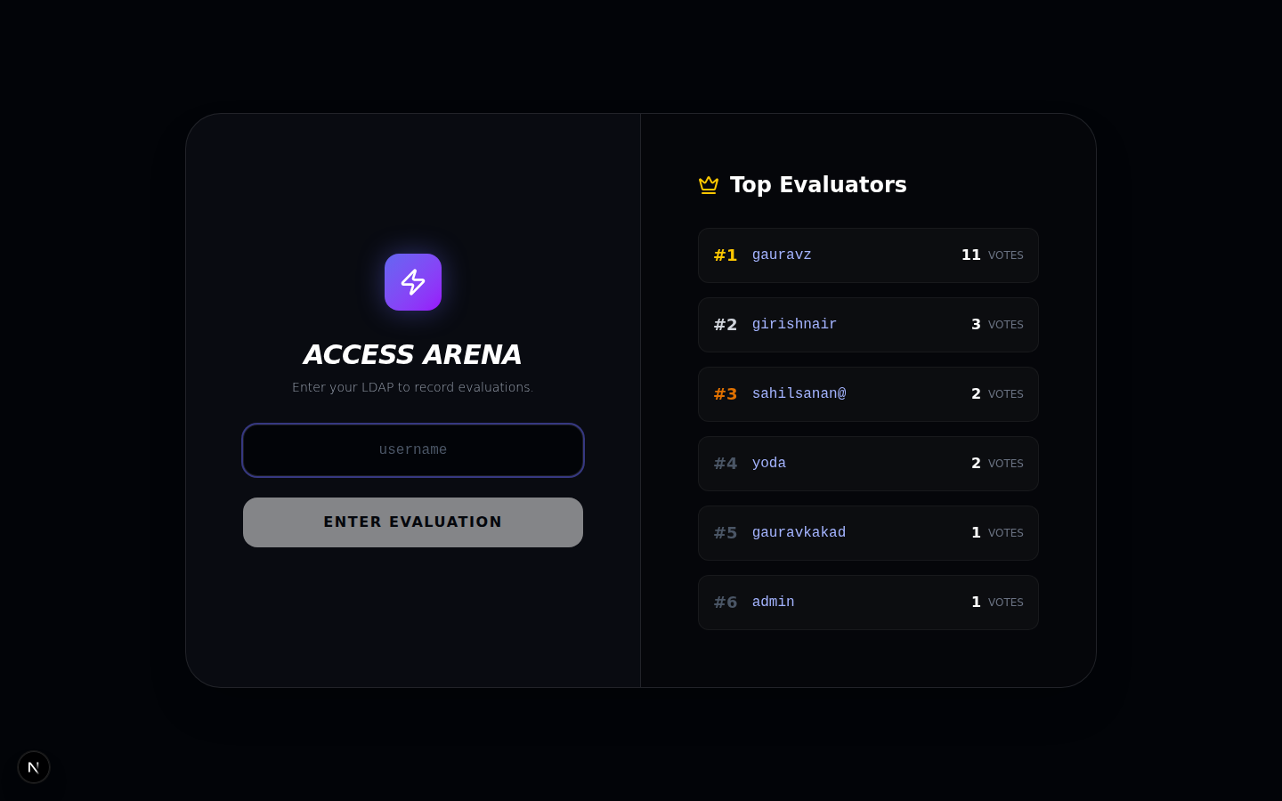
1. Access the Arena
Getting started
Navigate to the platform URL
Enter your LDAP handle in the login field
Press 'Enter Evaluation' to begin
The leaderboard shows top evaluators in real-time
Your vote count is tracked across sessions

Slide 3
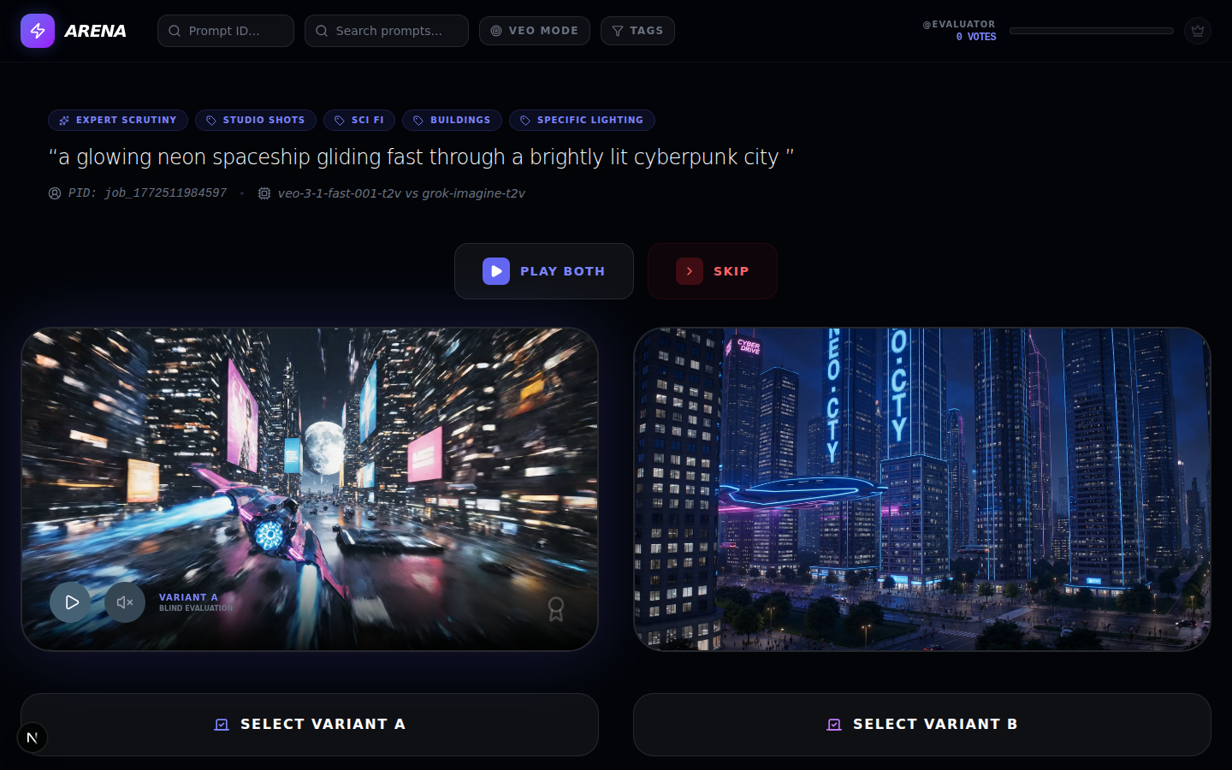
2. Side-by-Side Evaluation
Two anonymized video variants from the same prompt. Model identities are hidden until after you vote.

Slide 4
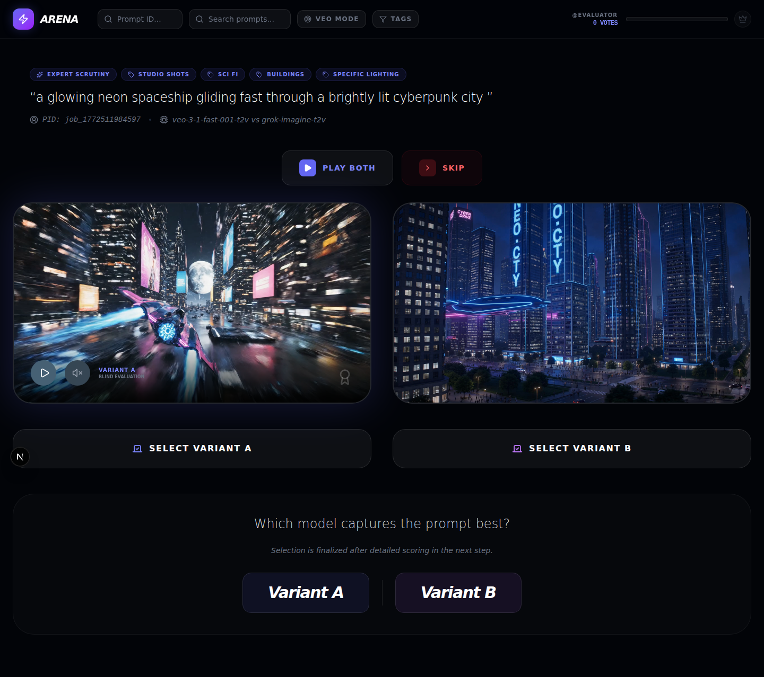
3. Voting Flow
How to vote
Watch both variants at least twice
Use 'Play Both' for synchronized playback
Click 'Select Variant A' or 'Select Variant B'
Complete the detailed scoring rubric
Use 'Skip' if neither variant is evaluable

Slide 5
4. Evaluation Criteria
Prompt Adherence
Motion Quality
Does the video faithfully execute all stated elements, timings, and visual requests?
Is the movement natural and fluid? Any temporal morphing or flickering artifacts?
Aesthetic Quality
Physics & Cohesion
Assess lighting, resolution, color grading, and cinematic quality.
Do objects interact realistically? Gravity, collisions, spatial consistency?
Audio Expressiveness
Audio-Visual Sync
If audio is present, does it match the scene's mood and energy?
Are sounds timed correctly with on-screen actions?

Slide 6
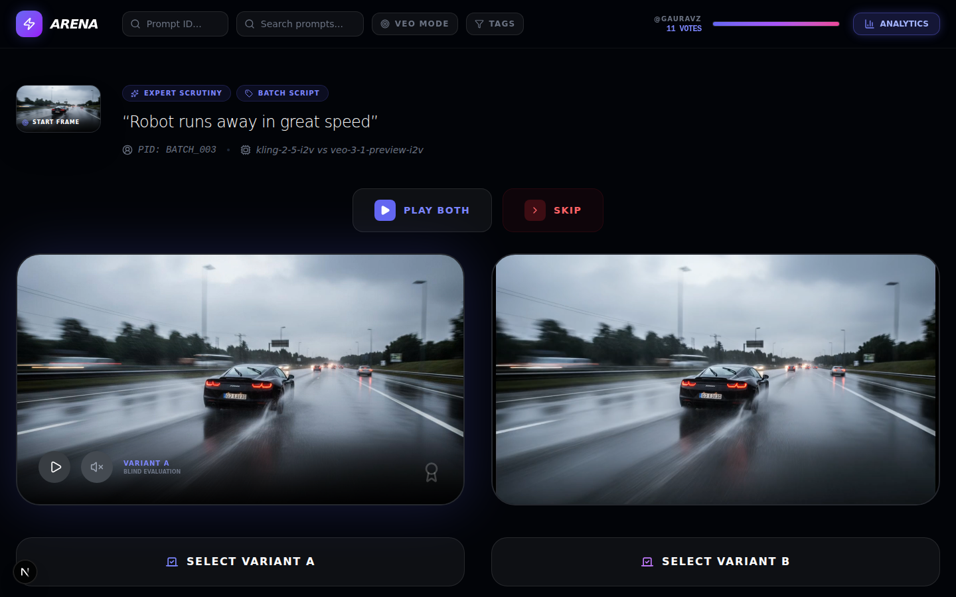
5. The 10-Vote Gate
Unlock analytics by evaluating
A progress bar in the top-right tracks your votes
Complete 10 evaluations to unlock the Analytics button
Once unlocked, access the full Benchmark Results dashboard
You can also submit custom benchmarking prompts
The leaderboard ranks all evaluators by vote count

Slide 7
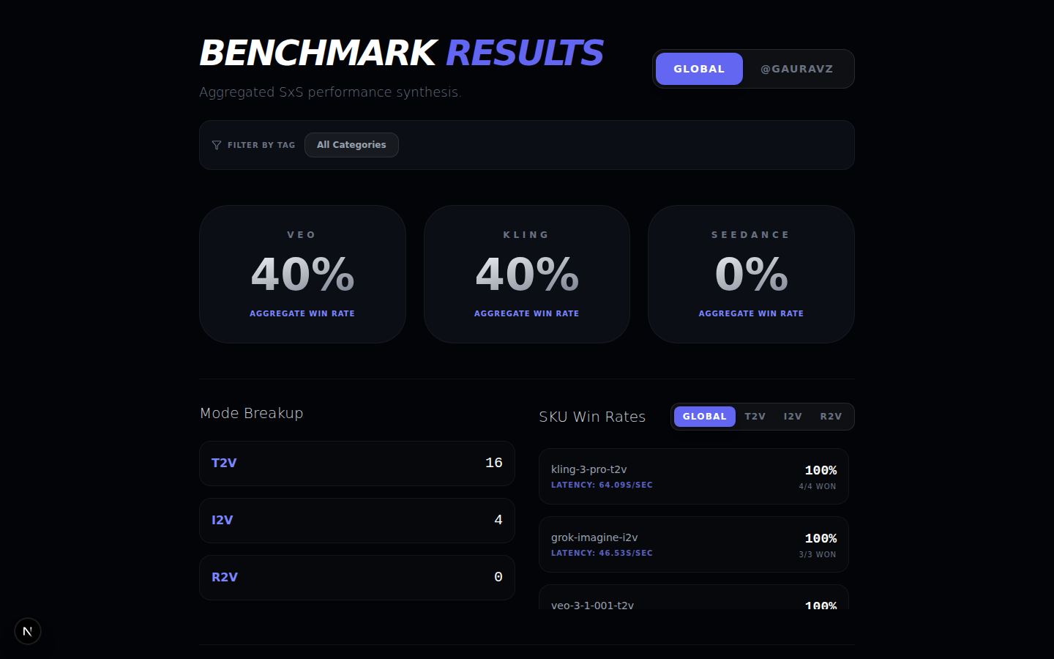
6. Benchmark Results
Aggregated win rates, mode breakup, per-SKU performance with latency, and radar charts across evaluation dimensions.

Slide 8
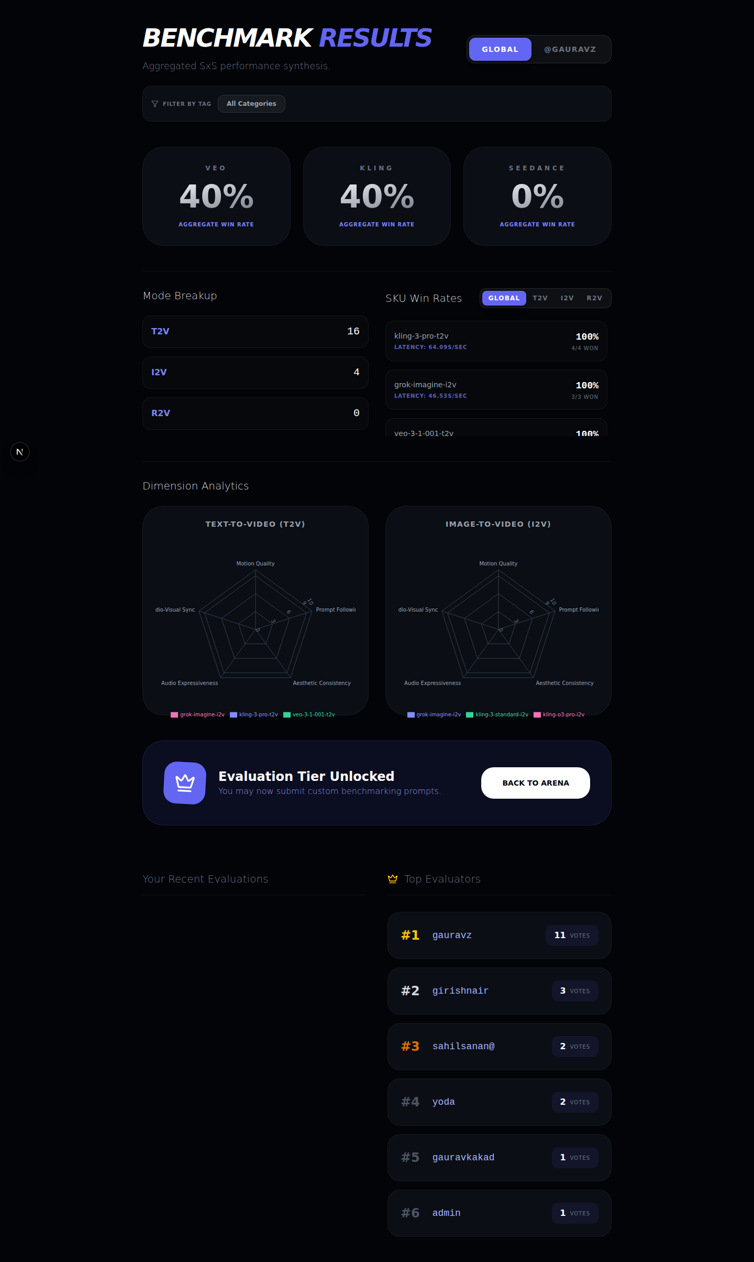
7. Leaderboard
Gamified participation
Top Evaluators ranked by total vote count
Visible on login screen and analytics dashboard
Dimension Analytics with radar charts for T2V and I2V
Toggle between Global and Personal results
Filter by prompt category tags
'Evaluation Tier Unlocked' badge at 10 votes

Slide 9
8. Tips for Great Evaluations
Watch each video at least twice
First pass for overall impression, second for details and artifacts.
Use audio when available
Audio expressiveness and sync are scoring dimensions.
Don't rush
Quality evaluations are more valuable than quantity.
Skip freely
If a pair is ambiguous or both outputs are equally bad/good, skip it.

Slide 10
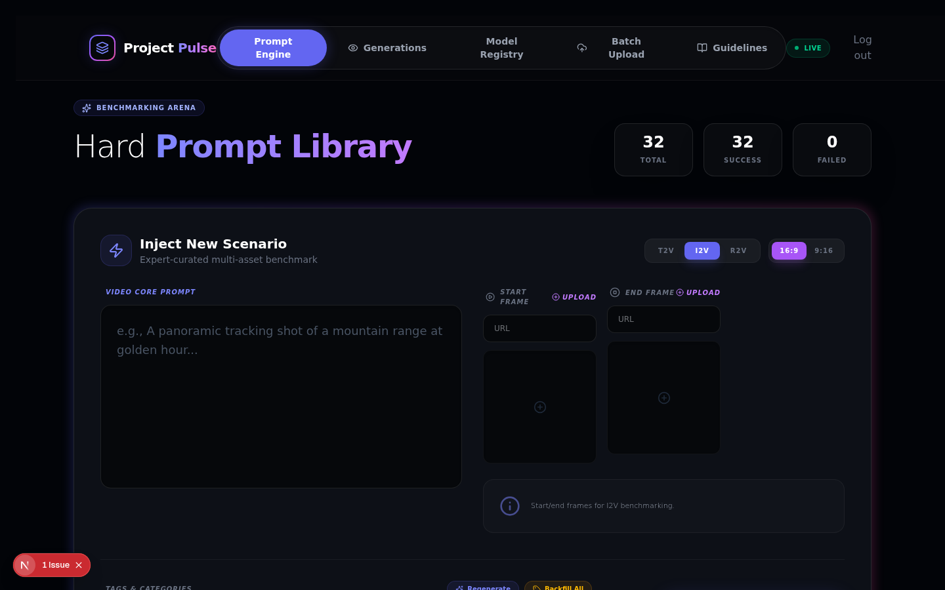
9. Admin — Prompt Engine
Create Hard Prompts with T2V, I2V, and R2V modes. Upload start/end frames, assign category tags, and trigger generation across all active models.

Slide 11
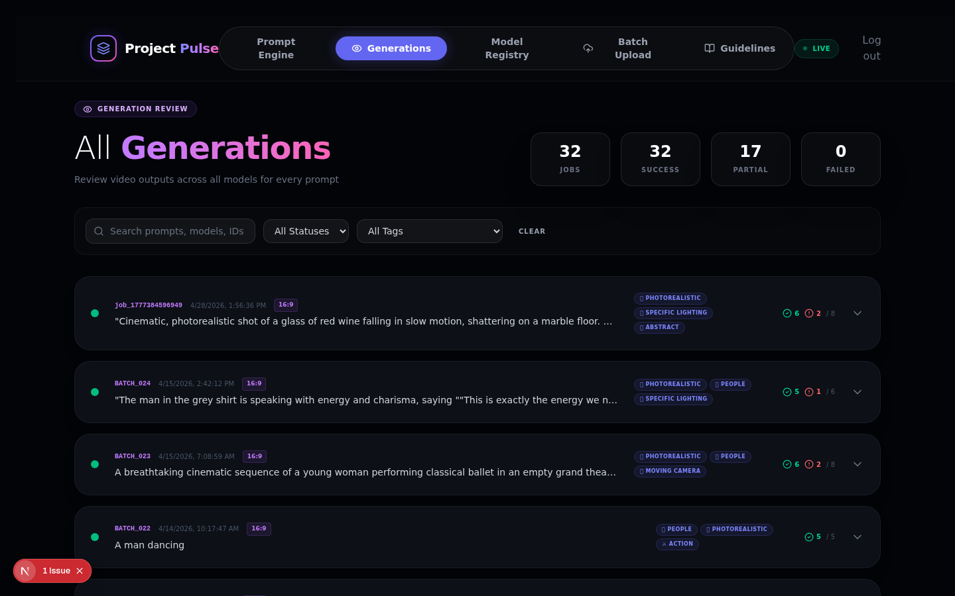
10. Admin — Generations Review
Track all generation jobs with status indicators, category tags, and success/failure counts. Filter by status, tags, or search by prompt text.

Slide 12
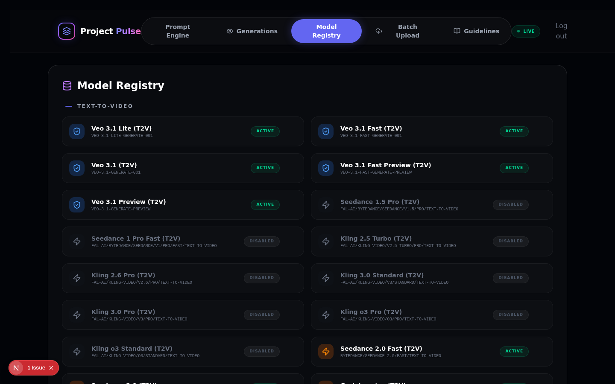
11. Admin — Model Registry
View and toggle all registered models. Supports Veo (Vertex AI), Kling, Seedance, and other providers.

Slide 13
Thank you!
Your evaluations directly shape the quality of our generative media models.
Complete 10 evaluations to unlock prompt submission

