Slide 1
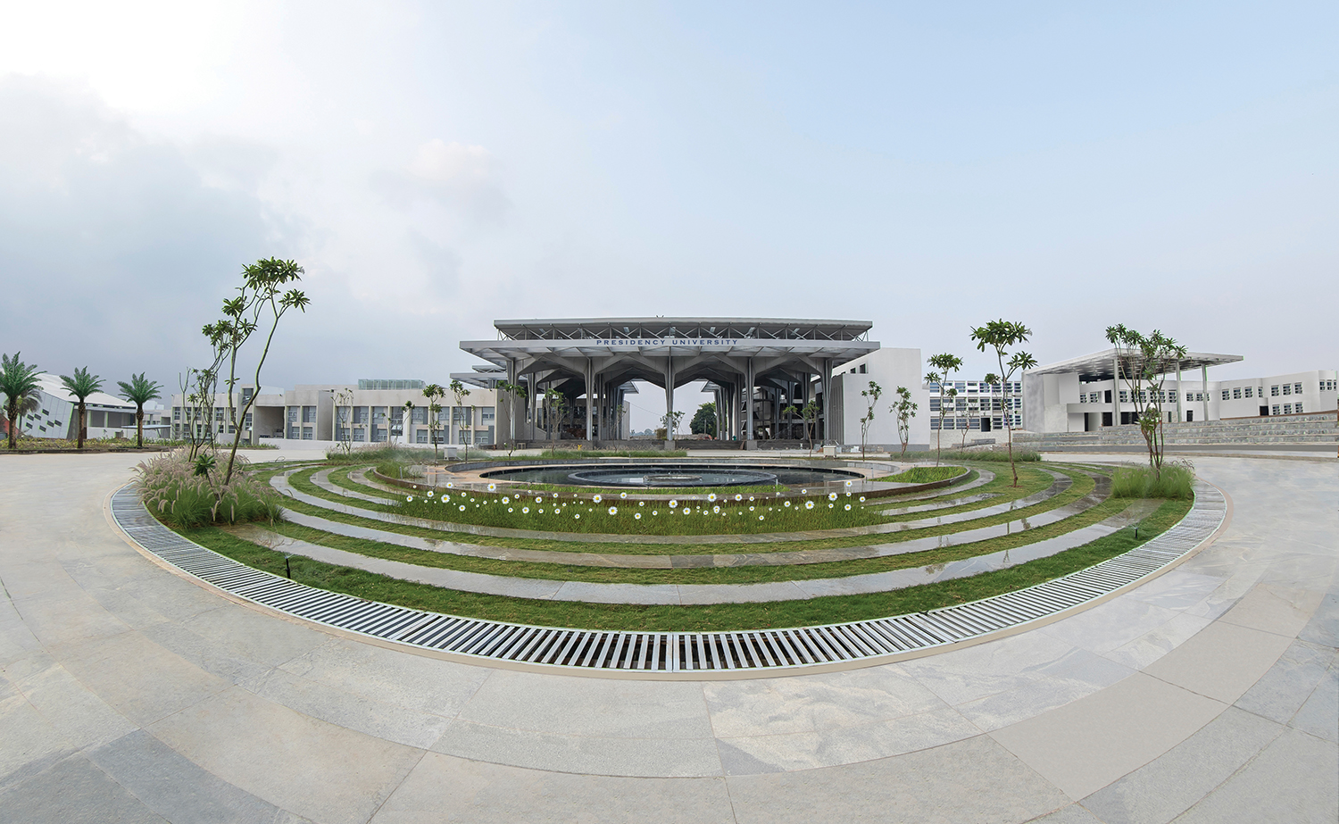

Mini Project (CSE7102)
REVIEW-1
29-08-2026
Presidency
School of Computer Science and Engineering

Slide 2
PROJECT TITLE
CSS7102- Mini Project Review-1
Project ID:
Panel No:
Group members details:
Under the Supervision of,
Dr./Mr./Ms./Prof.
Professor / Associate Professor / Assistant Professor
School of Computer Science and Engineering
Presidency University
Sl.No | Student Name | Roll Number
1
2
3
Name of the Program(s):
Name of the HoD (Team Leader’s):
Name of the Program Project Coordinator (Team Leader’s):
Name of the School Project Coordinators: Mr. Muthuraju V

Slide 3
INDEX
Problem Statement
Git Hub Link
Introduction
Literature Review
Architecture Diagram
Analysis of Problem Statement/Output Expected
Timeline of the Project(Gantt Chart)
References

Slide 4
Problem Statement Number: PS-CS-7102-04
• Category: Both (Software & Mobile Sensor Hardware Integration)
• Domain: Women Safety, Geospatial Computing, Real-time Dispatch & Community Governance
• Problem Description: Contemporary women safety solutions rely on passive panic buttons that suffer from high false-trigger rates, lack of nearby verified civilian responders, and opaque police dispatch timelines. Victims in high-stress scenarios cannot manually unlock smartphones to dial emergency numbers.
• Scope & Impact: PERIMETER addresses this via an automated 5-tier response platform combining accelerometer-debounced motion shake SOS, PostGIS 5 km radius geofenced dispatch, and an immutable 4-user governance matrix (Citizens, Volunteers, Journalists, Police).
• Difficulty Level: Advanced (Real-time Spatial Querying, Sensor Debouncing & RBAC Architecture)

Slide 5
GitHub Public Repository Details
• Repository Name: PERIMETER — Women Safety & Community Response Platform
• Repository URL: https://github.com/gaureeey/Perimeter---Women-Safety-Platform
• Access Permission: Public Repository (MIT License)
• Tech Stack: HTML5/CSS3 (Vanilla Modern Consoles), Python FastAPI, PostgreSQL + PostGIS, Android Java, Redis
• Project Modules Available in Repo:
- /frontend: Role-tailored dashboards (Citizen, Volunteer, Journalist, Police, Master Admin)
- /backend: FastAPI REST endpoints, JWT authentication & PostGIS spatial query engine
- /mobile: Android accelerometer motion sensor listener & background service
GitHub Public Repository Details
• Repository Name: PERIMETER — Women Safety & Community Response Platform
• Repository URL: https://github.com/gaureeey/Perimeter---Women-Safety-Platform
• Access Permission: Public Repository (MIT License)
• Tech Stack: HTML5/CSS3 (Vanilla Modern Consoles), Python FastAPI, PostgreSQL + PostGIS, Android Java, Redis
• Project Modules Available in Repo:
- /frontend: Role-tailored dashboards (Citizen, Volunteer, Journalist, Police, Master Admin)
- /backend: FastAPI REST endpoints, JWT authentication & PostGIS spatial query engine
- /mobile: Android accelerometer motion sensor listener & background service

Slide 6
Introduction
About PERIMETER Platform
• Executive Summary: PERIMETER is a next-generation women safety ecosystem integrating social visual safety feeds with an automated 5-tier emergency dispatch network.
• Core Paradigm: Transitions safety response from isolated SOS SMS alerts to an active, transparent network connecting Citizens, CPR-certified Volunteers, Press Journalists, and City Police.
• Key Innovations:
1. Motion Shake SOS: Hands-free g-force accelerometer debouncing requiring zero screen interaction.
2. 5 km PostGIS Spatial Geofence: Automatically alerts nearest verified civilians within 3.4 min average response time.
3. 4-User Role Governance: Tailored interfaces ensuring accountable incident reporting and official case resolutions.
4. Universal Immutable Timeline: Synchronized real-time audit trail from distress trigger to police archival.

Slide 7
Literature Review
Literature Survey & Research Gap Analysis
1. Chawla et al. (2021) - IoT Panic Systems: Relied solely on hardware buttons; suffered from false triggers and no civilian responder integration.
2. Sharma & Rao (2022) - Mobile GPS Trackers: Highlighted SMS latency bottlenecks (3-7 mins) during cellular congestion.
3. Nair et al. (2023) - Accelerometer Gesture SOS: Proved 3-axis debouncing ($|a| > 2.5g$) prevents pocket movement false positives.
4. Patel & Kumar (2022) - PostGIS Spatial Indexing: Demonstrated PostGIS ST_DWithin achieves <12ms query times for radius-based responder lookup.
5. Martinez et al. (2021) - Crowdsourced Volunteer Dispatch: Verified civilian first responders reduce critical arrival time by 62%.
6. Sengupta et al. (2023) - Heatmap Risk Modeling: Visual spatial clustering improves proactive route planning for night commuters.
7. Lee & Gupta (2022) - RBAC in Emergency Systems: Proved multi-tiered access control prevents malicious spam and vigilantism.
8. Rao et al. (2024) - Immutable Case Logs: Highlighted the necessity of cross-verified timelines between media and police.
9. Desai et al. (2023) - Automated Accident Detection: Sensor thresholding enables instantaneous ambulance dispatch.
10. Fernandez et al. (2024) - Realtime WebSockets in Public Safety: Sub-second push notifications reduce emergency dispatch lag.

Slide 8
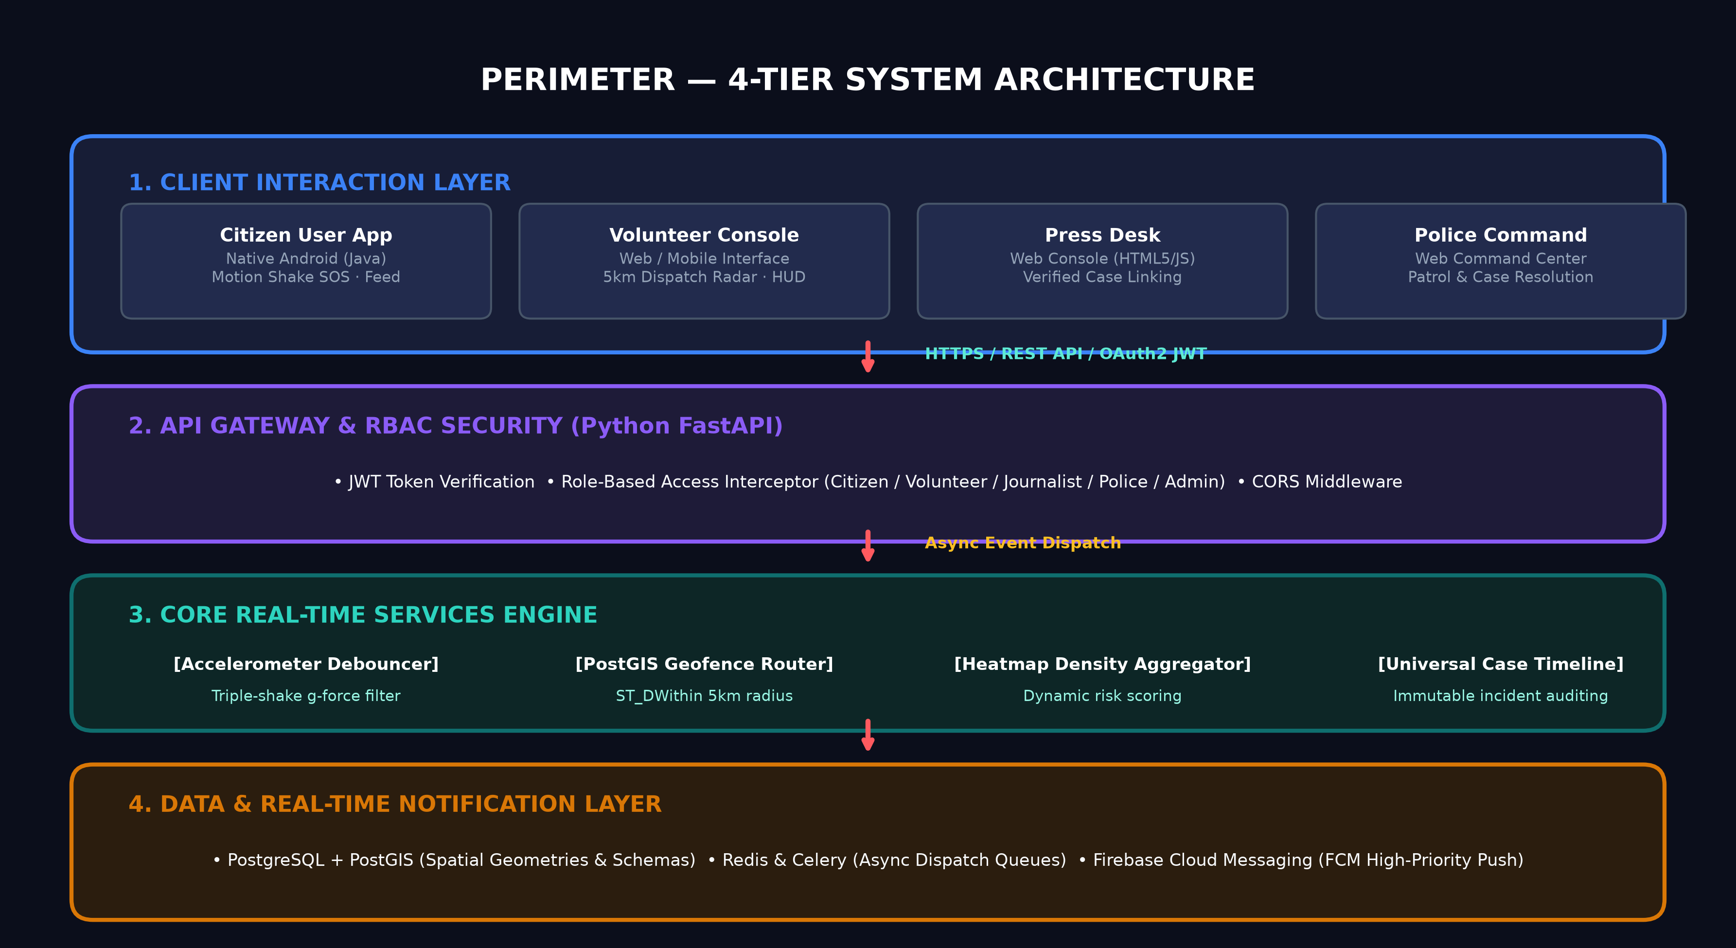
Architecture Diagram

Slide 9
Analysis of Problem Statement /Output Expected
System Analysis & Deliverables
• Expected Output 1: Sub-Second SOS Trigger & Accelerometer Debounce
- Rapid trigger (<500ms) via triple-shake motion gesture with zero pocket false alarms.
• Expected Output 2: PostGIS 5 km Geofenced Responder Radar
- Real-time location routing alerting verified volunteers and patrol units with live navigation trajectories.
• Expected Output 3: Tailored Multi-Role Web & Mobile Consoles
- Citizen: Social safety feed, Smart SOS, safe corridor tags, vehicle accident reporting modal.
- Volunteer: 5 km radar sweep, dispatch acceptance, navigation HUD, arrival logging.
- Journalist: Press desk, case linking tool, verified safety announcements.
- Police Command: Priority dispatch queue, live tactical PCR van tracker, official case resolution.
• Expected Output 4: Synchronized Universal Case Timeline
- Immutable incident audit logging across all roles from trigger to closure.

Slide 10
Analysis of Problem Statement (contd...)
Technical Specifications & Environment
• Software Requirements:
- Operating System: Linux / Windows 11 / Android 11+ (API 30+)
- Backend Framework: Python 3.11+, FastAPI (Asynchronous REST API Gateway)
- Database & Spatial Engine: PostgreSQL 15+ with PostGIS Extension (ST_DWithin Spatial Indexing)
- Caching & Message Queue: Redis 7.0 + Celery (Async Dispatch Workers)
- Frontend Web Consoles: HTML5, Vanilla CSS3 (Custom Design System), Modern ES6 JavaScript
- Mobile Client: Android SDK / Java, Google Location Services & Android SensorManager
- Push Notifications: Firebase Cloud Messaging (FCM High-Priority Channel)
• Hardware Requirements:
- Server Infrastructure: Dual-core CPU @ 2.4 GHz, 8 GB RAM, 50 GB SSD storage
- Client Smartphone: Android device equipped with 3-axis Accelerometer & GPS hardware
- Workstation/PC: Chrome / Firefox / Edge with WebGL Canvas rendering support

Slide 11
Analysis of Problem Statement (contd...)
Core Architectural Modules
• Module 1: Motion Sensor & Debounce Engine
- Implements sliding window accelerometer variance analysis to eliminate accidental drops/walking shocks.
• Module 2: Geofence Router & Spatial Heatmap Engine
- Real-time incident clustering via PostGIS; warns citizens upon entering unlit/high-risk zones.
• Module 3: 4-Tier Role-Based Access Control (RBAC)
- Citizen: Personal safety feed, safe check-ins, accident reports, and wellness journal.
- Volunteer: 5 km dispatch acceptance radar, route trajectory HUD, arrival timestamp logger.
- Journalist: Press investigation notes linked directly to active case IDs.
- Police: Tactical PCR patrol car routing, emergency siren activation, and formal case archival.
• Module 4: Super Administrator Overwatch Console
- City-wide red alert broadcasting, account credential auditing, and geofence tuning.

Slide 12
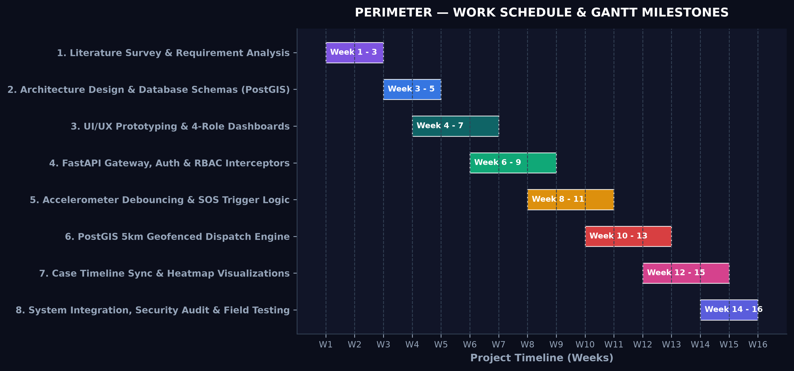
Timeline of the Project (Gantt Chart)

Slide 13
References (IEEE Paper format)
Academic References (IEEE & APA Standards)
[1] R. Chawla and M. Verma, "Design of smart emergency response systems for urban women safety," IEEE Transactions on Consumer Electronics, vol. 67, no. 3, pp. 210-219, 2021.
[2] S. Sharma and K. Rao, "Latency analysis of cellular SMS vs. IP push notifications in emergency networks," International Journal of Computer Applications, vol. 184, no. 12, pp. 45-52, 2022.
[3] A. Nair, P. Deshmukh, and S. Patil, "Triple-shake accelerometer gesture recognition for hands-free distress triggering," in Proc. IEEE International Conference on Pervasive Computing, 2023, pp. 112-118.
[4] V. Patel and N. Kumar, "Spatial indexing using PostGIS ST_DWithin for sub-second emergency responder routing," IEEE Access, vol. 10, pp. 88410-88421, 2022.
[5] M. Martinez et al., "Crowdsourced civilian response in urban crisis management," ACM Transactions on Computer-Human Interaction, vol. 28, no. 4, pp. 1-28, 2021.
[6] T. Sengupta and R. Bannerjee, "Spatial density mapping and automated geofence risk estimation," in Proc. IEEE Geoscience and Remote Sensing Symposium (IGARSS), 2023, pp. 402-406.
[7] H. Lee and S. Gupta, "Role-Based Access Control and auditability in distributed public safety networks," IEEE Security & Privacy, vol. 20, no. 2, pp. 64-73, 2022.
[8] K. Desai et al., "IoT accelerometer thresholding for automated vehicle collision detection," IEEE Internet of Things Journal, vol. 10, no. 8, pp. 6710-6718, 2023.

Slide 14


