Slide 1

BUILD • TEST • DEPLOY • OPERATE • SCALE
AI-Powered Executive
Intelligence Platform
An Engineering Onboarding Guide — the complete lifecycle of building a modern, agent-based enterprise application
For New Engineers
Version 1.0
August 2026

Slide 2




ONBOARDING
What this guide covers
The Why & What
The Architecture
How We Build
How We Operate
Project overview
Business problem & objectives
Functional & non-functional requirements
Solution architecture
Components & integrations
AI/LLM design
Database design
Coding standards & Git flow
TDD & the testing pyramid
CI/CD, IaC & environments
Monitoring & observability
Security & compliance
Maintenance, scaling, best practices
Read top-to-bottom: each section builds on the last. Nothing here assumes prior enterprise experience.

Slide 3

Part 1
THE WHY & WHAT
Project Overview,
Problem & Objectives
Before a single line of code: what we are building, for whom, and why it matters.

Slide 4


OVERVIEW
01
What are we building?
A single destination for technology leaders
Who uses it
A web platform that tracks AI trends, news, and influential research in near real time.
Content is collected, summarized, and categorized by autonomous AI agents — not by a manual editorial team.
Executives get personalized dashboards; summaries turn dense research into business-readable insight.
Subscribers pay per tier; admins configure sources and moderate content.
CEOs, CTOs, CIOs, engineering managers, product leads, and architects who must stay current on AI to steer their teams.
What makes it different (and hard)
The platform runs itself. Four AI agents do the daily work. That means we are building a data pipeline, an agent system, and a SaaS product at once — this deck teaches all three.

Slide 5





BUSINESS CASE
02
The problem, and what success looks like
The problem
AI moves faster than any leader can track. News, models, and research arrive daily across hundreds of sources. Decision-makers either drown in noise or fall behind — both are expensive.
Objectives — how we'll know it works
Aggregate
Summarize
Personalize
Assure quality
Pull trusted sources & research automatically, in real time and on schedule.
Turn dense papers into business-readable takeaways with clear impact.
Match each user's followed topics, companies, and domains.
De-duplicate, fact-check, and gate every item before it publishes.

Slide 6
REQUIREMENTS
03
Functional vs. Non-Functional
Functional — what it does
Non-Functional — how well it does it
Trends dashboard with topic categorization
Research insights with AI executive summaries
Personalized feed; follow topics/companies
Subscriber accounts, bookmarks, preferences
Subscription plans & secure billing
Admin portal: sources, moderation, RBAC
Security — encryption, RBAC, audit logs
Scalability — horizontal scaling of ingestion
Availability — read path survives agent outages
Performance — cached reads, isolated batch jobs
Compliance — robots.txt & source terms respected
Observability — every action traceable
Rule of thumb: functional = features on a checklist. Non-functional = the qualities that get you paged at 2am if ignored.

Slide 7

Part 2
THE ARCHITECTURE
Solution Architecture
& System Design
The layers, the components, how they connect, and where the AI lives.

Slide 8
ARCHITECTURE
04
The stack, top to bottom
Frontend
Next.js 16 · shadcn/ui · Tailwind · Vercel
▲ content flows up
Auth & Billing
Clerk (RBAC) · Stripe subscriptions
API / Edge
FastAPI · Server-Sent Events · rate limiting
Model Gateway
LiteLLM routing · summarization models · key mgmt
Orchestration
Google ADK 2.0 — task graphs, loops, HITL
Data Middleware
FastMCP — controlled tool/data access for agents
Background Tasks
Celery + Redis — arXiv crons, RSS, enrichment
Persistence
PostgreSQL · Pinecone · object storage · search index
Observability & Safety
Langfuse · Sentry · Pydantic schemas

Slide 9








COMPONENTS
05
Key components & external integrations
Frontend (Next.js)
Clerk + Stripe
FastAPI
Google ADK 2.0
Dashboards, trend feed, account UI. Consumes the live SSE stream.
Identity, RBAC across both portals, plans, invoicing, entitlements.
REST endpoints, SSE streaming, validation, rate limiting.
Runs the four agents as nodes in a task graph with retries & HITL.
Celery + Redis
Postgres + Pinecone
Search index
Langfuse + Sentry
Scheduled arXiv jobs, RSS listeners, enrichment, caching.
Transactional data plus vector embeddings for search & recs.
Keyword, faceted & trending search over articles and papers.
Agent traces plus application & frontend error tracking.

Slide 10





AI / LLM DESIGN
06
How the agents actually work
Sources
Ingestion agents
Quality gate
Publish + store
Dashboard
RSS · crawl · arXiv
Trend · Research
dedup · fact-check
Postgres · Pinecone
personalized
Orchestration (ADK 2.0)
Isolation (FastMCP)
Model gateway
Agents are nodes in a graph, not a loose script
Deterministic routing, loops & retries
Human-in-the-loop for risky steps
Each run is traced end-to-end
LLMs never touch the DB directly
Tools & data exposed via context servers
Least-privilege access per agent
Pydantic validates every in/out
One abstraction for all LLM calls (LiteLLM)
Route by task; swap providers freely
Central keys, retries, fallback
Per-agent model & token budgets

Slide 11


DATA
07
Database design — polyglot persistence
PostgreSQL — source of truth
Pinecone — vectors
Object storage + search
Users, subscriptions, sources, content metadata, categories, follows, bookmarks. Anything transactional and relational.
Embeddings of articles & papers for semantic search and 'more like this' recommendations.
Raw HTML & source PDFs in S3/GCS/R2; a search index (Typesense/Postgres FTS) for keyword & faceted queries.
Core relational tables (starter schema)
users
subscriptions
sources
articles
papers
categories
follows
bookmarks
agent_runs
audit_log
Design tips: use UUID keys, timestamp everything, keep large blobs out of Postgres, index the columns you filter on, and never store secrets in tables.

Slide 12

Part 3
HOW WE BUILD
Process, Standards
& the Testing Discipline
Agile flow, clean Git history, TDD, and a testing pyramid you can trust.

Slide 13






PROCESS
08
How we work: Agile + DevOps
Agile in practice
DevOps mindset
2-week sprints; small, shippable increments
Daily standup, sprint planning, retro
Work tracked as tickets in Jira/Linear
'Definition of Done' includes tests + docs
You build it, you run it — own your code in prod
Automate everything you'd otherwise repeat
Fast feedback loops over big-bang releases
Blameless culture when things break
Coding standards — non-negotiables
Format & lint
Typed everywhere
Small PRs
Docs as you go
Ruff/Black (Py), ESLint/Prettier (TS). Enforced in CI.
Python type hints + Pydantic; TypeScript strict mode.
< ~400 lines, one concern, clear description.
Docstrings, READMEs, ADRs for big decisions.

Slide 14

GIT
09
Source control & branching strategy
feature/trends-agent
short-lived · squash-merged via PR
main
Trunk-based
PRs + review
Conventional commits
Protected main
Short-lived branches off main; merge daily. Avoid long-running divergence.
Every change via Pull Request. At least one approval before merge.
feat:, fix:, chore: — readable history & automated changelogs.
No direct pushes. CI must pass. Deploys come from main.

Slide 15


TDD
10
Test-Driven Development: red, green, refactor
RED
GREEN
Why we do TDD
Write a failing test first
Write just enough code to pass
Tests become the spec — you design by using your own code
Catches regressions instantly
Forces small, testable units
Confidence to refactor & let AI tools help
TDD
loop
For AI-agent code specifically
REFACTOR
Mock the LLM — assert on the agent's decisions, not the model's prose
Test tool calls & schema validation deterministically
Golden-set tests for summary quality over time
Clean it up, tests stay green

Slide 16



TESTING
11
Unit, integration & end-to-end
Unit tests
One function or class in isolation. Milliseconds. The broad base — write the most here.
E2E
Integration
Integration tests
Real DB, real queues, mocked LLM. Prove components talk correctly.
Unit
End-to-end tests
Drive the real browser through sign-up → dashboard. Few but high-value.
Shift left: the cheaper the test, the more of them — and run them on every commit.

Slide 17

Part 4
SHIP IT
CI/CD, Infrastructure
& Environments
From a git push to running in production — automated, repeatable, reversible.

Slide 18




DELIVERY
12
The CI/CD pipeline
Commit
CI checks
Quality gates
Build
Deploy staging
Deploy prod
Push to a branch, open a PR
Lint · type · unit + integration tests
Coverage, security scan, code review
Container image, tagged & signed
Auto-deploy, run E2E smoke tests
Approve → rolling release
Everything before 'Deploy prod' is automatic. A red build blocks the merge — the pipeline is the gatekeeper, not a person.
Tooling: GitHub Actions (CI) · container registry · Vercel (frontend) · your cloud for services
on: [pull_request] → jobs: lint → test → build → deploy-staging → (manual approve) → deploy-prod
Fail fast, fix forward: if prod breaks, roll back to the last green image in one click.

Slide 19


INFRASTRUCTURE
13
Infrastructure as Code
What it means
Why it wins
Servers, databases, networks & permissions are defined in version-controlled files — not clicked together by hand in a console.
Reproducible environments, peer-reviewed infra changes, instant rebuilds, and no 'works on that one server' mystery.
Versioned
Repeatable
Disposable
Auditable
Infra changes reviewed like code
Spin up an identical env in minutes
Tear down & recreate without fear
Every change tracked in git history
Tools you'll see: Terraform / OpenTofu for cloud resources, Docker for containers, Helm/Kubernetes manifests for orchestration.

Slide 20

ENVIRONMENTS
14
Dev → Staging → Production
Development
Staging
Production
Your laptop / cloud dev box
Docker Compose for local services
Seed data, mocked LLM optional
Break things freely here
Mirror of production, smaller
Real integrations, test data
E2E & smoke tests run here
Last gate before users see it
Real users, real money, real data
Zero-downtime rolling deploys
Locked down; access audited
Monitored 24/7, on-call rotation

Slide 21

Part 5
RUN IT WELL
Observability, Security
& Staying Alive at Scale
Shipping is the start. Operating reliably and securely is the job.

Slide 22


OBSERVABILITY
15
Monitoring, logging & the 3 pillars
Metrics
Logs
Traces
Numbers over time — latency, error rate, queue depth, tokens used.
Structured event records. Searchable, correlated by request ID.
One request's path across services — plus every agent step (Langfuse).
SRE principles you'll live by
SLI
SLO
Error budget
Alert on symptoms
A metric users feel — e.g. dashboard load time
The target for that metric — e.g. 99.9% under 500ms
Allowed failure. Spend it on features, not firefighting
Page on user pain, not every CPU blip

Slide 23




SECURITY
16
Security & compliance — shift left
Shift-left: build security in from the first commit — scan dependencies, secrets, and code in CI — instead of bolting it on before launch.
Identity & access
Data protection
Automated scanning
Clerk-issued auth, RBAC per role, least privilege everywhere.
TLS in transit, encryption at rest, secrets in a vault — never in code.
SAST, dependency & secret scans as CI quality gates.
Compliance
AI-specific risks
Human review
Respect robots.txt & source terms; audit logs; data-retention policy.
Prompt-injection defense, output validation, no PII to third-party models.
Sensitive agent actions require human-in-the-loop approval.

Slide 24



OPERATE
17
Maintenance & support
Keep it current
Incident response
Patch dependencies, rotate keys, retrain/re-eval prompts as models change.
On-call rotation, runbooks, blameless post-mortems after every incident.
Support loop
Tech-debt budget
User issues → triage → ticket → fix → verify. Feedback shapes the backlog.
Reserve sprint capacity for refactors; debt ignored compounds fast.

Slide 25

Part 6
WORK SMARTER
Modern AI-Era
Engineering Practices
The force-multipliers: AI-assisted development, agentic patterns, and cloud-native design.

Slide 26



PRODUCTIVITY
18
AI-assisted development
Claude Code
GitHub Copilot
AI coding agents
Agentic coding in your terminal/IDE — delegate whole tasks, not just autocomplete.
Inline suggestions & chat while you type. Great for boilerplate and tests.
Hand off a ticket; the agent opens a PR you review. You stay the pilot.
How to use them well
Do
Don't
Review every line before you commit
Let AI draft tests, docs & boilerplate
Give it context: files, standards, examples
Paste secrets or customer data into prompts
Merge code you don't understand
Trust output without running the tests

Slide 27
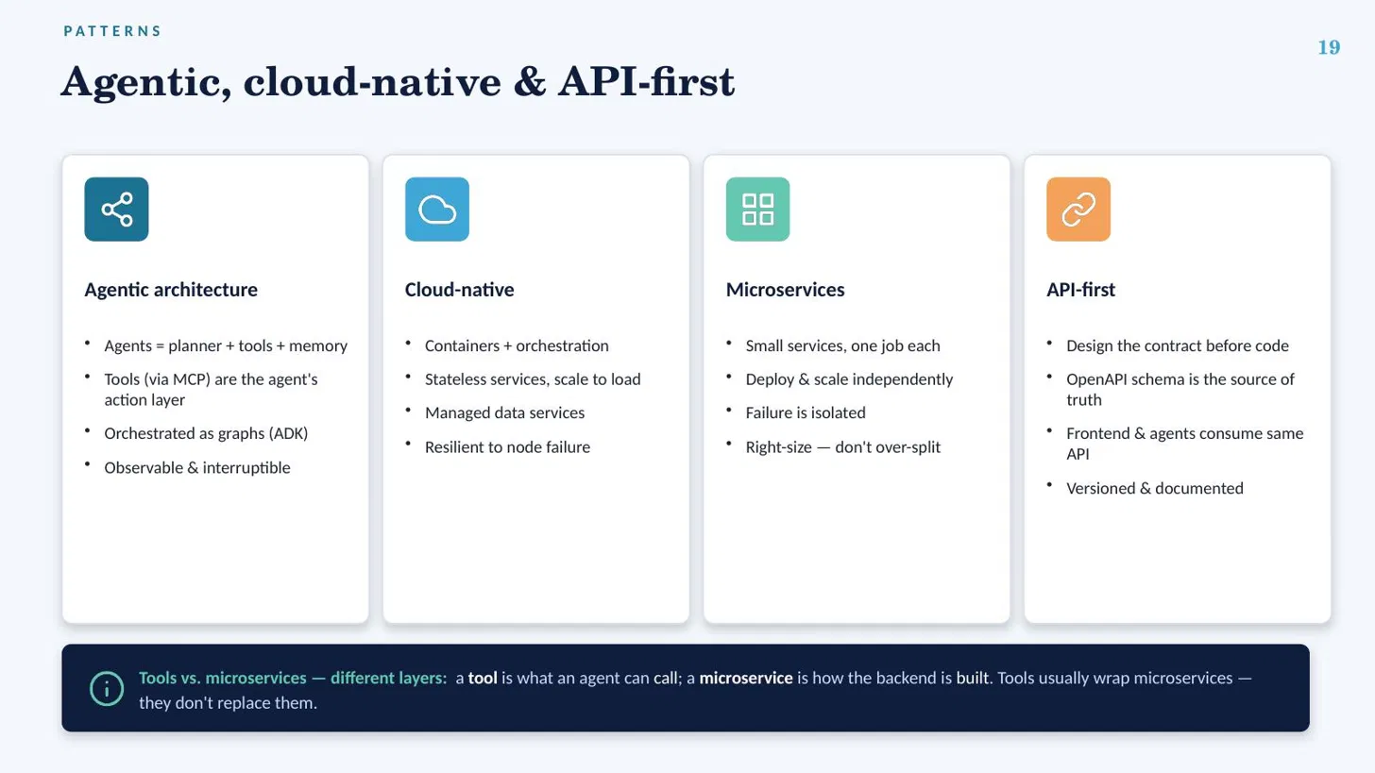

PATTERNS
19
Agentic, cloud-native & API-first
Agentic architecture
Cloud-native
Microservices
API-first
Agents = planner + tools + memory
Orchestrated as graphs (ADK)
Isolated from data via MCP
Observable & interruptible
Containers + orchestration
Stateless services, scale to load
Managed data services
Resilient to node failure
Small services, one job each
Deploy & scale independently
Failure is isolated
Right-size — don't over-split
Design the contract before code
OpenAPI schema is the source of truth
Frontend & agents consume same API
Versioned & documented

Slide 28



WISDOM
20
Common challenges & best practices
Non-deterministic AI Same input, different output.
Fix: Pin versions, validate outputs with Pydantic, use golden-set eval tests.
Runaway LLM cost Tokens add up fast at scale.
Fix: Cache, batch, set per-agent budgets, pick cheaper models per task.
Slow feedback loops Waiting kills momentum.
Fix: Fast CI, local mocks for the LLM, small PRs merged daily.
Over-engineering Building for scale you don't have.
Fix: Start simple; add microservices & caches when data demands it.
Silent failures Agents fail quietly, not loudly.
Fix: Trace everything, alert on symptoms, add human-in-the-loop gates.

Slide 29







WHAT'S NEXT
21
Future enhancements & scaling strategy
Product roadmap
Scaling strategy
Digests & newsletters
Trend prediction engine
Scale reads with caching & CDN before scaling databases
Add Celery workers horizontally as source count grows
Shard vector & search indexes as the corpus expands
Split a service out only when it becomes a bottleneck
Autoscale on real metrics (queue depth, latency), not guesses
Load-test before you need to, not after you're paged
Competitor monitoring
Conversational assistant
Mobile app
Multi-language support

Slide 30
Thank You!

