Slide 1




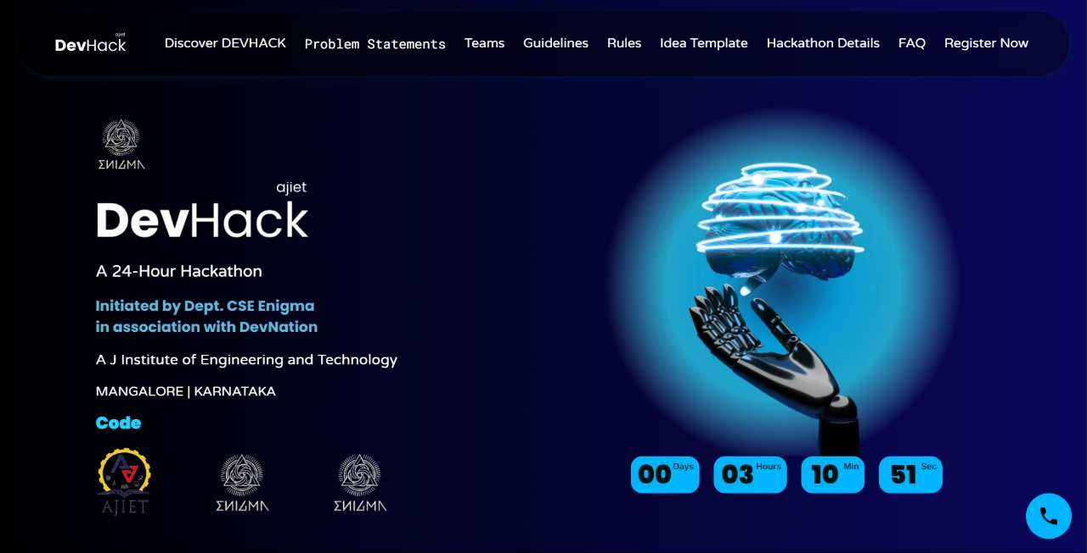
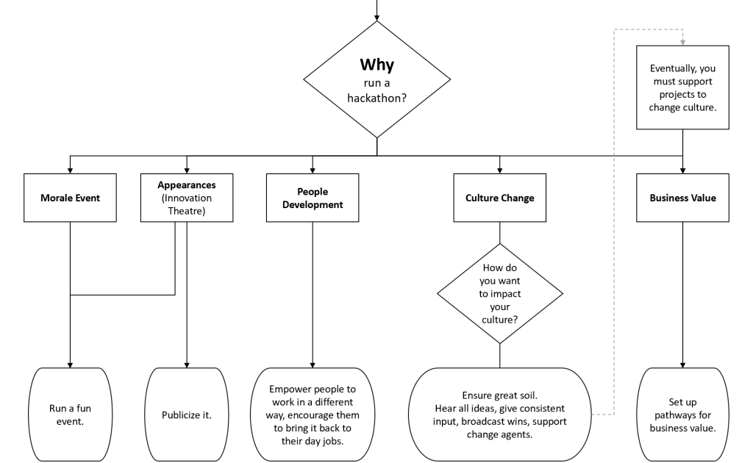
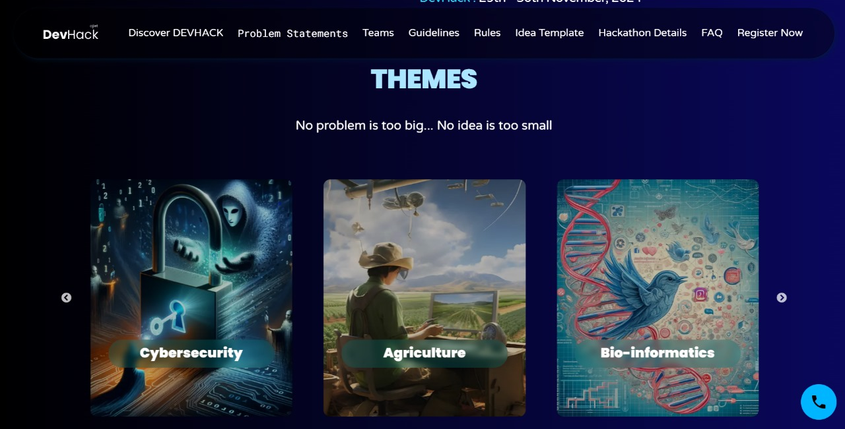
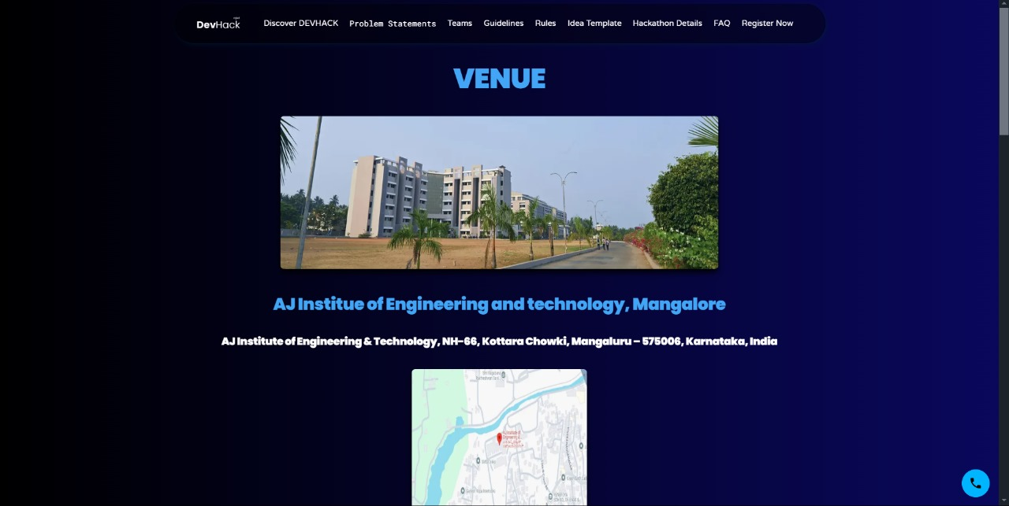
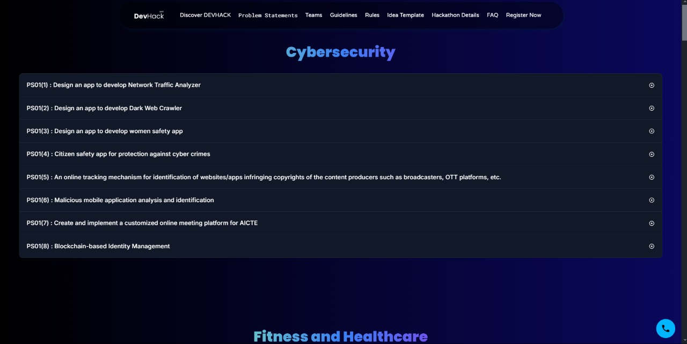
Dev Hack
P A Keertana
Ms. Vedavati Bandari
Department of Computer Science and Engineering
A J Institute of Engineering and Technology (IC202115628)
Abstract
Methodology
Results
Conclusion
The AJIET Hackathon Website offers event details, participant resources, and project showcases to support the annual competition. Built using Next.js with Daisy UI and Material UI, it ensures a responsive and user-friendly experience while streamlining communication and engagement for participants.
The AJIET Hackathon Official Website has proven to be a valuable tool for organizing and promoting the event. Its intuitive design and robust functionality have significantly improved communication between participants and organizers, enhancing the overall hackathon experience. Future iterations can further incorporate advanced features such as live event tracking and interactive forums for real-time collaboration.
Introduction
Hackathons are pivotal in fostering innovation and collaboration among students and professionals. AJIET's annual hackathon aims to cultivate problem-solving skills, encourage technological creativity, and provide participants with a platform to present their innovative solutions. The official website is designed to serve as a one-stop destination for event details, project submissions, and participant support. It ensures seamless communication between organizers and participants, enhancing the overall competition experience.
References
Next.js Documentation
- https://nextjs.org/docs
Daisy UI Documentation
- https://daisyui.com/Material
Material UI Documentation
https://mui.com/

