Slide 1




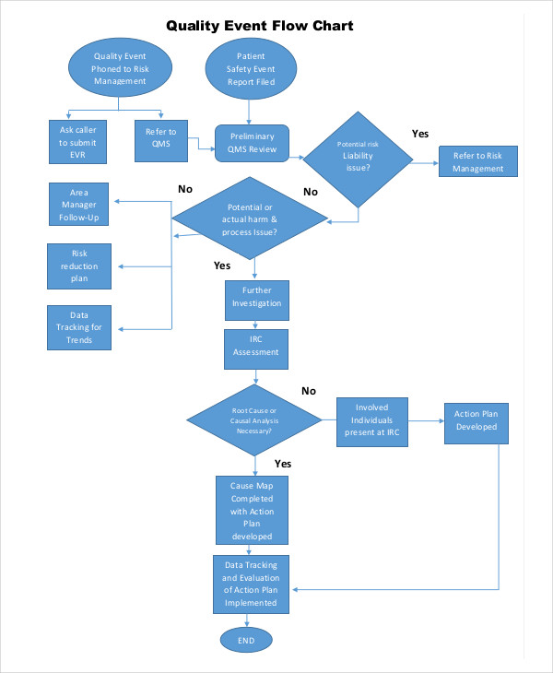
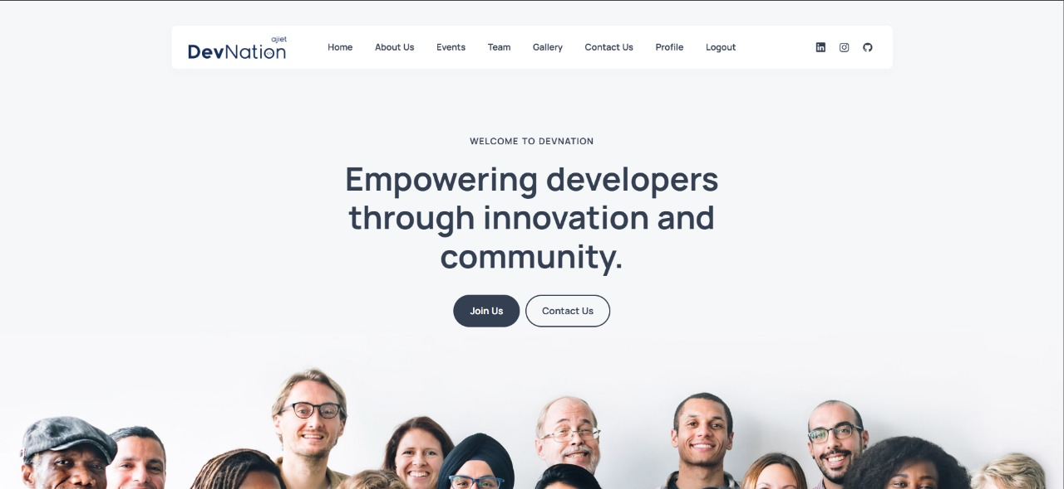
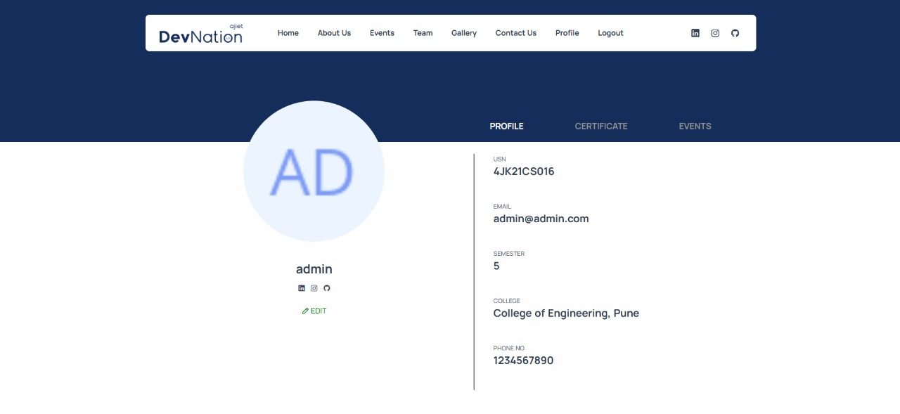
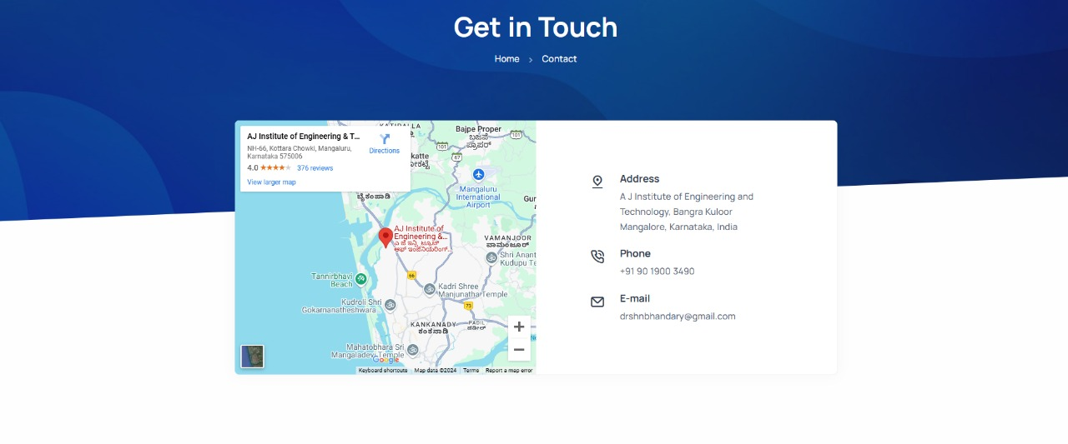
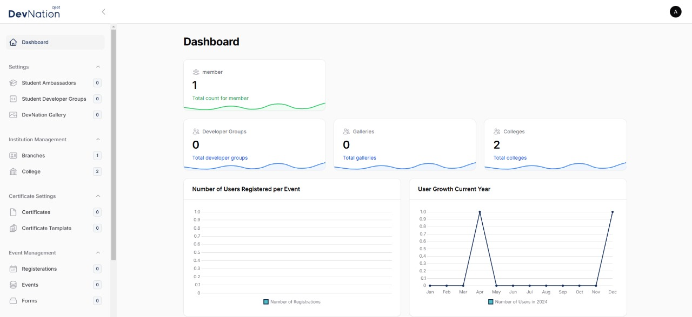
Devnation CMS
Milan C I
Guide: Dr. Antony P J
Department of Computer Science and Engineering
A J Institute of Engineering and Technology (IC202115628)
Abstract
Methodology
Results
Conclusion
DevNation CMS is an open-source project for the DevNation community, focused on simplifying content management. It offers tools for publishing, collaboration, and role-based access, with customizable templates and a user-friendly interface. Built for scalability and security, it ensures responsive performance to meet the community's diverse needs.
DevNation CMS highlights the potential of open-source, community-focused development using Laravel and SQL. Its robust architecture ensures flexibility and efficiency, making it a reliable solution for content management. Future plans include implementing AI-powered content recommendations and extending APIs for third-party integrations.
Introduction
DevNation CMS addresses the need for effective content management in digital communities. This open-source, community-driven platform evolves with user needs, offering intuitive tools for creating, curating, and managing content, supporting DevNation's digital presence.
References
Laravel Framework
Documentation: https://laravel.com/docsMySQL
Database Reference:
https://dev.mysql.com/doc/Community
Contributions:
Insights from DevNation forums and surveys. Open Source Methodologies: "Collaborative Development Practices,"

