Slide 1




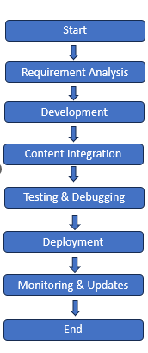
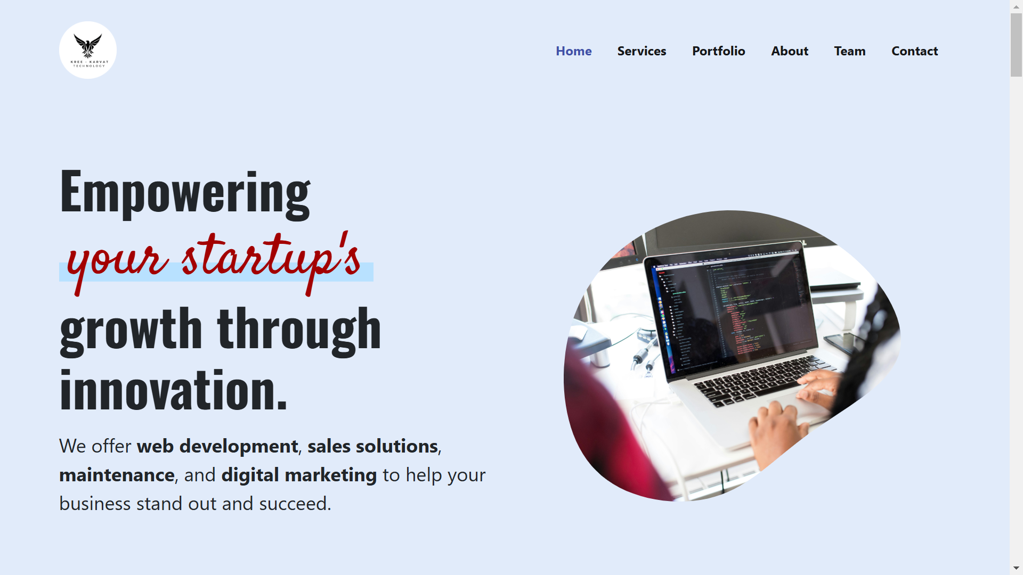
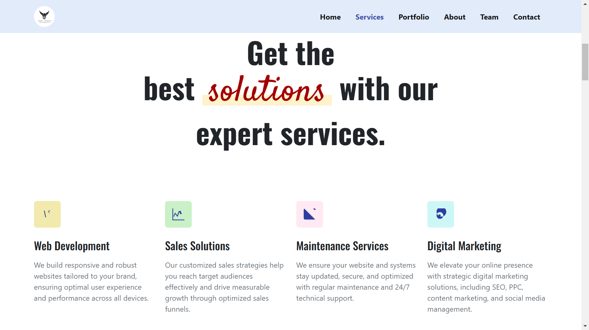
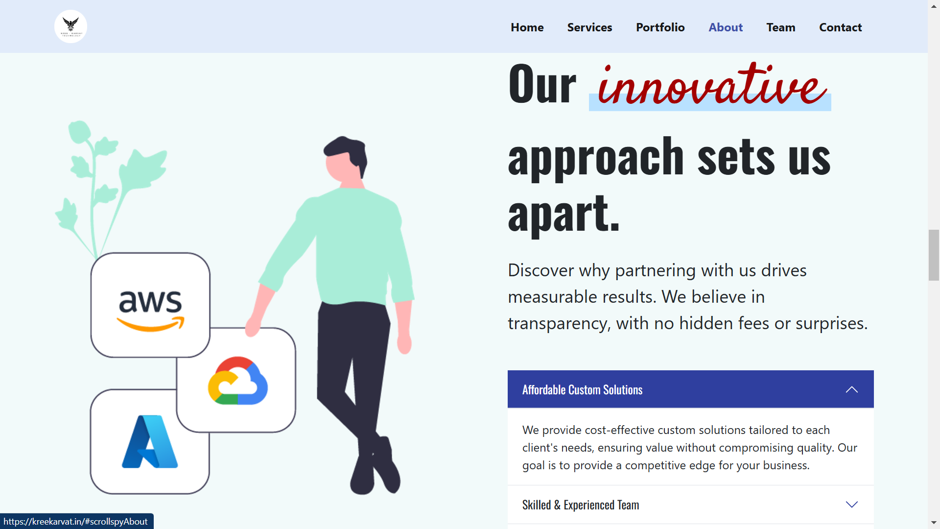
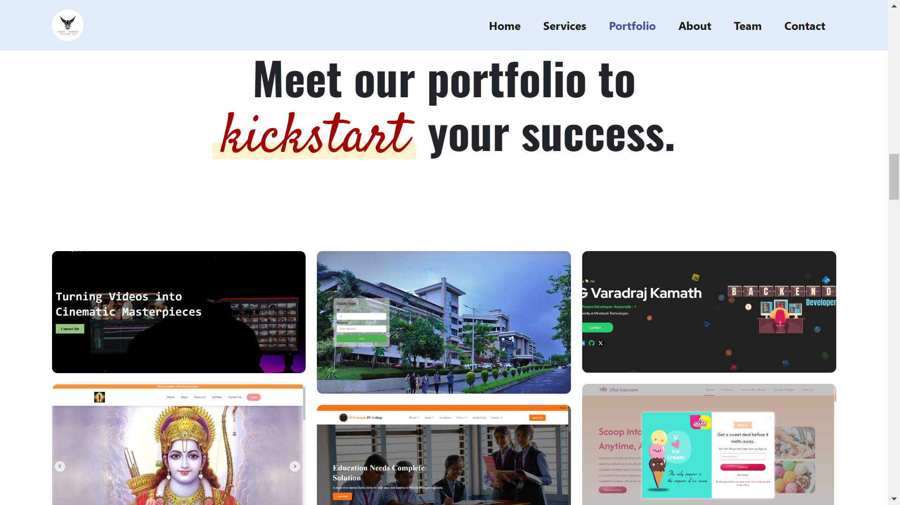
Kreekarvat Technologies Website
Nidhi D
Under the Guidance: Mrs. Vidya Myageri
Department of Computer Science and Engineering
A J Institute of Engineering and Technology (IC202115628)
Abstract
Methodology
Results
Conclusion
KreeKarvat Technologies: Empowering startups with innovative web solutions. We specialize in cutting-edge web development, design, and digital marketing services to elevate your online presence. From responsive websites to custom web applications, we deliver tailored solutions that drive growth and success for businesses of all sizes.
Client-Centric Approach: ReeKarvat Technologies tailors solutions specifically to the needs of startups and businesses of all sizes.
Comprehensive Services: Provides a full range of services from responsive web development to custom web applications and digital marketing.
Focus on Growth: Aims to elevate clients’ online presence and drive business growth through innovative and effective solutions.
Commitment to Innovation: Emphasizes cutting-edge technologies and creative design to ensure the success and longevity of digital projects.
Scalable Solutions: Delivers solutions that are adaptable to the evolving needs of businesses, helping them stay competitive in the digital space.
Introduction
KreeKarvat Technologies focuses on empowering startups and businesses by providing innovative and tailored web solutions. The project highlights the following:
Core Expertise: Specializes in cutting-edge web development, creative design, and impactful digital marketing.
Service Offering: Delivers responsive websites, custom web applications, and optimized digital strategies to enhance online presence.
Goal: Drives business growth and success by offering personalized solutions to meet diverse client needs, regardless of business size.
References
https://getbootstrap.com/
https://www.w3schools.com/bootstrap/bootstrap_ref_css_forms.asp
https://www.w3schools.com/references/index.php
https://www.w3schools.com/tags/

