Slide 1




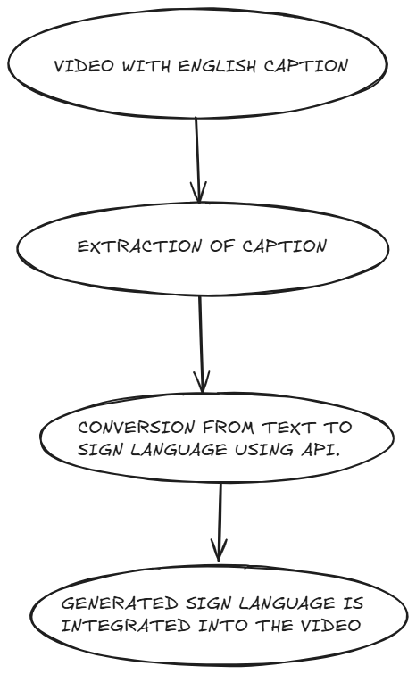
“SIGNFLIX: A VIDEO STREAMING PLATFORM WITH SIGN LANGUAGE”
Jnanesh, Milan CI, Gauresh G Pai, Himanshu Hegde
Department of Computer Science & Engineering
A J Institute of Engineering and Technology (IC202115628)
Abstract
Methodology
Results
Conclusion
Deaf and hard-of-hearing individuals often face challenges accessing video content due to limited or no sign language interpretation. SignFlix addresses this by providing a video streaming platform where users upload videos with captions, which are then processed via an API to generate sign language interpretation. This ensures an inclusive and accessible digital content experience.
1. Users upload videos with captions.
2. The platform extracts captions from the uploaded video.
3. Captions are sent to an external API for sign language conversion.
4. The interpreted sign language is rendered alongside the video.
SignFlix successfully demonstrated that captioned video content could be made accessible through sign language integration using external APIs. Initial user feedback indicates improved comprehension and inclusivity.
Planned features include a dual-screen interface displaying both the original video and the sign language interpretation side-by-side. Users will be able to control the playback of sign language—adjusting speed, synchronizing delays with the main video, and pausing independently. This will allow for a more personalized and accessible viewing experience.
SignFlix offers a scalable, automated and user-friendly solution to make video content accessible for the deaf and hard-of-hearing community without relying on manual interpretation.
Introduction
Video content is rapidly growing, yet most platforms lack proper sign language support. SignFlix bridges this gap by processing captions into sign language using external APIs, making it easier for deaf and hard-of-hearing viewers to understand and enjoy digital content.
References
1. World Health Organization – Deafness and hearing loss
2. Accessibility guidelines for multimedia content
3. APIs for text-to-sign language conversion
4. Documentations

