Slide 1

Presentation
On
“SIGNFLIX: A VIDEO STREAMING PLATFORM WITH SIGN LANGUAGE”
PRESENTED BY:
JNANESH : 4JK22CS020
GAURESH G PAI : 4JK22CS016
HIMANSHU HEGDE : 4JK22CS018
MILAN CI : 4JK22CS027
UNDER THE GUIDANCE OF
MRS. NAYANA YADAV M
ASSISTANT PROFESSOR, CSE

Slide 2
PROBLEM STATEMENT
Deaf and hard-of-hearing individuals struggle to access video content.
Most online videos lack proper sign language interpretation.
Automatic captions alone do not provide a fully accessible experience.
The lack of sign language support limits equal access to information and entertainment.

Slide 3
EXISTING SOLUTION
YouTube's Auto-Captions: YouTube provides automatic captions, but it lacks integrated sign language interpretation.
Sign Language Apps: Apps like The ASL App and HandTalk help translate text to sign language, but they are not integrated into mainstream video platforms.
Television & Streaming Services: Some streaming services (e.g., Netflix, Disney+) provide sign language interpretation for select content, but availability is limited.

Slide 4
PROPOSED SOLUTION
SignFlix is a video streaming platform designed to improve accessibility for the deaf and hard-of-hearing community by integrating sign language interpretation.
It provides sign language interpretation by processing video captions.
The platform ensures inclusive content by converting text into sign language using an API.

Slide 5
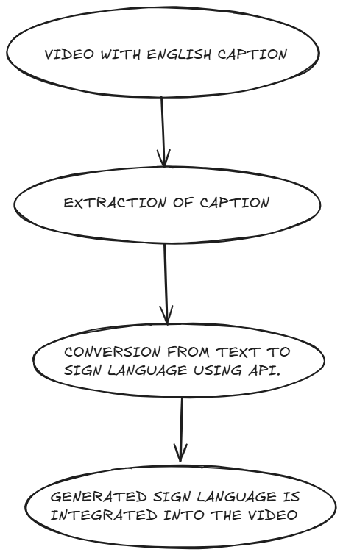
METHODOLOGY

Slide 6
LITERATURE REVIEW
[1] Sign Language Translation: A Survey of Approaches and Techniques
This survey explores various approaches to sign language translation, focusing on machine learning techniques like CNNs, RNNs, and hybrid models for static and dynamic signs. It reviews advancements in text-to-sign language systems and highlights challenges such as regional variations, scalability, and emotional expressiveness in digital signing.

Slide 7
[2] Gesture, Sign, and Language: The Coming of Age of Sign Language and Gesture Studies
This paper reviews the evolution of sign language research, highlighting three stages: the initial perception of sign language as pantomime, its recognition as a legitimate linguistic system similar to spoken languages, and the current understanding that modality influences linguistic structure. It explores the relationship between gestures and signs and examines modality and iconicity as central issues in sign language studies

Slide 8
[3] Streaming Video over the Internet: Approaches and Directions
This paper explores the challenges and solutions for streaming video over the Internet, focusing on bandwidth, delay, and loss requirements. It covers six key areas: video compression, application-layer QoS control, continuous media distribution services, streaming servers, media synchronization mechanisms, and streaming media protocols. The study discusses trade-offs between approaches and highlights future research directions to improve real-time multimedia services. Published in IEEE Transactions on Circuits and Systems for Video Technology, 2001.

Slide 9
REFERENCES
Sign Language Translation: A Survey of Approaches and Techniques
Gesture, Sign, and Language: The Coming of Age of Sign Language and Gesture Studies
Streaming Video over the Internet: Approaches and Directions
Next.js Documentation
Prisma Documentation

Slide 10
THANK YOU!

