Slide 1
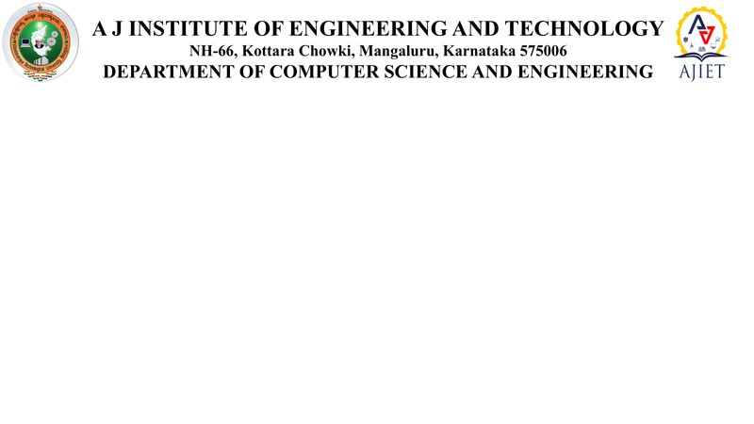
Presentation On
“SIGNFLIX:A VIDEO STREAMING PLATFORM WITH SIGN LANGAUAGE”
PRESENTED BY:
GAURESH G PAI: 4JK22CS016 JNANESH : 4JK22CS020
HIMANSHU HEGDE : 4JK22CS018 MILAN CI : 4JK22CS027
UNDER THE GUIDANCE OF:
MRS. NAYANA YADAV M
ASSISTANT PROFESSOR
DEPARTMENT OF CSE

Slide 2
CONTENTS
INTRODUCTION
PROBLEM STATEMENT
OBJECTIVE
PROGRESS UPDATE
REFERENCES

Slide 3
INTRODUCTION
In today's digital world, video content plays a significant role in entertainment, education, and communication. However, accessibility for the deaf and hard-of-hearing community is still a major concern. While subtitles help, they are not always a complete solution, especially for individuals who rely primarily on sign language for communication. There is a pressing need for inclusive platforms that ensure equal access to video content for everyone, regardless of their hearing ability.

Slide 4
PROBLEM STATEMENT
Lack of Accessibility: Traditional video platforms often rely solely on subtitles, which do not fully cater to the needs of deaf and hard-of-hearing individuals who primarily use sign language.
Manual Effort: Creating sign language interpretations manually for every video is time-consuming, labor-intensive, and not scalable for large volumes of content.
Limited Integration: There is no automated system that seamlessly integrates sign language interpretation into video content in real-time before uploading.
Digital Inclusion Gap: The absence of sign language support in most streaming platforms contributes to the digital divide, limiting equal access to information and entertainment.
Need for Automation: There is a critical need for a solution that can automatically read subtitles, convert them to sign language using 3D models, and embed this into videos to enhance accessibility.

Slide 5
OBJECTIVE
Automatic Subtitle Processing – To extract and analyze subtitles from user-uploaded videos.
Sign Language Generation – To convert subtitle text into sign language using a 3D animated model.
Video Integration – To embed the 3D sign language avatar in one corner of the video before final upload.
User-Friendly Platform – To provide an intuitive and inclusive video streaming experience for both content creators and viewers
Scalability & Efficiency – To create a scalable system that minimizes manual intervention while maintaining accuracy and performance.

Slide 6
PROGRESS UPDATE
API Research and Evaluation:Conducted research on subtitle parsing libraries and sign language generation APIs (e.g., Google Speech-to-Text, DeepMotion, or SignAll) to determine suitable tools for automatic sign interpretation.
Subtitle Extraction Testing: Successfully tested extraction of subtitles from uploaded video files (SRT, VTT formats), verifying time-sync accuracy and text segmentation for sign generation.
3D Avatar Integration Exploration: Initiated testing of 3D avatar rendering frameworks (such as Three.js, Blender WebGL exports, or Ready Player Me) for embedding animated sign language models into video content.
Pipeline Planning for Video Embedding: Designed a preliminary pipeline to overlay the 3D sign model into a video corner using FFmpeg or WebRTC-based methods before the upload process.

Slide 7
REFERENCES
FFmpeg – Open-source video processing tool
🔗 https://ffmpeg.org/
WebVTT / SRT Subtitle Format Documentation
🔗https://developer.mozilla.org/enUS/docs/Web/API/WebVTT_API
Three.js – JavaScript 3D library for rendering animated avatars
🔗 https://threejs.org/
Ready Player Me – Customizable 3D avatars
🔗 https://readyplayer.me/
Automatic Sign Language Generation from Text for Deaf Accessibility – Discusses NLP and animation for sign language synthesis.
🔗 https://scholar.google.com/
Video Accessibility Guidelines – W3C
🔗 https://www.w3.org/TR/media-accessibility-reqs/

Slide 8
THANK YOU

