Slide 1
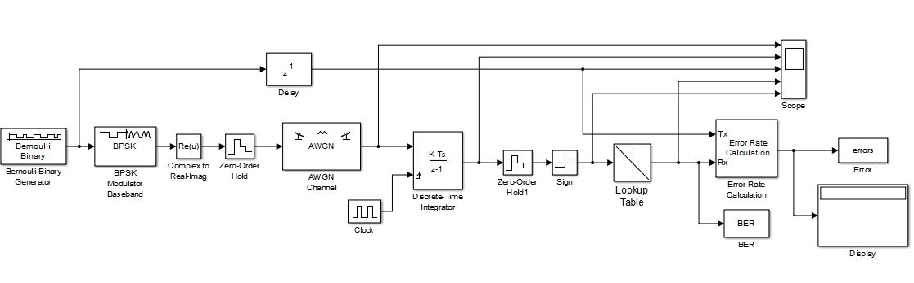
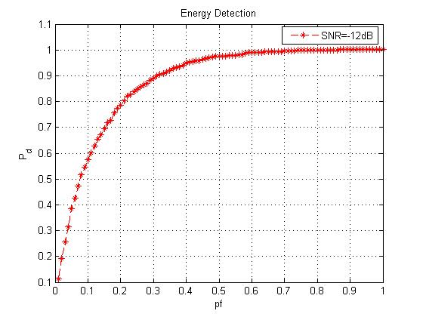
Simulink Models (BER and ROC Curves)

Slide 2
Index
BER Curve for BPSK in AWGN 1st model
BER curve for BPSK in AWGN 2nd model
BER Curve for BPSK in AWGN 3st model (using Integrator while demodulation)
BER curve BPSK in Rayleigh fading channel and output
BER curve for BPSK in Recian fading channel and output (for different K)
Energy Detection (Matlab script file and its output)
Energy Detection From Simulink Model .
ROC characteristics curve from Simulink Model at different SNR
Including Low Pass Filter
Next tasks :

Slide 3
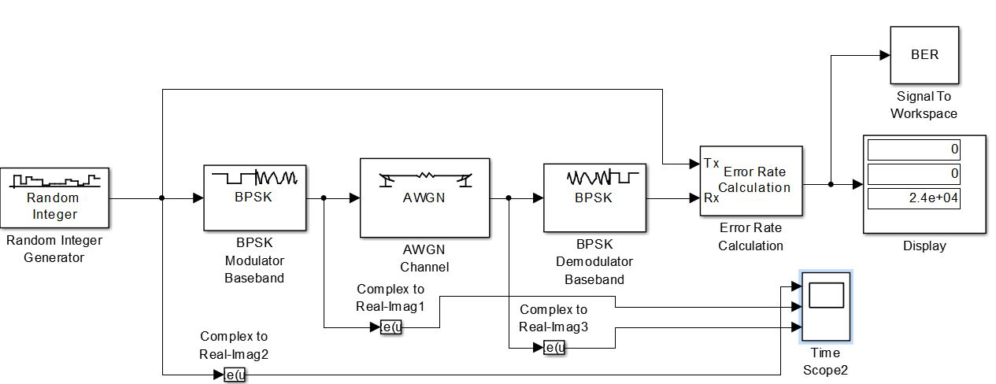
BPSK BER vs EbNo 1st model

Slide 4
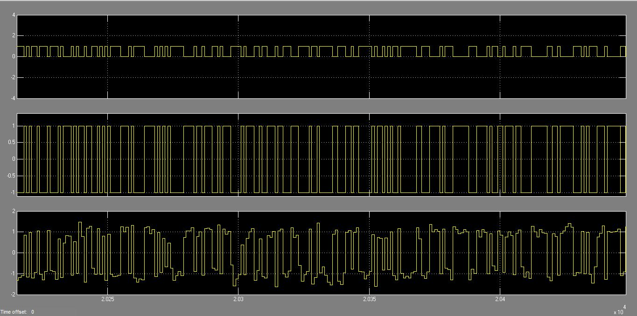
Waveforms
Sampling Problem

Slide 5
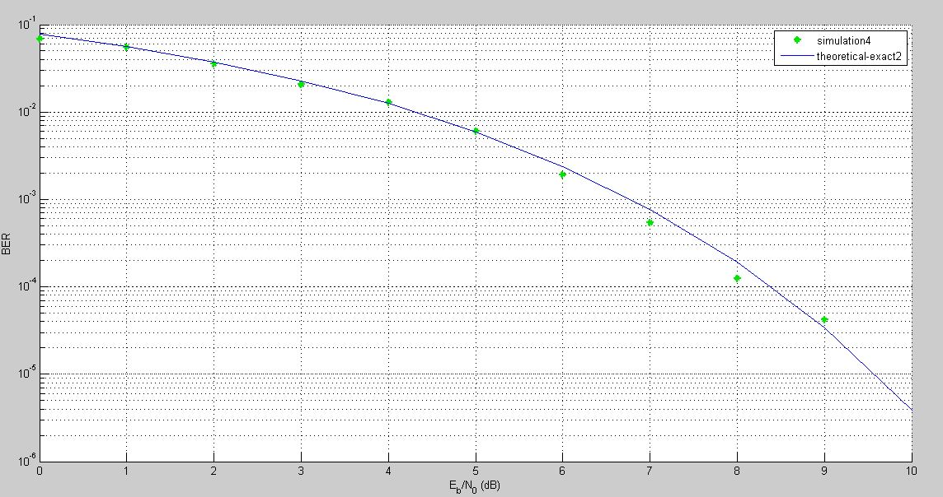
Output
Problem? Sampling is not done on each bit that we are sending

Slide 6
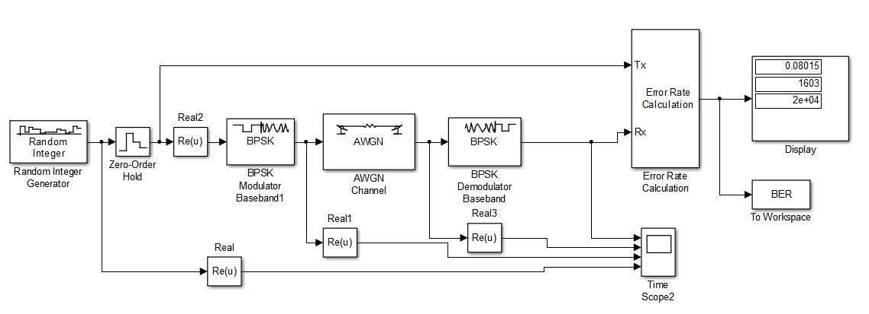
BPSK BER vs EbNo 2nd Model
For sampling

Slide 7
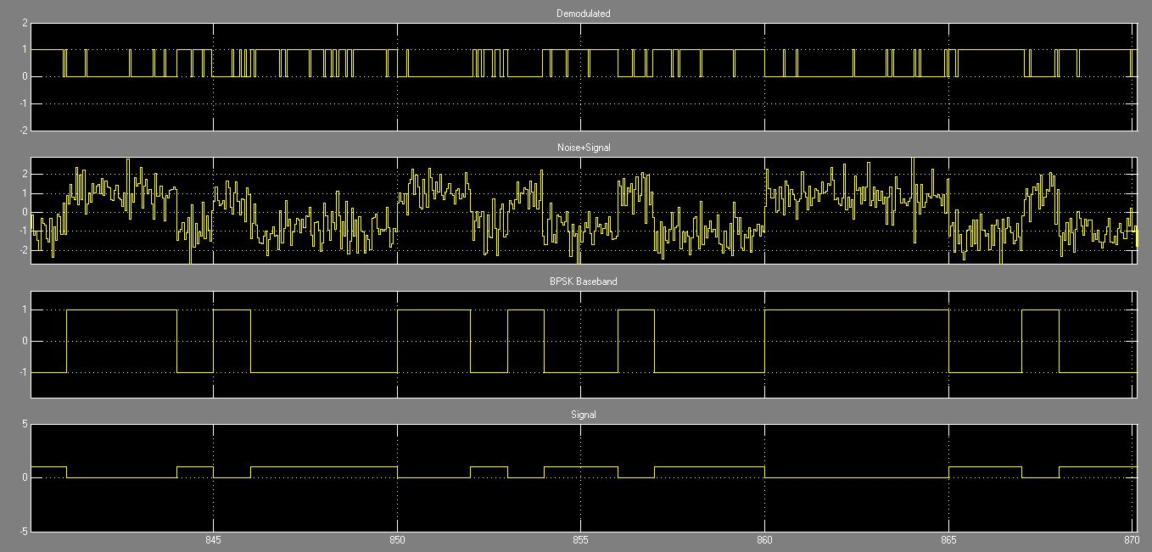
Waveforms
Sampling Per Bit

Slide 8
BPSK Baseband Eb/No vs BER Model 3rd using Integrator at receiver side
Model Run from Matlab script File and generate the output shown below

Slide 9
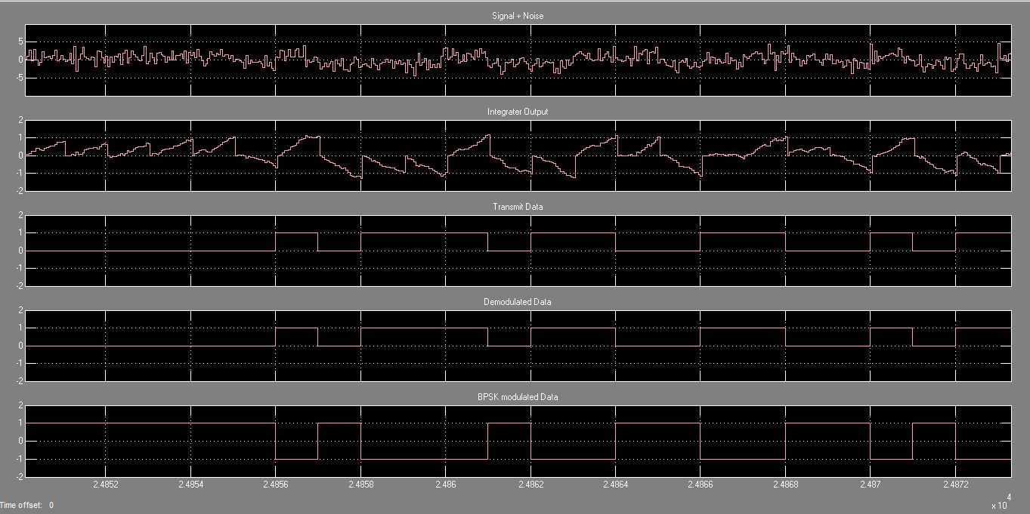
Waveform Output

Slide 10
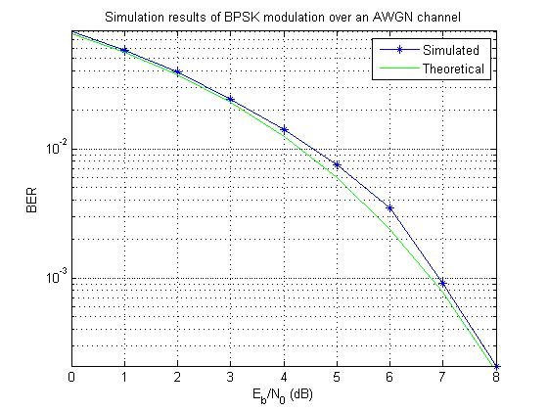
Output

Slide 11
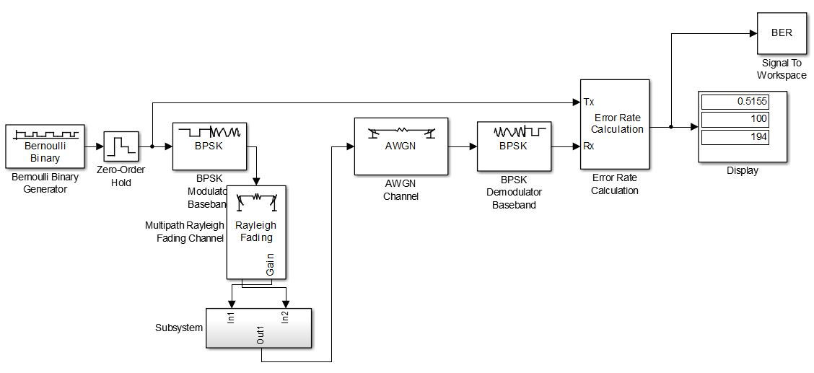
BER curve for BPSK under Rayleigh Channel

Slide 12
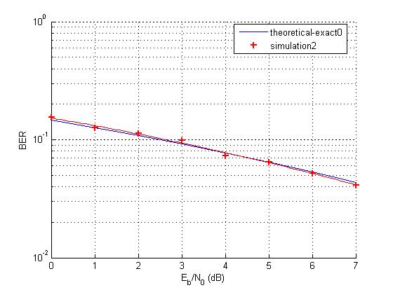
Output

Slide 13
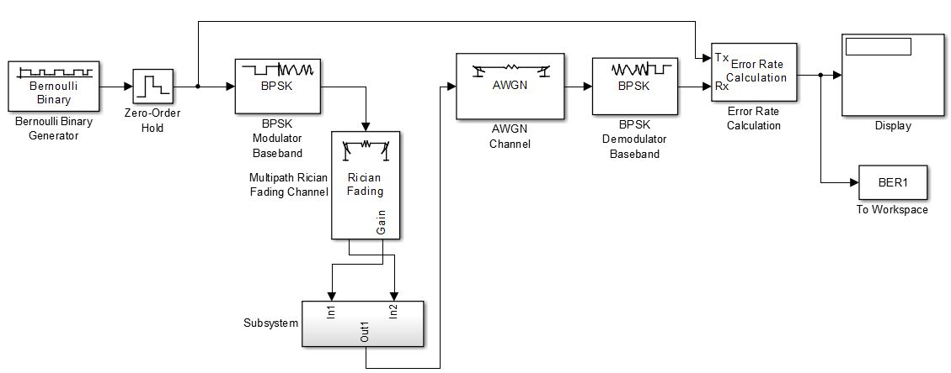
BER curve for BPSK under Recian Channel

Slide 14
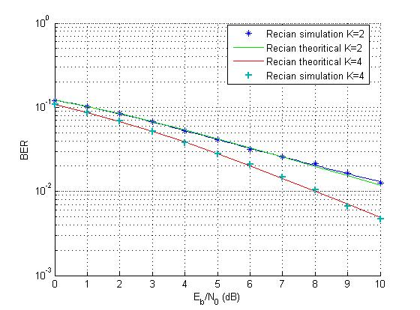
Output

Slide 15
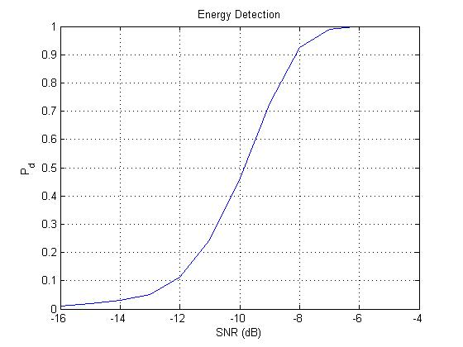
Energy Detection (Matlab Script File Taking BPSK Baseband Signal
This figure shows simulation for energy detection method of signal
detection in cognitive radio and its probability of detection for different
SNR values with AWGN channel.

Slide 16
“Sample Based” and “Frame Based” Signals
Sample Based:
time
They are MN distinct signals arranged in a matrix
Particular Case:
is like M distinct signals

Slide 17
“Sample Based” and “Frame Based” Signals
Frame Based:
They are N distinct signals, each one represented as a sequence of frames of length M
Particular Case:
one signal as a sequence of frames of length M

Slide 18
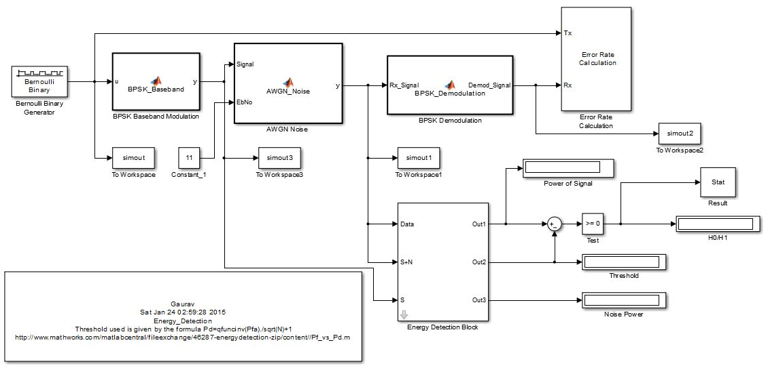
Energy Detection Simulink Model
Subsystem

Slide 19
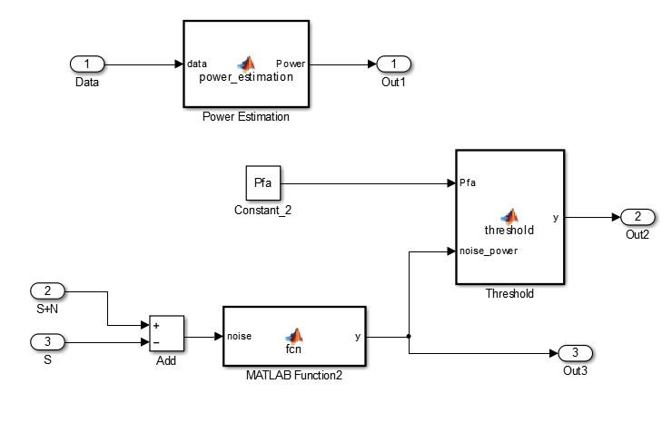
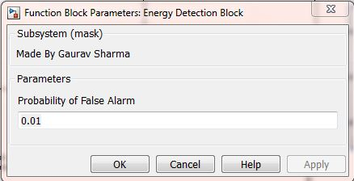
Subsystem

Slide 20
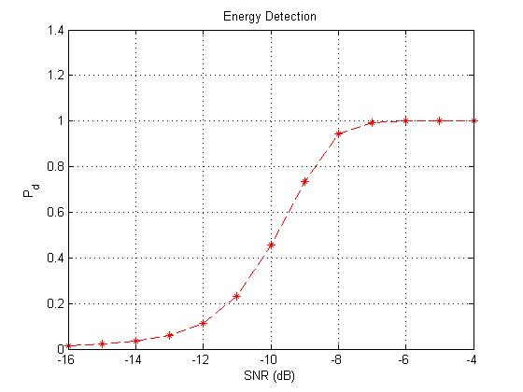
Output From Simulink model
Note:
The parameter Pfa, N, SNR can be changed in simulink model, to obtain Pd vs Pfa or Pd vs SNR curves
Pfa=0.01
N=1000
Probability of detection for different SNR values with AWGN channel Graph from Simulink Model .The simulation parameter :
Pfa =0.01
No. of sample N=1000

Slide 21
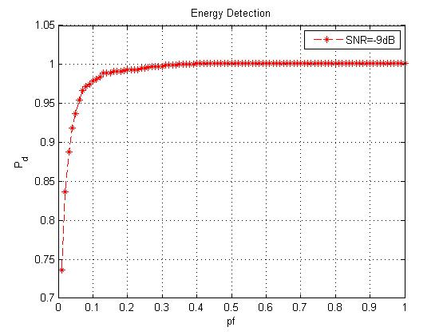
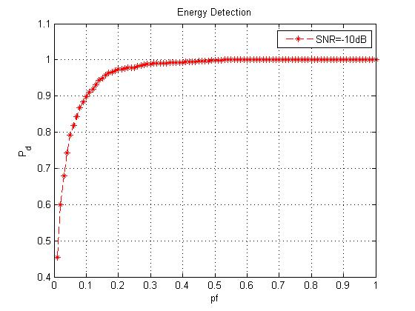
ROC Characteristics from Simulink Model
Pfa=0.01
N=1000
ROC curve Pd vs Pfa for SNR=-9dB (Left) and SNR=-10dB(Right)

Slide 22
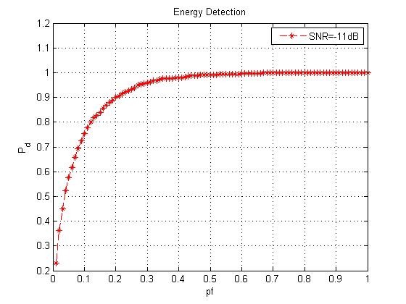
ROC curve for SNR=-11dB(left) and SNR= -12(Right)
Pfa=0.01
N=1000

Slide 23
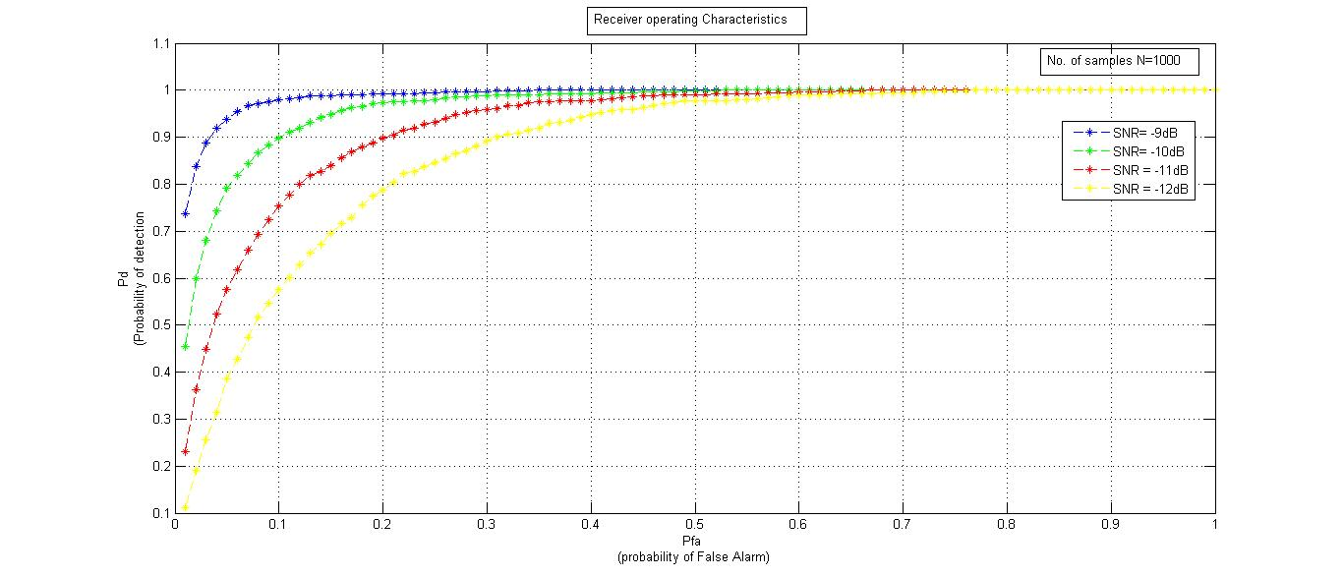
Combined Figure
Pfa=0.01
N=1000

Slide 24
The Above all Curve Can be Obtained By running The Matlab Script File which calls our simulink model.One such code is as follow :-
clc;
pf = 0.01:0.01:1;
for i=1:length(pf)
Pf=pf(i);
model='SDR';
simout=sim(model);
[m,n]=size(Stat);
count=0;
for j=1:m
if Stat(j,1)==1
count=count+1;
end
end
pde(i)=count/1000;
end
% Plot result (SNR Vs Pd)
figure()
plot(pf,pde,'--*r');
xlabel('pf');
ylabel('P_d');
title('Energy Detection');
g
Model name ‘SDR’
And Sim(‘model name’) is command to call the Model

Slide 25
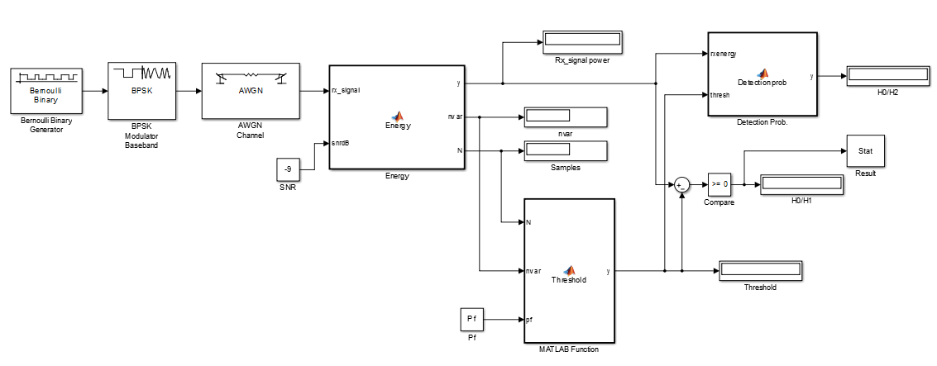
Including Low Pass Filter
Now, Including Low Pass Filter , it has been done but there is problem of setting parameter of LPF , but this problem will sort out in short time

Slide 26
Next Tasks: Simulink model for Fading Case Energy Detection On GNU Radio

