Slide 1
DEVOPS FINAL CAPSTONE · SESSION 21
Ledger
An expense tracker, taken from a laptop to a monitored Kubernetes cluster
Gauri Shukla
Enrollment 24BCS10115
github.com/gauri0508/ledger-capstone
Notes:
Hello, I am Gauri. My capstone is Ledger, a small expense tracker. The app is deliberately small so that the focus is on how it travels from my laptop to a monitored Kubernetes cluster: tests, Docker, the pipeline, security scanning, the registry, Terraform, Helm, Ingress, autoscaling, monitoring and troubleshooting. Everything shown is real output from the repository.

Slide 2
What Ledger does
You record what you spent (amount, category, date, note). The dashboard shows this month’s total, the all-time total, the number of expenses and the top category, with a filterable table underneath.
FRONTEND
React 18 + Vite, served by unprivileged nginx
BACKEND
FastAPI, SQLAlchemy, Alembic migrations, Prometheus metrics
DATABASE
PostgreSQL 16, StatefulSet with a persistent volume
PLATFORM
Docker, GitHub Actions, Trivy, GHCR, Terraform, Helm, Kubernetes, Prometheus, Grafana
The app is small on purpose. The point of the project is the path it takes to production, not the number of features.
Ledger · Gauri Shukla
2
Notes:
Ledger is a personal expense tracker. The domain is my own, as the brief requires; the DevOps layer follows the same architecture as the course’s TaskBoard reference. Four parts: a React frontend, a FastAPI backend, PostgreSQL, and the platform around it.

Slide 3
The path from a commit to a running pod
Commit
git push main
Test
ruff, pytest, npm build
Build
2 images, SHA tag
Scan
Trivy gate
Push
GHCR
Deploy
helm upgrade
→
→
→
→
→
UNDERNEATH
Terraform describes the VPC and the EKS cluster the production release would run on
INSIDE THE CLUSTER
Ingress routes traffic, the HPA scales the backend, Postgres keeps its volume
WATCHING IT
Prometheus scrapes /metrics through a ServiceMonitor, Grafana shows the dashboard
Ledger · Gauri Shukla
3
Notes:
This is the whole story in one line. Every push to main runs tests first, builds two images tagged with the commit SHA, scans them with Trivy, pushes them to GHCR and deploys with Helm. Underneath, Terraform describes the AWS infrastructure. Inside the cluster, Ingress, the HPA and the Postgres volume. On top, Prometheus and Grafana.

Slide 4
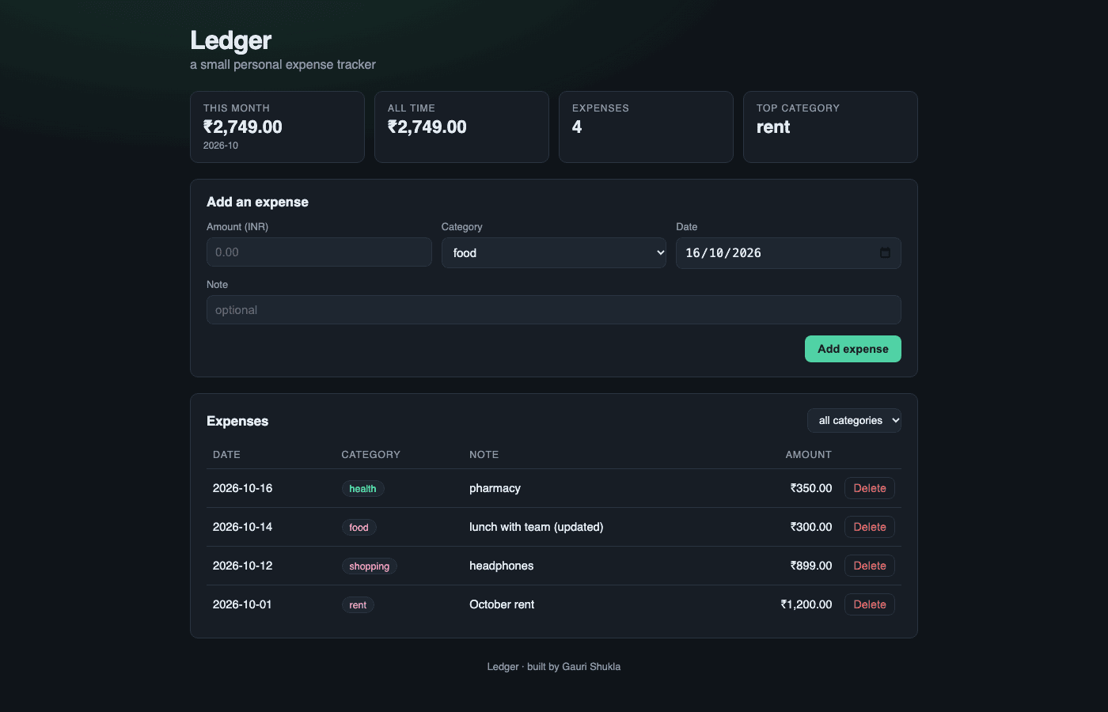
Application: six REST endpoints and a responsive UI
• GET/POST /api/expenses, GET/PUT/DELETE /api/expenses/{id}, GET /api/expenses/summary
• /health is liveness only; /ready runs SELECT 1 against Postgres and answers 503 if it fails
• /metrics in Prometheus format
• Schema owned by an Alembic migration; the container runs alembic upgrade head before uvicorn starts
Ledger · Gauri Shukla
4
Notes:
Six REST endpoints cover create, read, update, delete, list with a category filter, and a summary. On the right is the running UI from docker compose. The schema is created by an Alembic migration. Kubernetes uses /health to restart a pod and /ready to decide whether it gets traffic.

Slide 5
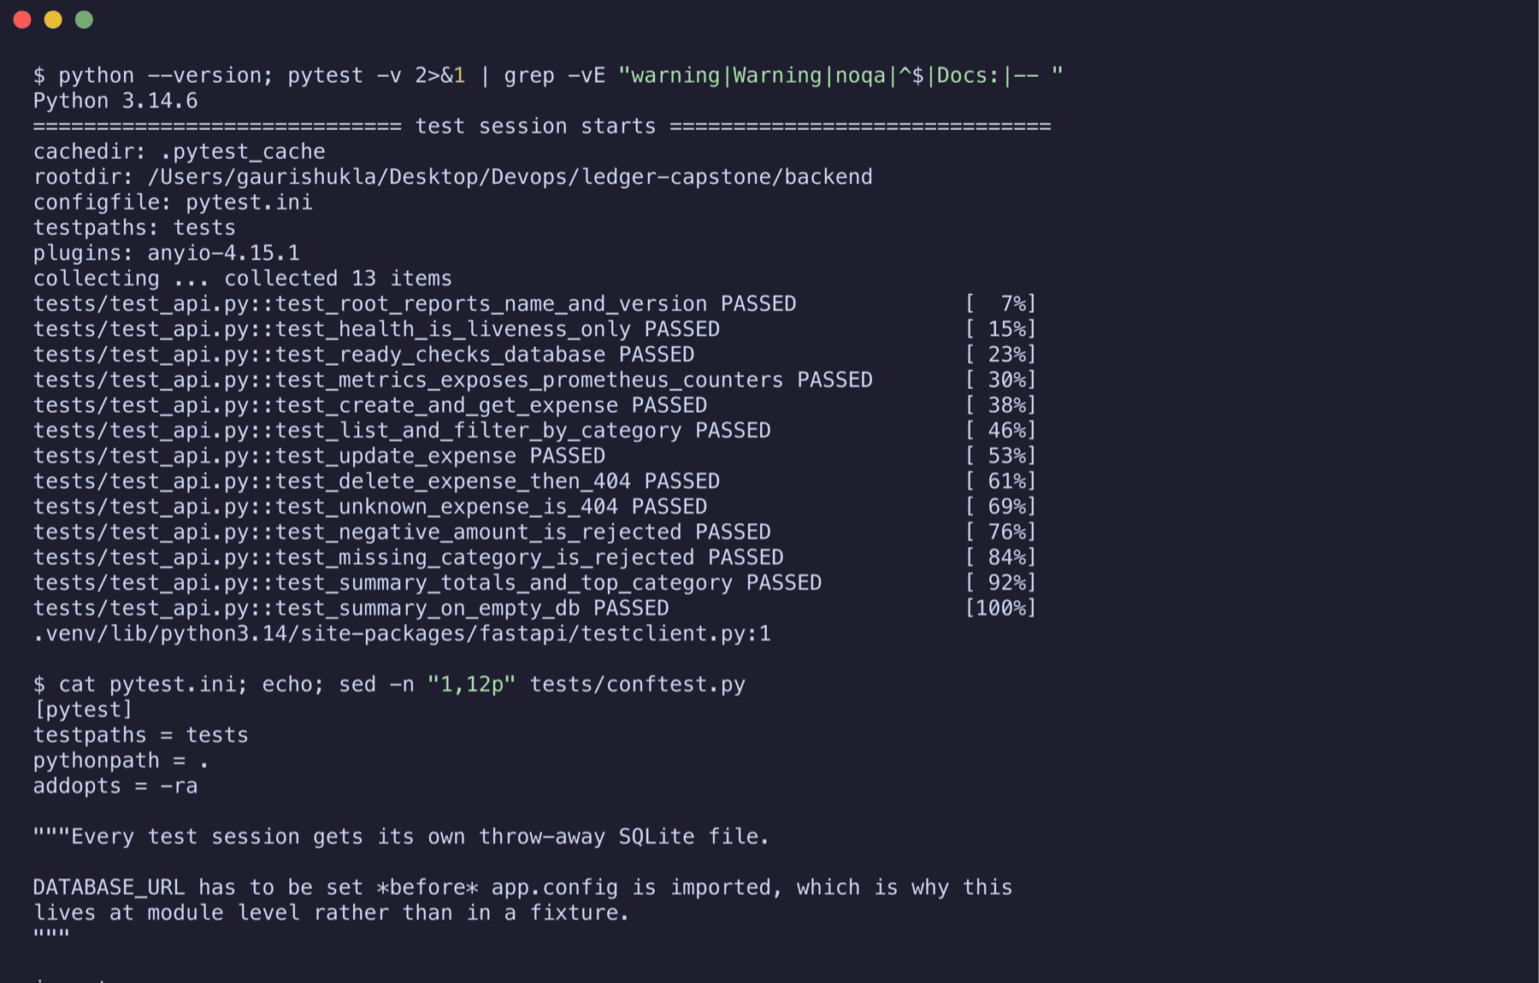
Tests run before any image exists
13 tests · 7 endpoints
pytest -v, all passed
• Happy paths, 404s, 422 validation, empty-database summary
• conftest.py points DATABASE_URL at a throw-away SQLite file; tables are dropped and recreated around every test
• ruff lint runs in the same job
• A failing test stops the pipeline: the build job never starts
Ledger · Gauri Shukla
5
Notes:
Thirteen tests across seven endpoints. They never touch the real database. This is the first quality gate of the pipeline; a failing test means no image is built.

Slide 6
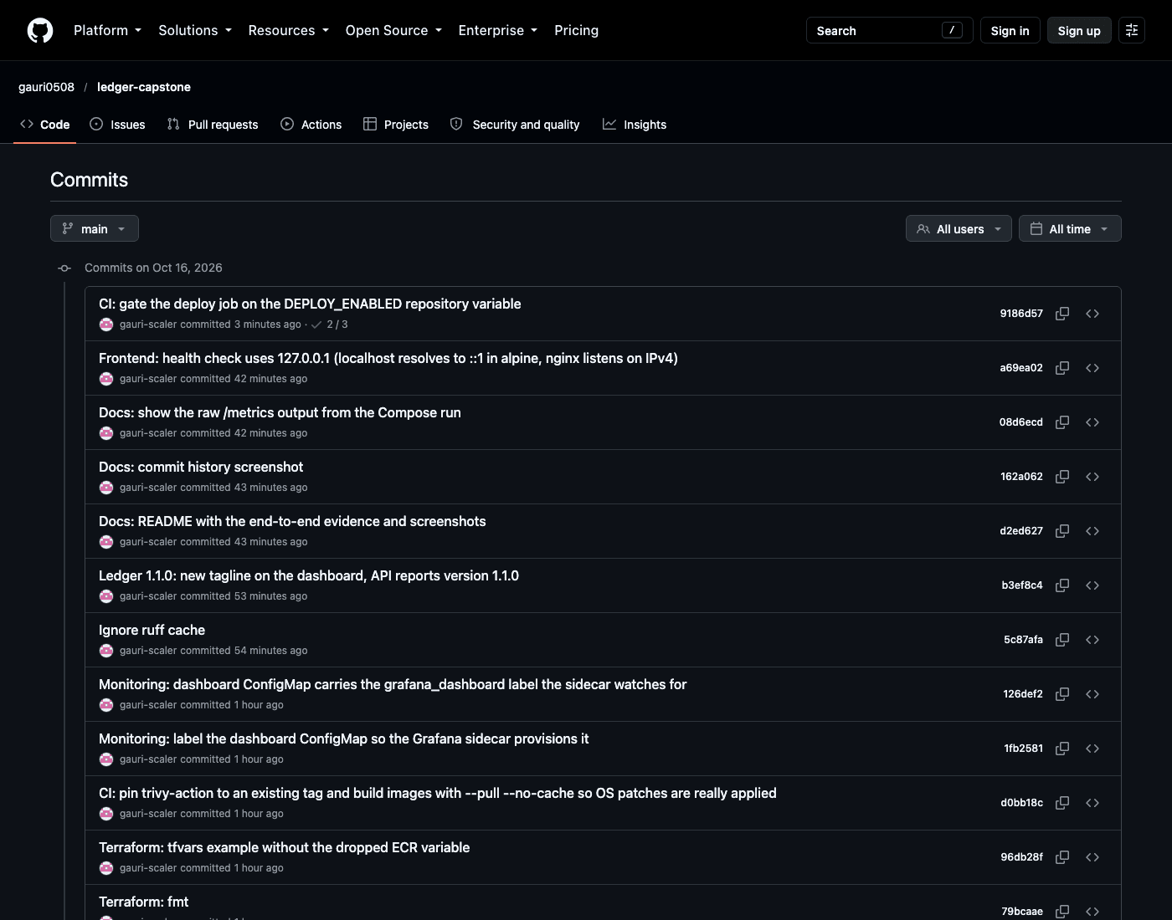
Git: one concern per commit
github.com/gauri0508/ledger-capstone
• Public repository, 27 commits
• Each commit is one piece: backend, tests, Dockerfile, frontend, chart, pipeline, monitoring
• Fixes are committed as fixes, with the reason in the message
• .gitignore keeps out .env, caches, node_modules, Terraform state
• No credentials in the history; the pipeline reads secrets from the repository settings
Ledger · Gauri Shukla
6
Notes:
The repository is public. I committed in small steps, one concern each, so the history reads like the build order of the project. Nothing sensitive is in the history.

Slide 7
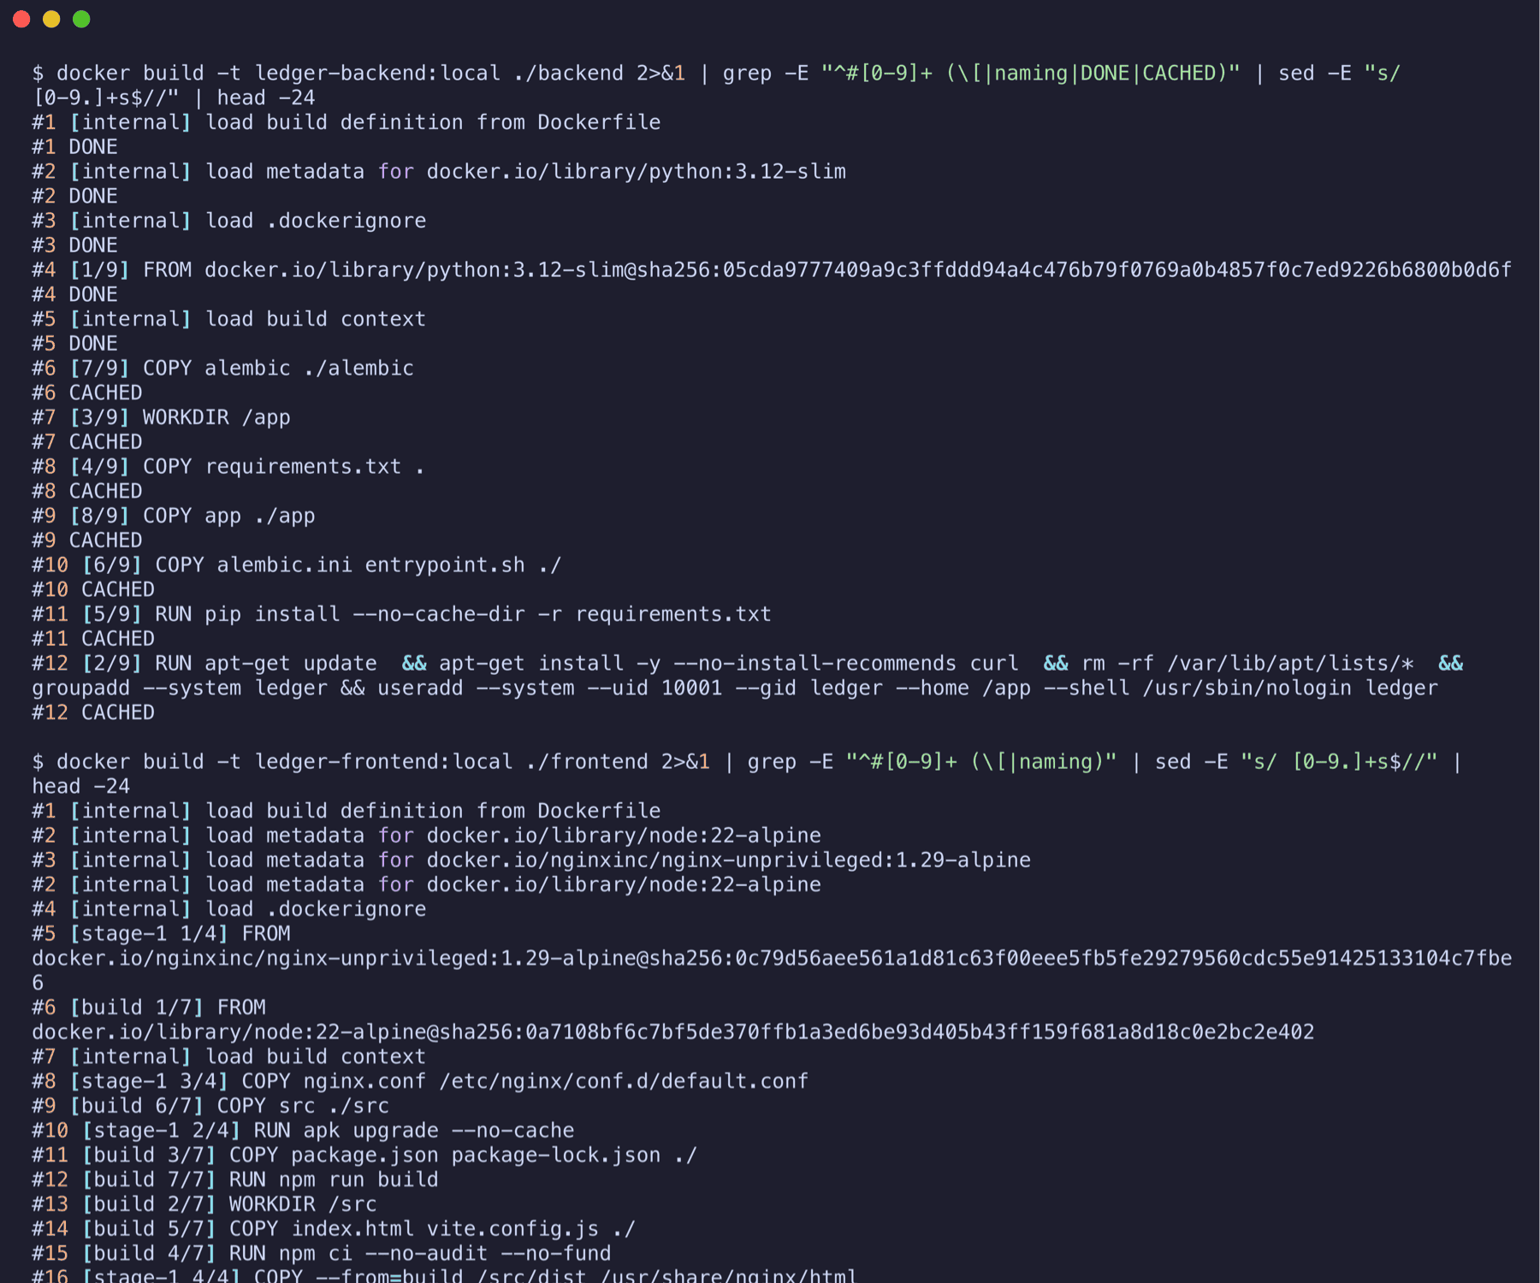
Docker: two images, both non-root
BACKEND · 379 MB
python:3.12-slim, user ledger (uid 10001), HEALTHCHECK on /health, entrypoint migrates then starts uvicorn
FRONTEND · 112 MB
Multi-stage: node:22 builds dist/, only dist/ is copied into nginx-unprivileged (uid 101). No Node in the final image
• docker compose up --build starts Postgres, the API and the UI; the API waits for the Postgres health check
Ledger · Gauri Shukla
7
Notes:
Two images. The backend image creates a system user and switches to it; the frontend uses a two-stage build so the final image is just nginx and the static bundle. The screenshot shows the build, the sizes and the id command inside each container proving neither runs as root.

Slide 8
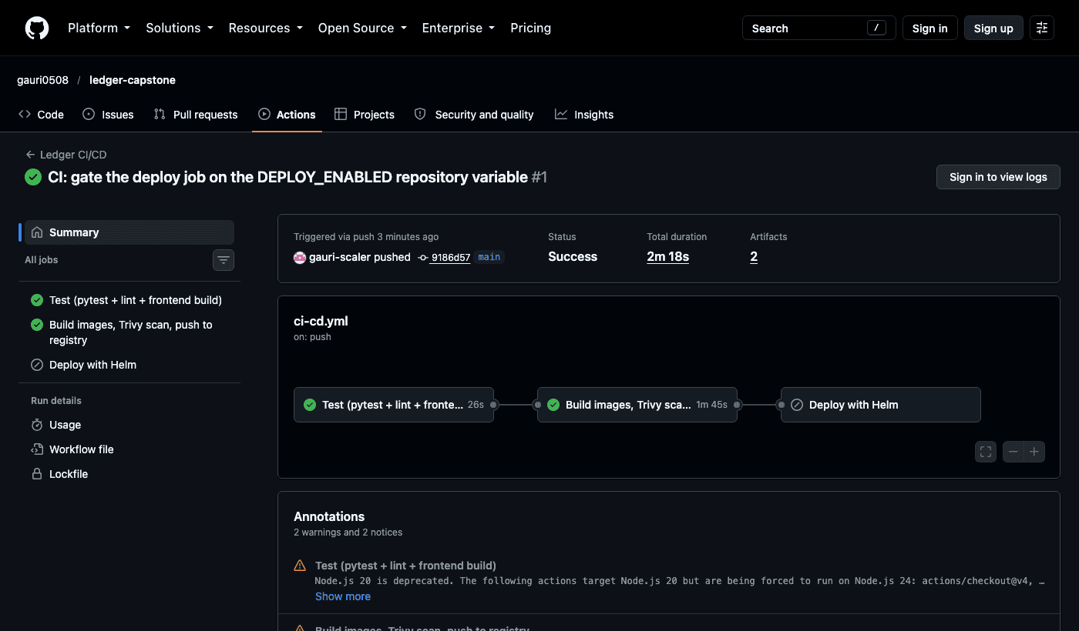
CI/CD: three jobs on every push to main
1 · TEST
ruff, pytest with a JUnit artifact, npm build with the dist artifact
2 · BUILD-SCAN-PUSH
docker build --pull --no-cache, tag = commit SHA, Trivy on both images, push to GHCR
3 · DEPLOY
helm upgrade --install with the SHA tag, then a smoke test through the Services
• On GitHub, jobs 1 and 2 ran green. Job 3 is gated on a variable because a hosted runner cannot reach my Minikube; the same file ran all three jobs locally with act.
Ledger · Gauri Shukla
8
Notes:
Three jobs: test, then build-scan-push, then deploy. The image tag is the commit SHA, so any running pod can be traced to the exact commit. On GitHub the first two jobs ran green and pushed to GHCR; the deploy job is gated because a GitHub runner cannot reach a Minikube on my laptop, and I ran the identical workflow locally with act to prove it.

Slide 9
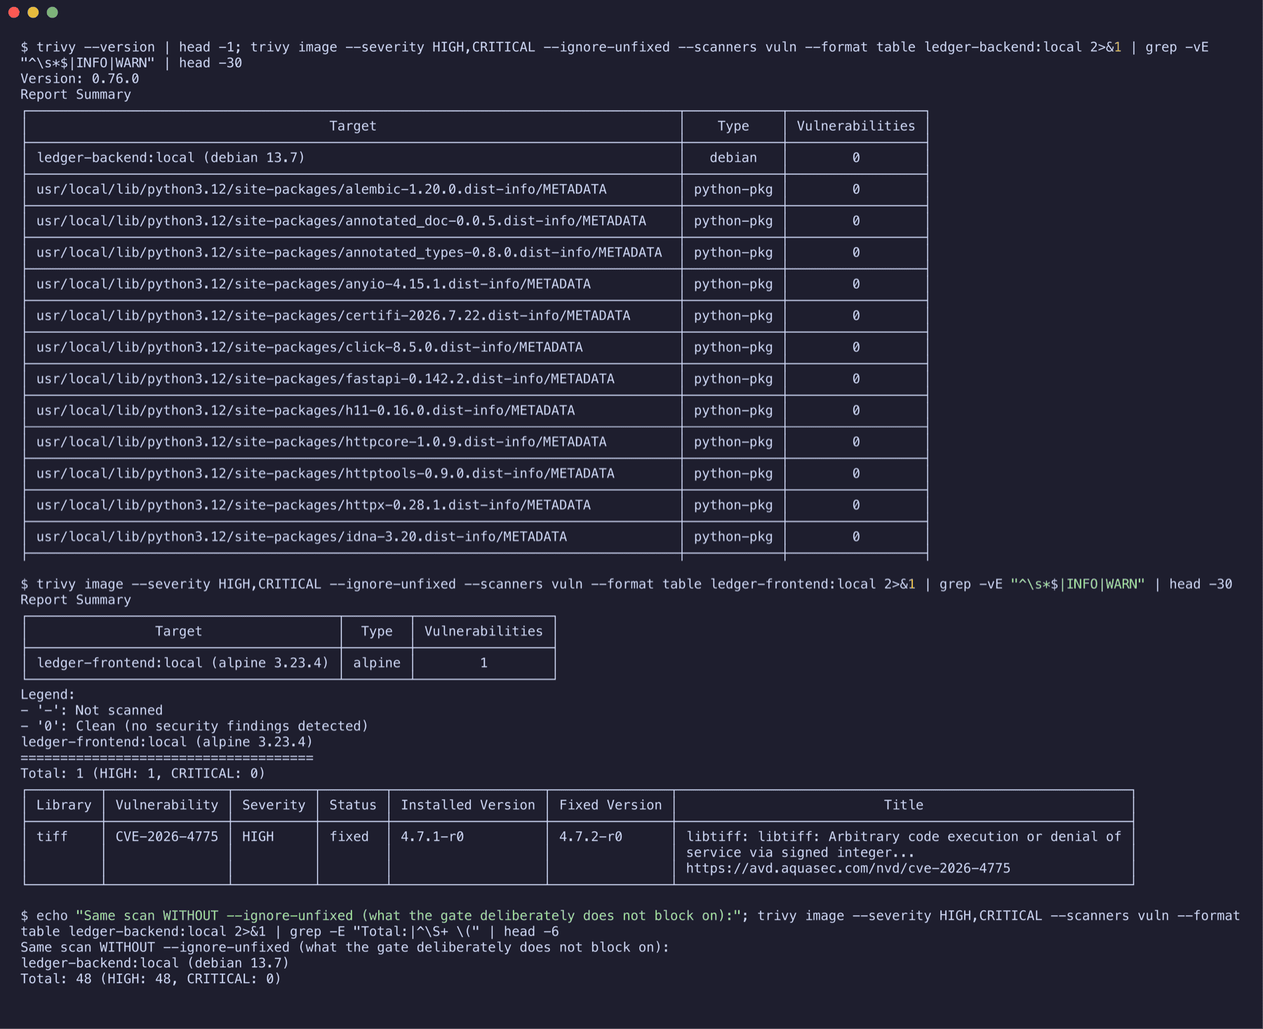
Security: Trivy fails the build on fixable HIGH or CRITICAL CVEs
WHAT IT FOUND
CVE-2026-4775 in libtiff 4.7.1 in the nginx base image, HIGH, fix available. The Dockerfile already ran apk upgrade, but Docker had cached that layer. Fix: the pipeline builds with --pull --no-cache. Both scans are clean since.
• Both images scanned in the pipeline, exit code 1 on findings
• ignore-unfixed: a CVE with no patch yet cannot block a release nobody can fix
Ledger · Gauri Shukla
9
Notes:
Trivy scans the OS packages and the Python packages of each image. The first scan of the frontend found a fixable HIGH in libtiff from the nginx base image, hidden by a cached Docker layer. The fix is in the pipeline: build with pull and no-cache. The unfixed findings in the Debian base are deliberately not blocking.

Slide 10
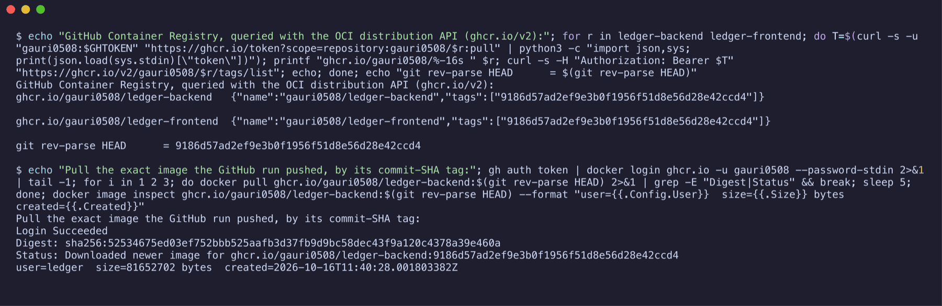
Registry: the tag is the commit
ghcr.io/gauri0508/ledger-backend:<sha>
ghcr.io/gauri0508/ledger-frontend:<sha>
• Pushed by the GitHub run with GITHUB_TOKEN, no personal token in the workflow
• One tag per commit: commit A gives image A, commit B gives image B
• kubectl get pods shows the same SHA on every running container
• The image was pulled back from GHCR by that tag to prove it is there
Ledger · Gauri Shukla
10
Notes:
Both images live in GitHub Container Registry. The tag is the full commit SHA. The screenshot queries the registry API for the tag list and pulls the backend image back by that tag.

Slide 11
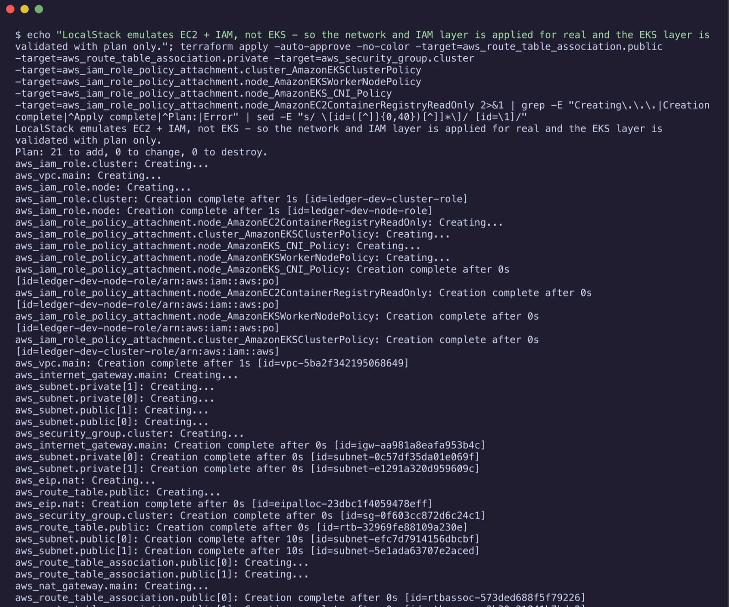
Terraform: VPC and EKS as code
WHERE IT RAN
No AWS account on this machine: the network and IAM layer was applied against LocalStack and verified with the AWS CLI. LocalStack does not emulate EKS; that layer is validated with plan only. One variable switches to real AWS.
• VPC 10.0.0.0/16, 2 public + 2 private subnets in two AZs, Internet Gateway, NAT Gateway, route tables
• EKS cluster, IAM roles, managed node group (t3.medium, 1 to 3 nodes), add-ons, OIDC provider
• 27 resources in the plan; terraform.tfvars.example holds no credentials
Ledger · Gauri Shukla
11
Notes:
Terraform describes the VPC across two availability zones and an EKS cluster with a managed node group. I want to be upfront: no AWS account on this machine, so the VPC and IAM layer ran against LocalStack and the EKS layer is plan-only. The HCL is unchanged for real AWS.

Slide 12
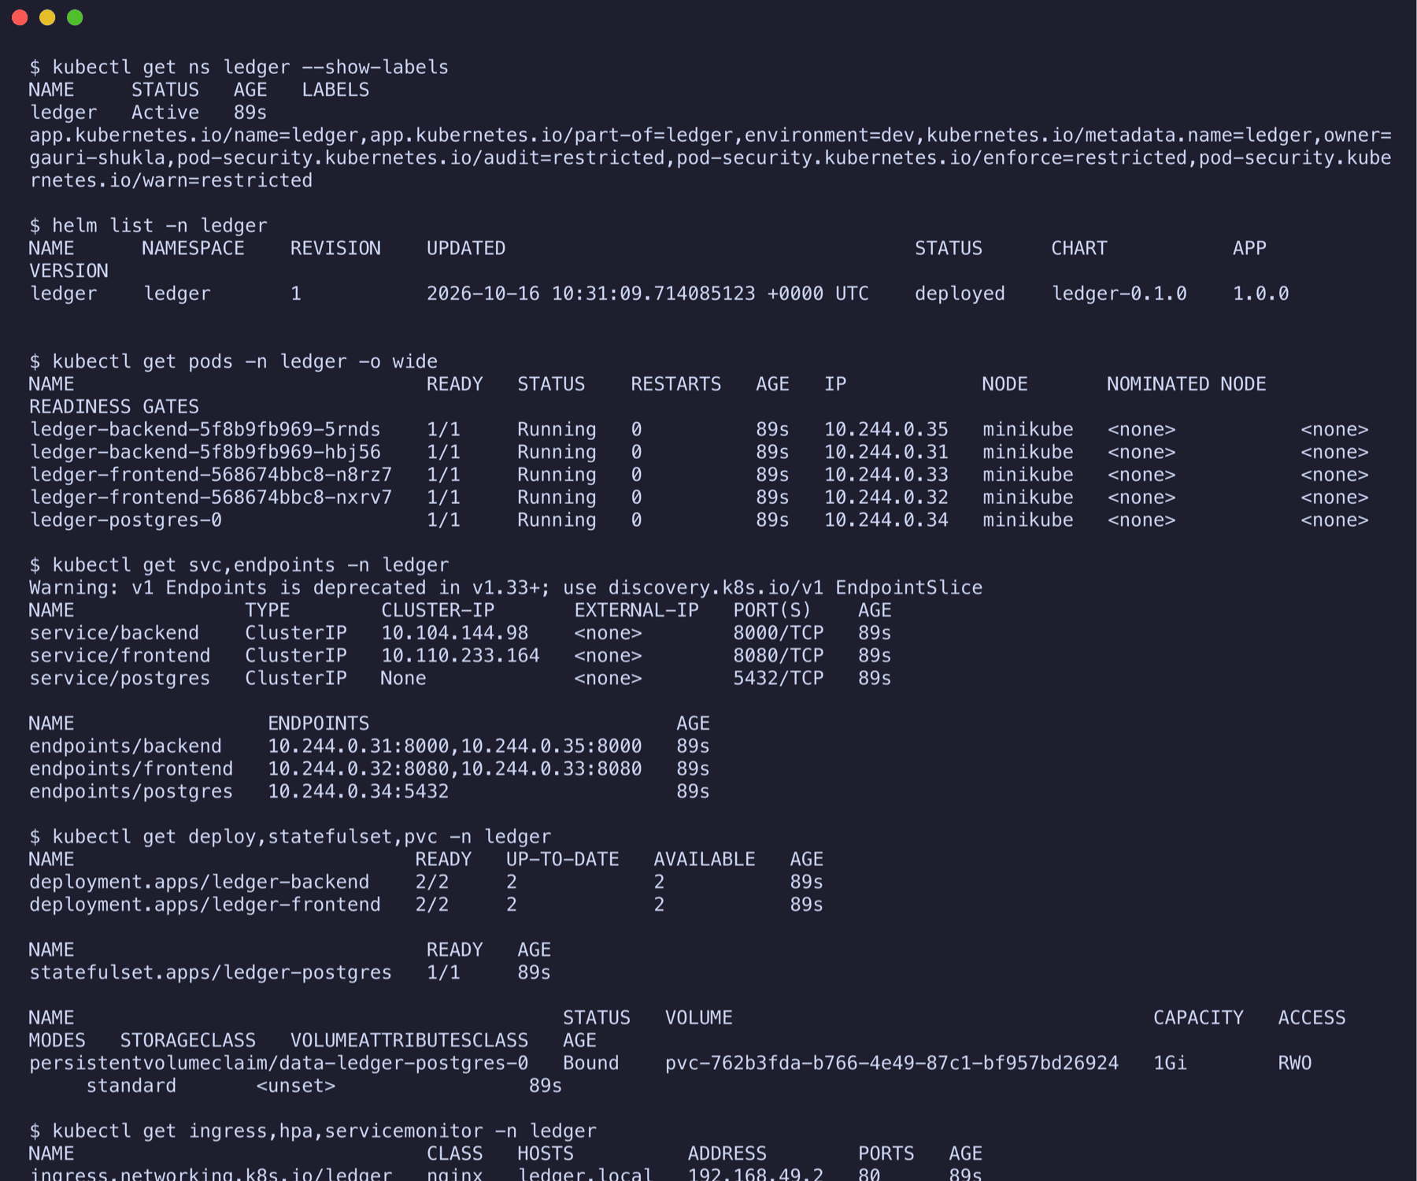
Kubernetes and Helm: one chart, five pods, all Running
• Deployments ×2: backend and frontend, 2 replicas each, rolling update
• Services ×3: ClusterIP backend:8000, frontend:8080, headless postgres
• StatefulSet + PVC: Postgres 16 with a 1 Gi volume
• Secret + ConfigMap, Ingress, HPA (2 to 5 at 60 % CPU), ServiceMonitor
• Namespace enforces the restricted Pod Security Standard; init containers wait for Postgres and migrate first
Ledger · Gauri Shukla
12
Notes:
Everything in the cluster comes from one Helm chart. The screenshot is the release as the pipeline left it: five pods Running, three services with endpoints, a bound volume claim, the Ingress and the HPA. Every container runs non-root with capabilities dropped.

Slide 13
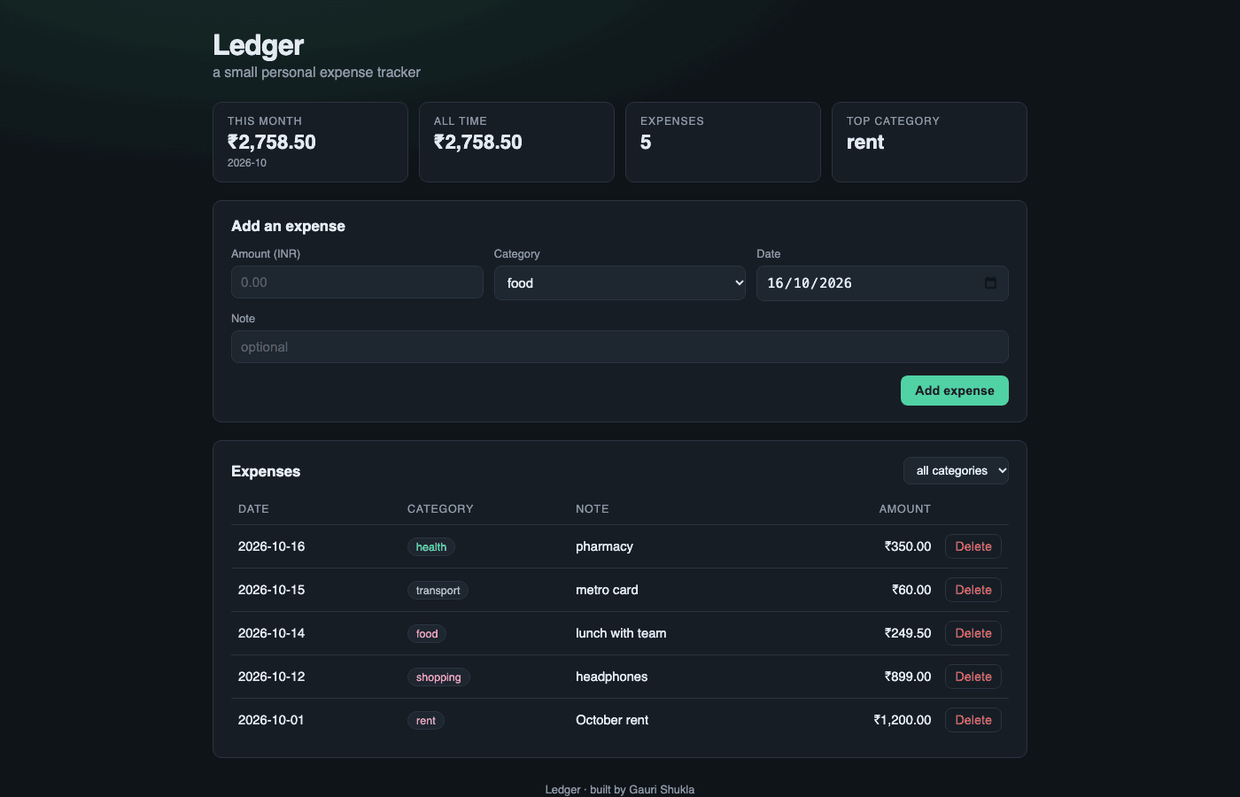
Ingress: one hostname, two routes
• ledger.local /api, /health, /ready, /metrics → backend:8000
• ledger.local / → frontend:8080
• The Ingress object is only configuration; ingress-nginx is the controller that serves it
• Longest prefix wins, so /api never falls through to the SPA
• The browser never learns the backend address
Ledger · Gauri Shukla
13
Notes:
One host, ledger.local. The API prefix and the probe paths go to the backend, everything else to the frontend. The screenshot is the application loaded through the Ingress address.

Slide 14
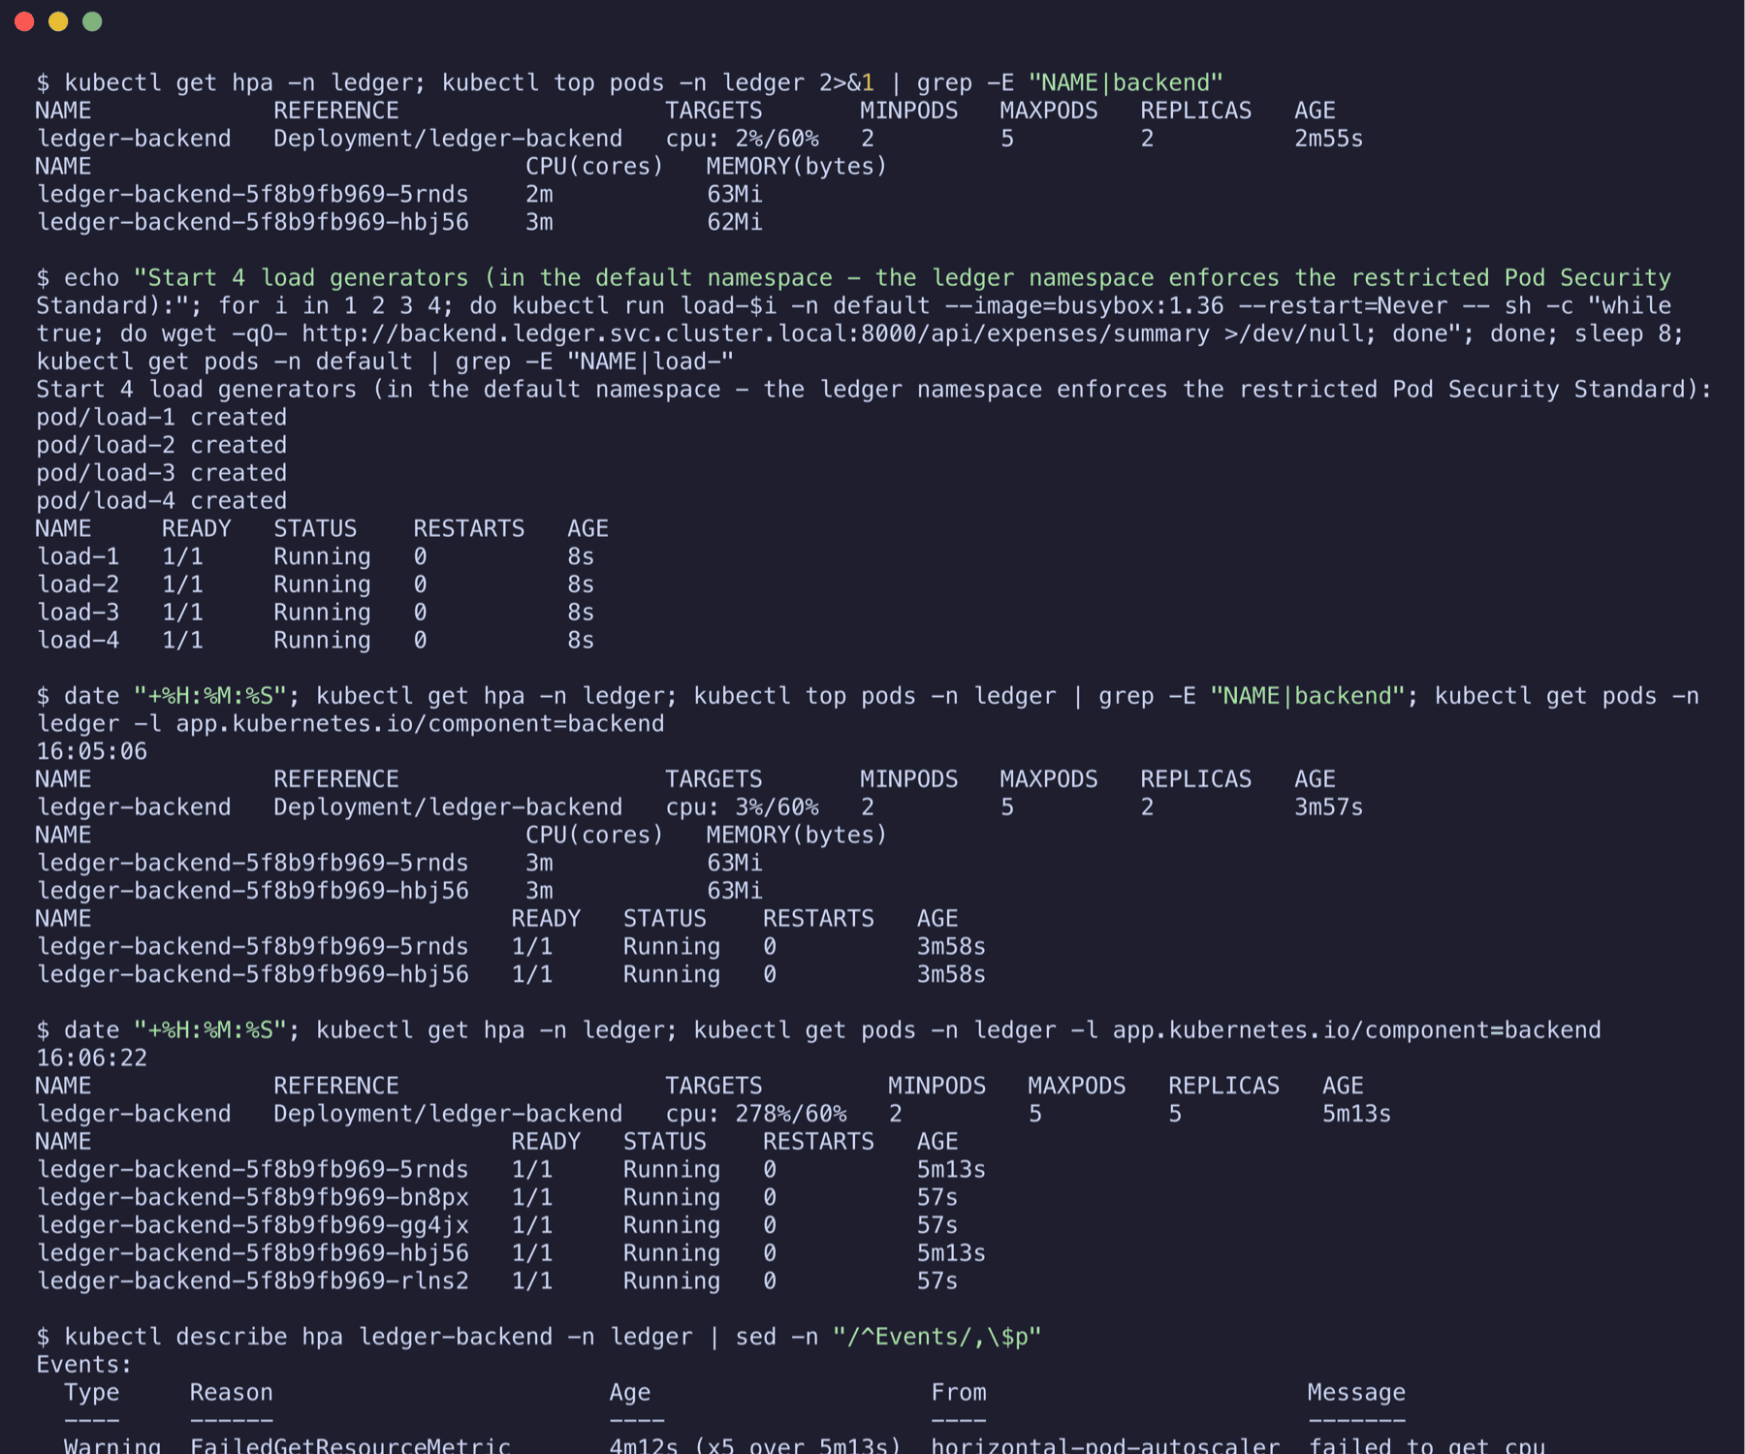
Autoscaling: 2 to 5 replicas under load, back to 2 after
3% → 278% → 2% CPU
idle, under load, load removed
• HPA target: 60 % of the CPU request, min 2, max 5
• Four in-cluster load generators hit /api/expenses/summary at about 1 100 requests/s
• Scale-up within a minute; scale-down after the stabilisation window
• Needs resource requests and the metrics-server
Ledger · Gauri Shukla
14
Notes:
Four busybox pods in a tight loop against the summary endpoint. CPU went from three percent of the request to 278 percent, the HPA scaled to five replicas within a minute, and after the load was removed it scaled back to two. The events show both decisions with their reasons.

Slide 15
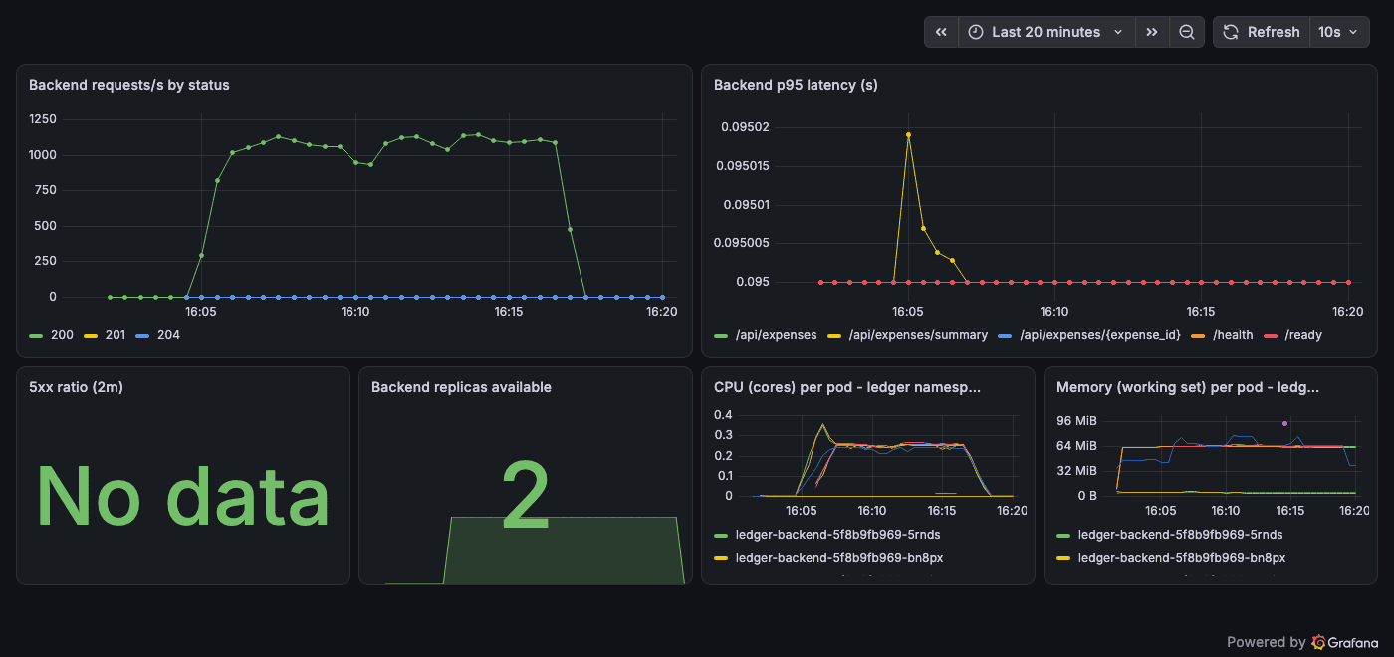
Monitoring: Prometheus scrapes it, Grafana shows it
• /metrics from prometheus-fastapi-instrumentator: requests and latency per handler, method and status
• A ServiceMonitor in the chart tells the Prometheus Operator what to scrape, every 15 s
• Targets page: every backend pod UP
• Dashboard provisioned from a ConfigMap: requests/s, p95 latency, 5xx ratio, replicas, CPU and memory per pod
Ledger · Gauri Shukla
15
Notes:
The backend exposes Prometheus metrics; the chart’s ServiceMonitor connects it to Prometheus. The Grafana dashboard is from the same load test: the request rate jumps to about eleven hundred per second, the replica panel goes from two to five and back.

Slide 16
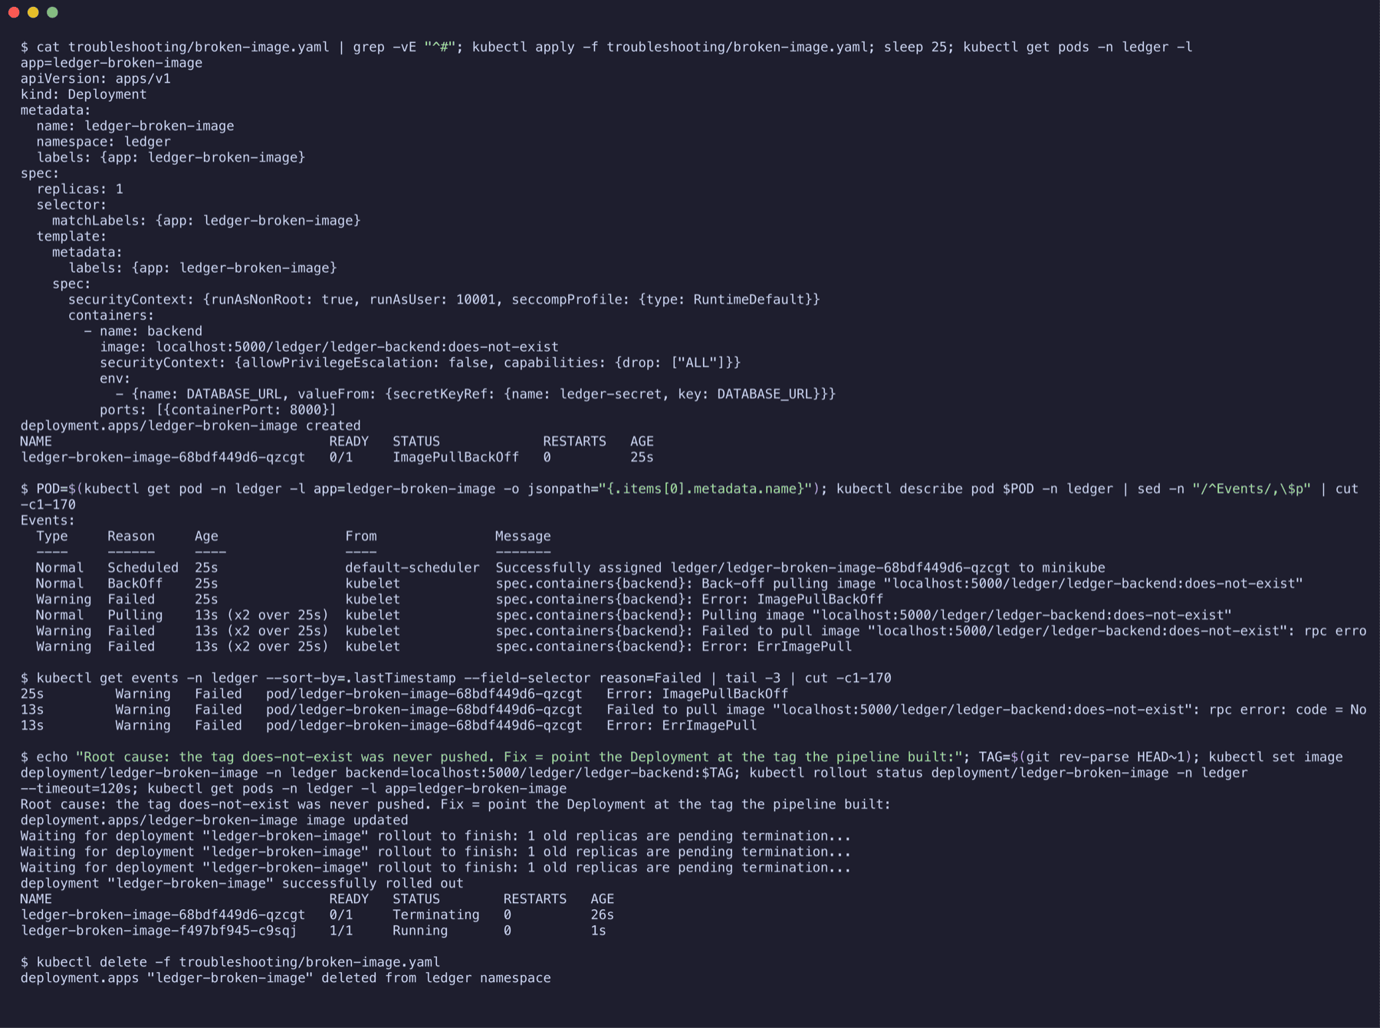
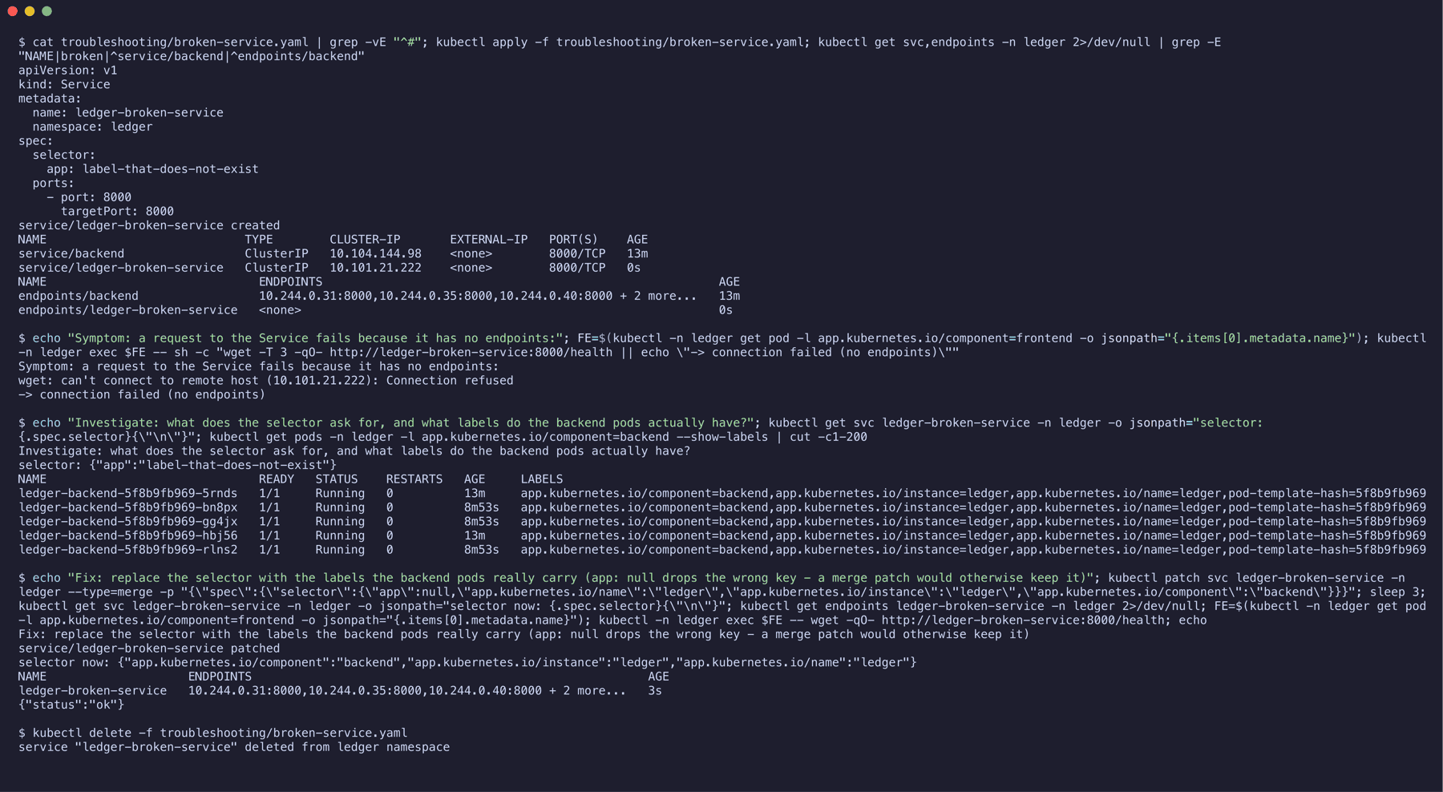
Troubleshooting: two things broken on purpose
BROKEN IMAGE · ImagePullBackOff
A Deployment with a tag that was never built. kubectl describe and get events show the pull failing. Fix: set the image to the SHA the pipeline pushed.
BROKEN SERVICE · no endpoints
A selector that matches no pod. get endpoints shows none, requests are refused. Compare the selector with get pods --show-labels, patch it, and the endpoints appear.
Ledger · Gauri Shukla
16
Notes:
Two deliberately broken manifests. An image tag that does not exist: ImagePullBackOff, describe and events say why, fix by pointing at a pushed tag. A Service whose selector matches nothing: no endpoints, connection refused; compare the selector with the pod labels and patch it. A merge patch keeps keys you do not mention, so the wrong label has to be set to null explicitly.

Slide 17
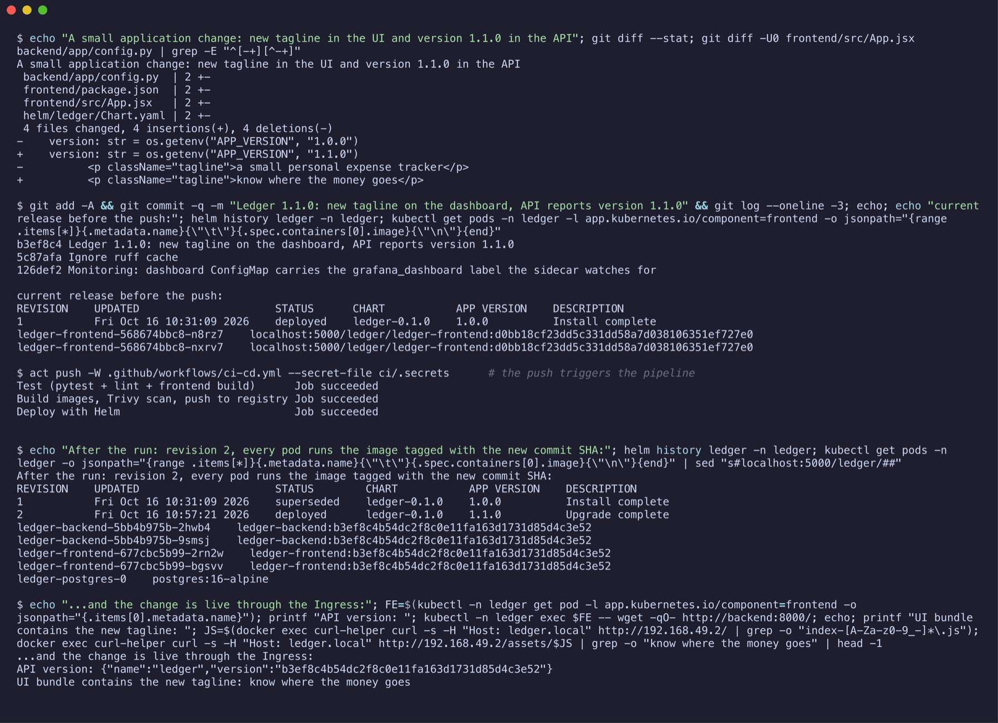
Live demo: one change, commit to cluster
• 1. Change the tagline in frontend/src/App.jsx and commit
• 2. git push: the Actions run starts, test job first
• 3. Build job: two images tagged with the new SHA, Trivy clean, pushed to GHCR
• 4. Deploy: helm upgrade to the next revision, rolling update with zero unavailable pods
• 5. kubectl get pods shows the new SHA on every container; the page shows the new tagline
• Already done once for the record (right): revision 1 to revision 2
Ledger · Gauri Shukla
17
Notes:
For the live part I make a small visible change, commit and push it, and we watch the run on GitHub: tests, then build, scan and push to GHCR with the new SHA. Then the Helm release goes to the next revision and the pods carry the new tag. The screenshot shows this done once already.

Slide 18
What I learned
Tests before images
A red test or a fixable CVE stops the run before anything is pushed.
Tags are provenance
A SHA tag tells me which commit is running. “latest” tells me nothing.
Caches can hide security fixes
apk upgrade only helps if the layer is rebuilt; the pipeline builds with --pull --no-cache.
Readiness is not liveness
/health restarts a pod; /ready decides whether it gets traffic.
A Service is a label query
No matching labels, no endpoints, no traffic. ServiceMonitor, HPA and Ingress work the same way.
Plan, then apply, then destroy
Terraform shows what will happen before it happens; destroy is how the bill stops.
github.com/gauri0508/ledger-capstone · README has every command and screenshot
Ledger · Gauri Shukla
18
Notes:
Six things I take away from this project. The repository README has every command, its output and the screenshots. Thank you, happy to take questions.

