Slide 1

Time Series Prediction
GAURI DENGARE
B00692537

Slide 2
Data Mining and Time Series
Finding patterns and trends within large data sets to predict the probability of future events
Series of measurements collected over time
Problem given : sale quantity of 100 key products for 119 days
Goal : To predict overall sale quantity for 100 key products and sale quantity of each product for each day for the next 29 days.
Model used : ARIMA

Slide 3
ARIMA
Auto-Regressive Integrated Moving Average
Auto-Regression(p term) : p observations from past as input to a regression equation to predict the value at the next time step
Integrated(I term) : Degree of differentiation in order to make data stationary
Moving Average(q term) : Combination of q lagged error terms

Slide 4
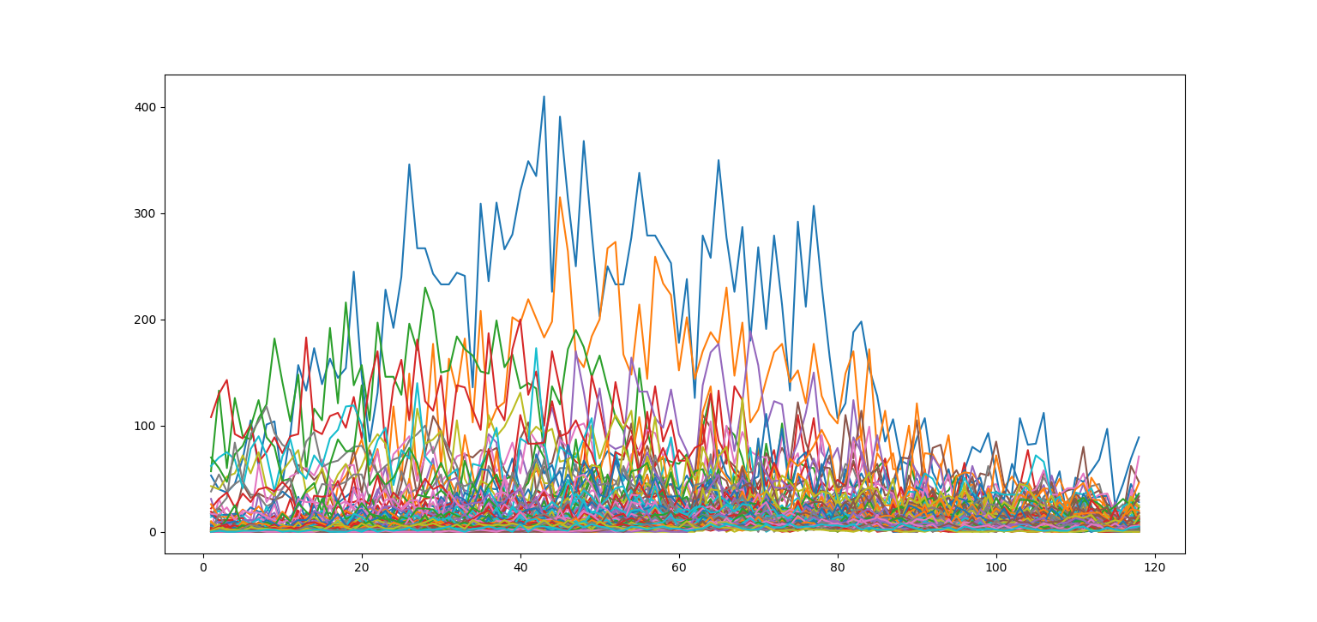
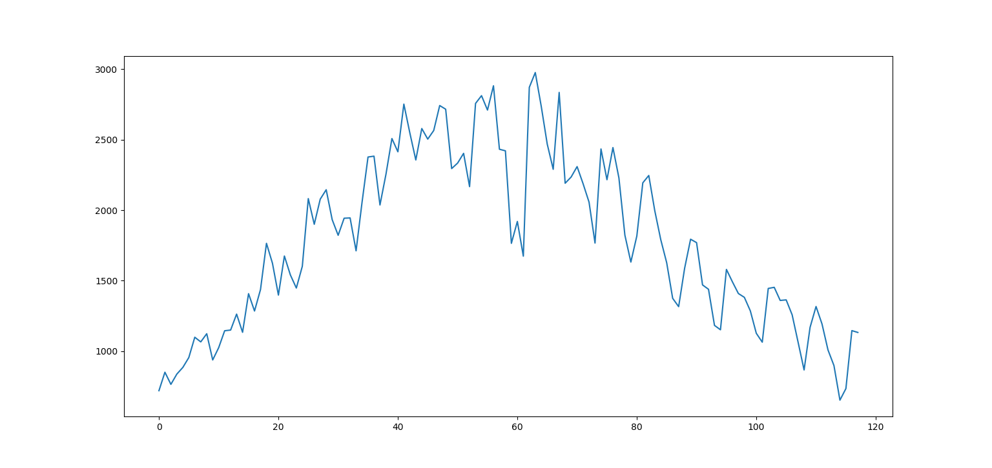
Original Dataset

Slide 5
Step 1 : Stationarity
Check stationarity
Dickey-Fuller Test : If Test Statistic < Critical value then
data is not stationary
Rolling Statistics :
If Mean & Variance is not constant over time then data is non-stationary
Conclusion : Given dataset is not stationary so differentiating the series with order 1(d term is 1)

Slide 6
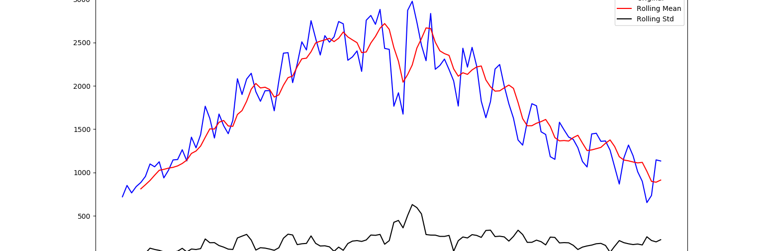
Rolling Statistics
Mean is not constant over time

Slide 7
Step 2 : p and q selection
PACF(Partial AutoCorrelation Function)
Helps selecting p value
Correlation between time series observations with lagged observations with no indirect correlations between interleaving observations
ACF(AutoCorrelation Function)
Helps selecting q value
Correlation between time series observations with previous time step observations

Slide 8
Step 3 : Evaluating Training Model
Dividing dataset into training and test
Training Dataset : 80% & Test Dataset : 20%
Model is trained using training dataset. Model learns from this data.
Test dataset is used to evaluate the trained model
Overall Prediction Test RMSE : 147.233
Each Product Each Day Prediction Test RMSE : Range - 1 to 20

Slide 9
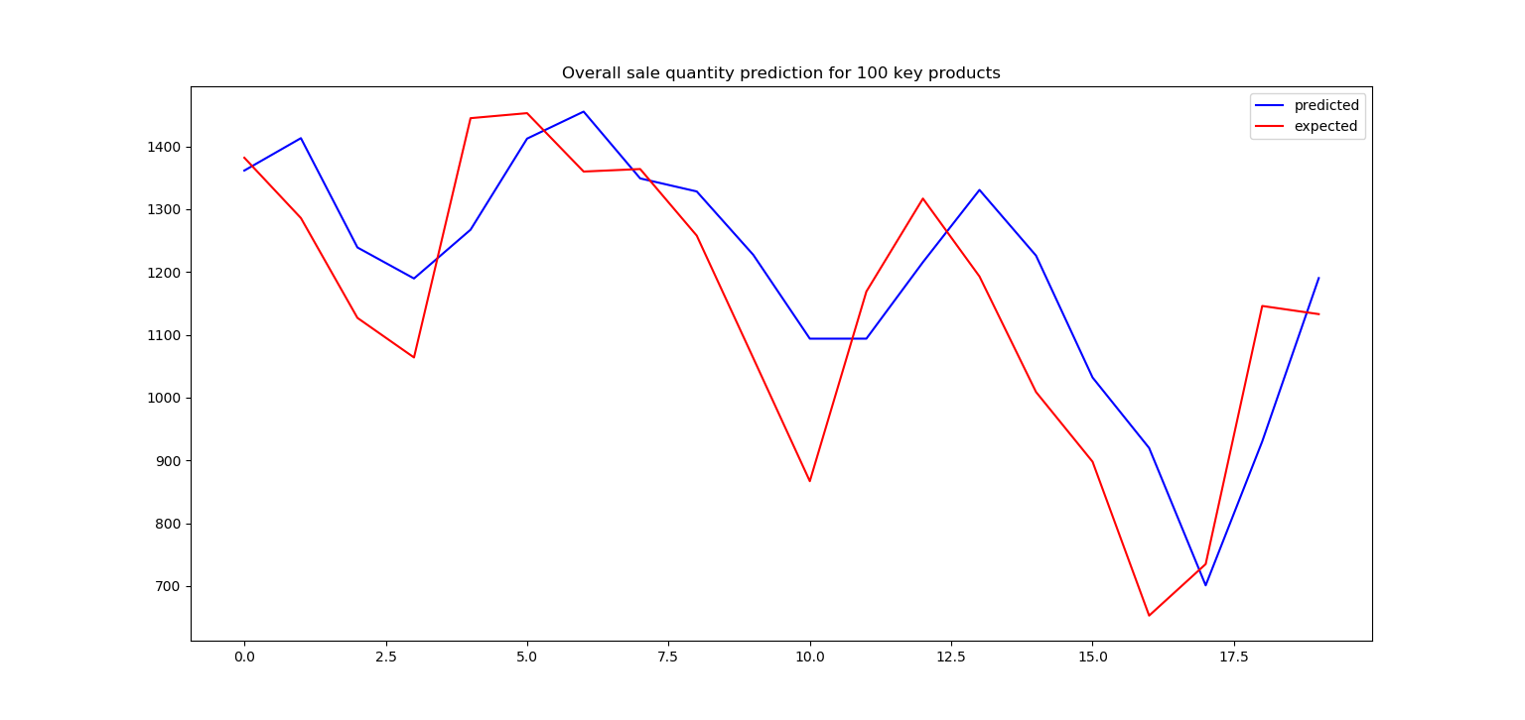
Overall sale prediction for 100 key products

Slide 10
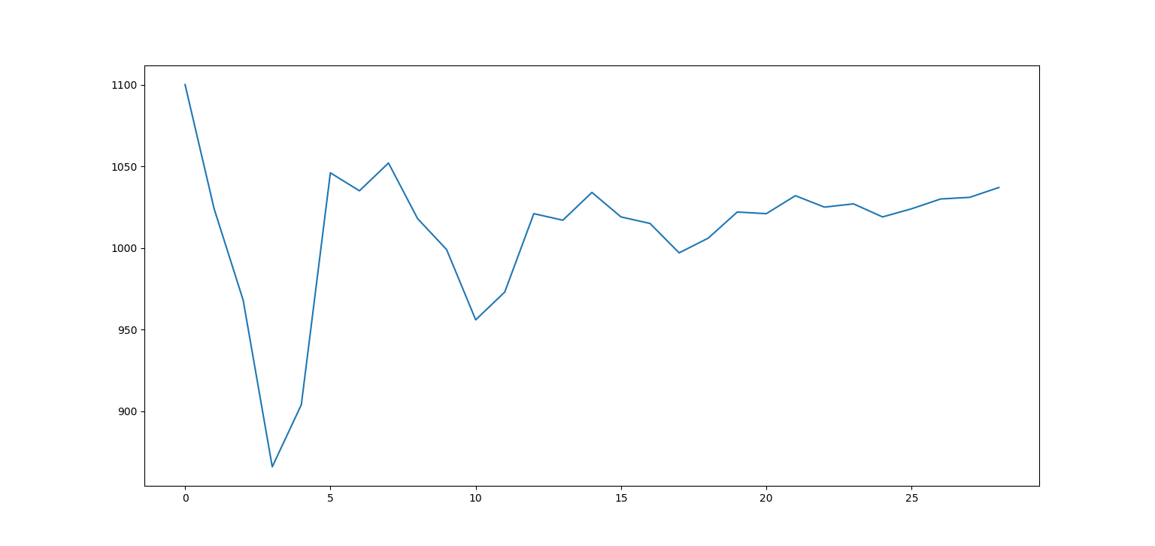
Overall sale prediction for 100 key products(29 days)

Slide 11
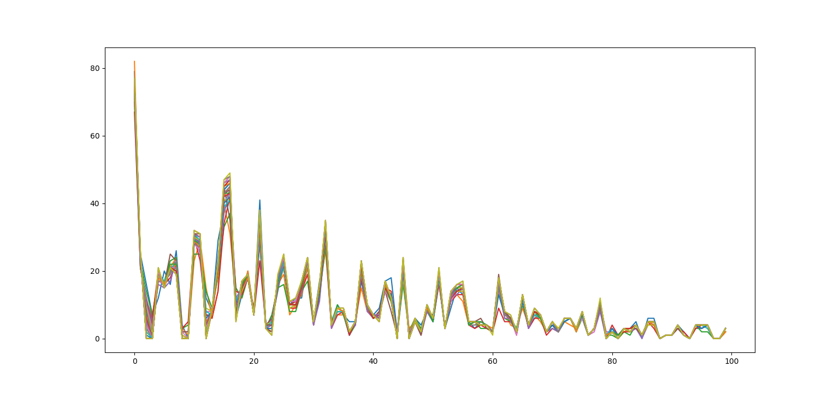
Sale prediction for each product for each day(29 days)

Slide 12
References
https://www.datascience.com/blog/introduction-to-forecasting-with-arima-in-r-learn-data-science-tutorials
https://medium.com/@stallonejacob/time-series-forecast-a-basic-introduction-using-python-414fcb963000
https://machinelearningmastery.com/gentle-introduction-autocorrelation-partial-autocorrelation/
https://machinelearningmastery.com/autoregression-models-time-series-forecasting-python/

Slide 13
Thank You

