Slide 1
Todo Application Deployment Project
Using Docker, Kubernetes, CI/CD, and Monitoring
Gauri Gagare | sunbeam
Mentor : Gajanan taur

Slide 2
Abstract
This project demonstrates deploying a Flask-based Todo application using modern DevOps practices. It covers containerization with Docker, orchestration with Kubernetes, persistence with PV/PVC, automation with GitHub Actions and ArgoCD, and monitoring with Prometheus.

Slide 3
Introduction
DevOps enables faster and reliable application delivery.
Docker ensures application portability.
Kubernetes manages scaling, orchestration, and fault tolerance.
CI/CD pipelines automate deployment.
Monitoring ensures observability and system health.

Slide 4
Objectives
1. Containerize the Todo app and database using Docker.
2. Deploy application on Kubernetes cluster.
3. Implement persistence with PV and PVC.
4. Automate CI/CD with GitHub Actions and ArgoCD.
5. Monitor system health using Prometheus.

Slide 5
System Design / Architecture
Architecture includes:
Docker containers for App and Database
Kubernetes cluster with Master and Worker
PV/PVC for data persistence
CI/CD pipeline with GitHub Actions & ArgoCD
Monitoring with Prometheus & Grafana

Slide 6
Implementation – Docker Setup
Installed Docker, created Dockerfile, built image, and ran containers for app and database.

Slide 7
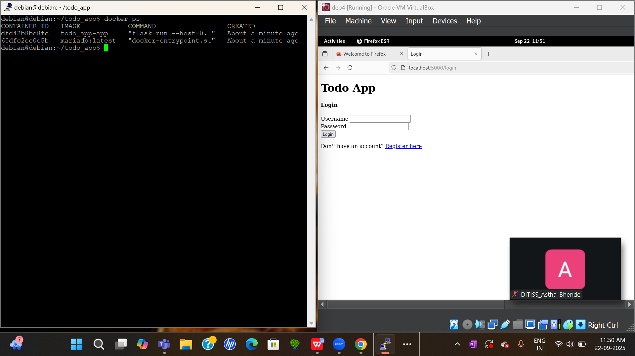

Slide 8

Implementation – Kubernetes Cluster Setup
Created master and worker nodes using kubeadm, verified nodes, and prepared cluster.

Slide 9
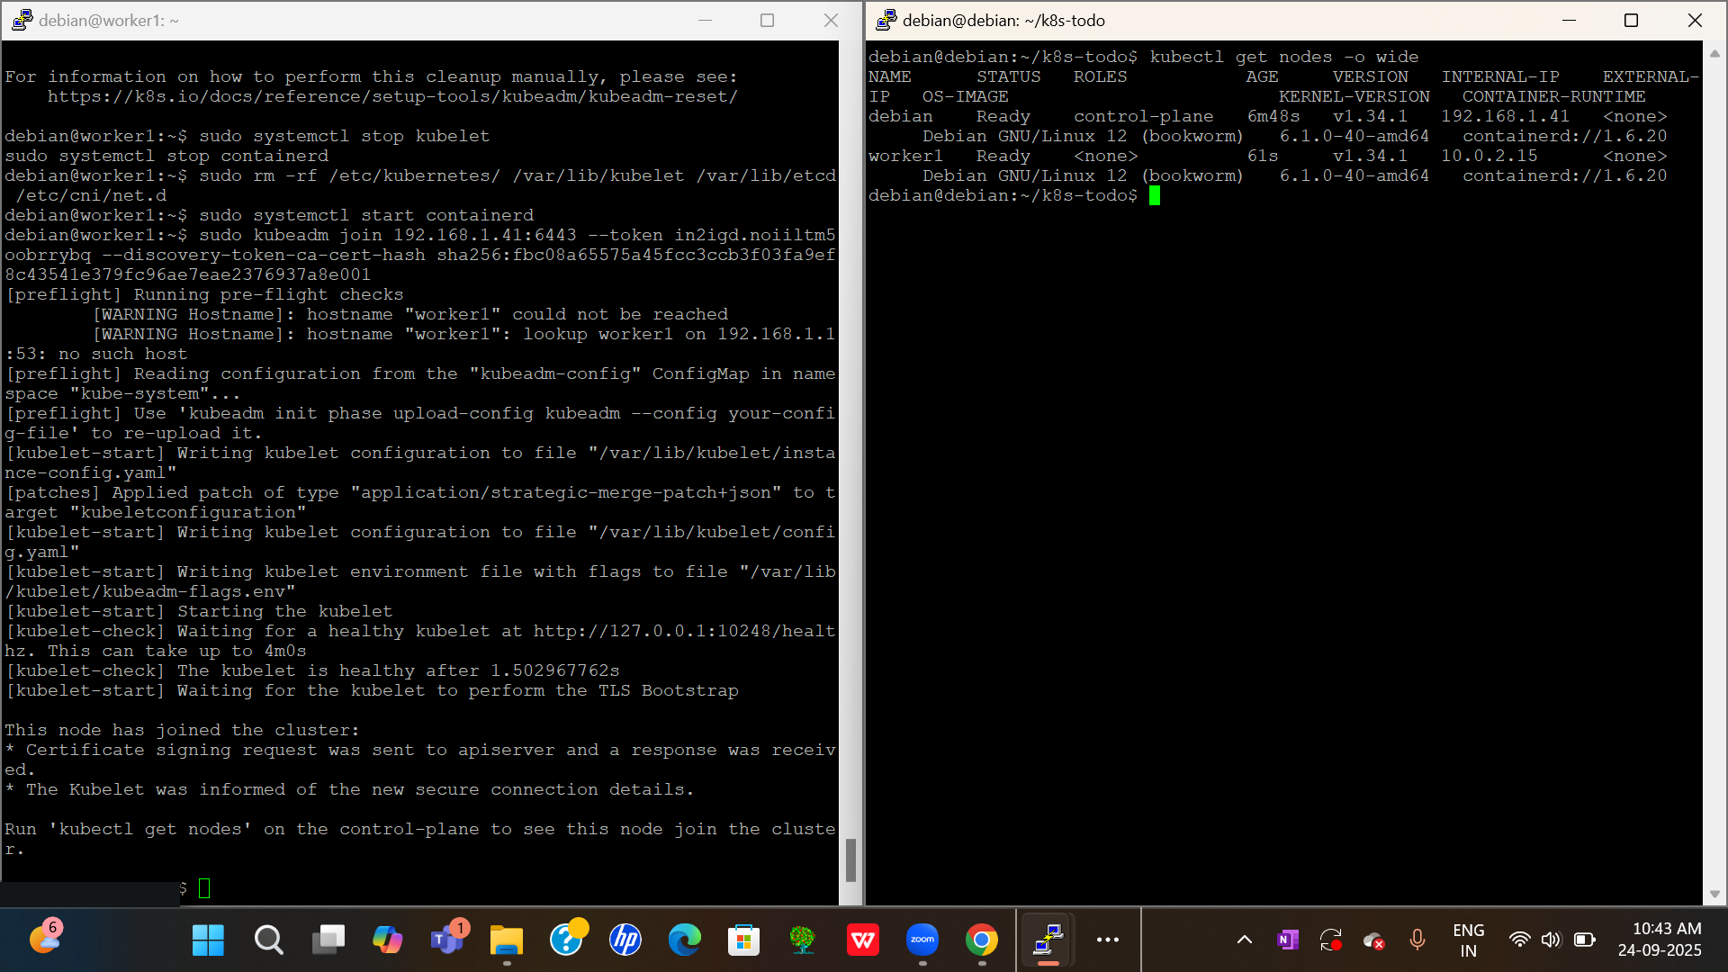

Slide 10
Implementation – Application Deployment
Wrote Deployment & Service YAMLs, deployed app and DB pods, and exposed app via service.

Slide 11
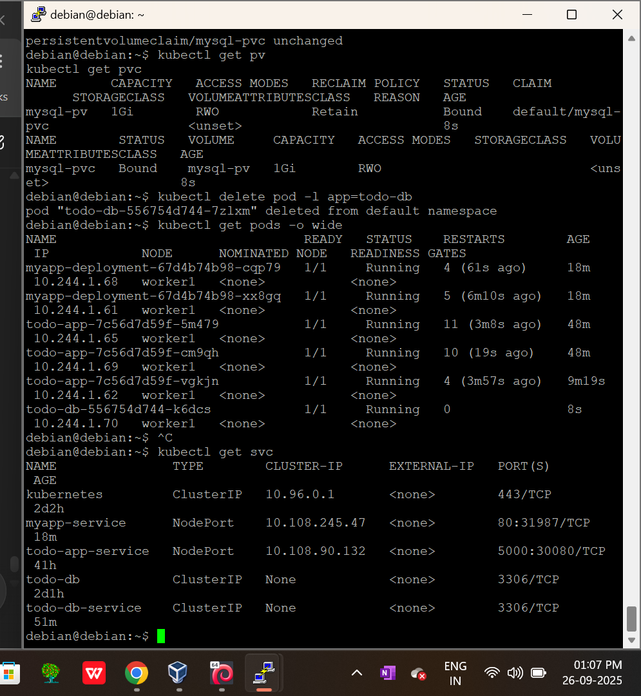

Slide 12
Implementation – Persistence + CI/CD
Configured Persistent Volumes and Claims for database storage. Used GitHub Actions for CI (build/test images) and ArgoCD for CD (sync with Kubernetes cluster).

Slide 13
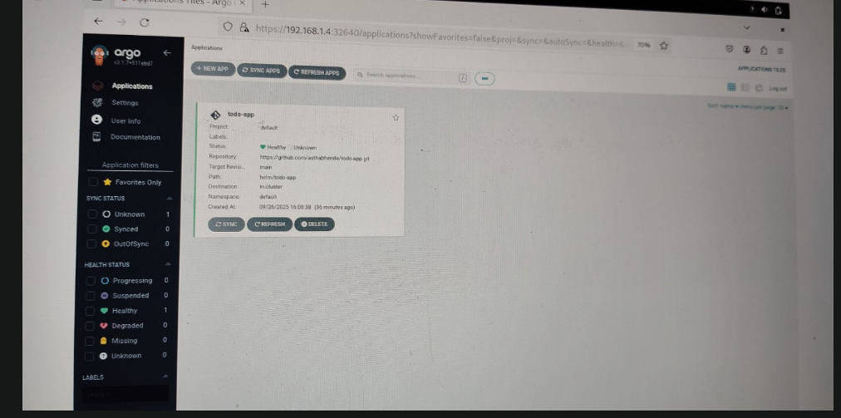

Slide 14
Implementation – Monitoring (
Installed Prometheus to collect cluster & app metrics, and Grafana for visualization.

Slide 15
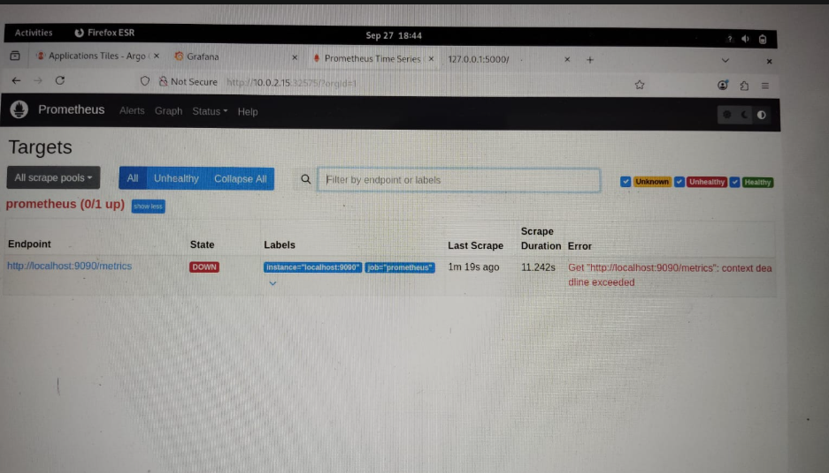

Slide 16
Results
• Todo application successfully deployed on Kubernetes.
• Data persisted across pod restarts.
• CI/CD pipeline automated build and deployment.
• Prometheus collected system and app metrics.
• Application became scalable, reliable, and observable.

Slide 17
Future Scope
Deploy on cloud platforms like AWS EKS, GCP GKE, Azure AKS.
Convert application into microservices.
Advanced CI/CD with security scanning and canary deployments.
Centralized logging with ELK stack.
High availability with multi-cluster deployments.

Slide 18
Conclusion
This project implemented the complete DevOps lifecycle:
Containerization (Docker)
Orchestration (Kubernetes)
Persistence (PV/PVC)
Automation (GitHub Actions & ArgoCD)
Monitoring (Prometheus)
It demonstrated how DevOps practices make applications production-ready.

Slide 19
References
1. Docker Documentation - https://docs.docker.com/
2. Kubernetes Documentation - https://kubernetes.io/docs/
3. GitHub Actions Documentation - https://docs.github.com/en/actions
4. ArgoCD Documentation - https://argo-cd.readthedocs.io/
5. Prometheus Documentation - https://prometheus.io/
6. Grafana Documentation - https://grafana.com/docs/
7. Flask Documentation - https://flask.palletsprojects.com/

