Slide 1

Amazon Sales Report
By: Gauri Gund

Slide 2
INTRODUCTION
Amazon Sales data refers to sales, high performing sellers and several other data points.
There are millions of Amazon sellers around the world. Amazon sales data Analysis focuses on the process of analyzing consumer behavior, sales, and several other attributes in order to make improved, data-driven decisions. It is key to successfully sustaining their businesses and earning profits and for this purpose, they analyze different metrics like
Total Sales, Sales Quantity, Total Profit, Sales, Last Year Sales and other metrics. By analyzing these different metrics, we will be able to increase and improve our performance. It can also help us to better understand the market trends and customers’ buying behaviors
and help us to know what the customers really want.
3

Slide 3
OBJECTIVE
The objective of the project is to Analyse Amazon Sales data to get a substantial data
which will help in bringing changes in a business in the future. It will help to reveals
flaws in the business model or in the way that one is going about conducting business. Sellers will be able to clearly see where they’re losing money, what the problem is, and reduce their losses accordingly. It facilitates coming up with strategic solutions to problems. This project aims to provide visual understanding of the data using Microsoft Power Bi
Extract-Transform-Load Data
Visualize the gathered Insights
Get Insights

Slide 4
DATA DESCRIPTION
ORDER ID
The ORDER ID is the ID given to the order.
1
2
ORDER DATE
The order date is the date when the product is ordered.
REGION
The region in which the customer stays.
3
COUNTRY
The Country in which the customer reside.
4
6

Slide 5
ITEM TYPE
Item type is the varieties of item sales in the Amazon.
5
6
SALES CHANNEL
Mode of shopping Online or Offline.
7
ORDER PRIORITY
Priority of Sales Range between low to high
8
SHIP DATE
Ship date when the product is dispatched.
UNIT SOLD
Number of unit sold per product.
9
7

Slide 6
UNIT PRICE
Selling Price of the product
10
11
UNIT COST
Cost of the Product.
TOTAL REVENUE
Total Sales of the Company.
12
13
TOTAL COST
Total Cost of the Company.
14
TOTAL PROFIT
Total Profit Earned by the Company.
8

Slide 7
INSIGHTS
1
KPIS
2
Profit Wise Analysis
3
Revenue wise Analysis
4
Cost wise Analysis
9

Slide 8
KPIS
44.17M
TOTAL PROFIT
137.35M
TOTAL REVENUE
93.18M
TOTAL COST
513K
UNIT SOLD
10

Slide 9

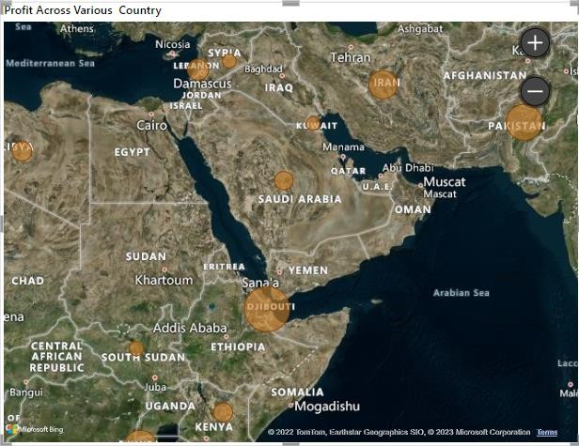


PROFIT WISE ANALYSIS
Profit Across Various Countries
KEY INSIGHTS
According to the visual the Profit is Highest in Djibouti and Least in Kuwait.
KUWAIT
TOTAL PROFIT- 1258(1.26K)
DJIBOUTI
TOTAL PROFIT-
2425318(2.43M)
11

Slide 10

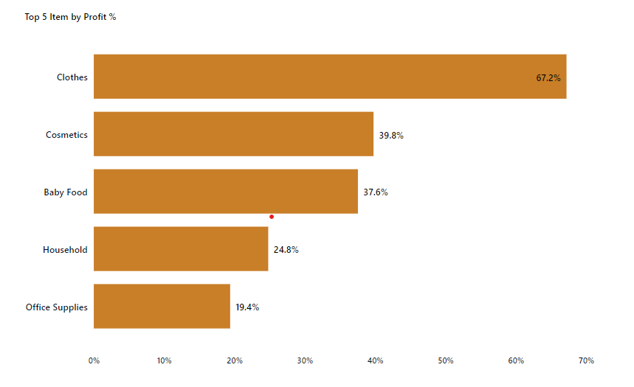
Top 5 Items by Profit %
KEY INSIGHTS
According to the visual we can see the Items which has highest Profit% which is Clothes having 67.2% and Office Supplies has Lowest Profit% having 19.4%.

Slide 11

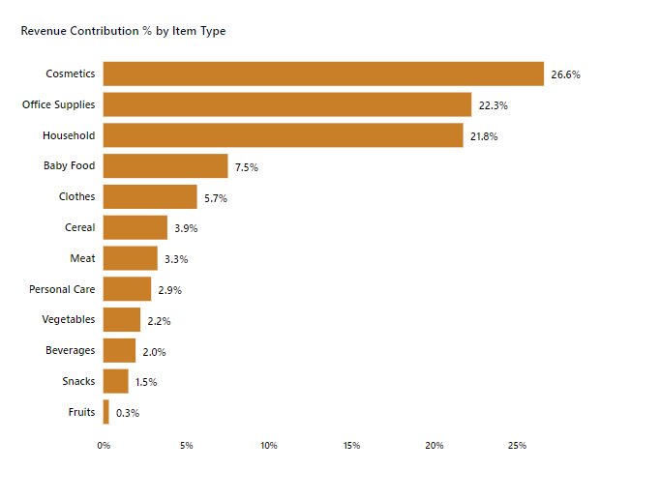
REVENUE WISE ANALYSIS
Revenue Contribution% by Item Type
KEY INSIGHTS
According to the visual we can see that the Cosmetics Item has the Highest Revenue Contribution
% where as Fruits has the
Lowest Revenue Contribution %

Slide 12

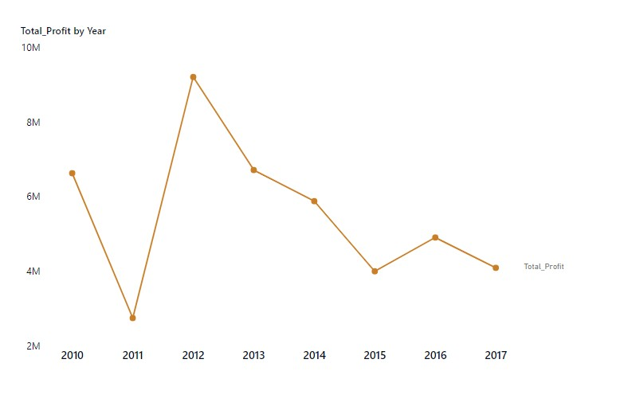
Total Profit by Year
KEY INSIGHTS
According to the visual we can see that 2012 has the highest Profit of 9.21M and 2011 has the Lowest Total Profit of 2.74M.

Slide 13
Thank You!!!

