Slide 1

Healthmedi360 soltoprob.
BY CODESS !!

Slide 2

OUR mission STAtement
"Despite increasing awareness, there exists a critical gap in accessible resources and support systems for mental fitness, contributing to rising rates of stress, anxiety, and depression globally."

Slide 3

Our solution
>> To provide a platform where both
Ayurvedic and Allopathic services will be
provided.
>> After the appointment , we’ll provide
Medicine to them.
>> By integrating with government system
We aspire to streamline information and foster
Collaboration for the benefit of our users.
>> This website will be helpful for the users in
Rural areas and for the senior citizens.
>> Regular monitoring and therapies will be
Done on monthly basis.

Slide 4
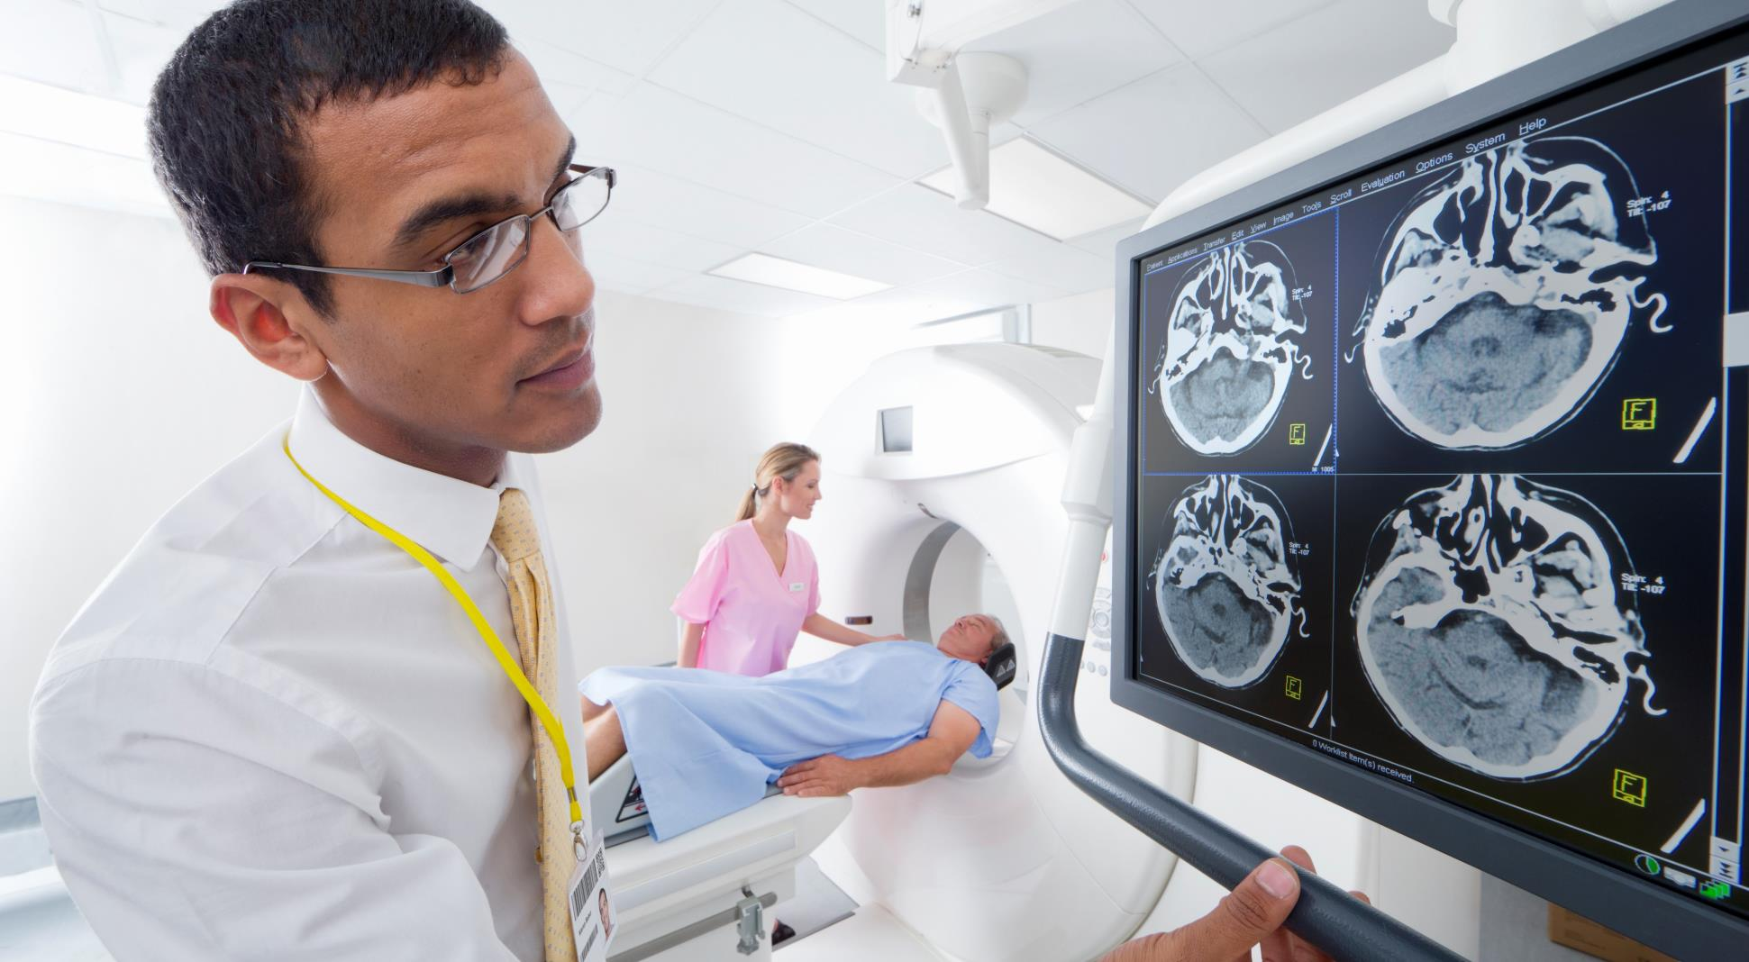





Industry outlook
66%
Rs. 104.5b
40-60%
1.91CR
3%
Average indians Population Who Visit their GP Regularly*
Healthcare Spending
Average Profit Margin
Average Annual Revenue per Doctor
Market Growth Per Year
Success

Slide 5

Our services
DOCTORS
THERAPIES
INTERSHIP
Offering comprehensive heathcare services provided by allopathic and ayurvedic pracitioners
Therapies will be provided in their nearest clinic . Patients will benefit from a wide range of therapies to their individual needs , encompassing evidence-based allopathic treatments as well as holistic ayurvedic therapies , ensuring personalized care
Our website facilitates vital internships for medical college students, fostering hands-on experience in healthcare settings.
PRESCRIPTION & MEDICINE
FITNESS
SUBSCRIPTION
With a user friendly interface and reliable sourcing , we ensure seamless delivery of prescribed medicines , promoting health and well being for our users
Personalized workouts , nutrition plans and wellness guidance for individual goals . With expert advice and diverse exercise routines , a journey towards improved health.
6 months subscription . Regular monitoring will be done

Slide 6


REVENUE MODEL
SUBSCRIPTION
INTERNSHIP
GOVERNMENT
For six months the price will be 499/- , in which regular monitoring of members will be done. Also on montly basis regular checkups will be done.
The price of the medicine will be charged .
For the people in rural and people below the poverty line will be given subscription half of the original price.
Intership will be provided to the students in medical college so they can get experience.
We’ll collaborate with the medical college for the promotion.
Connecting our website to the government will benefit the senior citizen and also the government sector people.

Slide 7




KEY TIMELINE GOALS
TODAY
SECOND QUARTER MILESTONES
Short Description
Q1 20YY
05
H+S MODEL
SOFTWARE AND HARDWARE MODEL IS READY AND EXECUTED!
03
ML MODEL
A ml model where it will show the health accuracy and monitoring.
02
WEBSITE
01
monitoring
we;’ll create a website and appoint dr. on it including the therapy centers and medicines
For a month we’ll monitor a health , heart rate by our watch.
W1
W2
W3
W4
W1
W2
W3
W4
W1
W2
W3
W4
W1
W2
W3
W4
marchy
april
may
june

Slide 8
THE TEAM
GAURI SHARMA
ARIEN JANGID
SIMRAN
TEAM LEADER
ML/DS
BACKEND
VISHAKHA MEHTA
ANUMESH RAO
FROTEND
ML

Slide 9

Thankyou!!
Mirjam Nilsson
SERVICE REPRESENTATIVE
nilsson@example.com

