Slide 1



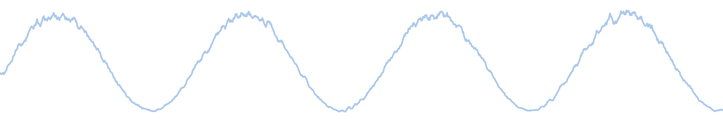
CoviSpark
CSBB 422 · Big Data Analytics · Course project
HDFS + YARN
Apache Spark
Distributed COVID-19 data analysis with Hadoop MapReduce, Apache Spark and a web dashboard
Flask dashboard
Notes:
CoviSpark runs one COVID-19 dataset through a small but complete big-data stack: HDFS for storage, a MapReduce job on YARN, five Spark jobs, and a web dashboard.

Slide 2



The project at a glance
36,000
25
10
1 + 5
rows in the dataset
countries, 2020–2023
Docker containers
MapReduce + Spark jobs
Store
Process
Present
The CSV goes into HDFS with a replication factor of 2, split across two DataNodes.
A Hadoop Streaming job totals each country on YARN; Spark runs five analyses on a two-worker cluster.
Flask serves the result files as JSON; a six-view dashboard turns them into charts and tables.

Slide 3
Ten containers, one network
Hadoop: HDFS + YARN
Apache Spark: standalone cluster
namenode
:9870 :9000
resourcemanager
:8088
spark-master
:8080 :7077
datanode1
datanode2
nodemanager1
nodemanager2
spark-worker1
2 cores · 1 GB
spark-worker2
2 cores · 1 GB
Host folders, bind-mounted into the containers
./data
input CSV
./mapreduce
mapper, reducer
./spark
PySpark script
./results
JSON + CSV
dashboard
Flask · :5000
Notes:
Hadoop has one NameNode, two DataNodes, a ResourceManager and two NodeManagers. Spark has a master and two workers. All ten containers share the hadoop-net bridge network; project folders are bind-mounted so scripts reach the cluster and results come back to the host.

Slide 4
Technology stack, layer by layer
Presentation
Flask 3.0 REST API · HTML/CSS/JS · Chart.js 4.4 (bundled)
Analytics
Apache Spark 3.5 · PySpark DataFrames, window functions, cache
Batch processing
Hadoop Streaming 3.2.1 · Python mapper and reducer
Scheduling
YARN · ResourceManager + 2 NodeManagers, 512 MB containers
Storage
HDFS · NameNode + 2 DataNodes, replication factor 2
Infrastructure
Docker Compose · 10 services on one bridge network

Slide 5
How data moves through the system
Dataset
OWID CSV
36,000 rows
HDFS
/covid19/input
replication 2
MapReduce
country totals
on YARN
Spark
5 jobs on
2 workers
results/
5 JSON files
+ 1 CSV
Dashboard
Flask API
6 views
01
start cluster
02
upload to HDFS
03
run MapReduce
04
run Spark
run_all.sh runs the four step scripts in order. Spark reads the CSV from the shared /data folder; MapReduce reads it from HDFS.

Slide 6
The dataset
Eleven OWID columns are used
iso_code
continent
location
date
new_cases
new_deaths
total_cases
total_deaths
people_vaccinated
total_vaccinations
population
Sample generator: fixed seed 42, 60-day sine waves, ±30% daily noise, deaths at 0.5–2.5% of cases, vaccinations from day 300.
Four waves, one per year: the shape the analysis should recover.

Slide 7
MapReduce: totals per country
split 0
has the header
mapper.py
emits key + values
HDFS input
owid-covid-data.csv
shuffle + sort
grouped by country
reducer.py
sums cases, deaths
split 1
no header
mapper.py
emits key + values
Header fix Only the first split starts with the CSV header. The run script reads it once and passes it to every mapper with -cmdenv COVID_HEADER, so all splits parse the same columns.
Notes:
Mapper output: country, continent, new_cases, new_deaths separated by tabs. Hadoop sorts by country, so the reducer only needs a running sum. The cluster output is identical to the local pipe version: mapper | sort | reducer.

Slide 8
Spark: one cached DataFrame, five jobs
Top 10 countries
max(total_cases) → top10_countries.json
1
Continent totals
sum(new_cases) → continent_totals.json
2
Read CSV
header, inferSchema
Clean
cast · fill 0 · drop OWID_
cache()
reused 5×
Global wave
Window rowsBetween(-3, 3) → global_wave.json
3
Case-fatality rate
deaths ÷ cases × 100 → cfr_by_country.json
4
Vaccination share
vaccinated ÷ population → vaccination_progress.json
5

Slide 9
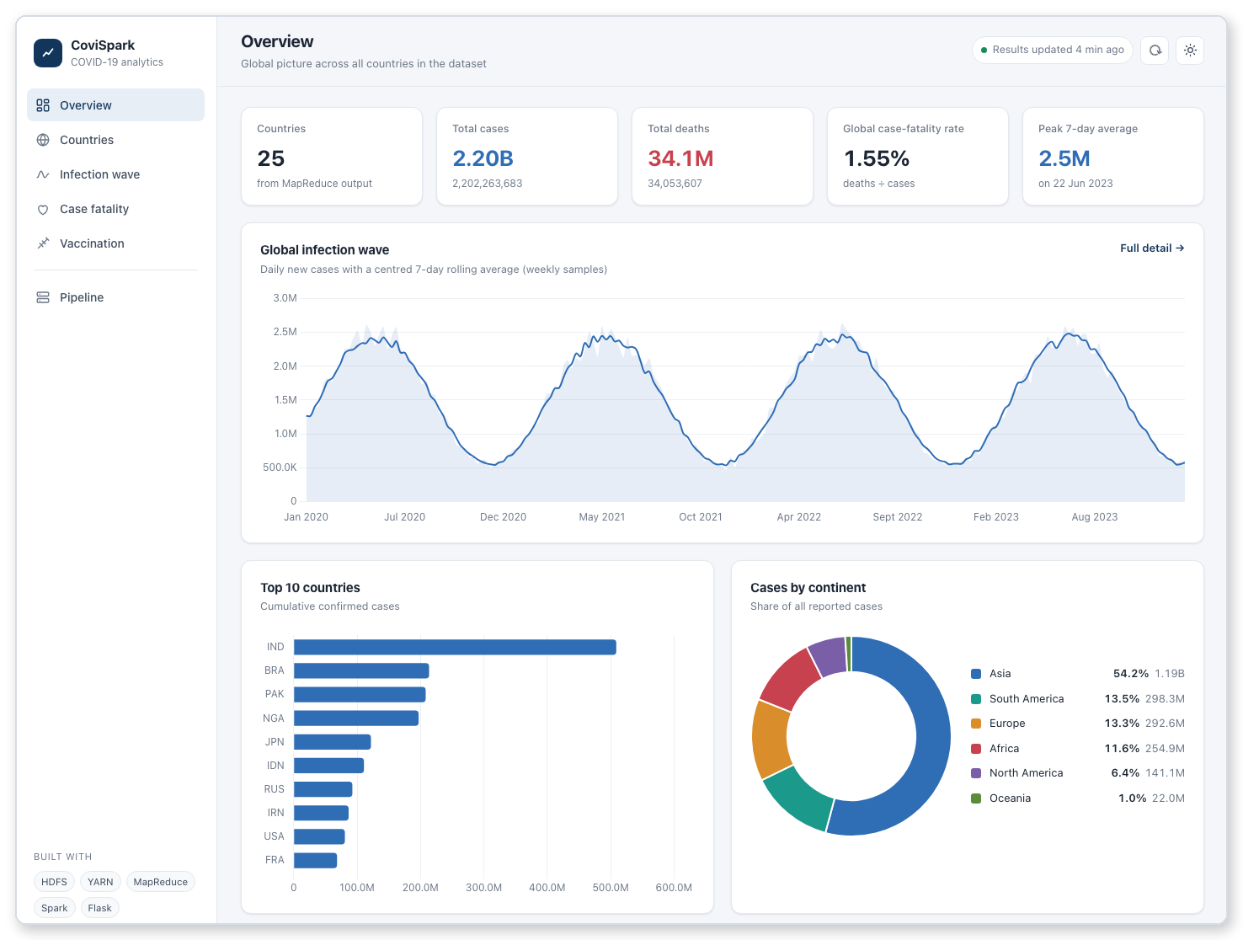
The dashboard
Overview
KPIs, wave, top 10, continents
Countries
search, filter, sort all 25
Infection wave
daily series, year filters
Case fatality
top 15 vs global rate
Vaccination
top 15 shares
Pipeline
output status, cluster UIs
Notes:
Flask exposes /api/status, /api/summary, /api/countries, /api/top10, /api/continents, /api/wave, /api/cfr and /api/vaccination. The front end is plain HTML, CSS and JavaScript with Chart.js bundled locally, in light and dark themes.

Slide 10
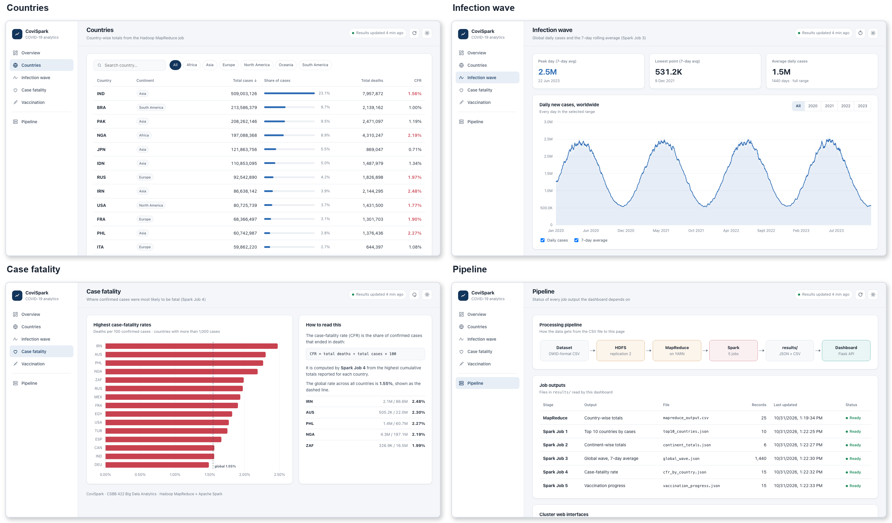
Four more views

Slide 11
Running it end to end
1
01_start_cluster.sh
docker-compose up -d · wait for HDFS
Cluster mode
bash run_all.sh
2
02_upload_data.sh
generate CSV if missing · hdfs dfs -put
HDFS, YARN and Spark in 10 containers
3
03_run_mapreduce.sh
streaming job on YARN · export CSV
Local mode
bash scripts/05_run_local.sh
Same jobs on the host; MapReduce as mapper | sort | reducer
4
04_run_spark.sh
spark-submit to spark-master:7077
Then open http://localhost:5000

Slide 12
What the pipeline found
2.20B
34.1M
1.55%
2.5M
cases
deaths
global CFR
peak 7-day avg
Notes:
Numbers come from the generated dataset, not real statistics. Highest CFR: IRN at 2.475%. Peak of the smoothed global curve: 2023-06-22.

Slide 13
Four waves, recovered by Spark Job 3
2.5M
peak 7-day average
2023-06-22
531K
lowest 7-day average
2021-12-09
1.5M
average daily cases
1,440 days
Notes:
Daily global cases from the generated dataset with Spark's centred 7-day rolling average. The generator uses a 60-day sine period, which shows up as one wave a year over 1,440 days.

Slide 14

How we know it works
Spark jobs 1–5
match an independent pandas recomputation
MapReduce on YARN
identical to the local pipe output
Split handling
two halves of the file give the same totals
MapReduce vs Spark
sum of new cases = max of total cases
HDFS
2 live DataNodes, replication 2
YARN
2 NodeManagers, 2 maps + 1 reduce
Spark cluster
2 workers alive, app finished on 4 cores
Dashboard
all routes 200, all views render, no JS errors
Final check: cluster torn down with its volumes and rebuilt from scratch with run_all.sh.

Slide 15




Limits and next steps
Synthetic data
Spark reads a shared folder
Single-partition window
Swap in the real OWID file; the code needs no change.
Point COVID_DATA at hdfs:// to use HDFS for Spark too.
Fine for 1,440 days; partition it for larger date ranges.
Old base images
One machine
Read-only dashboard
Hadoop images date from 2019; Spark comes from Bitnami's legacy archive.
Run the same images on several hosts or Kubernetes for real scaling.
A button that submits the pipeline would make it a control panel.

Slide 16
Thank you
Dashboard localhost:5000 · HDFS :9870 · YARN :8088 · Spark :8080

