Slide 1





AI PROJECT
Multi-Document RAG Chatbot using Flowise
Develop an AI-powered chatbot capable of answering questions from multiple document formats — supporting PDF, Word, and PowerPoint files within a single conversational interface.
Multi-Document Ingestion
Semantic Document Search
Conversational Q&A
Context-Aware Responses
Reduced Hallucinations via RAG

Slide 2
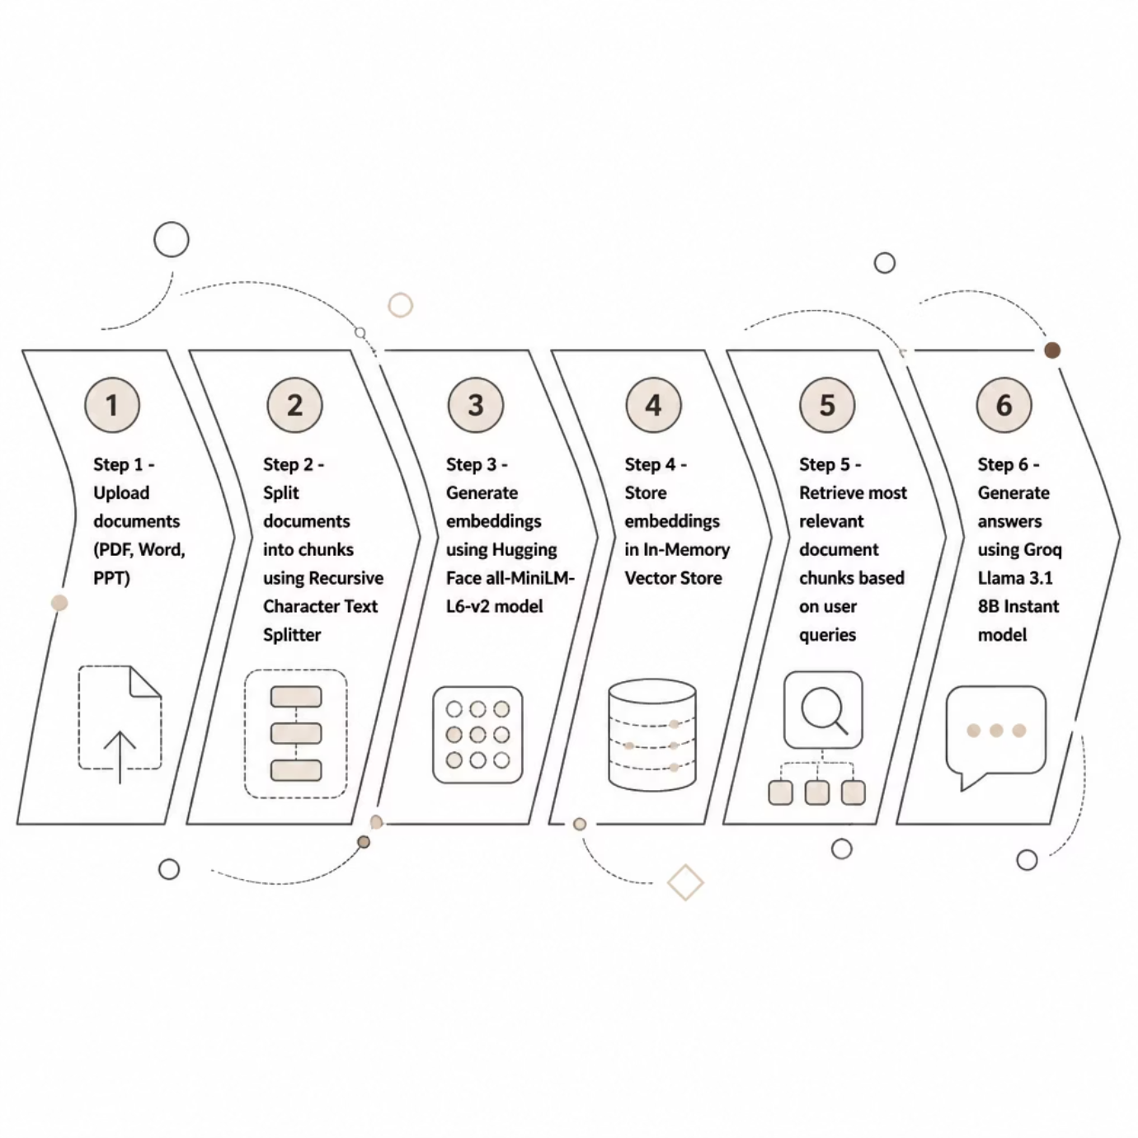


System Architecture & Workflow
Step-by-Step Workflow
Technologies Used
Flowise
Groq LLM
Hugging Face Embeddings
Vector Store Retrieval
RAG Framework

Slide 3
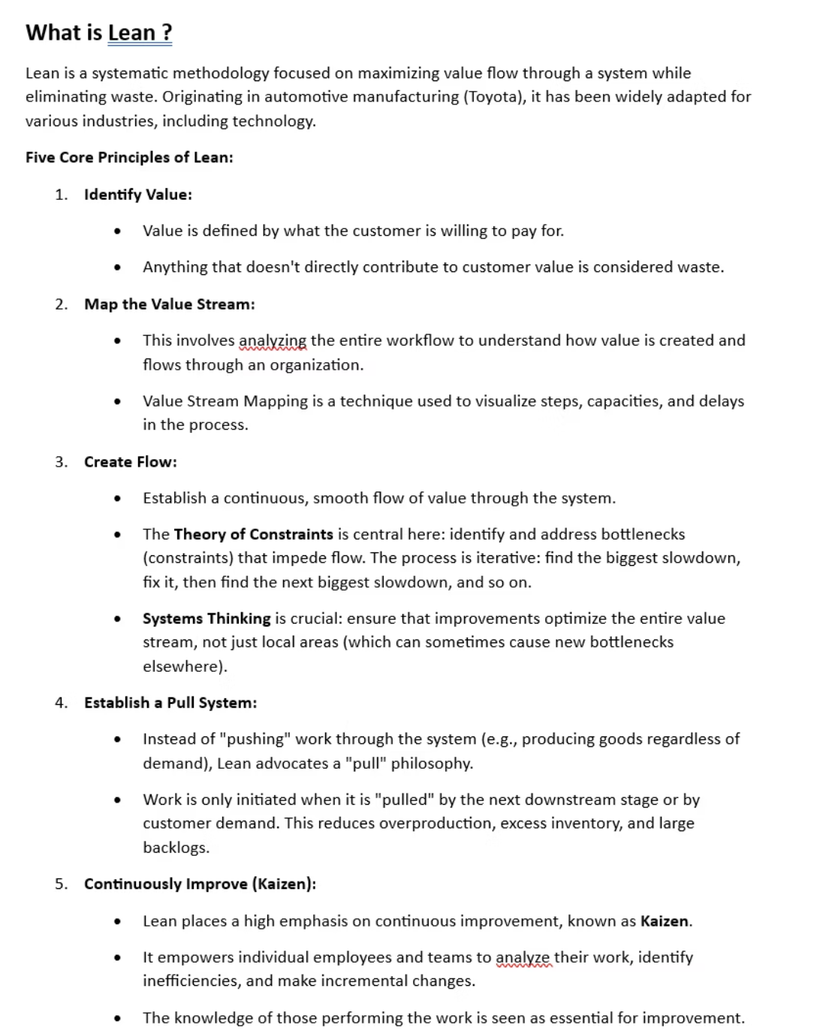
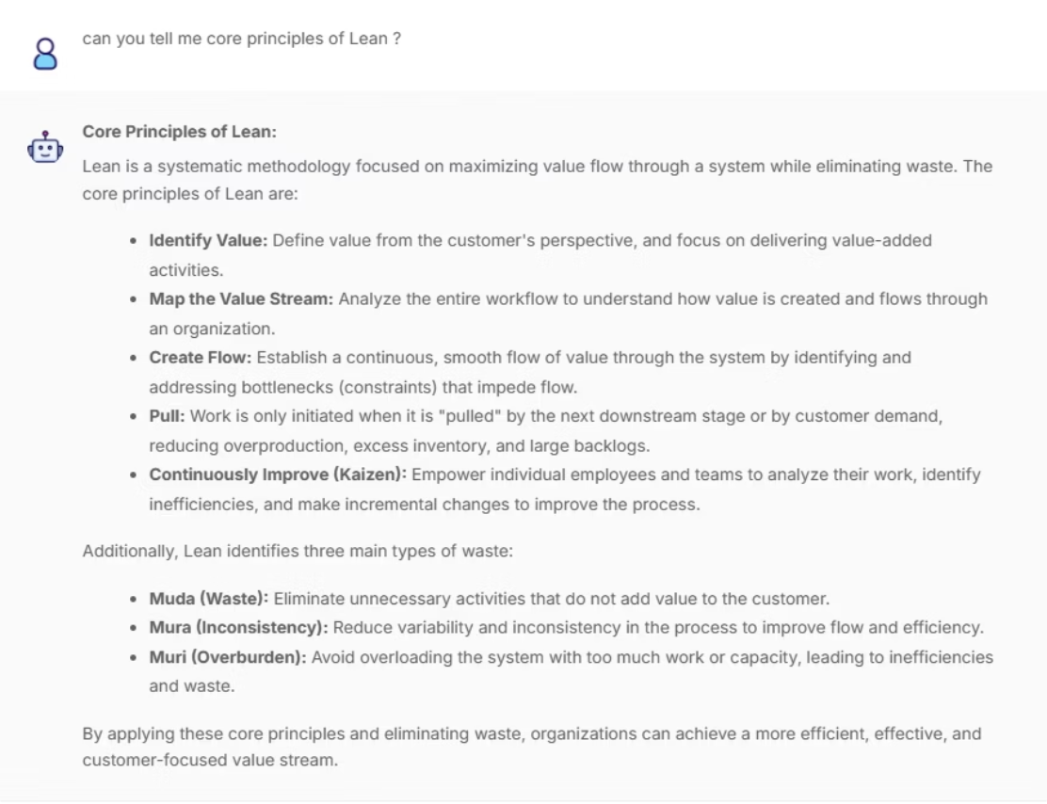
ScreenShots
Word Document
Document
Chatbot

Slide 4
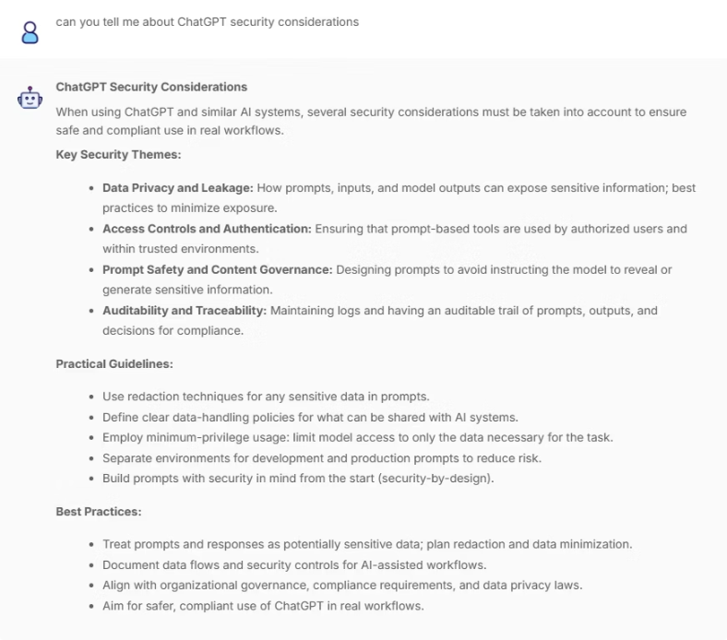
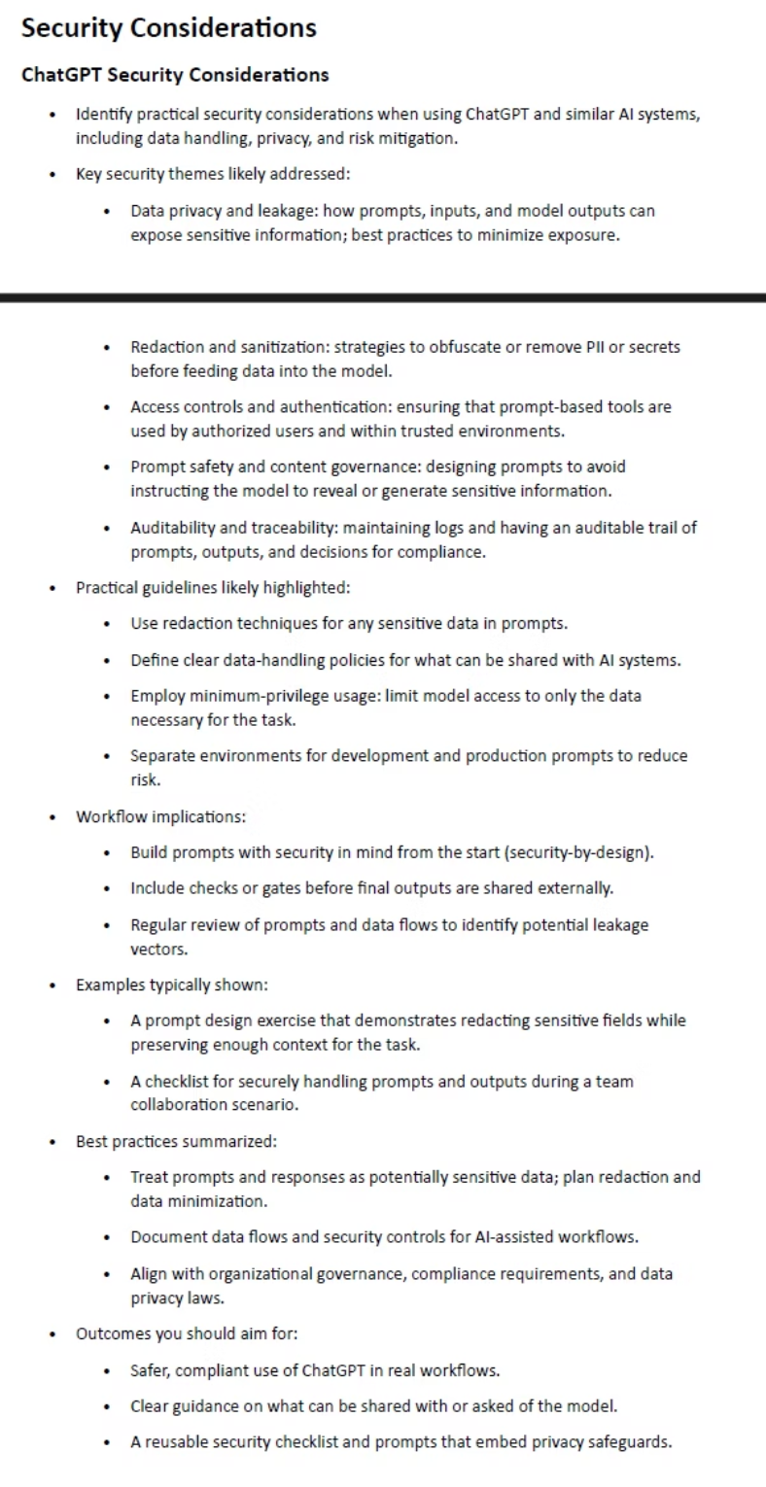
ScreenShots
PDF
📋 Results

Slide 5
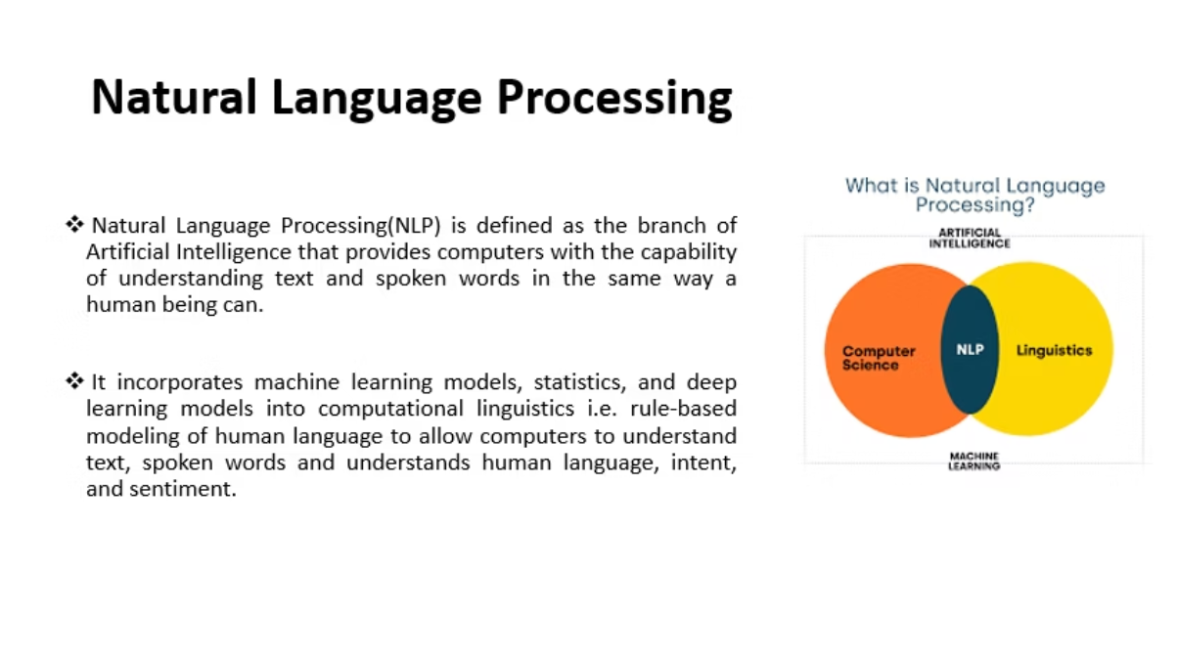
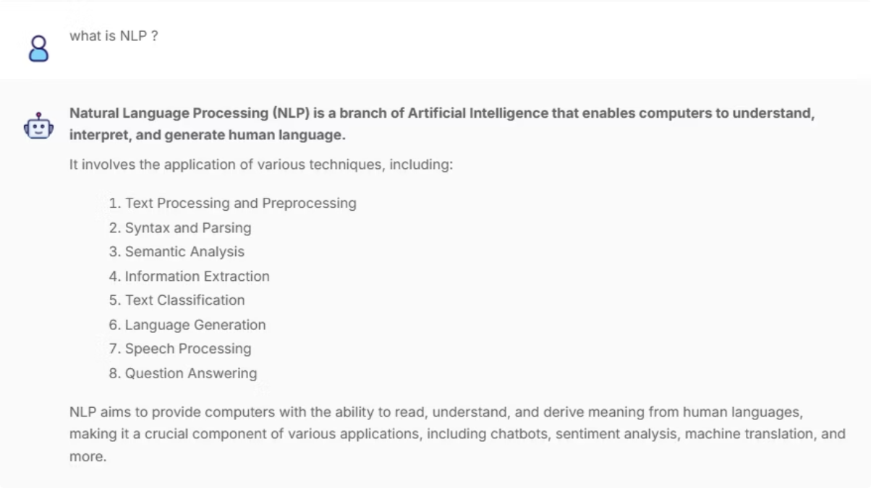
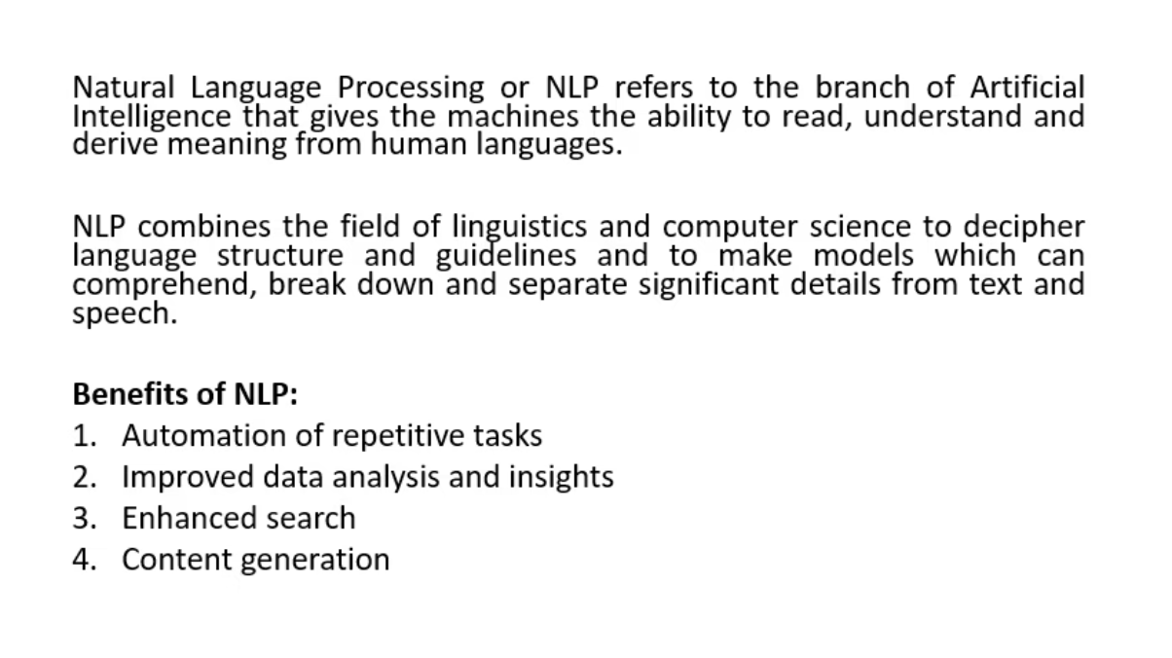
ScreenShots
PPT

