Slide 1
SmartFormFiller
AI-Powered Form Filling Assistant for Indian Citizen Services
Submitted By:
Gauri Pakhare
Ruchita Gandhi
Anushka Bhuskat
Mentored By: Prof. Kalyani P. Sable ( Assistant Professor CSE Department)
Institution: Shri Sant Gajanan Maharaj College of Engineering, Shegaon.

Slide 2
Project Overview
Objectives:
Problem Statement:
To develop an AI-based system that automatically extracts key personal details from uploaded documents.
To auto-fill government service forms by correctly mapping extracted data to respective form fields.
To provide a user-friendly review and edit interface before final form submission.
To support multiple Indian languages to ensure accessibility for diverse users.
To enable voice-based input for users who face difficulty in typing or reading.
To reduce manual effort, errors, and processing time at Seva Kendras.
Citizens in India often face difficulties while filling government service forms at Seva Kendras due to repetitive data entry, language barriers, and manual errors. An AI-powered form filling assistant is needed to automatically extract details from uploaded documents and allow users to correct or complete incorrect information using voice input, while supporting multiple Indian languages to make the process faster, more accurate, and accessible.
The Solution:
An AI-powered assistant that automatically fills digital government form templates by extracting data from uploaded documents such as Aadhaar or Voter ID.
Key Innovation: Combining Optical Character Recognition (OCR) with AI to map unstructured text into structured fields.

Slide 3
System Workflow
The sources define a clear logical flow for the application:
User Authentication:
Secure login through SupaBase.
OCR Extraction:
Raw text is pulled from documents via OCR.space API.
AI Mapping:
Groq AI converts unstructured text into specific form fields.
Review & Edit:
Users can manually verify and correct data before final submission.
Document Upload:
Users upload PDFs or Images (Aadhaar, PAN, etc.).
Submission:
Forms are submitted and can be downloaded as a PDF for offline use.

Slide 4
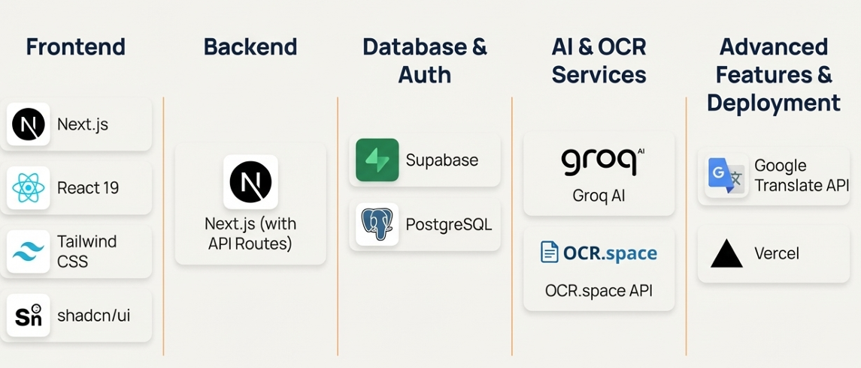
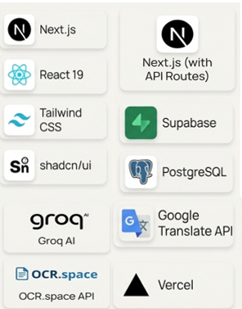
Technology Stack
The project is built using a modern full-stack architecture:
Frontend: Next.js 16/18, React 19, Tailwind CSS, and shadcn/ui.
Backend: Next.js API routes and Node.js.
Database & Auth: Supabase (PostgreSQL) using JWT tokens.
AI & OCR Services: OCR.space API and Groq AI models.
Multilingual Support: Google Translate API (English + 8 Indian languages).
Deployment: Hosted on Vercel with integrated environment variables.

Slide 5


Performance And Results
90%
3-5
--
Accuracy
Speed
Social Impact
The system achieves over 90% accuracy in
entity extraction and data mapping.​
Average processing time is between
3–5seconds per document.​
Significantly reduces the time and effort
required for senior citizens to access
digital government services.​

Slide 6
Roles And Responsibilities
Member 1: Anushka Bhuskat
Role: Frontend Development & Deployment.
Technologies Used:
Developed:
Member 2: Gauri Pakhare
Role: Authentication, Database & AI Processing.
Technologies Used:​
Supabase, OCR.space API, Groq AI.
Developed:
Implemented Supabase authentication (email & password).
Managed PostgreSQL database for form data.
Integrated OCR to extract text from PDFs and images.
Used Groq AI to: Process extracted text,
Convert unstructured data into structured form fields.
Next.Js, react.19, Tailwind CSS, Shadcn/ui.
Designed the complete UI, including Login, Signup, and Document Upload screens.
Developed Auto-filled form preview interface.
Ensured the design is responsive and user-friendly for non-technical citizens.
Managed application deployment on Vercel.

Slide 7
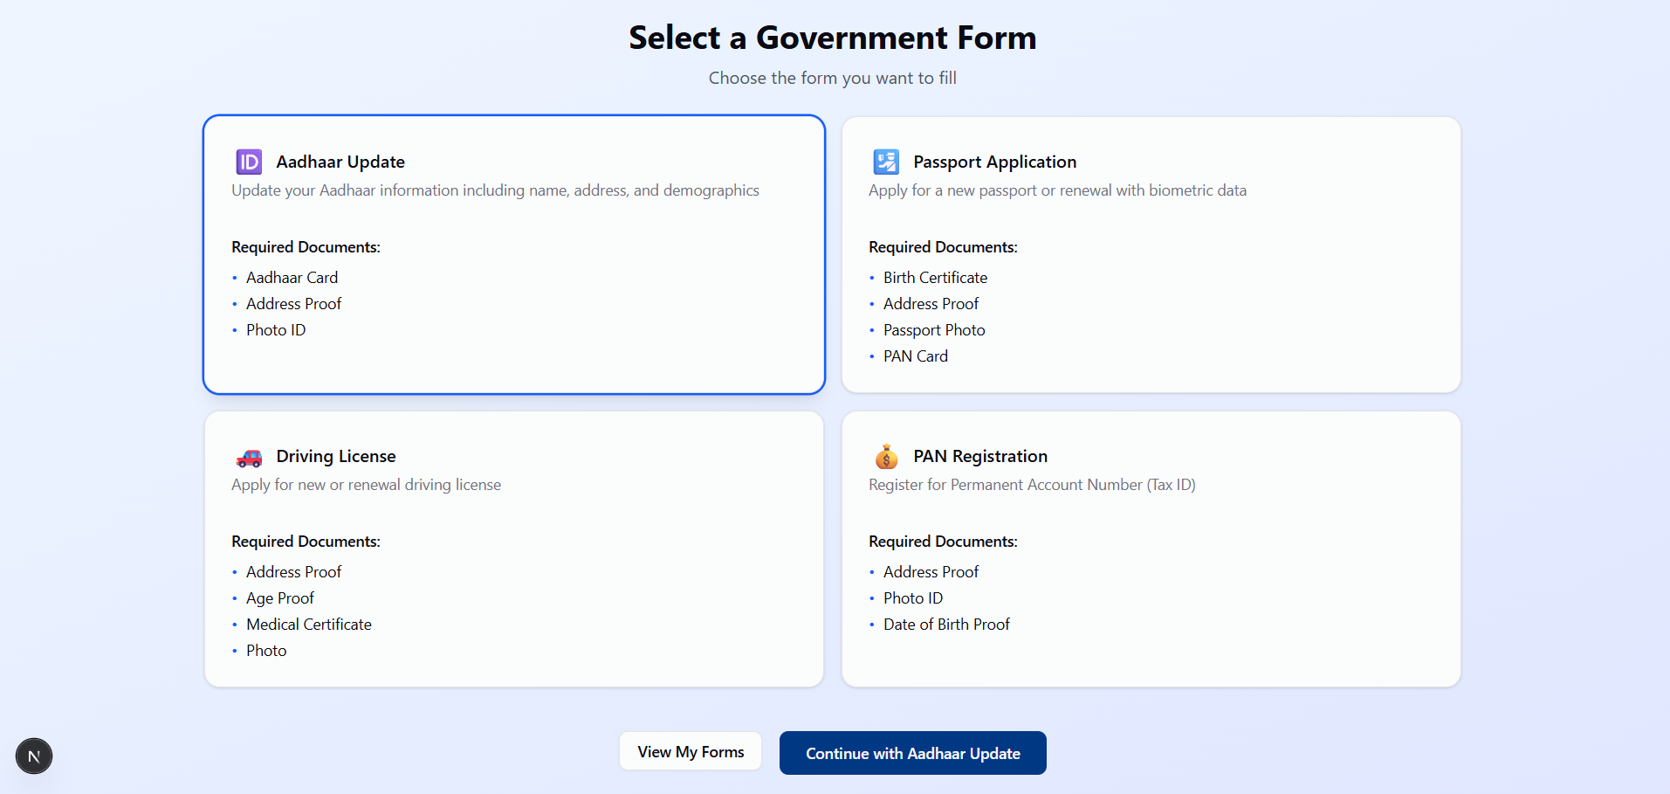
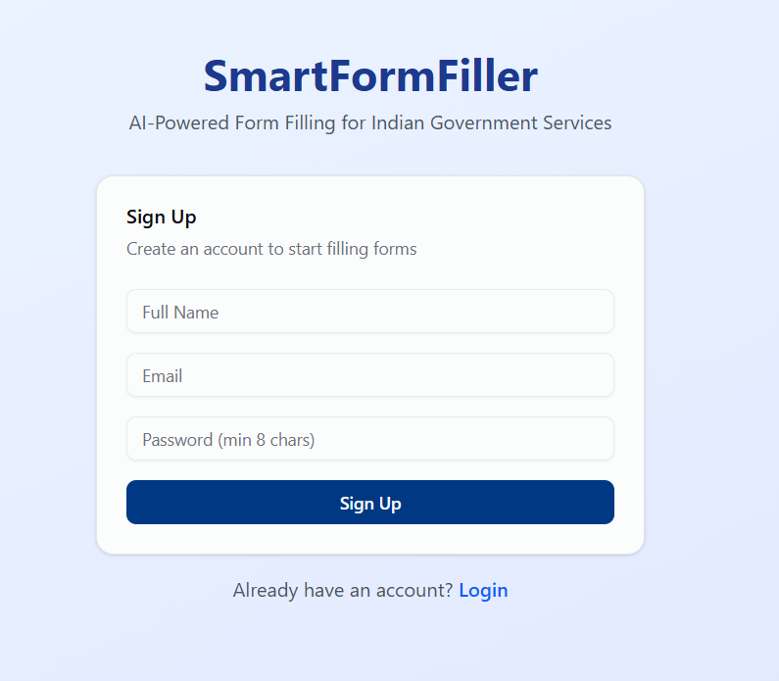
Roles And Responsibilities
Member 3:​​ Ruchita Gandhi
Role: Backend Development & Advanced Features​
Technologies Used:​​
Next.js API Routes​, Google Translate API.​​
Developed:
Backend APIs for: Form submission,​ Data update and retrieval​.
Implemented secure data validation and error handling​.
Added multilingual support:​ English + 8 Indian languages.
Implemented PDF Download Managed data flow between frontend, AI, and database.​

Slide 8
Conclusion
The AI-Powered Form Filling Assistant simplifies government form submission by automatically extracting details from uploaded documents like Aadhaar, PAN, and Voter ID. Using OCR and AI, it auto-fills the required fields, supports multiple languages and voice input, and allows users to review and edit the form before finalizing. This solution reduces manual effort, minimizes errors, and makes government services faster and more accessible. The SmartFormFiller bridges the digital gap for Indian citizens, providing a scalable, accurate and inclusive solution for e-governance.​
Project Demonstration:
Click to view SmartFormFiller website.

